Slide 1
分类 Classification
逻辑回归
Logistic
Regression

Slide 2

Classification
Email: Spam / Not Spam?
Online Transactions: Fraudulent (Yes / No)?
Tumor: Malignant / Benign ?
0: “Negative Class” (e.g., benign tumor)
1: “Positive Class” (e.g., malignant tumor)

Slide 3

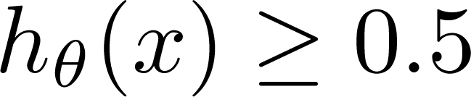
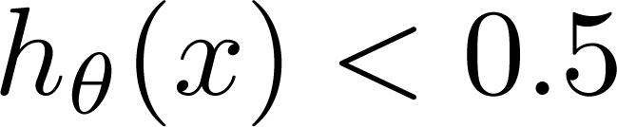
(Yes) 1
Malignant ?
(No) 0
Tumor Size
Tumor Size
Threshold classifier output at 0.5:
If , predict “y = 1”
If , predict “y = 0”

Slide 4
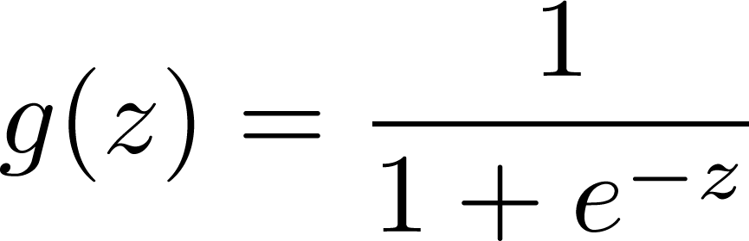
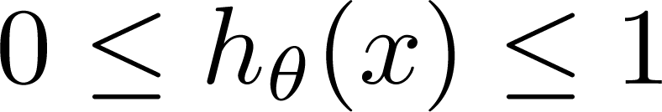
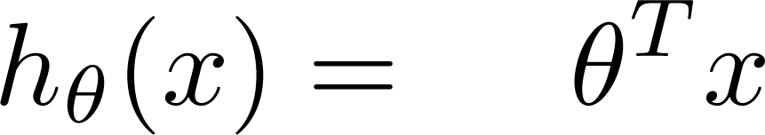
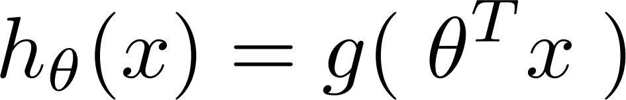
Logistic Regression Model
Want
1
0.5
Sigmoid function
Logistic function
0

Slide 5
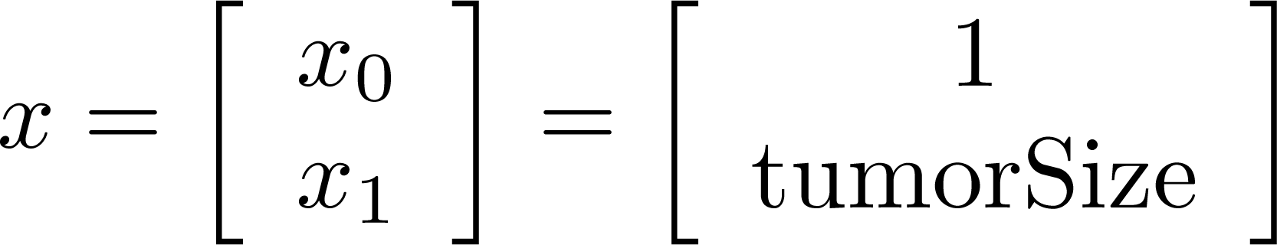
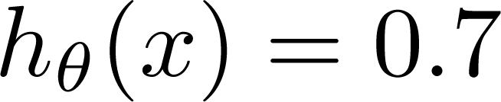
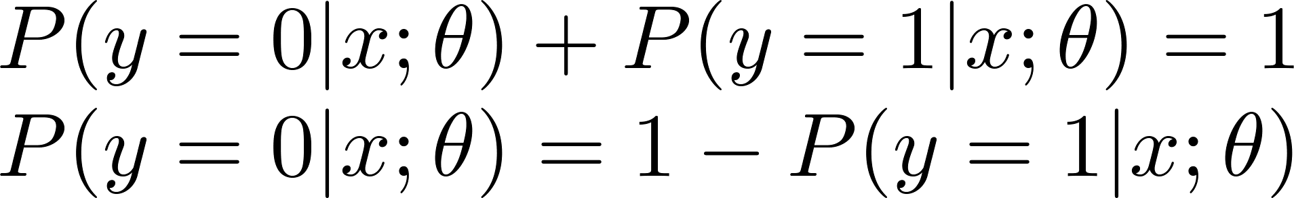
Interpretation of Hypothesis Output
= estimated probability that y = 1 on input x
Example: If
Tell patient that 70% chance of tumor being malignant
“probability that y = 1, given x,
parameterized by ”

Slide 6

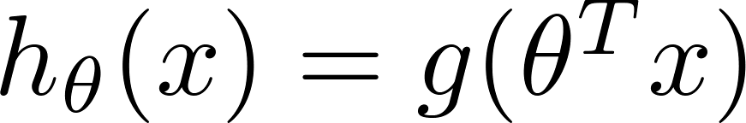
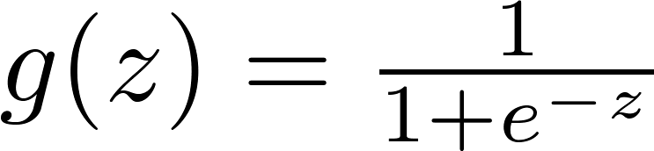

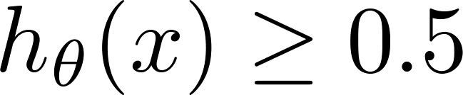

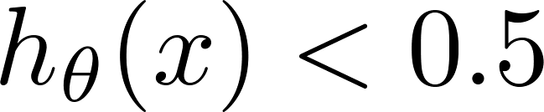
Logistic regression
1
z
Suppose predict “ “ if
predict “ “ if

Slide 7
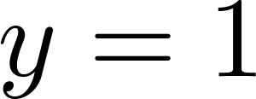

Decision Boundary
x₂
3
2
1
1
2
3
x₁
Predict “ “ if

Slide 8
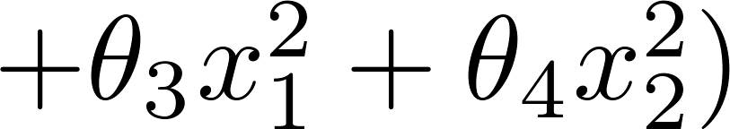
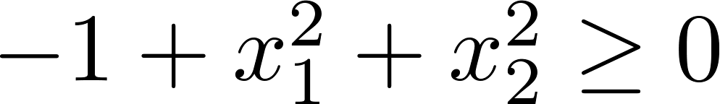
Non-linear decision boundaries
x₂
1
x₁
-1
1
-1
Predict “ “ if

Slide 9
代价函数 Cost function
逻辑回归
Logistic
Regression

Slide 10
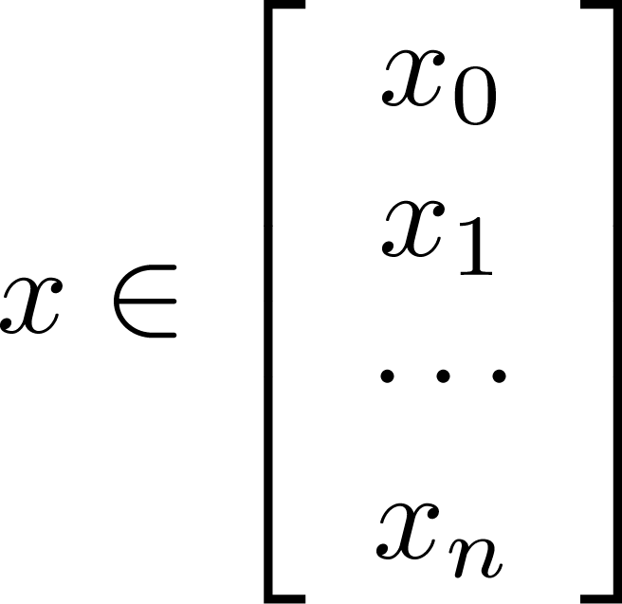
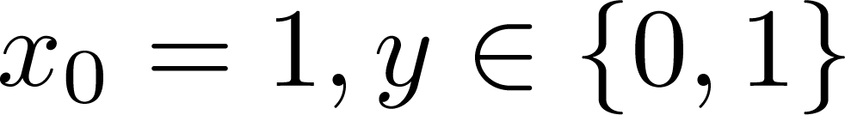
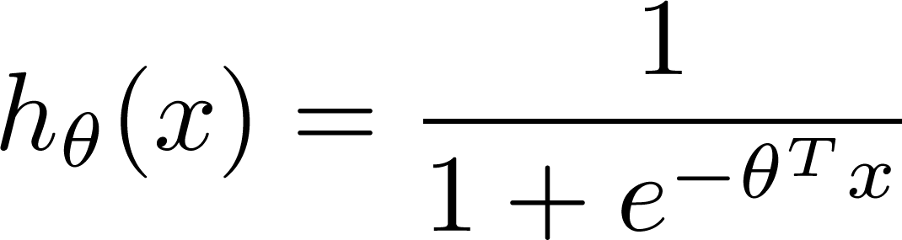

Training set:
m examples
How to choose parameters ?

Slide 11
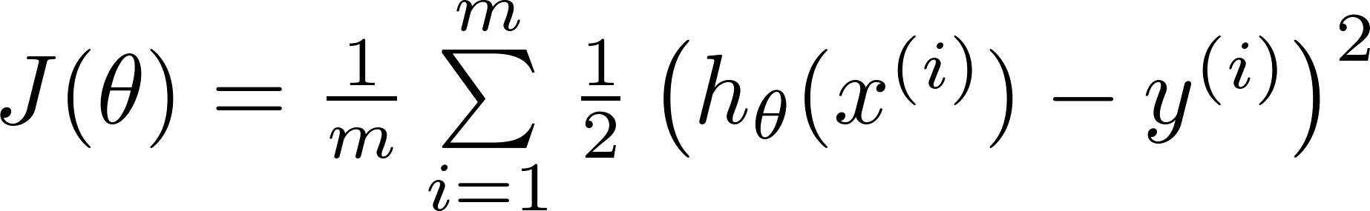

Cost function
Linear regression:
“non-convex”
“convex”

Slide 12
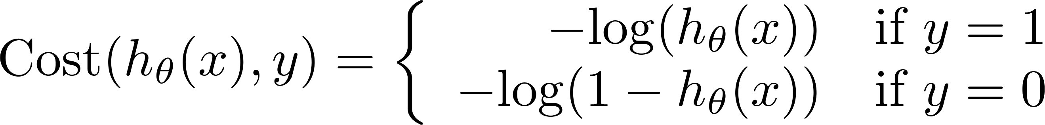
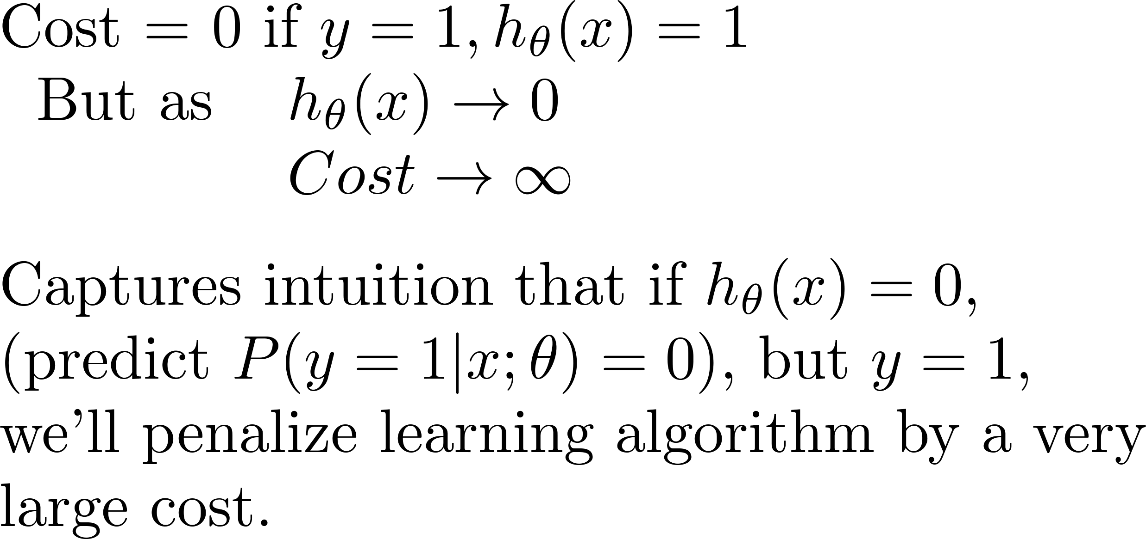

Logistic regression cost function
If y = 1
0
1

Slide 13
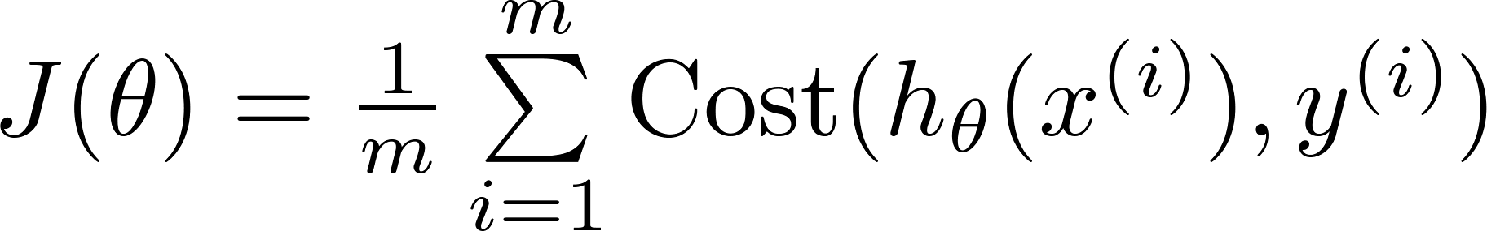
Logistic regression cost function

Slide 14

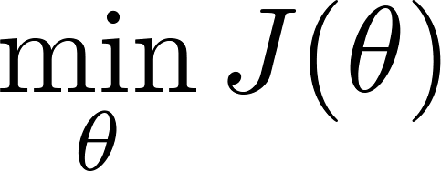

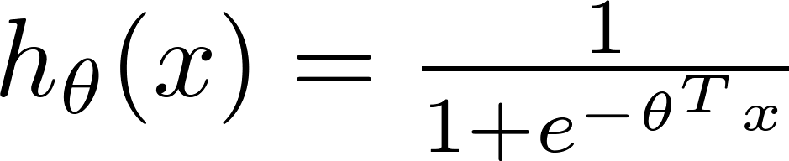
Logistic regression cost function
To fit parameters :
To make a prediction given new :
Output

Slide 15


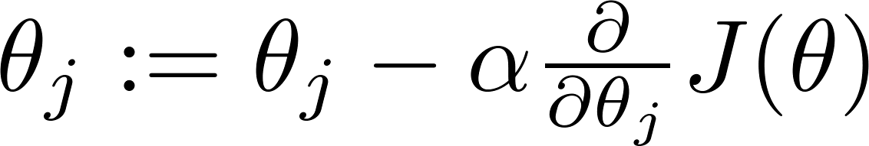


Gradient Descent
Want :
Repeat
(simultaneously update all )

Slide 16
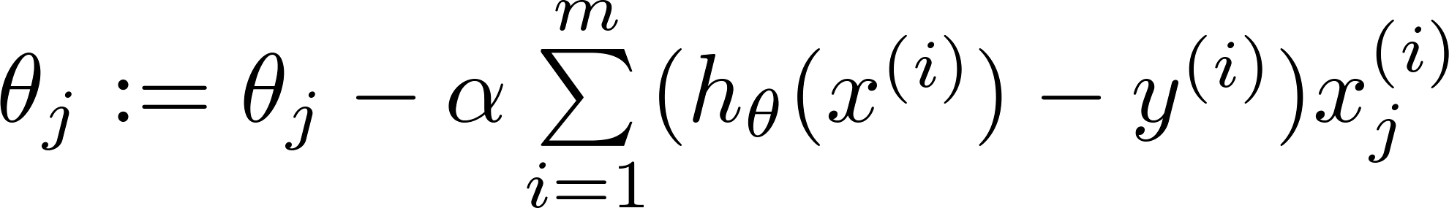
Gradient Descent
Want :
Repeat
(simultaneously update all )
Algorithm looks identical to linear regression!

Slide 17

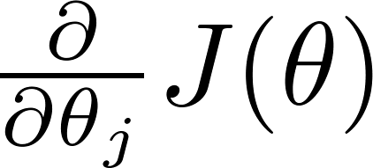
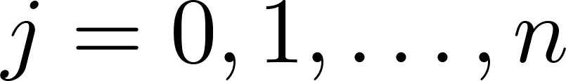

Optimization algorithm
Given , we have code that can compute
(for )
Optimization algorithms:
Gradient descent
Advantages:
No need to manually pick
Often faster than gradient descent.
Disadvantages:
More complex
Conjugate gradient
BFGS
L-BFGS

Slide 18
多分类问题：一对多 Multi-class classification: One-vs-all
逻辑回归
Logistic
Regression

Slide 19
Multiclass classification
Email tagging: Work, Friends, Family, Hobby
Medical diagrams: Not ill, Cold, Flu
Weather: Sunny, Cloudy, Rain, Snow

Slide 20
Binary classification:
Multi-class classification:
x₂
x₂
x₁
x₁

Slide 21
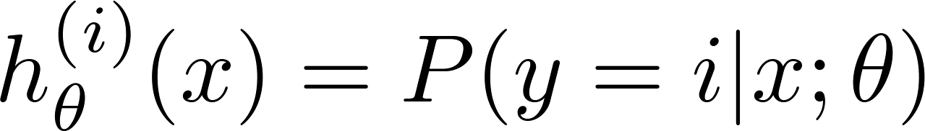

x₂
One-vs-all (one-vs-rest):
x₁
x₂
x₂
x₁
x₁
Class 1:
Class 2:
Class 3:
x₂
x₁

Slide 22
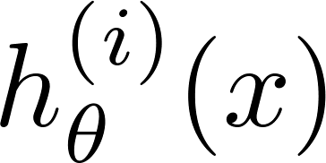

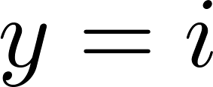
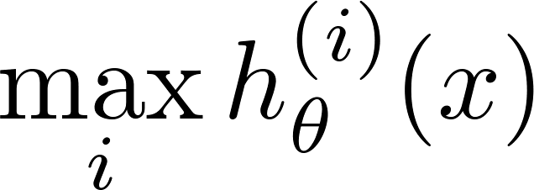
One-vs-all
Train a logistic regression classifier for each class to predict the probability that .
On a new input , to make a prediction, pick the class that maximizes

