Slide 1
分类 Classification
逻辑回归
Logistic
Regression

Slide 2
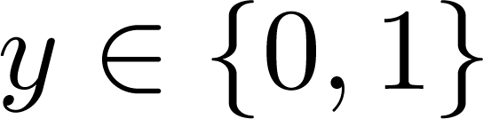
Classification
Email: Spam / Not Spam?
Online Transactions: Fraudulent (Yes / No)?
Tumor: Malignant / Benign ?
0: “Negative Class” (e.g., benign tumor)
1: “Positive Class” (e.g., malignant tumor)

Slide 3

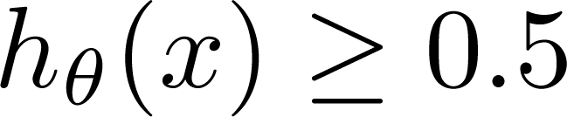
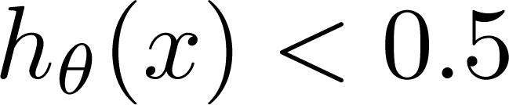
(Yes) 1
Malignant ?
(No) 0
Tumor Size
Tumor Size
Threshold classifier output at 0.5:
If , predict “y = 1”
If , predict “y = 0”

Slide 4
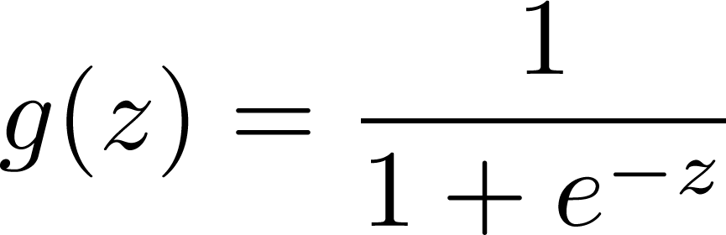
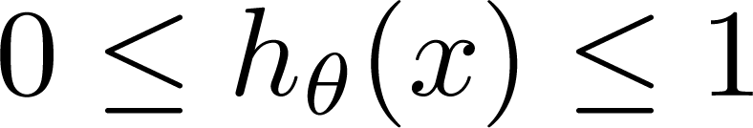
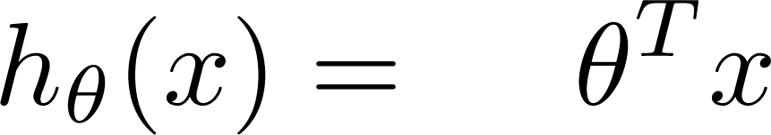
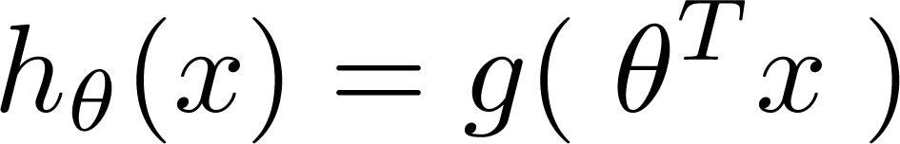
Logistic Regression Model
Want
1
0.5
Sigmoid function
Logistic function
0

Slide 5
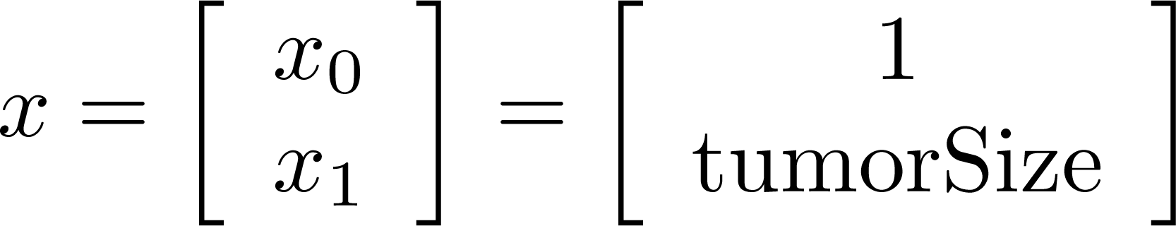
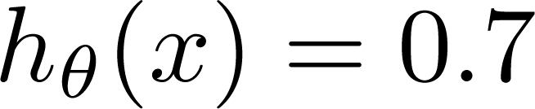
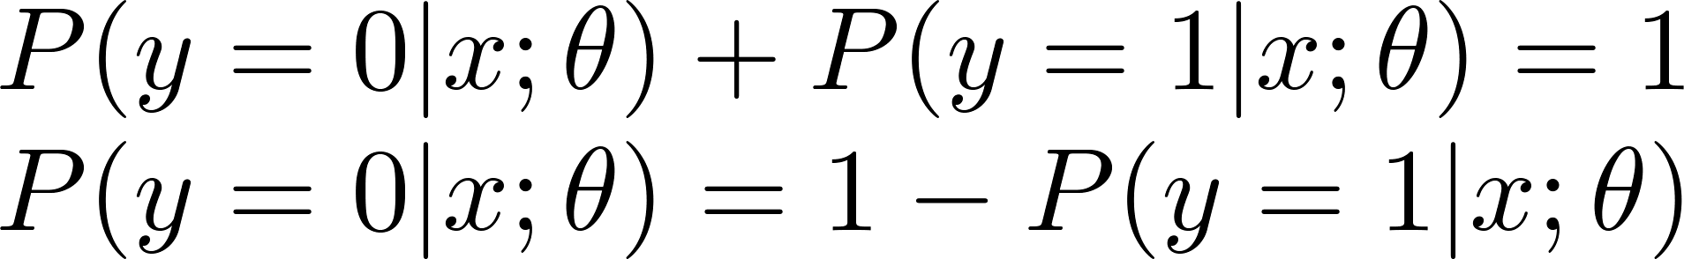
Interpretation of Hypothesis Output
= estimated probability that y = 1 on input x
Example: If
Tell patient that 70% chance of tumor being malignant
“probability that y = 1, given x,
parameterized by ”

Slide 6

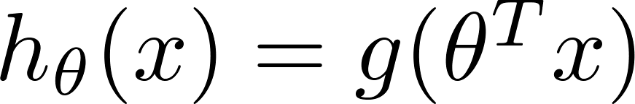
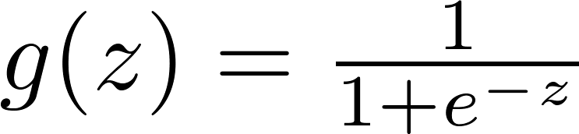

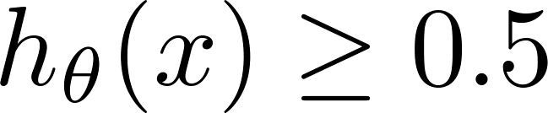

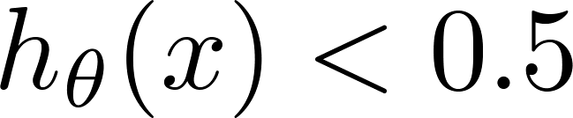
Logistic regression
1
z
Suppose predict “ “ if
predict “ “ if

Slide 7
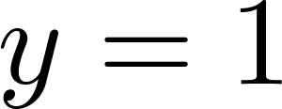
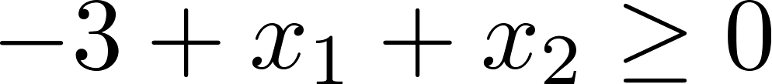
Decision Boundary
x₂
3
2
1
1
2
3
x₁
Predict “ “ if

Slide 8
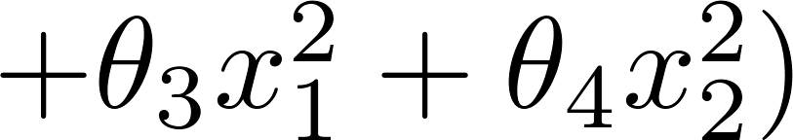
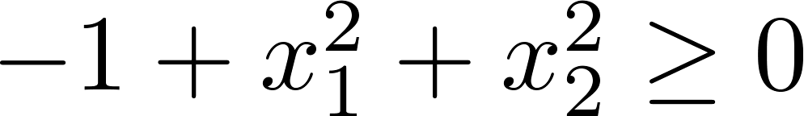
Non-linear decision boundaries
x₂
1
x₁
-1
1
-1
Predict “ “ if

Slide 9
代价函数 Cost function
逻辑回归
Logistic
Regression

Slide 10
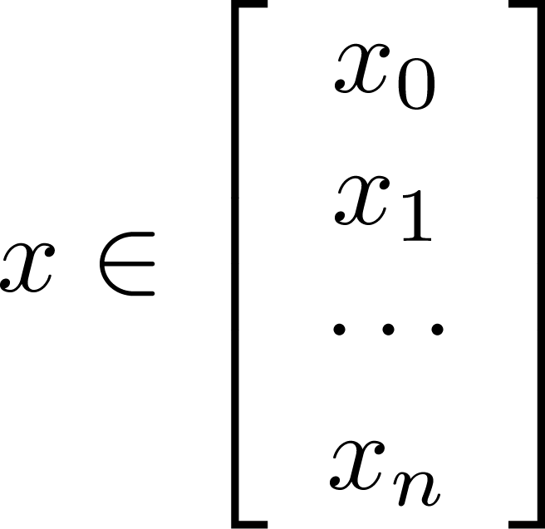
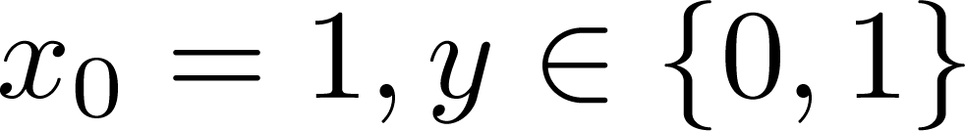
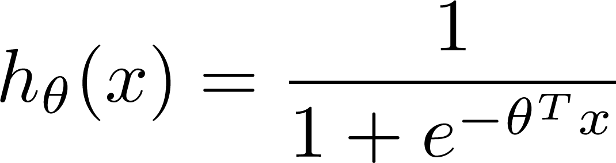

Training set:
m examples
How to choose parameters ?

Slide 11
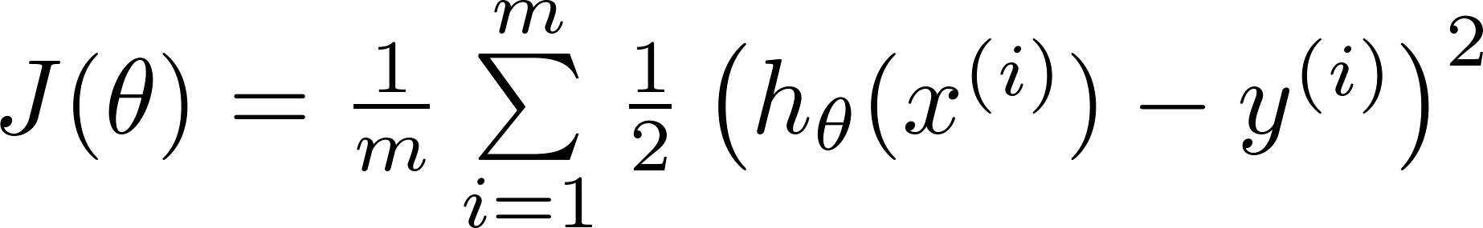

Cost function
Linear regression:
“non-convex”
“convex”

Slide 12
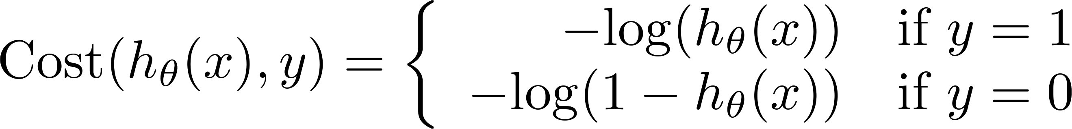
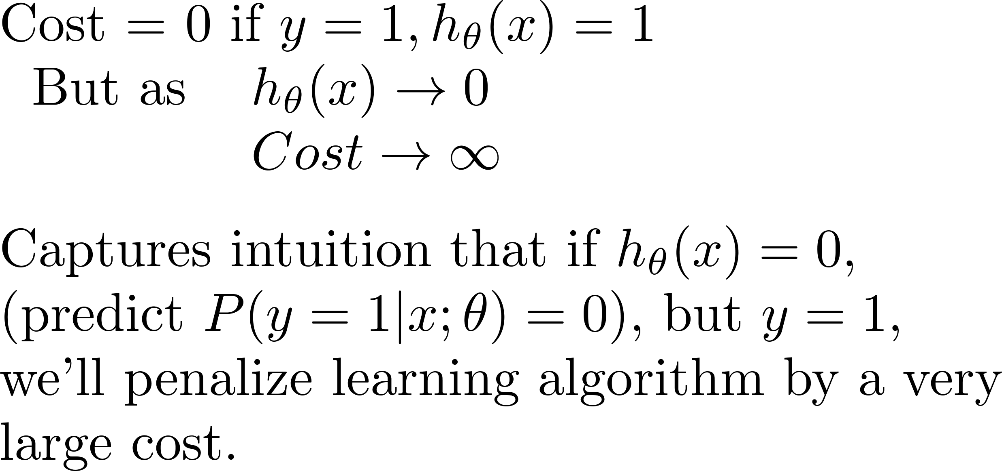
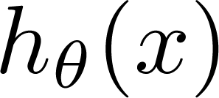
Logistic regression cost function
If y = 1
0
1

Slide 13
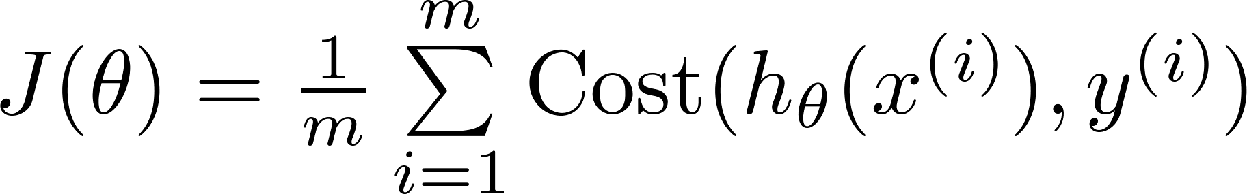
Logistic regression cost function

Slide 14

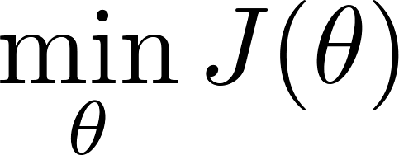

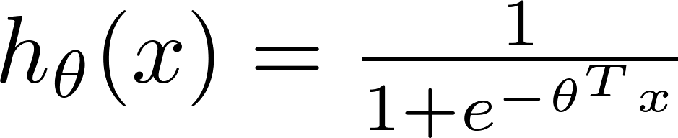
Logistic regression cost function
To fit parameters :
To make a prediction given new :
Output

Slide 15


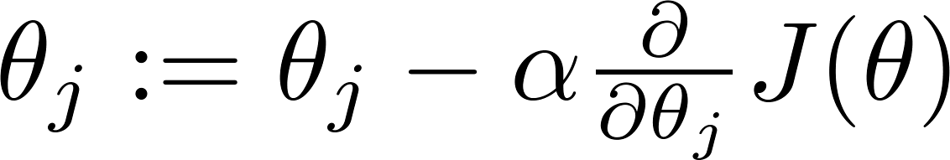


Gradient Descent
Want :
Repeat
(simultaneously update all )

Slide 16
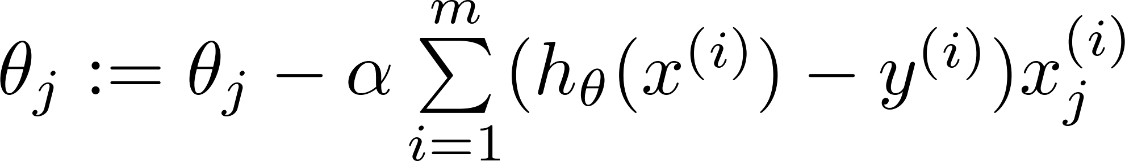
Gradient Descent
Want :
Repeat
(simultaneously update all )
Algorithm looks identical to linear regression!
Don’t forget the feature scaling!

Slide 17

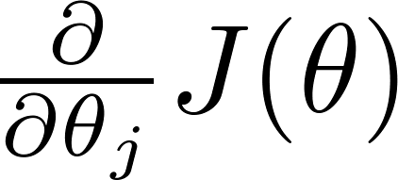
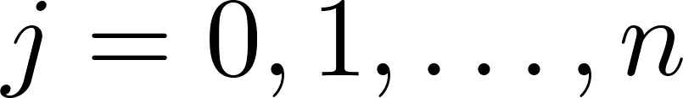

Optimization algorithm
Given , we have code that can compute
(for )
Optimization algorithms:
Gradient descent
Advantages:
No need to manually pick
Often faster than gradient descent.
Disadvantages:
More complex
Conjugate gradient
BFGS
L-BFGS

Slide 18
一些梯度下降算法之外的选择： 除了梯度下降算法以外，还有一些常被用来令代价函数最小的算法，这些算法更加复杂和优越，而且通常不需要人工选择学习率，通常比梯度下降算法要更加快速。这些算法有：共轭梯度（Conjugate Gradient），局部优化法(Broyden fletcher goldfarb shann,BFGS)和有限内存局部优化法(LBFGS) ，fminunc是 matlab和octave 中都带的一个最小值优化函数，使用时我们需要提供代价函数和每个参数的求导，下面是 octave 中使用 fminunc 函数的代码示例：
function [jVal, gradient] = costFunction(theta) jVal = [...code to compute J(theta)...]; gradient = [...code to compute derivative of J(theta)...]; end options = optimset('GradObj', 'on', 'MaxIter', '100'); initialTheta = zeros(2,1); [optTheta, functionVal, exitFlag] = fminunc(@costFunction, initialTheta, options);

Slide 19
多分类问题：一对多 Multi-class classification: One-vs-all
逻辑回归
Logistic
Regression

Slide 20
Multiclass classification
Email tagging: Work, Friends, Family, Hobby
Medical diagrams: Not ill, Cold, Flu
Weather: Sunny, Cloudy, Rain, Snow

Slide 21
Binary classification:
Multi-class classification:
x₂
x₂
x₁
x₁

Slide 22
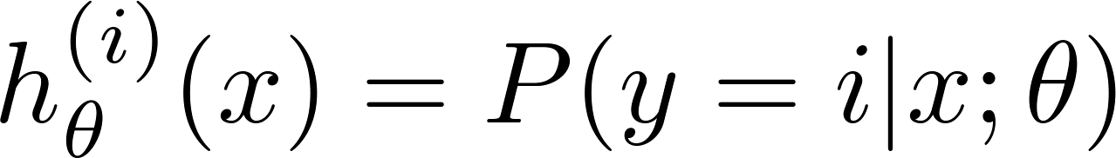

x₂
One-vs-all (one-vs-rest):
x₁
x₂
x₂
x₁
x₁
Class 1:
Class 2:
Class 3:
x₂
x₁

Slide 23
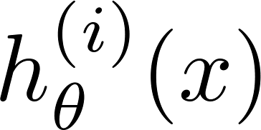

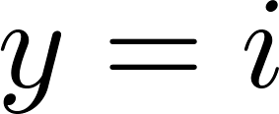
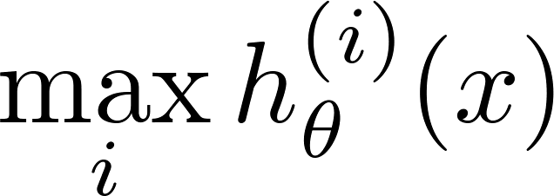
One-vs-all
Train a logistic regression classifier for each class to predict the probability that .
On a new input , to make a prediction, pick the class that maximizes

Slide 24
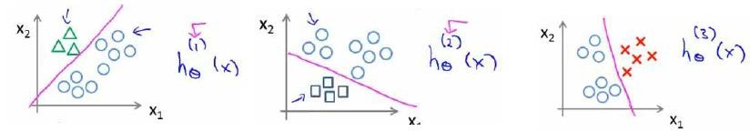
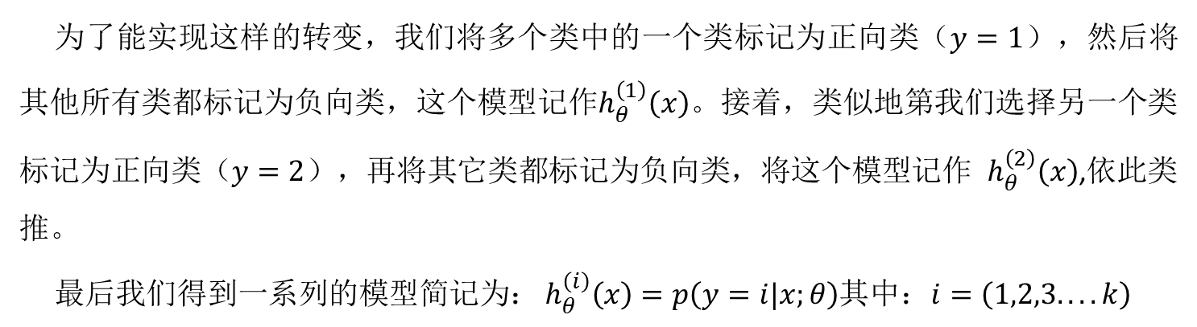
为了能实现这样的转变，我们将多个类中的一个类标记为正向类（$y=1$），然后将其他所有类都标记为负向类，这个模型记作$h_{θ}^{\left(1\right)}\left(x\right)$。接着，类似地第我们选择另一个类标记为正向类（$y=2$），再将其它类都标记为负向类，将这个模型记作 $h_{θ}^{\left(2\right)}\left(x\right)$,依此类推。
最后我们得到一系列的模型简记为： $h_{θ}^{\left(i\right)}\left(x\right)=p\left(y=i|x;θ\right)$其中：$i=\left(1,2,3....k\right)$
最后，在我们需要做预测时，我们将所有的分类机都运行一遍，然后对每一个输入变量，都选择最高可能性的输出变量。

