Slide 1
U.S. Department of State Bureau of Population, Refugees, and Migration (PRM) PRM’s Protracted Refugee Situations Strategy : Research Findings and Preliminary Evaluation Results Department of State Evaluation Conference June 7, 2011
Presented by: Fruzsina Csaszar, PRM

Slide 2

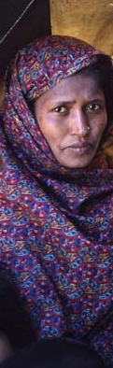


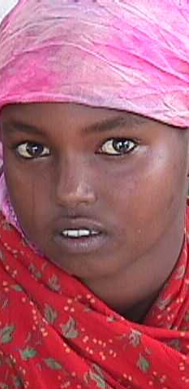

Humanitarian Assistance:
Focus on Beneficiaries

Slide 3
What is a “protracted” refugee situation?

Slide 4
What factors cause protracted refugee situations?

Slide 5
Why did PRM select focus populations?

Slide 6
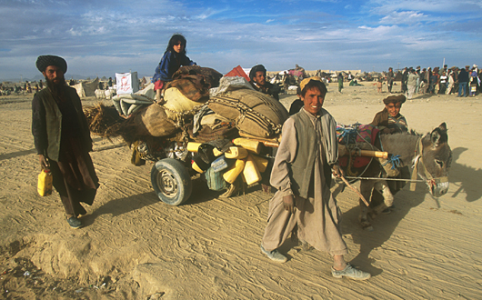
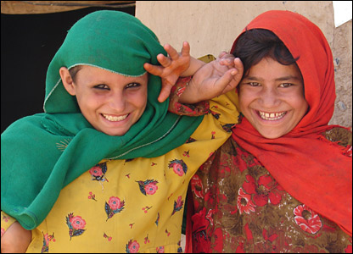
Focus Populations for PRM:
Afghans in Pakistan

Slide 7
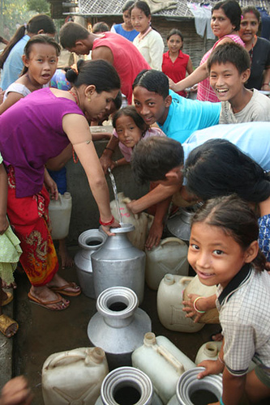
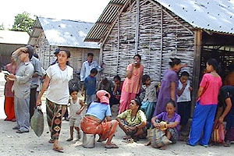
Six Focus Populations for PRM:
2. Bhutanese in Nepal

Slide 8
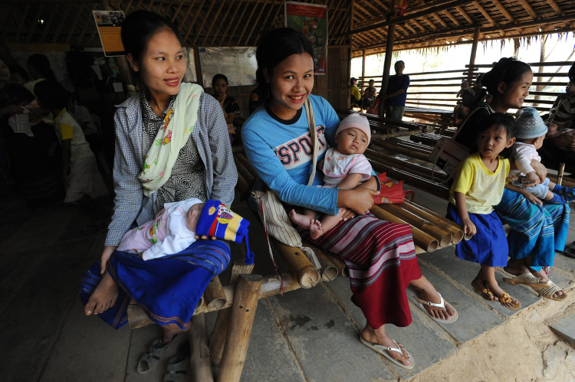
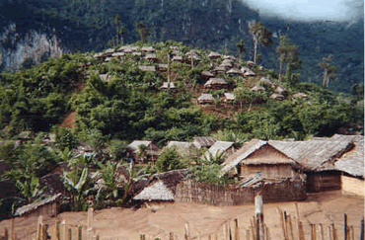
Six Focus Populations for PRM:
3. Burmese in Thailand

Slide 9
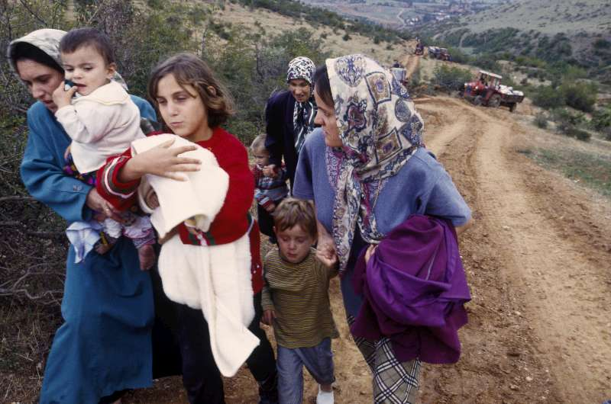

Six Focus Populations for PRM:
4. Refugees from Croatia and Bosnia in Serbia

Slide 10

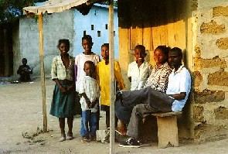
Six Focus Populations for PRM:
5. Liberians in West Africa

Slide 11
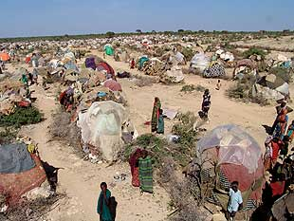
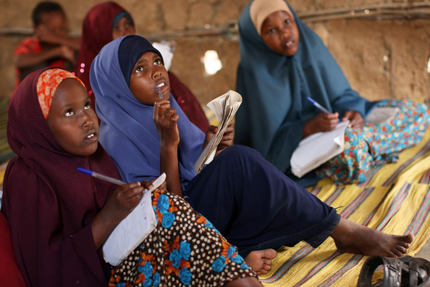
Six Focus Populations for PRM:
6. Somalis in Kenya

Slide 12
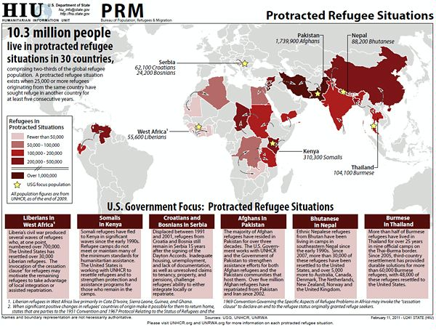

Slide 13
What is the solution to these protracted situations? How can the U.S. Government help?

Slide 14
Evaluation questions:
What types of interventions work and what doesn’t work in supporting refugees’ economic welfare, protection, and self-reliance in protracted situation?
How can we strengthen humanitarian assistance programs for these populations?

Slide 15
Two populations:
Somali refugees in the Dadaab camps in Kenya
Colombian refugees in settlements/cities in Ecuador

Slide 16
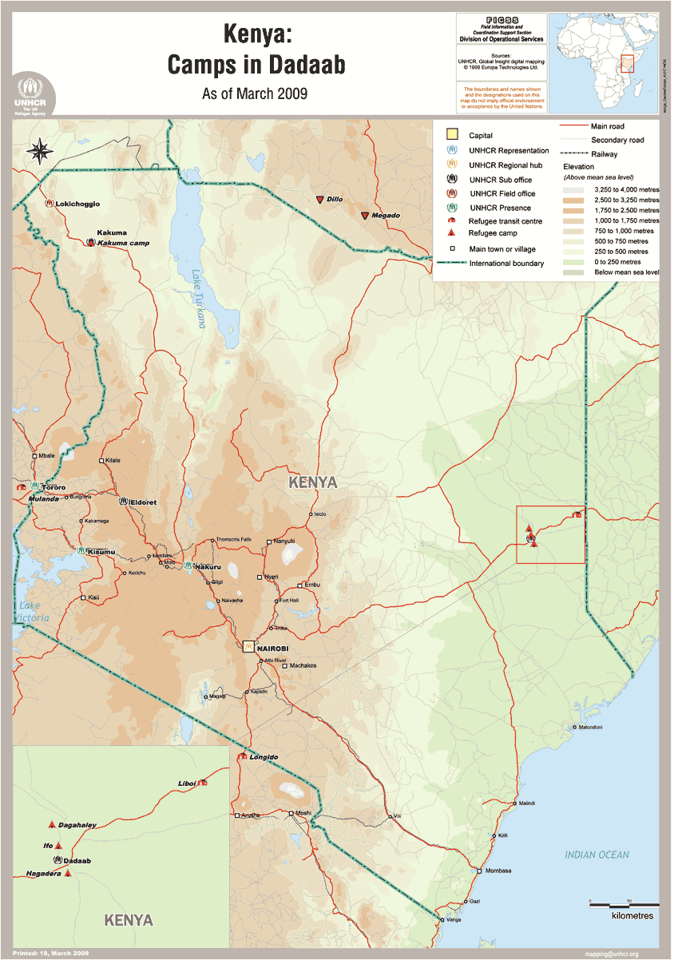
Dadaab refugee camps

Slide 17
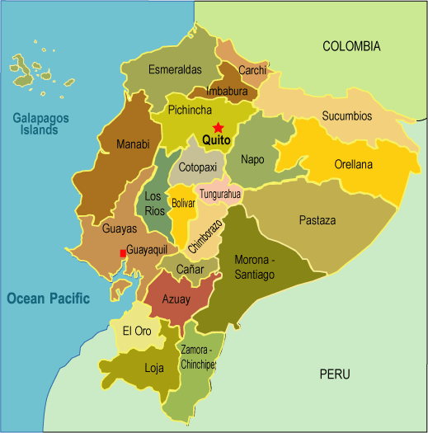
Ecuador

Slide 18
Methodology
Document review
Semi-structures questionnaires
Focus group discussions
Key informant interviews
Secondary research

Slide 19
Preliminary Findings

Slide 20
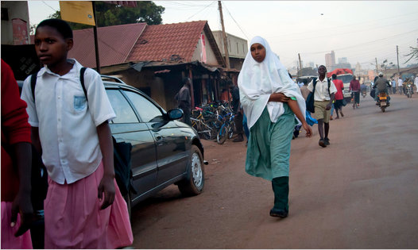
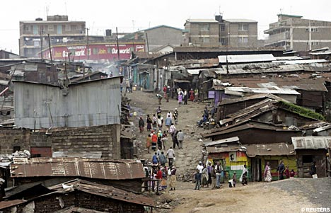
Urban Research Findings

Slide 21
Applying Research and Evaluation Findings & Recommendations

Slide 22
Strengthening Programs that Promote Self-Sufficiency and Protection Strengthening Relief to Development Linkages

