Slide 1

Highway Maintenance in Ontario
Area Maintenance Contracts
AASHTO Subcommittee on Maintenance
Contract Management and Operations Branch
Contract Management Office
Maintenance Contracts Section
July 18, 2011

Slide 2
Province of Ontario
Second largest province in Canada:
  area of 1,076,395 km² (~416,000 mi²)
  population over 13.2 million
More than 90 per cent of all Ontarians reside within 10 km of a provincial highway.
Safest roads in North America
Maintaining safe roads and keeping traffic moving are key economic and social goals of the Ministry

Slide 3
Ontario
Highway Network
  38,600 lane-km of provincial highway
  16,500 centre-line km
  Over 2,700 bridges/structures.
  29 remote airports and 9 ferry services
  Carry about $3 billion of goods every day
  Every day, about $600M worth of goods cross the border
  $59 billion dollar replacement value
  In 2010-2011, Ontario spent about $285M on highway maintenance and $1.9B on construction and rehabilitation
Over 432,000 vehicles use Highway 401 near Highway 400 every day, making this highway through Toronto one of the busiest sections of highway in North America

Slide 4
Highway Maintenance Overview
Highway maintenance is a statutory obligation of the Ministry
  Public Transportation and Highway Improvement Act Section 33
    The highway shall be maintained and kept in repair by the Ministry…
    Liable in case of default by the Ministry to keep the highway in repair
Maintenance standards and objectives have remained consistent
  Delivery models and specification approach have changed
Highway maintenance activities include:
  Winter maintenance – plowing, sanding, salting, anti-icing, clean up
  Pavement Maintenance – pothole patching, shoulders, debris removal
  Pavement Marking – lines, symbols
  Electrical – illumination, traffic signals
  Roadside Features – guiderail, drainage, fences, signs, vegetation
  Incident response
  Patrolling

Slide 5
Highway Maintenance Delivery
Pre-1995
Large staff for in-house delivery of work
Approximately half of winter maintenance work outsourced under direct ministry supervision
1996 business plan to fully outsource by 1999
1996 to 2009
A blend of contract types
  Area Maintenance Contracts (AMC’s) – lump sum, contractor provides services including planning and scheduling maintenance activities
  Managed Outsourcing contracts (MO’s), unit price based contracts with ministry directing maintenance activities
Savings/value for money achieved – approximately 12.5%
Ministry ensures maintenance quality standards are achieved
Current Service Delivery Approach
Shift to 100% AMC model

Slide 6
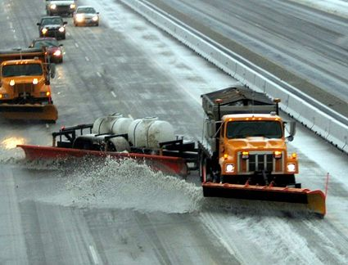
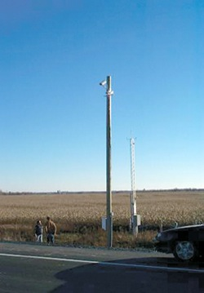
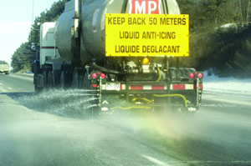
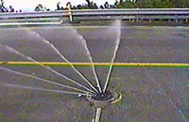
Highway Maintenance - Innovations
New technologies and innovations introduced since 1996 to meet safety, service improvement and cost-saving objectives:
  Road Weather Information System (RWIS)
  Anti-Icing liquids
  GPS-based vehicle information
  Tow-Plows
  Fixed-Automated Spray Technology (FAST)

Slide 7
Current Approach
3rd Generation Area Maintenance Contracts (2009-2026)
Performance Contracts are the next step in AMC evolution
  Shift from method-based contracts to performance contracts
  Increase scope of AMCs
    in-scope capital
    data collection (culverts and facilities condition)
  Introduce asset management concepts
  Increased opportunities for contractor innovation
  Contractor responsible for determining how to do the work and achieve the required performance outcome or result
Exercise due diligence through oversight and contract administration
Road liability held by ministry
First 3rd generation AMC tendered in 2009
On-schedule to achieve AMCs province-wide by August 2014

Slide 8
3rd Generation AMCs - Objectives
Provide a one window approach for the delivery of maintenance over a 9-13 year term, which will improve service to the public by:
  Achieving value for money by managing public assets and investments
  Holding the Service Provider ultimately accountable for service quality
  Promote the development of a performance-based industry
  Increase average size of contract areas to allow greater efficiencies
    1,000 ~ 2,200 equivalent 2-lane-km
  Provide a high degree of confidence that operations will be completed proactively and products will perform as intended
  Reduced contract oversight effort by the ministry
  Improve cost effectiveness
Develop ministry and industry knowledge and acceptance of performance requirements for the delivery of maintenance operations
Introduce the concept of International Standard Organization (ISO) certified contractors
Allows for greater flexibility to identify and implement innovations
Provide flexibility for new models in 2020 - 2026 timeframe

Slide 9
3rd Generation AMCs - Procurement
Evaluation streamlined to match performance management approach
Contractor Prequalification
  Ensure has the financial resources and adequate technical and managerial skills to satisfactorily perform the work
Proposal submission
  Evaluation of organization and service management
  Evaluate winter maintenance strategy
  Minimum technical threshold requirement
Preferred proponent determined by lowest bid price
Eight of twenty-two contracts awarded to date
  Value for Money in awards
    Industry competition – healthy number of bids and competitive range of prices

Slide 10
3rd Generation AMCs - Quality
Contract requires ISO Certification
  Quality Management (ISO 9001:2008)
  Environment (14001:2004)
  Registration within 6-months of contract start and maintained throughout
Contractor develops, documents and registers how they will achieve outcome targets
Key step to ensure contractors are responsible for managing their performance and delivering contract requirements
ISO requires annual audits
  Results of external and internal audits available to ministry

Slide 11
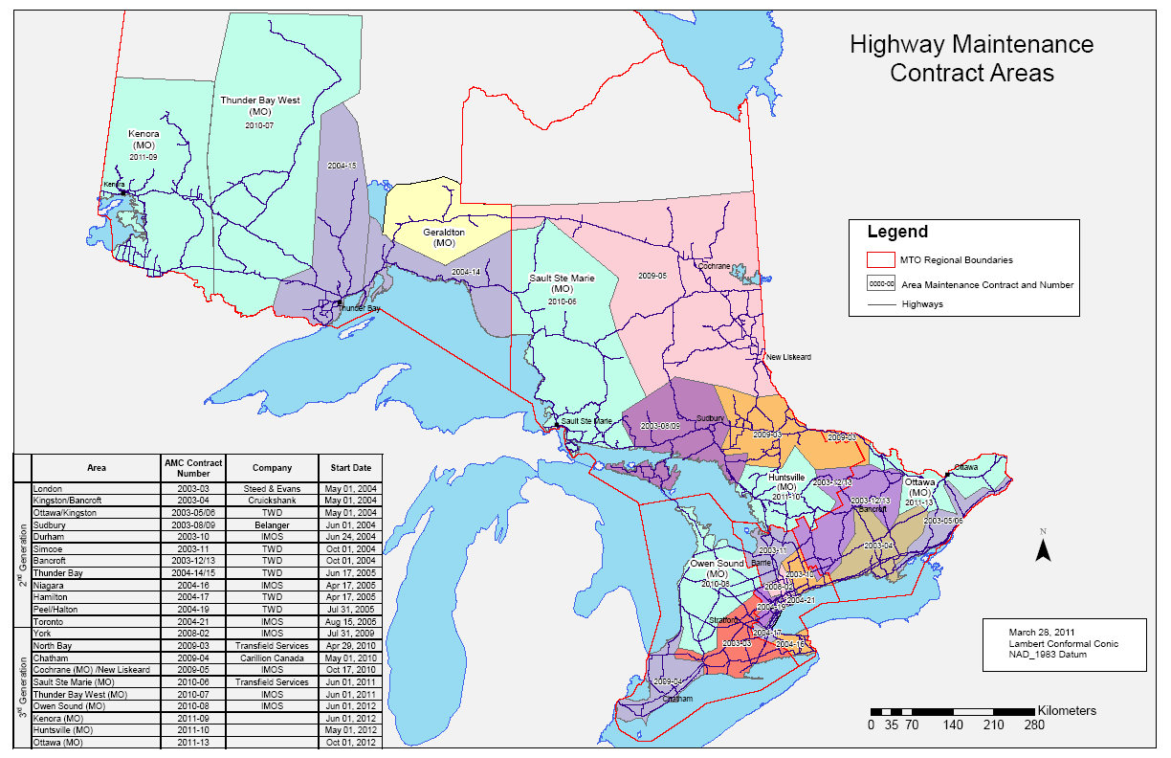
Maintenance Contract Areas To Date

Slide 12
3rd Generation AMCs – Overview
Outcome targets set to achieve ministry quality standards
  Promote highway safety
  Maintain and preserve the infrastructure
  Measurable requirements
  Support ministry business practices
  Implemented for all service areas, e.g.
    Winter maintenance
    Pavement maintenance
    Roadside features
Based on:
  Ministry Maintenance Quality Standards and Best Practices
  Ontario Provincial Standards

Slide 13
3rd Generation AMCs - Specs
Example – Potholes
Method-based specification:
  Contract lists all potential deficiencies and provides a table detailing the repair time line based on class of highway and severity of the deficiency
  Potholes – 200mm x 200mm or greater and a depth > 50mm - repair in 3 to 7 days (depending on highway class)
Performance contract specification (asphalt and concrete pavement)
  No potholes greater than 75mm deep
  No more than 3 potholes in an area of 20m²
  No more than 10 potholes per lane km
  Size defined as 0.04m² (200mm x 200mm)
  Consequences of Non-conformance
    $5,000 for each pothole deeper than 75mm and greater than 0.04m²
    $5,000 for each occurrence of more than three potholes greater than 0.04m² within an area of 20m²
    $1,000 for each occurrence of 10 or more potholes per lane-km.
    Subsequent consequences for on-going non-repair

Slide 14
3rd Generation AMCs - Specs
Example – Cable Guiderail
Method-based specification (subset or requirements):
  Lists deficiencies and provides repair time line based on location of guiderail (shoulder, median) and type of the deficiency
  Cables – sagged in excess of 50mm, tightened within 21 days. Frayed within 7 days
  Posts – more than 3 consecutive broken posts (median), replace within 7 days
Performance contract specification (subset)
  No frayed/broken cables, no cable height exceeding standard by more than 5cm, no exposed anchors or missing hardware
  No more than 4 consecutive broken posts
  Temporary repairs and repairs within 30 days of end of Winter Transition period
  Consequences of Non-conformance (subset)
    $5,000 for each occurrence of frayed and/or missing cables or height exceeding design standard by more than 5cm
    $1,000 per occurrence of more than 4 consecutive damaged posts
    $1,000 per occurrence of temporary repairs not completed within 24 hours
    Subsequent consequences for non-repair continuing

Slide 15
3rd Generation AMCs – In-scope Capital
Annual commitment for low-complexity capital work
Contractor plans, ministry modifies/approves, contractor delivers
Work Items
  Asphalt patching/paving
  Shouldering
  Single and Double Surface Treatment
  Centerline Culvert Installation
  Guide Rail
  Brushing
  Spraying
  Ditch Clean Out
  Capital Improvements - Facilities
$1.5M ~ $3M per contract

Slide 16
3rd Generation AMCs – Data Collection
Contractor collects and provides select data collection, e.g.
  Non-structural culvert inventory and condition
  Facilities condition
Data assists contractor with developing plans for in-scope capital work
  Provides data for ministry processes also

Slide 17
3rd Generation AMCs - Oversight
Ministry staff are responsible to ensure the contractor meets their contractual obligations
  Focus on results, not methods
Contract administration is used to:
  Provide a progressive set of actions or consequences to encourage the contractor to deliver the desired performance
  Escalation of performance concerns when necessary
    Verbal notice
    Written notice
      Non-conformance
      Instruction Notice
      Liquidated Damages
    Warning of Infraction
    Infraction Report
    Qualification Committee
    Default
  Demonstrate due diligence

Slide 18
3rd Generation AMCs – Oversight
Ministry staff assess conformance to contract requirements using audit and sampling principles
  Hands-on training to ministry staff in advance of contract start
  Oversight Manual applied Province-wide
  Utilize various tools/sources of information: Documentation review, GPS-based monitoring systems, field inspections
Ongoing communication with contractor important
Consistency of exercise of judgement and discretion by ministry

Slide 19
3rd Generation AMCs - Metrics
Overall, contractors meet the performance requirements
New reporting for third generation contract being implemented to measure:
  Number of assessments performed
  Number of outcome targets measured
    Number of conformances
    Number of non-conformances
  How non-conformances addressed
    e.g. verbal, written or financial

Slide 20
Summary
Philosophy/Concepts in summary
  The Work is the same, more efficient, timely and flexible
  Service provider is accountable
  How the Work is measured changes
Strong and competitive contracting industry
  Ontario Road Builders’ Association (ORBA) represents maintenance contractors
Audit and sampling-based oversight
Maintained maintenance standards for traveling public
Safest roads in North America

Slide 21
The End
Thank you
Questions?

