Slide 1
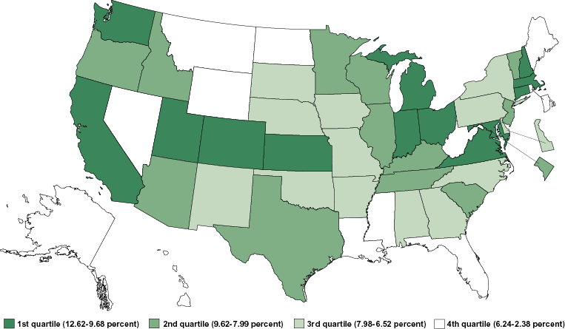
Employment in high-technology establishments as share of total employment: 2000
Notes:
1

