Slide 1



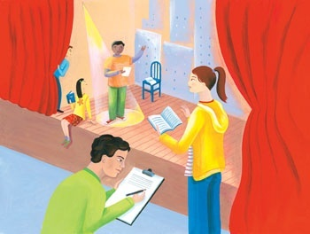
Connecting Assessment,
Language, and Learning
Jill Morgan
CTB/McGraw-Hill Trainer
Shelby Gallagher
Indiana LAS Links Program Manager

Slide 2
Today’s Agenda
Elementary LAS Links Placement Test
Administration and scoring of Speaking
Administration of Listening, Reading, Writing
Scoring of Writing
Tabulation of scores
Note: This two-hour course is for examiners of students entering grades 1-5. PreLAS is used for entering Kindergarten students.

Slide 3
Materials covered
LAS Links Placement Test grades K-1, 2-3 and 4-5
LAS Links Placement Test Examiner’s Guide grades K-5
Student Profile Sheet

Slide 4
PREPARE TO TEST

Slide 5
Administer the Placement Test
One-on-one
In a quiet place
Allow:
25 minutes to administer
5 minutes to score

Slide 6
General Administration Procedures
Make the student comfortable
Make the directions clear
No hints or clues
Listen for fluent English
  Tester must be:
    Fluent in English
    Trained to score
  May repeat and model the Practice Item but never the test questions
Notes:
Establish a rapport with the child and make him or her feel comfortable before beginning the actual test
Ensure student understands the directions
Provide directions in the child’s home language if available and necessary (note: be sure test items including practice items are administered in English)
Do not inadvertently give hints or clues that reveal the answer
An item is wrong when the child does not make a response that is appropriate for a fluent English speaker of the same age
Remember the purpose of the test is to determine where the student needs help. Artificially inflating the student’s score means the student may not get the help needed

Slide 7
Placement Test Summary
Speaking |  | 6 Constructed Response
Listening |  | 6 Multiple Choice
Reading |  | 6 Multiple Choice
Writing |  | 5 Multiple Choice 2 Constructed Response
Total Estimated |  | 18 items 20 minutes

Slide 8
SPEAKING

Slide 9
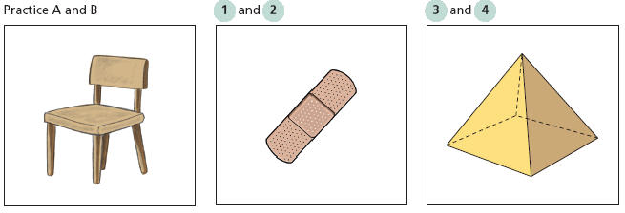
Speak in Words
What is it? What is it used for?
  Page 2 Placement Test

Slide 10
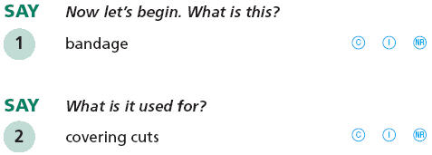
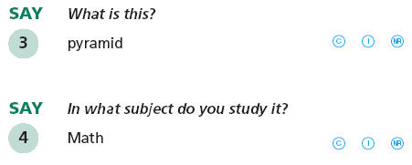
Speak in Words
Mark Correct, Incorrect, or No Response
  Page 3 Placement Test

Slide 11
Speak in Words items 1-4
Prompt | Anticipated Response | Additional Correct Responses
What is this? What is it used for? | Bandage Covering cuts | Band-Aid® When I get hurt
What is this? In what subject do you study it? | Pyramid Math | Luxor History
  Page 58 Examiner’s Guide

Slide 12
SPEAKING
RUBRIC SCORING

Slide 13
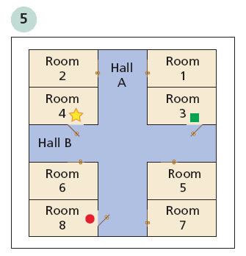
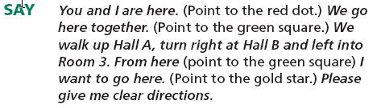
Speak in Sentences
Page 4 Placement Test
Notes:
One example of a Speak in Sentences item. There are several types: picture to describe, bookcase for location, and this map for directions.

Slide 14
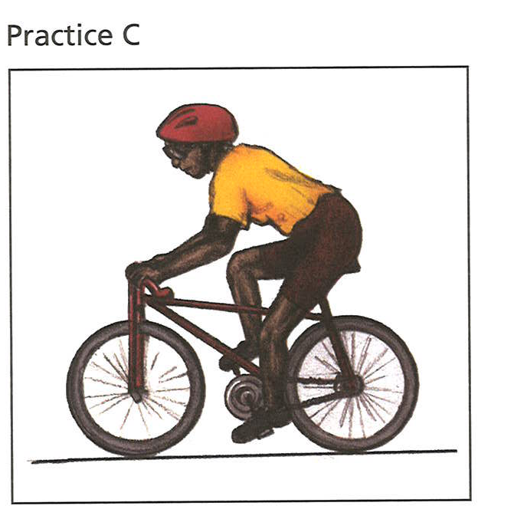
Speak in Sentences
Tell me what is happening in the picture.
Page 4 Placement Test
Notes:
One example of a Speak in Sentences item. There are several types: picture to describe, bookcase for location, and this map for directions.

Slide 15

Scoring Speaking 0-3 - in a nutshell
0 = nothing in English or no words related to the prompt
1 = words related to the prompt but do not satisfy the task
2 = satisfies the task with errors in grammar or vocabulary
3 = satisfies the task with ease of a native speaker
Notes:
Use this for participant response to describe scores.
Pull out your rubric sheet with the O-3 Scoring Checklist and the O-3 Rubric from the Manual
Find the Scoring Checklist on page 5 of the Placement Test booklet
Find the Rubric on Page 47 of the Examiner’s Guide.
Take a moment to read over these descriptors.

Slide 16
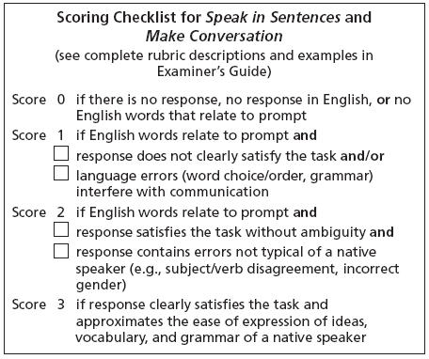
Scoring Checklist 0-3
Speak in Sentences and Make Conversation
  Page 5 Placement Test
  Page 47 Examiner’s Guide
Notes:
Use this for participant response to describe scores.

Slide 17
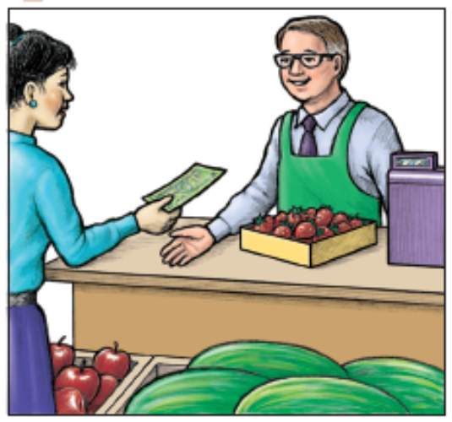
Speak in Sentences
Sample response Grades 2-3
  The girl and man eat it.
  Score:
Samples Responses pages 50, 54, & 58 Examiner’s Guide
Notes:
Animated slide (score and rationale show up with mouse click)
Tell me what is happening in the picture.
She is cutting paper./ She is making an art project
Here is a student response. What do you see that fits the descriptors?

Slide 18
Speak in Sentences
  The girl and man eat it.
  Score: 1
  Rationale:
  Relates to the prompt
  Does not satisfy the task
Notes:
Animated slide (score and rationale show up with mouse click)
Here is a student response. What do you see that fits the descriptors?

Slide 19
Speak in Sentences
  She buyed the foods.
Notes:
Animated slide (score and rationale show up with mouse click)
Here is a student response. What do you see that fits the descriptors?

Slide 20
Speak in Sentences
  She buyed the foods.
  Score: 2
  Rationale:
  Satisfies the task
  Grammatical error (“buyed”)
Notes:
Animated slide (score and rationale show up with mouse click)
Here is a student response. What do you see that fits the descriptors?

Slide 21
Speak in Sentences
  She is buying some fruit.
Notes:
Animated slide (score and rationale show up with mouse click)
Here is a student response. What do you see that fits the descriptors?

Slide 22
Speak in Sentences
  She is buying some fruit.
  Score: 3
  Rationale:
  Satisfies the task
  Ease of expressions of a native speaker
Notes:
Animated slide (score and rationale show up with mouse click)
Here is a student response. What do you see that fits the descriptors?

Slide 23
Quiz #1
Speak in Sentences Scoring
Answer the 3 questions in the Polling pane.
Notes:
Handout. Based on time work in groups or pairs to read through responses, scores and rationales, then score on next page.

Slide 24
Scoring Practice
Speak in Sentences
Your turn to score
Notes:
Handout. Based on time work in groups or pairs to read through responses, scores and rationales, then score on next page.

Slide 25
Scoring Sample #1
Sample response Grades 4-5
Listen to the response and mark your score in the Polling pane.
  Please give me clear directions (from Room 3 to Room 4).
0 = nothing in English or no words related to the prompt
1 = words related to the prompt but do not satisfy the task
2 = satisfies the task with errors in grammar or vocabulary
3 = satisfies the task with ease of a native speaker
Notes:
Animated slide (score and rationale show up with mouse click)
Here is a student response. What do you see that fits the descriptors?

Slide 26
Scoring Sample #1
  Room 3 is Hall B.
  Score: 1
  Rationale:
  Relates to the prompt
  Does not satisfy the task
Notes:
Animated slide (score and rationale show up with mouse click)
Here is a student response. What do you see that fits the descriptors?

Slide 27
Scoring Sample #2
Listen to the response and mark your score in the Poll Question pane.
0 = nothing in English or no words related to the prompt
1 = words related to the prompt but do not satisfy the task
2 = satisfies the task with errors in grammar or vocabulary
3 = satisfies the task with ease of a native speaker
Notes:
Animated slide (score and rationale show up with mouse click)
Here is a student response. What do you see that fits the descriptors?

Slide 28
Scoring Sample #2
  Go in the Hall B to Room 4 right.
  Score: 2
  Rationale:
  Satisfies the task
  Error in usage (the Hall, right)
Notes:
Animated slide (score and rationale show up with mouse click)
Here is a student response. What do you see that fits the descriptors?

Slide 29
Scoring Sample #3
Listen to the response and mark your score in the Poll Question pane.
0 = nothing in English or no words related to the prompt
1 = words related to the prompt but do not satisfy the task
2 = satisfies the task with errors in grammar or vocabulary
3 = satisfies the task with ease of a native speaker
Notes:
Animated slide (score and rationale show up with mouse click)
Here is a student response. What do you see that fits the descriptors?

Slide 30
Scoring Sample #3
  Go from Hall B straight to Room 4.
  Score: 3
  Rationale:
  Satisfies the task
  Ease of a native speaker
Notes:
Animated slide (score and rationale show up with mouse click)
Here is a student response. What do you see that fits the descriptors?

Slide 31
Scoring Sample #4
Sample response Grades 2-3
Listen to the response and mark your score in the Poll Question pane.
  Tell me what is happening in the picture.
0 = nothing in English or no words related to the prompt
1 = words related to the prompt but do not satisfy the task
2 = satisfies the task with errors in grammar or vocabulary
3 = satisfies the task with ease of a native speaker
Notes:
Animated slide (score and rationale show up with mouse click)
Here is a student response. What do you see that fits the descriptors?

Slide 32
Scoring Sample #4
  She and he for the fruit.
  Score: 1
  Rationale:
  Relates to the prompt
  Does not satisfy the task
Notes:
Animated slide (score and rationale show up with mouse click)
Here is a student response. What do you see that fits the descriptors?

Slide 33
Scoring Sample #5
Listen to the response and mark your score in the Poll Question pane.
  Tell me what is happening in the picture.
0 = nothing in English or no words related to the prompt
1 = words related to the prompt but do not satisfy the task
2 = satisfies the task with errors in grammar or vocabulary
3 = satisfies the task with ease of a native speaker
Notes:
Animated slide (score and rationale show up with mouse click)
Here is a student response. What do you see that fits the descriptors?

Slide 34
Scoring Sample #5
  She pay the money.
  Score: 2
  Rationale:
  Satisfies the task
  Grammatical error (She pay)
Notes:
Animated slide (score and rationale show up with mouse click)
Here is a student response. What do you see that fits the descriptors?

Slide 35
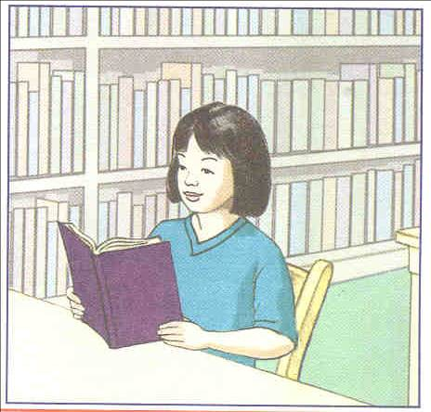
Scoring Sample #6
Sample response Grades K-1
Listen to the response and mark your score in the Poll Question pane.
  Tell me what is happening in the picture.
0 = nothing in English or no words related to the prompt
1 = words related to the prompt but do not satisfy the task
2 = satisfies the task with errors in grammar or vocabulary
3 = satisfies the task with ease of a native speaker
Notes:
Animated slide (score and rationale show up with mouse click)
Here is a student response. What do you see that fits the descriptors?

Slide 36
Scoring Sample #6
  He’s reading…she’s reading his book.
  Score: 2
  Rationale:
  Satisfies the task
  Grammatical error (‘his book’)
  Self-correction improves response
Notes:
Animated slide (score and rationale show up with mouse click)
Here is a student response. What do you see that fits the descriptors?

Slide 37
Scoring Sample #7
Listen to the response and mark your score in the Poll Question pane.
  Tell me what is happening in the picture.
0 = nothing in English or no words related to the prompt
1 = words related to the prompt but do not satisfy the task
2 = satisfies the task with errors in grammar or vocabulary
3 = satisfies the task with ease of a native speaker
Notes:
Animated slide (score and rationale show up with mouse click)
Here is a student response. What do you see that fits the descriptors?

Slide 38
Scoring Sample #7
  She’s reading a book in the library.
  Score: 3
  Rationale:
  Satisfies the task
  Fluent, no error.
Notes:
Animated slide (score and rationale show up with mouse click)
Here is a student response. What do you see that fits the descriptors?

Slide 39
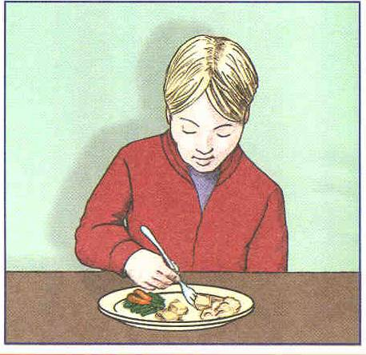
Scoring Sample #8
Listen to the response and mark your score in the Poll Question pane.
  Tell me what is happening in the picture.
0 = nothing in English or no words related to the prompt
1 = words related to the prompt but do not satisfy the task
2 = satisfies the task with errors in grammar or vocabulary
3 = satisfies the task with ease of a native speaker
Notes:
Animated slide (score and rationale show up with mouse click)
Here is a student response. What do you see that fits the descriptors?

Slide 40
Scoring Sample #8
  Lunch?
  Score: 1
  Rationale:
  One word response does not satisfy the task
  Lacks sentence formation
Notes:
Animated slide (score and rationale show up with mouse click)
Here is a student response. What do you see that fits the descriptors?

Slide 41
Scoring Sample #9
Listen to the response and mark your score in the Poll Question pane.
  Tell me what is happening in the picture.
0 = nothing in English or no words related to the prompt
1 = words related to the prompt but do not satisfy the task
2 = satisfies the task with errors in grammar or vocabulary
3 = satisfies the task with ease of a native speaker
Notes:
Animated slide (score and rationale show up with mouse click)
Here is a student response. What do you see that fits the descriptors?

Slide 42
Scoring Sample #9
  That boy is eating with broccolis and carrots.
  Score: 2
  Rationale:
  Satisfies the task
  Errors in vocabulary not typical of a native speaker (‘with broccolis and carrots’)
Notes:
Animated slide (score and rationale show up with mouse click)
Here is a student response. What do you see that fits the descriptors?

Slide 43
Scoring Sample #10
Listen to the response and mark your score in the Poll Question pane.
  Tell me what is happening in the picture.
0 = nothing in English or no words related to the prompt
1 = words related to the prompt but do not satisfy the task
2 = satisfies the task with errors in grammar or vocabulary
3 = satisfies the task with ease of a native speaker
Notes:
Animated slide (score and rationale show up with mouse click)
Here is a student response. What do you see that fits the descriptors?

Slide 44
Scoring Sample #10
  Umm…the boy’s eating.
  Score: 3
  Rationale:
  Satisfies the task
  Fluently spoken
  ‘Umm’ is typical of native speakers
Notes:
Animated slide (score and rationale show up with mouse click)
Here is a student response. What do you see that fits the descriptors?

Slide 45
Make Conversation
Tell, Ask, Describe, Explain
Score 0 to 3 – same rubric
Page 7 Placement Test
Notes:
Second section scored with same rubric/checklist.

Slide 46
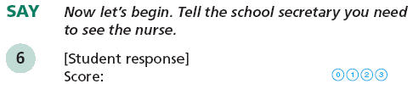
Make Conversation
Page 7 Placement Test
Notes:
Second section scored with same rubric/checklist.

Slide 47
Make Conversation
Sample response Grades 4-5
  The nurse.
Pages 51, 55 & 59 Examiner’s Guide
Notes:
Not animated. Review quickly since practice with Speak in Sentences has provided good understanding already.
Speaking Item 6.

Slide 48
Make Conversation
  The nurse.
  Score: 1
  Rationale:
  Relates to the prompt
  Does not satisfy the task
  No sentence structure
Notes:
Not animated. Review quickly since practice with Speak in Sentences has provided good understanding already.

Slide 49
Make Conversation
  I needing the nurse.
Notes:
Not animated. Review quickly since practice with Speak in Sentences has provided good understanding already.

Slide 50
Make Conversation
  I needing the nurse.
  Score: 2
  Rationale:
  Satisfies the prompt
  Sufficient sentence structure
  Not typical of a native speaker
Notes:
Not animated. Review quickly since practice with Speak in Sentences has provided good understanding already.

Slide 51
Make Conversation
  I feel sick and need to see the nurse.
Notes:
Not animated. Review quickly since practice with Speak in Sentences has provided good understanding already.

Slide 52
Make Conversation
  I feel sick and need to see the nurse.
  Score: 3
  Rationale:
  Satisfies the task
  Ease of expression of a native speaker
Notes:
Not animated. Review quickly since practice with Speak in Sentences has provided good understanding already.

Slide 53
Quiz #2
Make Conversation Scoring
Answer the 3 questions in the Polling pane.
Notes:
Handout. Based on time work in groups or pairs to read through responses, scores and rationales, then score on next page.

Slide 54
Scoring Practice
Make Conversation
Your turn to score
Notes:
Handout. Based on time work in groups or pairs to read through responses, scores and rationales, then score on next page.

Slide 55
Scoring Sample #1
Sample response Grades 2-3
Listen to the response and mark your score in the Poll Question pane.
  Tell a friend about your favorite food.
0 = nothing in English or no words related to the prompt
1 = words related to the prompt but do not satisfy the task
2 = satisfies the task with errors in grammar or vocabulary
3 = satisfies the task with ease of a native speaker
Notes:
Animated slide (score and rationale show up with mouse click)
Here is a student response. What do you see that fits the descriptors?

Slide 56
Scoring Sample #1
  I like eat the favorites.
  Score: 1
  Rationale:
  Does not satisfy the task – mentions ‘favorites’ but no specific food
  Relates to the prompt
  Not a single word response repeated from the prompt so not a zero
Notes:
Animated slide (score and rationale show up with mouse click)
Here is a student response. What do you see that fits the descriptors?

Slide 57
Scoring Sample #2
  Tell a friend about your favorite food.
0 = nothing in English or no words related to the prompt
1 = words related to the prompt but do not satisfy the task
2 = satisfies the task with errors in grammar or vocabulary
3 = satisfies the task with ease of a native speaker
Notes:
Animated slide (score and rationale show up with mouse click)
Here is a student response. What do you see that fits the descriptors?

Slide 58
Scoring Sample #2
  My favorite food is pizza.
  Score: 3
  Rationale:
  Satisfies the task
  Ease of expression of a native speaker
Notes:
Animated slide (score and rationale show up with mouse click)
Here is a student response. What do you see that fits the descriptors?

Slide 59
Scoring Sample #3
  Tell a friend about your favorite food.
0 = nothing in English or no words related to the prompt
1 = words related to the prompt but do not satisfy the task
2 = satisfies the task with errors in grammar or vocabulary
3 = satisfies the task with ease of a native speaker
Notes:
Animated slide (score and rationale show up with mouse click)
Here is a student response. What do you see that fits the descriptors?

Slide 60
Scoring Sample #3
  I, my best is candy.
  Score: 2
  Rationale:
  Satisfies the task
  Use of “best” is sufficient for the task
  Self-correction is acceptable and does not affect scoring
Notes:
Animated slide (score and rationale show up with mouse click)
Here is a student response. What do you see that fits the descriptors?

Slide 61
Scoring Sample #4
Sample response Grade 1
  Explain why we raise our hands when we want to talk in the classroom.
0 = nothing in English or no words related to the prompt
1 = words related to the prompt but do not satisfy the task
2 = satisfies the task with errors in grammar or vocabulary
3 = satisfies the task with ease of a native speaker
Notes:
Animated slide (score and rationale show up with mouse click)
Here is a student response. What do you see that fits the descriptors?

Slide 62
Scoring Sample #4
  We raise our hands to take turns.
  Score: 3
  Rationale:
  Satisfies the task
  Ease of expression of a native speaker
Notes:
Animated slide (score and rationale show up with mouse click)
Here is a student response. What do you see that fits the descriptors?

Slide 63
Scoring Sample #5
  Explain why we raise our hands when we want to talk in the classroom.
  .
0 = nothing in English or no words related to the prompt
1 = words related to the prompt but do not satisfy the task
2 = satisfies the task with errors in grammar or vocabulary
3 = satisfies the task with ease of a native speaker
Notes:
Animated slide (score and rationale show up with mouse click)
Here is a student response. What do you see that fits the descriptors?

Slide 64
Scoring Sample #5
  He raise him hand so it is him turn.
  Score: 2
  Rationale:
  Satisfies the task
  Not expressed with the ease of a native speaker (pronoun “him” and verb agreement error “raise”)
Notes:
Animated slide (score and rationale show up with mouse click)
Here is a student response. What do you see that fits the descriptors?

Slide 65
Scoring Sample #6
  Explain why we raise our hands when we want to talk in the classroom.
  .
0 = nothing in English or no words related to the prompt
1 = words related to the prompt but do not satisfy the task
2 = satisfies the task with errors in grammar or vocabulary
3 = satisfies the task with ease of a native speaker
Notes:
Animated slide (score and rationale show up with mouse click)
Here is a student response. What do you see that fits the descriptors?

Slide 66
Scoring Sample #6
  Raise hand, talking.
  Score: 1
  Rationale:
  Relates to the prompt
  Does not satisfy the task
  No sentence structure
Notes:
Not animated. Review quickly since practice with Speak in Sentences has provided good understanding already.

Slide 67
Scoring Sample #7
  Ask if you may have some paper.
0 = nothing in English or no words related to the prompt
1 = words related to the prompt but do not satisfy the task
2 = satisfies the task with errors in grammar or vocabulary
3 = satisfies the task with ease of a native speaker
Notes:
Animated slide (score and rationale show up with mouse click)
Here is a student response. What do you see that fits the descriptors?

Slide 68
Scoring Sample #7
  Ummm…ummm if I can have a paper for write?
  Score: 2
  Rationale:
  Satisfies the task
  Word order not typical of a native speaker (“if I can have”)
Notes:
Animated slide (score and rationale show up with mouse click)
Here is a student response. What do you see that fits the descriptors?

Slide 69
Scoring Sample #8
  Explain why we should be quiet when the teacher is talking.
0 = nothing in English or no words related to the prompt
1 = words related to the prompt but do not satisfy the task
2 = satisfies the task with errors in grammar or vocabulary
3 = satisfies the task with ease of a native speaker
Notes:
Animated slide (score and rationale show up with mouse click)
Here is a student response. What do you see that fits the descriptors?

Slide 70
Scoring Sample #8
  The, the homework.
  Score: 1
  Rationale:
  Single word response that relates to the prompt.
  No sentence
  Does not satisfy the task
Notes:
Animated slide (score and rationale show up with mouse click)
Here is a student response. What do you see that fits the descriptors?

Slide 71
Scoring Sample #9
  Explain why we should be quiet when the teacher is talking.
0 = nothing in English or no words related to the prompt
1 = words related to the prompt but do not satisfy the task
2 = satisfies the task with errors in grammar or vocabulary
3 = satisfies the task with ease of a native speaker
Notes:
Animated slide (score and rationale show up with mouse click)
Here is a student response. What do you see that fits the descriptors?

Slide 72
Scoring Sample #9
  Because we’re doing work.
  Score: 3
  Rationale:
  Satisfies the task sufficiently to be a 3
  Expressed with the ease of a native speaker
Notes:
Animated slide (score and rationale show up with mouse click)
Here is a student response. What do you see that fits the descriptors?

Slide 73
Scoring Sample #10
  Describe how we line up in class.
0 = nothing in English or no words related to the prompt
1 = words related to the prompt but do not satisfy the task
2 = satisfies the task with errors in grammar or vocabulary
3 = satisfies the task with ease of a native speaker
Notes:
Animated slide (score and rationale show up with mouse click)
Here is a student response. What do you see that fits the descriptors?

Slide 74
Scoring Sample #10
  Stand carefully and don’t push on anybody. Don’t squish anybody..
  Score: 3
  Rationale:
  Satisfies the task
  Expressed with the ease of a native speaker
Notes:
Animated slide (score and rationale show up with mouse click)
Here is a student response. What do you see that fits the descriptors?

Slide 75
LISTENING & READING

Slide 76
Administer the Listening Test
  Administered by a fluent English speaker reading from the Examiner’s Guide
  Students mark their own responses
  Pages 2-6, 16-21 & 31-35 Examiner’s Guide
  Pages 8-9 in grade 4-5 Placement Test

Slide 77
Administer the Reading Test
  Administered by a fluent English speaker reading from the Examiner’s Guide
  Students mark their own responses
  Pages 7-11, 22-25 & 36-38 Examiner’s Guide
  Pages 10-13 Placement Test grades 4-5

Slide 78
WRITING

Slide 79
Administer the Writing Test
  Administered by a fluent English speaker reading from the manual
  Students mark their own answers in Use Conventions
  Students do their own writing in Write About and Write Why
  Pages 12-14, 26-29 & 39-42 Examiner’s Guide

Slide 80
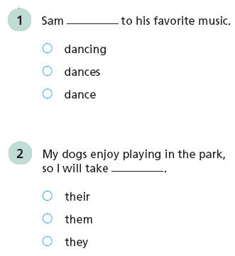
Use Conventions
  Page 14-15 Placement Test Grades 4-5

Slide 81
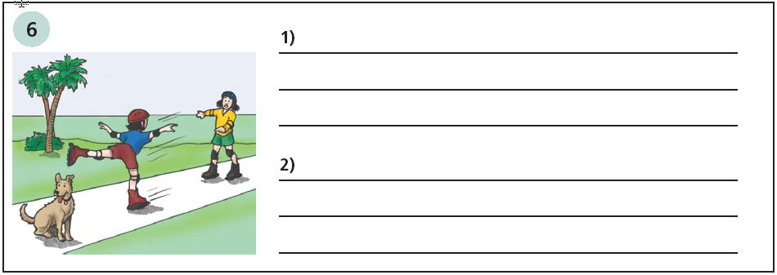
Write About
Description:
Write two complete sentences describing the picture. (Grade 1 writes one sentence.)
  Page 16 Placement Test grades 4-5
Notes:
This section also scored 0 to 3. Writing is a different rubric from Speaking.

Slide 82
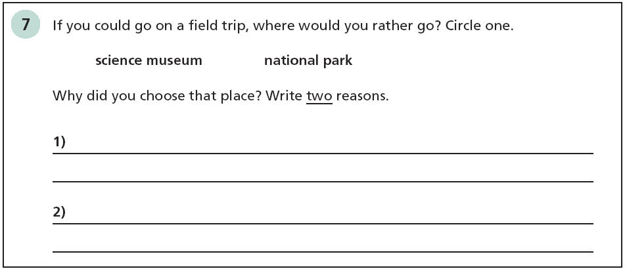
Write Why
Description:
Make a choice; write two reasons. (Grade 1 writes one reason.)
  Page 17 Placement Test grades 4-5
Notes:
As with Speaking, two sections of Writing are scored with the same rubric.

Slide 83
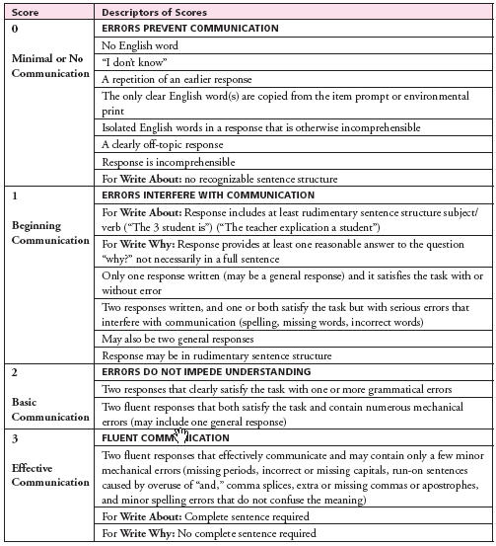
Writing Rubric 0 – 3 for grades 2 - 12 (different rubric used for gr 1)
  Page 49 Examiner’s Guide
Notes:
Here is the entire 0 to 3 rubric. Find handout and make notes.

Slide 84
0 Errors prevent communication
Minimal or no communication
No response, blank
Repeated response
Copied word
Incomprehensible
Off topic
No sentence structure (Write About)
Notes:
Review key phrases in preparation for looking at Write Why.

Slide 85
1 Errors interfere
Beginning communication
Rudimentary sentence (Write About)
One reasonable answer (Write Why)
Only one answer satisfies the task
Serious errors

Slide 86
Write About
Sample Response Grades 4-5
  The dog is no luking. The gital have a god exize.
Notes:
How do you score this? (click to see score) Here is an example of a score 1. Ask participants: Why is it scored one?
Rationale: Only one response written that satisfies the task with minor spelling errors

Slide 87
Write About
  The dog is no luking. The gital have a god exize.
  Score 1
  Rationale:
  Serious errors in one or more sentences interfere with communication
Notes:
How do you score this? (click to see score) Here is an example of a score 1. Ask participants: Why is it scored one?
Rationale: Only one response written that satisfies the task with minor spelling errors

Slide 88
2 Basic communication
Two responses satisfy the task with one or more grammatical errors
Two fluent responses with numerous mechanical errors

Slide 89
Write About
  The dog is loking away the childrens.
  The girls are skating.
Notes:
How do you score this? (click to see score) Here is an example of a score 1. Ask participants: Why is it scored one?
Rationale: Only one response written that satisfies the task with minor spelling errors

Slide 90
Write About
  The dog is loking away the childrens.
  The girls are skating.
  Score 2
  Rationale:
  Two sentences that both satisfy the task
  Grammatical error not typical of a native speaker (missing ‘from’)
Notes:
How do you score this? (click to see score) Here is an example of a score 1. Ask participants: Why is it scored one?
Rationale: Only one response written that satisfies the task with minor spelling errors

Slide 91
3 Fluent communication
Effective communication
Two fluent responses with no grammatical errors
May contain only a few minor mechanical errors
Write Why does not require complete sentence

Slide 92
Write About
  The girls are skating.
The dog is not looking.
Notes:
How do you score this? (click to see score) Here is an example of a score 1. Ask participants: Why is it scored one?
Rationale: Only one response written that satisfies the task with minor spelling errors

Slide 93
Write About
  The girls are skating.
The dog is not looking.
  Score 3
  Rationale:
  Two sentences that both satisfy the task.
  Fluent – no grammar errors
Notes:
How do you score this? (click to see score) Here is an example of a score 1. Ask participants: Why is it scored one?
Rationale: Only one response written that satisfies the task with minor spelling errors

Slide 94
Write Why
Sample Response Grades 4-5
  Is bery butiful.
  I am the chosing park is bery butiful.
Notes:
How do you score this? (click to see score) Here is an example of a score 1. Ask participants: Why is it scored one?
Rationale: Only one response written that satisfies the task with minor spelling errors

Slide 95
Write Why
  Is bery butiful.
  I am the chosing park is bery butiful.
  Score 1
  Rationale:
  Two responses but the same reason is repeated so there is only one response that satisfies the task.
  Write Why responses can be just the reason; a complete sentence is not required.
Notes:
How do you score this? (click to see score) Here is an example of a score 1. Ask participants: Why is it scored one?
Rationale: Only one response written that satisfies the task with minor spelling errors

Slide 96
Write Why
  I could seeing things that are old.
  I could see dinosaure.
Notes:
How do you score this? (click to see score) Here is an example of a score 1. Ask participants: Why is it scored one?
Rationale: Only one response written that satisfies the task with minor spelling errors

Slide 97
Write Why
  I could seeing things that are old.
  I could see dinosaure.
  Score 2
  Rationale:
  Two sentences and both satisfy the task.
  Grammar errors (‘seeing,’ ‘dinosaure’ needs to be plural or have the article ‘a’)
Notes:
How do you score this? (click to see score) Here is an example of a score 1. Ask participants: Why is it scored one?
Rationale: Only one response written that satisfies the task with minor spelling errors

Slide 98
Write Why
  I would like to learn about science.
  I would love to see science things.
Notes:
How do you score this? (click to see score) Here is an example of a score 1. Ask participants: Why is it scored one?
Rationale: Only one response written that satisfies the task with minor spelling errors

Slide 99
Write Why
  I would like to learn about science.
  I would love to see science things.
  Score 3
  Rationale:
  Two sentences and both satisfy the task.
  Fluent -- No errors in grammar.
Notes:
How do you score this? (click to see score) Here is an example of a score 1. Ask participants: Why is it scored one?
Rationale: Only one response written that satisfies the task with minor spelling errors

Slide 100
Quiz #3
Scoring
Answer the 3 questions in the Polling pane.
Notes:
Handout. Based on time work in groups or pairs to read through responses, scores and rationales, then score on next page.

Slide 101
Scoring Practice
Speak in Sentences
Your turn to score
Notes:
Handout. Based on time work in groups or pairs to read through responses, scores and rationales, then score on next page.

Slide 102
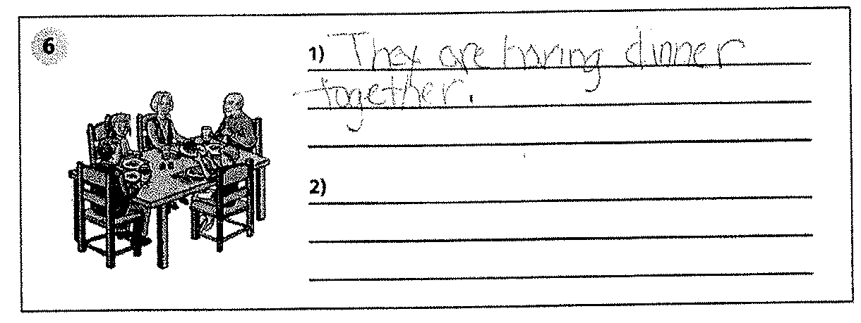
Write About Scoring Sample #1
Sample Response Grades 4-5
Notes:
How do you score this? (click to see score) Here is an example of a score 3.
Ask participants: Why is it scored one?
Rationale: Two responses in sentences that satisfy the task with grammatical errors (missing article, verb tense error, incorrect pronoun).

Slide 103
Write About Scoring Sample #1
  Score 1
  Rationale:
  Only one response.
  Satisfies the task but must have two responses to score 2.
Notes:
How do you score this? (click to see score) Here is an example of a score 3.
Ask participants: Why is it scored one?
Rationale: Two responses in sentences that satisfy the task with grammatical errors (missing article, verb tense error, incorrect pronoun).

Slide 104
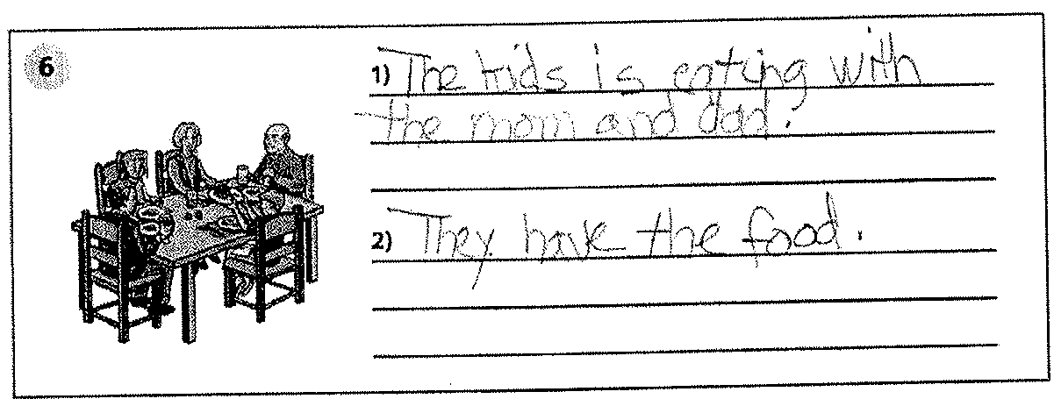
Write About Scoring Sample #2
Notes:
How do you score this? (click to see score) Here is an example of a score 3.
Ask participants: Why is it scored one?
Rationale: Two responses in sentences that satisfy the task with grammatical errors (missing article, verb tense error, incorrect pronoun).

Slide 105
Write About Scoring Sample #2
  Score 2
  Rationale:
  Two responses and both satisfy the task.
  Errors in usage (subject/verb agreement; ‘the food’).
Notes:
How do you score this? (click to see score) Here is an example of a score 3.
Ask participants: Why is it scored one?
Rationale: Two responses in sentences that satisfy the task with grammatical errors (missing article, verb tense error, incorrect pronoun).

Slide 106
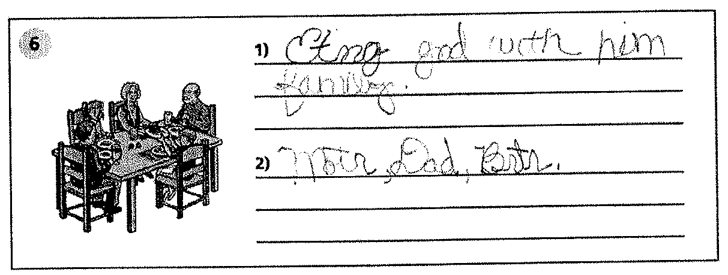
Write About Scoring Sample #3
Notes:
How do you score this? (click to see score) Here is an example of a score 3.
Ask participants: Why is it scored one?
Rationale: Two responses in sentences that satisfy the task with grammatical errors (missing article, verb tense error, incorrect pronoun).

Slide 107
Write About Scoring Sample #3
  Score 1
  Rationale:
  Two responses with the first only rudimentary sentence structure and the second a list of words.
  The first response is sufficient to satisfy the task but two responses are required to score 2.
Notes:
How do you score this? (click to see score) Here is an example of a score 3.
Ask participants: Why is it scored one?
Rationale: Two responses in sentences that satisfy the task with grammatical errors (missing article, verb tense error, incorrect pronoun).

Slide 108
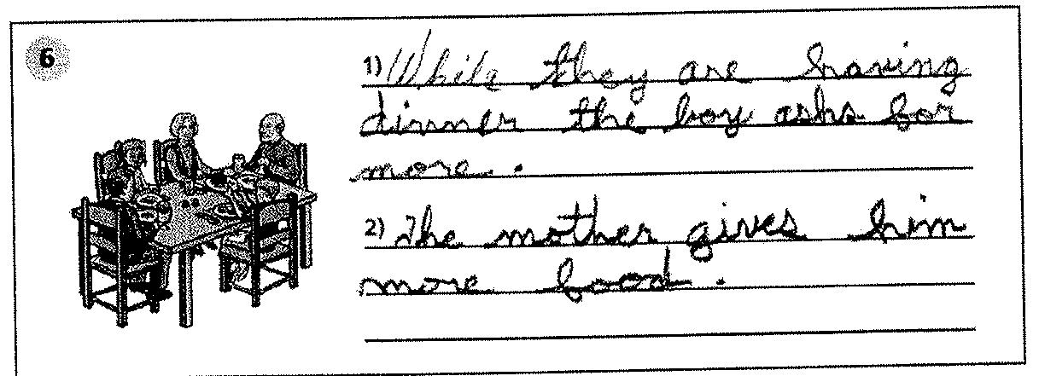
Write About Scoring Sample #4
Notes:
How do you score this? (click to see score) Here is an example of a score 3.
Ask participants: Why is it scored one?
Rationale: Two responses in sentences that satisfy the task with grammatical errors (missing article, verb tense error, incorrect pronoun).

Slide 109
Write About Scoring Sample #4
  Score 3
  Rationale:
  Two responses that both satisfy the task.
  Fluent, grammatically correct.
Notes:
How do you score this? (click to see score) Here is an example of a score 3.
Ask participants: Why is it scored one?
Rationale: Two responses in sentences that satisfy the task with grammatical errors (missing article, verb tense error, incorrect pronoun).

Slide 110
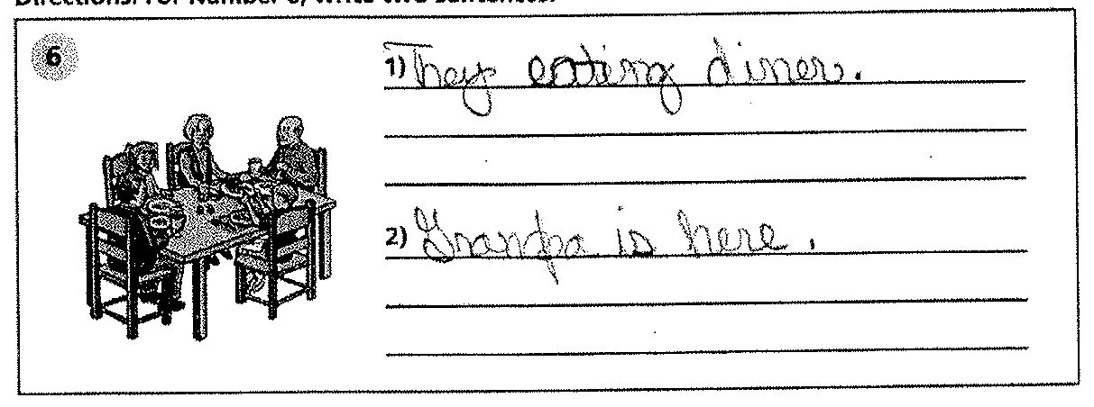
Write About Scoring Sample #5
Notes:
How do you score this? (click to see score) Here is an example of a score 3.
Ask participants: Why is it scored one?
Rationale: Two responses in sentences that satisfy the task with grammatical errors (missing article, verb tense error, incorrect pronoun).

Slide 111
Write About Scoring Sample #5
  Score 2
  Rationale:
  Two responses and both satisfy the task.
  Error in grammar (missing auxiliary verb).
Notes:
How do you score this? (click to see score) Here is an example of a score 3.
Ask participants: Why is it scored one?
Rationale: Two responses in sentences that satisfy the task with grammatical errors (missing article, verb tense error, incorrect pronoun).

Slide 112
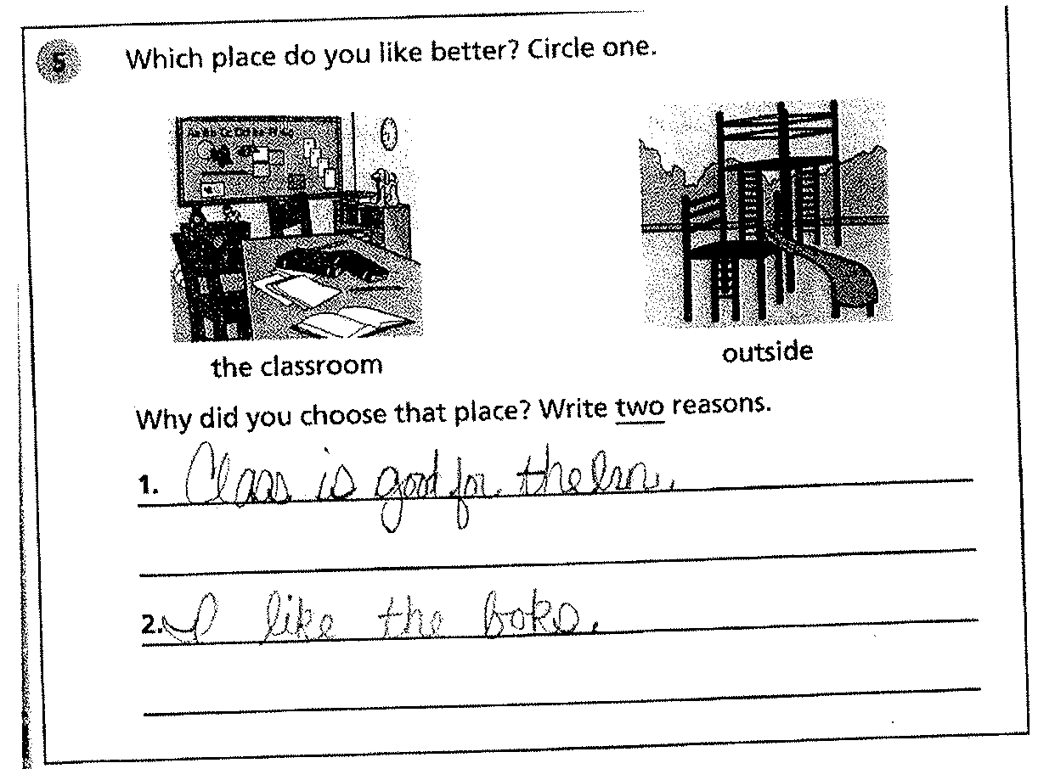
Write Why Scoring Sample #1
Sample Response Grades 2-3
Notes:
How do you score this? (click to see score) How do you score this? (click to see score) Example of Score 1.
Ask participants: Why is it scored one?
Rationale: Only one response written that could be said to satisfy the task: “hamburger with cheese”

Slide 113
Write Why Scoring Sample #1
  Score 2
  Rationale:
  Two responses and both satisfy the task.
  Numerous errors in mechanics (spelling) and usage (for the learn).
Notes:
How do you score this? (click to see score) How do you score this? (click to see score) Example of Score 1.
Ask participants: Why is it scored one?
Rationale: Only one response written that could be said to satisfy the task: “hamburger with cheese”

Slide 114
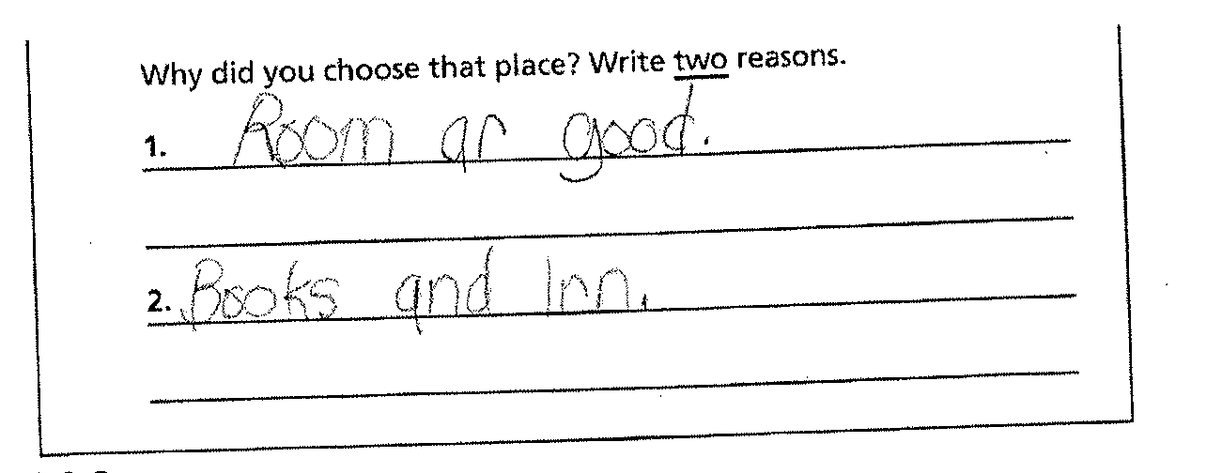
Write Why Scoring Sample #2
Notes:
How do you score this? (click to see score) How do you score this? (click to see score) Example of Score 1.
Ask participants: Why is it scored one?
Rationale: Only one response written that could be said to satisfy the task: “hamburger with cheese”

Slide 115
Write Why Scoring Sample #2
  Score 1
  Rationale:
  Two responses but only the first satisfies the task.
  The second is two words that don’t make a reason without a subject/verb, such as ‘I like.’
Notes:
How do you score this? (click to see score) How do you score this? (click to see score) Example of Score 1.
Ask participants: Why is it scored one?
Rationale: Only one response written that could be said to satisfy the task: “hamburger with cheese”

Slide 116
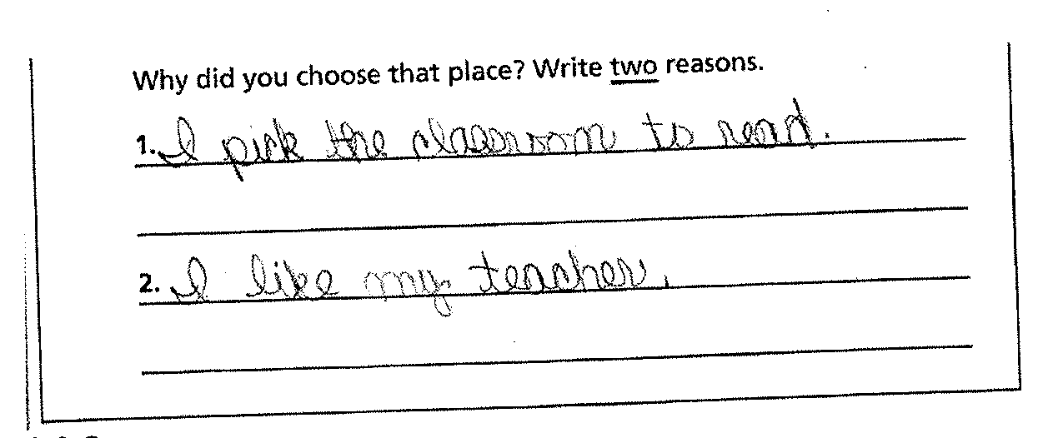
Write Why Scoring Sample #3
Notes:
How do you score this? (click to see score) How do you score this? (click to see score) Example of Score 1.
Ask participants: Why is it scored one?
Rationale: Only one response written that could be said to satisfy the task: “hamburger with cheese”

Slide 117
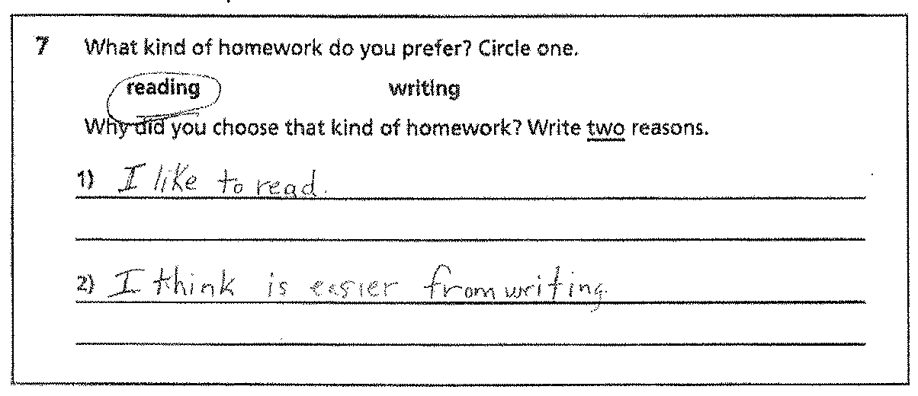
Write Why Scoring Sample #3
  Score 3
  Rationale:
  Two responses and both satisfy the task.
  Fluent, without grammatical error (‘to read’ is grammatically accurate usage).
Notes:
How do you score this? (click to see score) How do you score this? (click to see score) Example of Score 1.
Ask participants: Why is it scored one?
Rationale: Only one response written that could be said to satisfy the task: “hamburger with cheese”

Slide 118
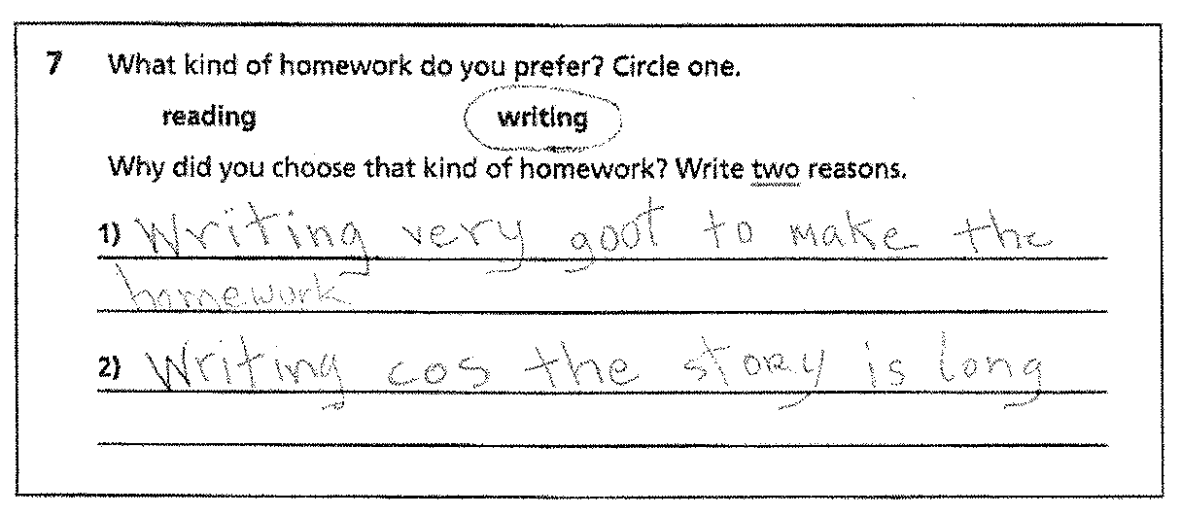
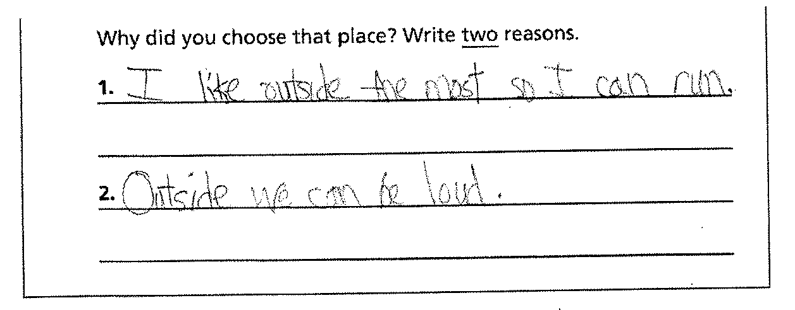
Write Why Scoring Sample #4
Notes:
How do you score this? (click to see score) How do you score this? (click to see score) Example of Score 1.
Ask participants: Why is it scored one?
Rationale: Only one response written that could be said to satisfy the task: “hamburger with cheese”

Slide 119
Write Why Scoring Sample #4
  Score 3
  Rationale:
  Two responses and both satisfy the task.
  Fluent, without grammatical error.
Notes:
How do you score this? (click to see score) How do you score this? (click to see score) Example of Score 1.
Ask participants: Why is it scored one?
Rationale: Only one response written that could be said to satisfy the task: “hamburger with cheese”

Slide 120
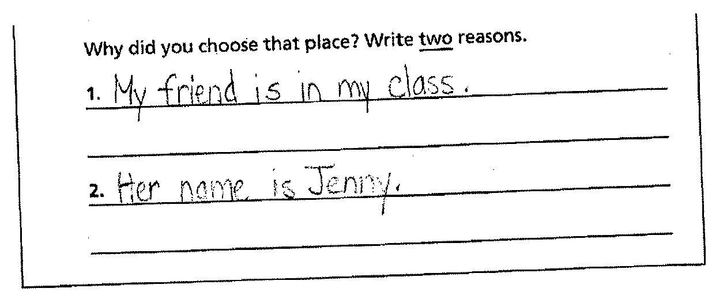
Write Why Scoring Sample #5
Notes:
How do you score this? (click to see score) How do you score this? (click to see score) Example of Score 1.
Ask participants: Why is it scored one?
Rationale: Only one response written that could be said to satisfy the task: “hamburger with cheese”

Slide 121
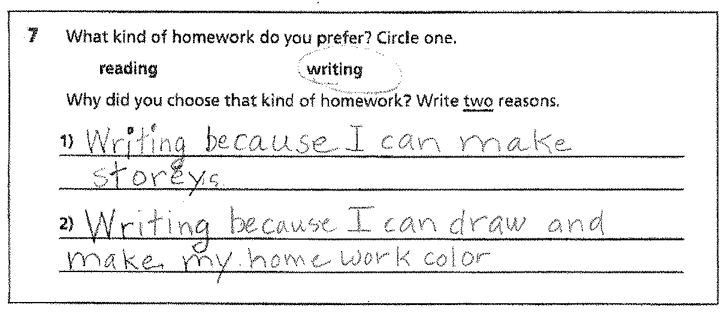
Write Why Scoring Sample #5
  Score 1
  Rationale:
  Two responses and only the first one satisfies the task.
  The second sentence elaborates on the first and is not a second reason.
Notes:
How do you score this? (click to see score) How do you score this? (click to see score) Example of Score 1.
Ask participants: Why is it scored one?
Rationale: Only one response written that could be said to satisfy the task: “hamburger with cheese”

Slide 122
TABULATION & SCORING

Slide 123
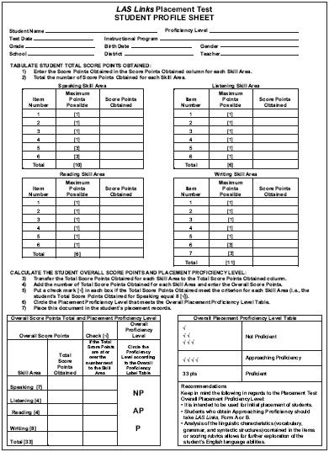
Tabulation of scores
Pages 63, 65 & 67 Examiner’s Guide
Answer Keys in Examiner’s Guide pages 62, 64 & 66

Slide 124
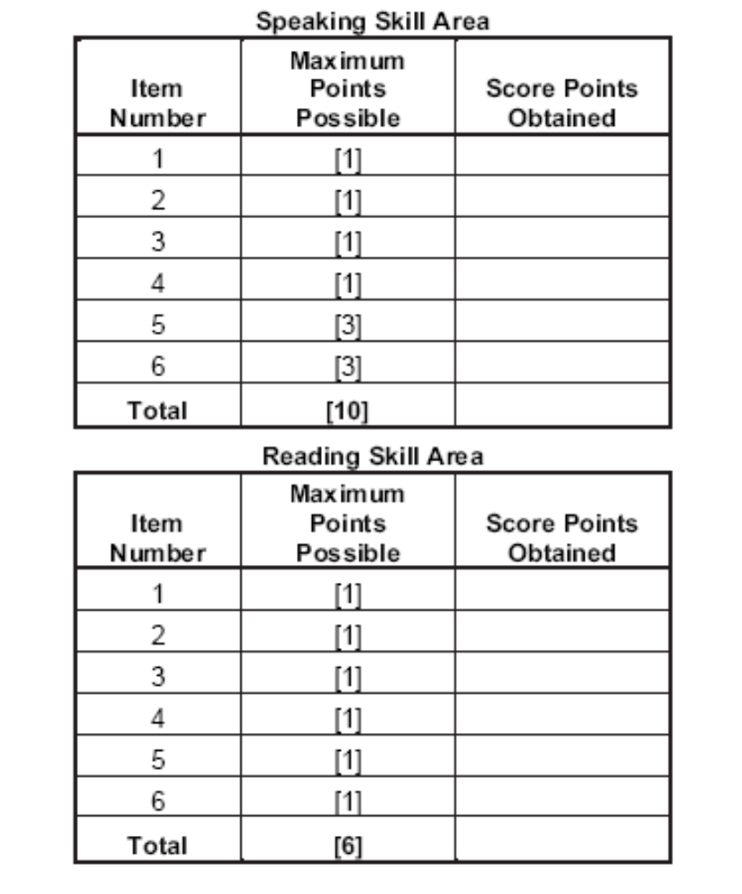
Tabulation of scores

Slide 125
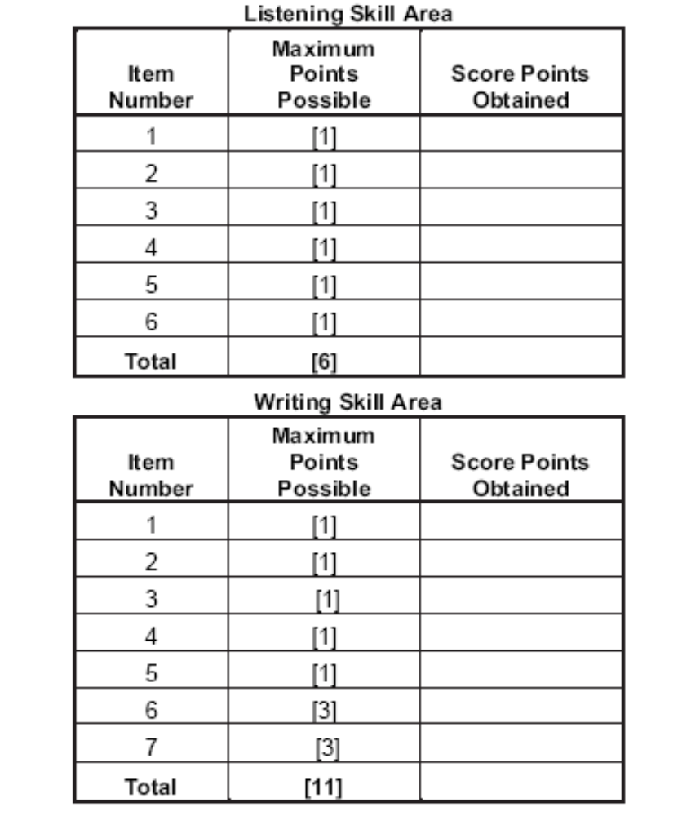
Tabulation of scores

Slide 126
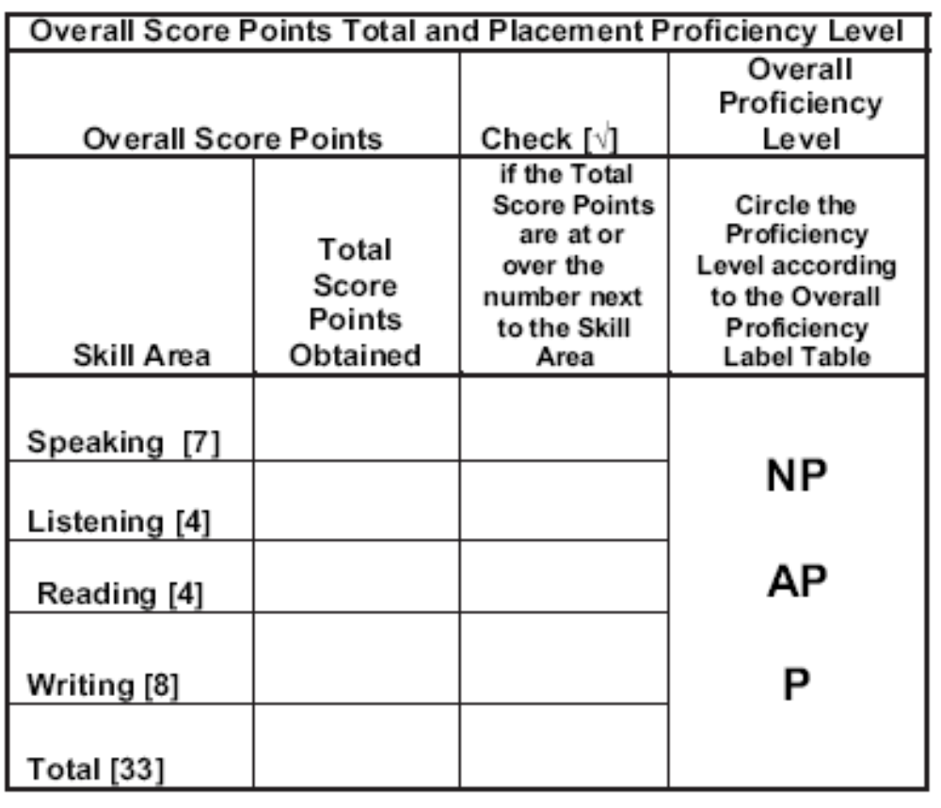
Tabulation of scores

Slide 127
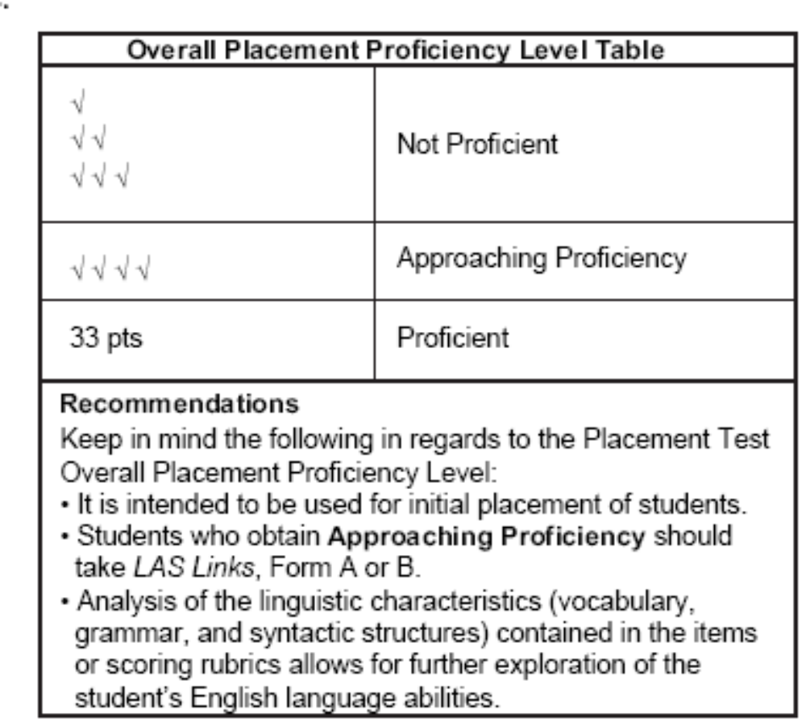
Tabulation of scores

Slide 128
WE’RE ALMOST DONE

Slide 129
What we covered today
Elementary LAS Links Placement Test
Speaking with 0-3 rubric
Listening, Reading, Writing multiple choice
Writing with rubric 0-3
Tabulation of scores

Slide 130
CTB Support for Indiana
Call: CTB/Indiana Help Desk (800) 282-1132
Email:
ctb_ilepa_helpdesk@ctb.com

Slide 131
One last thing
Thank you for your time today and your commitment to the students
Before you log off, please complete the evaluation questions in the Polling pane.

