Slide 1
Validation of OMI total ozone using ground-based Brewer and Dobson observations
D. Balis1, M. Kroon2, E. Brinksma2, P. Heikkinen5, M.Koukouli1, V. Amiridis3 and C. Zerefos4
1Laboratory of Atmospheric Physics, Aristotle University of Thessaloniki, Greece
2KNMI
3National Observatory of Athens, Greece
4Geology Department, University of Athens, Greece
5Finnish Meteorological Institute

Slide 2
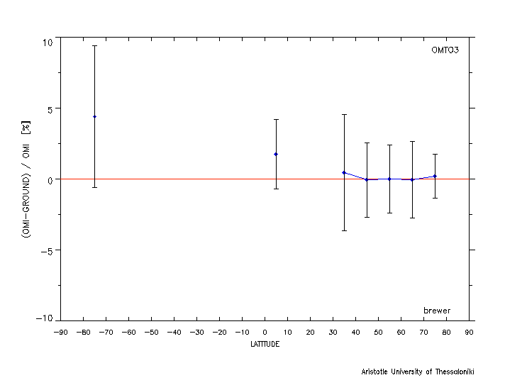
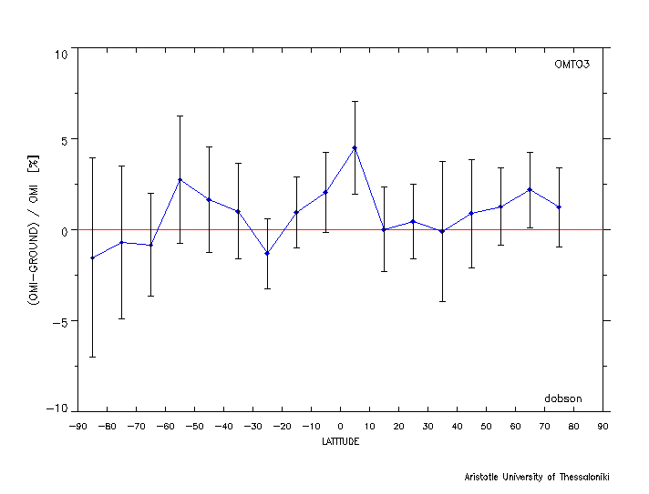
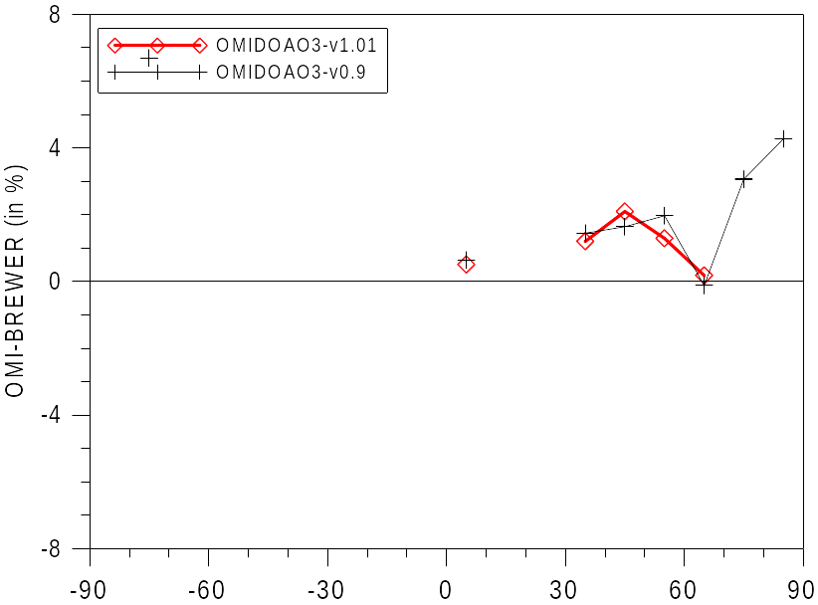
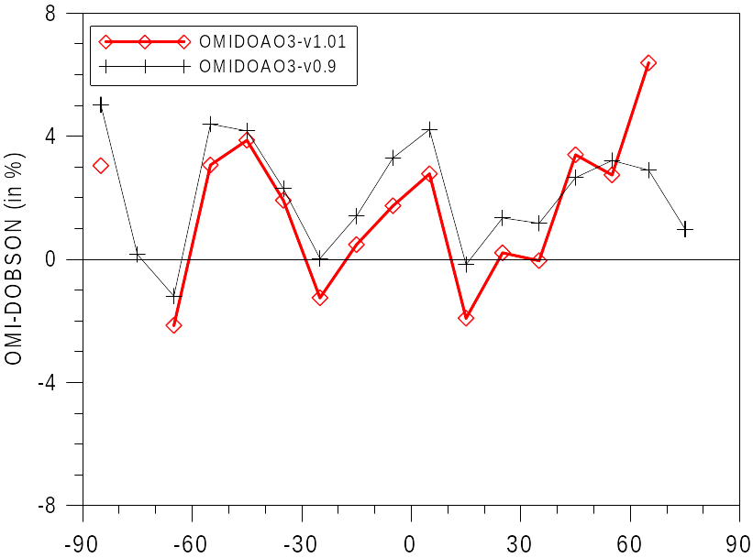
Latitude Dependence

Slide 3
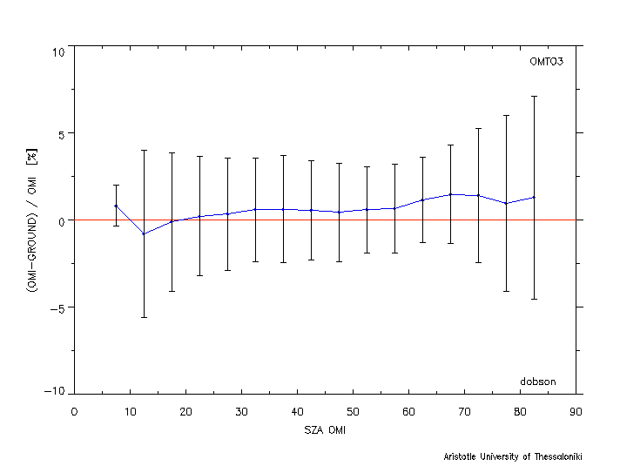
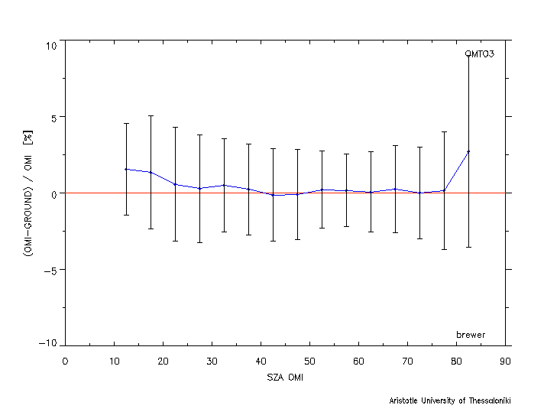
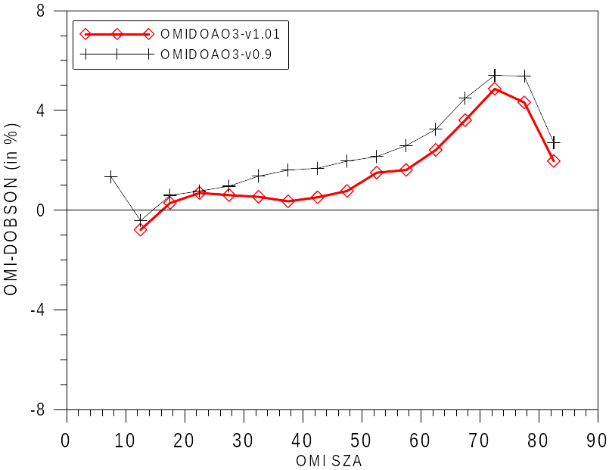
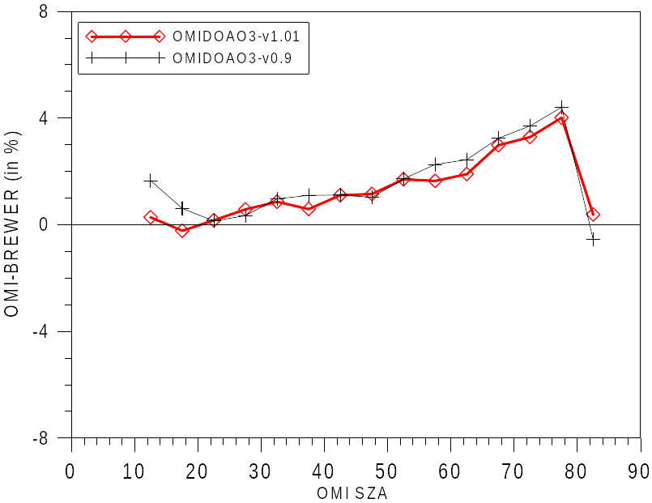
Solar Zenith Angle Dependence

Slide 4
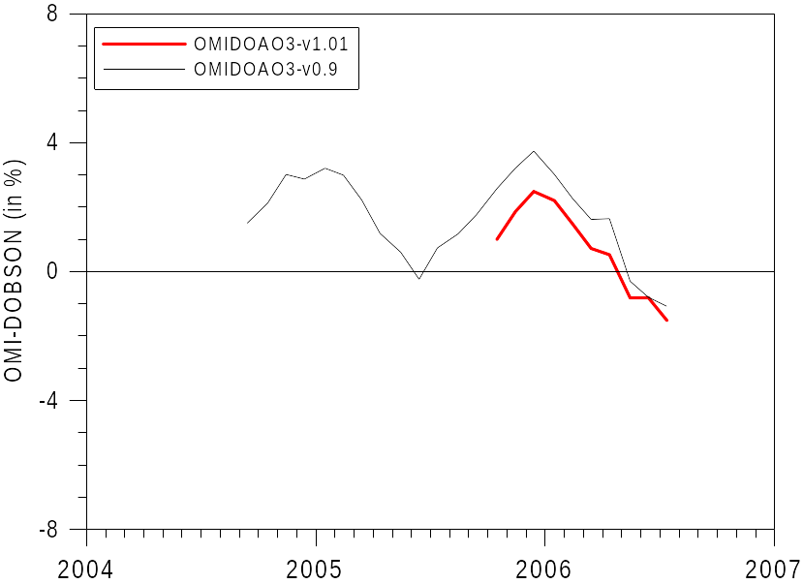
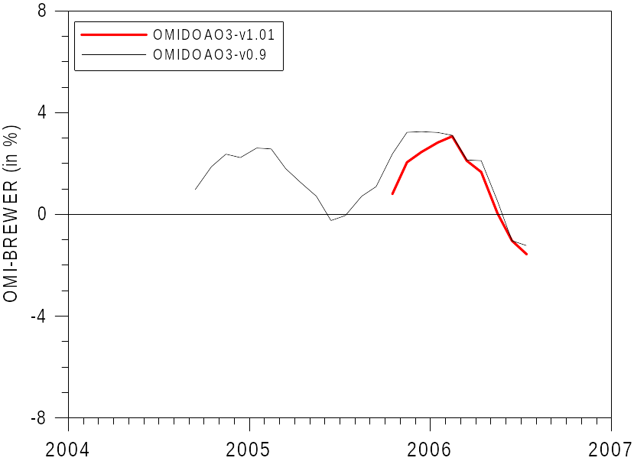
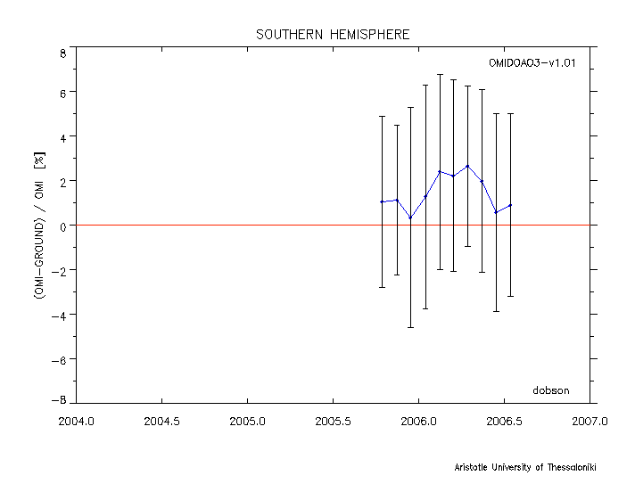
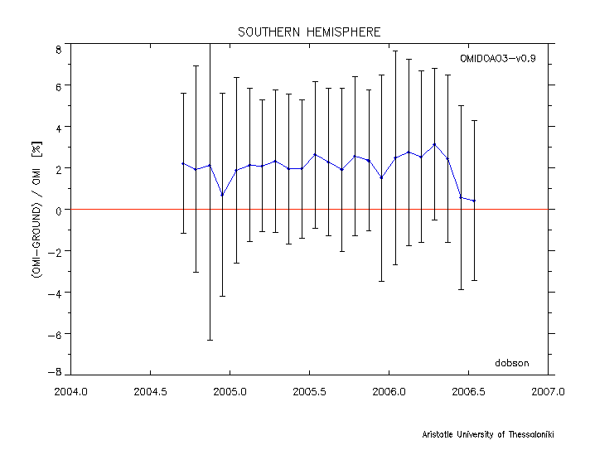
OMDOAO3 time series
Northern Hemisphere
Northern Hemisphere

Slide 5
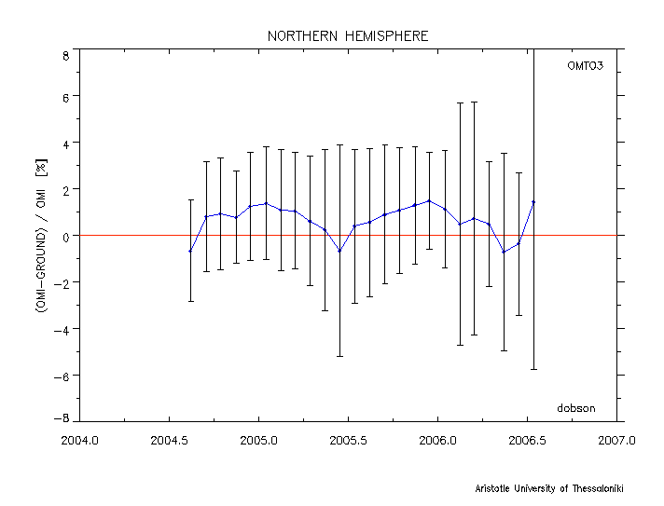
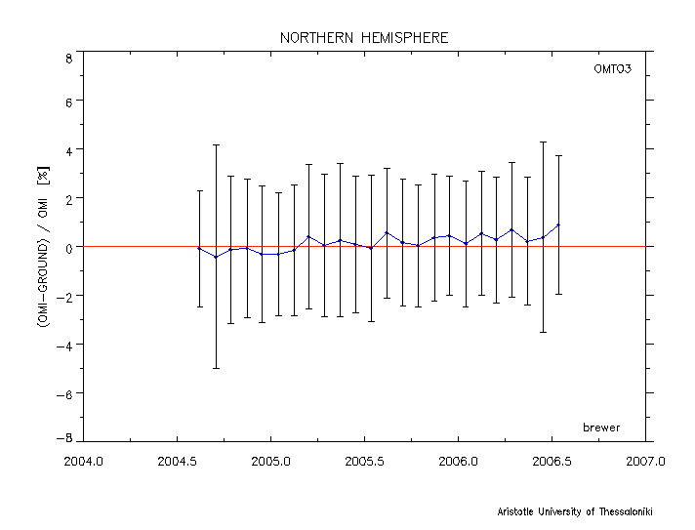
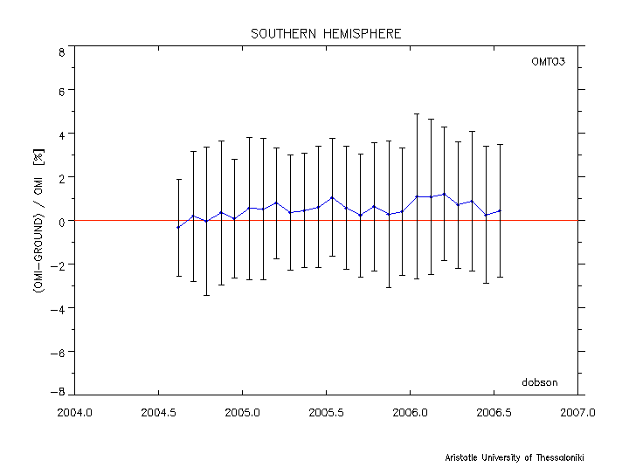
OMTO3 Time Series

Slide 6
Conclusions
The average difference between OMIDOAO3-v1.01 and Brewer observations is 1.6±4.4% while the corresponding difference between OMIDOAO3-v0.9 and Brewer observations is 1.8±4.4%. The mean difference between OMTO3 and Brewer observations is 0.06±3.5% (valid mainly for 30-60ºN).
The average difference between OMIDOAO3-v1.01 and Dosbon observations is 1.35±4.5% while the corresponding difference between OMIDOAO3-v0.9 and Dobson observations is 2.15±5.4%. The mean difference between OMTO3 and Dobson observations is 0.69±3.5%.
OMI-DOAS comparisons show a seasonal dependence with an amplitude of 1.5% for the Brewer comparisons and slightly larger but in phase (2%) for the Dobson comparisons. This seasonality is similar and in phase with the one found in GDP4.0-ground comparisons. It seems that the amplitude in the OMIDOA3v1.01 comparisons has been slightly reduced (more data needed)
OMI-TOMS-Brewer comparisons presented do not show any seasonality and are remarkably stable around 0%. OMI-TOMS-Dobson comparisons show seasonality similar to the OMI-DOAS-Dobson comparison with reduced amplitude

