Slide 1
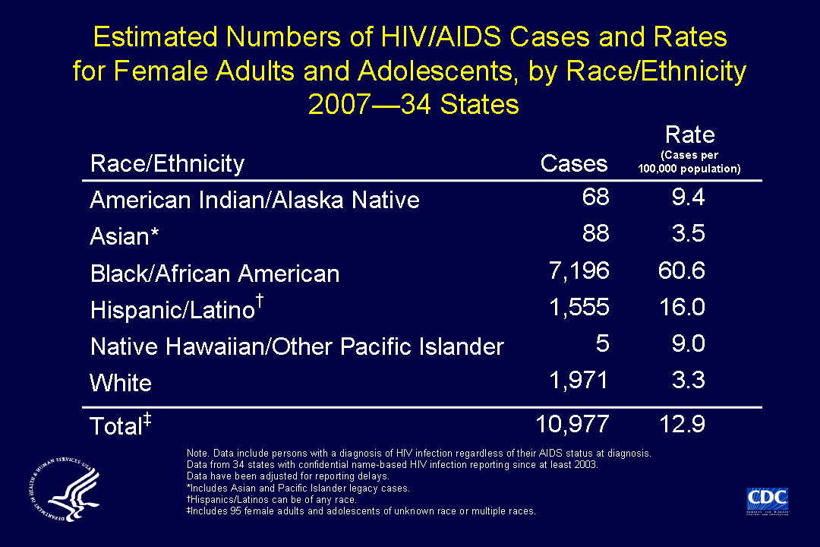
Notes:
This slide shows diagnosis rates for HIV/AIDS cases among female adults and adolescents residing in 34 states with confidential name-based HIV infection surveillance.
For female adults and adolescents, the rate (HIV/AIDS cases per 100,000) for blacks/African Americans (60.6) was nearly 20 times as high as the rate for whites (3.3) and nearly 4 times as high as the rate for Hispanics/Latinos (16.0).
Relatively few cases were diagnosed among Asian (3.5), American Indian/Alaska Native (9.4), and Native Hawaiian/other Pacific Islander females (9.0), although the rates for these groups were higher than the rate for white females.
The following 34 states have had laws or regulations requiring confidential name-based HIV infection reporting since at least 2003: Alabama, Alaska, Arizona, Arkansas, Colorado, Florida, Georgia, Idaho, Indiana, Iowa, Kansas, Louisiana, Michigan, Minnesota, Mississippi, Missouri, Nebraska, Nevada, New Jersey, New Mexico, New York, North Carolina, North Dakota, Ohio, Oklahoma, South Carolina, South Dakota, Tennessee, Texas, Utah, Virginia, West Virginia, Wisconsin, and Wyoming.
The data have been adjusted for reporting delays.
Asian/Pacific Islander legacy cases are cases that were collected under the old race/ethnicity classification system. Asian/Pacific Islander legacy cases are included in the totals for Asians.
Hispanics/Latinos can be of any race.

