Slide 1
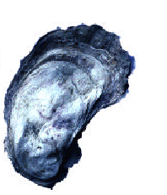
Gulf Coast Oysters: A Raw Deal
(The Villainy of Vibrio vulnificus)
County of San Diego
Department of Environmental Health

Slide 2
Overview of Vibrio vulnificus
What is Vibrio vulnificus?
Who is at Risk
Symptoms
Resulting Illnesses
Incidence
Diagnosis and Treatment

Slide 3
Overview of Gulf Coast Oysters
Background
Oysters in the Retail Setting
Oyster Regulations
Cooking Times
Post-harvest Treatments of Oysters
Prevention
Recommendations

Slide 4

Vibrio vulnificus (Vv)
Commonly found in the Gulf of Mexico
Occurs naturally, rather than as a result of pollution
Accumulates in oysters and other shellfish
Presence is highly correlated with water temperature

Slide 5
Vibrio vulnificus
Infections generally occur from March to December. Peaks from May through October depending on water temperature
Does not alter the appearance, taste, or odor of oysters

Slide 6
Vibrio vulnificus
95% of all seafood-related deaths due to Vv
Most healthy people are resistant to infection
Infection in high-risk individuals can lead to death in 2 to 3 days
People with pre-existing medical conditions are 80 times more likely to develop Vv bloodstream infections than are healthy people
Notes:
Last bullet information came from the CDC website

Slide 7
Who is at risk?
People with liver disorders such as cirrhosis, liver cancer, hepatitis
Hemochromatosis
Diabetes mellitus
HIV/AIDS
Cancer
Individuals who take prescribed medication to lower stomach acid levels

Slide 8
Symptoms of Vibrio vulnificus
Symptoms can start from 12 to 72 hours after eating infected food.
Vomiting
Diarrhea
Stomach pains
Skin rashes and blisters
Shaking chills
High fever

Slide 9
Vibrio vulnificus Infections
Vibrio can infect the body in 2 ways:
Ingestion- exposure to contaminated seafood such as raw Gulf Coast oysters
Dermal- through an open wound exposed to contaminated seawater

Slide 10
Resulting Illnesses
Primary septicemia-fevers and chills often with vomiting, nausea, and diarrhea. Painful skin lesions may develop.
Gastroenteritis-associated with ingestion. Vomiting, diarrhea and abdominal cramps can occur.

Slide 11
Wound Infections from V. vulnificus
Results when skin lacerations or abrasions come into direct contact with seawater that contains Vv
Infections usually begin with redness, swelling and intense pain around the infected site
Often fluid-filled blisters develop and progress to tissue necrosis. Can resemble gas gangrene
About 50% of patients with Vv wounds will require surgery or amputation

Slide 12
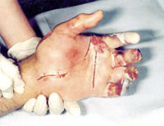
Vibrio vulnificus Infections
Most Vv infections are acute but with no long-term consequences
In patients who develop septic shock from infection with Vv, the mortality rate is 50%
In rare instances, skin infection can result in necrotizing fasciitis.
Notes:
Information from the CDC website
Picture is of a man’s hand that was infected with Vibrio Vulnificus. Part of his fingers were amputated due to the infection.

Slide 13
Incidence of V. vulnificus
Approximately 50 culture-confirmed cases, 45 hospitalizations, and 16 deaths reported each year from the Gulf Coast region
Nationwide, there are about 95 cases (half are culture confirmed), 85 hospitalizations, and 35 deaths per year
Notes:
The Gulf Coast Region include the following states (MS, AL, LA, TX, FL)
Information from the CDC web site

Slide 14
Diagnosis and treatment of
V. vulnificus infection
Routine stool, wound, or blood cultures
The diagnostic laboratory should be notified when this infection is suspected by the physician. (special growth medium can increase yields)
Treated with antibiotics such as Doxycycline or a third-generation cephalosporin (e.g., ceftazidime)
Notes:
Information from the CDC website

Slide 15
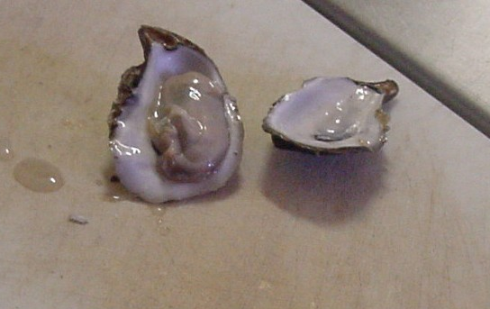
Gulf Coast Oysters
Found in five Gulf Coast States (MS, AL, LA, TX, FL)
Can filter 50 gallons of water per day
Can accumulate bacteria and viruses in their body
Excellent source of zinc. Some consider it an aphrodisiac
Concern with oysters harvested during warm months

Slide 16
Oyster Regulations
Retailers selling Gulf oysters must notify consumers that the “consumption of raw oysters can cause illness and death among people with liver disease, chronic illnesses, or weakened immune systems”
Regulations require oyster lot tagging, labeling, and record retention
Notes:
Regulation began March 1991 in California

Slide 17
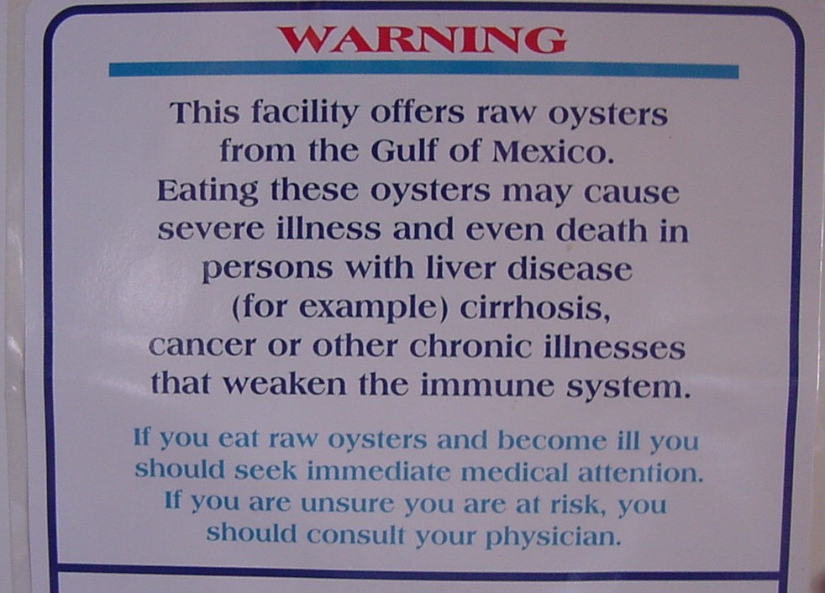
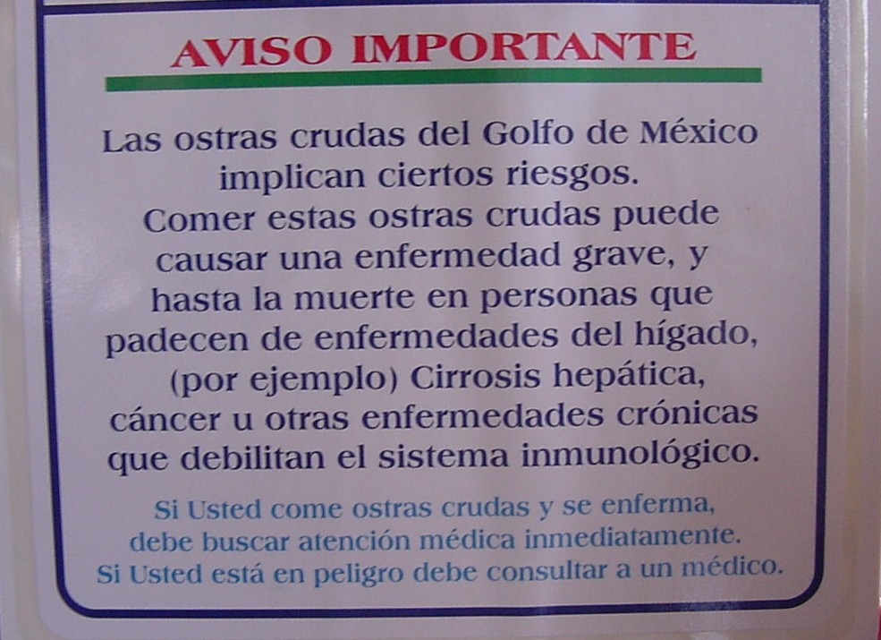
Gulf Coast Oyster Warning
(English and Spanish)

Slide 18
Recommended cooking times for Oysters
Guidelines for Cooking Oysters
Steaming shellstock*
4-9 minutes
Boiling shellstock*
3-5 minutes at full boil after they open
Frying shucked oysters
3 minutes in oil at 375^{O}F
Boiling shucked oysters
3 minutes boiling or simmering or until the edges curl
Broiling shucked oysters
3 inches from heat for 3 minutes
Baked oysters
10 minutes at 450^{O}F
Food Code requires raw animal food to be cooked to the equivalent of 145 ^{O}F for 15 seconds
Use small pots to boil or steam oysters or shellstock to assure those in the middle will be thoroughly cooked. Discard any oysters that do not open during cooking, as they may not have received adequate heat treatment.
SOURCE: US FOOD and DRUG ADMINISTRATION (FDA)

Slide 19
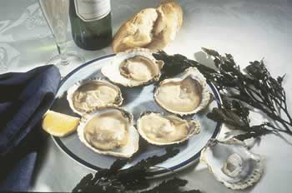
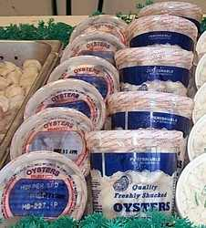
Oyster Consumption
Oysters are served on the half shell or pre-packaged

Slide 20
Post-harvest Treatments for Oysters
Post-harvest treatments are the only sure way to eliminate the naturally occurring pathogens from raw shellfish
Cool-pasteurization, high pressure processing, mild heat or irradiation of oysters
Notes:
AmeriPure Company uses a mild heat treatment of in-shell oysters which is capable of killing V. vulnificus.

Slide 21
Prevention of V. vulnificus infections
Eat oysters that have been cooked properly
Eat oysters that have been post-harvest treated
Do not let raw seafood touch cooked seafood
If eating raw oysters, ask the origin of the oysters
Avoid eating raw oysters
Do not swim/wade in seawater with open sores or wounds

Slide 22
Summary of V. vulnificus
Most healthy individuals are not at risk
Serious illness or death can occur in persons with preexisting liver disease or compromised immune systems
Infection of open wounds can be serious

Slide 23
Conclusion
Individuals with chronic illnesses of the liver, stomach, blood, diabetes or other immune disorders, are at greater risk of serious illness from raw oysters. If unsure of risk, consult a health care provider.

Slide 24
Recommendations
Consumers have a choice and can request treated or cooked oysters
Encourage at risk individuals to consult with their health provider

Slide 25
Sites for further information
www.issc.org
www.cdc.gov
www.fda.gov

Slide 26
Contact Information
Reportable Illness
Health and Human Services Agency
(619) 515-6620
Suspect Food borne Illness
Dept of Environmental Health
(619) 338-2356 or fhdutyeh@sdcounty.ca.gov
Presentation prepared by Beck Goldberg,MPH
Graduate School of Public Health
April 2003

