Slide 1

In-Situ Sea Level Measurements
Mark A. Merrifield
University of Hawaii
The GCOS Network - Progress Report
Global Sea Level Rise
Relative Sea Level Rise
Extreme Events

Slide 2
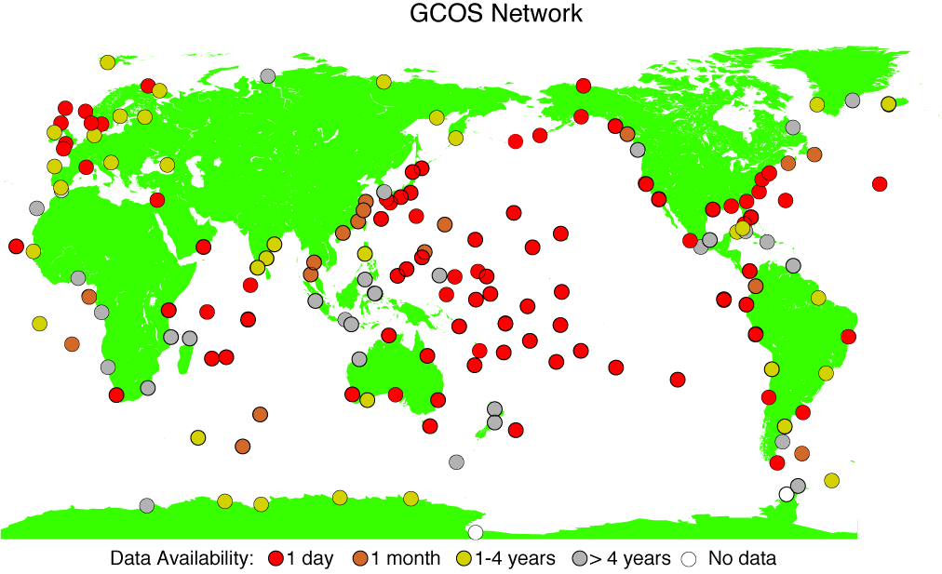

Slide 3
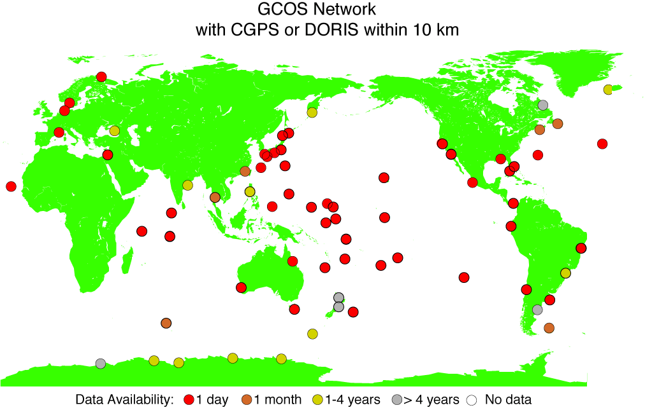

Slide 4
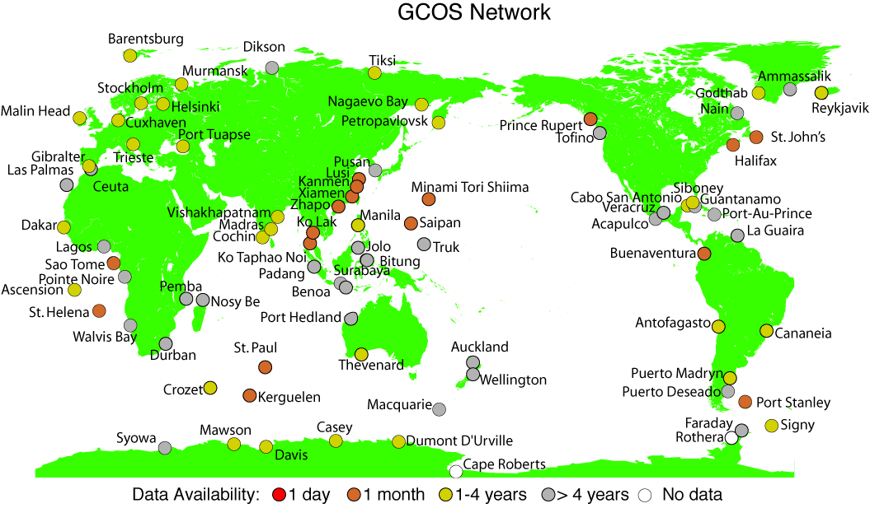

Slide 5
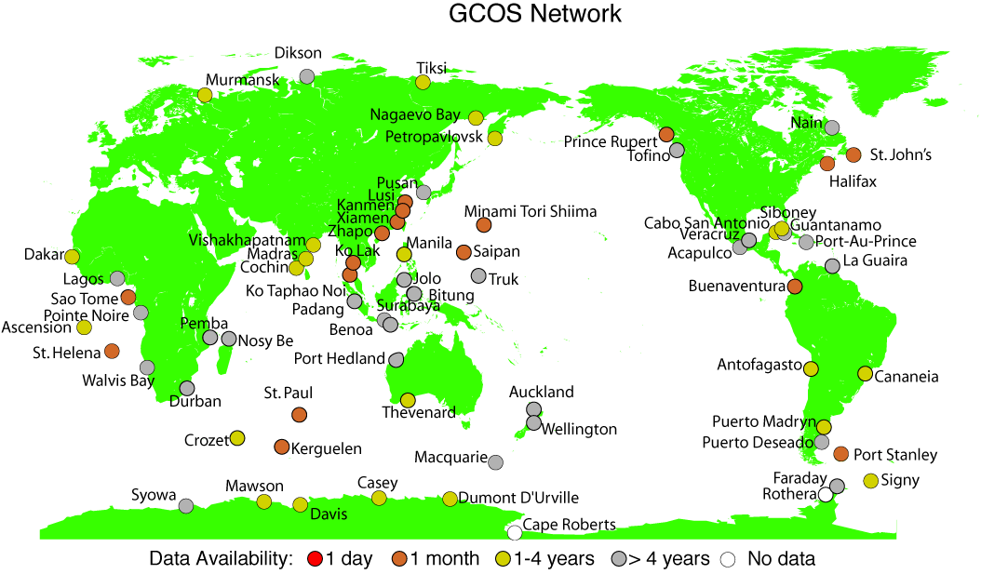
ESEAS

Slide 6
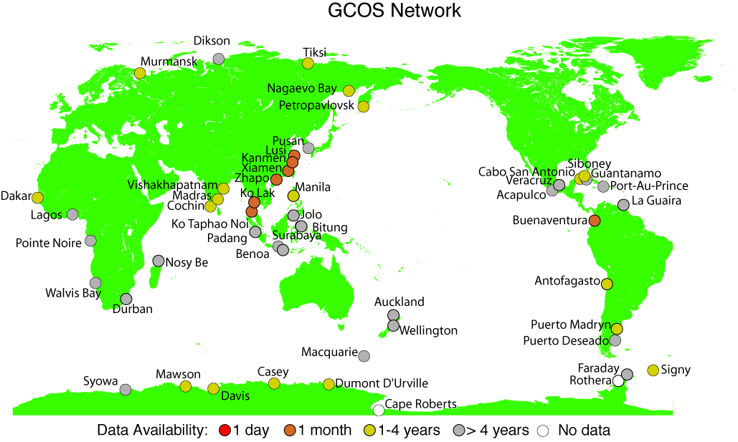
ESEAS
UK, France, Australia, Japan, Canada

Slide 7
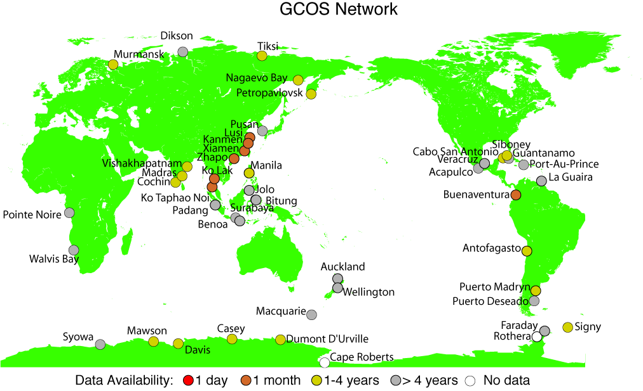
ESEAS
UK, France, Australia, Japan, Canada
ODINAFRICA

Slide 8
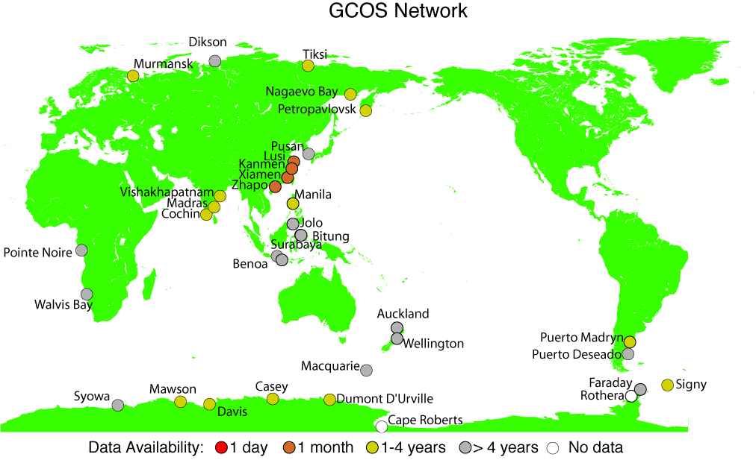
ESEAS
UK, France, Australia, Japan, Canada
ODINAFRICA
Tsunami Networks

Slide 9
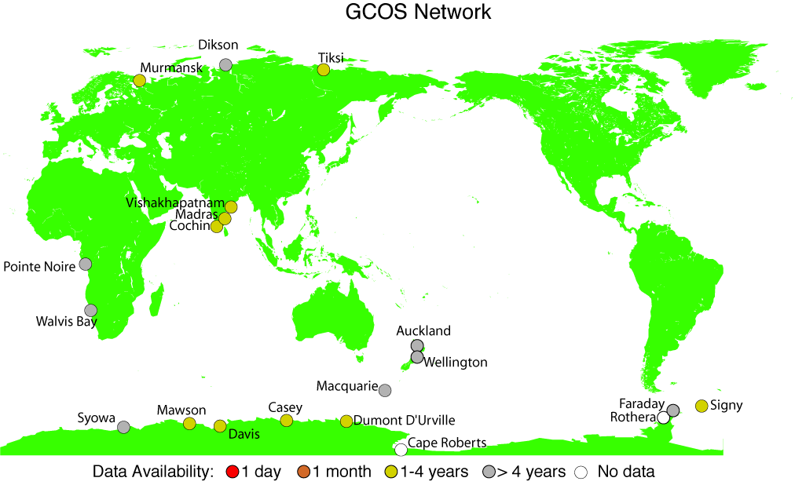
ESEAS
UK, France, Australia, Japan, Canada
ODINAFRICA
Tsunami Networks
NOAA Partnerships - Indonesia, Argentina, Philippines, Korea, China, Russia

Slide 10
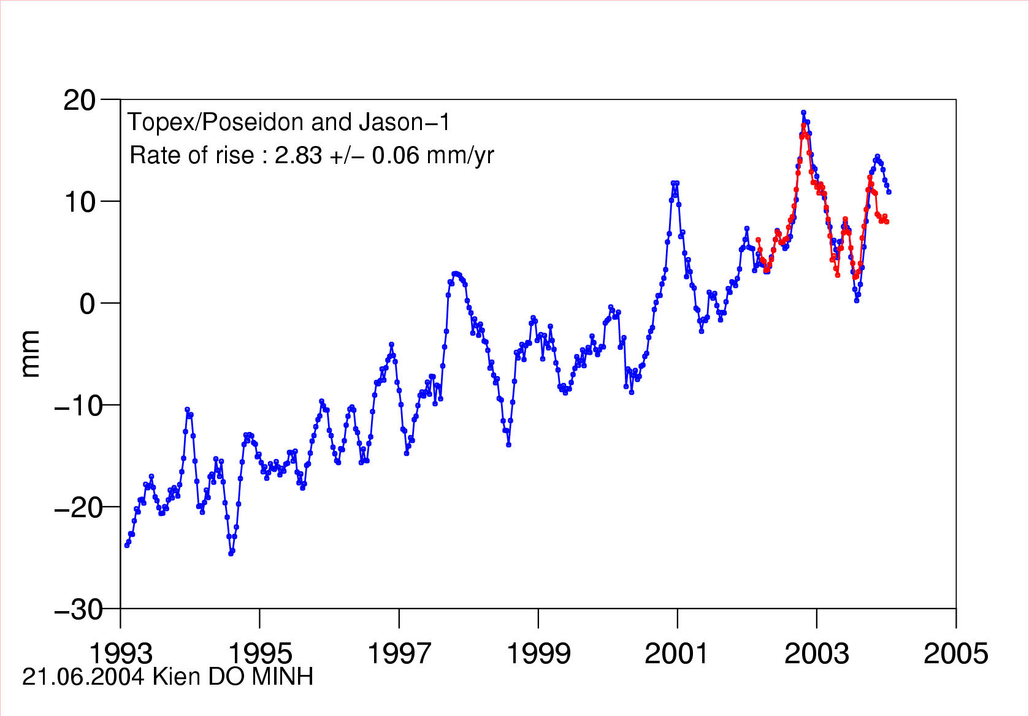
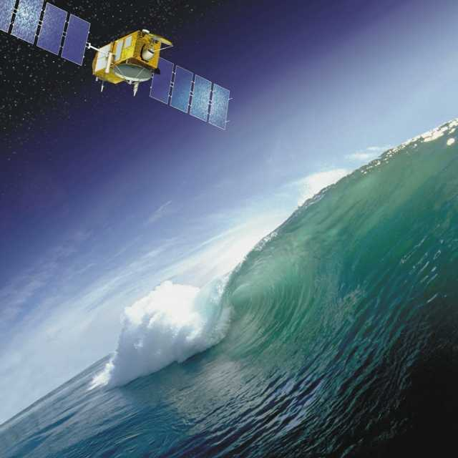
Sea level curve from Topex & Jason (1993-2004)
After correction of post-glacial rebound:
3. mm/yr
A. Cazenzave

Slide 11
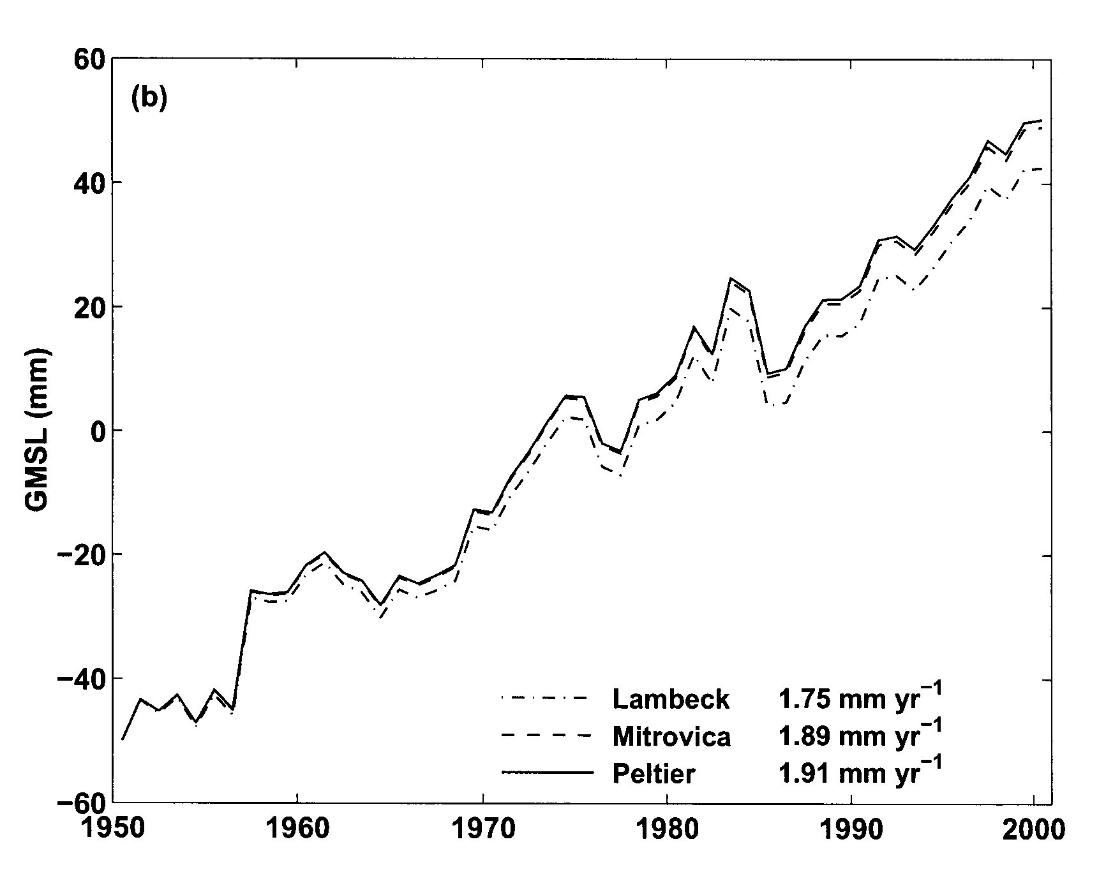
Past reconstruction of global mean sea level change
based on tide gauges and altimetry data (1950-2000)
From Church et al. (2004)
Church et al., 2004
A. Cazenzave

Slide 12
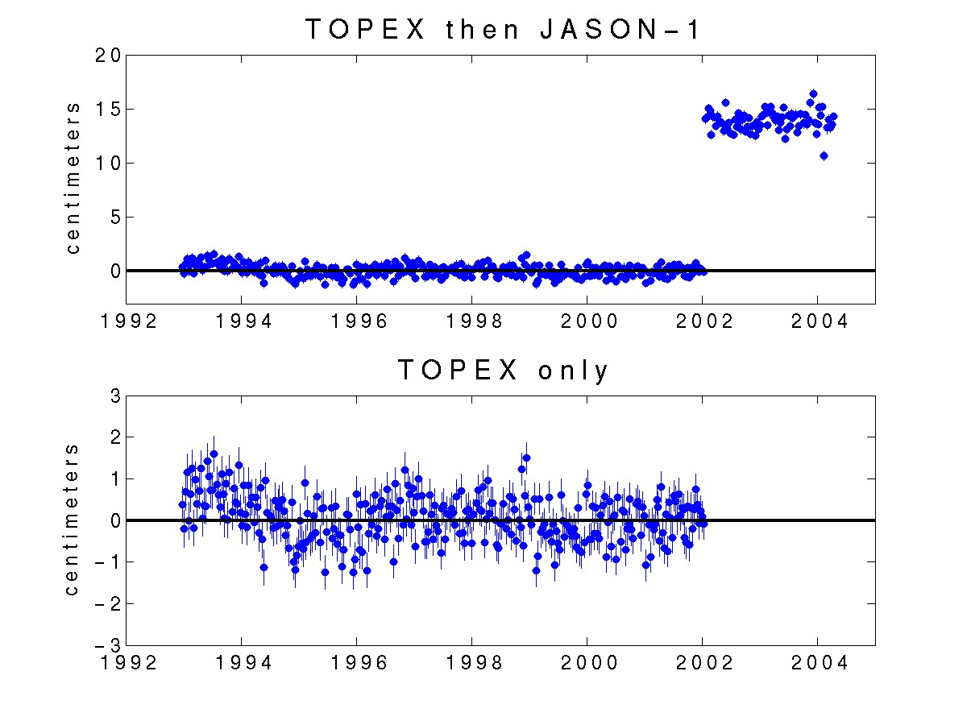
G. Mitchum

Slide 13
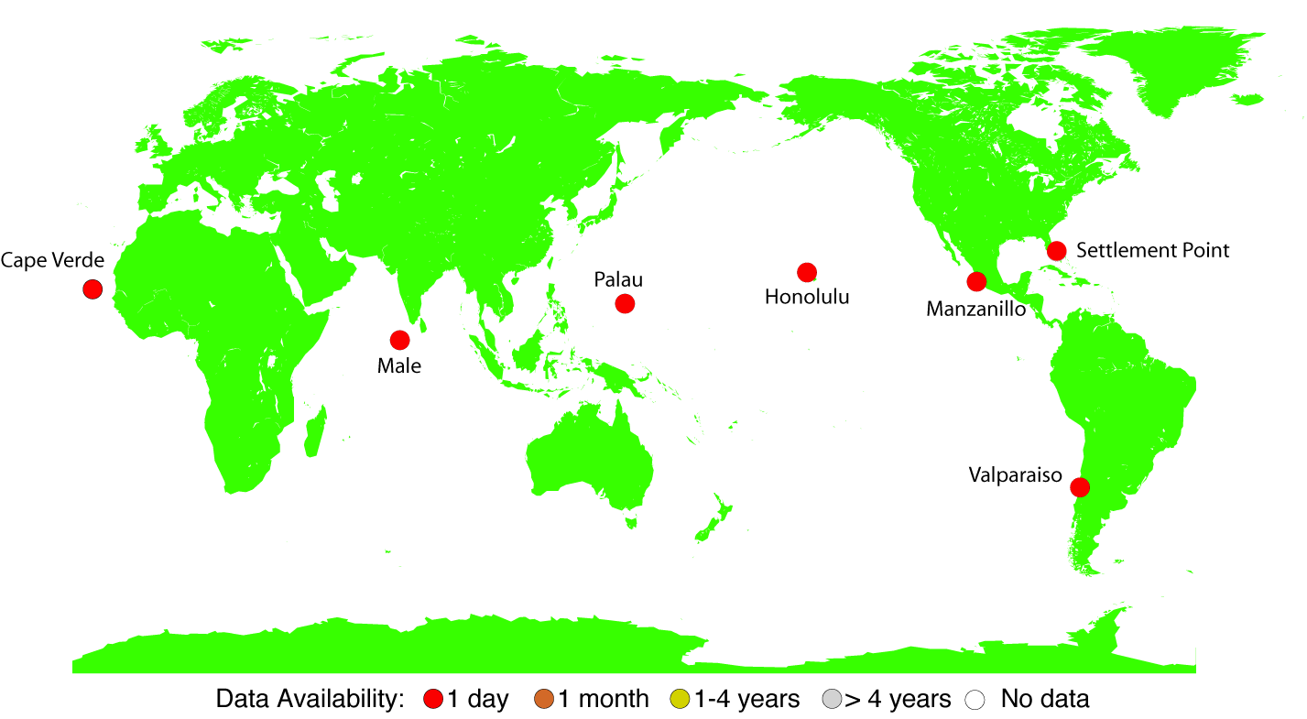
UHSLC - PGF CGPS/TG Stations

Slide 14
GPS Reference Frame Issues
Need a global GPS reference frame designed for estimating vertical rates
Several analysis groups are considering this problem
Relative vertical GPS rates provide insights into RSL
    Example - the Hawaiian Islands

Slide 15
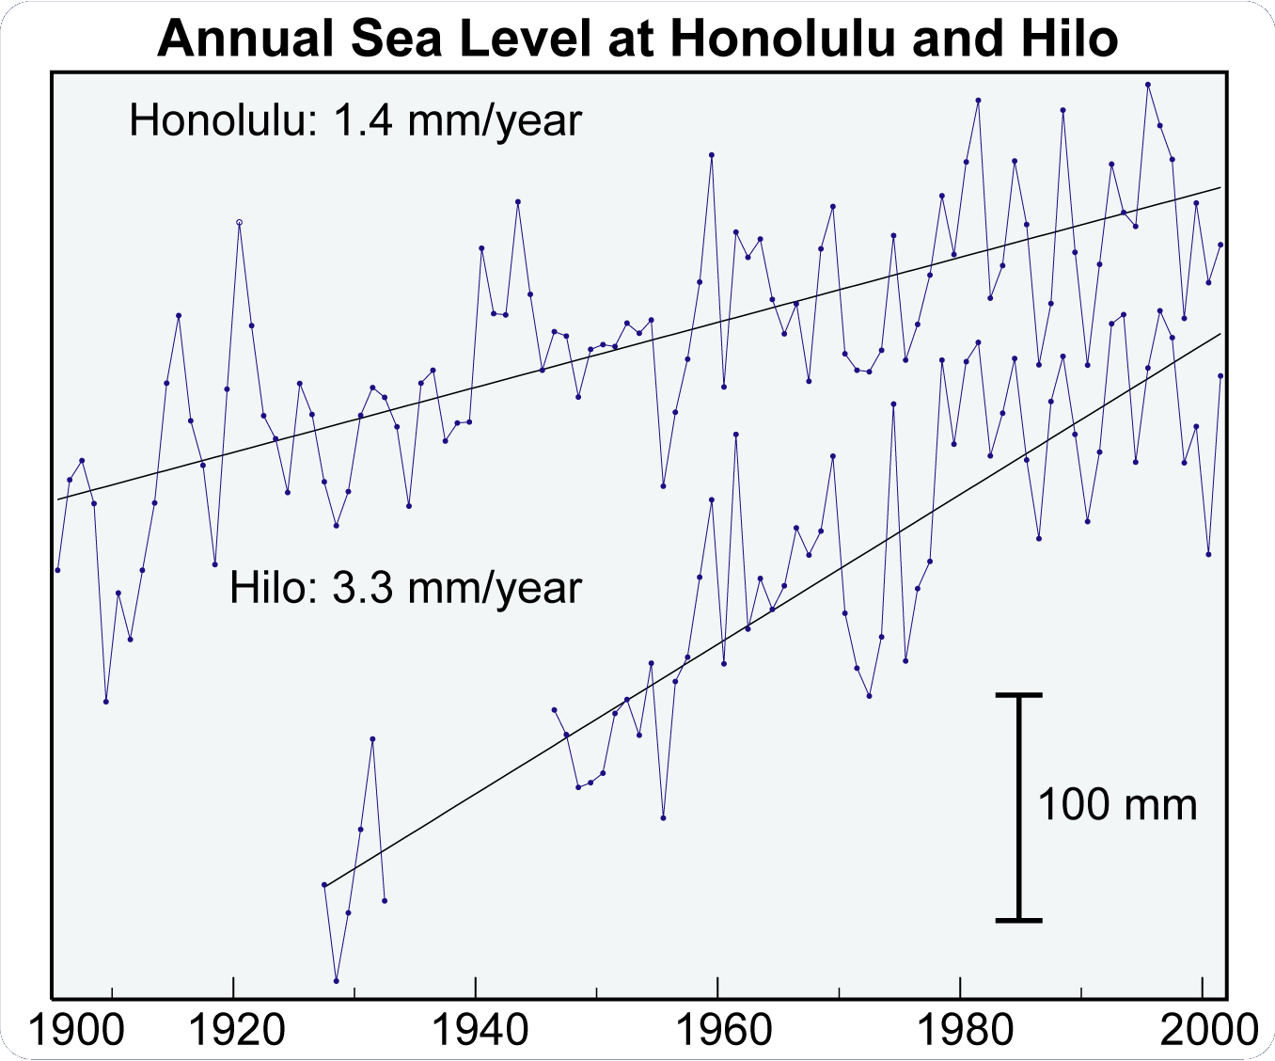
Hawaii Sea Level Rise
A general rise in sea level has been observed since the early 1900’s
Rate at Hilo is higher than at Honolulu
Interpretation: Oahu is stable, the Big Island is sinking

Slide 16
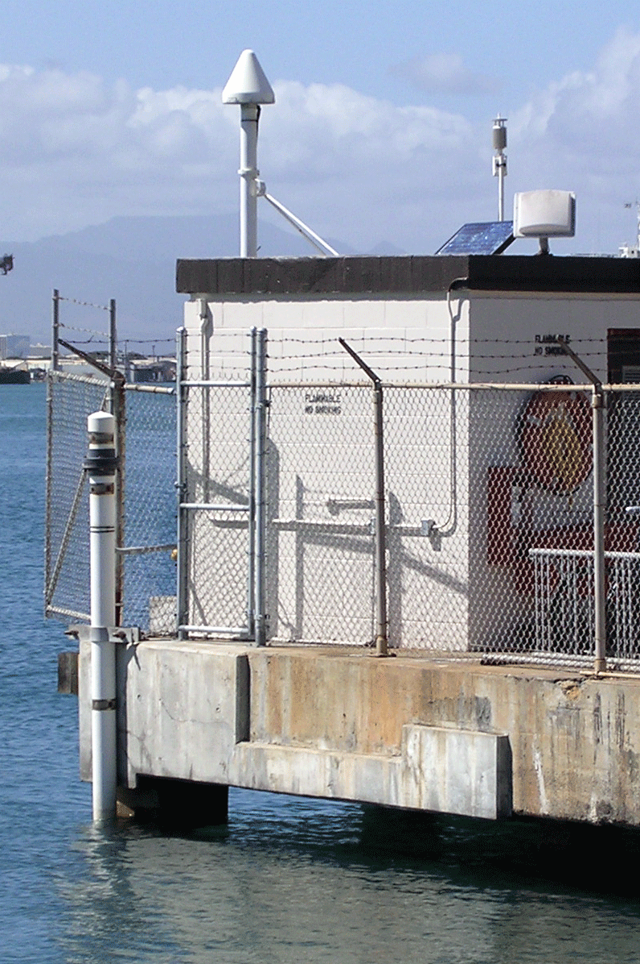
Honolulu Tide Gauge

Slide 17
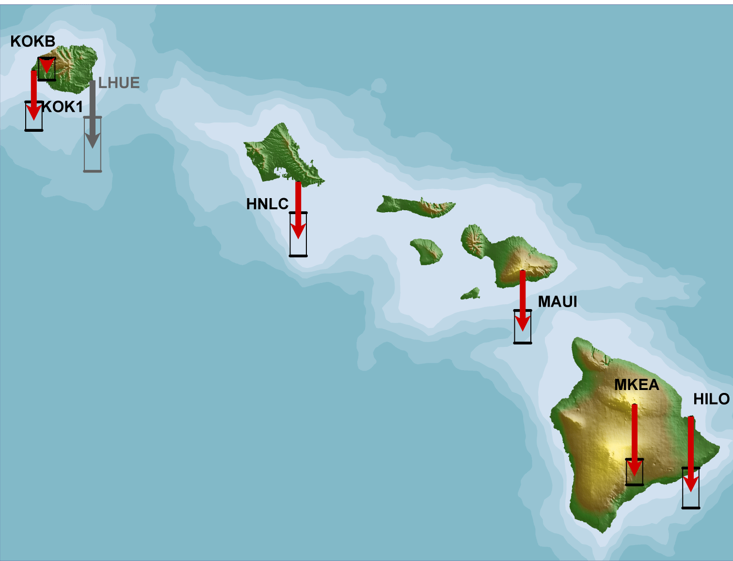
GPS Velocities
Hilo-Honolulu Differential
Sea Level* 1.9 ± 0.9 mm/yr
GPS -0.4 ± 0.4 mm/yr
95% Confidence intervals. * entire time series
KOKB -0.2 mm/yr
KOK1 -1.2 mm/yr
HNLC -1.4 mm/yr
MAUI -1.5 mm/yr
MKEA -1.8 mm/yr
HILO -1.9 mm/yr

Slide 18
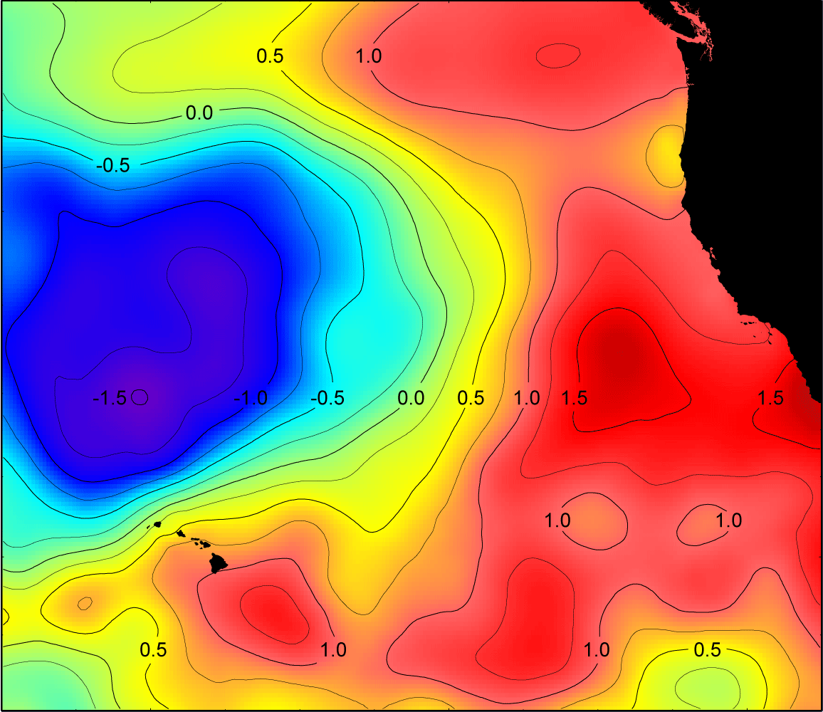
Steric Trend at Hawaii
Similar in structure to decadal ocean signals (e.g. PDO)
Hilo-Honolulu differential = 0.7mm/yr
Not definitive given available hydrographic data, but self-consistent with sea level trends
Midway (not shown) agrees with this steric trend

Slide 19
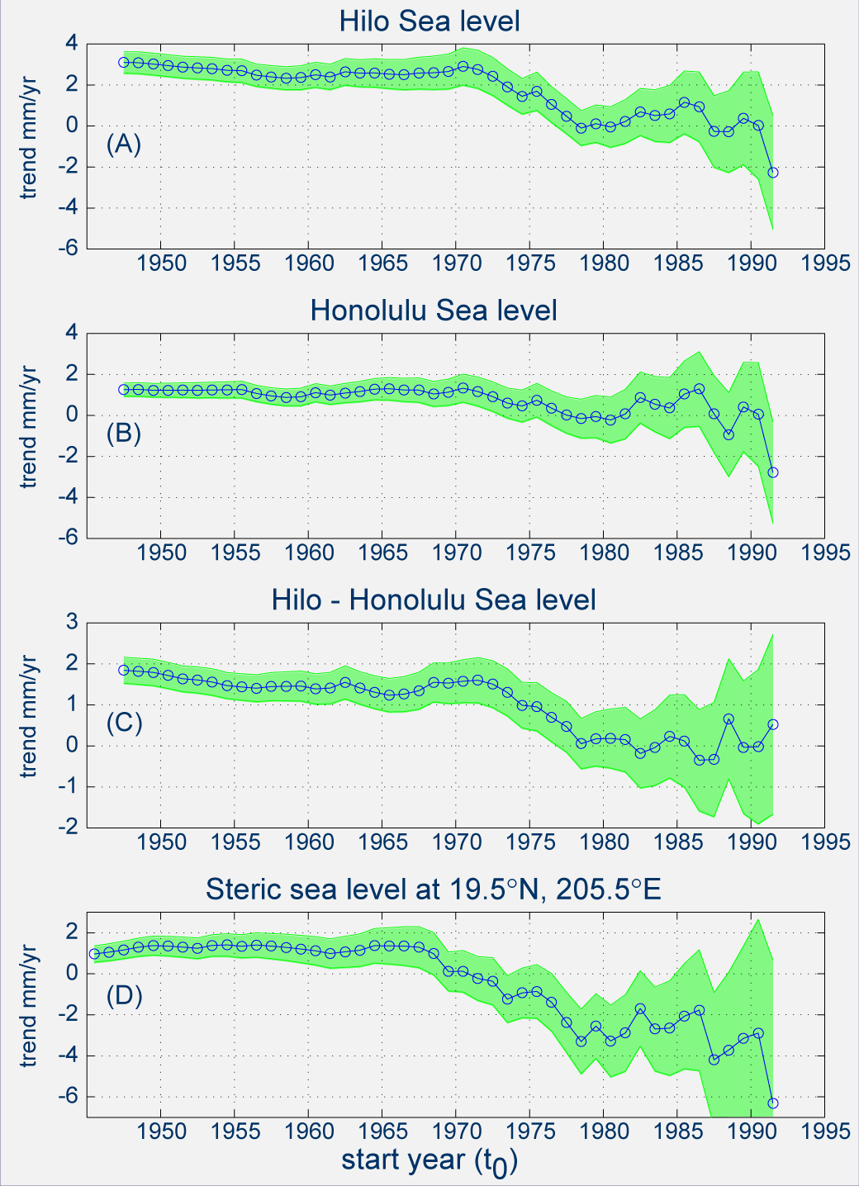
Trend Changes 1945-2002
Computation of the average rate of relative sea level rise from time t₀ to Dec. 2002, for various starting times t₀, as well as the associated 95% confidence interval

Slide 20
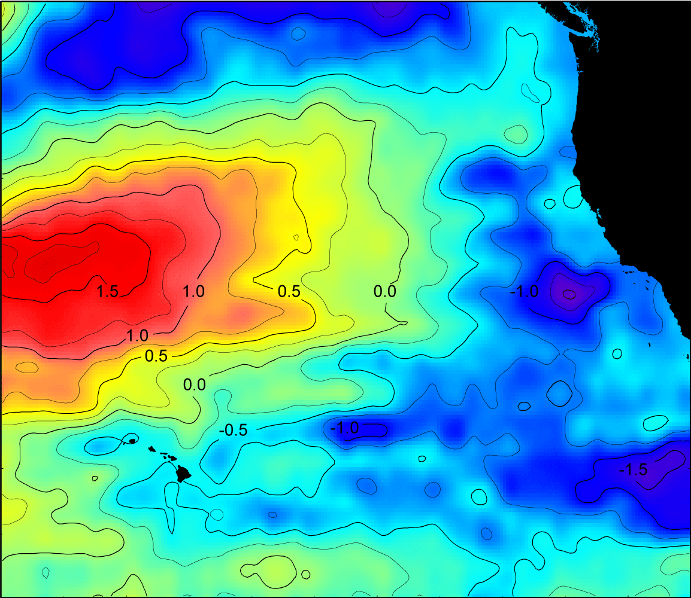
TOPEX/Poseidon SSH Trends

Slide 21
Interferometric Point Target Anaysis of SAR Data - Applications for Interpreting Relative and Absolute Sea Level Change
Charles Morgan and Ben Brooks

Slide 22
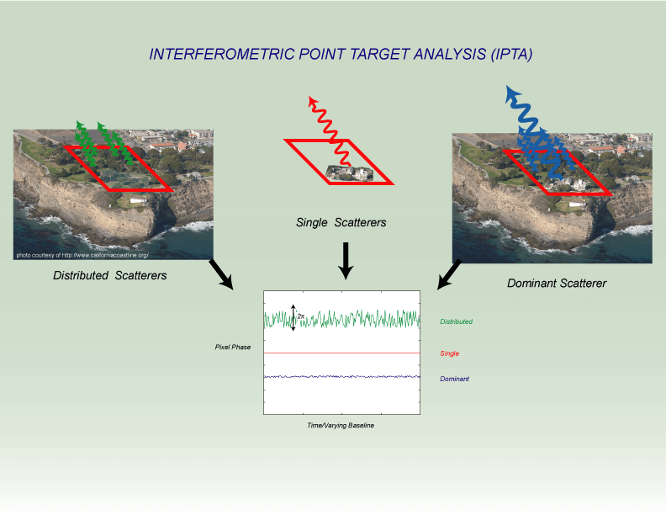

Slide 23
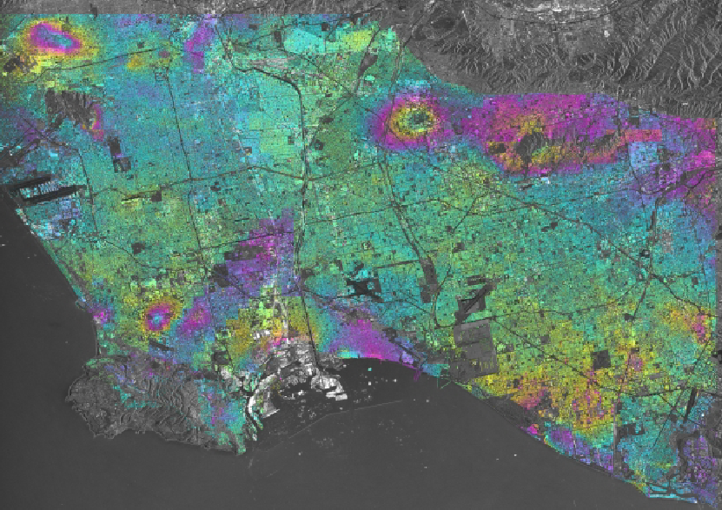
Greater Los Angeles

Slide 24
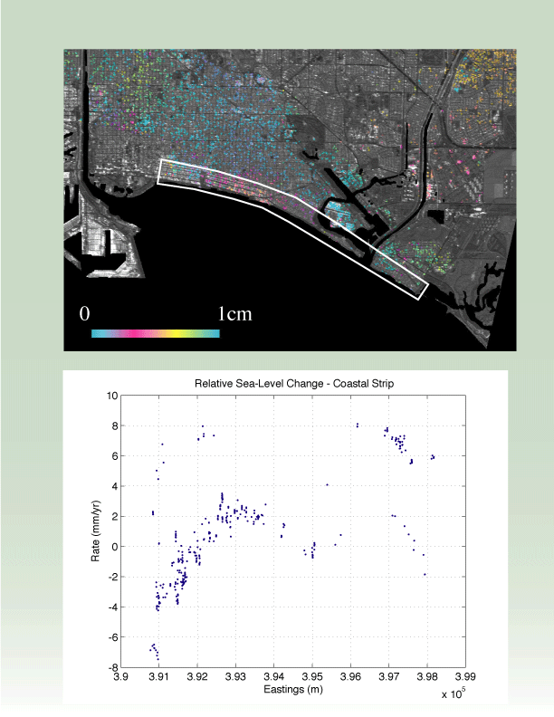
Coastal Land Motion and RSL

Slide 25
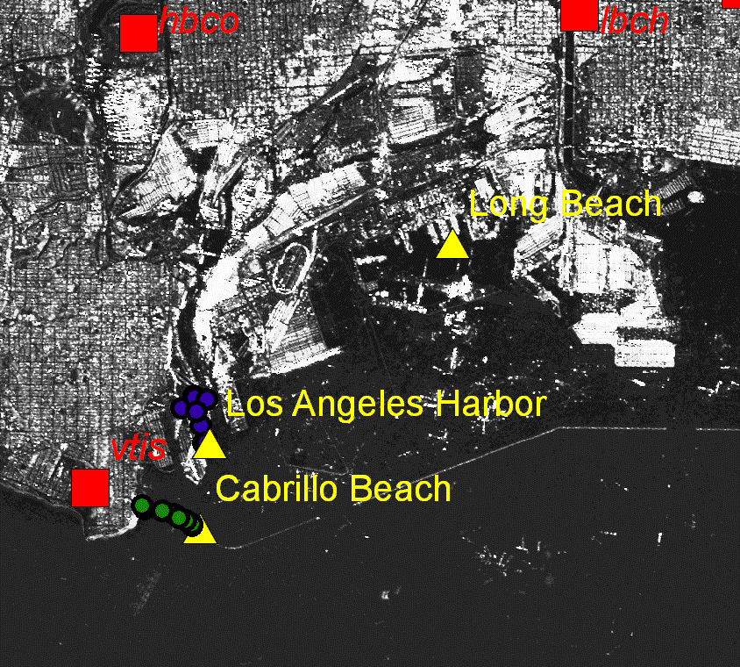

Slide 26
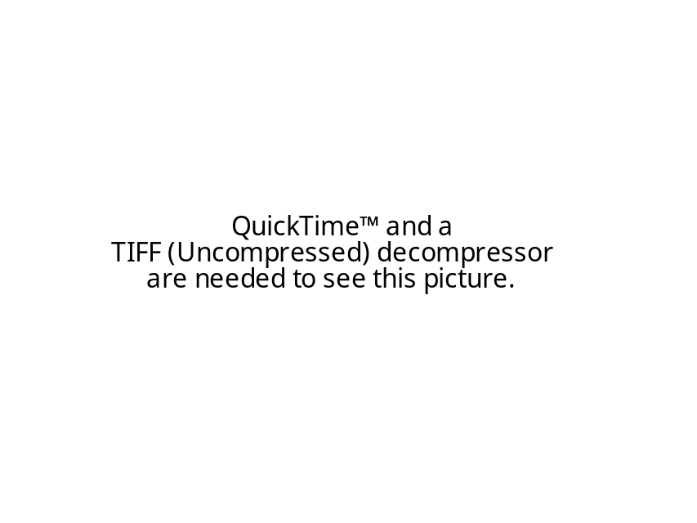

Tuvalu and Sea Level Rise

Slide 27
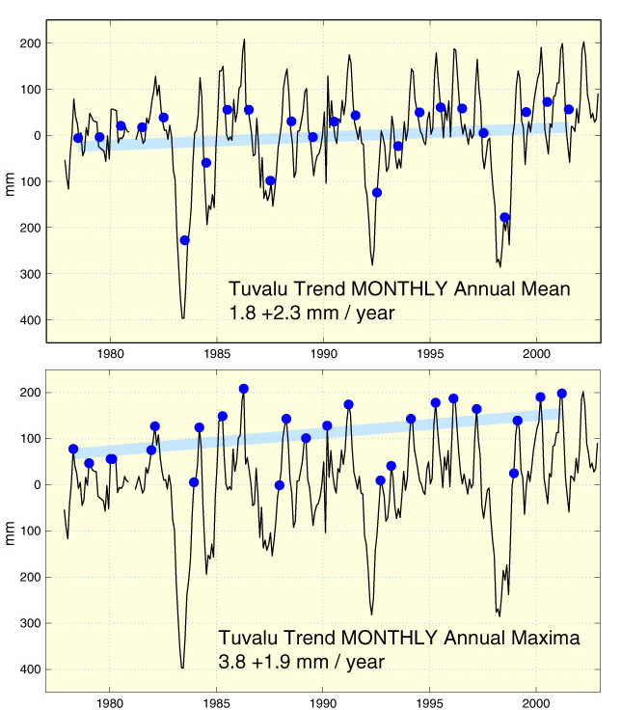
Sea Level Extremes vs. Sea Level Rise

Slide 28
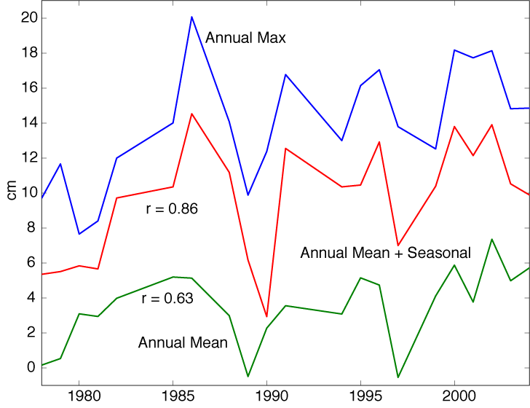

Slide 29
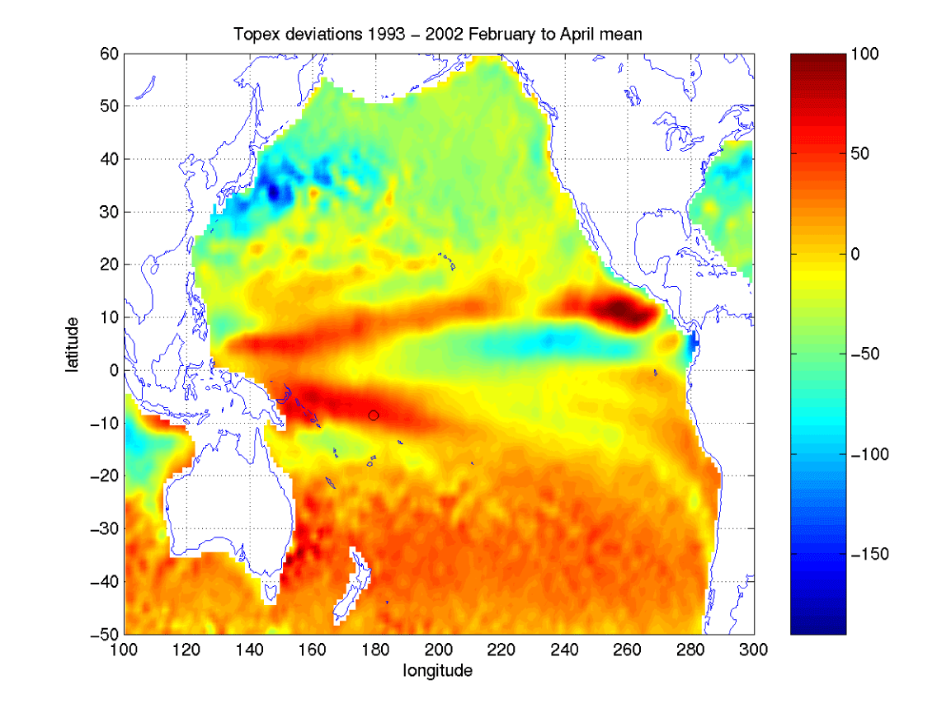
Sea Level Extremes vs. Sea Level Rise
Tuvalu

Slide 30
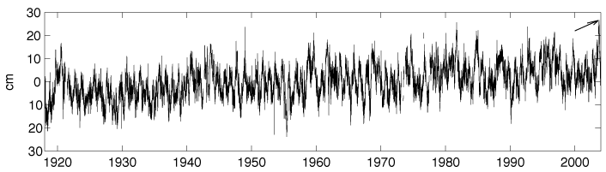
Sea Level Extremes and Mesoscale Variability
Honolulu Sea Level
Highest recorded daily sea level
Flooding of low-lying coastal areas
Enhanced beach erosion
Disruption of coastal engineering projects
Firing and Merrifield, 2004

Slide 31
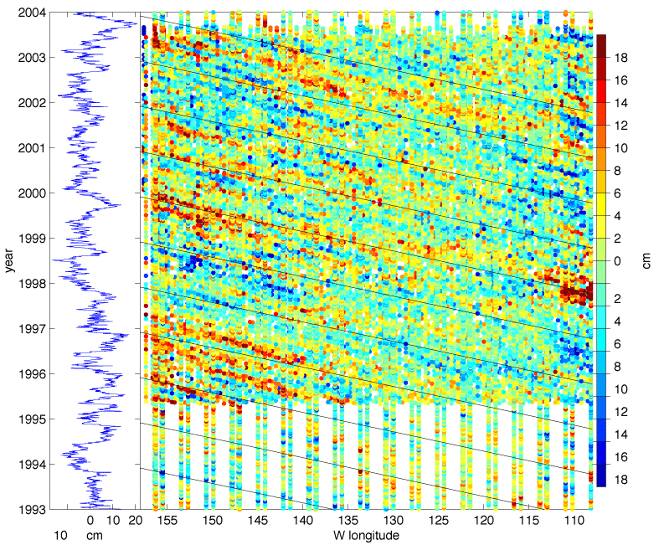
Sea Level Extremes and Mesoscale Variability
High Event
Honolulu
Sea Level
Satellite SSH
Firing and Merrifield, 2004

Slide 32
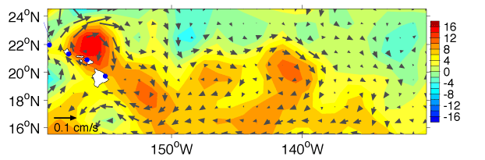
Sea Level Extremes and Mesoscale Variability
Anticyclonic Eddy
NCOM SSH
Firing and Merrifield, 2004

Slide 33
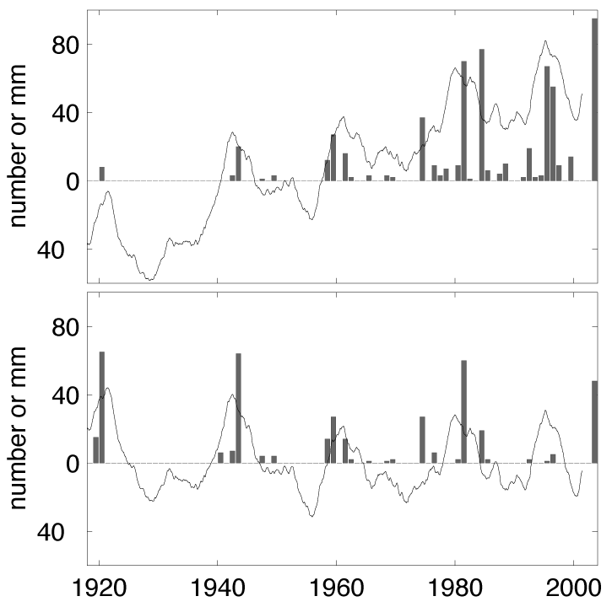
Sea Level Extremes and Mesoscale Variability
Firing and Merrifield, 2004

Slide 34
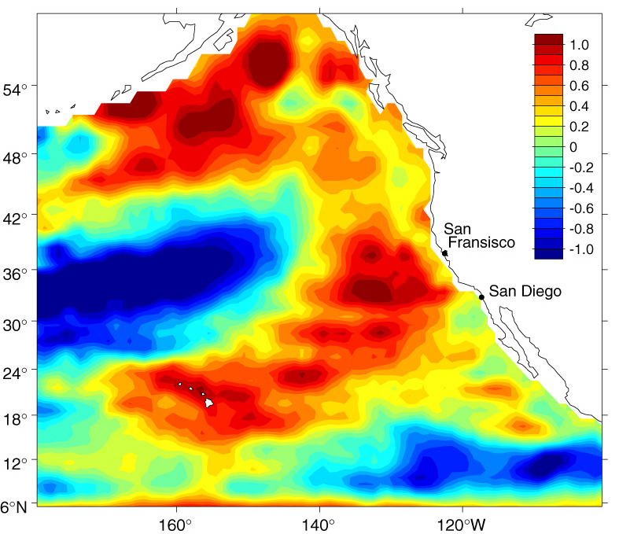
Sea Level Extremes and Mesoscale Variability
Firing et al., 2004

Slide 35
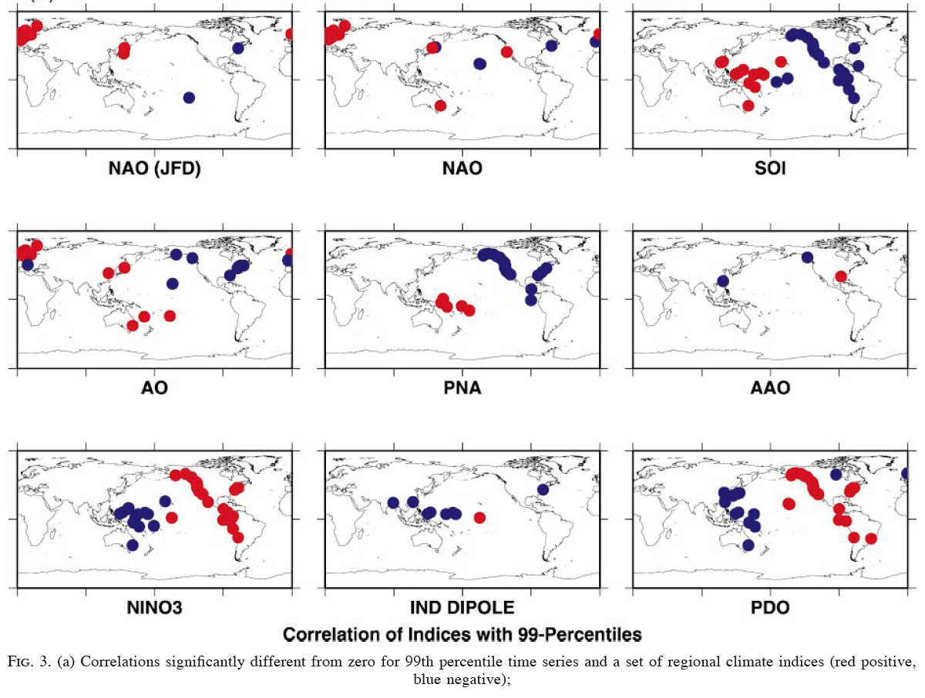
Extreme Events and Climate Variability
Woodworth and Blackman, 2004

Slide 36
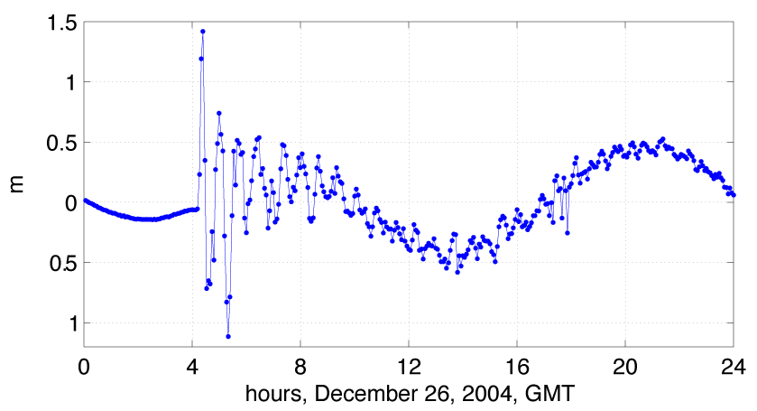
The Indian Ocean Tsunami
Male, Maldives - GLOSS Tide Gauge Stations
Merrifield et al., 2005

Slide 37
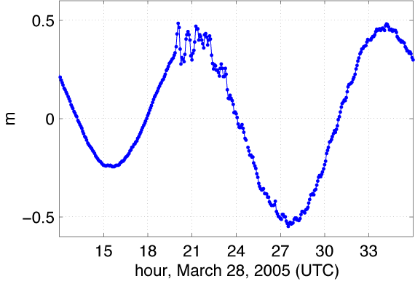
March 2005 Tsunami
Male, Maldives

Slide 38
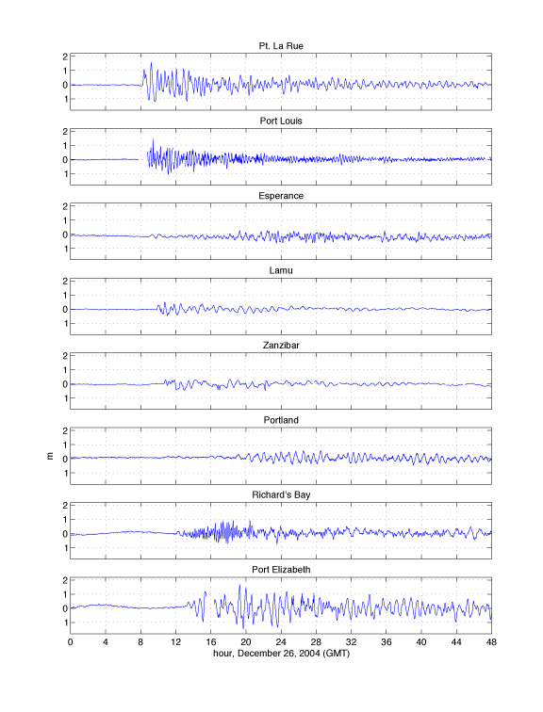
The Indian Ocean Tsunami
Male, Maldives - GLOS Tide Gauge Stations
Merrifield et al., 2005

Slide 39
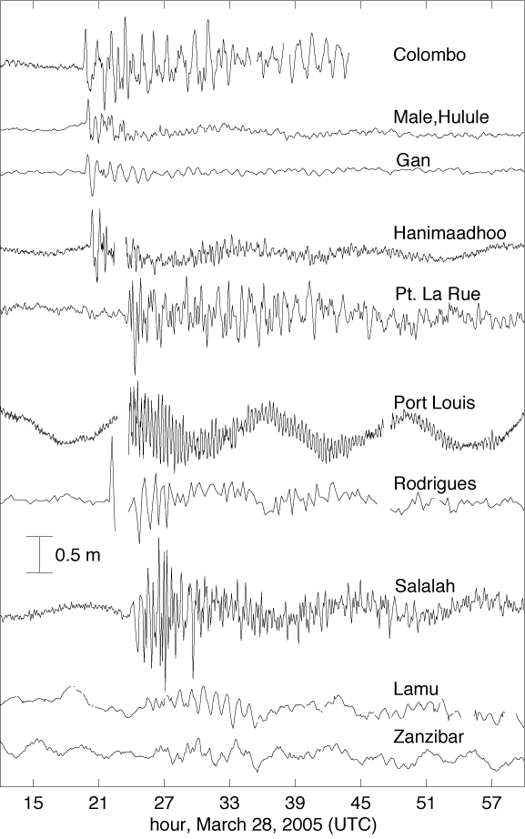

Slide 40
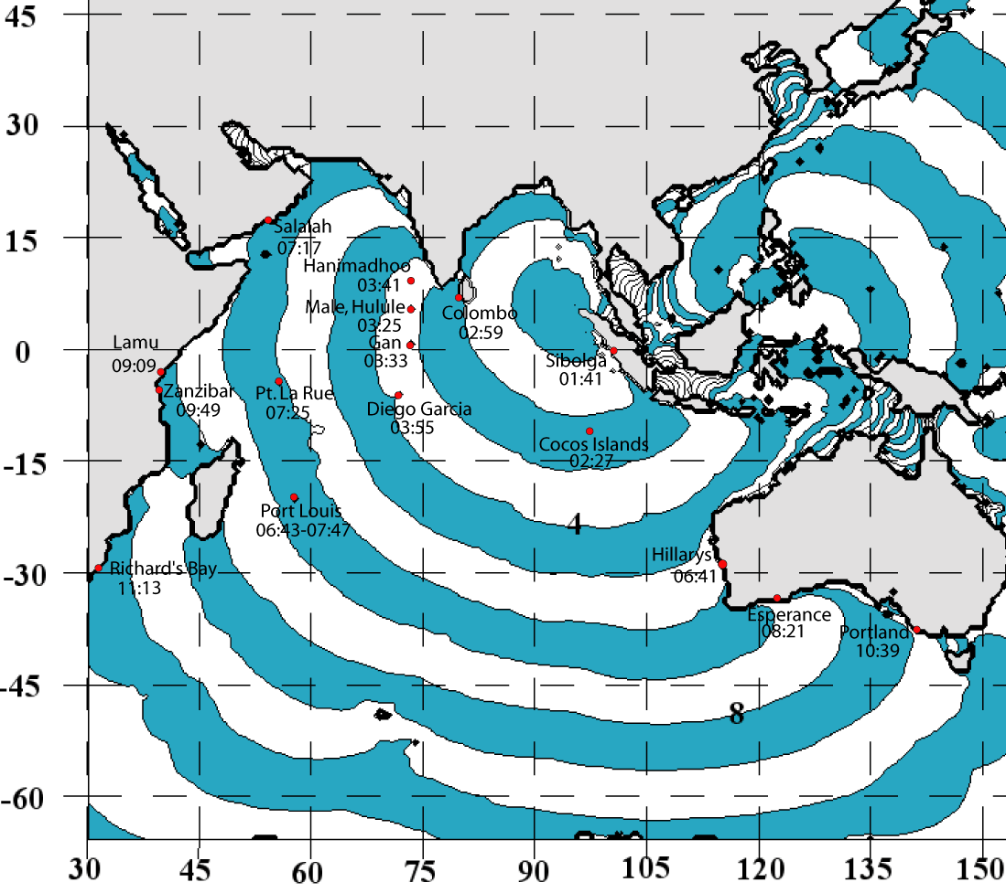
The Indian Ocean Tsunami
Merrifield et al., 2005

Slide 41
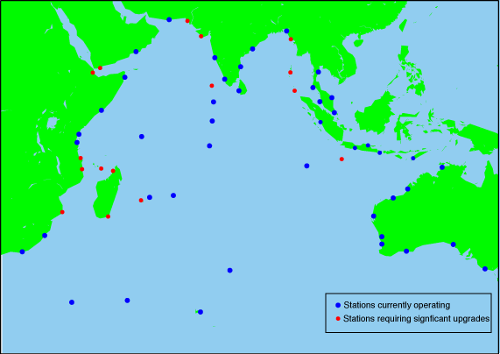
The Indian Ocean Tsunami
Merrifield et al., 2005

Slide 42
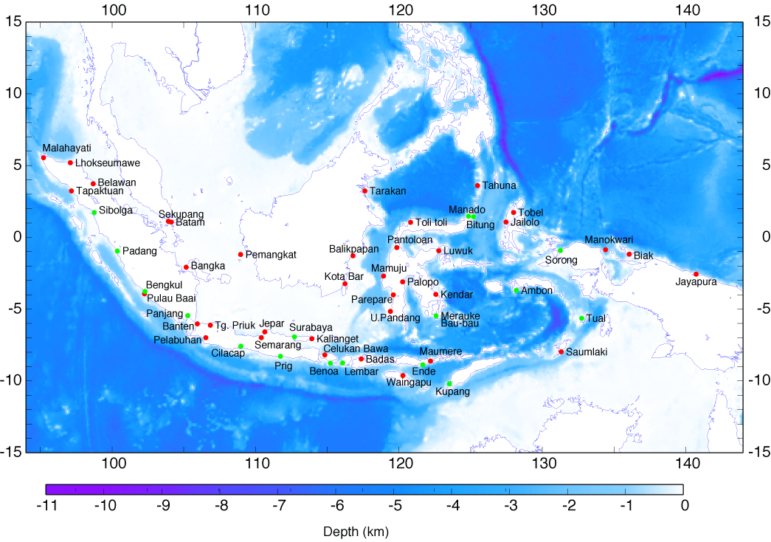

Slide 43
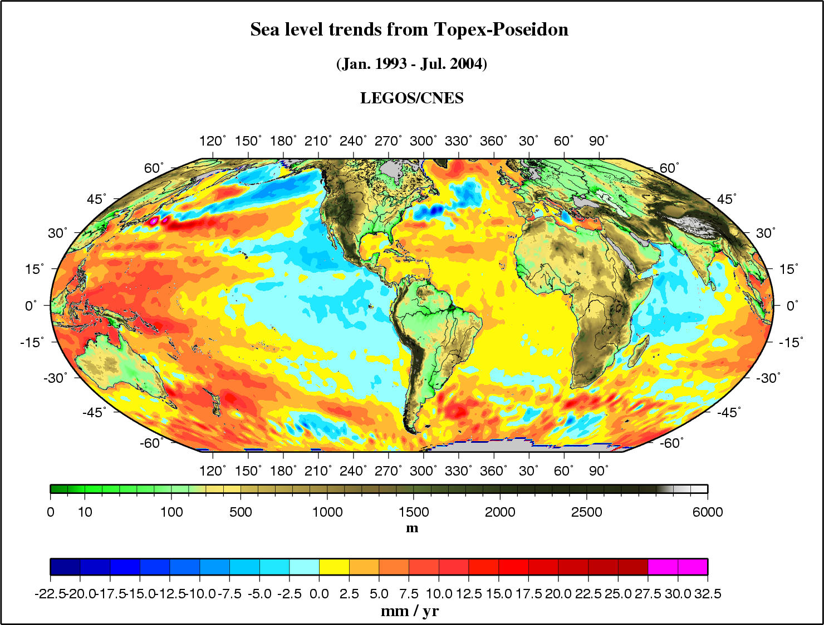
Regional distribution of sea level trends
(Jan.1993 - Jul. 2004) from Topex/Poseidon
A. Cazenzave

Slide 44
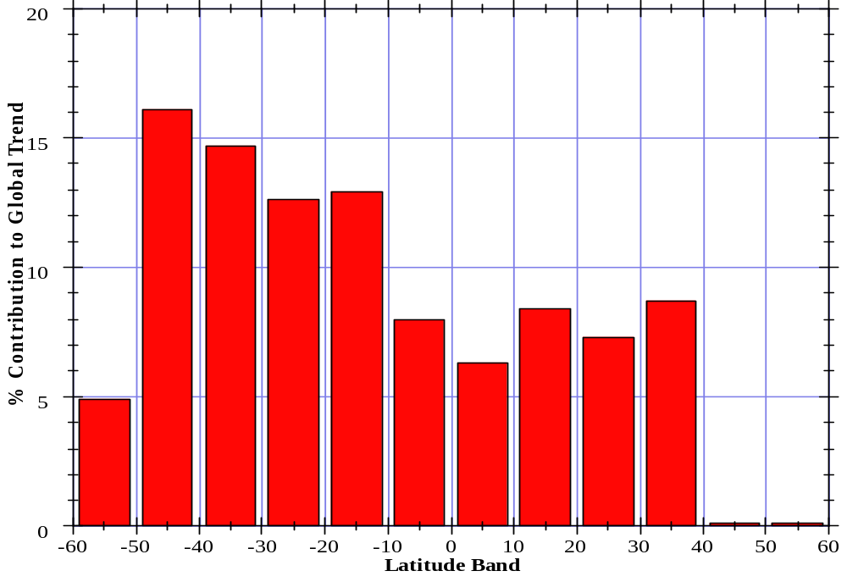
Percent Contribution to Global Trend
A. Cazenzave

