Slide 1
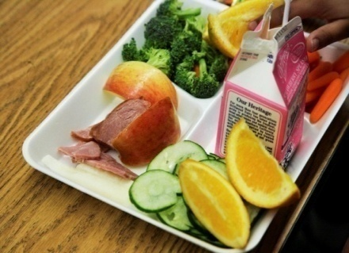
Procuring Local Foods
Working Group #1
Farm to School: Linking the Land and the Lunchroom
School and Community Nutrition, KDE
Friday, March 23, 2012

Slide 2
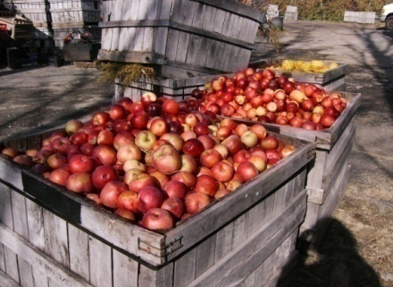
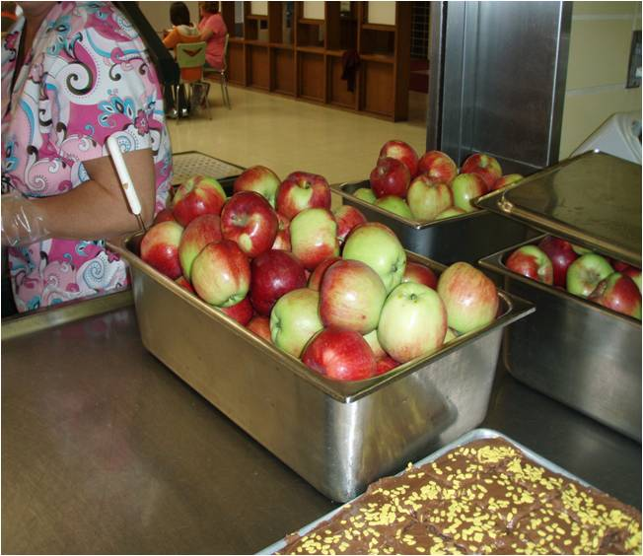
Today’s Goals
Identify mechanisms and procedures for schools to use when purchasing local, farm fresh products

Slide 3
General Procurement

Slide 4
Competition!
Most important principle of a sound procurement is that it is competitive
Free and open competition means that all suppliers are on a level playing field and have the same opportunity to compete
Procurement procedures may never unduly restrict or eliminate competition

Slide 5
Full and Open Competition
3016.36(c)(1)
All procurement transactions will be conducted in a manner providing full and open competition consistent with the standards of §3016.36. Some of the situations considered to be restrictive of competition include but are not limited to:
(i) Placing unreasonable requirements on firms in order for them to qualify to do business,
(ii) Requiring unnecessary experience and excessive bonding,

Slide 6
Full and Open Competition
(iii) Noncompetitive pricing practices between firms or between affiliated companies, (collusion)
(iv) Noncompetitive awards to consultants that are on retainer contracts,
(v) Organizational conflicts of interest,
(vi) Specifying only a “brand name” product instead of allowing “an equal” product to be offered and describing the performance of other relevant requirements of the procurement, and
(vii) Any arbitrary action in the procurement process.

Slide 7
Full and Open Competition
(2) Grantees and subgrantees will conduct procurements in a manner that prohibits the use of statutorily or administratively imposed in-State or local geographical preferences in the evaluation of bids or proposals, except in those cases where applicable Federal statutes expressly mandate or encourage geographic preference. (FNS does allow Geographic Preference for unprocessed locally grown or locally raised agricultural products.)

Slide 8
Local rule
7 CFR 210.21(c): A school food authority may use its own procurement procedures which reflect applicable State and local laws and regulations, provided that procurements made with nonprofit school food service account funds adhere to the standards set forth in this part and §§3016.36(b) through 3016.36(i), 3016.60 and 3019.40 through 3019.48 of this title, as applicable, and in the applicable Office of Management and Budget Circulars. School food authority procedures must include a written code of standards of conduct meeting the minimum standards of §3016.36(b)(3) or §3019.42 of this title, as applicable.

Slide 9
Why is competition important?
Cost of products and services!

Slide 10
Why is competition important?
Quality of products and services

Slide 11
What regulations must SFAs follow?
Program Regulations for Procurement:
NSLP: 7 CFR 210.21
SBP: 7 CFR 220.16
Uniform Administrative Requirements for Procurement:
State/local governments: 7 CFR 3016.36
Non-profits: 7 CFR 3019.44

Slide 12
Procurement Framework

Slide 13

Procurement Methods
Informal procurement
Small Purchase Threshold –
Kentucky - $20,000
Formal procurement
Competitive Sealed Bidding
Competitive Negotiation

Slide 14
Small Purchase Threshold
Federal regulations set forth that a procurement contract under $100,000 in value may be awarded using informal methods
States or localities may set a lower small purchase threshold, thereby imposing more formal procedures

Slide 15
What does this mean?
Informal procurements must maximize full and open competition
SFAs should put specs in writing before contacting any potential vendors
A minimum of three sources must be be contacted who are eligible, able, and willing to provide product or service

Slide 16
Formal Procurement Methods
Used when the value of purchase exceeds applicable Federal, State, or local threshold for small purchases
More rigorous and prescriptive:
Competitive Sealed Bidding
Competitive Negotiation

Slide 17
What does this mean?
Detailed specs must be developed
Technical and cost factors
Bids/Solicitations must be publicly solicited
Measure and document why one company’s response to a particular criterion is better than another

Slide 18
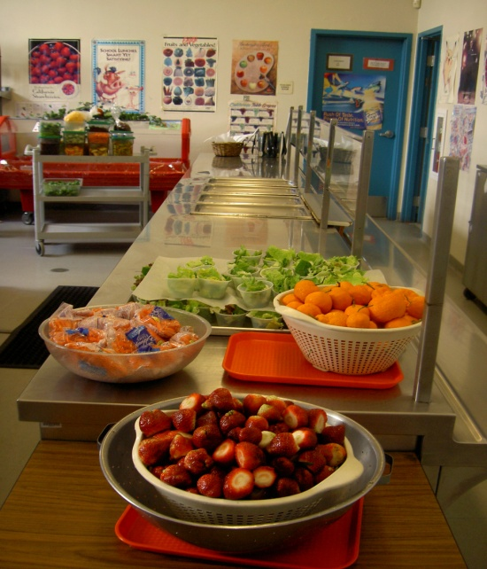
Keep in mind…
SFAs may not intentionally split purchases to fall below the small purchase threshold and avoid formal procurement methods

Slide 19
How SFAs Can Purchase from Local Producers

Slide 20

Developing Product Specifications
The key to effective purchasing of local food items requires the school food authorities (SFA) to take some important steps before they actually begin the procurement process. Before purchasing for the Child Nutrition Programs, the SFA must evaluate their current food service operations and needs; this is also known as forecasting.

Slide 21
Evaluating Current FS Needs
SFAs should also evaluate their current food service needs, such as:
Necessary food volume;
Student preferences;
Menu requirements; and
Required transportation and delivery needs.

Slide 22
Developing Specifications
SFAs should think carefully about developing specifications that reflect the specific characteristics of the products they seek. The following examples are indicators that may be used within a product’s specification:
Degree of ripeness or maturity;
Condition upon receipt of product;
Age of product;
Weight range;
Preservation or processing method;
US Standard for Grade; and
Temperature during delivery and upon receipt.

Slide 23
Developing Specifications
Although not all-encompassing, the examples below provide some specification elements that are important factors to discuss with local producers to ensure that expectations and requirements are clear:
Specification Elements Examples:
Size: Indicate the size an apple must be to qualify as part of a reimbursable meal, so that expectations are set up front.
Quantity: Farmers and SFAs sometimes speak different languages—schools may not be used to ordering apples in “bushels” from their national distributor; be aware of language barriers.
Quality: Indicate that lettuce must be a healthy green color with no brown leaves.

Slide 24
Developing Specifications
Specification Elements Examples (con’t):
Cleanliness: Indicate that lettuce should be clean with no visible signs of dirt or insects.
Packaging: A local farmer may sell product in 25 pound boxes, but the SFA may need lighter/smaller packaging in order for staff to carry.
Food Safety: Include a checklist of questions for the farmer to complete regarding their agricultural practices (consult our Food Safety webpage for more information: http://www.fns.usda.gov/fns/safety/pdf/best_practices.pdf)
Delivery: Establish a delivery day and time for products.

Slide 25


Developing Specifications
There are important elements to consider when drafting specification for local food items. Elements such as: size, quantity, quality, cleanliness, packaging, food safety and delivery. Consult USDA resources such as the Food Buying Guide for Child Nutrition Programs and Fruits and Vegetables Galore to aid in the development of product specifications.

Slide 26
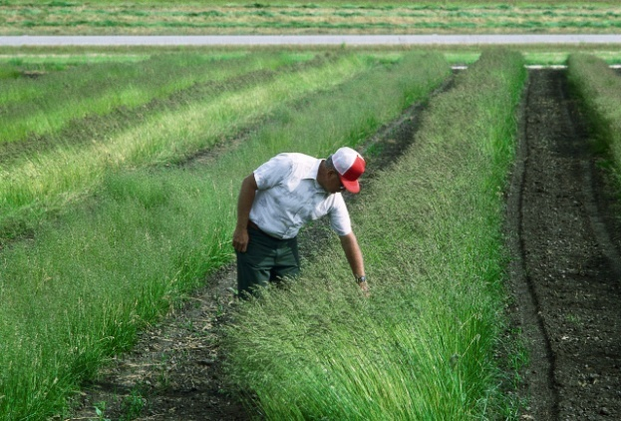
Direct from Farmer
Potential benefits of purchasing from local farmers:
Shortening the supply chain
Cutting out the middle man
Reducing fuel costs
Forming relationships for growing specifications

Slide 27
Farmer Cooperatives (Co-ops)
Farmer cooperatives may develop a group distribution strategy
Purchasing from a farmer co-op may help food service directors reduce time spent on administrative tasks

Slide 28
Farmers’ Markets
Informal Procurement Process
Farmers are contacted and one is determined to have lowest price
Farmer brings the schools’ order to the farmers’ market in addition to their product
Food service staff have opportunity to inspect product quality and see other available products for future menu planning

Slide 29
Regional Wholesaler
Support sales and marketing of local farm products
Provide standard pack sizes and specifications
Transportation
Price
Cutting out the distributor
Notes:
I’m not sure what you mean by Wholesaler – I interpret that to be a wholesale distributor that buys from farms and redistributes the product by selling in to customers i.e. a produce vendor, Sysco Foods, etc..

Slide 30
Form Buying Cooperatives
Neighboring school districts develop a group purchasing strategy
Buying co-ops often increase purchasing power and volume requests
Co-ops must still follow procurement regulations when purchasing for the group

Slide 31
Geographic Preference
7 CFR 210.21(g) and 7 CFR 220.16(f)
Geographic preference. (1) A school food authority participating in the Program, as well as State agencies making purchases on behalf of such school food authorities, may apply a geographic preference when procuring unprocessed locally grown or locally raised agricultural products. When utilizing the geographic preference to procure such products, the school food authority making the purchase or the State agency making purchases on behalf of such school food authorities have the discretion to determine the local area to which the geographic preference option will be applied;

Slide 32
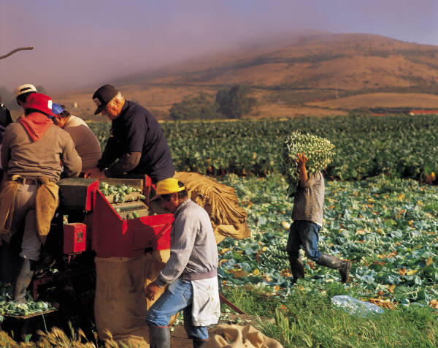
Geographic Preference
(ii) Proposals will be solicited from an adequate number of qualified sources;
(iii) Grantees and subgrantees will have a method for conducting technical evaluations of the proposals received and for selecting awardees;

Slide 33
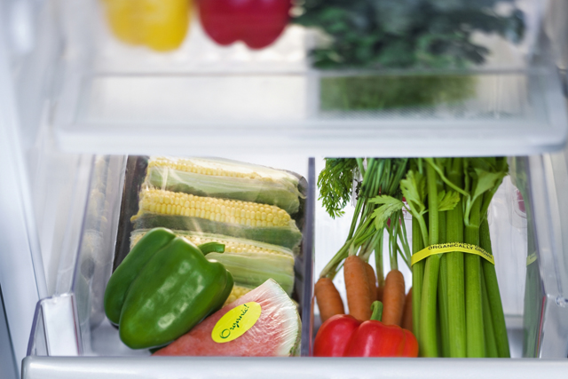
Geographic Preference
(2) For the purpose of applying the optional geographic procurement preference in paragraph (g)(1) of this section, ‘‘unprocessed locally grown or locally raised agricultural products’’ means only those agricultural products that retain their inherent character.

Slide 34
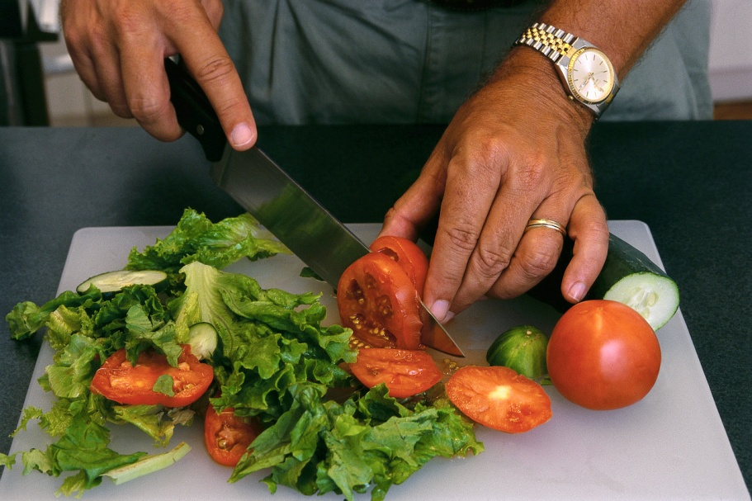
Geographic Preference
The effects of the following food handling and preservation techniques shall not be considered as changing an agricultural product into a product of a different kind or character: Cooling; refrigerating; freezing; size adjustment made by peeling, slicing, dicing, cutting, chopping, shucking, and grinding; forming ground products into patties without any additives or fillers; drying/ dehydration; vacuum packing and bagging (such as placing vegetables in bags or combining two or more types of vegetables or fruits in a single package); the addition of ascorbic acid or other preservatives to prevent oxidation of produce; butchering livestock and poultry; cleaning fish; and the pasteurization of milk.

Slide 35

Geographic Preference
Unallowable food handling and preservation techniques
Heating/canning -- the inherent character of the product is not retained because the heating process involved in canning changes the agricultural product into a product of a different kind or character

Slide 36
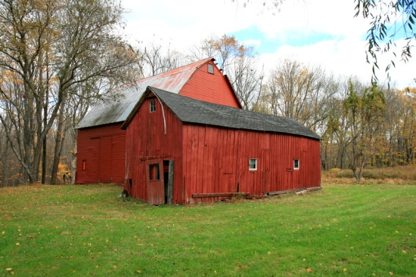
Geographic Preference
What is Local?
Discretion to define the local area for any geographic preference is left to the institution responsible for procurement
“Local” must not be defined in a way that unnecessarily limits competition
Bottom line: Reduce the carbon foot print of the cost of procuring locally grown or locally raised agricultural products.

Slide 37
How a Geographic Preference Can Work in Procurement

Slide 38
Formal Procurement:
1
Develop solicitation and incorporate geo preference points into scoring criteria
Publicly announce the IFB/RFP
Evaluate bidders using established criteria
Producers of locally-grown unprocessed products receive extra points in scoring
Determine most responsive and responsible bidder at lowest price
5
2
3
4

Slide 39
Informal Procurement:
1
Develop your specs in writing
Identify sources eligible, able, and willing to provide products
Contact at least three sources
Evaluate bidders’ response to your specs
Determine most responsive and responsible bidder at lowest price
5
2
4
3

Slide 40

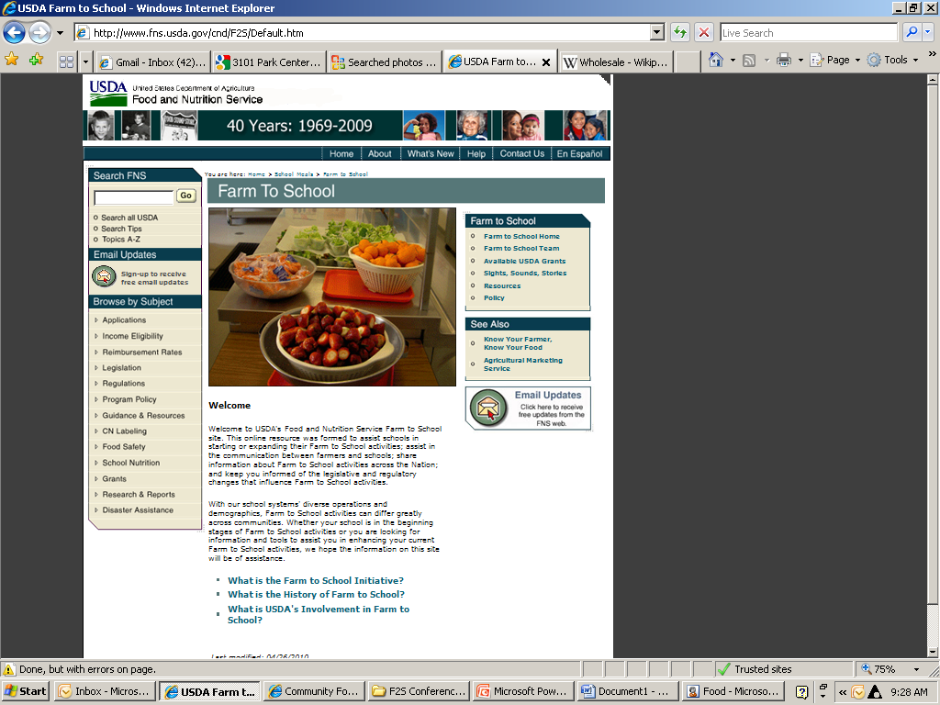
Farm to School Website
New website: www.fns.usda.gov/cnd/F2S
Resources
USDA Grants
Policy
Team Updates
Site visits
Webinars

Slide 41
Where do I find this guidance?
http://www.fns.usda.gov/cnd/governance/regulations.htm
http://www.fns.usda.gov/cnd/F2S/f2spolicy.htm
Denise Hagan, Director, KY DOE
School and Community Nutrition
(502) 564-5625;
denise.hagan@education.ky.gov

Slide 42
Thank you! Questions?

