Slide 1
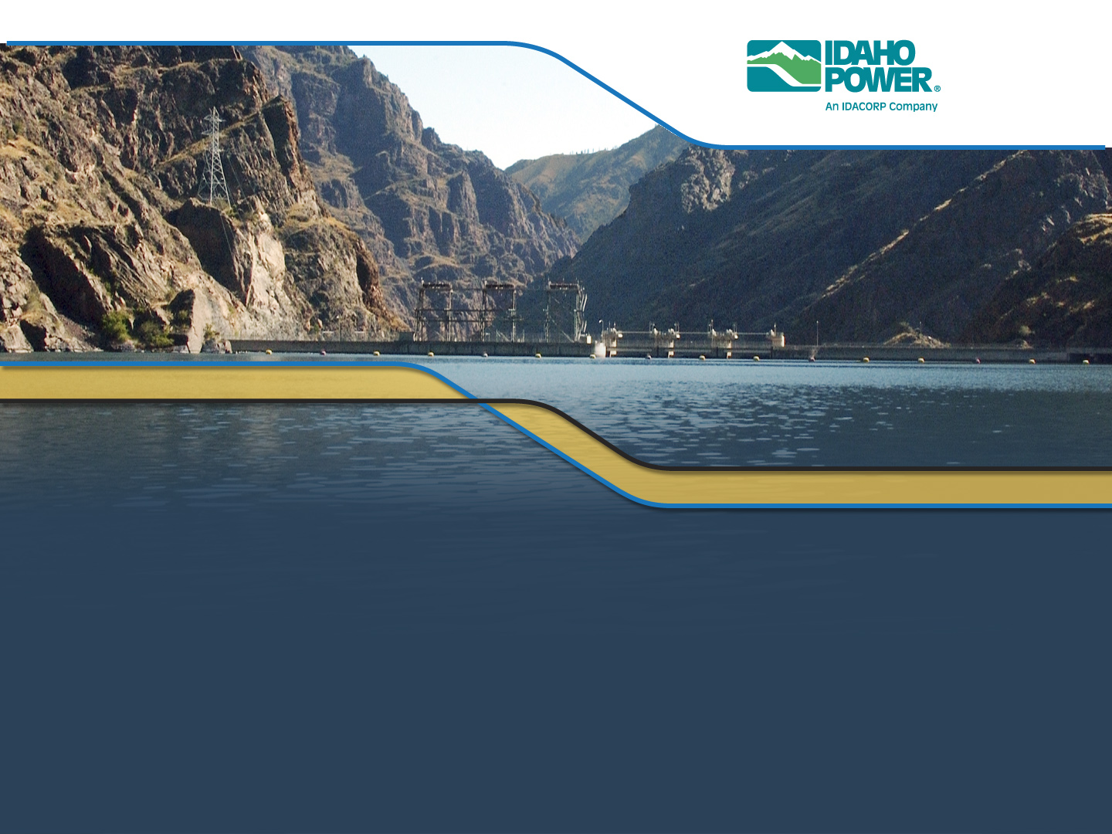
Potential Locations for a Swan Falls Inflow Monitoring Site

Slide 2
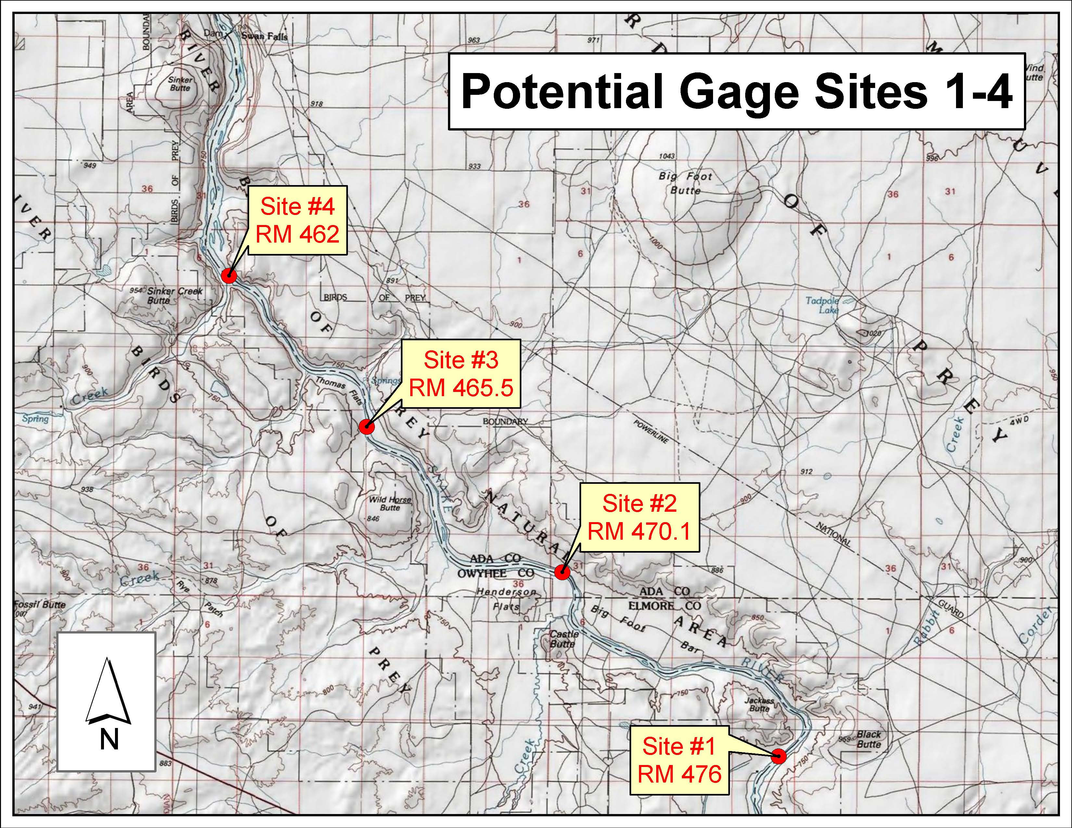

Slide 3
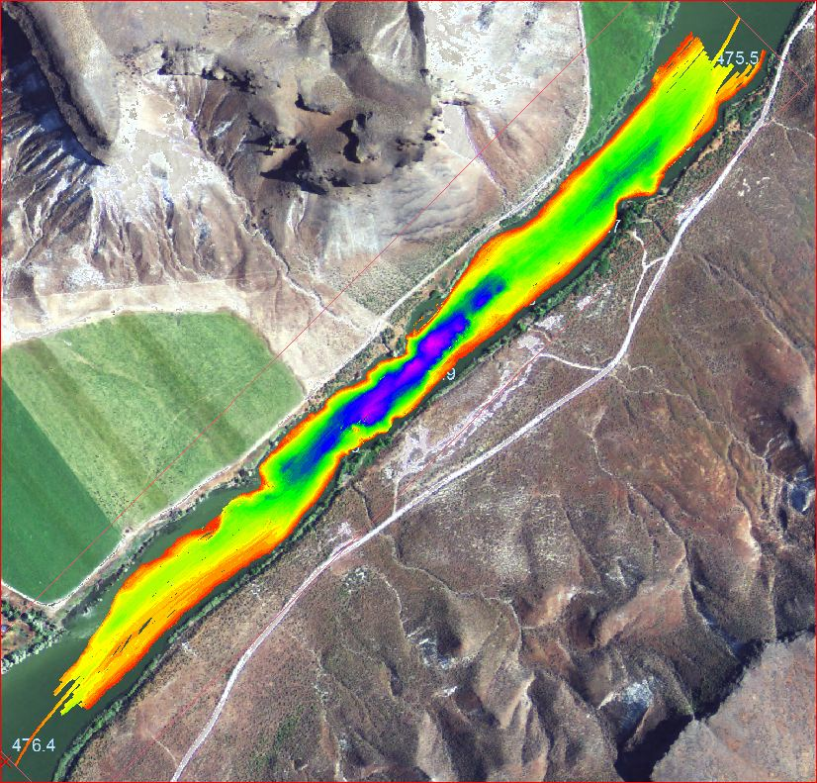
Site #1

Slide 4
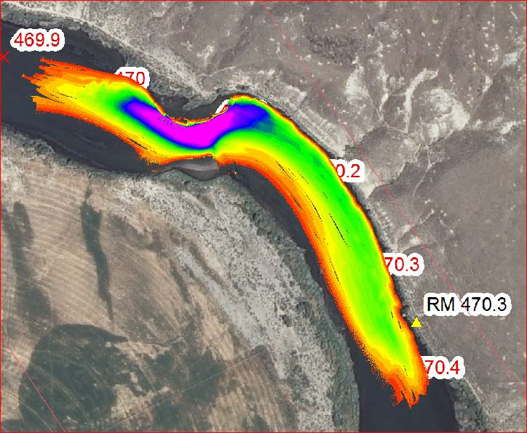
Site #2

Slide 5
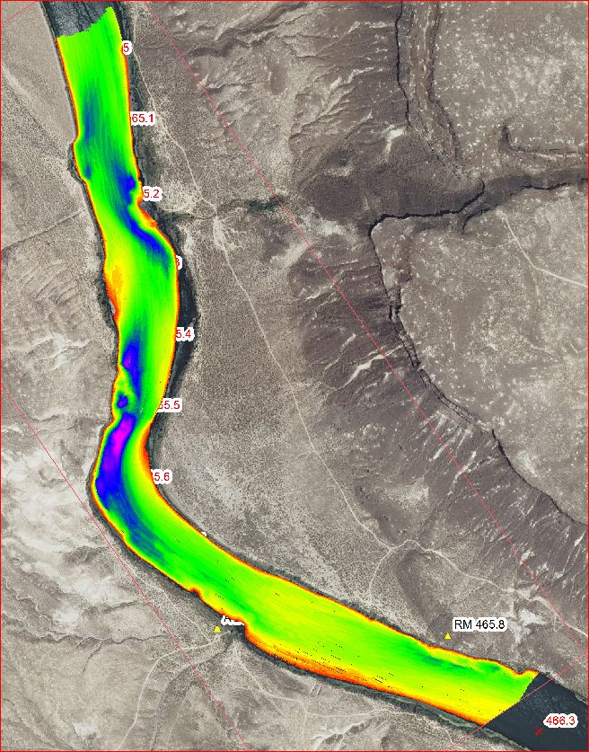
Site #3

Slide 6
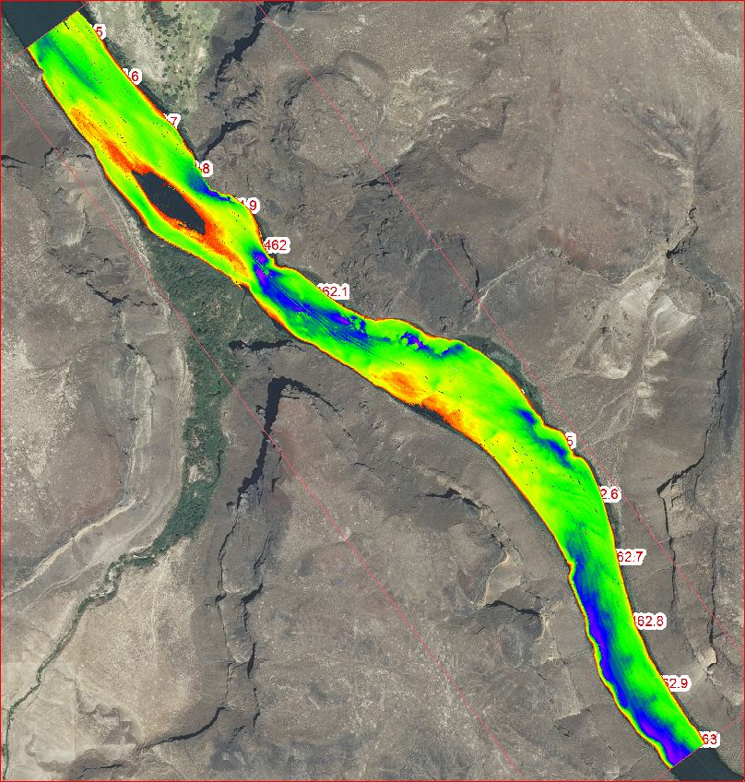
Site #4

Slide 7

Velocity Profiling

