Slide 1

INTEGRATION OF THE NATIONAL MAP: DATA LAYERS AND FEATURES
27 May 2004
Michael P. Finn
E. Lynn Usery
Michael Starbuck
Gregory M. Jaromack
Bryan Weaver
mfinn@usgs.gov

Slide 2

Outline
Goals and Objectives
Approach
Data
Test Sites
Methods
Conclusions

Slide 3

Goals and Objectives
The National Map will consist of integrated datasets
Current USGS digital products are single layer and not vertically-integrated
The goal is to develop procedures for automated integration based on metadata
Framework for layer integration based on metadata
Framework for feature integration
Example results for Atlanta and St. Louis

Slide 4


Slide 5
Integrating Disparate Networks
Conceptual Data Flow:
Federated Database design – Local schemas mapped to a global schema for attribute conflation and maintenance.
Physical Integration Processes:
Vertical Integration = Cross-thematic topological integrity
Horizontal Integration = Same-theme edge-matching

Slide 6
Approach
Layer-based
  Use existing seamless datasets
  Determine integration feasibility based on resolution and accuracy
Feature-based
  Implement integration on feature by feature basis
  Use developed feature library

Slide 7
Data
Orthoimages from Nunn-Lugar-Domenici 133 priority cities of the Homeland Security Infrastructure Program
National Hydrography Dataset (NHD)
National Elevation Dataset (NED)
Transportation (DLG, TIGER, State DOT, others)
National Land Cover Dataset (NLCD, others)

Slide 8
Test Sites
St. Louis, Missouri
  Initially the Manchester and Kirkwood quadrangles
Atlanta
  Initially the Chamblee and Norcross quadrangles

Slide 9
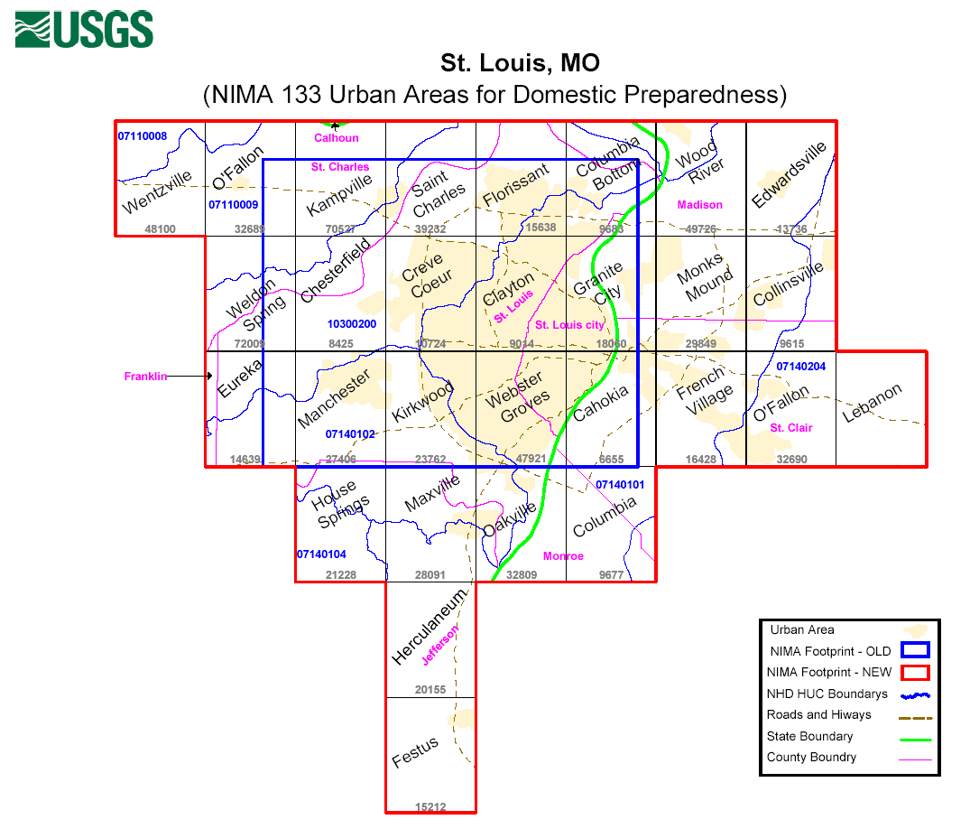

Slide 10
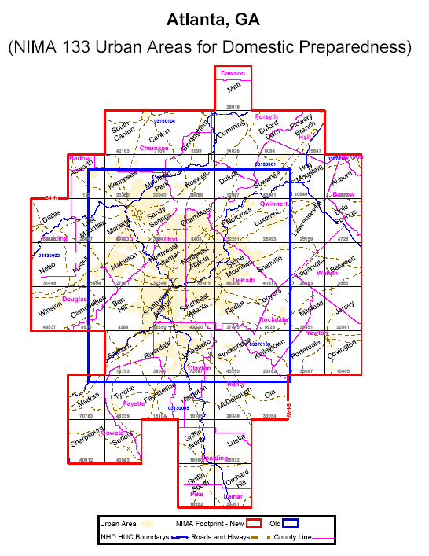

Slide 11
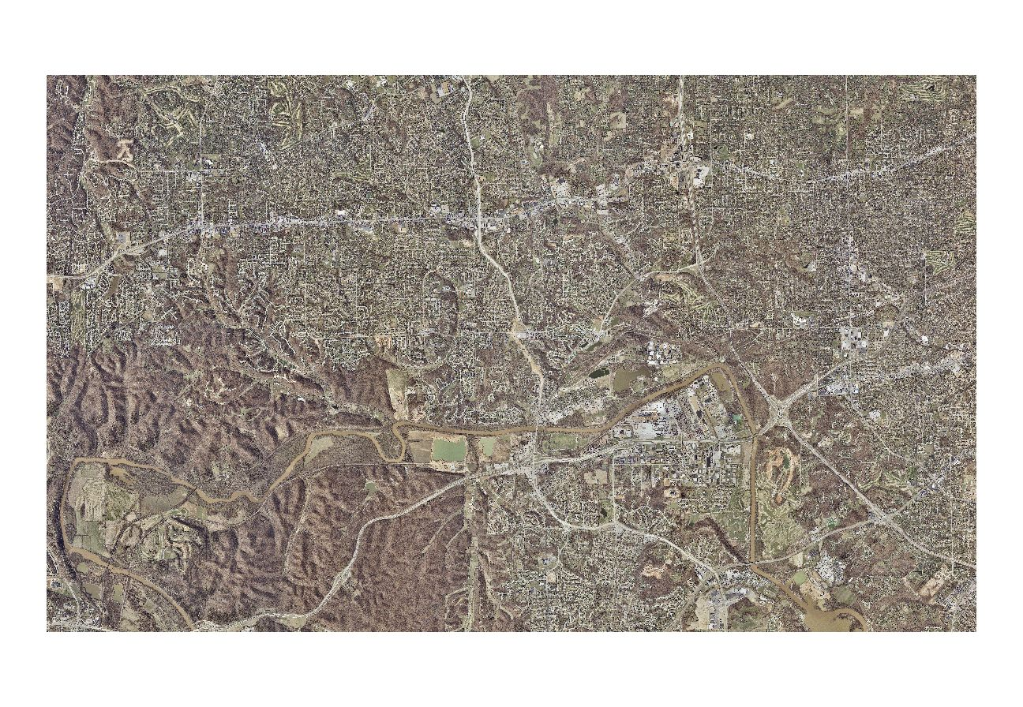

Slide 12
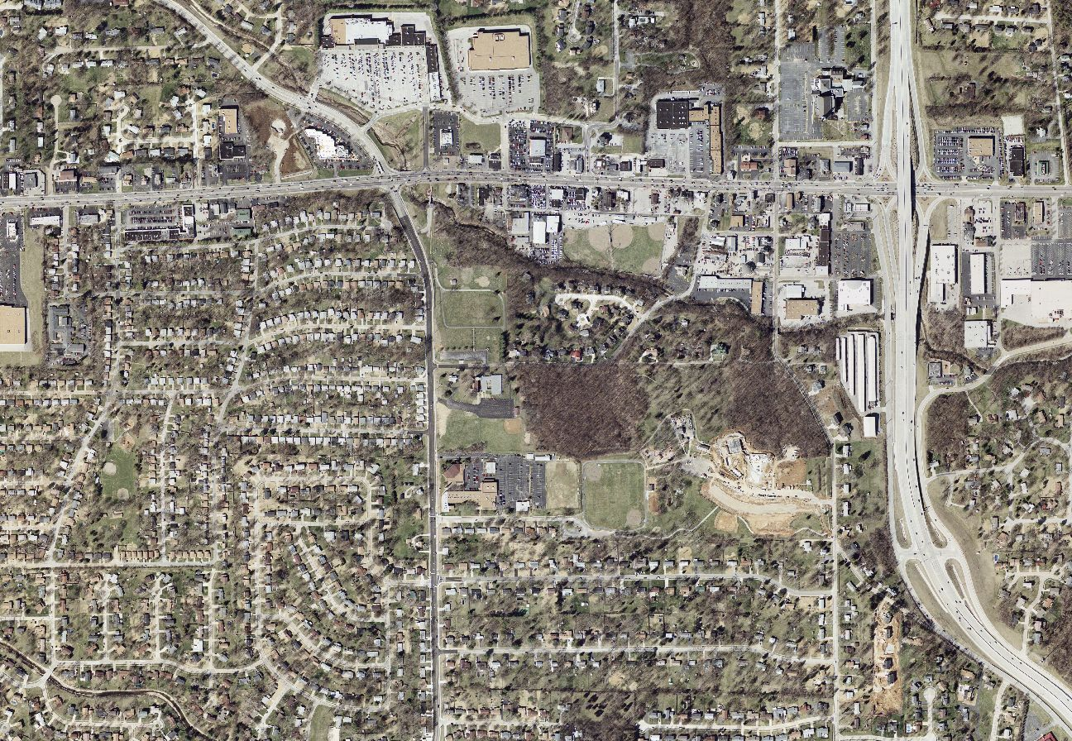

Slide 13


Slide 14
Challenges Facing TNM: Institutional
Masser and Campbell (1995)
  Variation in participant priorities
  Variation in GIS experience among participants
  Differences in spatial data handling
The more participants in a data sharing program, the greater organizational complexity (Meredith, 1995; Fountain, 2001).
Azad et al. (1995) found an inverse relationship between the interdependency of participants and the likelihood of program success.

Slide 15
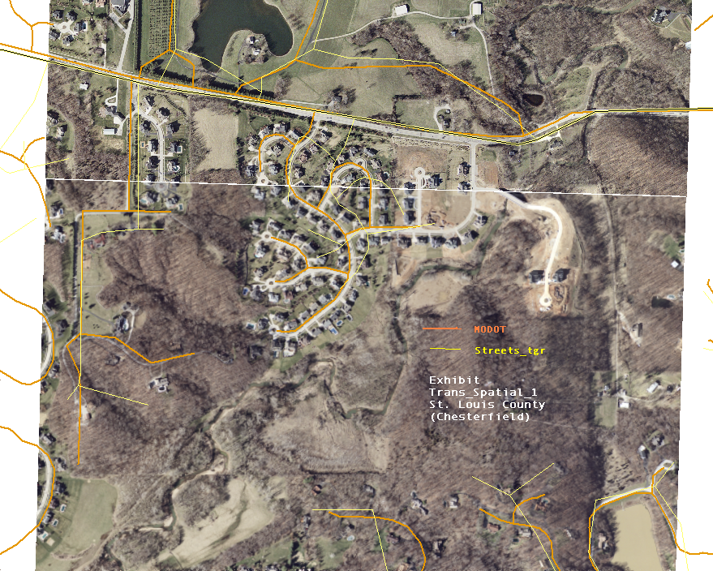
Challenges Facing TNM: Technical
Most datasets are outdated and inaccurate:

Slide 16
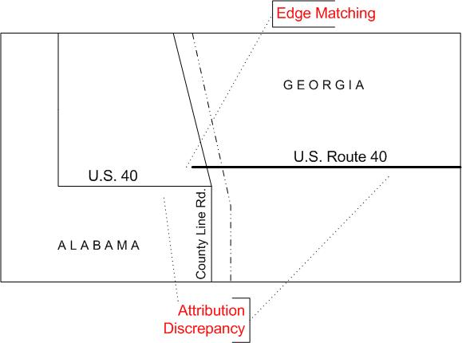
Challenges Facing TNM: Technical
Horizontal data integration:

Slide 17
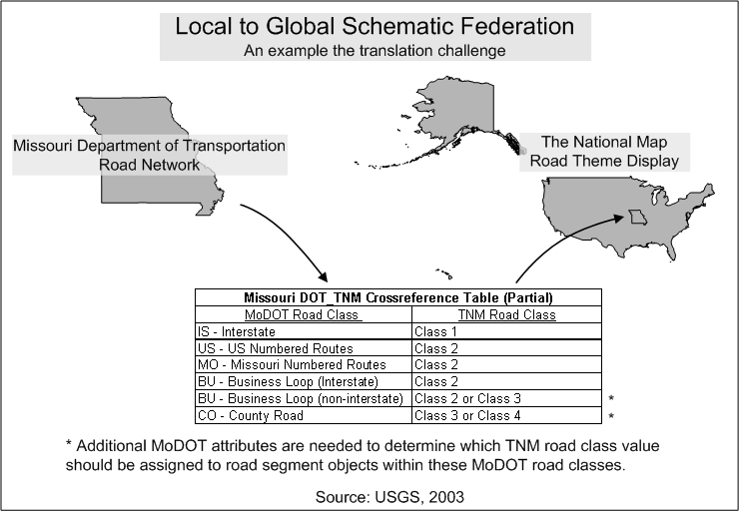
Attribute Translation from Local to Global

Slide 18
Technical Factors Complicating Integration:
Total length of coincident participant boundaries
Road network feature density at the participant boundaries
Complexity (attribute precision) of the global schema

Slide 19
Methods
Layer integration
  Determine compatible resolutions and accuracies and use metadata to automatically combine appropriate datasets
  Determine transformations possible that integrate datasets of incompatible resolutions and accuracies
  Determine limits of integration based on resolution and accuracy

Slide 20
Cartographic Transformations from Keates
Sphere to plane coordinates – projection
  Mathematical, deterministic, correctable
Three-dimensional to two-dimensional surface
  Mathematical, deterministic, correctable
Generalization
  Non-mathematical, scale dependent, humanistic, not correctable

Slide 21
Scale and Resolution Matching (Mathematical Transformations)
Working postulate: If data meet NMAS (NSSDA), then integration can be automated based on the scale ratios
  If linear ratios of scale denominators are >= ½ , then integration is possible through mathematical transformations (12 – 24 K = 0.5)
  For ratios < ½ , generalization results in incompatible differences (12 – 48 K = 0.25)

Slide 22
Generalization Issues
Selection – common features may not appear on data layers to be integrated (Topfer’s Radical Law)
Simplification – lines may contain reduced numbers of points and have different shapes
Symbolization – for map sources, symbolization may result in areas shown as lines or points
Induction – features may have been interpolated and appear differently on different sources

Slide 23
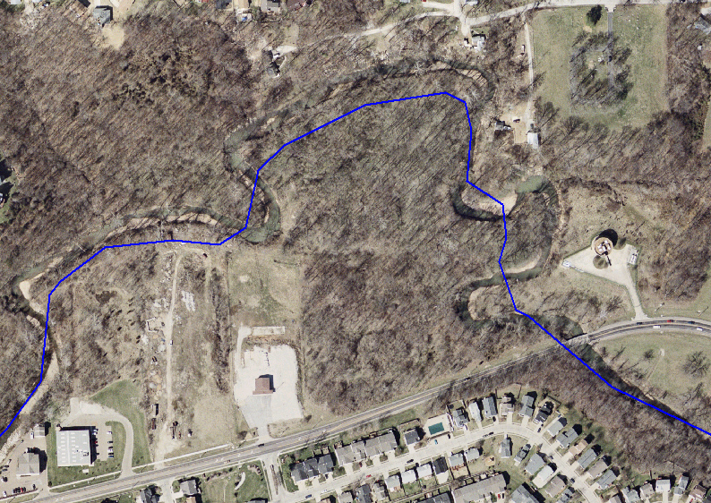
NHD on Ortho

Slide 24
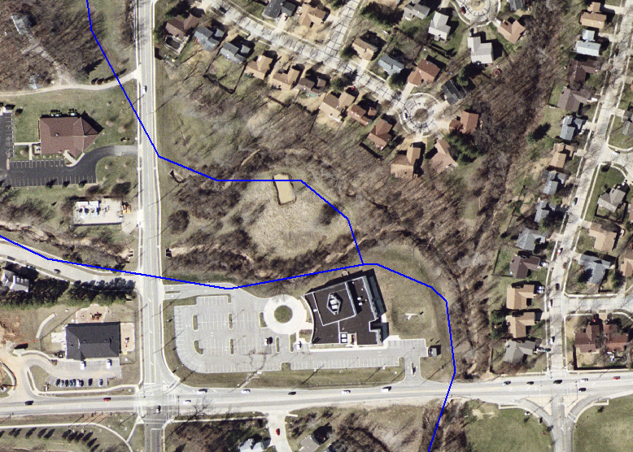
NHD on Ortho

Slide 25
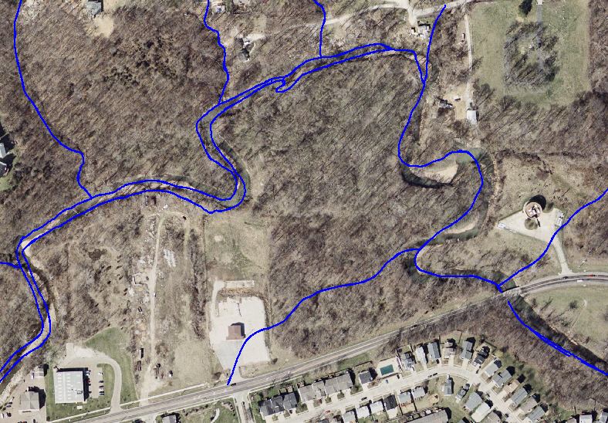
STL CO on Ortho

Slide 26
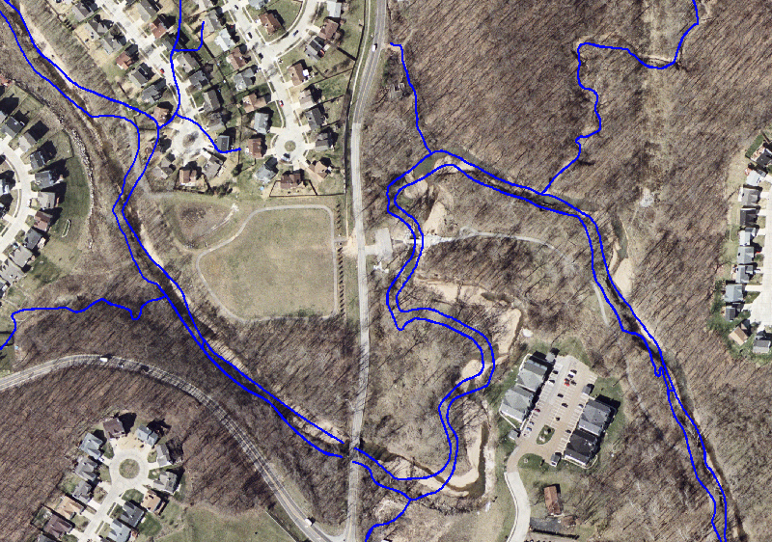
STL CO on Ortho

Slide 27


Slide 28
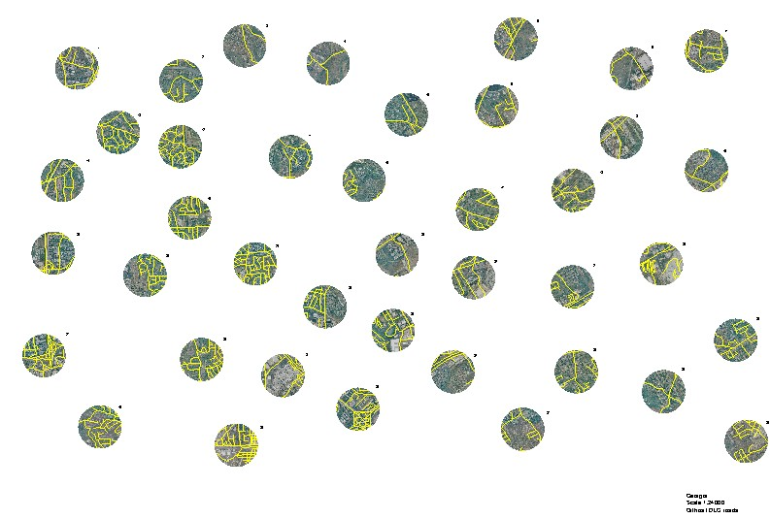

Slide 29
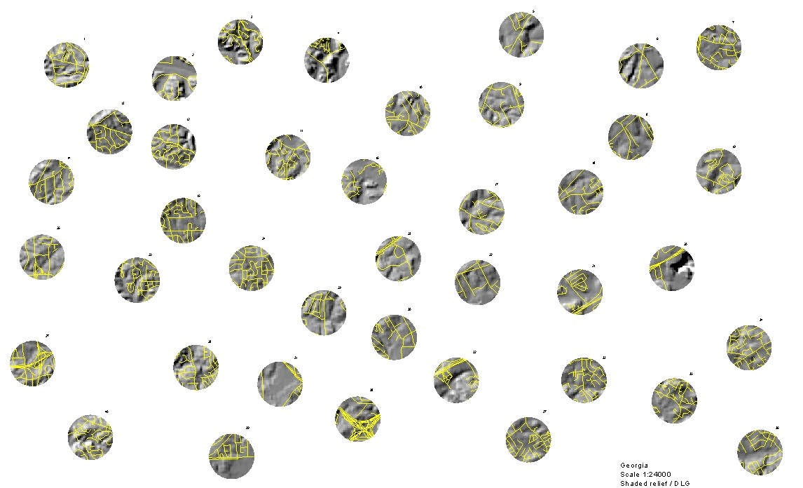

Slide 30
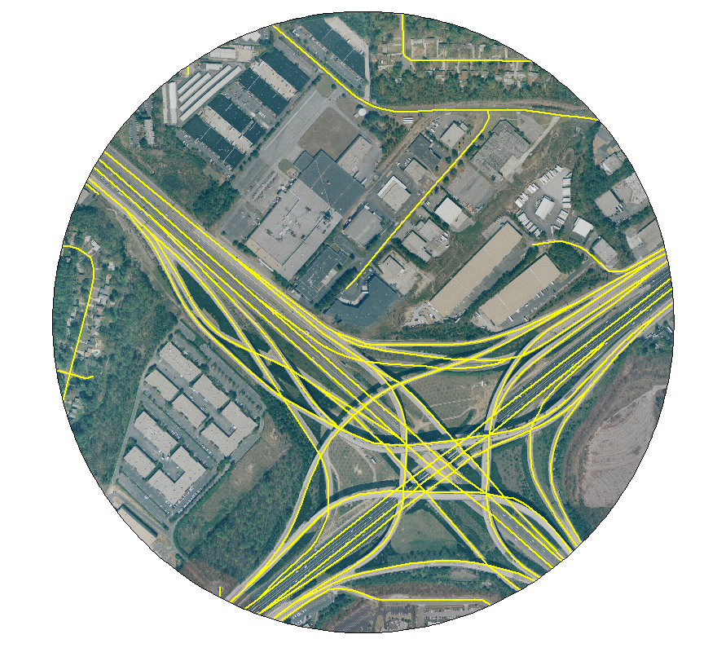
GA DOT on Ortho (12K)

Slide 31
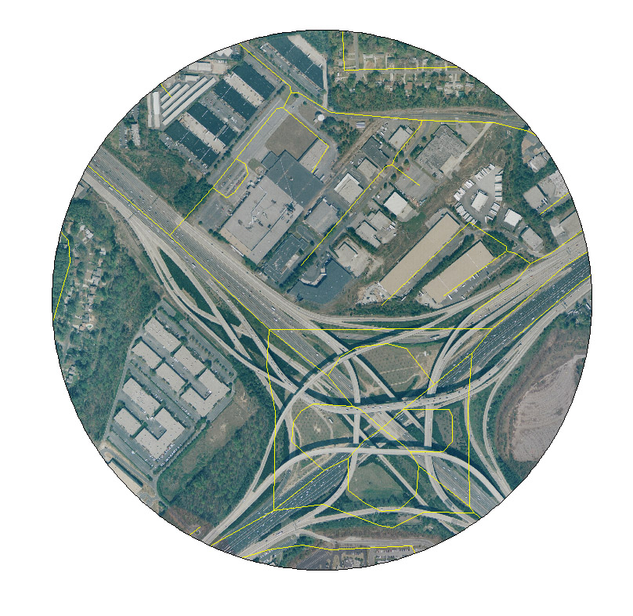
USGS DLG on Ortho (12K)

Slide 32
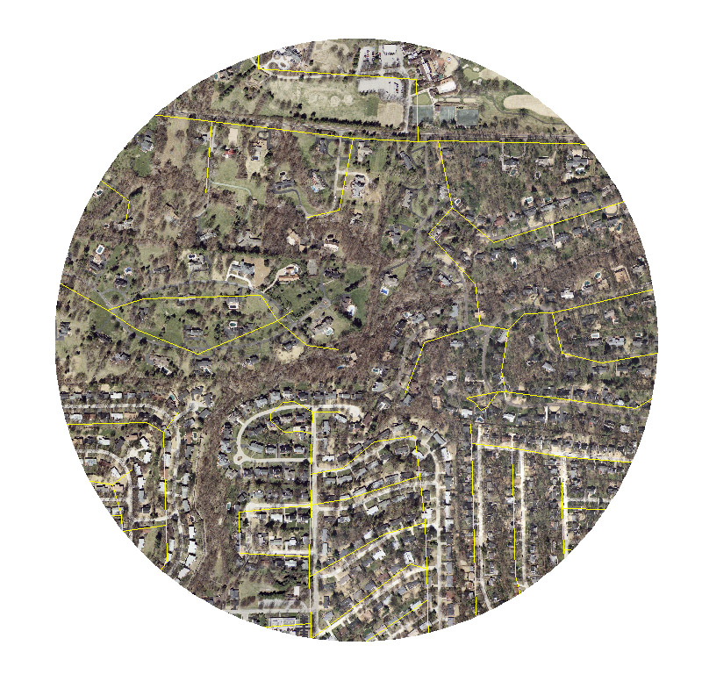
Census TIGER on Ortho (12K)

Slide 33
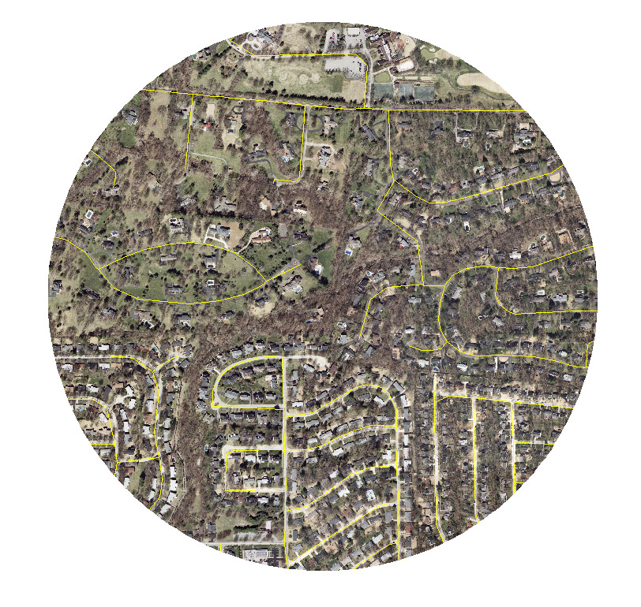
MO DOT on Ortho (12K)

Slide 34
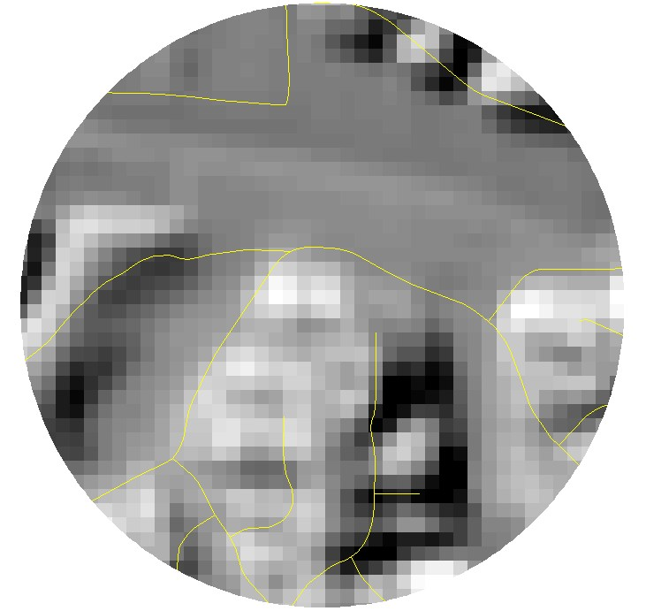
Transportation on Shaded Relief

Slide 35
Feature Integration
Metadata exists on a feature basis
  Accuracy, resolution, source are documented by feature
  Use Feature Library with an integration application

Slide 36
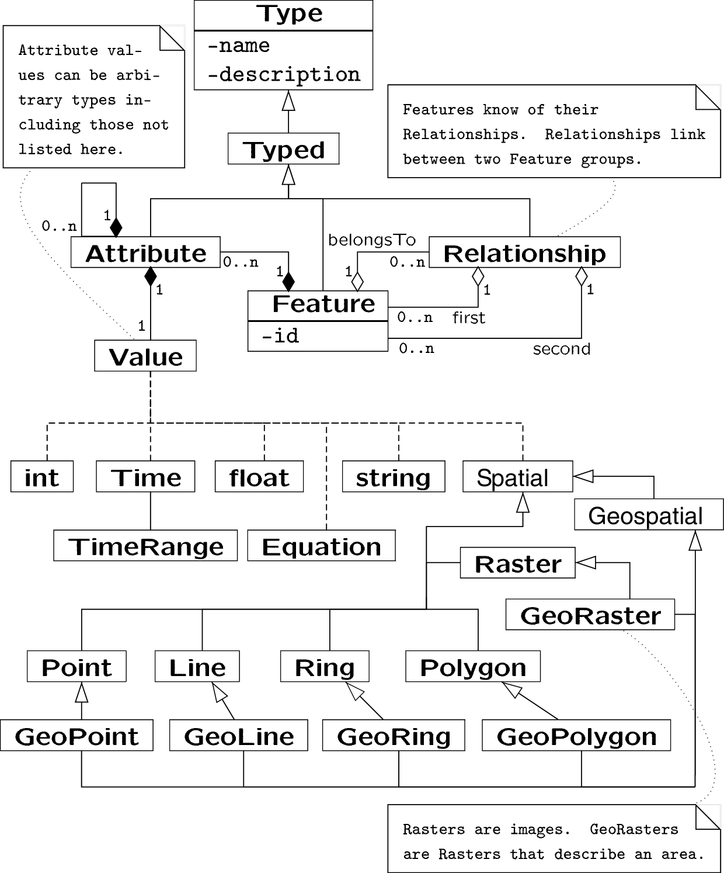

Slide 37
Conclusions
Data integration of layers for The National Map can only be accomplished with datasets that are compatible in resolution and accuracy
Mathematical transformation can automate integration with limited ranges of scales, but cannot correct generalization differences
The National Map road data will leverage the U.S. Census Bureau’s TIGER Enhancement Program and local data providers
Technical integration (horizontal and vertical) and institutional integration present many challenges to partnering

Slide 38
INTEGRATION OF THE NATIONAL MAP: DATA LAYERS AND FEATURES
27 May 2004
Michael P. Finn
E. Lynn Usery
Michael Starbuck
Gregory M. Jaromack
Bryan Weaver
http://mcmcweb.er.usgs.gov/carto_research/

Slide 40
Catalog Data Model, v1
Map Services are software, located through a URL
Partners are organizations
Layers are spatial data, managed by a service
Partners
Services
Layers
One partner can run many map services
One map service can have many data layers
Partner Examples
LMIC (MN)
Microsoft
MSDIS (MO)
USGS data programs
Service Examples
MetroGIS WMS
TerraServer USA
MSDIS WMS
USGS NHD WMS
Layer Examples
Highways
DOQ
county_boundaries
NHD_Network
106 services
2/24/04
2166 layers, 623 visible to the public
2/24/04
53 partners
2/24/04
Notes:
The catalog is essentially a database of map services
Partner, Service, Layers correspond to tables in the catalog

Slide 41
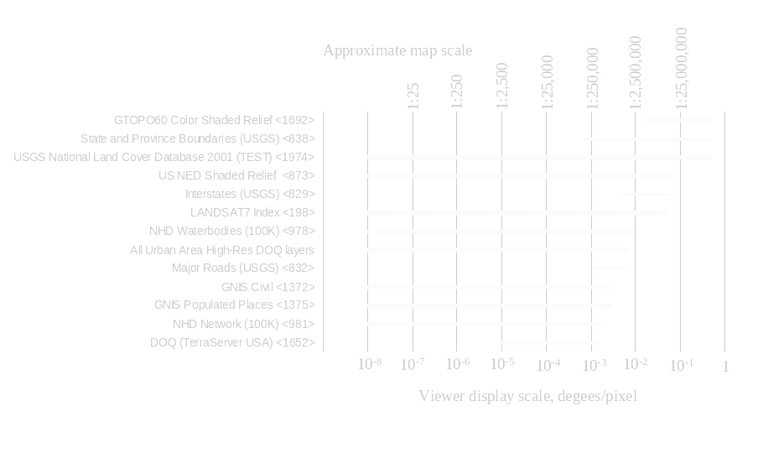

Slide 42
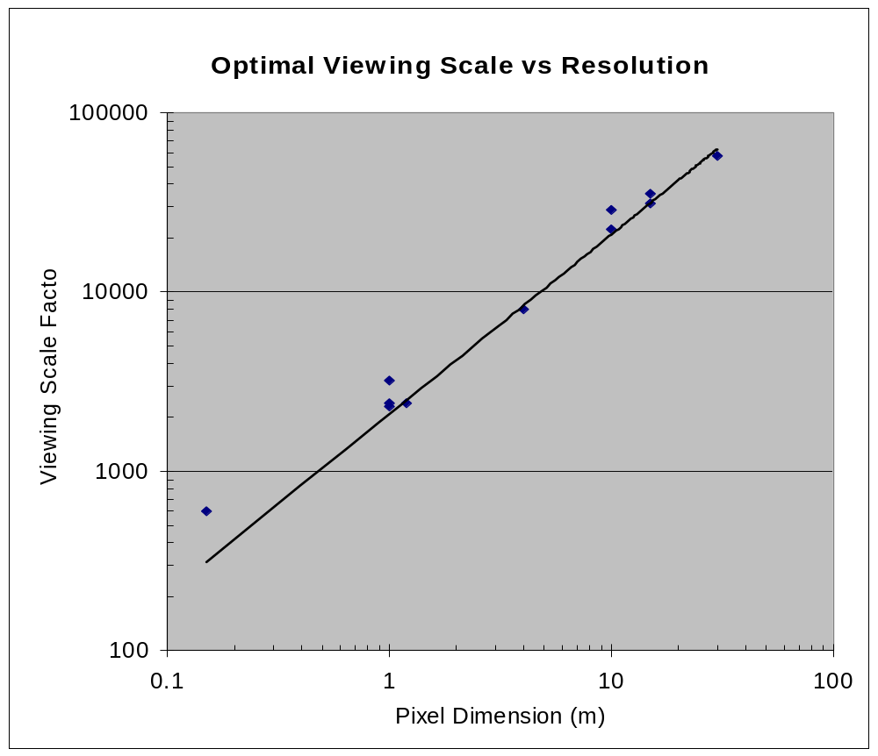
2500

Slide 43
