Slide 1
Can we expect to forecast Weeks 3 and 4?
Matt Newman
CIRES/Climate Diagnostics Center, U of Colorado and NOAA/ESRL/PSD
Collaborators: Prashant Sardeshmukh, Cécile Penland, Philip Sura, Chris Winkler, Jeff Whitaker
NOAA 32nd Annual Climate Diagnostics and Prediction Workshop, Tallahassee

Slide 2
Outline of talk
Study of the mechanics of the atmosphere
Search for elusive empiric periodicities

Slide 3
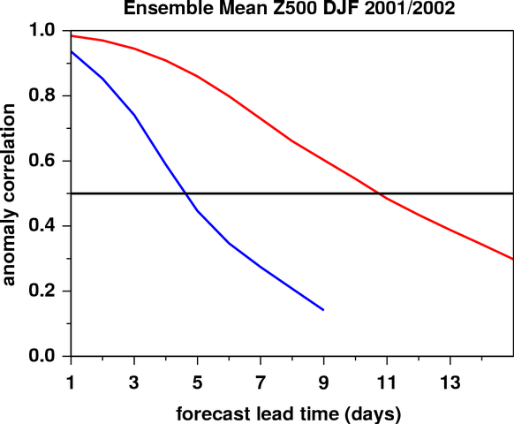
Daily vs. extended range forecast skill
Forecast skill
Most skill is lost for “short-waves” for a 5-day forecast.
“long-waves” skillful well into week 2.
Obvious point: Weeks 3 and 4 forecasts will mostly be of large-scale dynamics
“long-waves”
“short-
waves”
Figure courtesy Jeff Whitaker

Slide 4
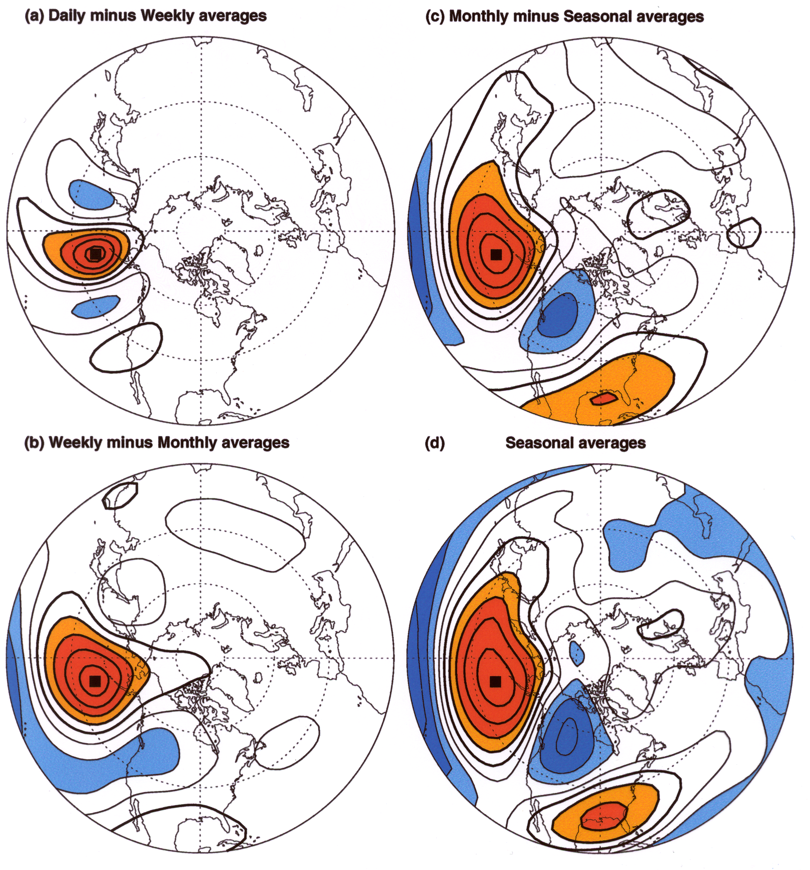
Teleconnections: high-frequency vs. low-frequency
Differences between
synoptic and climate variability appear on timescales as short as a week
Synoptic
Monthly
The maps show the
correlation of the “band-pass
filtered” 500 mb anomaly
height time series at all
points on the hemisphere with
the time series at a
north Pacific “base point”.
Positive correlations
are indicated by red and
negative correlations by
blue colors.
Weekly
Seasonal
Figure courtesy Gil Compo

Slide 5
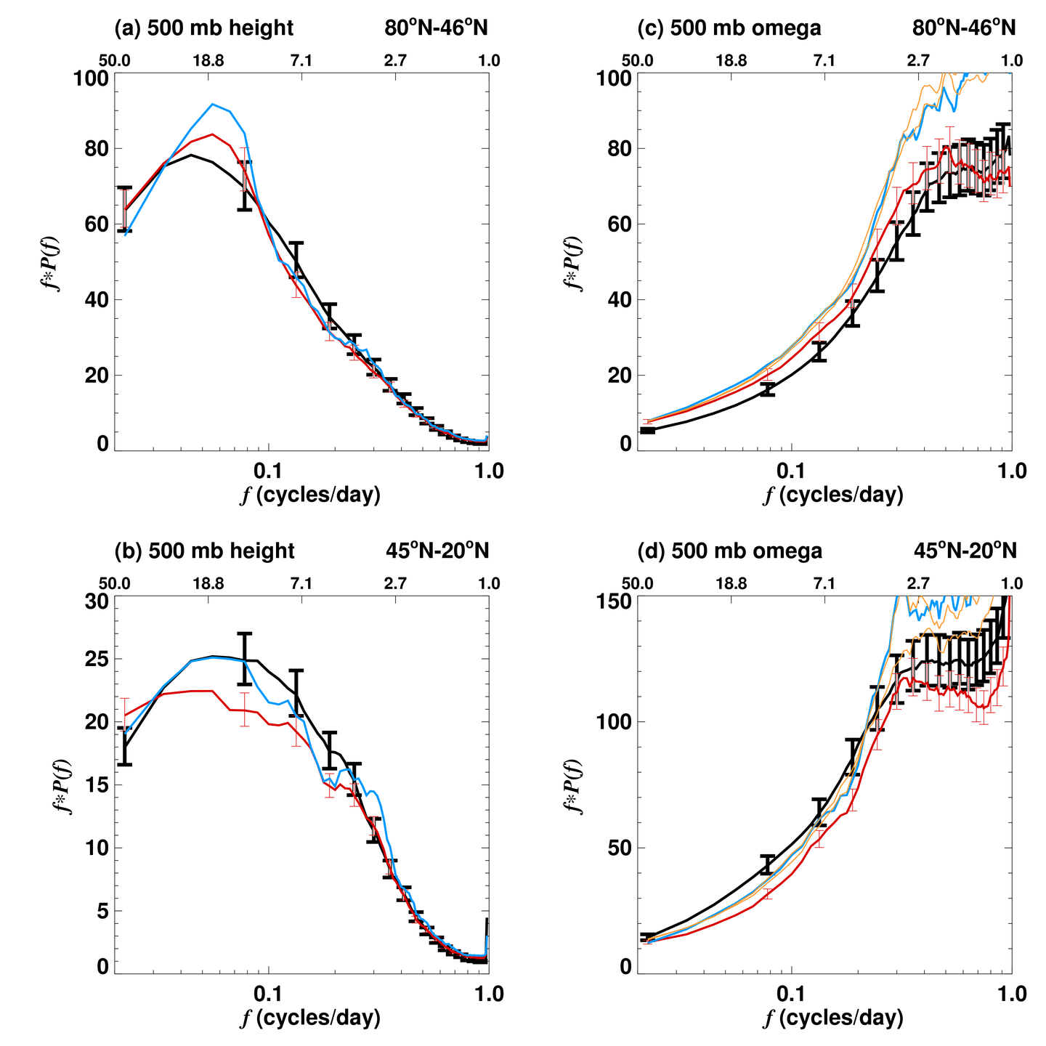
Separation of scale: baroclinic and barotropic
Variance-conserving spectra of 500 mb height (left) and omega (right), averaged in high and mid latitudes
500 mb Φ
500 mb ω
Figure courtesy Gil Compo

Slide 6
Motivation
Consider the dynamical system describing the variable x,
dx/dt = N(x) + F (N is a nonlinear operator and F is external forcing)
This can always be rewritten as
dx/dt = slow nonlinearity + fast nonlinearity
If:
we are only interested in the slowly evolving portion of x
and there is a big difference between “fast” and “slow”
this may be usefully approximated as
dx/dt = Lx + white noise

Slide 7
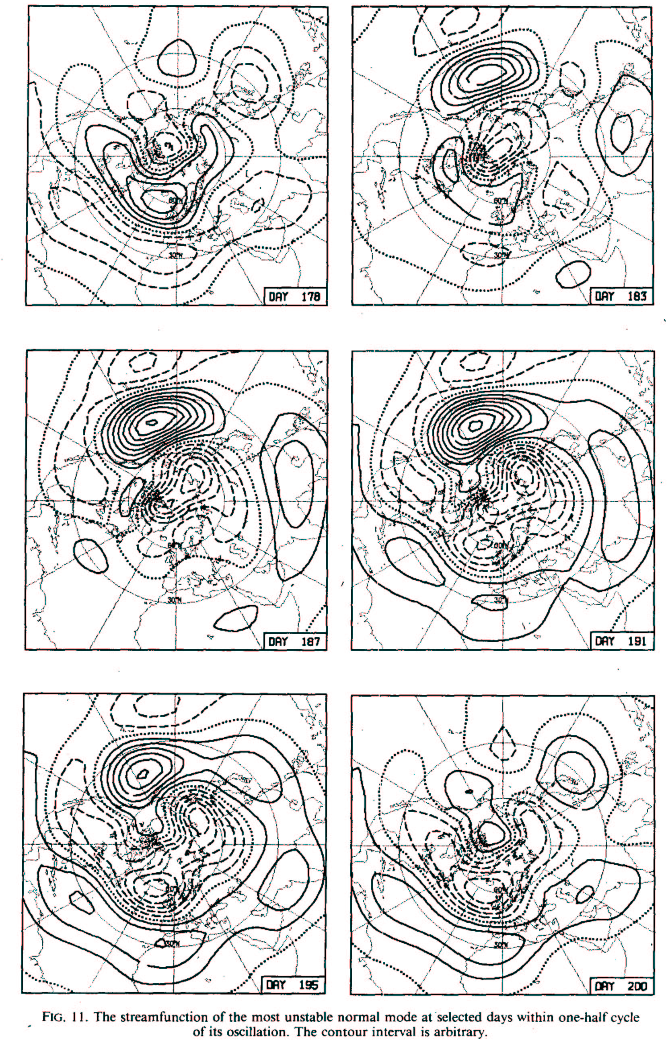
Barotropic eigenmode
Assume dx/dt = L_{B}x + F_{s} where L_{B} represents linear barotropic dynamics.
Then weekly variations result from the least damped (closest to neutral) eigenmodes of L_{B}.
Simmons, Wallace, and Branstator 1983

Slide 8
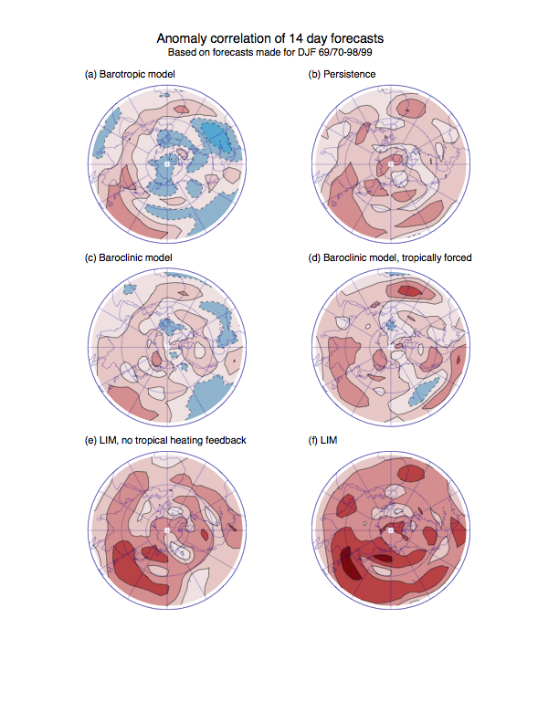
Problem: Barotropic dynamics alone can’t explain time evolution
Solution (?): A different linear operator: dx/dt = Lx + F
[but a linear baroclinic L is only slightly better] and/or a second model for the forcing: dF/dt = MF + ξ_{s}
Week 2 skill (250 hPa)
c.i.=0.15; blue < 0
Barotropic model
Persistence
Winkler, Newman, and Sardeshmukh 2001

Slide 9
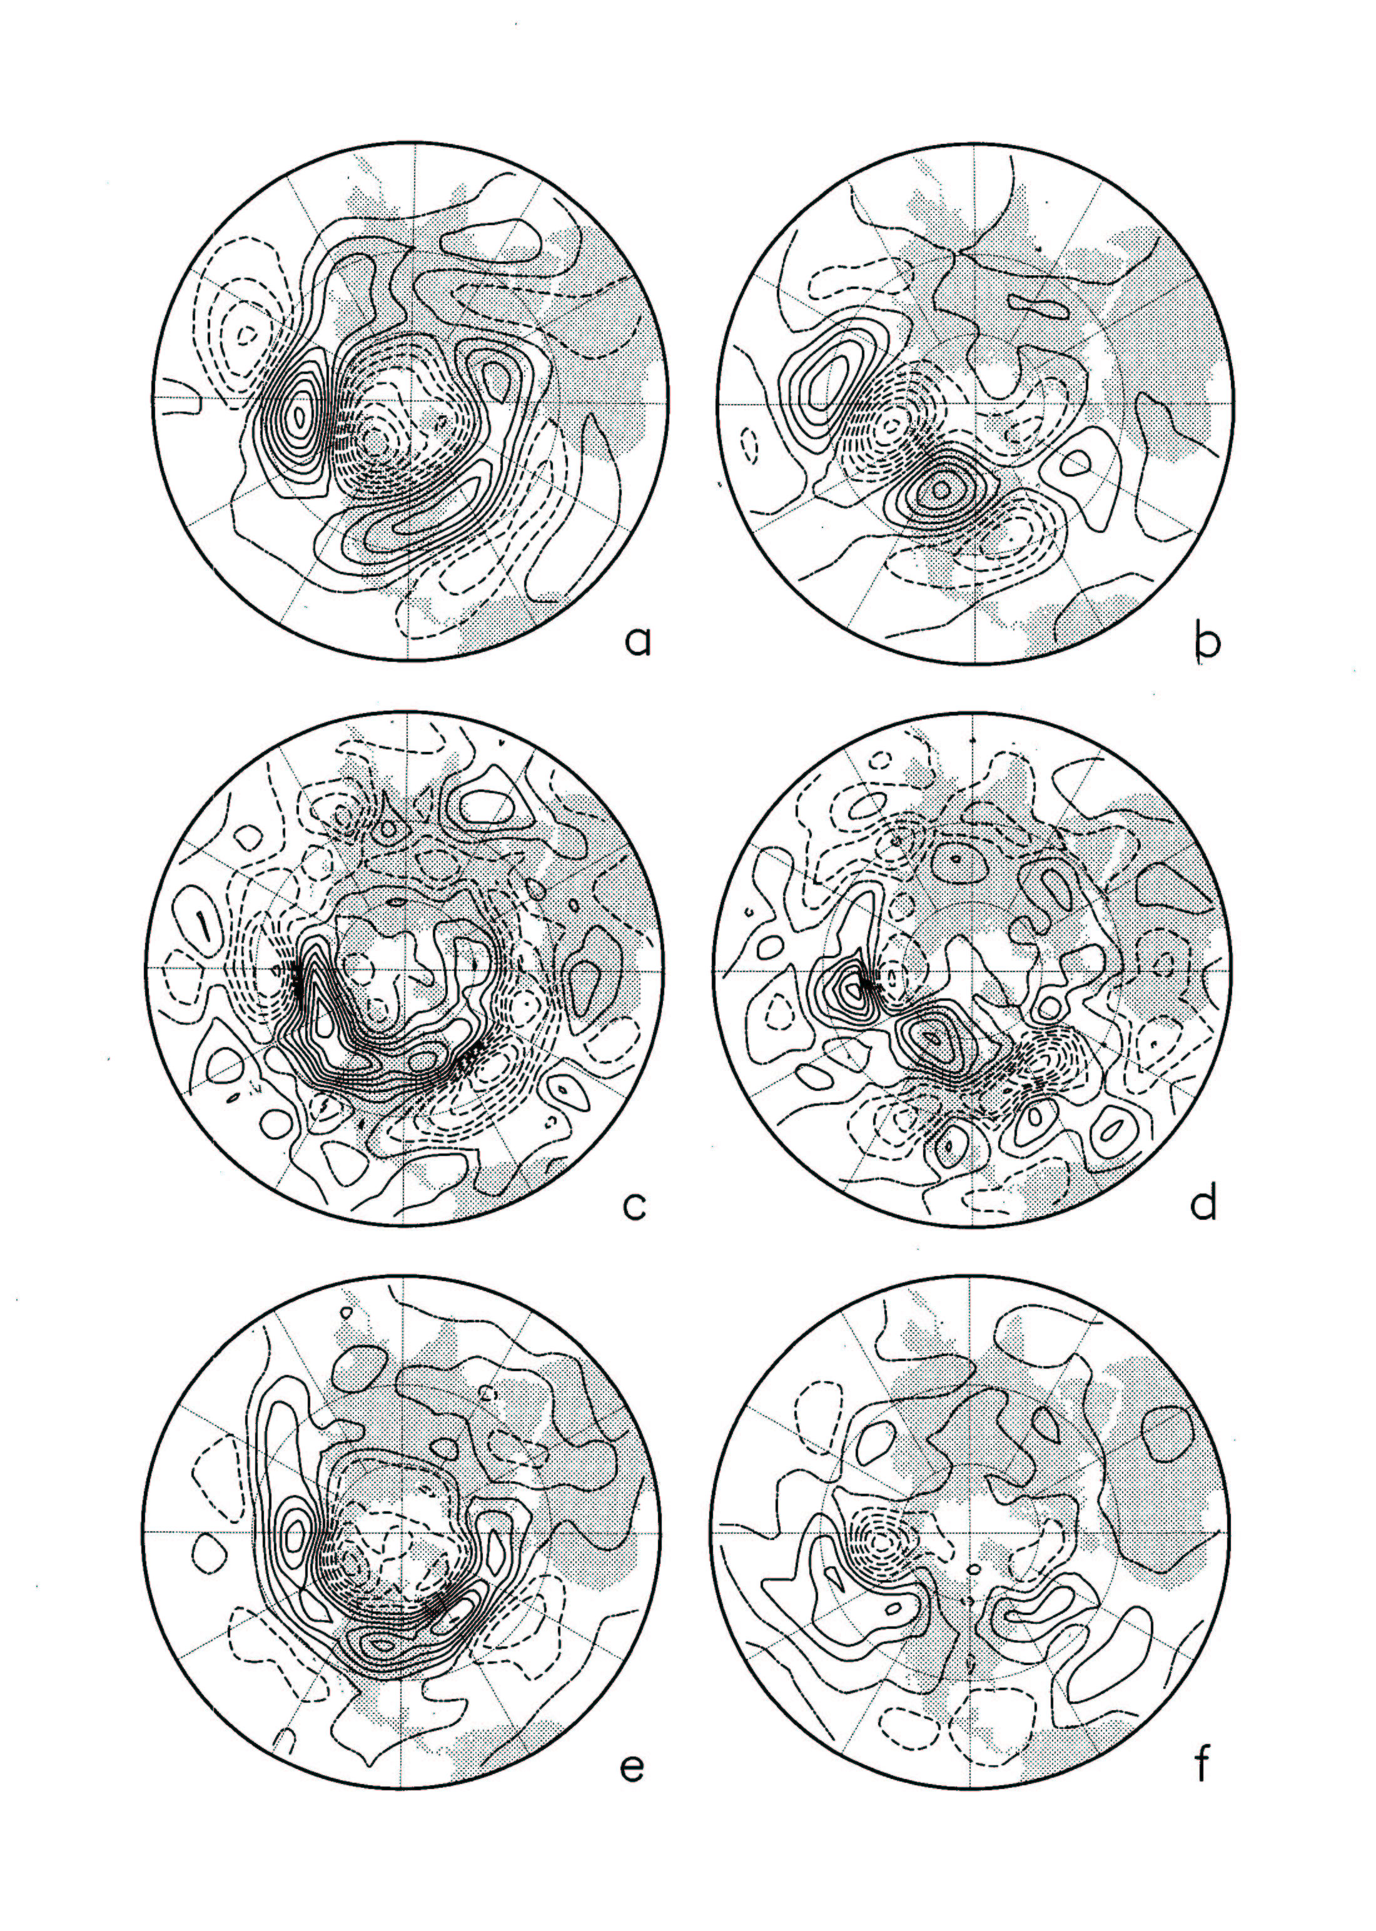
Change L: include linear parameterization of transient eddy feedback
Synoptic eddy feedback favors the development of some anomalies (left) but not others (right) in perpetual January GCM run
300 mb streamfunction anomaly
Streamfunction tendency due to synoptic eddies
Branstator 1995
Notes:
From Branstator (1995). Results from 200 month perpetual January run.
Observationally, it’s hard to separate cause/effect with feedback.

Slide 10
Candidates for “boundary forcing” to extratropical troposphere
Surface anomalies
  SST
  Soil moisture anomalies (warm season)
  Sea ice/snow cover anomalies (seasonal)
Tropical heating
  Driven by SST (e.g., ENSO)
  Atmospheric phenomena (e.g., MJO)
Stratospheric anomalies
These act all at the same time and not independently.

Slide 11
Two ways to determine L
“Forward method” -- derive L from a physical model (including linear parameterization of nonlinear terms)
This may be difficult.
“Inverse method” -- derive L from observed statistics of both extratropical anomaly and “forcings”
This may be easier, but is not pain-free.

Slide 12
Linear inverse model (LIM)
If the climate state x evolves as
dx/dt = Lx + F_{s}
Then τ₀-lag and zero-lag covariance are related as
C(τ₀) = exp(Lτ₀) C(0)
So we can solve for L.
Test of linearity: for much longer lags τ, is
C(τ) = exp(Lτ) C(0) ?
x(t) = 86-component vector whose components are the time-varying
coefficients of the leading slp, ψ_{T} (250 and 750 hPa), H, and ψ_{S} (30 hPa)
PCs of 7-day running means.
L is thus a
86x86 matrix
Trained on 5-day lag

Slide 13
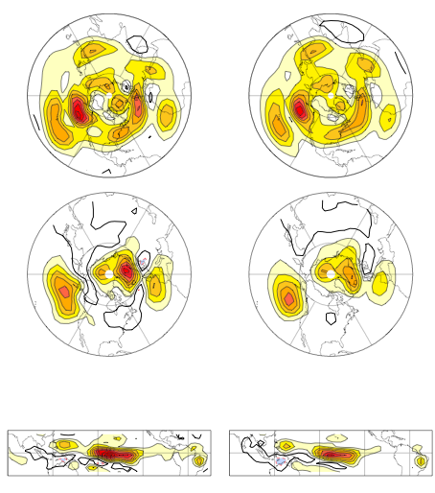
Dynamics are effectively linear
Observed 21-day lag covariance
(left) reproduced by the LIM (right)
Observed
LIM
250 hPa ψ
slp
Heating
Newman and Sardeshmukh 2007

Slide 14
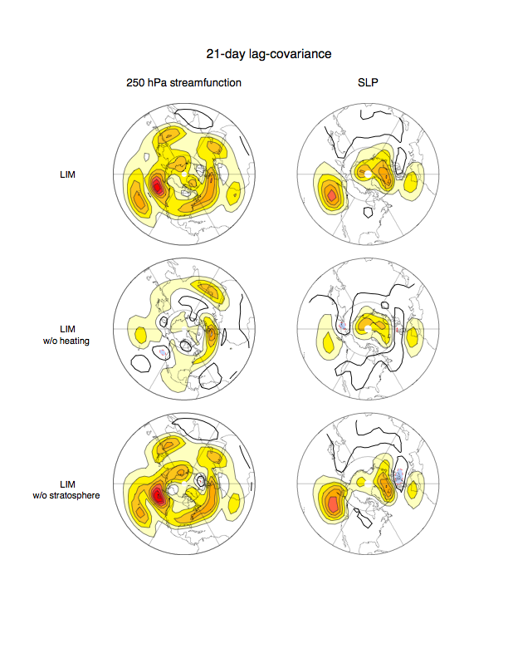
Heating is responsible for most of the persistent variability captured by this LIM
Top:
LIM 21-day lag covariance
Middle:
LIM 21-day lag covariance, effects of H removed from L
Bottom:
LIM 21-day lag covariance, effects of ψ_{s} removed from L
250 hPa ψ
slp
LIM
LIM
w/o
Heating
LIM
w/o
Strat.
Newman and Sardeshmukh 2007

Slide 15
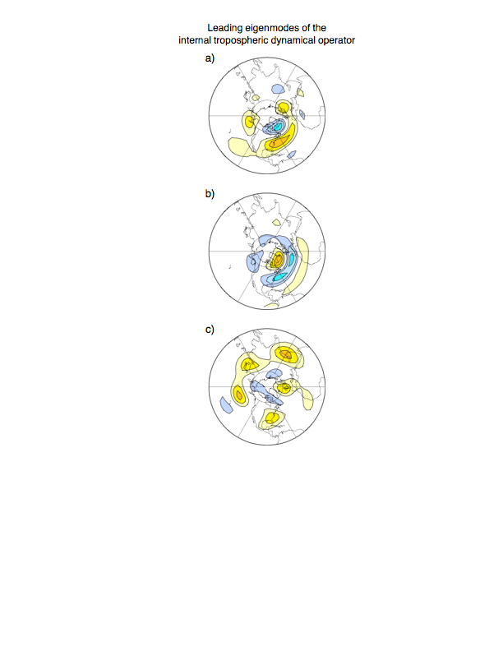
Remaining persistence due to “internal” extratropical dynamics
Leading eigenmodes of “troposphere-only” portion of L correspond to remaining persistence
Newman and Sardeshmukh 2007

Slide 16
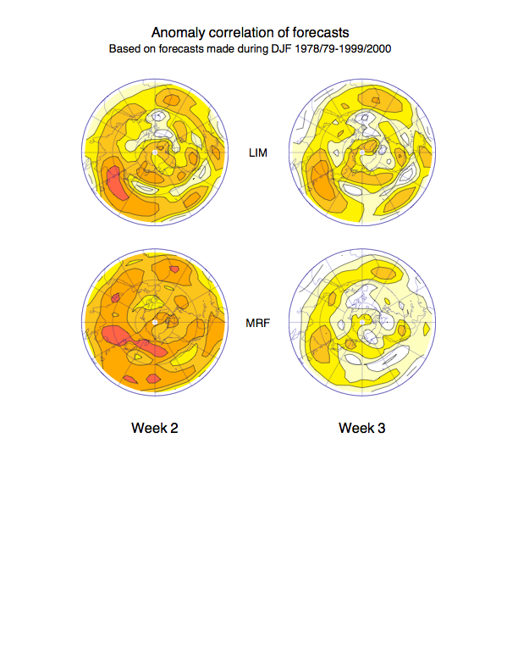
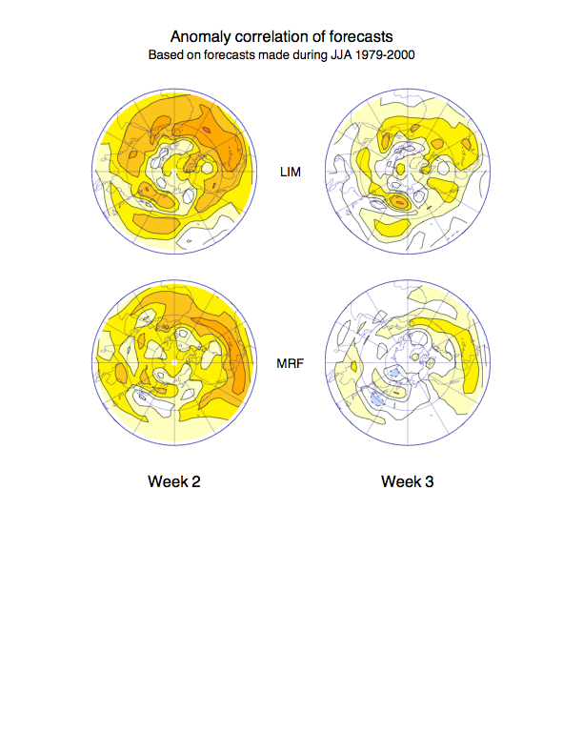
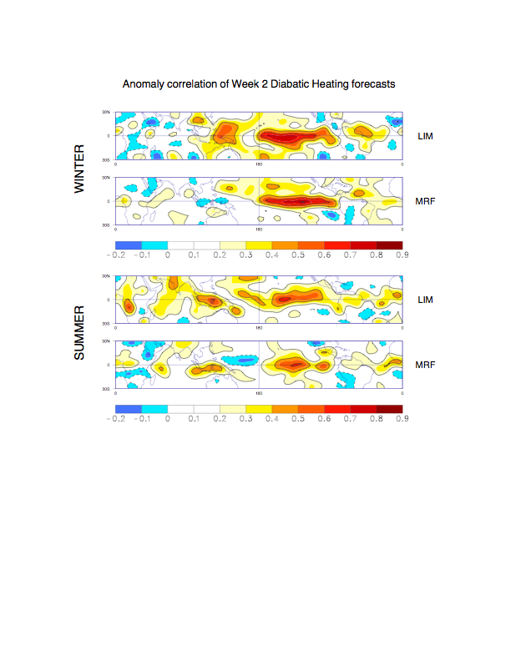
Week 3 250 hPa ψ skill, LIM and Reforecast (1979-2000)
WINTER
SUMMER
LIM
(cross-validated)
Reforecast
Newman, Sardeshmukh, Winkler, and Whitaker 2003

Slide 17
Even if the climate system is exactly effectively linear, why does the LIM outperform the GCM at Week 3?
[Or, are there sources of skill that may be exploited in future GCMs?]
Tropical heating forecast skill in LIM
No climate drift in LIM

Slide 18
Week 2 TROPICAL skill, LIM and Reforecast
LIM
Reforecast
LIM
Reforecast
Newman, Sardeshmukh, Winkler, and Whitaker 2003

Slide 19
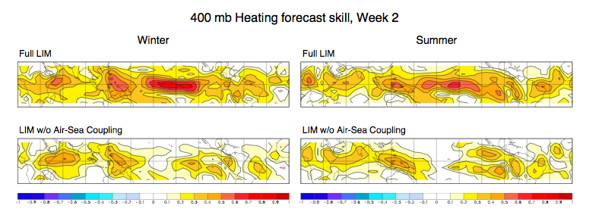
Week 2 skill from tropical “C-LIM”
Different state vector: 3 levels each of tropical heating, streamfunction, velocity potential, plus SST (38 PCs)
Diabatic heating forecast skill severely degraded without air-sea coupling, but this is mostly due to lack of ENSO SST forcing.

Slide 20
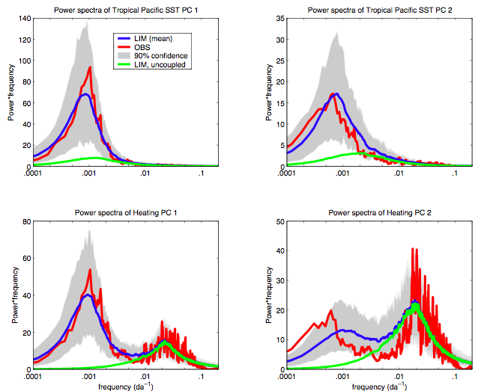
Power spectra of leading SST, heating PCs
Test of linearity: LIM trained on 1-week lag reproduces 40-50 day and 4-7 yr spectral peaks.
Without coupling:
SST variability is
weakened and
peak period is shorter.
Heating variability on subseasonal timescale is minimally altered.

Slide 21
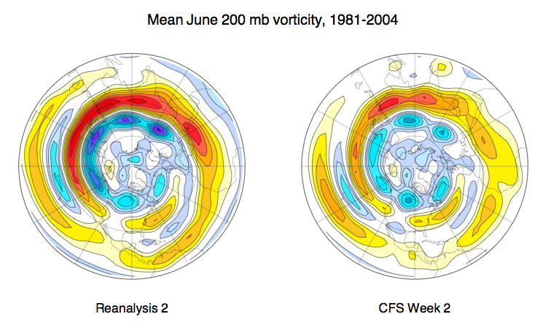
Week 2 June climate drift

Slide 22
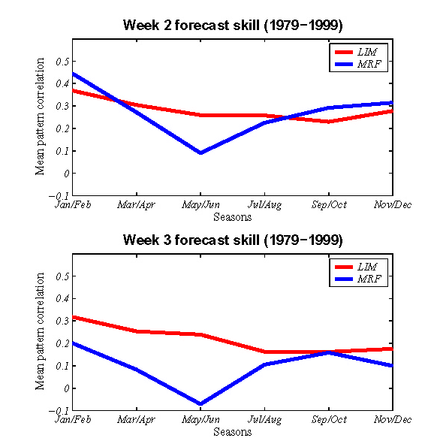
Seasonal cycle of LIM, Reforecast skill
Skill of LIMs (red line) constructed
for two-month “seasons” compared to reforecast skill (blue line).
Skill measure is pattern correlation of 250 hPa streamfunction in Northern Hemisphere between 120E-60W.
J/F
M/A
M/J
J/A
S/O
N/D

Slide 23
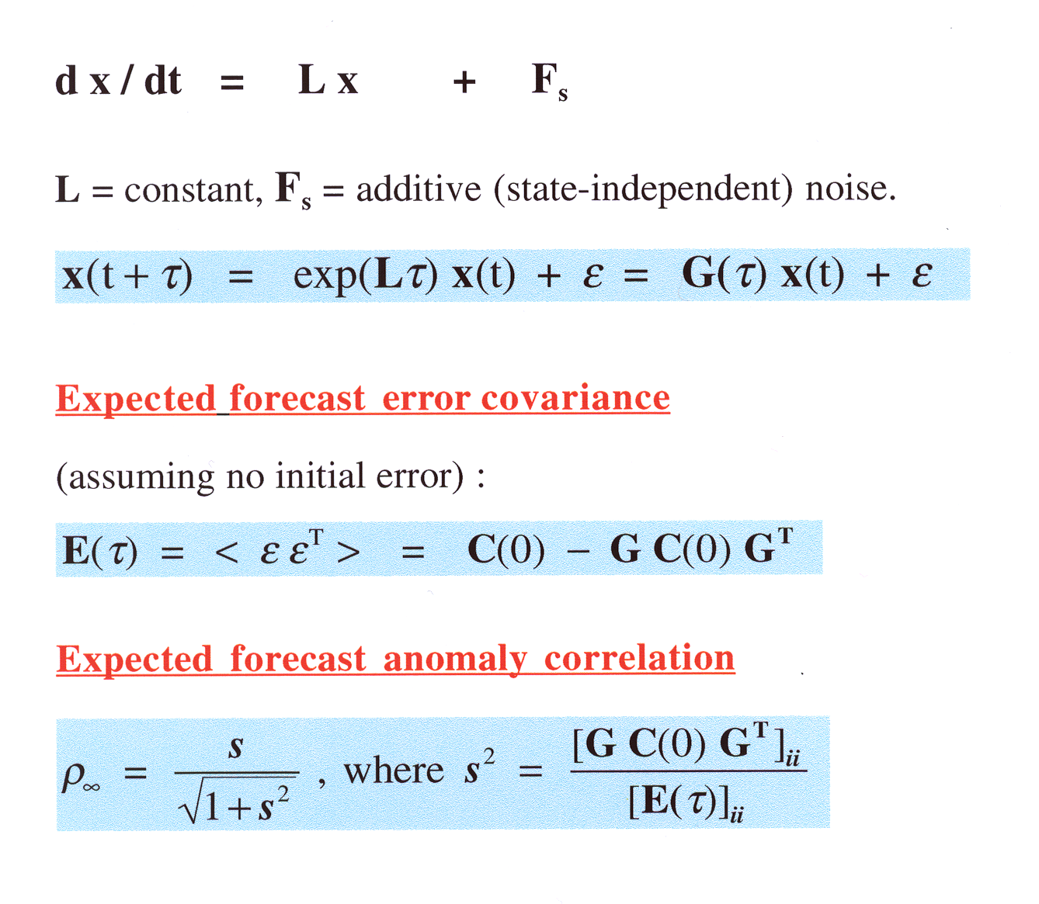
Predicting skill within the LIM
“signal”
“noise”

Slide 24
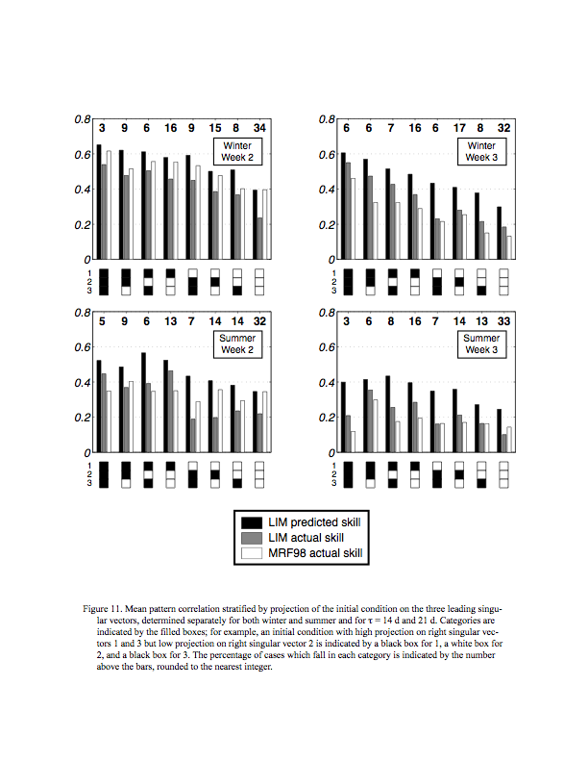
Predicting Week 3 skill
Comparing predicted LIM forecast skill with actual LIM and reforecast skill (pattern correlation of NH 250 hPa ψ)
WINTER
SUMMER
Poorer LIM summer skill: reality or due to missing land obs?

Slide 25
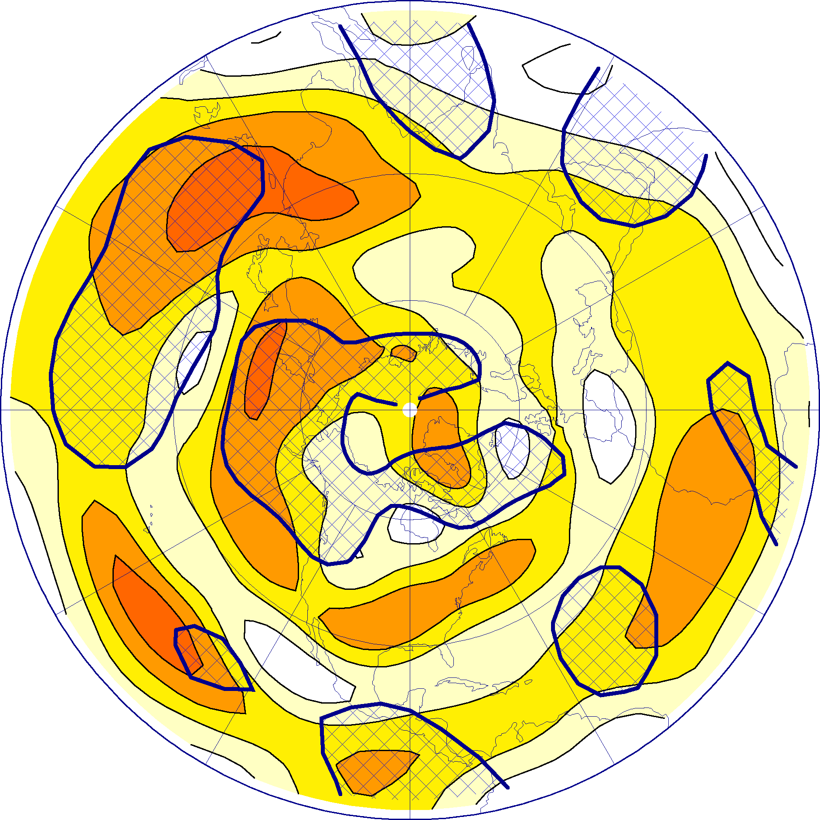
LIM is skillful even where the PDF is non-Gaussian
Color Shading:
Wintertime Week 3 LIM forecast skill, 250 hPa ψ
Hatching:
where the streamfunction PDF is non-Gaussian (by the K-S criterion, 95% significant)
Sura, Newman, Sardeshmukh, and Penland 2004

Slide 26
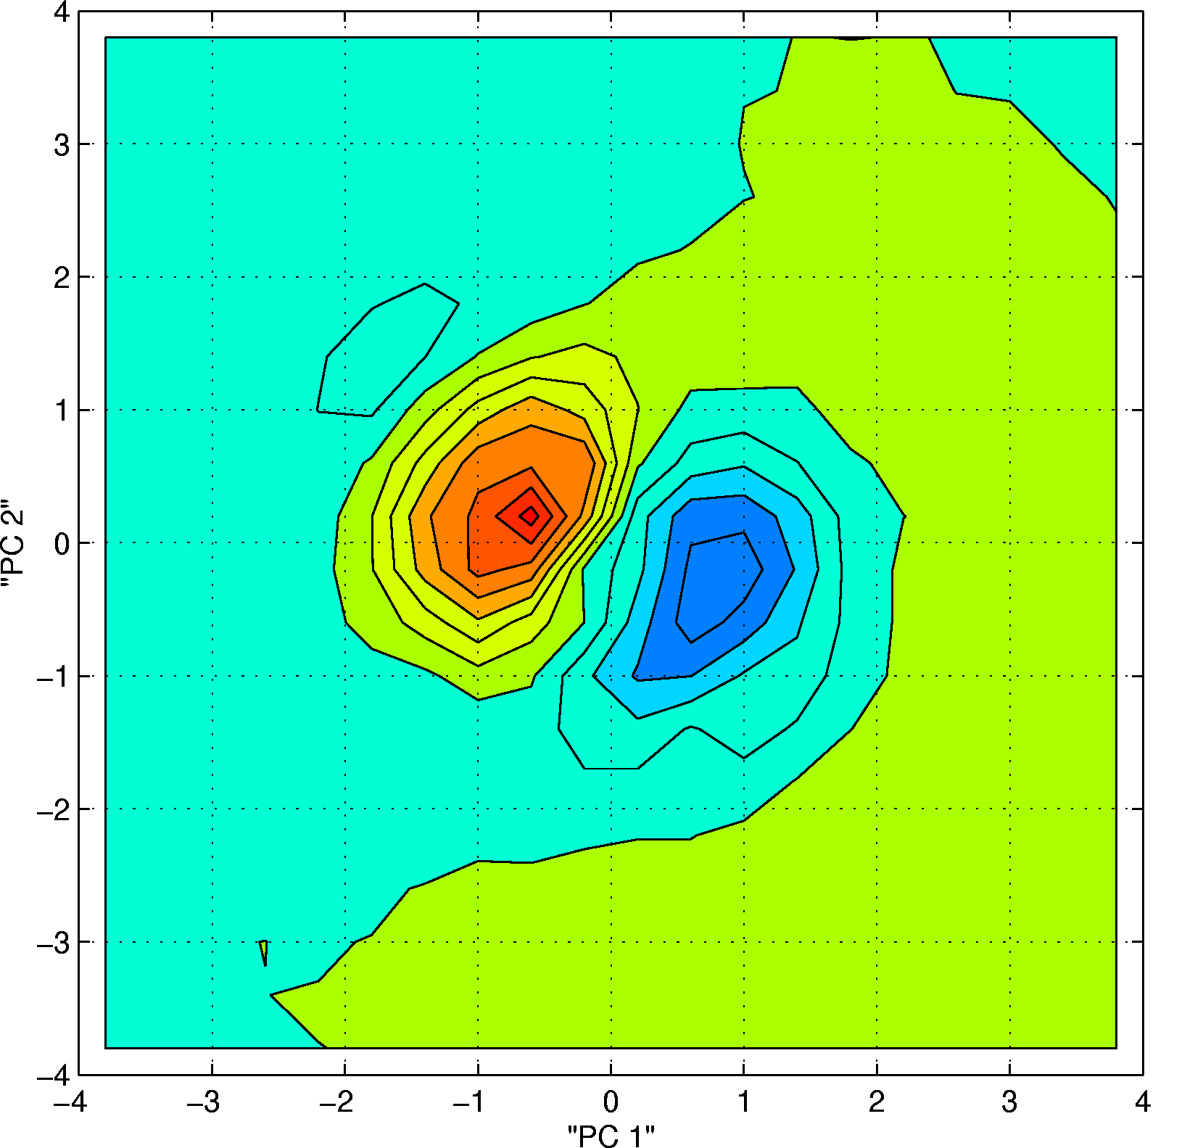
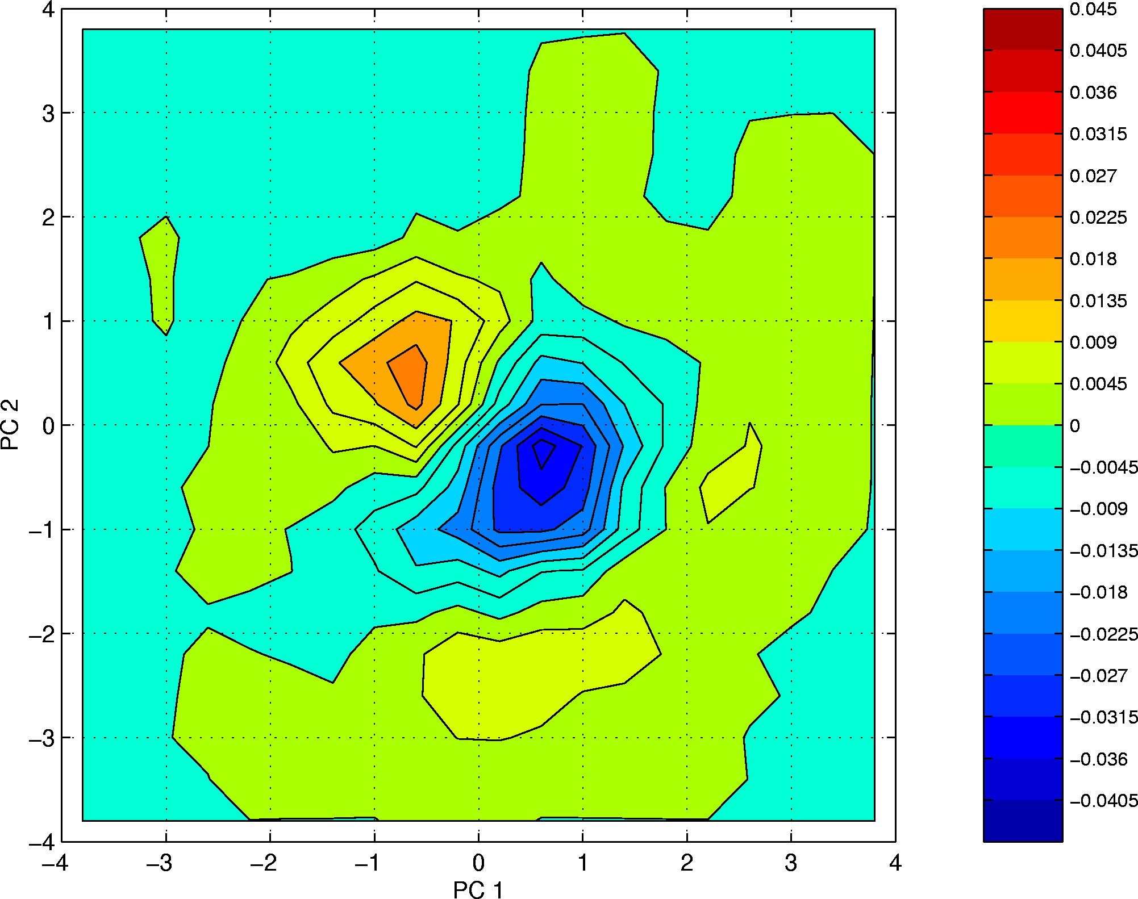
Observed departures from Gaussianity can be mimicked by linear multiplicative noise (can be part of L)
Departure from Gaussianity of joint pdf derived from least damped barotropic mode (period=33 days, eft=14 days) with some stochastic damping and steady forcing
Departure from Gaussianity of
Joint p.d.f of first two EOFs of
750 mb streamfunction, DJF
1950-2002
Sura, Newman, Sardeshmukh, and Penland 2004

Slide 27
Can we expect to forecast Weeks 3 and 4?
Yes, but:
Empirical models (LIM + others in Tropics) appear to still have better forecast skill than GCM
But there are may be areas of nonoverlapping skill (particularly for skewed distributions), and/or we may use more skillful tropical LIM forecasts to nudge GCM.
Extratropical forecast skill is modest on average
But there are cases when the skill is relatively high. These cases can to some extent be identified a priori and provide forecasts of opportunity.
As GCM skill surpasses LIM, predictability estimates from LIM may remain useful
But in the mean time, Week 3 and Week 4 forecasts may be made now.

Slide 28
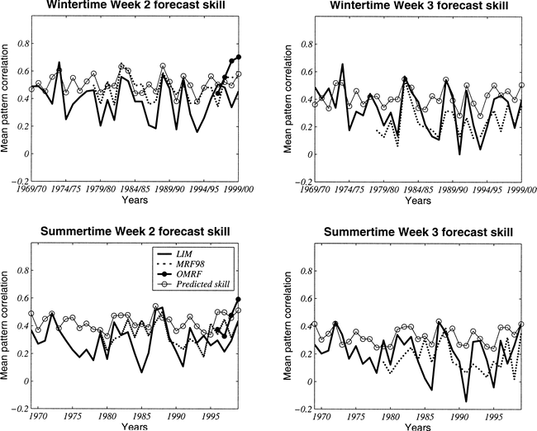
Week 3 skill not all ENSO
Predictability Variations: Winter vs. Summer
Solid: LIM (Actual) Circles: LIM (predicted) Dotted: Reforecast
ENSO: Red arrows warm events; Blue arrows cold events

