Slide 1


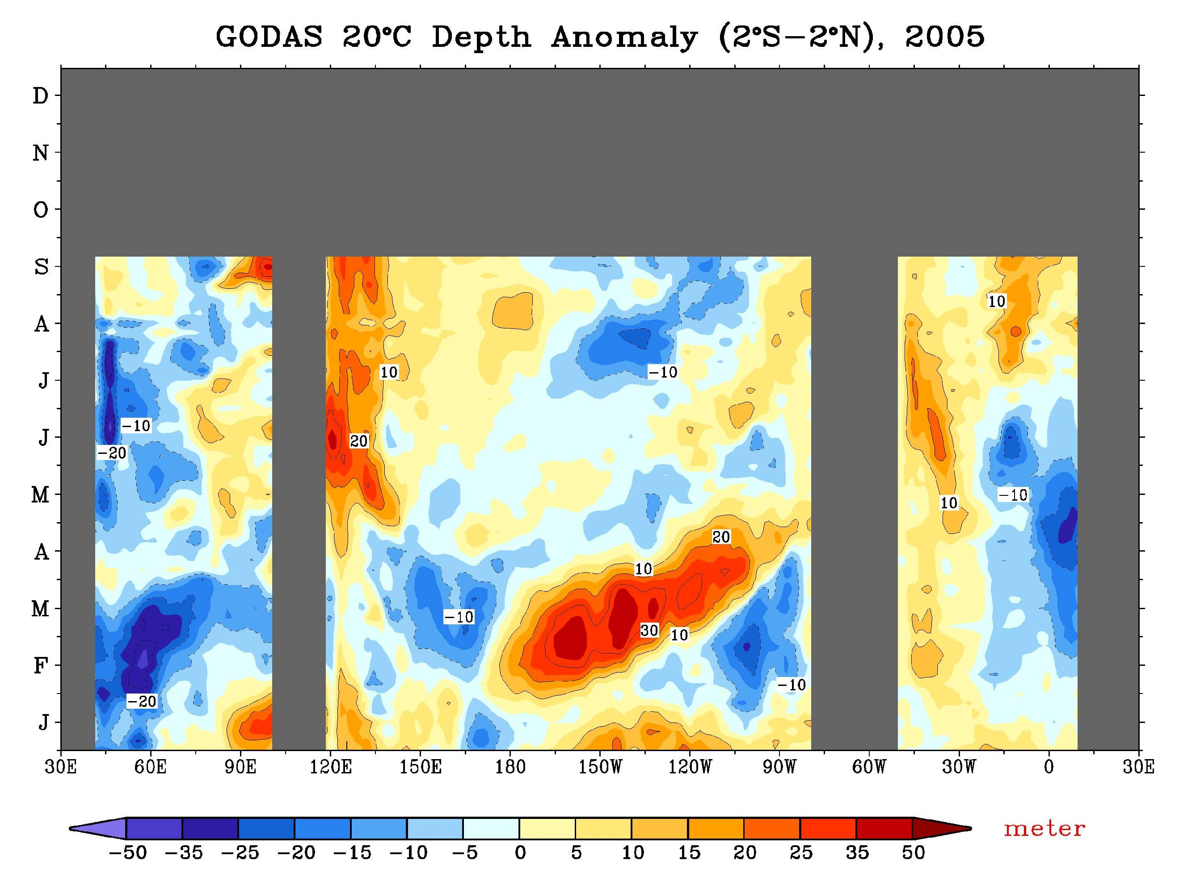
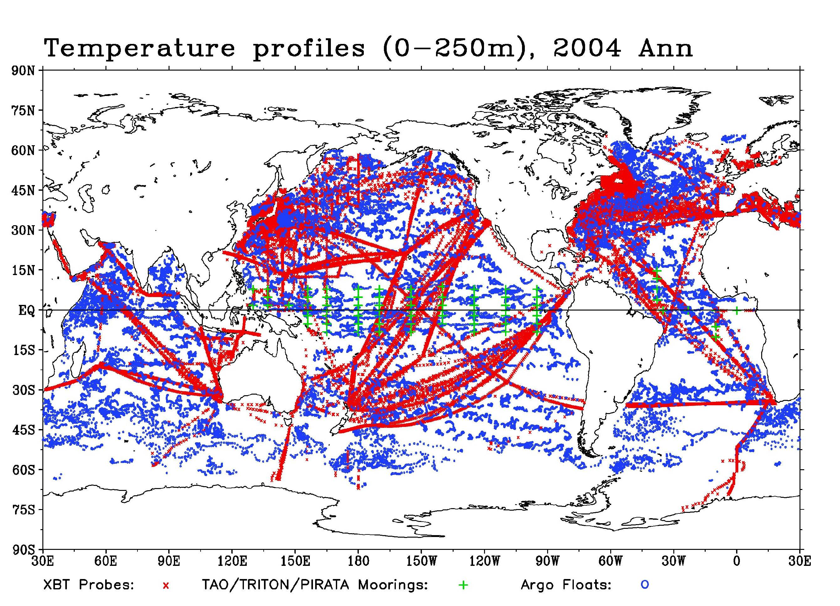
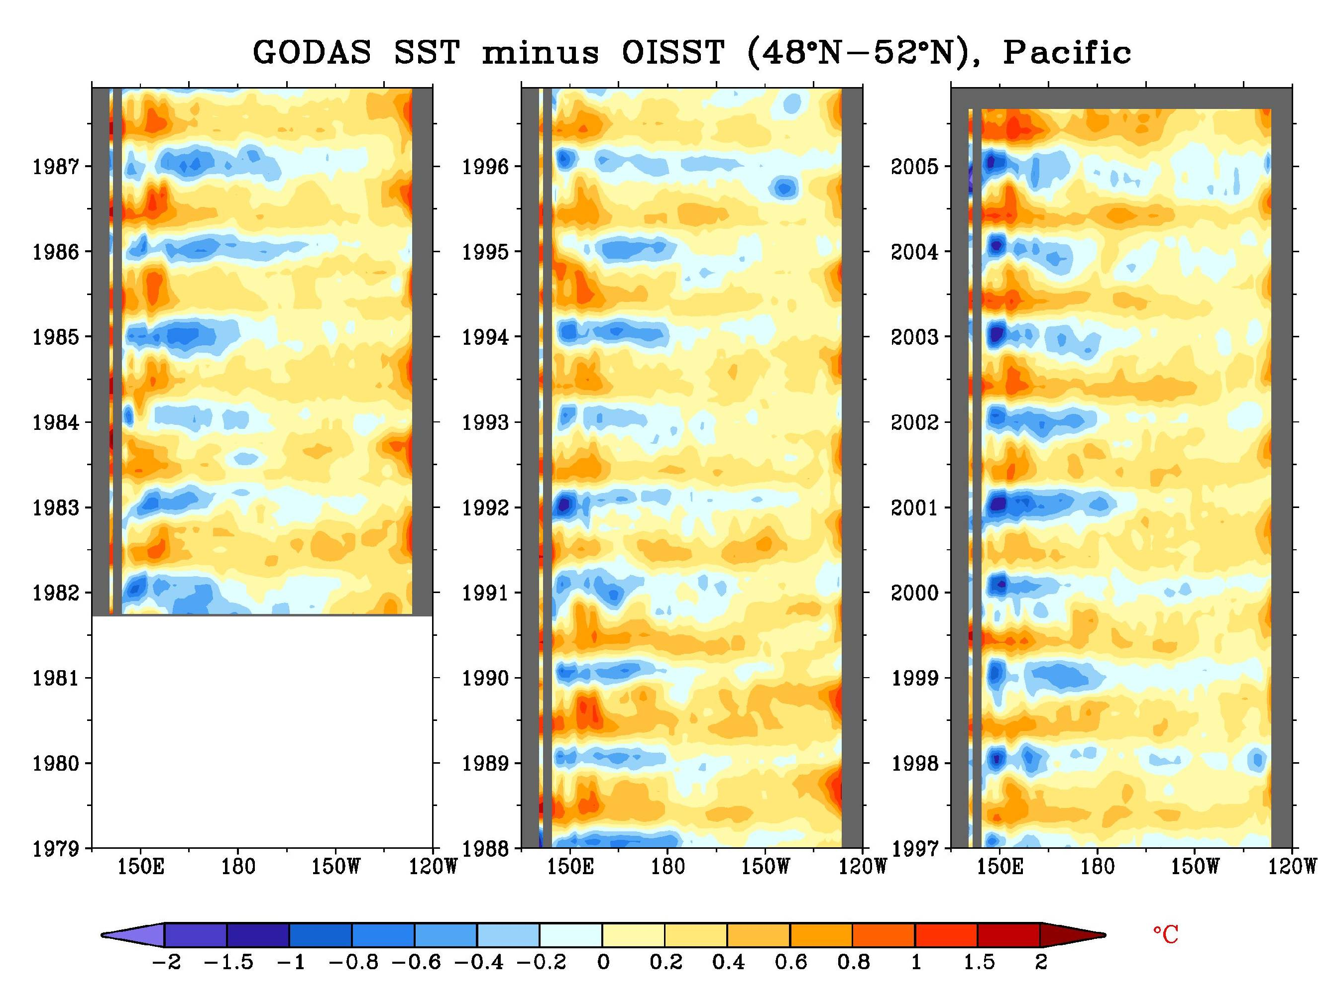
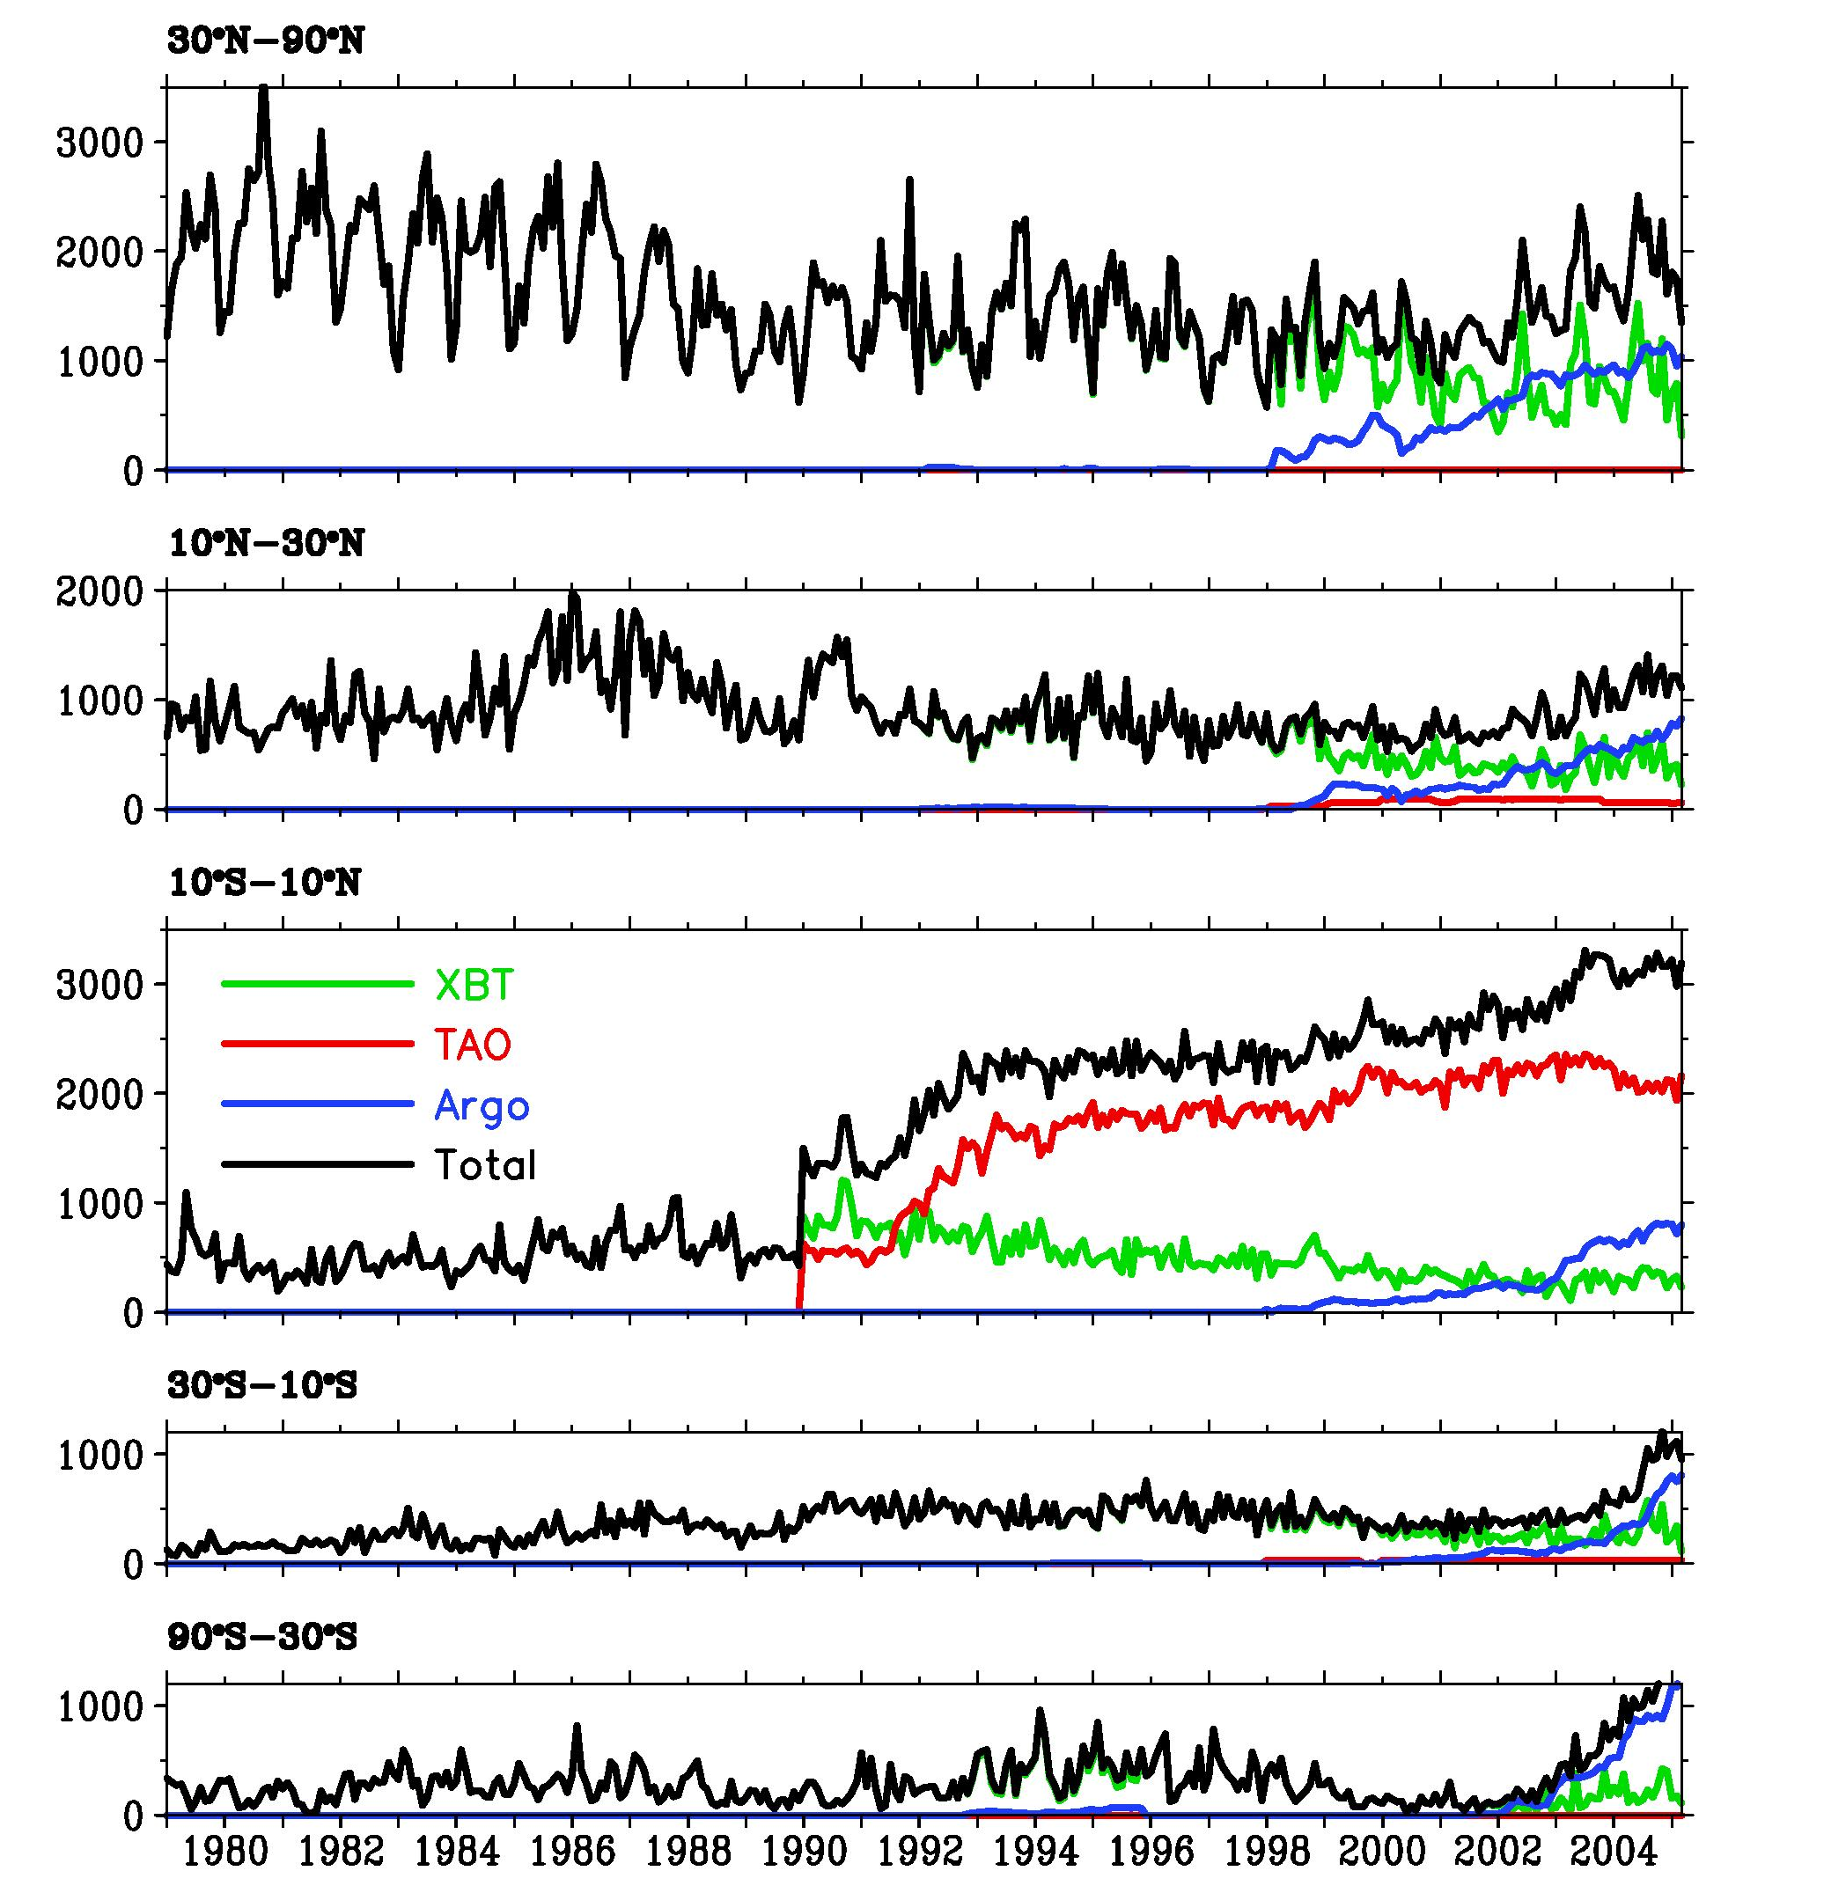
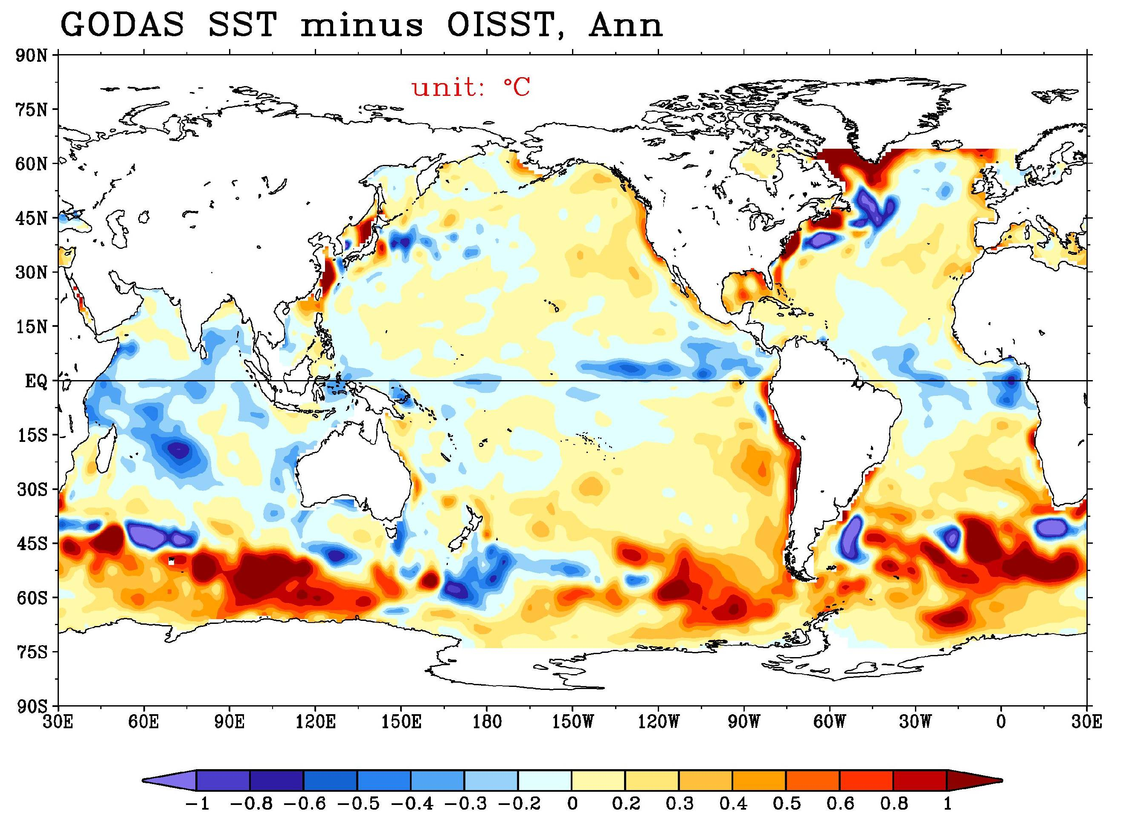
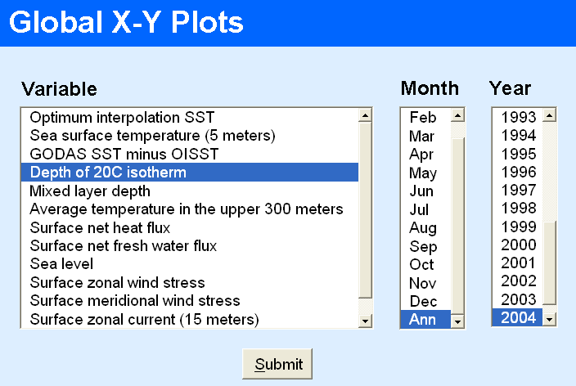
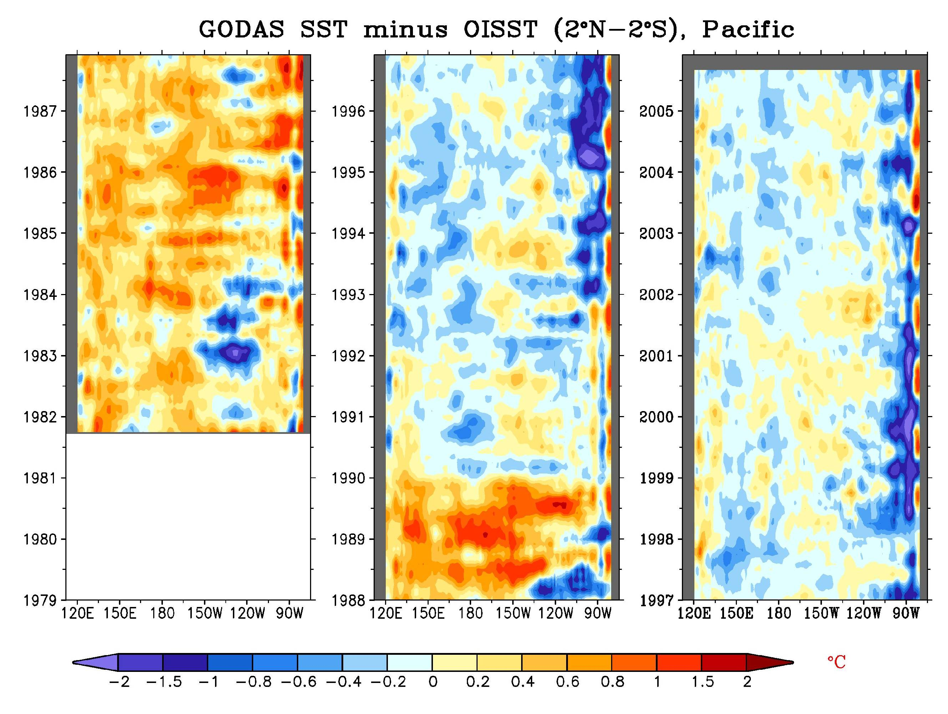
A Web Site of Global Ocean Data Assimilation System (GODAS)
http://www.cpc.ncep.noaa.gov/products/GODAS
Boyin Huang, Yan Xue, and David Behringer
Climate Prediction Center/NCEP/NOAA
1. Introduction
Since 1995, the National Environmental Prediction Center (NCEP) has been producing real time ocean analysis and reanalysis using Ocean Data Assimilation System (ODAS, traditionally referred to as RA6) (Ji et al. 1995). The new Global Ocean Data Assimilation System (GODAS) was developed to be the replacement for RA6, and to provide oceanic initial conditions for the global Climate Forecast System (CFS) newly developed at NCEP (Behringer and Xue 2004).
4. Temperature profiles assimilated in GODAS
To show users the effectiveness of ocean observing system, temperature profile distributions and counts from XBT, TAO/TRITON/PIRATA, and Argo observations used in GODAS are illustrated in the following examples: the profile distribution in 2004 and profile counts from 1979 to 2005 at five latitudinal bands.
6. Web site updated at real-time
Visualized monthly and pentad averages are updated at real-time as indicated in the following example for 20ºC isotherm depth anomaly in 2005, where east-propagating Kelvin wave activities were evident.
7.3. GODAS validation-3
The biases may also be season-dependent. The SST deviations from OISST near 50ºN indicate the North Pacific is generally colder in winter and warmer in summer than observations. Similar biases were also found in the North Atlantic and the Southern Ocean.
2. GODAS
The GODAS is based on the GFDL MOM3. The model domain extends from 70°S to 65°N and has a resolution of 1° by 1° enhanced to 1/3° between 10ºS and 10ºN. The model has 40 levels with a 10 meter resolution in the upper 200 meters.
The GODAS is forced by the momentum flux, heat flux and fresh water flux from the NCEP atmospheric Reanalysis 2 (R2). In addition the temperature in the top model level is relaxed to weekly analyses of observed sea surface temperature (SST), while the surface salinity is relaxed to annual salinity climatology.
The GODAS assimilates temperature profiles from XBTs, TAO/TRITON/PIRATA moorings, and Argo profiling floats. It also assimilates synthetic salinity profiles. The assimilation method is the 3DVAR scheme.
Comparing with observations, the temperature in GODAS is better than that in RA6, and the sea surface height in GODAS between 1990 and 2003 is as good as or better than that in RA6.
7.1. GODAS validation-1
The GODAS products exhibit certain biases. The climatological annual SST anomalies indicate SST deviations from Optimal Interpolation SST were less than 0.2ºC in most of the tropical oceans. However, cold biases can be identified in the tropics oceans, and warm biases are strong in the coastal oceans and the Southern Ocean.
8. Summary
The GODAS web site is sponsored by Office of Climate Observation of NOAA, and is intended to
Gain a broader dissemination of GODAS data products
Provide real-time monitoring of ocean climate variability
Assess effectiveness of ocean observing system
Compare with other ocean analyses
Please visit the GODAS web site at http://www.cpc.ncep.noaa.gov/products/GODAS, and contact boyin.huang@noaa.gov, yan.xue@noaa.gov, or david.behringer@noaa.gov for more information.
Temperature profile numbers
3. GODAS products
The GODAS web site provides
2-Dimensional surface and other oceanic variables such as
winds, surface net heat flux, freshwater flux, SST, mixed
layer depth, 20ºC isotherm depth, sea level height, heat
content of upper 300-meter, etc.
3-Dimensional ocean temperature, zonal current, and
meridional current.
The GODAS products are categorized into
Monthly (January-December) and annual climatology.
Monthly averages from January 1979 to September 2005, and
Pentad averages from January 1979 to September 2005.
The web site visualized these products at
Ocean surface (longitude-latitude plots),
Latitudinal sections (longitude-depth and longitude-time
plots),
Longitudinal sections and zonal averages (latitude-depth
plots).
Animations of these plots.
5. GODAS web site
The GODAS web site http://www.cpc.ncep.noaa.gov/products/GODAS is designed for users to easily access visualized GODAS products. Users can browse the web site and select appropriate variables such as shown below. Users can access original binary data at
http://cfs.ncep.noaa.gov/cfs/godas
7.2. GODAS validation-2
The biases may be time-dependent. As indicated below, tropical surface oceans of the GODAS exhibits warm biases before 1990 and cold biases after 1990, which might be associated with large increases in TAO observations as proposed by Xue and Behringer (2005).
References
Behringer, D.W., and Y. Xue, 2004: Evaluation of the global ocean data assimilation system at NCEP: The Pacific Ocean. Eighth Symposium on Integrated Observing and Assimilation Systems for Atmosphere, Oceans, and Land Surface, AMS 84th Annual Meeting, Washington State Convention and Trade Center, Seattle, Washington, 11-15.
Ji, M., A. Leetmaa, and J. Derber, 1995: An ocean analysis system for seasonal to interannual climate studies. Mon. Wea. Rev., 123, 460-481.
Xue, Y., and Behringer, D.W., 2005: Operational global ocean data assimilation system at NCEP, to be submitted to BAMS.

