Slide 1
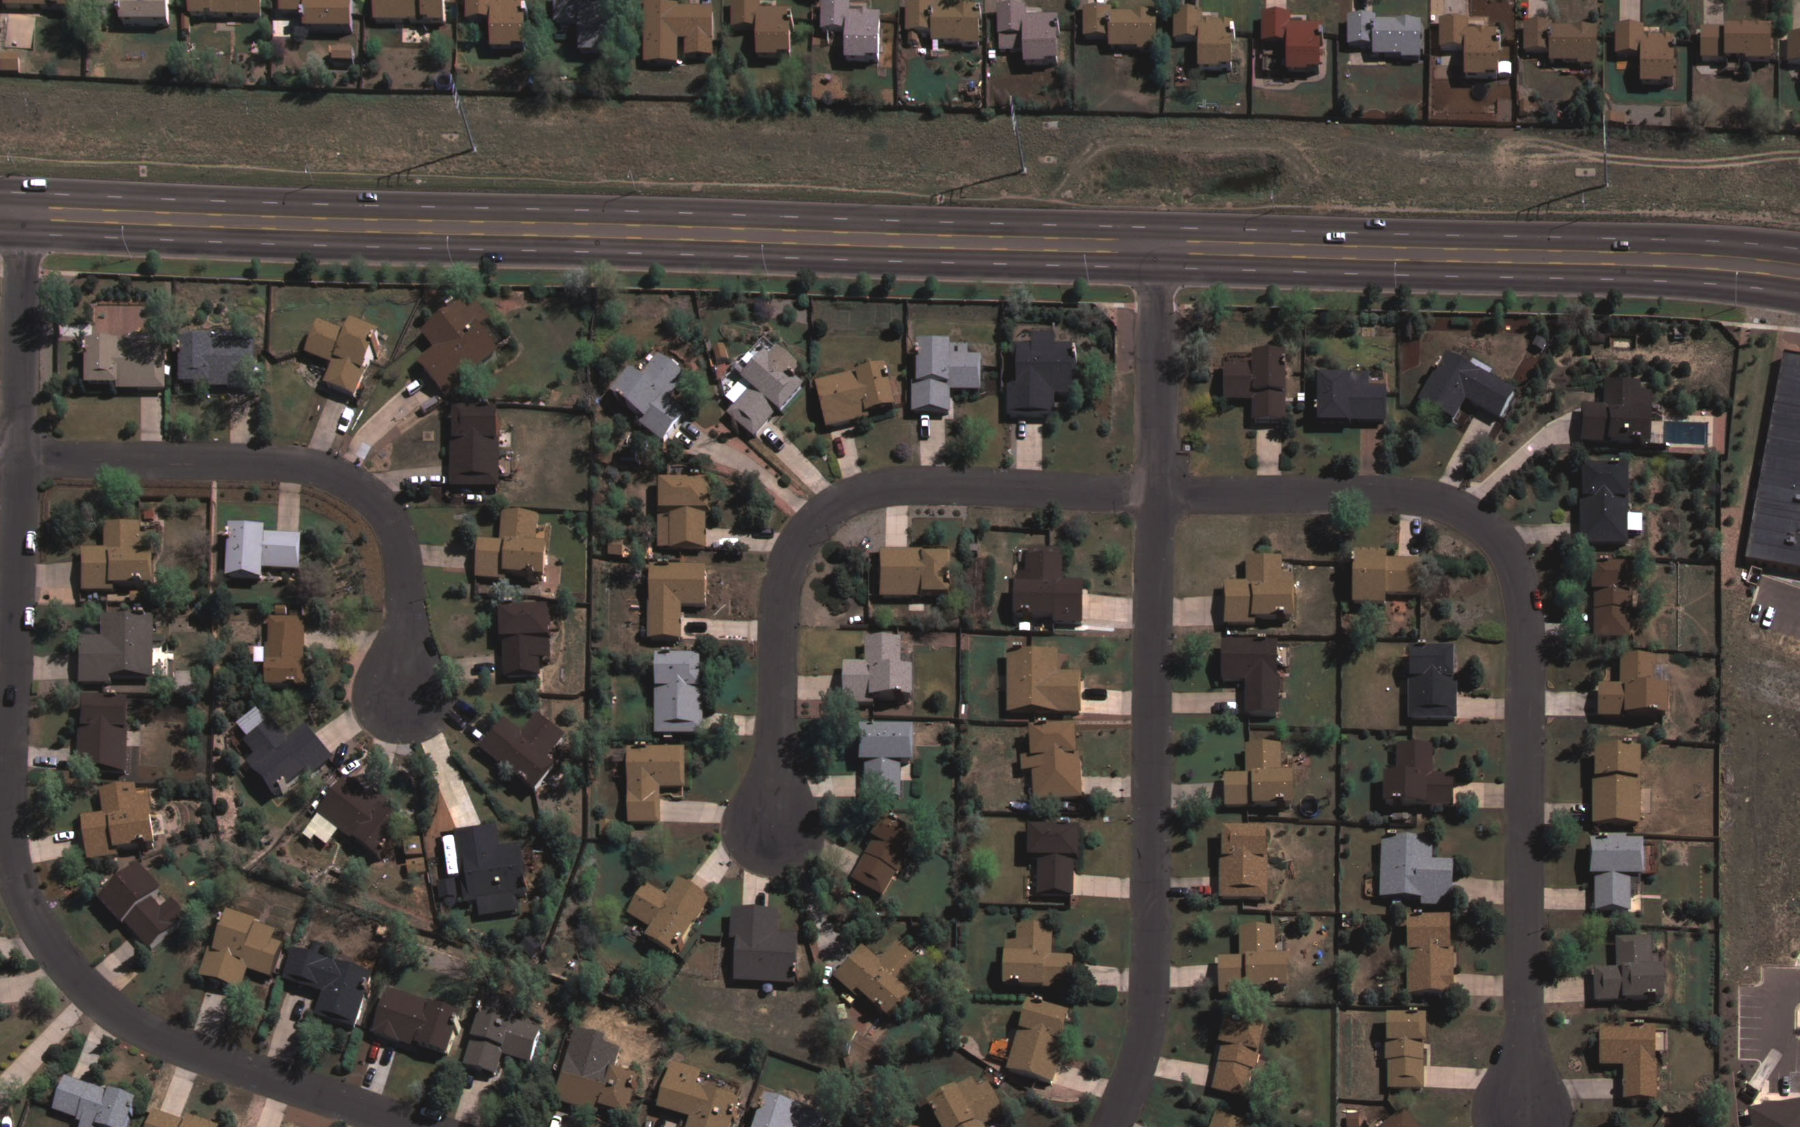
Advanced Mapping with Digital
Sensors
Mark E. Meade, PE, PLS, CP
Photo Science, Inc.

Slide 2
Why Digital Imagery?
Eliminates film, lab processing, digital scanning
Highest quality imagery available today
  Very high signal-to-noise ratio (SNR)
12-bit data results in stunning imagery
  4096 values versus 256 in 8-bit imagery
No artifacts to deal with… lint, dust, scratches
Very stable geometry, first generation imagery
Simultaneous collection of pan, color, and IR

Slide 3
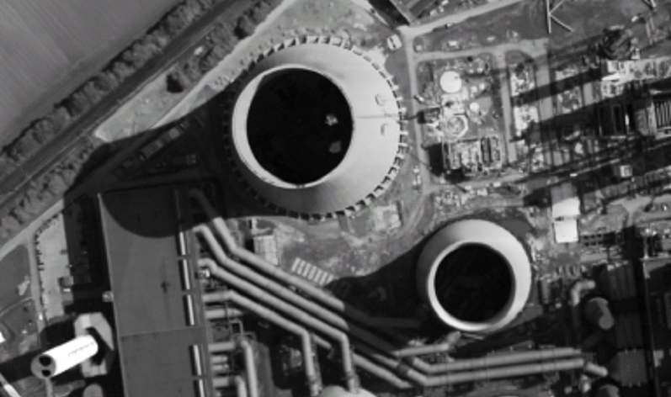
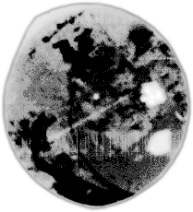
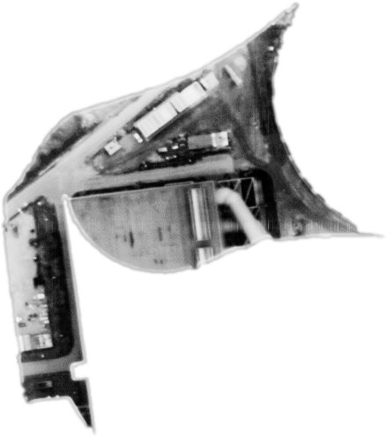
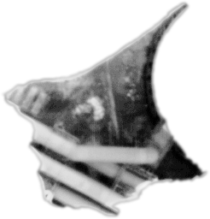
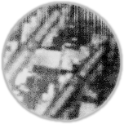
Advantages of 12-bit Imagery
Notes:
Wegen der zunehmenden Bedeutung von Digitalen Systemlösungen hat Z/I eine Hochauflösende / Digitale / Luftbild / Reihen / Meß / Kamera entwickelt.
Während der Text gesprochen wird, entsteht eine Bildserie am Folienrand und gleichzeitig auf dem Monitor im Flugzeug, 1 Bild / 2 Sekunden; dabei Geräusch von Kamera / Verschluß, Dreieck Field of View ca. 75° leuchtet auf bei jeder Auslösung
am Ende der Szene wird das digitale Bild hochgezoomt,

Slide 4
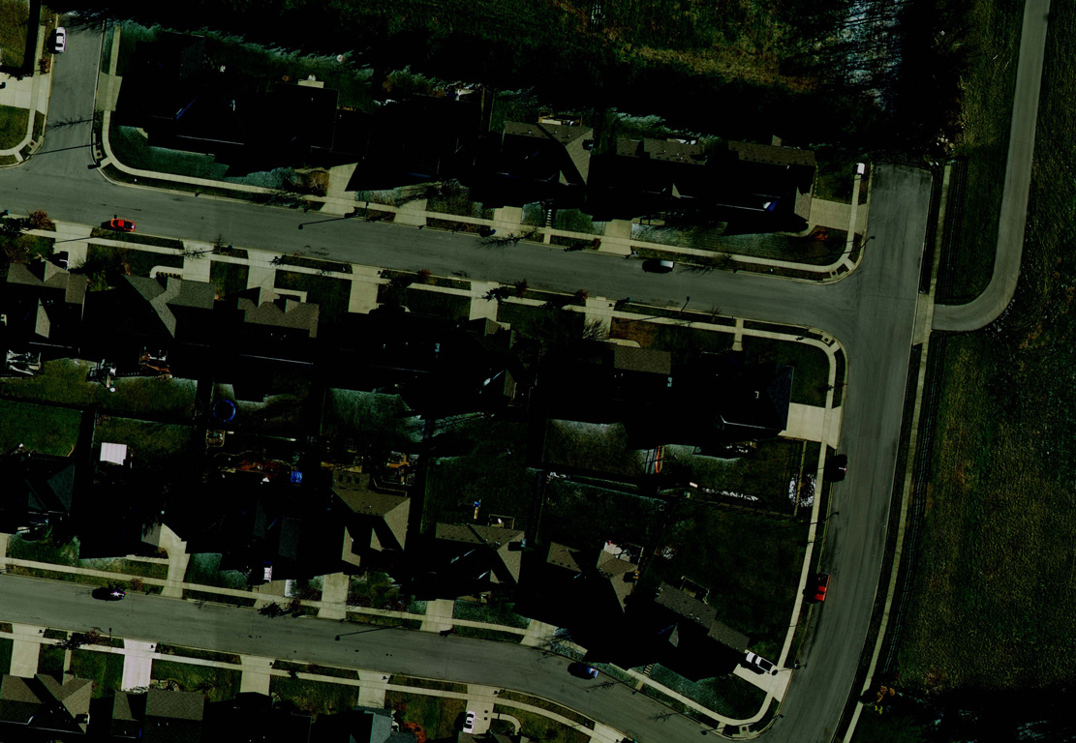

Slide 5
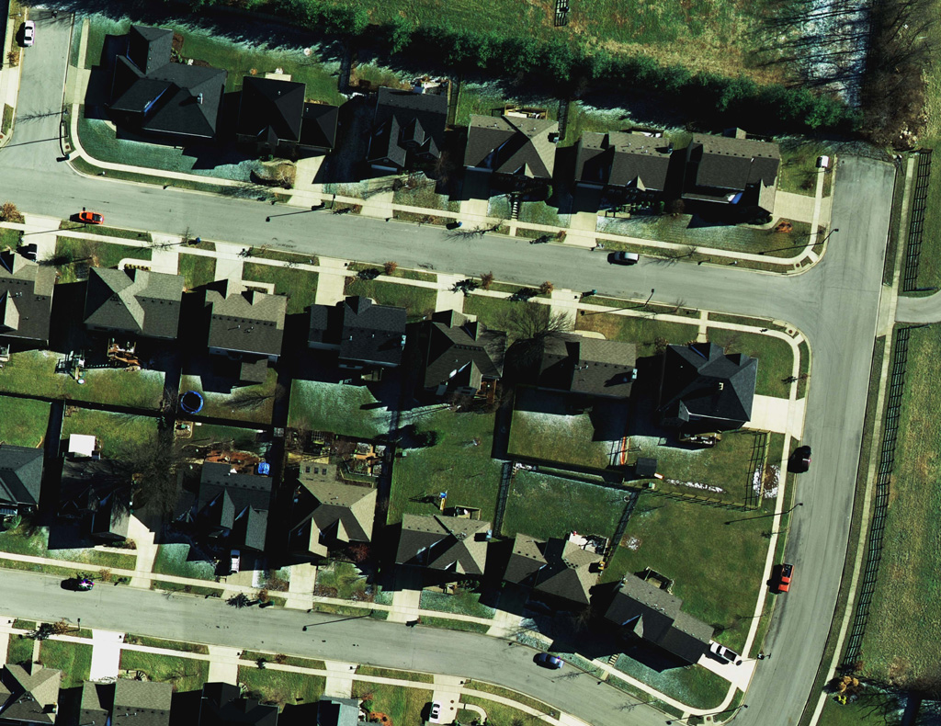

Slide 6
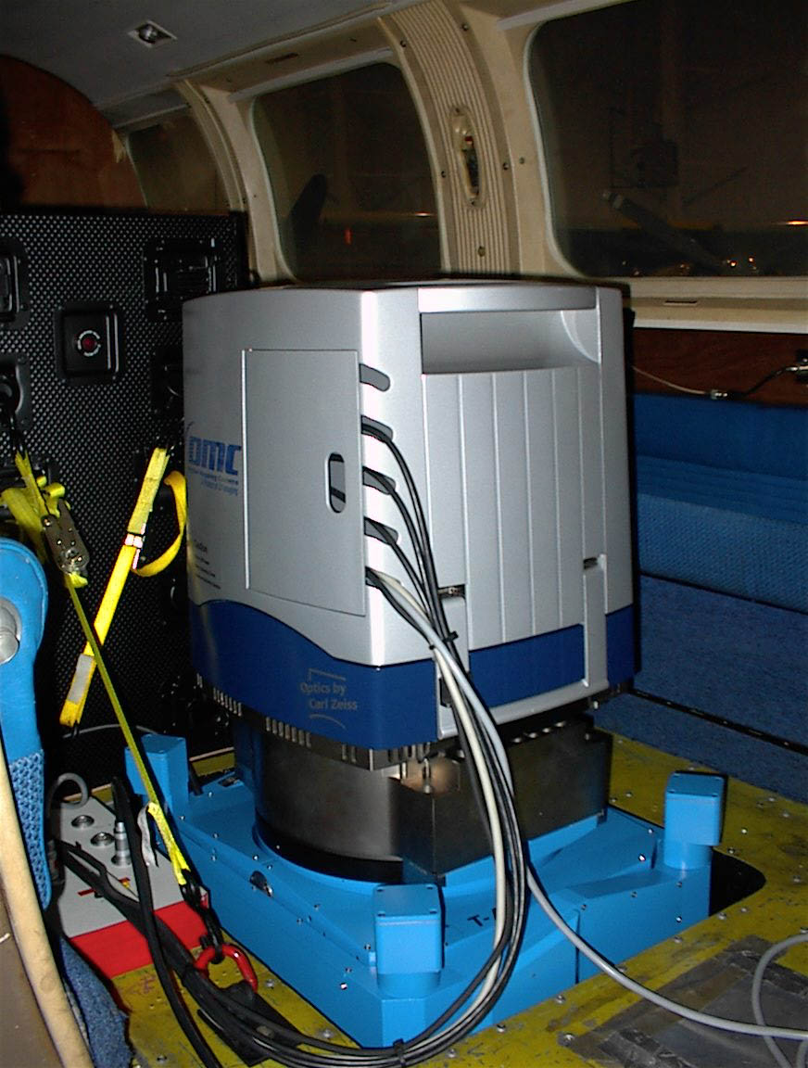
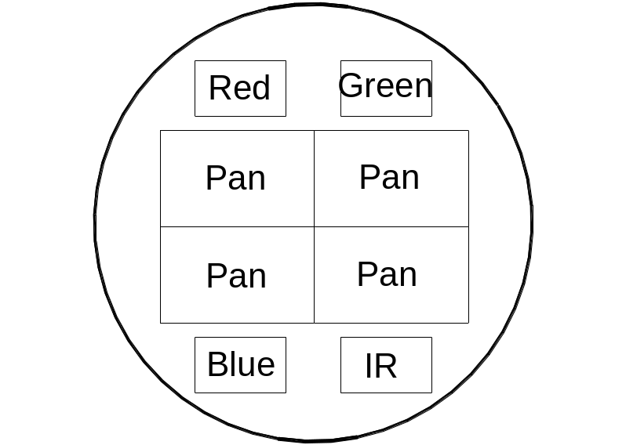
Z/I Digital Mapping Camera
State-of-the-art digital framing camera produces exceptional imagery.

Slide 7
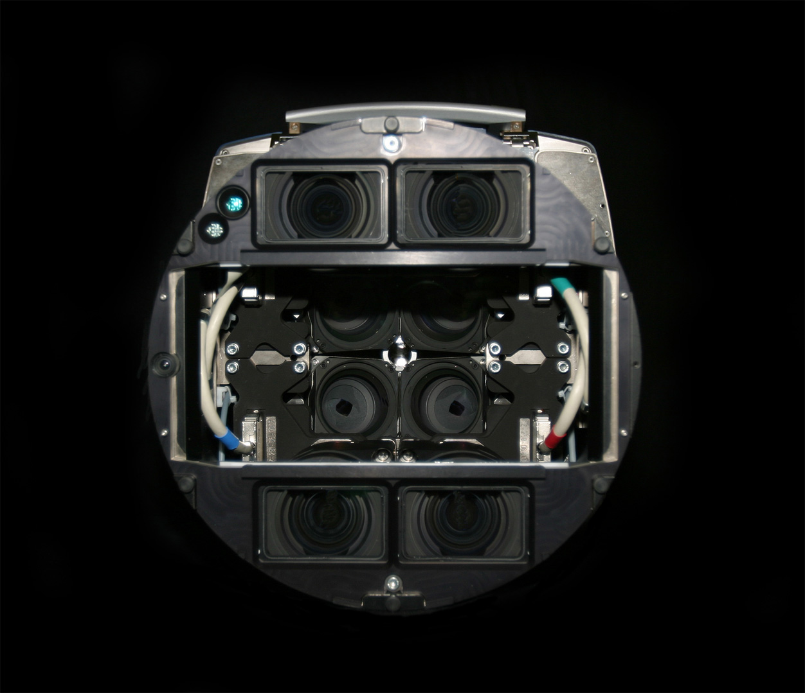

Slide 8
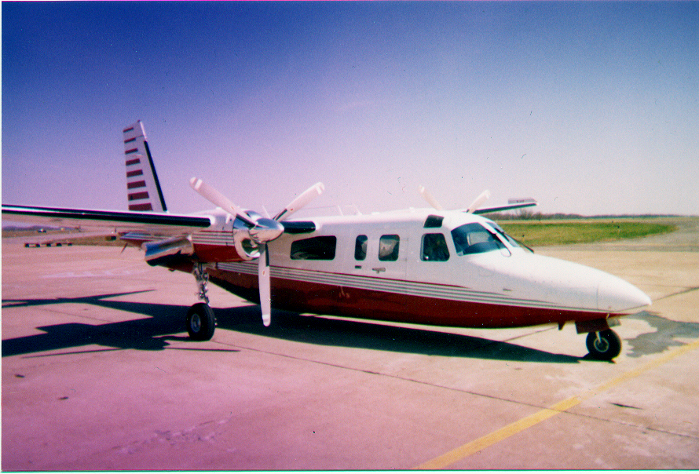

Slide 9
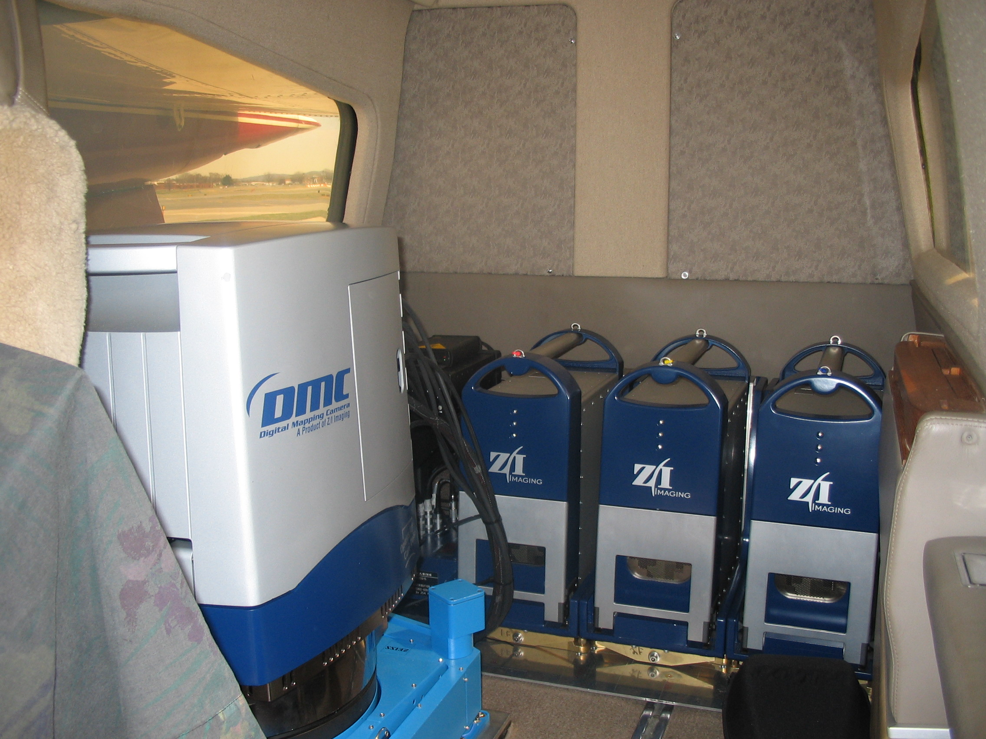

Slide 10
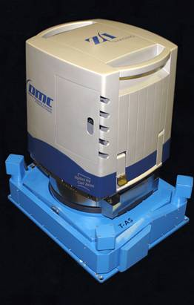
Digital Cameras
Cost $400K to $1.5M
Two types… framing camera and push broom.
Several advantages, few disadvantages compared to film cameras.

Slide 11
Digital Sensors Today
Large-Format Framing Camera
  Z/I Digital Mapping Camera (DMC)
  Vexcel Ultra Cam D
Large-Format Push Broom Sensor
  Leica Geosystems ADS 40
  Jena JAS 150
Medium Format Framing Sensors
  Applanix Digital Sensor System (DSS)
  Digital Modular Aerial Camera (DIMAC)

Slide 12
Digital Camera versus Film
Advantages
  B&W, color, and infrared in a single pass.
  No need for film, processing, other lab products.
  Scanning not required.
  Imagery free from lint, dust, scratches.
  Production of imagery can start on the same day of flight.
  Better spectral resolution than film cameras.
Disadvantages
  Calibration somewhat of an issue
  Data storage from capture until production!

Slide 13
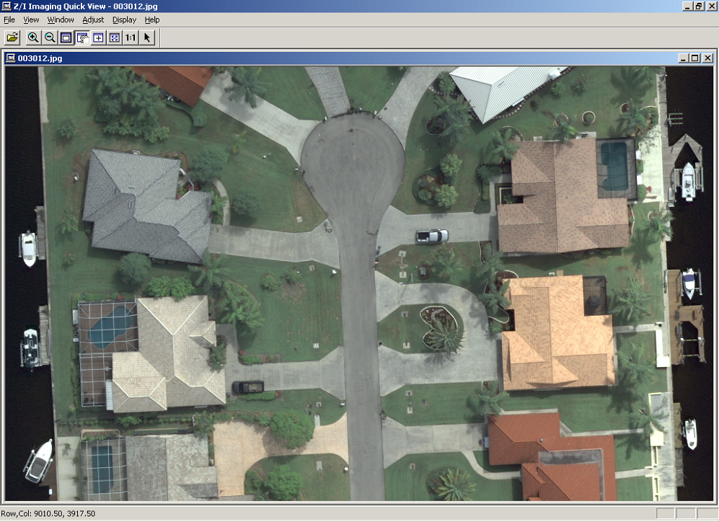

Slide 15
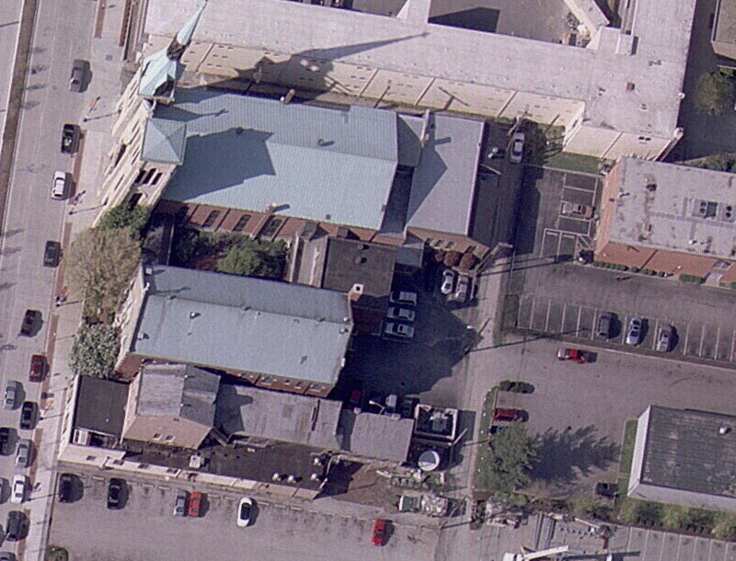

Slide 16
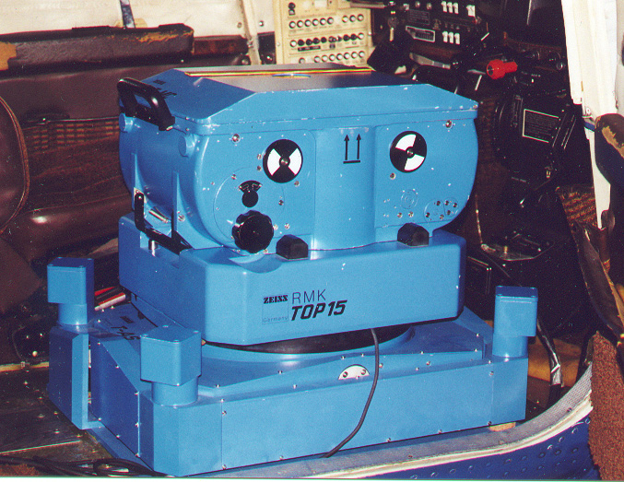
Traditional Film Approach

Slide 17
Film Approach
Advantages
Many film cameras owned by mapping firms
Most have FMC capabilities
Relatively inexpensive ($100k to $500k)
Strong geometry for mapping applications
Disadvantages
Must scan analog film to get to digital environment
Film grain, dust, lint, hairs evident in imagery

Slide 18
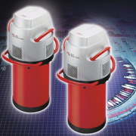
Pushbroom Sensor (Leica ADS 40)
12,000 pixels wide

Slide 19
Pushbroom Digital Approach
Advantages
High quality digital imagery (1’ and less resolution)
Medium cost digital platform ($1M)
Simultaneous capture of pan, color, and IR
Productive for creation of digital orthophotos
Does not require mosaic lines in the direction of flight
Disadvantages
Weaker mapping geometry than both film and DMC
Aerotriangulation solution less rigorous
More difficult to create stereopairs for compilation

Slide 20
Framing Sensor (Z/I DMC)

Slide 21
DMC Approach
Advantages
Highest quality digital imagery available today
FMC included on all cameras
Very strong geometry for mapping
Ideal for AT, easy to create stereopairs for compilation
Capable of very high image resolution (to 0.10 feet)
Simultaneous capture of pan, color, and IR
Disadvantages
Most expensive hardware available ($1.8M)
Requires ortho mosaic lines in the direction of flight

Slide 22
Comparison of Camera Options
 | DMC | ADS 40 | Film
Highest Quality Imagery | √ | √
Forward Motion Compensation | √ |  | √
Strong Mapping Geometry | √ |  | √
Most Productive for Orthos |  | √
Ability to Perform AT | √ |  | √
B&W, Color, Color IR | √ | √
Maximum Ideal Resolution | 0.10’ | 0.5’ | 0.25’

Slide 23
Data Issues
High resolution cameras can create 900 GB of data per flying day.
Data storage and backup problems are significant.
Timing from flight to production an issue.

Slide 24
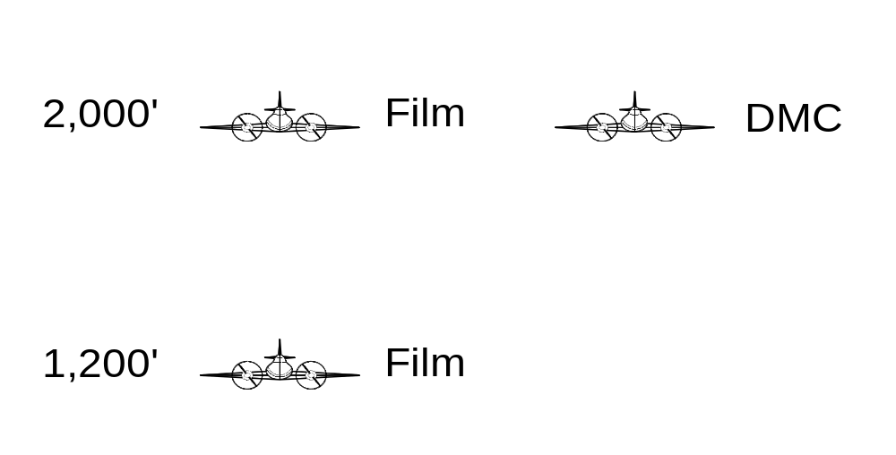
PennDOT Accuracy Analysis

Slide 25
DMC Accuracy Analysis
Performed in conjunction with PennDOT
Film flown at 1,200’ and 2,000’ AMT
DMC flown at 2,000’AMT
45 ground check points
Horizontal accuracy of DMC comparable to 1,200’ AMT film (RMSE 0.27’ vs 0.28’)
Vertical accuracy of DMC comparable to 2,000’ AMT film (RMSE 0.27’ vs 0.27’)

Slide 26
Digital Sensor Summary
We are early on the technology curve
2008 will see many more mapping firms purchasing a digital sensor
Hardware manufacturers will continue impressive R&D investments
Not right for every project, but can be significant for the right ones
Amount of spectral information far superior to any other acquisition method

Slide 27
Number of Exposures… Film vs Digital
80,000
Film Photography
Digital Imagery
60,000
40,000
20,000
2004
2005
2006
2007

Slide 28
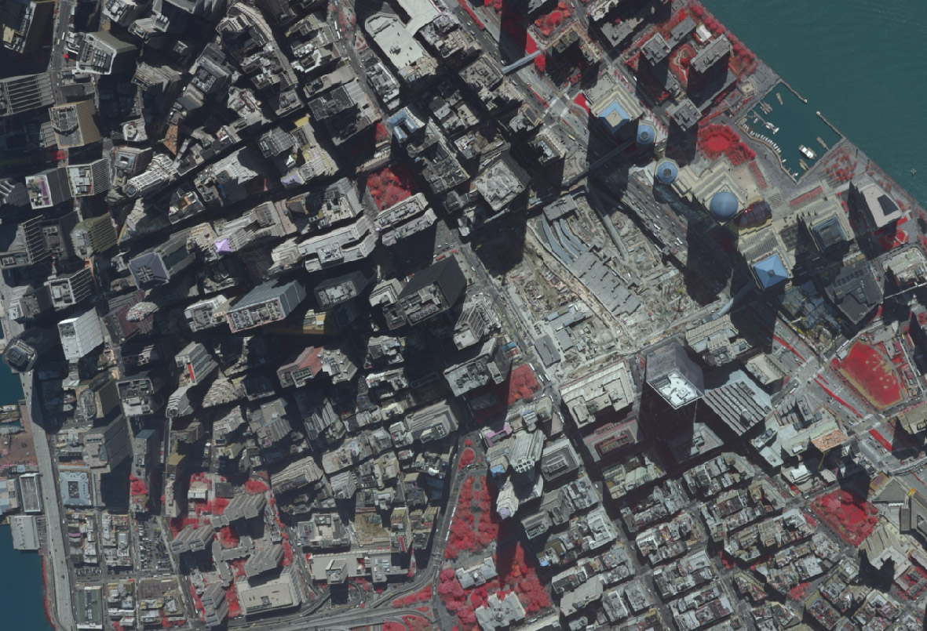

Slide 29


Slide 30
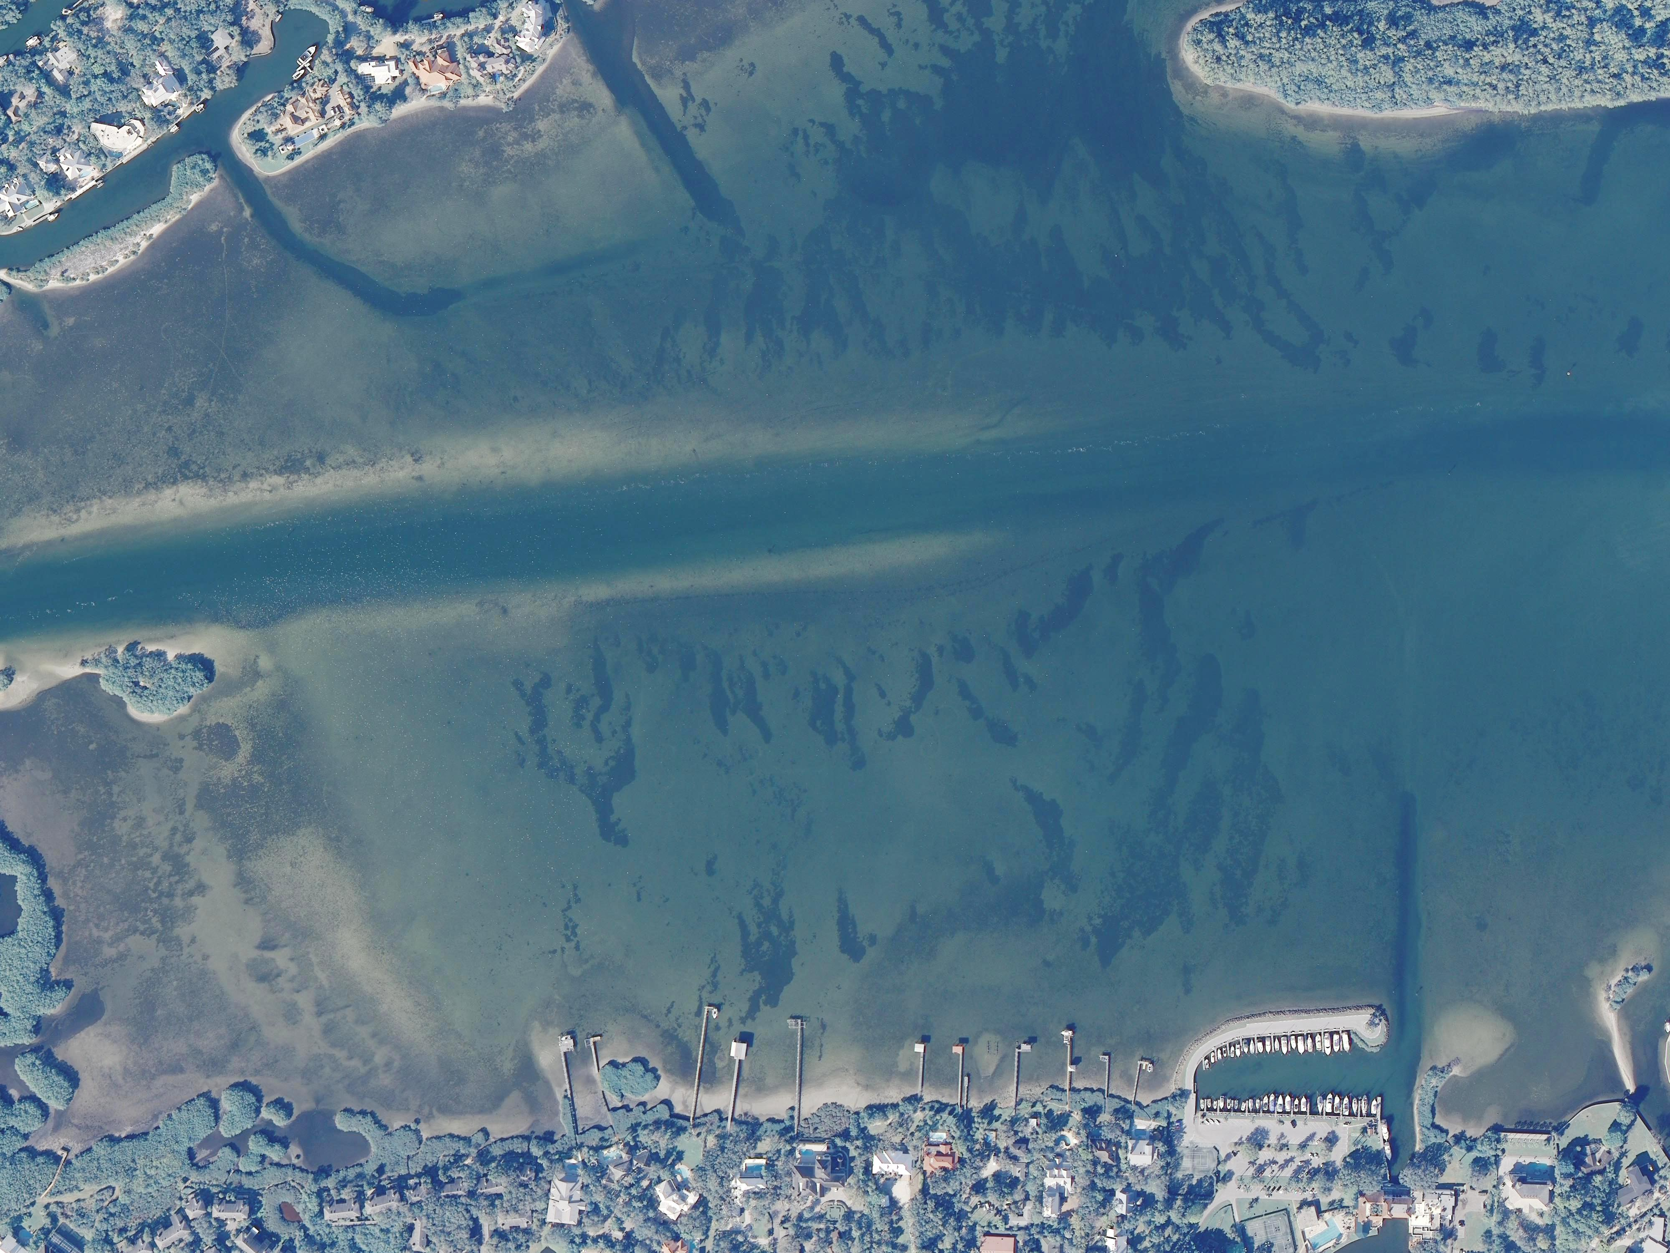

Slide 31
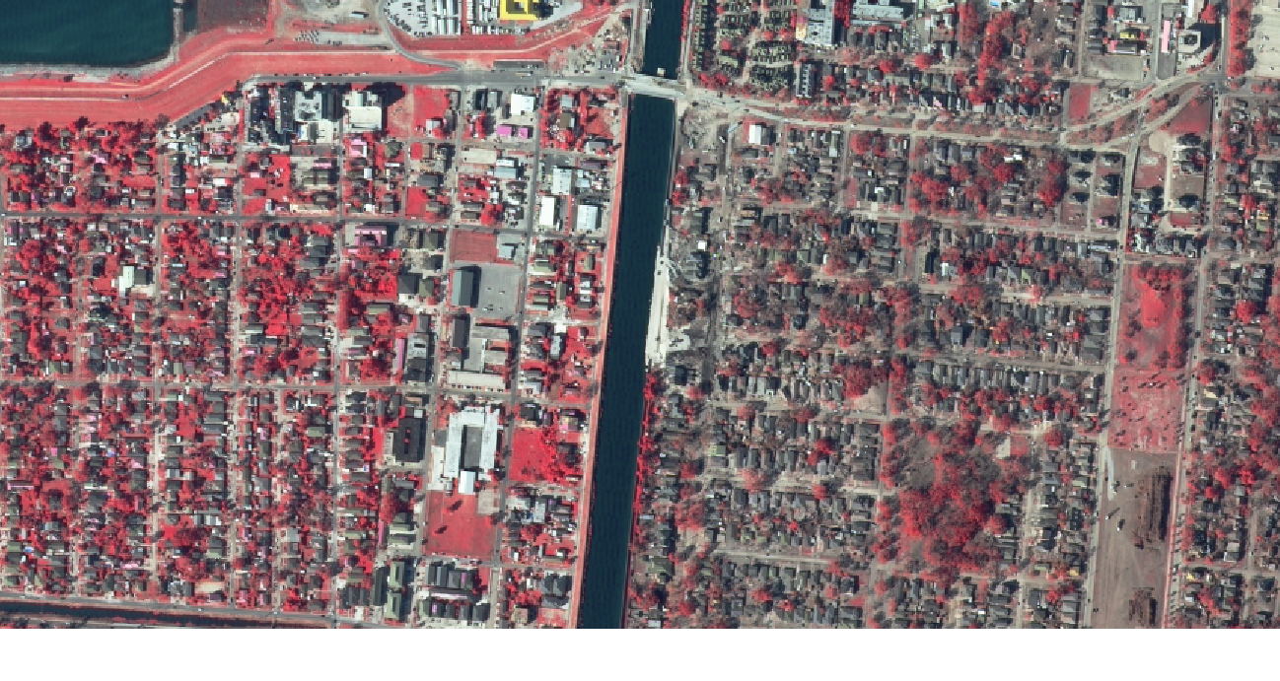

Slide 32
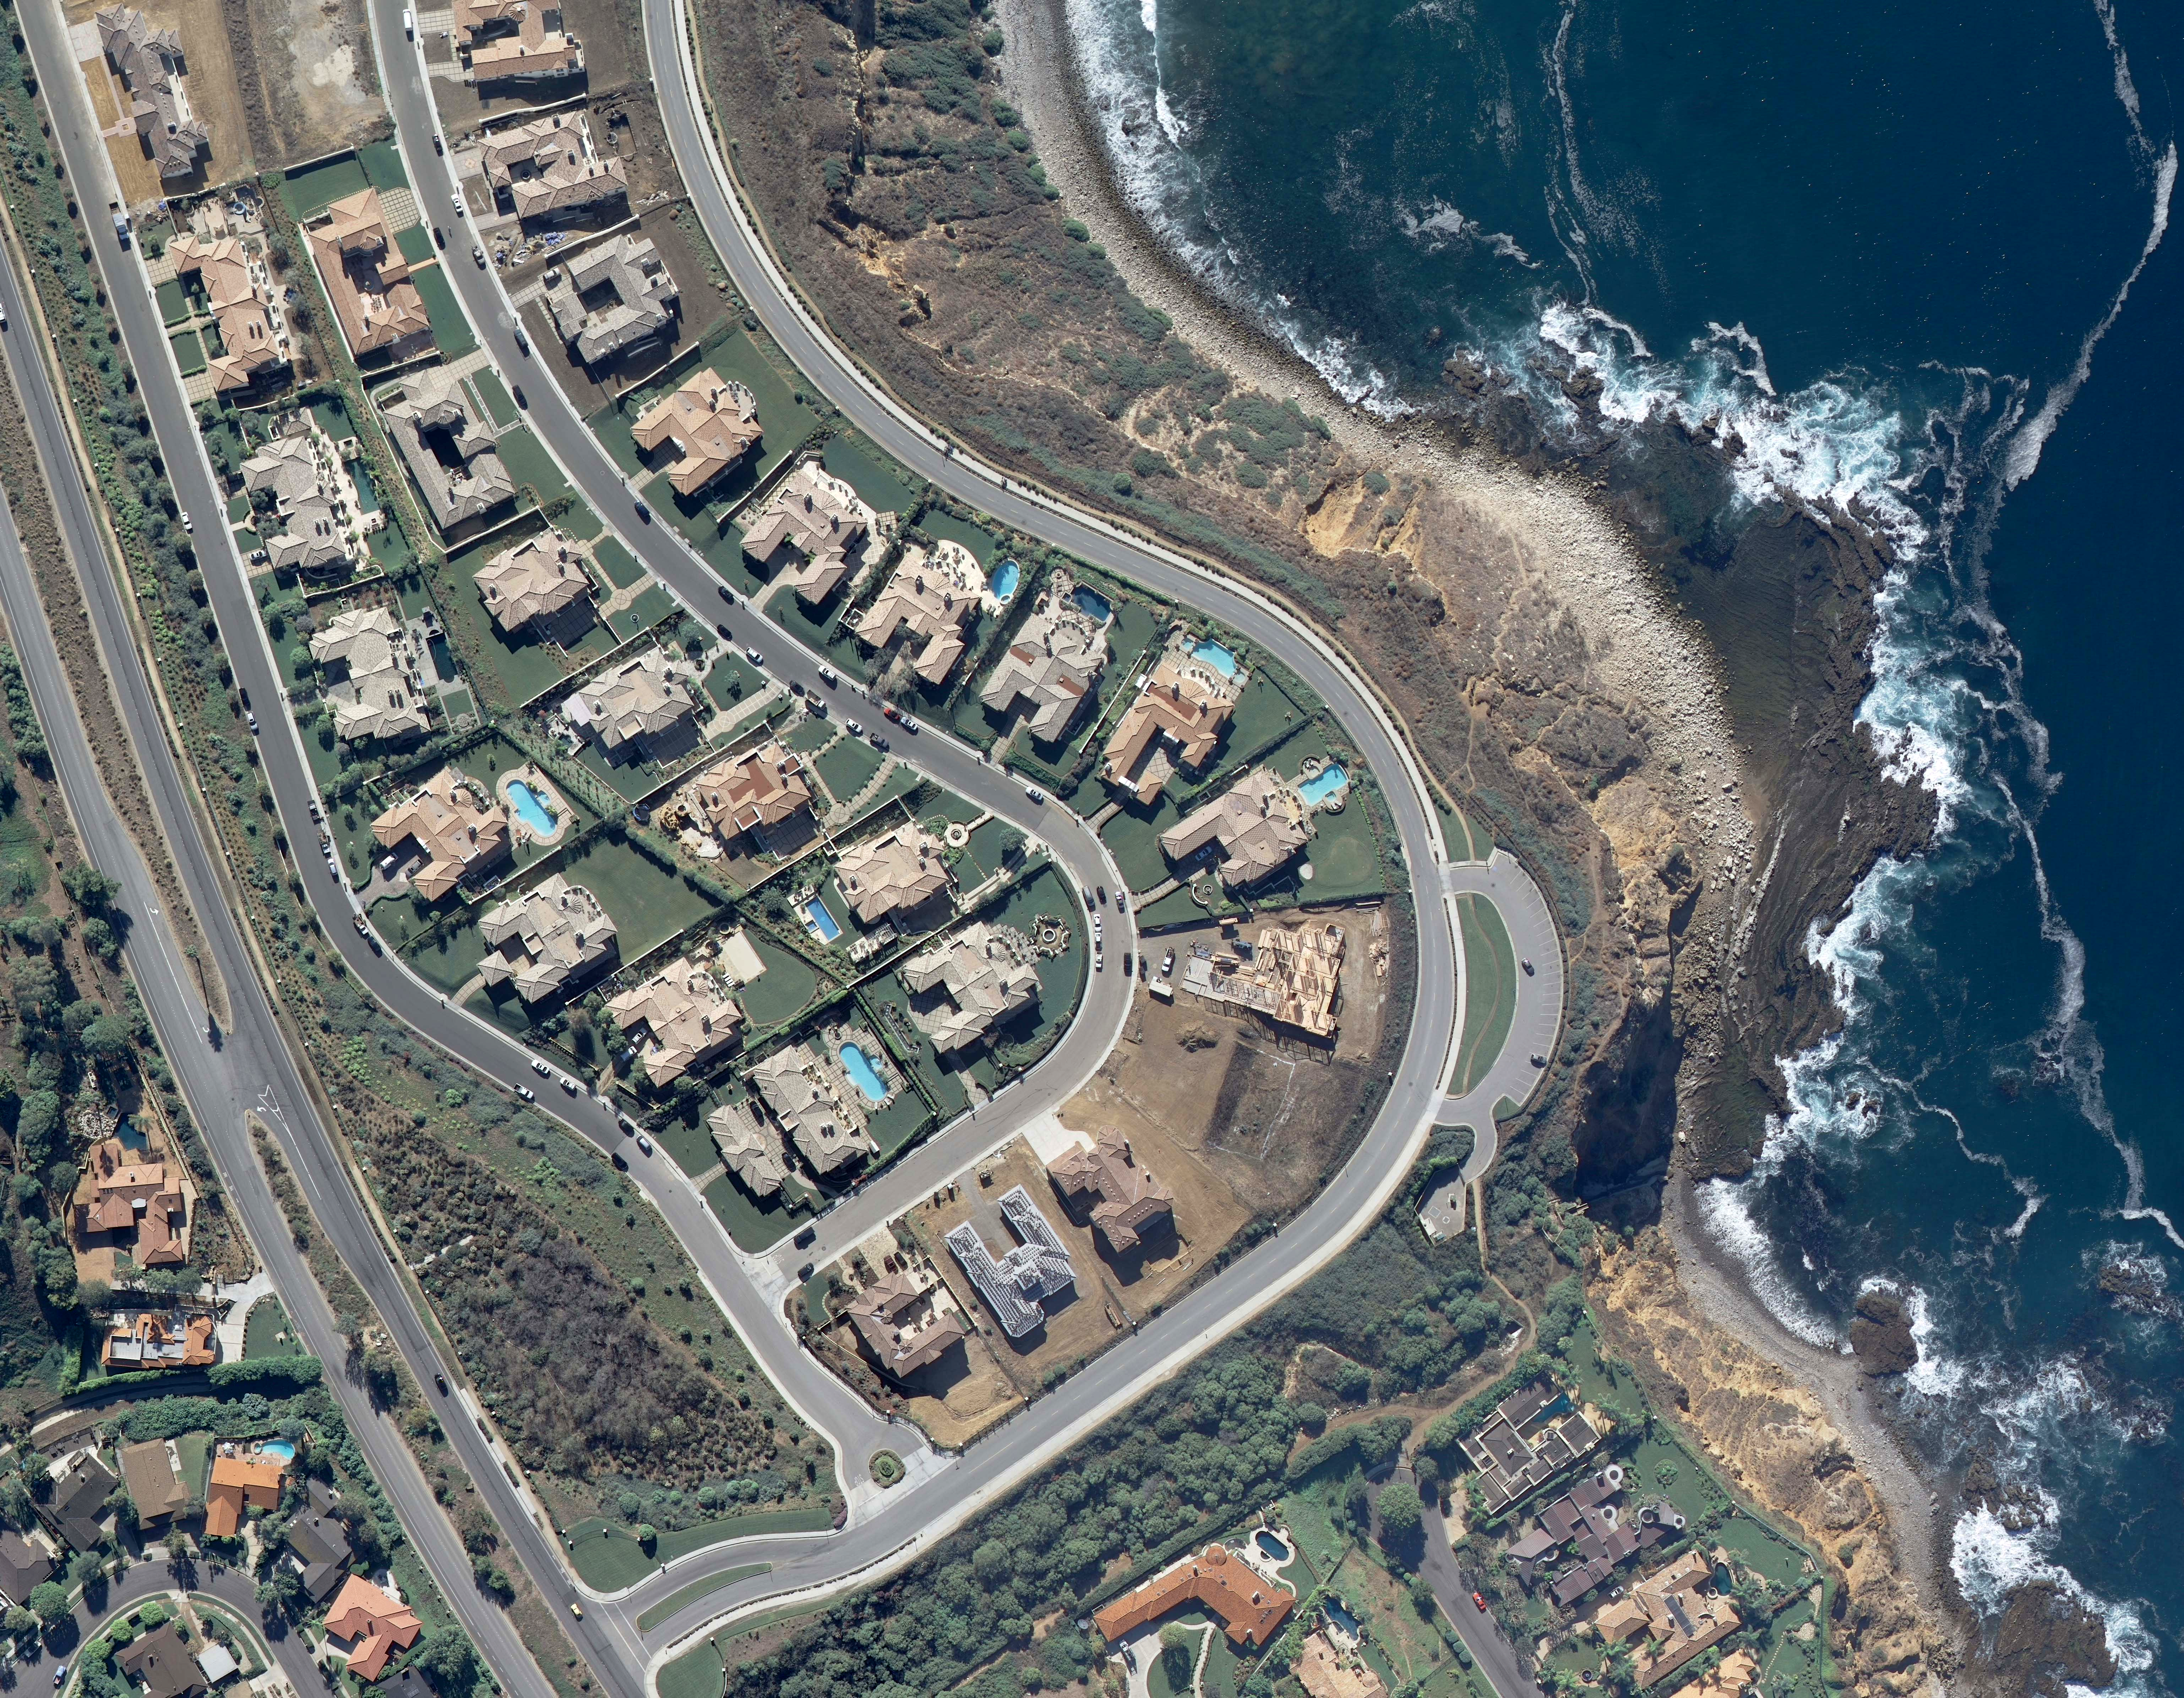

Slide 33
Questions?

