Slide 1
RDA专题：RDA名称权威记录（NAR）中的关系标识符
Ana Lupe Cristán
政策与标准部
美国国会图书馆
2012年3月
Notes:
1
1

Slide 2
RDA – 附录K
第29章 关系记录指南……
相关人物 – 第30章
相关家族 – 第31章
相关机构 – 第32章
RDA – 附录J
第25章 – 相关作品
第26章 – 相关表达
关系标识符
– MARC 21
Notes:
2
This section concentrates on the MARC coding not so much the RDA attributes and FRAD/FRBR tasks. That information is in Module F of November’s refresher workshop by Judy Kuhagen as well as Documents R-5 and R-6.
This covers the FRAD task: Relate. In RDA you’ll find the guidelines in Chapter 29 on recording the relationships between Persons, Families and Corporate bodies with more details, description, purpose and scope in Chapters, 30, 31, and 32 respectively for each of these entities.
Generally these are used with terms from Appendix K. Appendix J is used to describe relationships that are described in Chapters 25 and 26, note that these are the same relationship designators used for bibliographic records. Another appendix that has relationship designators is Appendix I – but that contains the list of relationship designators that you use to relate persons, families, and corporate bodies to particular manifestations (bibliographic records) such as: author, contributor, editor, illustrator, etc. Let’s look at this another way [CLICK]

Slide 3
关系标识符 – 概述
附录 I
- 将个人、家族和团体与作品、表达和载体表现相关联
- 仅用于书目记录
附录 J
- 将作品、表达和载体表现与作品、表达和载体表现相关联
- 同时用于书目记录和规范记录（原称“参见”）
附录 K
- 将个人、家族和团体与个人、家族和团体相关联
- 仅用于规范记录（原称“参见”）
Notes:
[INSTRUCTOR: read slide and reinforce that these relationships are what used to be called “see- also references” especially when talking about the use on authority records. The point of this slide is to reinforce that Appendix I is only used for bibliographic records (and that this session will not talk about those designators). We will touch on J as that appendix is used for both and we will look more at K as that is ONLY used for authority records]

Slide 4
附录一 – 提示：书目记录的关系标识符 – 测验
RDA书目记录：
100 1# $a 三岛由纪夫，$d 1925-1970，$e 作者。
240 10 $a 潮骚。$l 英语
245 14 $a 潮声 / $c 三岛由纪夫；译者：Meredith Weatherby。
700 1# $a Weatherby, Meredith，$e 译者。
权威记录：
100 1#
___ __ $a 三岛由纪夫，$_ 1925-1970。$_ 潮骚。$_ 英语
d
t
l
100 1#
___ __ $a Weatherby, Meredith
Notes:
4
4
And just so that you remember how you use (or that we don’t use Appendix I in NARs).
Let’s start off with a quick quiz. Based on the information in this snippet of a bibliographic record create a Name/Title NAR for this bibliographic record and create an NAR for the translator.
[Instructor - Students should supply MARC tags for the NAR – the point of the exercise is to point out that
we did not carry over the relationship designator from the bibliographic record to either one of the NARs. The answers show up by clicking thru each one]
4

Slide 5
关系标识符（29.5）- 附录K
K.2.1 人物对其他人物
- 替代身份
- 真实身份
K.2.2 人物对家族
- 家族成员
- 始祖
K.2.3 人物对机构
- 雇员
- 创始人
- 团体成员
- 现任者
- 赞助人
K.3.1 家族对人物
- 后代
K.3.2 家族对家族
- 后裔家族
K.3.3 家族对机构
- 创始家族
- 赞助家族
K.4.1 机构对人物
- 雇主
K.4.2 机构对家族
- 创办机构
- 赞助机构
K.4.3 机构对机构
- 下级机构
- 上级机构
- 被合并机构
- 前身机构
- 合并产生的机构
- 拆分产生的机构
- 后继机构
Notes:
So as I mentioned earlier the Relationship designators between persons, families, and corporate bodies (formerly known as see-alsos) are found in RDA in Appendix K.
This slide shows you all the available terms to relate these entities one to another.
Note that Appendix K covers other relationships especially for families to persons such as “progenitor” and for corporate entities relationship to persons such as “founder” “employer”, etc. but notice that the terms that we use “earlier/later” are not used to show those relationships – they are now called Predecessor/Successor.
Another reminder that RDA’s Appendix J is used to relate works, expressions, and manifestations and we’ll talk about those later.

Slide 6
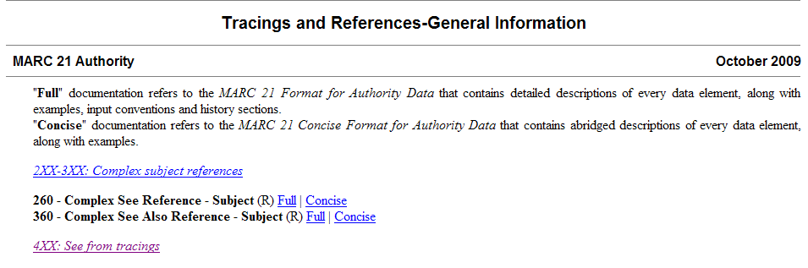
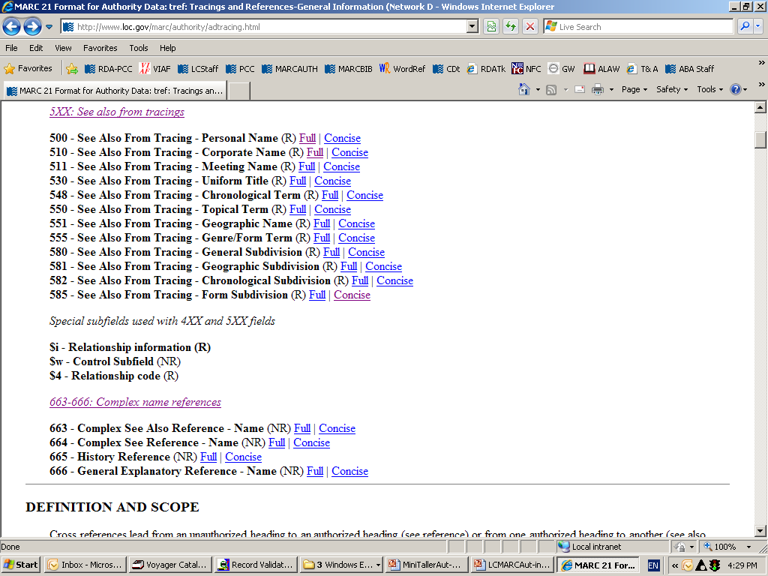
MARC 21 规范数据格式
追溯与参考-一般信息
MARC 21 规范档 2009年10月
“完整”文档指的是《MARC 21 规范数据格式》，其中包含对每个数据元素的详细描述，以及示例、输入规范和历史部分。
“简明”文档指的是《MARC 21 规范数据简明格式》，其中包含对每个数据元素的简略描述，以及示例。
2XX-3XX：复杂主题参考
260 - 复杂参见参考 - 主题 (R) 完整 | 简明
360 - 复杂亦参参考 - 主题 (R) 完整 | 简明
4XX：从追溯查看
5XX：另见从描记图
与4XX和5XX字段配合使用的特殊子字段
Si - 关系信息 (R)
Sw - 控制子字段 (NR)
S4 - 关系代码 (R)
Notes:
In the MARC format on the Tracings and References- General Information section you’ll need to go to the Special subfields used with 4XX and 5XX fields to read the definitions and guidelines for use. That is highlighted here with other information snipped out so that it would all fit on the slide.

Slide 7
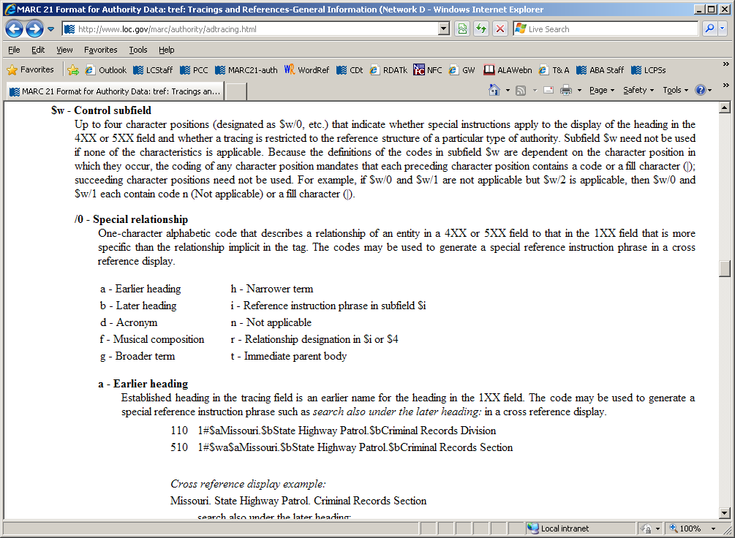
MARC 21 规范数据格式
$w - 控制子字段
最多四个字符位置（指定为 $w/0 等），用于指示特殊指令是否适用于 4XX 或 5XX 字段中标题的显示，以及追踪是否仅限于特定类型权威记录的参考结构。如果没有任何特征适用，则不需要使用子字段 $w。由于子字段 $w 中代码的定义取决于它们出现的位置，因此对任何字符位置的编码都要求每个前面的字符位置包含一个代码或填充字符 ()；后续字符位置可以不用。例如，如果 $w/0 和 $w/1 不适用但 $w/2 适用，那么 $w/0 和 $w/1 各包含代码 n（不适用）或填充字符 ()。
/0 - 特殊关系
描述实体在 4XX 或 5XX 字段中与 1XX 字段中的实体的关系的单字母代码，这种关系比标签中隐含的关系更具体。这些代码可用于在交叉引用显示中生成特殊的参考指令短语。
a - 早期标题
b - 后期标题
d - 首字母缩写词
f - 音乐作品
g - 上位词
h - 下位词
i - 子字段 $i 中的参考指令短语
n - 不适用
r - $i 或 $4 中的关系指定
t - 直接上级机构
Notes:
This slide show a the MARC 21 page for subfield $w and shows the possible positions for use. Notice position 0 (zero) of the subfield $w. Here are the codes used and their definitions.
The only ones that we currently use in the LC/NAF are code “a”-earlier heading and “b”-later heading; but now we have a new code and the definition: “r” -relationship designation in $i or $4 – LC and NACO catalogers will only supply $i and not use $4 so we are not going to talk about $4.

Slide 8
LC政策：代码“r”与子字段$i
子字段$w/0“r”与子字段$i的使用为可选项
编码为“r”的子字段$w/0必须与子字段$i配合使用（代码“r”用于表明存在子字段$i）
使用子字段$i时，请将术语首字母大写，并在子字段$a前添加冒号
请勿在4XX字段中使用$w/0“r”和子字段$i
仅在5XX字段中使用$w/0“r”和子字段$i
Notes:
[INSTRUCTOR: $w/0 should be stated as “Subfield w position zero” - Here are the LC policies for the use of code “r” and subfield $i.
After going over the bullet 2 say] REMEMBER: Terms from Appendix K and J must be used in subfield $i but only if subfield $w contains value “r”. In other words code “r” in position zero of the subfield $w announces that there will be a subfield $i with information on a relationship.

Slide 9
LC政策：代码“r”和子字段$i——家族名称
家族名称
- 在子字段$w/0中使用代码“r”，并添加子字段$i，使用附录K中的相应术语以表示家族关系
- RDA NAR示例：
- 100 3# $a Weir（家族：$g Weir, Robert Walter, 1803-1889）
- 500 1# $w r $i 始祖：‡a Weir, Robert Walter, $d 1803-1889
Notes:
If you are creating a Family name and want to add the 5XX to show the relationship to the Progenitor (remember this is an optional addition) you may add a subfield $w/0 coded “r” plus the subfield $i with the Appendix K relationship designator

Slide 10
示例 - 代码“r”和子字段$i——家族姓氏
子字段$w/0编码为“r”及子字段$i原本并非专为AACR2 NAR设计，但为了对互惠NAR进行编码，必须允许其使用。
- AACR2 NAR：
- 100 1# $a Weir, Robert Walter, $d 1803-1889
- RDA NAR：
- 100 3# $a Weir (Family : $g Weir, Robert Walter, 1803-1889)
- 500 1# $w r $i 始祖：‡a Weir, Robert Walter, ‡d 1803-1889
- 不强制要求互惠——但若希望添加此类互惠信息则完全可以，且可添加至AACR2 NAR中！
- 处理家族姓氏时，请务必使用始祖的规范名称形式。
- 500 3# $w r $i 后代：‡a Weir (Family : $g Weir, Robert Walter, 1803-1889)
Notes:
As the slide states subfield $i was only meant to be used with RDA (AACR2 did not have rules for the creation of family names); but because catalogers wanted to link to a person’s name that had been established under AACR2 LC has authorized the use of indicator 3 and of subfield $w/0 coded “r” and the subfield $i with the reciprocal relationship designator. [CLICK to bring in reciprocal 5XX] – The authorized access point for the progenitor means there must be an NAR for the personal name.
[Instructor: IF anyone asks if the date in the 100 for the progenitor should have a subfield $d – remind them that: Subfield d in Family Names is defined for use as the date of the family NOT of the progenitor – therefore not needed]

Slide 11
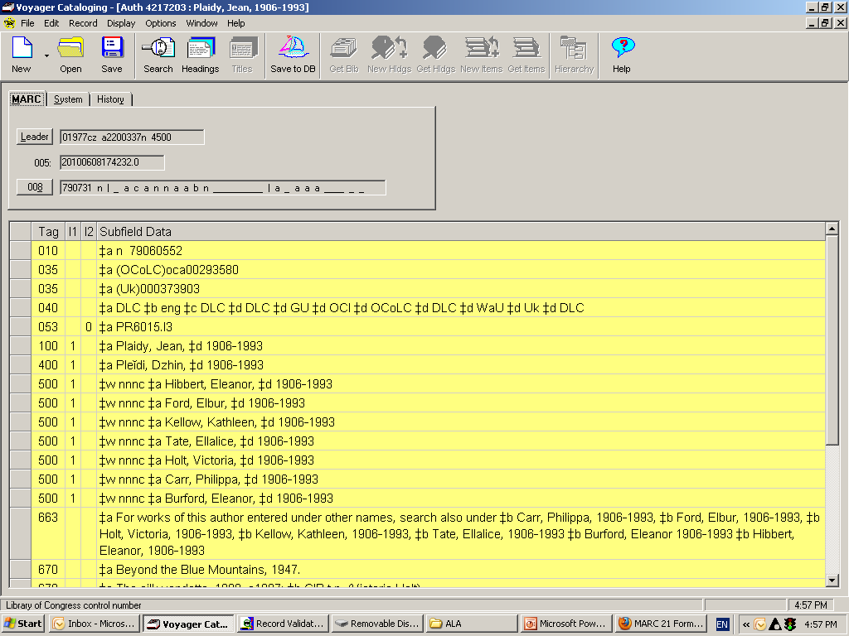
LC关于使用代码“r”和子字段$i的政策
个人名称——笔名
- 请勿对多个笔名使用$w/0、“r”及子字段$i。
- 请将$w nnnc与663字段注释结合使用（参见常见问题解答：http://www.loc.gov/catdir/cpso/pseud.pdf）
示例：n 79060552
035 $a(Uk)000373903
040 $a DLC $b eng $c DLC $d DLC $d GU $d OCI $d OCoLC $d DLC $d WaU $d Uk $d DLC
053 0 $a PR6015.I3
100 1 $a 普莱迪，简，$d 1906-1993
400 1 $a 普列伊迪，德金，$d 1906-1993
500 1 $w nnnc $a 希伯特，埃莉诺，$d 1906-1993
500 1 $w nnnc $a 福特，埃尔伯，$d 1906-1993
500 1 $w nnnc $a 凯洛，凯瑟琳，$d 1906-1993
500 1 $w nnnc $a 泰特，埃拉利斯，$d 1906-1993
500 1 $w nnnc $a 霍尔特，维多利亚，$d 1906-1993
500 1 $w nnnc $a 卡尔，菲利帕，$d 1906-1993
500 1 $w nnnc $a 伯福德，埃莉诺，$d 1906-1993
663 $a 对于以其他名称著录的该作者作品，另见 $b 卡尔，菲利帕，1906-1993，$b 福特，埃尔伯，1906-1993，$b 霍尔特，维多利亚，1906-1993，$b 凯洛，凯瑟琳，1906-1993，$b 泰特，埃拉利斯，1906-1993 $b 伯福德，埃莉诺 1906-1993 $b 希伯特，埃莉诺，1906-1993
670 $a 《越过蓝山》，1947年。
92
示例：n 79060552
92
Notes:
For pseudonyms under AACR2 we use a combination of subfield $w/ position 3 “c” and a 663 note to tie together multiple pseudonyms and we will continue to do that under RDA until we have had the time to discuss with our subject colleagues the impact of undoing the “Basic name” approach to authors with multiple pseudonyms.
Currently under LCSH we need to identify one name for use in biographies, etc. Stay tuned for development on this issue.

Slide 12
LC政策：代码“r”和子字段$i——笔名
可选地，对于单个笔名，可使用$w/0、“r”代码和子字段$i。
- 示例：
- 100 1 $a King, Stephen
- 500 1 $w r $i 别名身份：$a Bachman, Richard
- 100 1 $a Bachman, Richard
- 500 1 $w r $i 真实身份：$a King, Stephen
- 或者，继续使用不带子字段$w的简单500字段
- 对于笔名，需遵循互惠原则
- 无论是仅有一个笔名还是多个笔名
- 这意味着每个名称都必须拥有独立的NAR
Notes:
But for a single pseudonym we now have the option of using subfield $w/0 in conjunction with subfield $i and the terms from Appendix K. Currently we would only use a simple 500 to connect the two names. As you see this is more user friendly and it may be something catalogers will want to use, but again this is still an option.

Slide 13
LC政策代码“r”与子字段$i——机构名称
机构名称（依据 LCPS 32.1.1.3）
- 在RDA NAR中，请勿为早期/后期关系使用代码“r”和子字段$i
- – 继续在5XX字段中使用编码为“a”（早期）和/或代码“b”（后期）的子字段$w/0以关联机构名称
- 在此情况下，每条NAR均需建立对应的反向NAR
请注意，PCC成员馆不受LC政策关于使用早期/后期关系的约束。自美国RDA测试项目启动以来，它们在关联机构名称时，已开始使用附录K术语创建带有关系指示符的NAR。
Notes:
Remind LC catalogers that PCC libraries have been adding Appendix J and especially Appendix K terms in NARs.
While Appendix J terms are easily absorbed into the LC/NAF without notice but, the Appendix K terms are more intrusive as we’ll see in the next few slides.

Slide 14
$w 子字段 – 早期/后期 – 机构
NAR 1
1XX _# $a 机构A
5XX _# $w b $a 机构B
NAR 2
1XX _# $a 机构B
5XX _# $w a $a 机构A
5XX _# $w b $a 机构C
NAR 3
1XX _# $a 机构C
5XX _# $w a $a 机构B
Notes:
This slide shows the current example of what we do when Body A changes its name to Body B – We add the “b” in $w/0 of the NAR for Body A and to the NAR for Body B and subsequently we add the $w/0 “a” when Body B changes it’s name to Body C you add another 5XX with $w/0 for the later name and create the a new NAR for Body C with the $w/0.
Just as we have been doing – we are continuing our practice under RDA per LCPS 32.1.1.3.

Slide 15
LC政策代码“r”与子字段$i——机构名称
但是，如果需要某个机构名称的后期形式，而早期形式已存在于由PCC创建的、包含子字段$i和附录K关系标识符的RDA名称权威记录中，该怎么办？
- 采用编目员的判断
- 为该名称的最新形式创建一个新的RDA名称权威记录，其中子字段$w/0编码为“r”，并添加子字段$i
- 或者直接添加$w/0，分别标注a（早期）和b（后期）
- 此情况下允许使用混合NAR——这指的是允许混合使用MARC内容标识，而非指标题本身是混合的
Notes:
Remember that earlier I said that LC started out saying that code “r” and subfield $i had been created specifically for RDA but we quickly found that these had to be used in AACR2 NARs because there was no other way to make the reciprocal link when connecting to an existing AACR2 NAR – and I showed you the example of a cataloger that wanted to link a person to an RDA family name and the name was already established as AACR2 so we had to allow code “r” and subfield $i not just for RDA NARs.
The same is true for corporate names LC will continue to code for earlier/later relationships but supposing you have a situation where you need a new NAR and there are NARs created by a PCC library using RDA Appendix K and these relationships are not called earlier/later but called “predecessor/successor” – well, as with the family name we have what might be termed a hybrid situation – LC catalogers will have to pull out the old Cataloger Judgment charm and decide on one of 2 choices. Let’s look at the example on the next page.

Slide 16
LC政策子字段$w r与$i – 关系标识符 – 机构
PCC编目员创建的RDA NAR 1
1XX _# $a 机构A
5XX _# $w r $i 后继者：$a 机构B
PCC编目员创建的RDA NAR 2
1XX _# $a 机构B
5XX _# $w r $i 前继者：$a 机构A
5XX _# $w r $i 后继者：$a 机构C
5XX _# $w b $a 机构C
LC编目员创建的NAR 3
1XX _# $a 机构C
5XX _# $w r $i 前继者：$a 机构B
5XX _# $w a $a 机构B
Notes:
In this case here we see 2 reciprocal NARs created by a PCC cataloger and now the LC cataloger has the need to create a NAR for a later change of name then the cataloger must choose to decide is to follow the pattern used or to make the new NAR with the earlier/later usage – up to you – use your judgment and common sense. In this case hybrid NARs are OK – the hybridness is really just in the mixing of MARC subfielding so we can live with this.

Slide 17
LC政策代码“r”与子字段$i——机构名称
团体名称
- 可选地，可使用代码“r”和子字段$i将个人与团体名称关联起来
- 不要求双向关联
- 5XX系列中使用的名称必须经过规范控制
- 注意：RDA中并未规定团体名称中必须包含个人姓名——此处无LCPS（本地处理说明）
- 当前个人与团体名称关系的示例
110 2# Art Tatum Trio
500 1# Tatum, Art, $d 1909-1956
100 1# Tatum, Art, $d 1909-1956
510 2# Art Tatum Trio
Notes:
This example shows the NAR for the Art Tatum Trio - under the previous LCRI – LC restricted making links between the group and the person unless the person’s name appear as part of the name of the corporate entity and we encouraged reciprocity.
Under RDA there is no LCPS limiting the addition of these relationships – but just as before if you do make those links the names in the 5xx must be established; however reciprocity is not required.

Slide 18
LC政策：代码“r”与子字段$i
示例：
- 110 2# $a R.E.M（音乐团体）
- 500 1# $w r $i 成员：$a Stipe, Michael, $d 1960-
- 500 1# $w r $i 成员：$a Buck, Peter, $d 1956-
- 500 1# $w r $i 成员：$a Mills, Mike, $d 1958 12月17日-
- 500 1# $w r $i 成员：$a Berry, Bill, $d 1958-
- 670 ## $a Rock on, c1985: ‡b v. 3（R.E.M.成立于1980年； Michael Stipe，主唱；Pete Buck，吉他；Mike Mills， 贝斯与主唱；Bill Berry，鼓与主唱；所在地， 佐治亚州雅典市。）
Notes:
Example for R.E.M.
In this case making all the relationships to the band members means that you will also have to create authority records for the names of the persons. Continue to rely on 670 information to show that a member has been added, etc.

Slide 19
LC政策：代码“r”和子字段$i——附录K中缺少关系标识符
某些关系标识符是单向的——部分术语尚未在附录K中定义
- 在下例中，对于“团体成员”没有合适的对等术语
- 100 1# $a Stipe, Michael, $d 1960-
- 510 2# $a R.E.M. (音乐团体)
- 100 1# $a Buck, Peter, $d 1956-
- 510 2# $a R.E.M. (音乐团体)
Notes:
Here’s a lacuna in RDA; because currently there is no term available to in Appendix K to convey the relationship between corporate body and the person (other than employer) then on the personal name NAR we’d simply have a 5XX without the subfield $i – in other words what we call a “simple” see also.

Slide 20
LC政策：代码“r”与子字段$i
谨慎使用个人对机构实体的关系标识符
使用关系标识符将机构实体与个人关联时，需警惕其反向关系。
- 在为美国国会图书馆（LC）或迪士尼等机构建立规范权威记录（NAR）时，若为每位在职人员都添加“雇员”关系标识符，将产生数千条名称记录。
- 示例：
- 100 1# $a 林顿, 詹姆斯·H.
- 510 2# $w r $i 雇主: $a 美国国会图书馆
Notes:
Relate the corporate body to the person but be wary of the reciprocal relationship for example in the case of the NAR for the Library of Congress or Disney, or any large institution it would be thousands of names to be added to the NAR if you added the relationship “Employee” for each person.

Slide 21
LC关于使用代码“r”和子字段$i的政策
5XX字段中使用的所有名称均应已确立
在一个NAR中使用的5XX字段，在相关NAR中无需互为对应的5XX字段
- 110 2# $a 美国国会图书馆
- 500 1# $w r $i 雇员：$a Guiles, Kay D.
- 500 1# $w r $i 雇员：$a Reser, David
- 500 1# $w r $i 雇员：$a Phong, Tran
- 500 1# $w r $i 雇员：$a Sinclair, Linda
+ 以及大量其他示例
最佳实践：建议改用MARC 373字段来显示这些关联团体关系
- 示例：100 1# $a Guiles, Kay D.
- 373 ## $a 美国国会图书馆 $s 1958
Notes:
In RDA making the reciprocal 5XX on the opposite NAR is not required – especially in the case of Employer/Employee relationships. A best practice would be to add the 373 to NAR instead of a 510 to the personal name NAR to show the relationship– this is cataloger judgment.
Consider that in the case of a musical group, architectural firm or other corporate body that has 6 or 7 prominent members showing a reciprocal relationship to those persons may be acceptable, but for a large institution that has hundreds/thousands of employees it would be best practice to not make those relationships in the NAR.

Slide 22
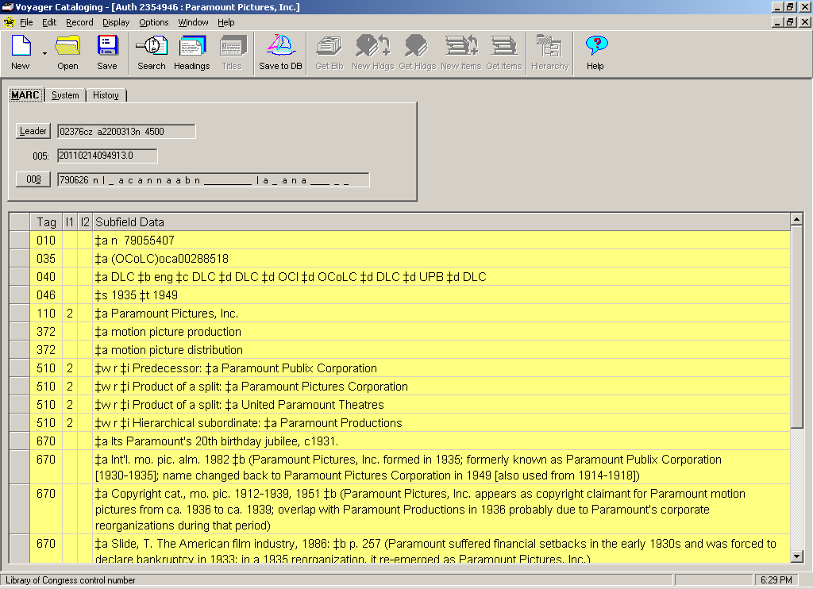
010 $a n 79055407
035 $a (OCoLC)pca00288518
示例
040 $a DLC $b eng $c DLC $d DLC $d OCI $d OCoLC $d DLC $d UPB $d DLC
046 $s 1935 $t 1949
110 2 $a 派拉蒙影业公司
372 $a 电影制作
372 $a 电影发行
510 2 $w r $i 前身：$a 派拉蒙公共公司
510 2 $w r $i 分拆产物：$a 派拉蒙影业公司
510 2 $w r $i 分拆产物：$a 联合派拉蒙剧院
510 2 $w r $i 层级从属：$a 派拉蒙制作
670 $a 其派拉蒙20周年庆典，约1931年。
670 $a 国际电影年鉴 1982 $b (派拉蒙影业公司于1935年成立；前身为派拉蒙公共公司[1930-1935]；1949年改回名为派拉蒙影业公司[也用于1914-1918])
670 $a 版权目录，电影 1912-1939, 1951 $b (派拉蒙影业公司作为派拉蒙电影的版权所有者出现，时间约为1936年至1939年；与1936年的派拉蒙制作重叠可能是由于派拉蒙在此期间进行了公司重组)
670 $a Slide, T. 美国电影业，1986: $b 第257页 (派拉蒙在20世纪30年代初遭受财务挫折，并于1933年被迫宣布破产；在1935年的重组中，它重新以派拉蒙影业公司的身份出现。)
示例
M
M
Notes:
So now your saying – I ain’t scared of no relationship designator - but look at this NAR and at the corporate body relationships to other corporate bodies shown here and note the complexity. Me, I prefer the simple earlier/later, but if an institution has the need and time for catalogers to show all these relationships, the use of Appendix K facilitates this – so just be aware of the possibilities.

Slide 23
附录J：规范记录（NAR）中的关系标识符
示例：
046 ## $k 1933
130 ## $a 《魔鬼兄弟》（电影）
380 ## $a 电影
500 1# $w r $i 影视改编作品：‡a Auber, D. F. E. $q (Daniel François Esprit), $d 1782-1871. $t Fra Diavolo
670 ## $a 《魔鬼兄弟》，1933年。
670 ## $a IMDB.com，2010年12月27日 ‡b （《魔鬼兄弟》；改编自奥贝尔《Fra Diavolo》的电影，由米高梅公司制作并于1933年发行）
Notes:
Before we wrap up - I want to quickly show you an example of using terms from Appendix J in NARs for works and expressions – Here is an example of using a relationship designator for Related Works (Work to Work relationship) – The Motion picture is a work and the term used shows its relationship to the opera by Auber. Notice also the 046 subfield $k the date of the creation of the work and the 380 added to show Form of the work.

Slide 24
附录J：NAR中的关系标识符
示例：
046 ## $k 1830
100 1# $a 奥贝尔，D. F. E. $q (丹尼尔·弗朗索瓦·埃斯普里), $d 1782-1871. $t 《弗拉·迪亚沃洛》
380 ## $a 歌剧
530 ## $w r $i 改编为电影（作品）：‡a 《魔鬼兄弟》（电影）
670 ## $a 维基百科，2010年12月27日 ‡b （《弗拉·迪亚沃洛》； 特拉奇纳客栈；特拉奇纳旅馆；丹尼尔·奥贝尔创作的喜歌剧；大致基于米凯莱·佩扎的生平；1830年1月28日在巴黎首演）
Notes:
This is of course reciprocal on the Name/Title NAR for the work and in this case the term is Adapted as a motion picture (work): and again notice the 046 this time for the creation of the opera based on when it was first performed. These are the same relationships you might make in the bibliographic record but they can also be made in NARs.

Slide 25
附录J：NAR中的关系标识符
附加测验：
100 1# $a 三岛由纪夫, $d 1925-1970. $t 潮骚. $l 英语
400 1# $a 三岛由纪夫, $d 1925-1970. $t 潮骚
670 ## $a 潮骚, 1994.
336 ## $a 文本 $2 rdacontent
500 1# $w r $i 译自：$a 三岛由纪夫, $d 1925-1970. $t 潮骚
互惠式NAR参考价值有限：
100 1# $a 三岛由纪夫, $d 1925-1970. $t 潮骚
500 1# $w r $i 译为：$a 三岛由纪夫, $d 1925-1970. $t 潮骚. $l 英语
Notes:
25
25
One last example for Appendix J in the form of a quiz. So here is the NAR for the name/title – authorized access point for the preferred title. What could we add to this NAR? It’s an expression so we add 1) a 336 for the type of content (field used only for expressions which this is) and 2) a 500 with the relationship designator from Appendix J for Related Expressions – Derivative Expression Relationships: Translation of – NOTICE here that you do not need to add (work) in this case because that is all it could ever be – a translation of a work so no need to repeat.
Note also that in this case the reciprocal NAR is not very helpful (at least in the current scenario) but perhaps in the future… – the point is that some PCC institutions are making these relationships in NARs now so you will see these in the LC/NAF.
25

Slide 26
有问题？ LChelpforRDA@loc.gov

