Slide 1
Convolution Hardware Accelerator
Oscar Kellner

Slide 2
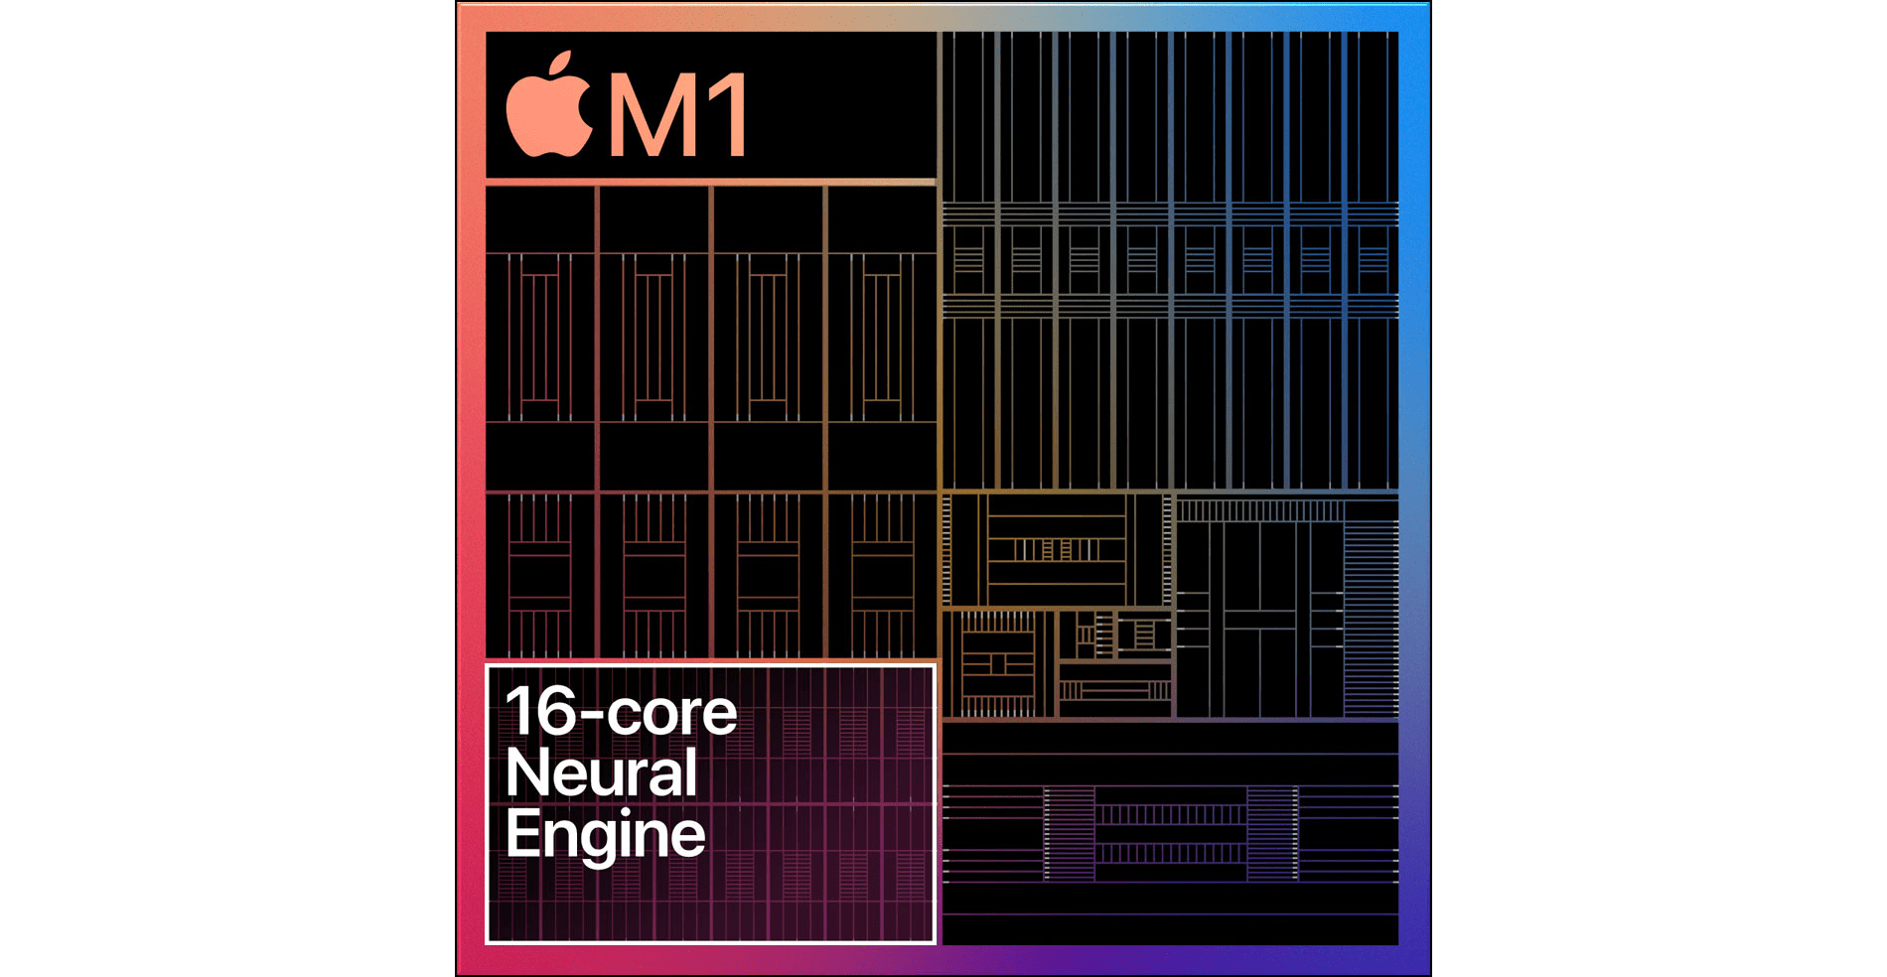
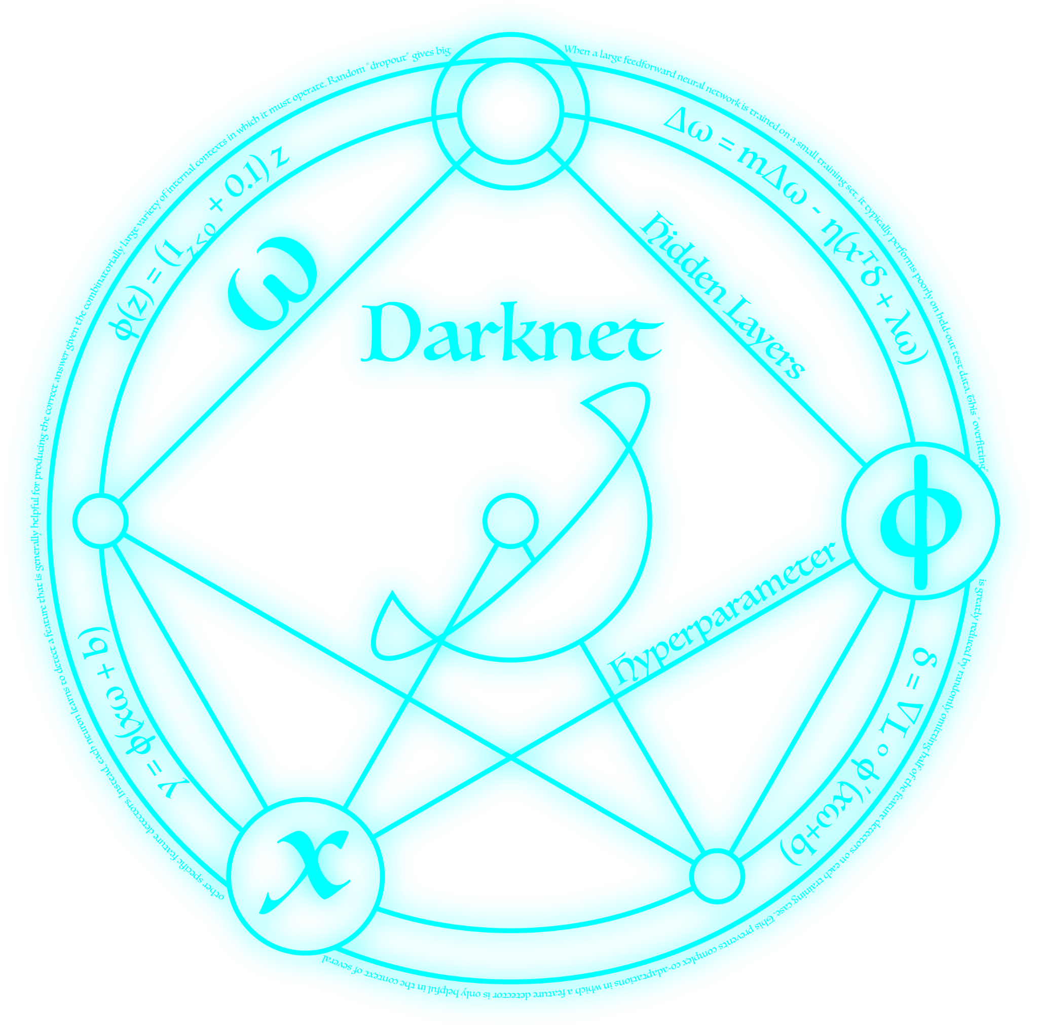

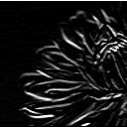
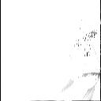
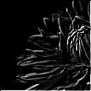
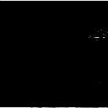

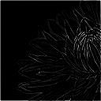
Introduction
Machine Learning and Image Processing is cool
Kind of fast in optimized software, but can it be faster with the help of dedicated hardware?
Goal: design convolution hardware accelerator for use within existing machine learning framework (Darknet)

Slide 3
Tasks
Design new HW friendly algorithm
Synthesize and optimize hardware
Verify with Python
Interfacing in C
Integrate with Darknet

Slide 4
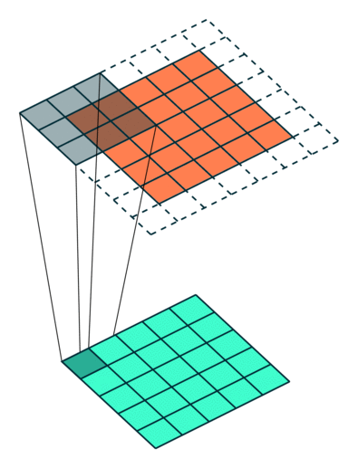
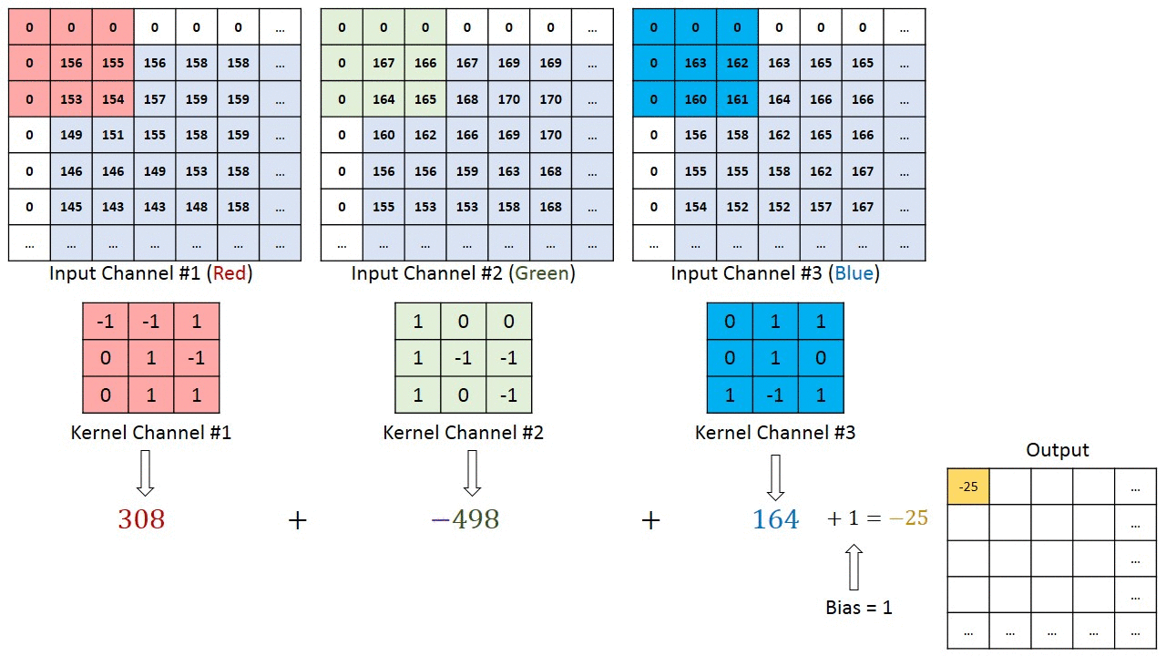
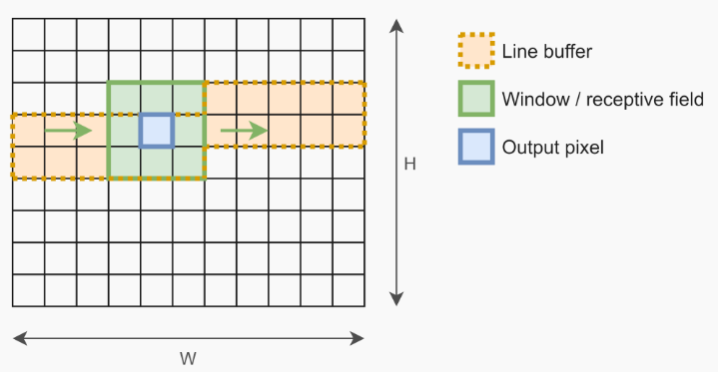
Convolution Overview

Slide 5
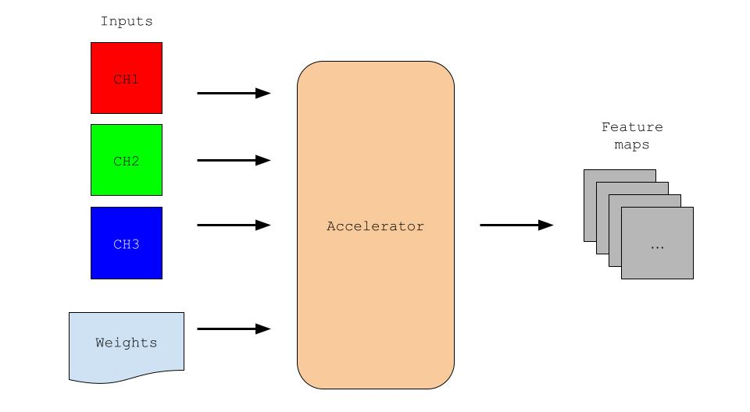
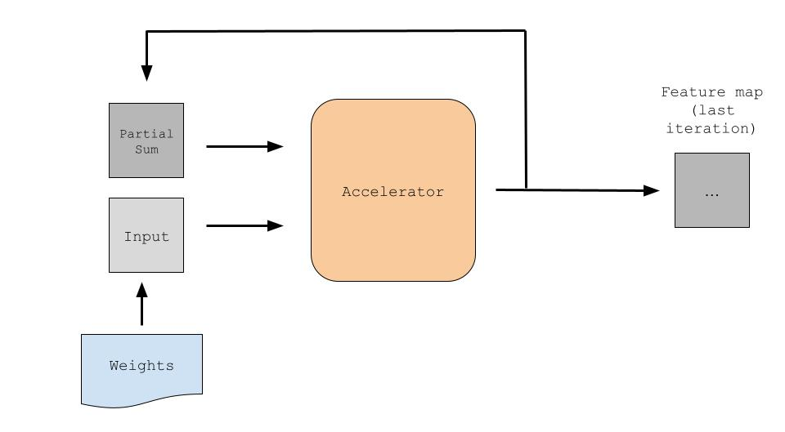
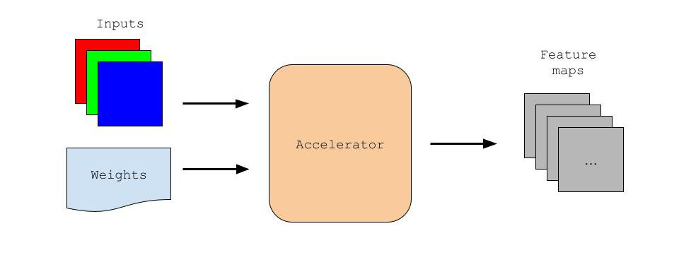
Designs

Slide 6
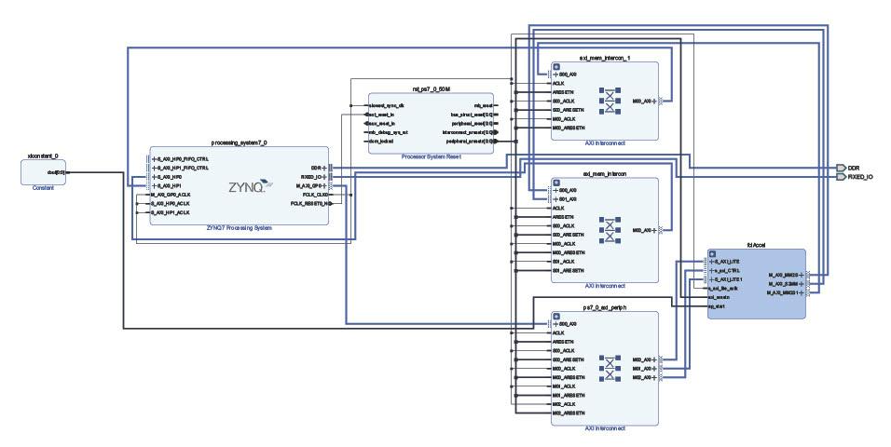
Block Diagram

Slide 7
Performance (first layer of tiny.cfg only)
Unoptimized hardware w/ Python:
Optimized hardware w/ Python:
About 3.4 times speedup after optimization, 5.6 times when discounting loading overhead
Optimized hardware in C:
About 1.3 times faster than Python (not accounting for filling buffers)

Slide 8
What about the whole network?
SEGMENTATION FAULTS!
Darknet will not run on the PYNQ!
When one segfault is fixed, more arise.
It may be possible to fix them all, but there wasn’t enough time left.

Slide 9
Lessons Learned
Test everything first before integration!
Too much time spent hastily debugging ‘broken’ designs
Communicate more often

Slide 10
References
https://medium.datadriveninvestor.com/convolutional-neural-networks-3b241a5da51e
https://m-alcu.github.io/blog/2018/01/13/neural-layers/
https://towardsdatascience.com/convolutional-layer-hacking-with-python-and-numpy-e5f64812ca0c
https://pjreddie.com/darknet/
https://basile.be/2019/03/18/a-tutorial-on-non-separable-2d-convolutions-in-vivado-hls/

