Slide 1
Analytics Team Blog: OfficeR
11 May, 2018

Slide 2
Heading for Text Slide
Here I have random text It even covers multiple lines Maybe it should be my lymerick That I didn't ever submit
Here I've added a random second paragraph This paragraph is indented Just to indicate a small amount of what can be done with text in OfficeR

Slide 3
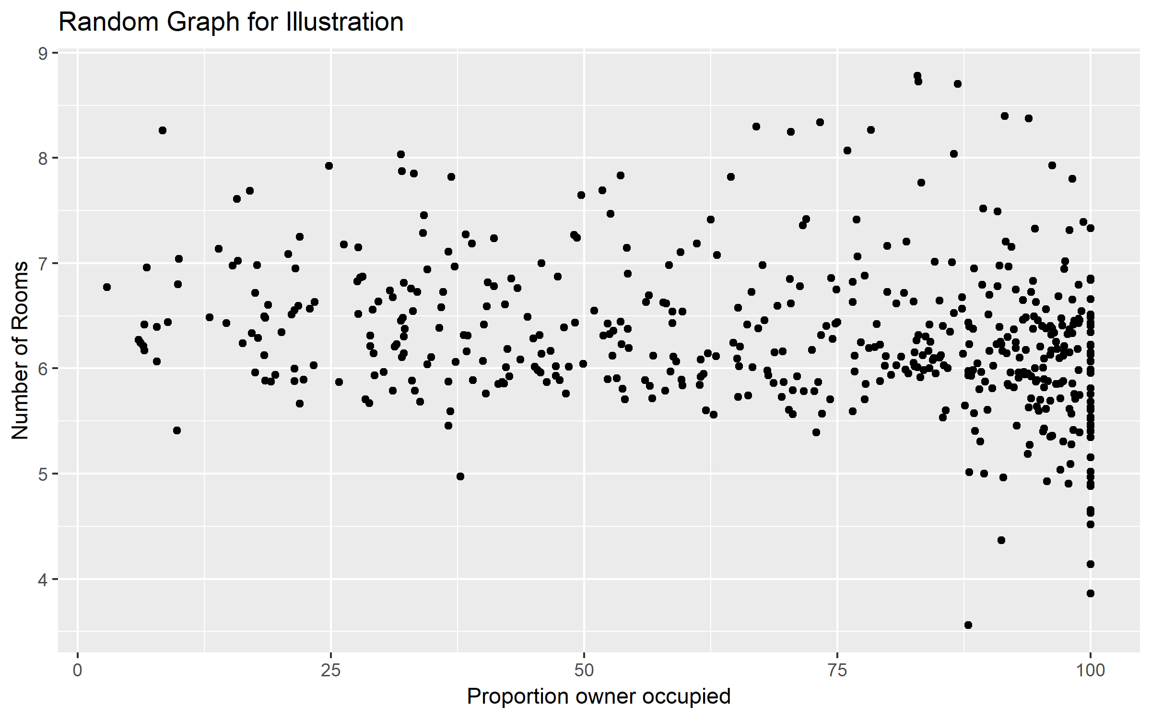
This is the title for my graph slide. Very original

Slide 4
This is the title of the slide that contains my table. Even more original
ColumnHead1 | ColumnHead2 | ColumnHead3 | ColumnHead4
Row 1 | 4 | 5 | 7
Row 2 | 1 | 3 | 9
Row 3 | 2 | 6 | 8
Row 4 | 10 | 19 | 432
Row 5 | 2 | 6 | 8
Row 6 | 2 | 6 | 8
Row 7 | 2 | 6 | 8
Row 8 | 2 | 6 | 8

