Slide 1
Learning Management System
Project of Team 12

Slide 2
Charter
Official Project Name
University LMS
Project Sponsor
Ministry of High Education & Scientific Research

Slide 3
Purpose
A multi-platform application and system that provides an easier way to manage and enhance the learning process specially in the collegial phase.

Slide 4
Key Deliverables
For Students
A website and a phone application where they can study, learn and be examined.
For Professors and TAs
A dashboard which they put their materials and exams and get results that are enhanced by artificial intelligence to get better overview of the students’ progress
For University/College
A general dashboard which it tracks students portfolios, profiles and grades.

Slide 5
Project Resources
Initial Budget
For servers components:
2 Millions EGP
Hired Developers
Salary
Continuous Budget
Maintenance Servers
10 thousands EGP
IT Managers
Salary

Slide 6
Assumptions
The application will be compatible with most popular phones versions and supports Android/IOS.

Slide 7
High-Level Risks
Network failure of servers
Data Loss
Unwanted Access
Modifying of grades
Leaking of personal data

Slide 8
Project Acceptance
Stability under heavy pressure
Interoperability and synchronization between other services.

Slide 9
Exclusions
Any HR related dashboards for managing the workers and employees in the university.

Slide 10
Work Breakdown Structure
Starting
Requirements
Doing study about the project
Plan the project
Hardware and Software
Operating System
Testing Devices
Coding
Algorithm Design
Coding the functions in all tasks
Test Functions
Interface the application
Finishing
Test the application
Fixed Errors
Finish the application
Install the Application
Training the administrators

Slide 11
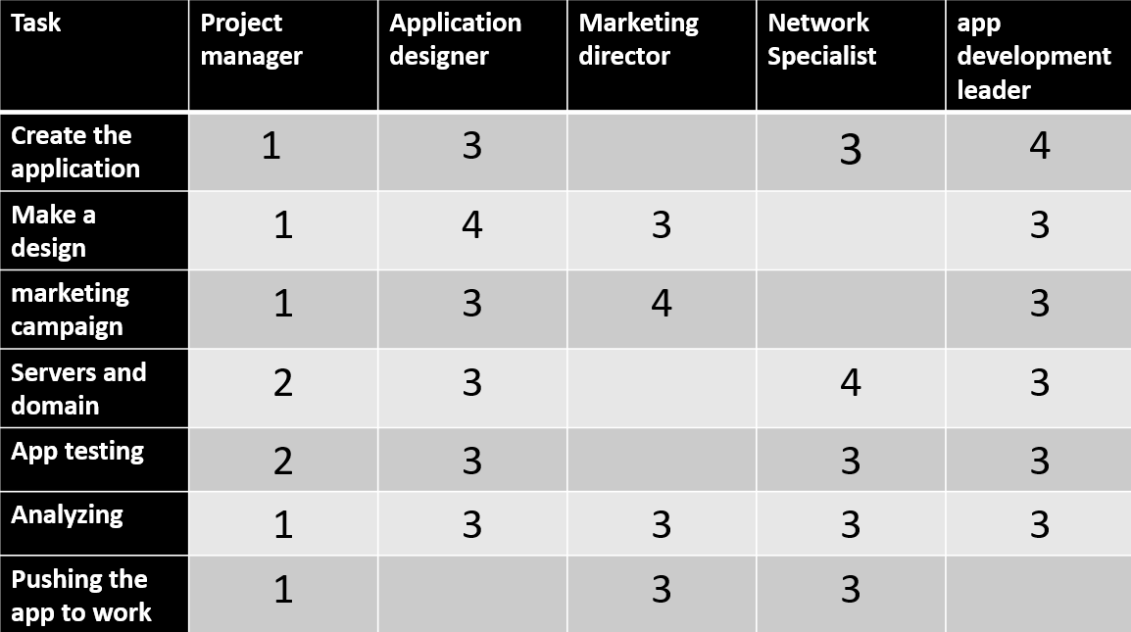
Responsibility Matrix

Slide 12
Risks
Failure of the servers
Solution: Keeping maintenance and emergency unit.
Unauthorized access
Solution: Updating databases, increasing awareness about security.
Leaking of exams.
Solution: optional use of AI to check others answers.

Slide 13
Network
Activity | Description | Preceding Activity | Duration(Months)
A | Planning & Setting Environment | None | 3
B | Designing | A | 4
C | Implementation | A | 6
D | Testing | B & C | 3
E | Publishing Phase | D | 2
3 | B | 7
2 | Designing
5 | 4 | 9
0 | A | 3
0 | Planning & Setting Environment
0 | 3 | 3
9 | D | 12
0 | Testing
9 | 3 |  | 12
12 | E | 14
0 | Publishing Phase
12 | 2 |  | 14
3 | C | 9
0 | Implementation
3 | 6 |  | 9

Slide 14
Resources
ID | RES | DUR | ES | LF | SL | 1 | 2 | 3 | 4 | 5 | 6 | 7 | 8 | 9 | 10 | 11 | 12 | 13 | 14 | 15 | 16 | 17
A | 2 | 3 | 0 | 5 | 2 | 2 | 2 | 2 | 2 | 2
B | 4 | 4 | 3 | 9 | 2 |  |  |  |  |  | 3 | 3 | 3 | 3
C | 2 | 6 | 3 | 9 | 0 |  |  |  |  |  | 1 | 1 | 1 | 1
D | 3 | 3 | 9 | 12 | 0 |  |  |  |  |  |  |  |  |  | 3 | 3 | 3
E | 2 | 2 | 12 | 14 | 0 |  |  |  |  |  |  |  |  |  |  |  |  | 2 | 2
Total Resource Load |  |  |  |  |  | 2 | 2 | 2 | 2 | 2 | 4 | 4 | 4 | 4 | 3 | 3 | 3 | 2 | 2
Resource Available |  |  |  |  |  | 4 | 4 | 4 | 4 | 4 | 4 | 4 | 4 | 4 | 4 | 4 | 4 | 4 | 4 | 4 | 4 | 4

Slide 15
Budget Baseline
ID | Budget | 1 | 2 | 3 | 4 | 5 | 6 | 7 | 8 | 9 | 10 | 11 | 12 | 13 | 14
A | 450 | 150 | 150 | 150
B | 800 |  |  |  | 200 | 200 | 200 | 200
C | 1300 |  |  |  | 250 | 250 | 250 | 150 | 100 | 300
D | 1000 |  |  |  |  |  |  |  |  |  | 400 | 400 | 200
E | 200 |  |  |  |  |  |  |  |  |  |  |  |  | 100 | 100
Total | 3750 | 150 | 150 | 150 | 450 | 450 | 450 | 350 | 100 | 300 | 400 | 400 | 200 | 100 | 100
Commutative |  | 150 | 300 | 450 | 900 | 1350 | 1800 | 2150 | 2250 | 2550 | 2950 | 3350 | 3550 | 3650 | 3750
Matrix of activity with cost
ID
A | 150 | 150 | 100
B | 200 | 200 | 200 | 200
C | 250 | 250 | 250 | 150 | 100 | 300
D | 400 | 400 | 200
E | 100 | 100

Slide 16
Project Team
Zeyad Ahmed Ali
Zeyad Mohamed Hashem
Raed Reda Yaseen
Zeyad Walid El-Hosseiny
Zeyad Ali Mohamed
Romario Nageh
Zeyad Mohamed Hosny

