Slide 1
CPE 301 Project Presentation- PID Speed Control of DC Motor with Encoder
Eilat Avidan
avidan@unlv.nevada.edu

Slide 2
AIM & ACCOMPLISHMENT
AIM:
To control the speed of a DC motor with encoder
Send the speed motor to the terminal using FTDI chip (USART)
ACCOMPLISHMENT
The motor encoder is sending the speed value to the terminal every one second using FTDI chip (USART)

Slide 3
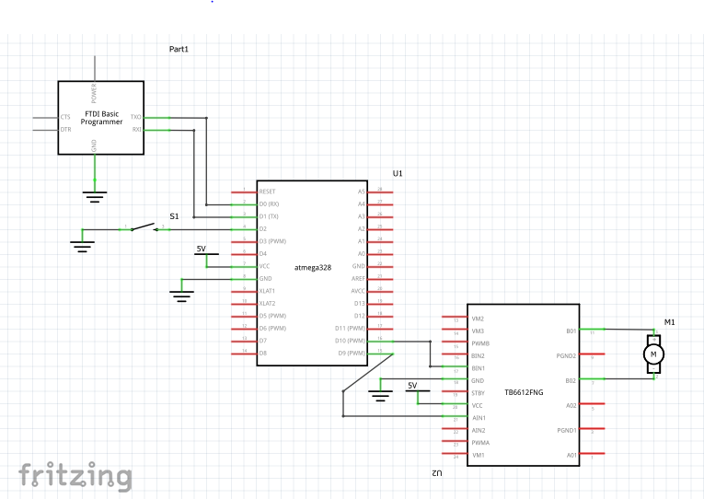
SCHEMATICS

Slide 4
DESIGN STAGES
Components
AVR ATMEGA328p
DRV8833 Dual Motor Driver
2,737 RPM- motor with encoder
FTDI chip
Switch
Power supply (5V)
Interfaces
Atmega328p – DRV8833
DC motor encoder- DRV8833 (driver)
Atmega328p – FTDI (USART)

Slide 5
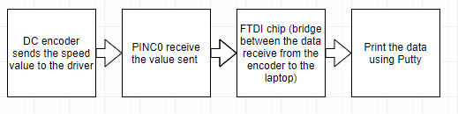
CODE DEVELOPMENT
Initialization
Initialize USART (void USART_init( unsigned int ubrr ))
Initialize ADC (void adc_init(void))

Slide 6
DEMO SNAPSHOT/VIDEO
Just Provide Links

