Slide 1
Jenkins (for JAVA world)
SDL - KHTP

Slide 2
Agenda
Introduction
What’s Continuous Integration?
CI Overview
What’s Jenkins?
Jenkins Architecture Overview
Execution Architecture
How we use Jenkins
Jenkins Features
Installation & Configuration
Requirement
Installation
Manage Jenkins
Configure System
Configure Global Security
Manage Plugins
Manage Nodes
Jenkins Jobs
Build Steps
New Job
Configuring Job
SCM Checkout
Pre-build Steps
Build Wrapper
Builder Runs
Recording
Notification
Jenkins Benefits
Conclusion

Slide 3
INTRODUCTION

Slide 4
What’s Continuous Integration (CI)?
Also referred to as "build automation"
Basic concept
CI server continuously integrates newly checked-in code into a build
Runs unit tests and rejects the build if they fail – (Optional)
Deploy builds to other servers – (Optional)

Slide 5


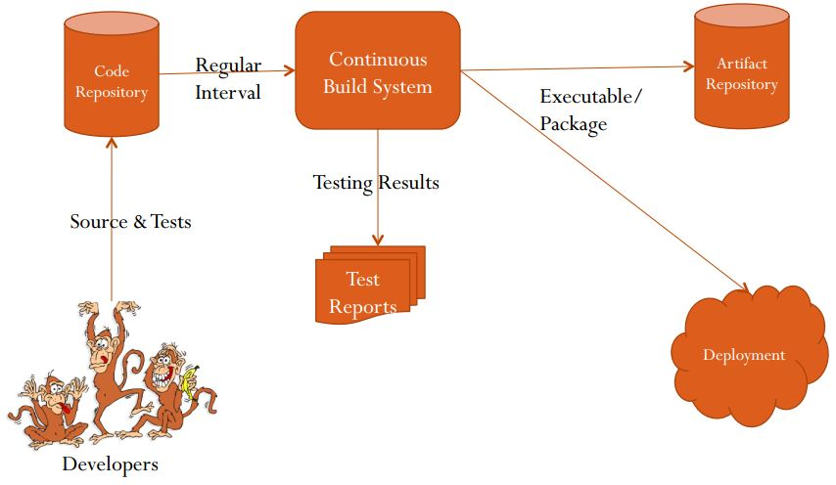

CI Overview

Slide 6
What’s Jenkins?
Continuous Integration (CI) server
Formerly known as Hudson
Java Based, Open source
Runs in servlet container such as Tomcat, JBOSS
Plugin Extensibility – Support over 400

Slide 7
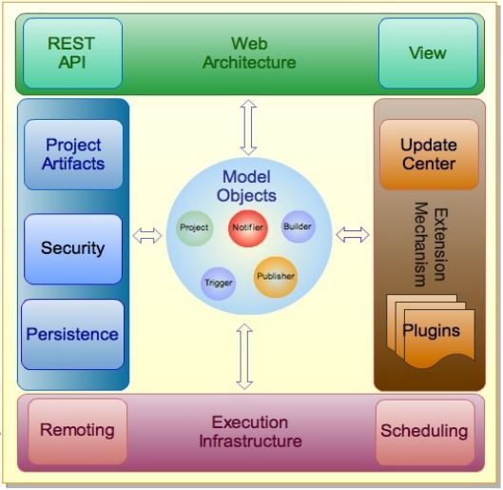
Jenkins Architecture Overview

Slide 8
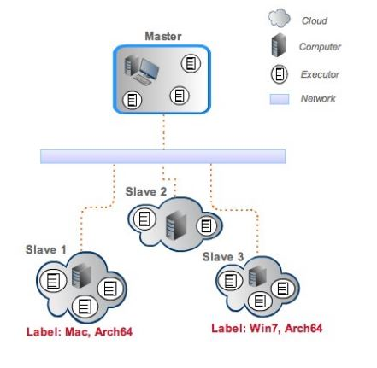
Execution Architecture

Slide 9
How We Use Jenkins
Developer
SVN Server
commits code to
Jenkins jobs scheduled to check for new code in SVN
If new code exists, Jenkins
does SVN checkout
Jenkins
Server
Jenkins builds WAR, deploys to server

Slide 10
Jenkins Features
Integrate with repository
Checkout the codes
Distributed Builds
Build and test
Generate test report
Notification
Archive and store in artifact repository
Deploy

Slide 11
Jenkins - Installation

Slide 12
Jenkins Requirements
Web Server (Tomcat, JBOSS, …)
Build tool (Maven, Ant)
SCM (Svn, Git, …)

Slide 13
Jenkins Installations
Download the WAR file from Jenkins Homepage
Deploy it to the Tomcat server
Start the Tomcat service
Jenkins can be accessible thru – http://localhost:8080/jenkins

Slide 14
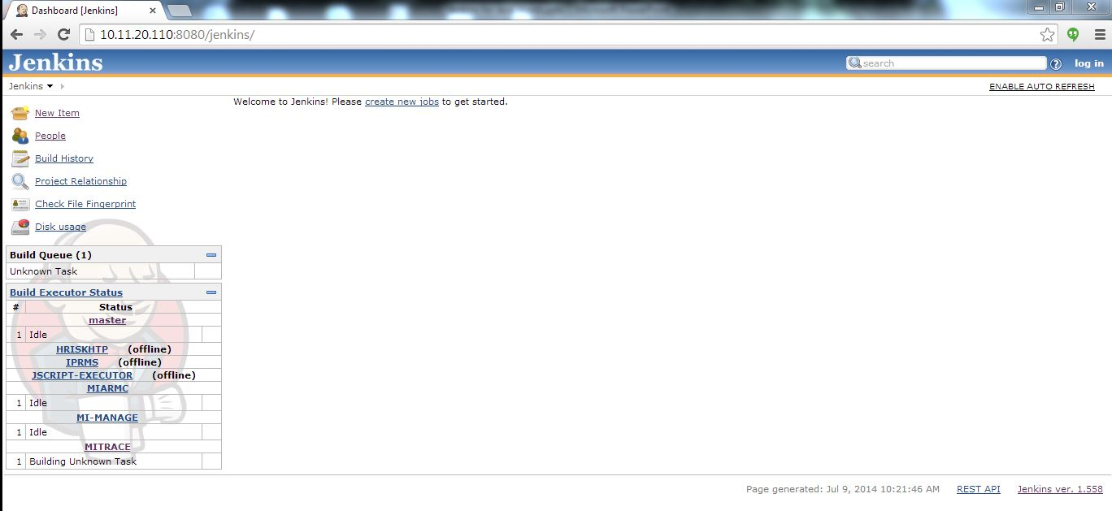
Jenkins – Main Page

Slide 15
Configure Jenkins

Slide 16
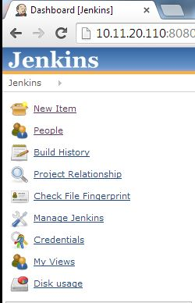
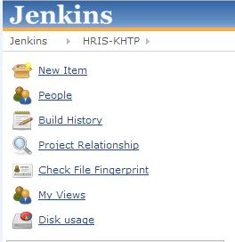
Jenkins Administration
Administrator
User

Slide 17
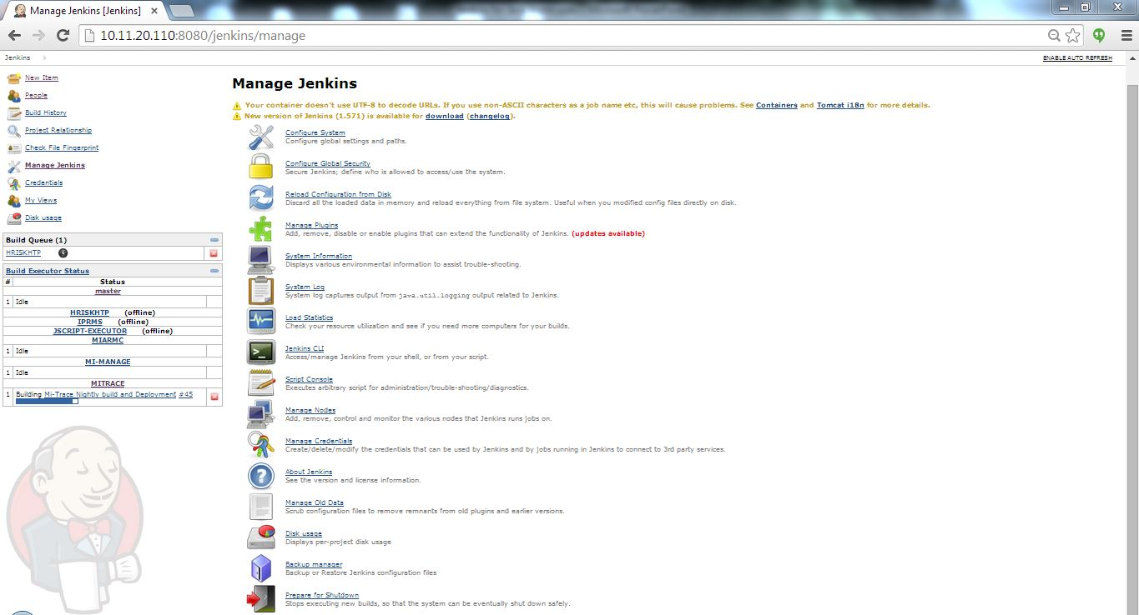
Manage Jenkins
Configure System

Slide 18
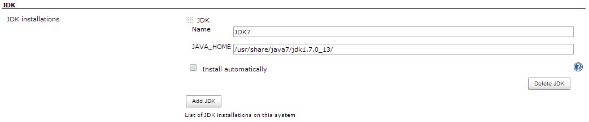
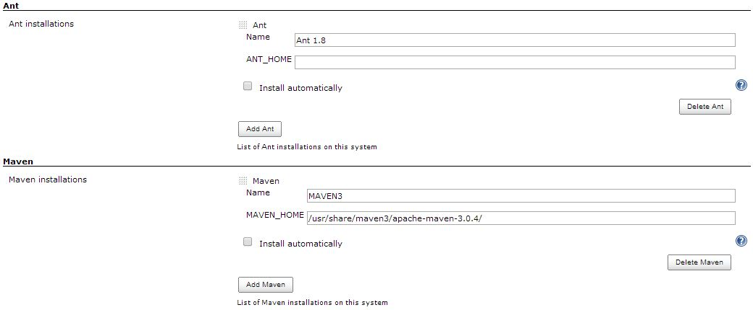
Configuring JDK & Build Tools
JDK
ANT
MAVEN

Slide 19
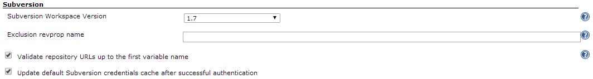
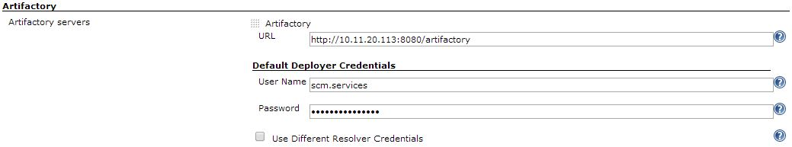
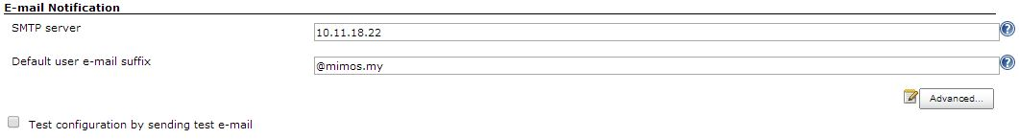
SVN
ARTIFACTORY
SMTP

Slide 20
Manage Jenkins
Configure Global Security

Slide 21
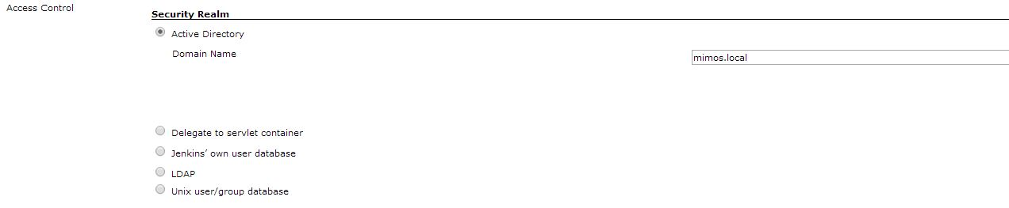
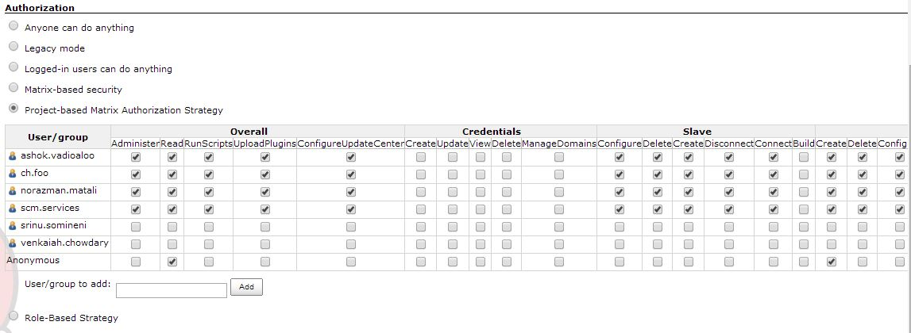
Secure Jenkins

Slide 22
Manage Jenkins
Manage Plugin

Slide 23
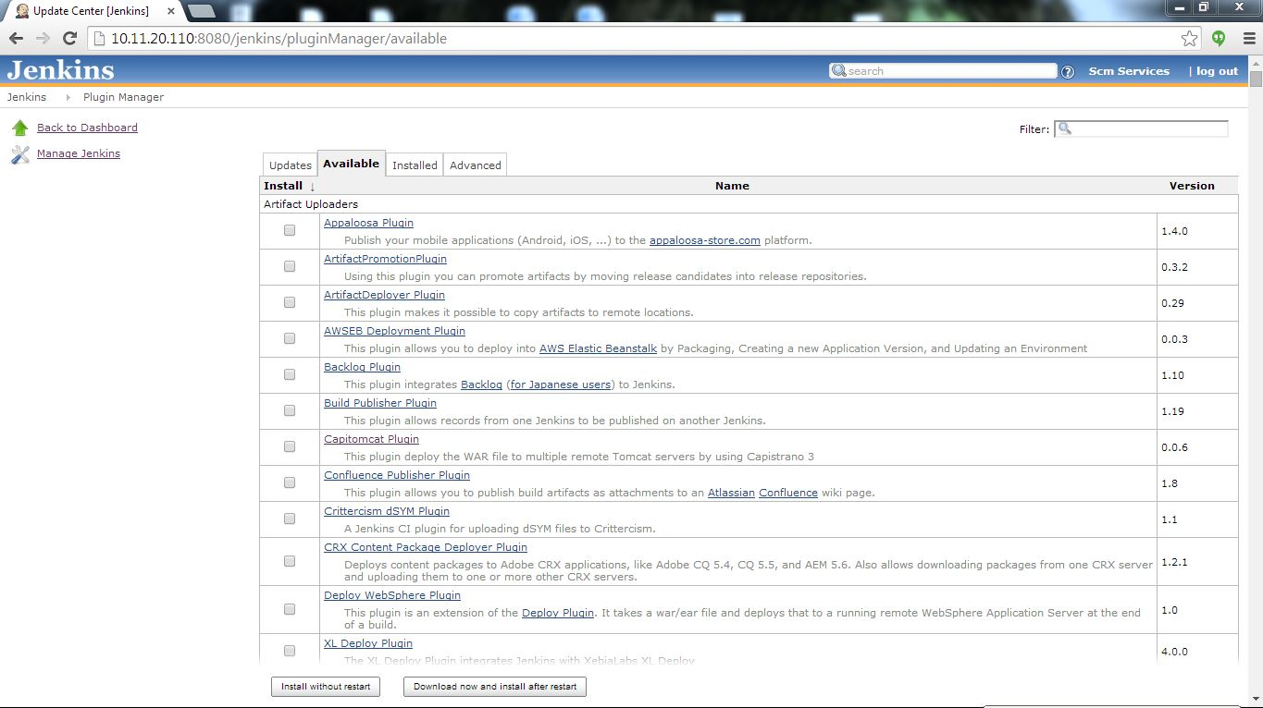
Jenkins Plugins Manager

Slide 24
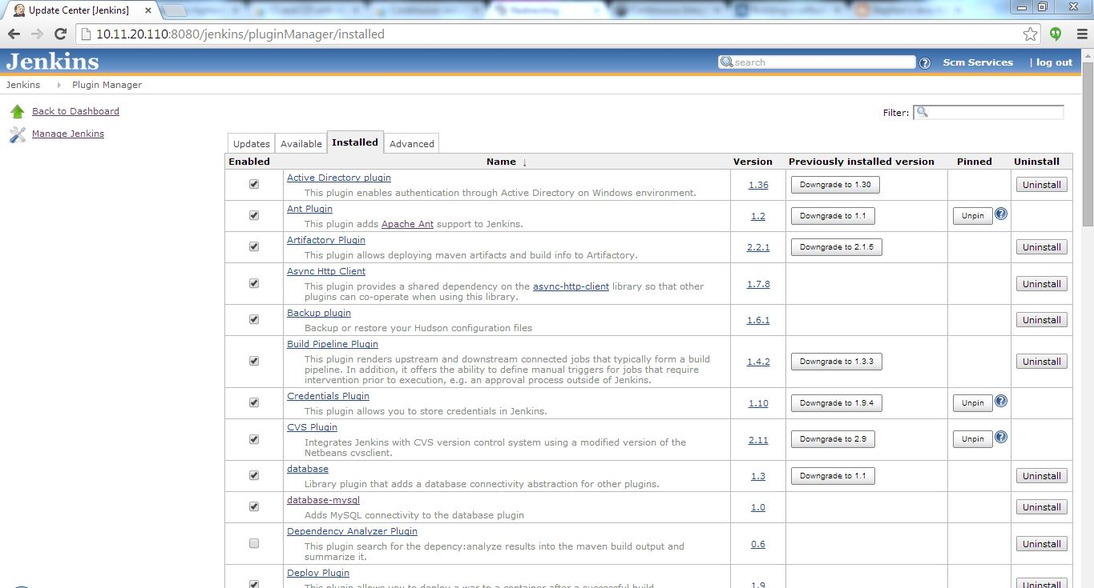
Jenkins Plugins Manager

Slide 25
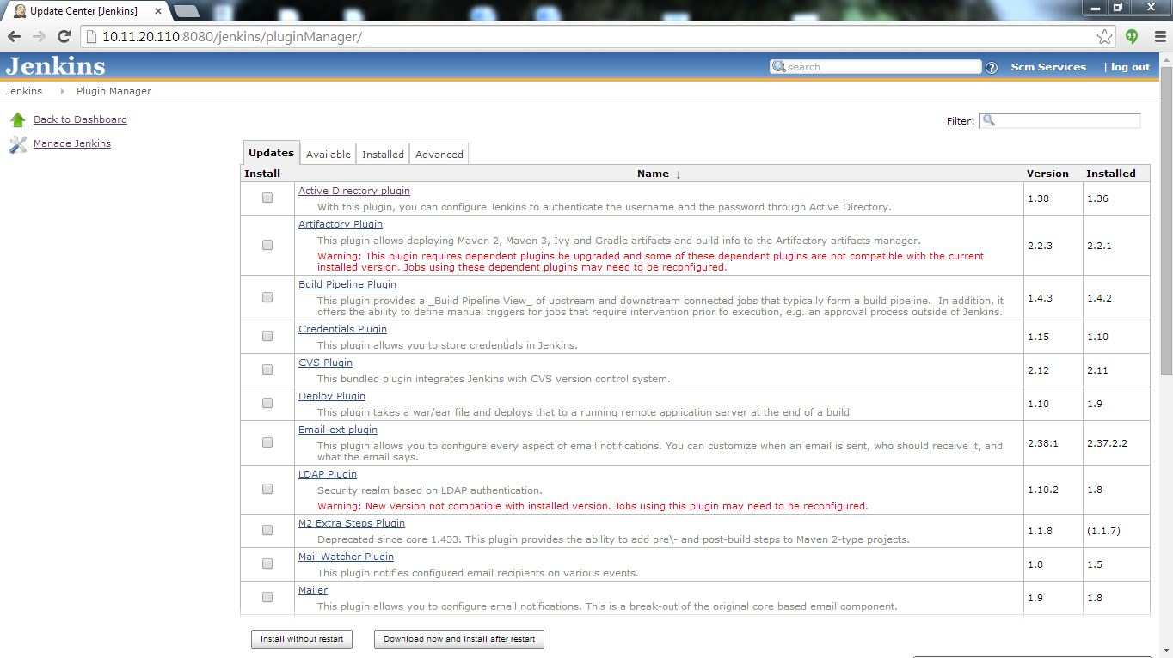
Jenkins Plugins Manager

Slide 26
Manage Jenkins
Manage Nodes

Slide 27
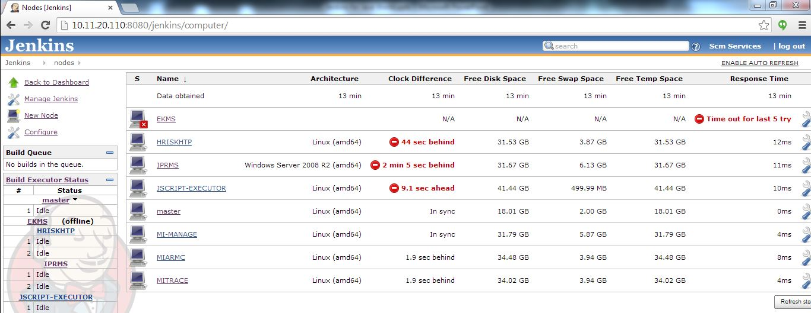
Distributed Build

Slide 28
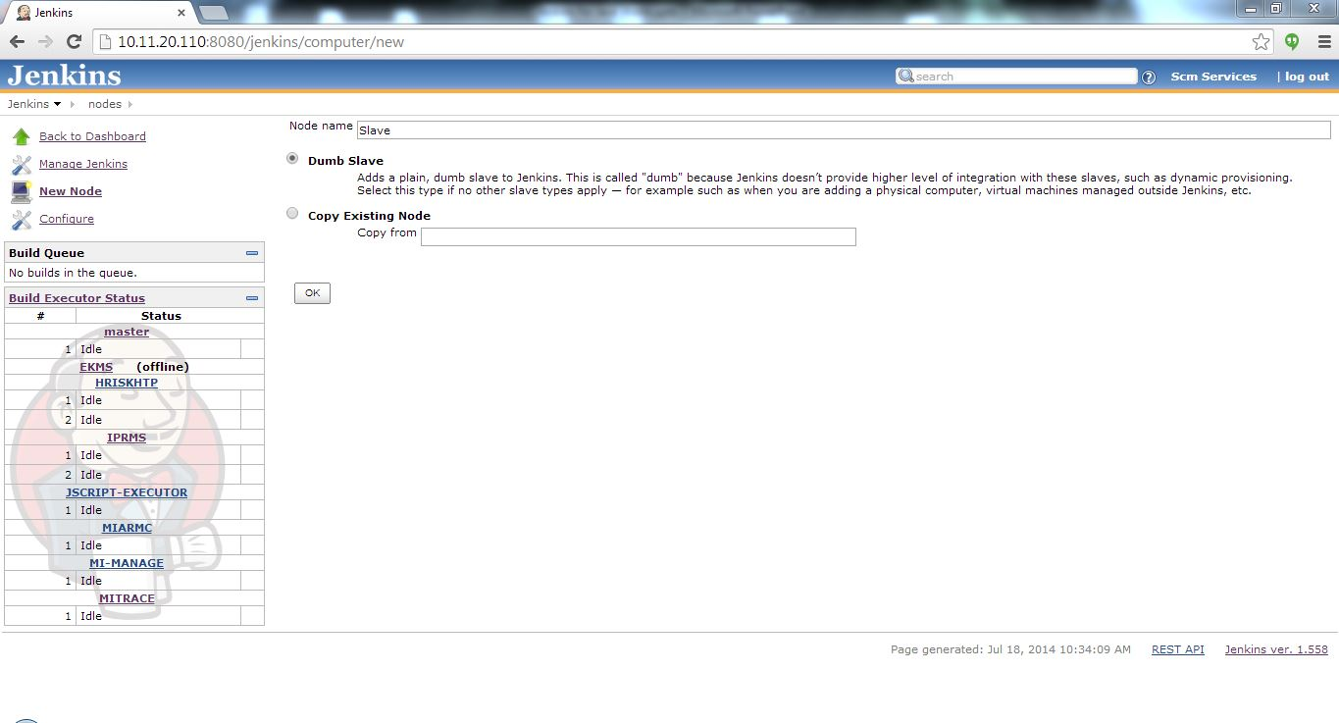
Jenkins – Configure Node

Slide 29
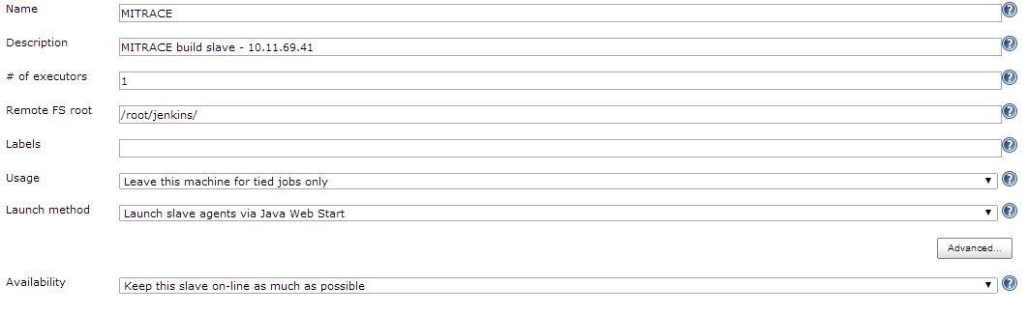
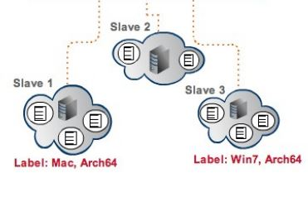
Jenkins – Configure Node

Slide 30
Jenkins JOBS

Slide 31
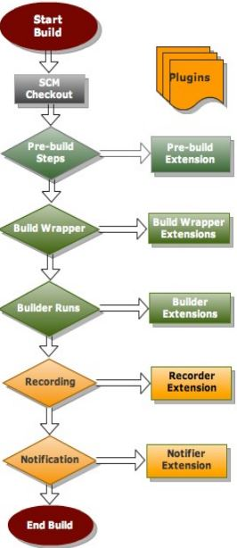
Jenkins – Build Steps

Slide 32
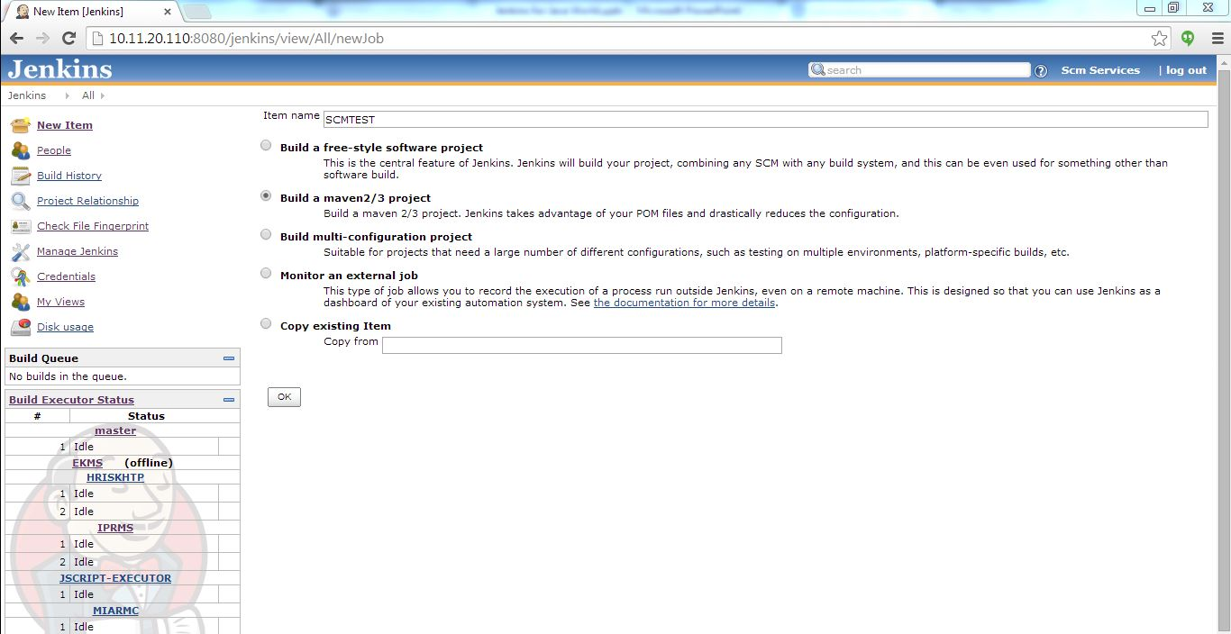
Jenkins - New Job

Slide 33
Configure jenkins jobs
Integration with external tools

Slide 34
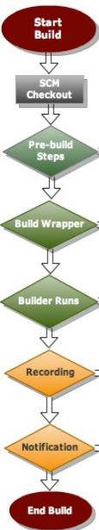
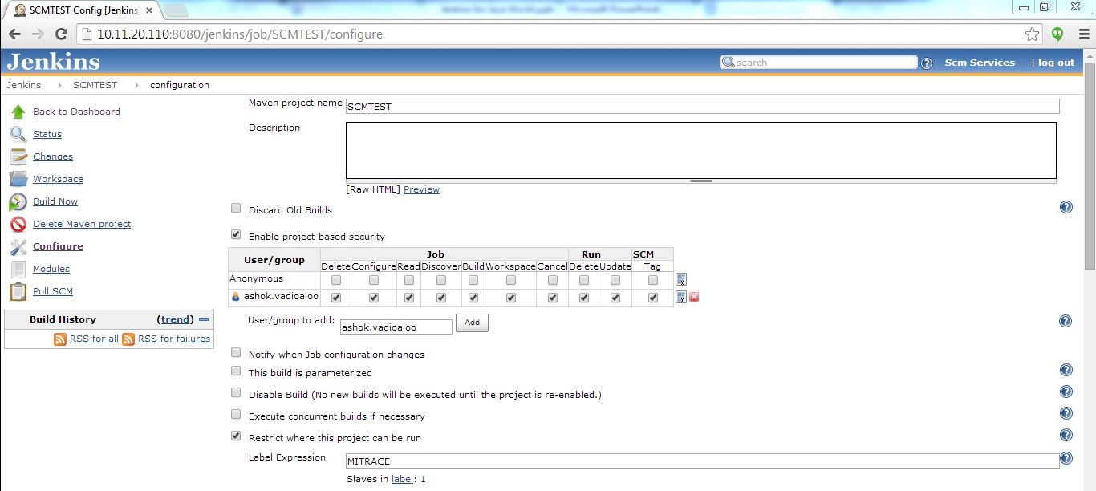

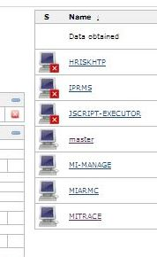
Jenkins – Job Configuration

Slide 35
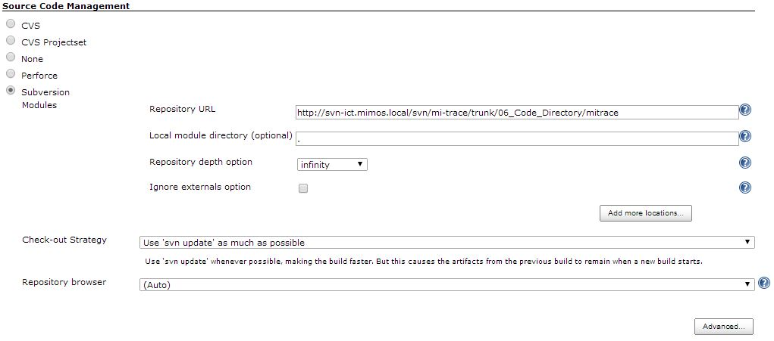
Job Configuration – Cont’d

Slide 36
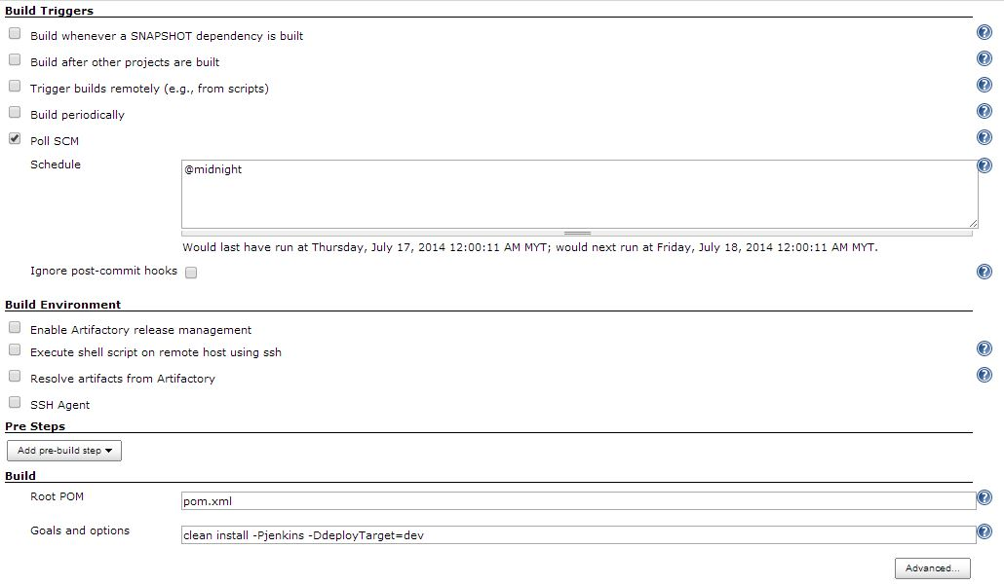
Job Configuration – Cont’d

Slide 37
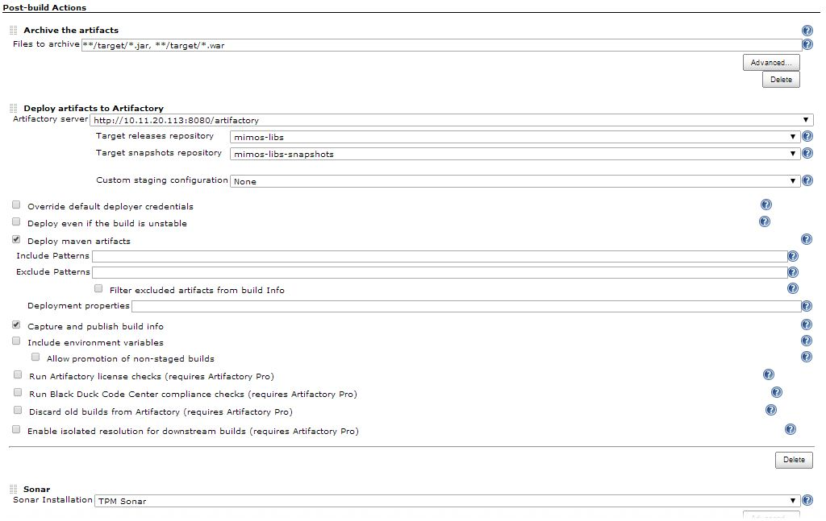
Job Configuration – Cont’d

Slide 38
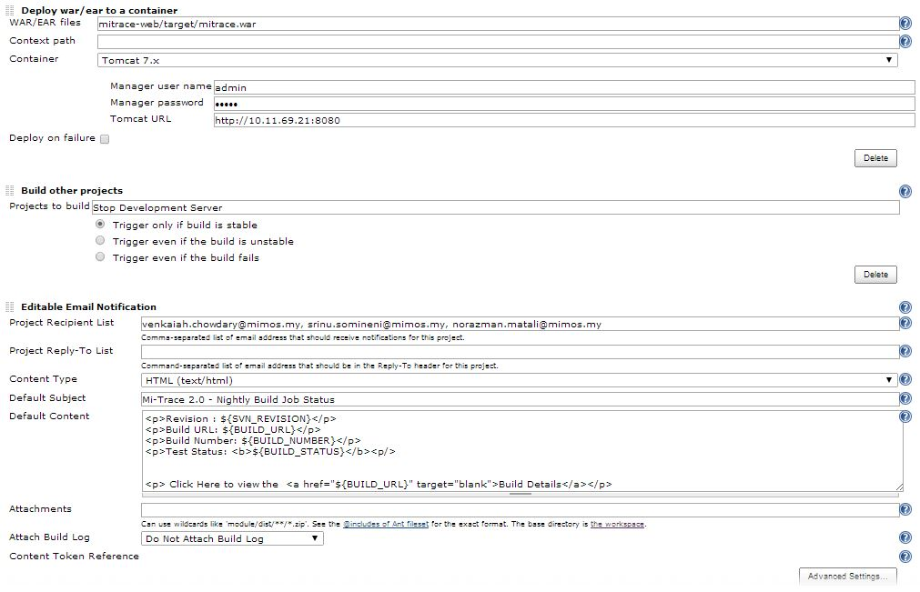
Job Configuration – Cont’d

Slide 39
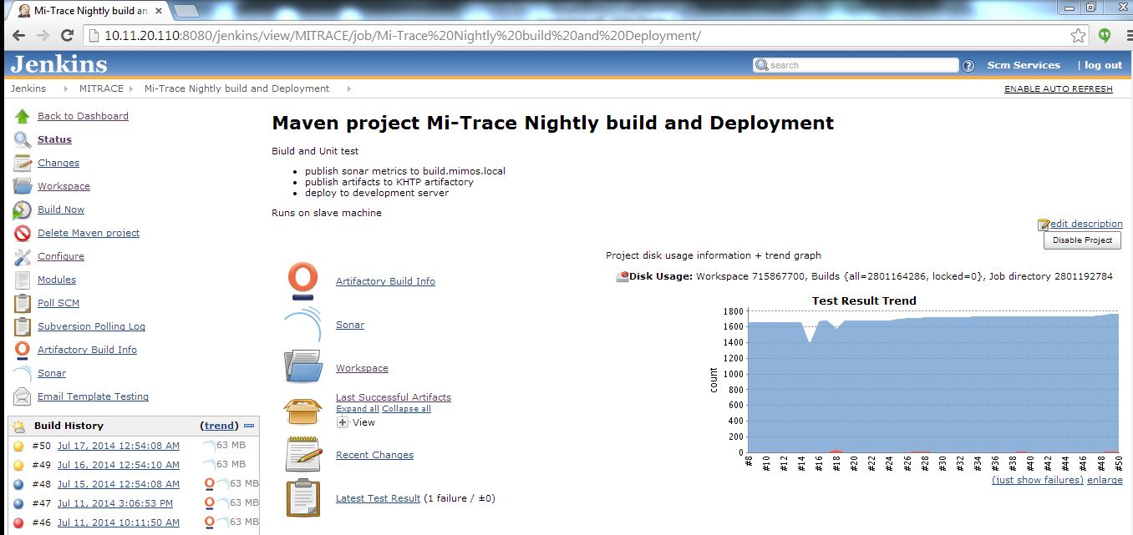
Jenkins Sample – Job Status Page

Slide 40
Jenkins Benefits
Jenkins plugins extensibility makes Jenkins to adapt to many systems
Jenkins provides everything for a robust continuous integration system which helps a lot for team that practice Agile
Jenkins continuously providing access to the working copies of software which supports the Agile principle

Slide 41
Conclusion
CI is very important for complex projects that practice Agile
Jenkins is very good CI build server due to it’s ;
Core Features
Plugins Extensibility
Flexibility

