Slide 1


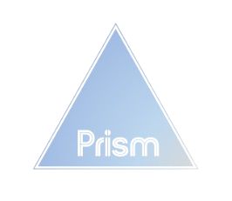
Prism's Q4 2021 Performance: Key Metrics and Insights

Slide 2
Executive Summary: Assessing Prism’s Health and Growth Strategies
Situation
Low Conversion Rate
Reduction in GPM
Expected increase in return rate
Overspending on ads
Complication
Lagging behind competitors
Selling low profit items
Brand Reputation Impact
RTBHouse underperforming
Resolution
Display reviews
Increase Prism stock
Introduce store credit
Refocus ad spend for RTBHouse

Slide 3
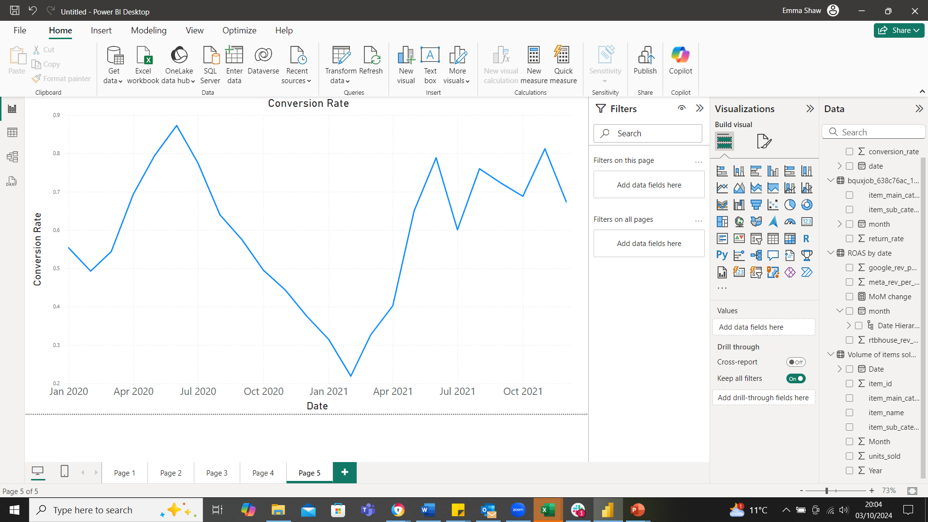
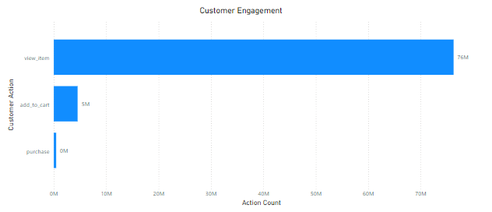
Maximising Conversion Rates Through Customer Insights
Prism CVR
0.59%
Asos CVR
3.1%
Display reviews to increase conversions by 270% = 2.07%
Notes:
Q4 2020 saw a rapid decline in CVR, now improved to an average of 0.59%, still below ASOS's 3.1%.
To prevent another CVR drop, we aim to boost conversions in early 2022.
Focus on increasing items added to cart, as they are significantly lower than items viewed.
Recommend introducing review data to encourage customers to add items to cart and improve purchase rates.
By displaying reviews, we have potential to increase CVR by 270% taking our CVR up to 2.07%.
Having review data would benefit the company for future analysis.
References
Displaying online reviews increases conversion by 270% (Spiegel Research Center)

Slide 4
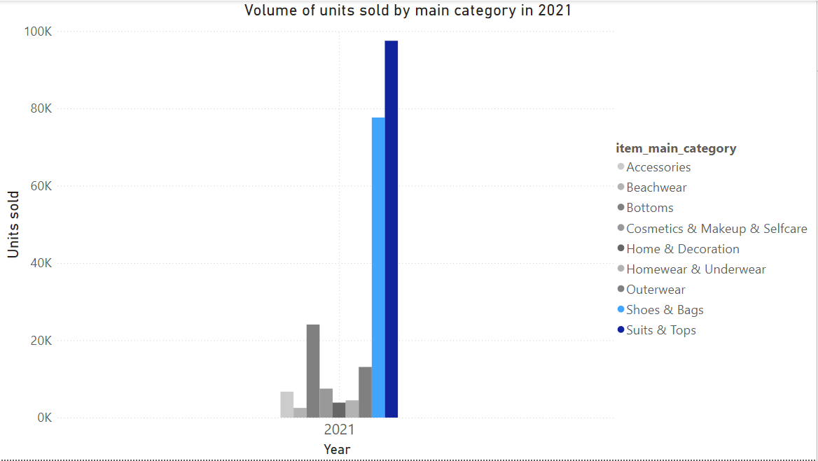
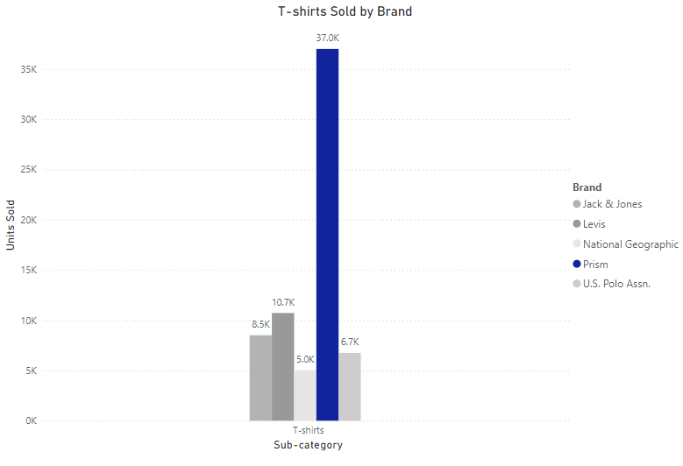
Optimising Profitability: The Strategic Importance of Prism Stock
Volume of items sold has increased by 262% in last year, but GPM is down 1%
Suits & Tops and Bags & Shoes are most sold categories
Sub-category T-shirts has volume of units sold 92,180 and GPM of 56.67%
Prism T-shirts have highest profit margin (75.65%)
Reduce inventory of cosmetics by 10% and invest into Prism T-shirts
Current Profit of Prism T-shirts | Forecasted Profit | % increase
£114,174.35 | £132,881.37 | 16.37
Prism GPM
2020 48%
2021 47%
Asos GPM
44.2%
Notes:
Volume of items sold increased by 262% last year, but GPM declined by 1%.
Suits & Tops, and Shoes & Bags are top categories; T-shirts and Shoes are best-selling items.
Prism T-shirts identified as most profitable combined with high units sold with a GPM (75.65% GPM); recommend increasing inventory for Prism T-shirts.
We recommend reducing inventory of lower-profit and lower-selling items to enhance overall GPM By reallocating 10% of costs from Cosmetics & Makeup (£127,000) to boost Prism T-shirt inventory, improving their profit by 16.37%

Slide 5

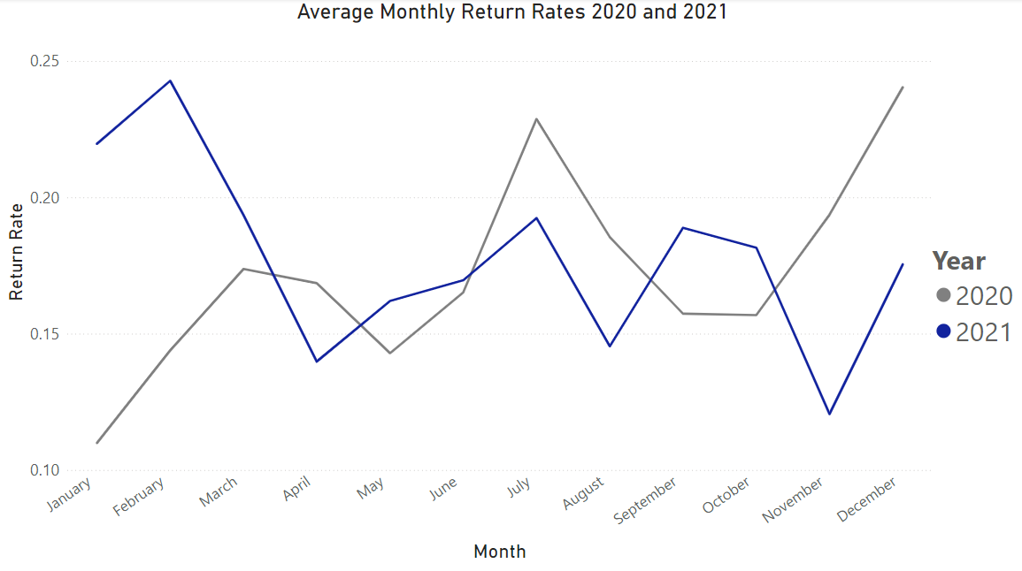
Retaining Customers and Cutting Losses: The Benefit of Store Credit
Return rate down 25% since Dec 2020
Expect due to seasonality that returns will increase in Jan 22
We propose offering a promotional code for next purchase to those that opt for store credit vs refund
57% consumers have demonstrated to opt for store credit
Prism Average
26.61%
Industry Standard
20-30%
Notes:
Our average return rate is looking better with a decrease of 25% since December 2020
Industry standard between 20-30%, doing well but want to ensure this continues
We predict an increase due to seasonality in Jan 22
Mitigate this and reduce impact on costs, offer discount codes for store credit
Research – 57% customers will opt for store credit
With discount we predict that this could even be higher
Also increase our customer retention and encourage future purchases, improving long-term profitability
References
A report from Shopify found that the average return rate in eCommerce is between 20% and 30%.
Online reviews, according to BazaarVoice, effectively decreased the frequency of returned merchandise by 20%

Slide 6
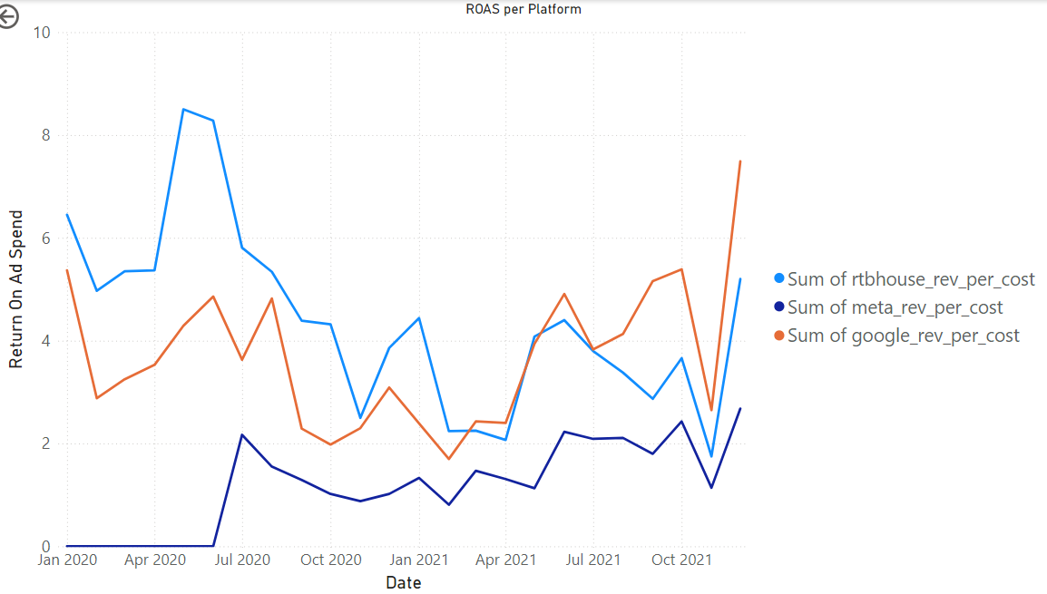
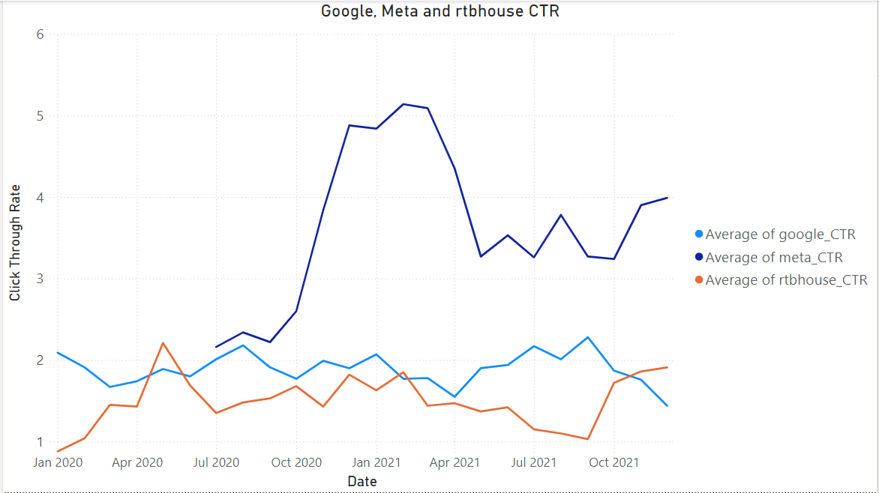
Lowering Operational Expenses to Enhance ROAS
Google ROAS 2.8x ROAS on Meta Q4 2021
Reduce RTBHouse cost by 10%
Invest this money into additional A/B to optimise current marketing strategy for google, monitor CTR
Prism Average CTR
2.30%
Industry Standard CTR
0.51-2.69%
Notes:
Google is currently our strongest ad platform for ROAS, it is almost 3x Meta’s ROAS
Meta’s click-through rate is highest
We therefore want to optimise google
We recommend reducing the investment into RTBHouse by 10%
We looked into investing this straight into google ad spend, however ROAS was not significant using the 10%
Therefore
Use additional investment into optimising google using extra A/B testing monitor CTR
Industry average CTR 0.51-2.69%, ours is 2.3 so optimising google could really improve engagement

Slide 7
Final Insights
Increase CVR up to 2.07% by collecting and displaying customer reviews
Increase inventory in Prism t-shirts
Offer discount alongside store credit on returned items
Reduce Rtbhouse ad spend by 10% and re-invest

