Slide 1


Predicting US Working Visa Applications
COMP47350: Data analytics
Amy mccormack, Aoife o’sullivan, muireann Mac Carthy, Eimear Galligan

Slide 2

The Problem
In order to employ foreign workers, companies in the US must submit an application to the Department of Labour.
The DOL must certify that there are not sufficient US workers willing, qualified and available to accept the job opportunity.
Employment of a foreign worker must not adversely affect the wages and working conditions of similarly employed U.S. workers.
We want to uncover insights that can help predict visa decisions.

Slide 3


The Data
Data was collected and distributed by the US Department of Labour
It covers 2012-2017 and includes information on employer, position, wage offered, job posting history, employee education, past visa history, economic sector of employment, and final decision.
Made up of 374,362 rows and 154 columns.
Notes:
The dataset is in the form of a CSV file collected and distributed by the US Department of Labor.
Data covers 2012-2017 and includes information on employer, position, wage offered, job posting history, employee education ,past visa history, economic sector of employment, and final decision.
Rows: 374,362 Columns:154 columns
There are many inconsistencies with how the data was collected. At the end of 2012, the column labels were altered so corresponding columns labelled ‘foreign_worker’ and ‘fw’ were collecting the same information. Similarly with the position information there are two subsets labelled ‘job_info’ and ‘ji’. There will be a lot of cleaning and organising involved in preparing this data before any predictions models can be considered

Slide 4
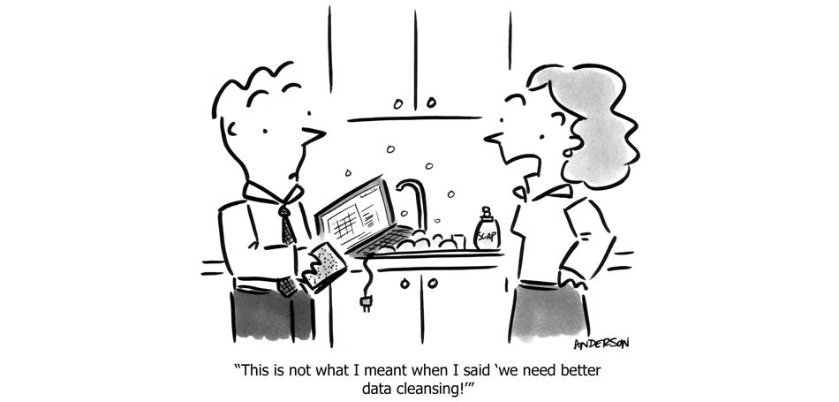
Data Cleaning
Decided to focus solely on H1-B applications – brought row count to 283, 018.
Dropped 77 features with less than 50% values recorded.
Made up of 374,362 rows and 154 columns.
Re-labelled 4 features with irregular cardinality.
Corrected data types for certain features and categorized as Boolean or float as appropriate.
Dropped cases where the application was withdrawn focusing on ‘Certified’ or ‘Denied’ cases.
Found that 91% of cases were certified. Created a new balanced dataframe by undersampling the majority class.
Resulting cleaned dataframe: 153, 625 rows, 98 columns.
Notes:
Originally the dataset contained applications for various visa types to the US including J-1,B-2,L-1,EWI,E-2,E-1,F-1,B-1 and many more. We wanted to focus solely on the H-1B visa which is a non-immigrant visa that allows US companies to employ graduate level workers in specialty occupations that require theoretical or technical expertise in specialized fields such as in IT, finance, accounting, architecture, engineering, mathematics, science, medicine, etc.
Due to the inconsistent collection of the data there were also a huge amount of null values recorded for many of the features. We decided to drop any columns that had less that 50% values recorded.
Upon further inspection of the remaining features we analysed the irregular cardinality of the features was flagged. Some features were relabelled and complete case analysis was carried out on some features. No features / rows were dropped as a result of the complete case analysis.
The target feature also required cleaning as there were four recorded values, ‘Certified, Certified-Expired, Withdrawn, Declined’. Cases which were ‘Certified-Expired’ were relabelled certified and cases where status was ‘Withdrawn’ were dropped. This left us with a boolean target feature of either ‘Certified’ or ‘Denied’.
While cleaning the data, we also discovered that our dataset was unbalanced, 91% of all cases were certified, whereas only 9% of cases were denied. Unbalanced datasets do not lend themselves well to machine learning approaches. So to deal with this, we undersampled the majority class and created a new dataset with an equal split of certified and denied cases.

Slide 5

Feature Selection
After further data cleaning, we narrowed down our features of interest to 15 variables, including employer name, state, country of citizenship, job title, unit of pay, etc.
All variables were categorical and some had very high cardinality.
A new challenge presented itself as we had to find a way to categorize these variables of interest into groups and reduce their cardinality.
Notes:
After further data cleaning, we narrowed down our features of interest to 15 variables, ranging from employer city and state, country of citizenship, job title and unit of pay, amongst others.
All our variables were categorical and some had a very high cardinality (>10k).
Country of citizenship, for example, had a cardinality of 150. We considered this an interesting feature that we wanted to keep and investigate if this had an impact on the outcome of the visa case.
In order to deal with it’s cardinality, we found a way to group countries in two different ways. We scraped information from the web and grouped countries in terms of GDP (low, medium and high). In addition, we scraped travel advisory information from the US government to categorize countries according to said advice (exercise normal precautions, exercise increased caution, reconsider travel or do not travel). We considered these meangingful ways of capturing countries in terms of their socioeconomic status and in terms of how the US perceives said country.
Furthermore, we reduced the cardinality of decision date - we grouped the into month and year, as we thought it would be interesting to see if any changes over time, might be related to a change in the political climate in the US. To reduce the cardinality for the 50 states, we grouped by geographical region and also grouped states by political party (democratic/republication), and finally we used regular expressions to reduce the cardinality for job titles and grouped according to industry (technology, education, sales and marketing, construction and engineering, health and medicine, science, accounting and finance, law, other). We considered industry an interesting variable as we hypothesized that those applying for jobs in the burgeoning technology field to be more likely to get certified.
We plotted the variables and in the end, were left with was decision month and year, state categorized by region, job title categorized by industry, unit of pay, source name (Name of the entity providing prevailing wage information for the job), pw level (Level of the prevailing wage determination).

Slide 6
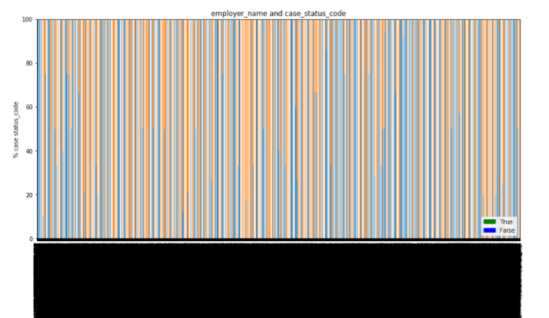

Slide 7
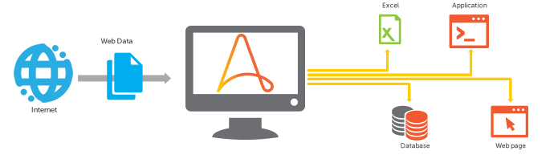
Feature Selection
We used a variety of methods to make sense of the data and create new variables which would group features like job title and country of citizenship in a meaningful way.
For example, grouped US states by political party using regular expressions and data scraping with Beautiful Soup.
This made features much easier to get valuable information from.
Final features: decision month and year, state categorized by census region, job title categorized by industry, unit of pay, source name and prevailing wage level.
Notes:
of their socioeconomic status and in terms of how the US perceives said country.
Furthermore, we reduced the cardinality of decision date - we grouped the into month and year, as we thought it would be interesting to see if any changes over time, might be related to a change in the political climate in the US. To reduce the cardinality for the 50 states, we grouped by geographical region and also grouped states by political party (democratic/republication), and finally we used regular expressions to reduce the cardinality for job titles and grouped according to industry (technology, education, sales and marketing, construction and engineering, health and medicine, science, accounting and finance, law, other). We considered industry an interesting variable as we hypothesized that those applying for jobs in the burgeoning technology field to be more likely to get certified.
We plotted the variables and in the end, were left with was decision month and year, state categorized by region, job title categorized by industry, unit of pay, source name (Name of the entity providing prevailing wage information for the job), pw level (Level of the prevailing wage determination).

Slide 8
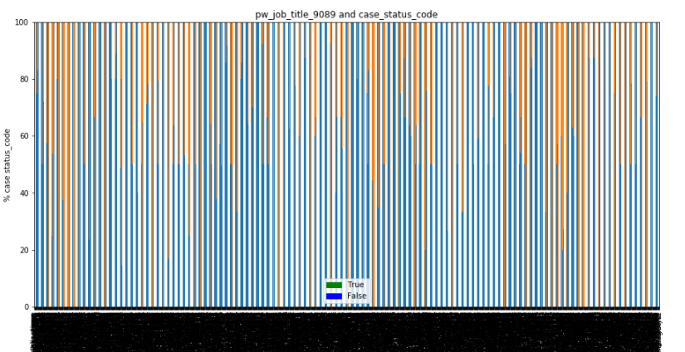
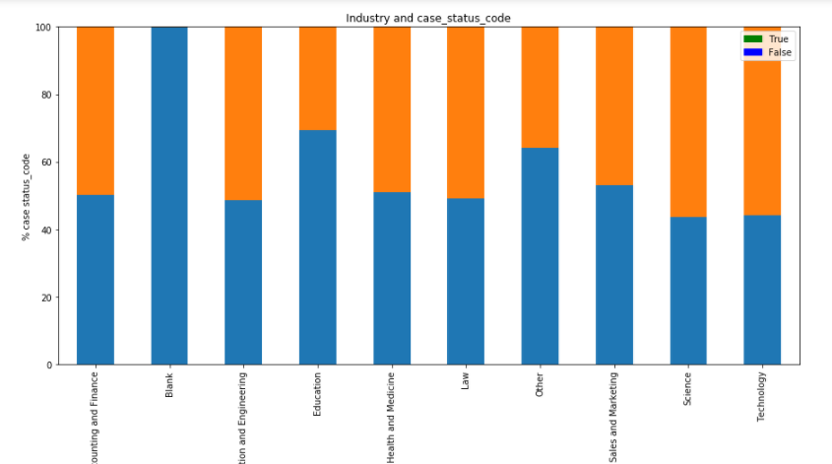

Slide 9
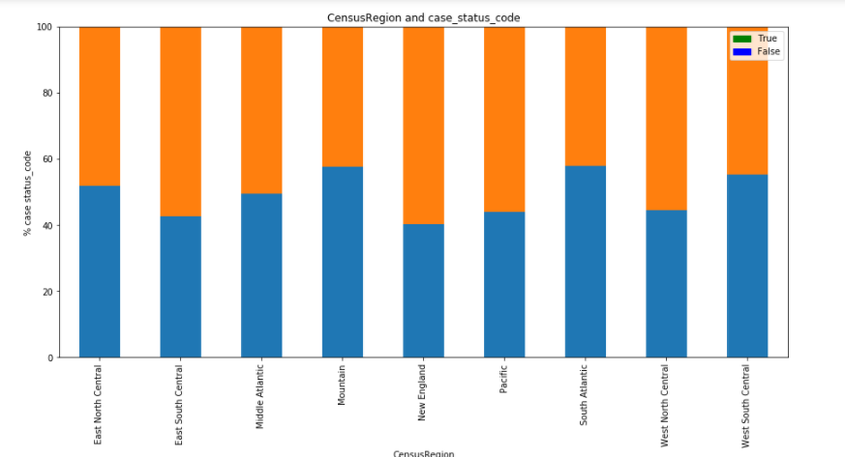
Feature: Census Region

Slide 10
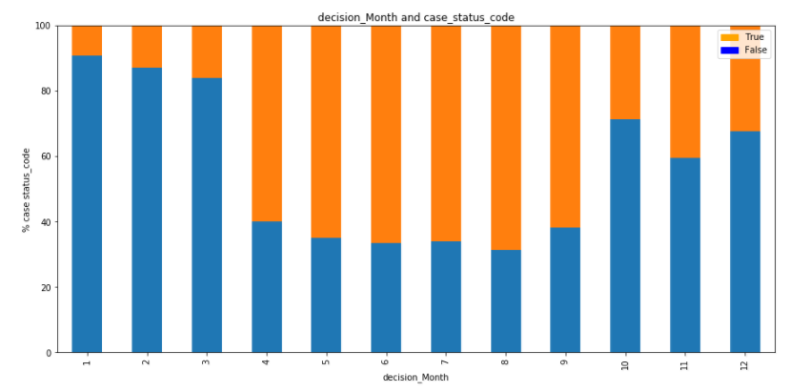
Feature: Decision Month

Slide 11
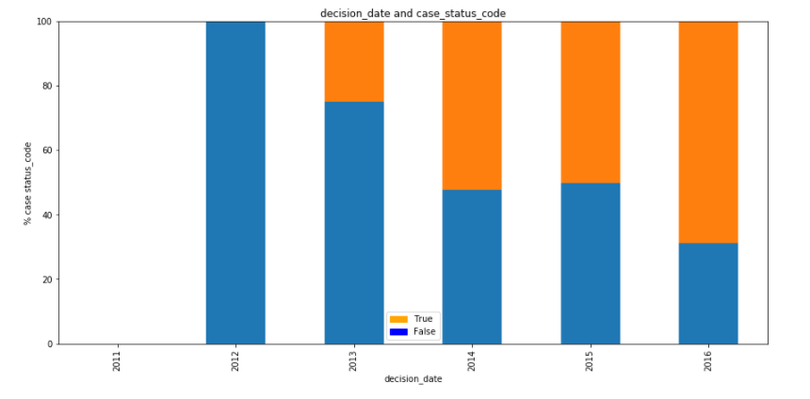
Feature: Decision Year

Slide 12

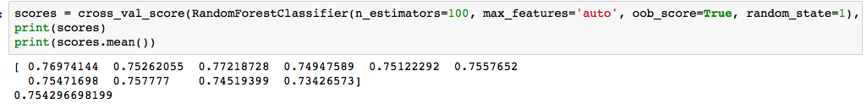
The Models
We implemented two predictive models, logistic regression and random forest, to predict the outcome of a visa application.
We found that random forest worked better and gave us more accurate results, perhaps due to the nature of our variables (categorical) and the number of variables we had.

Slide 13

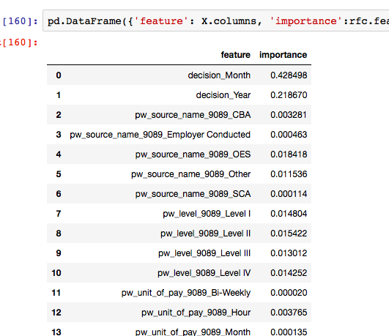
The Results
Best predictors were decision month and year.
Industry had only a minor impact on the accuracy (10% increase in the training model, but only 2% in the cross validations).
Features like region proved to be not as important, but may have been data loss when grouping into region.
Salary level, source name and unit of pay only slightly affected the accuracy of the model.
Notes:
Best features were decision month and decision year.
Industry had minor impacts on the accuracy an increase in the training model of 10% but only a 2% increase in the cross validations
Factors like region proved not be as important but there may be data loss when grouping them from state to region
The salary level, source name and unit of pay made slight differences but were in no way deciding factors.

