Slide 1
Run Sakai 10.6
for Development
Presenter: Le Ngoc Thach

Slide 2
Content
1
Run Sakai demo
2
Explore Sakai via exercises

Slide 3
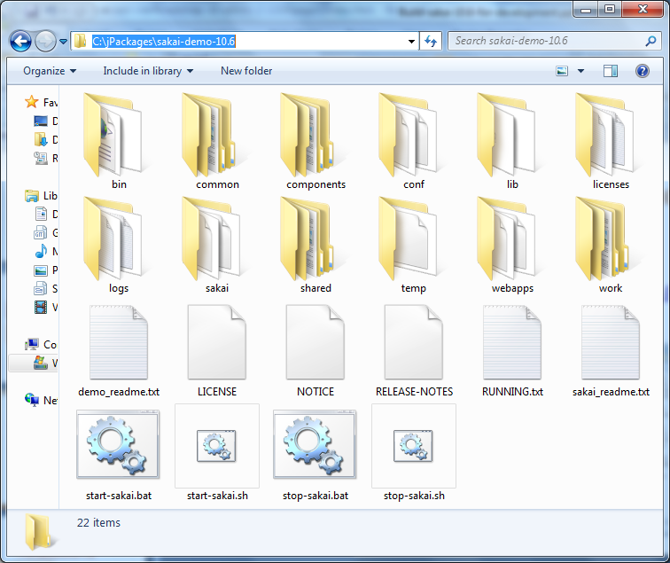
Run sakai demo version
Download
http://source.sakaiproject.org/release/10.6/artifacts/sakai-demo-10.6.zip
Extract to C:\jPackages

Slide 4
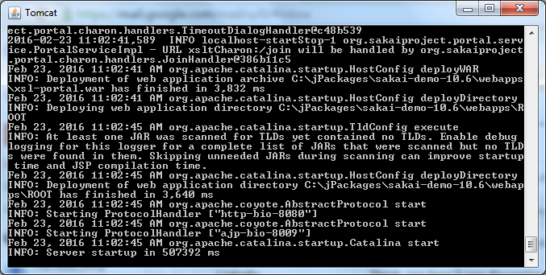
Start sakai
Double click on “C:\jPackages\sakai-demo-10.6\start-sakai.bat”

Slide 5
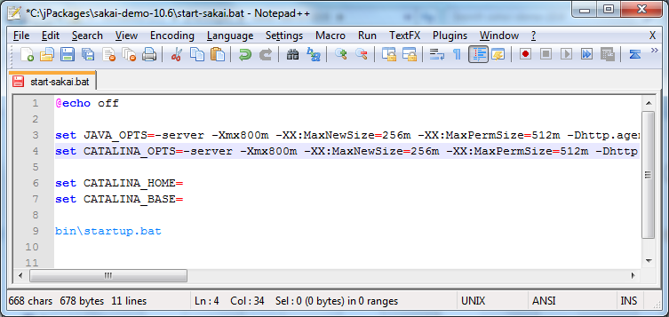
Trouble shootinhg
Edit “C:\jPackages\sakai-demo-10.6\start-sakai.bat”

Slide 6
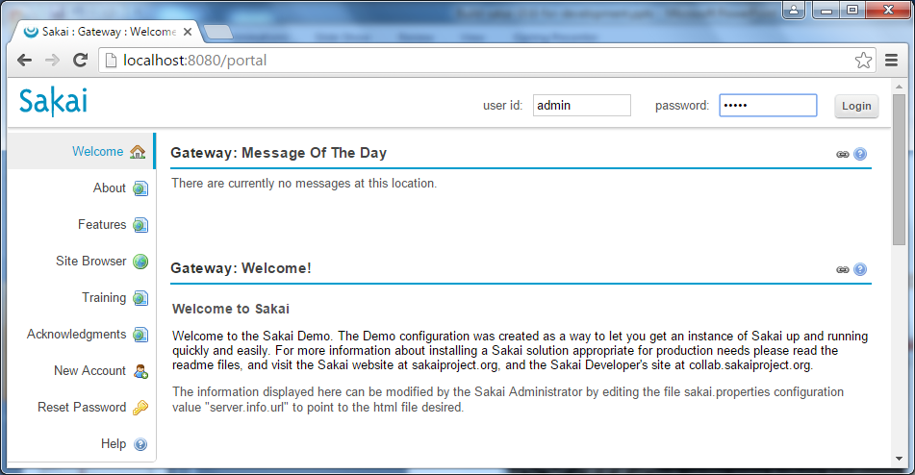
Explore sakai
Login with account: admin/admin

Slide 7
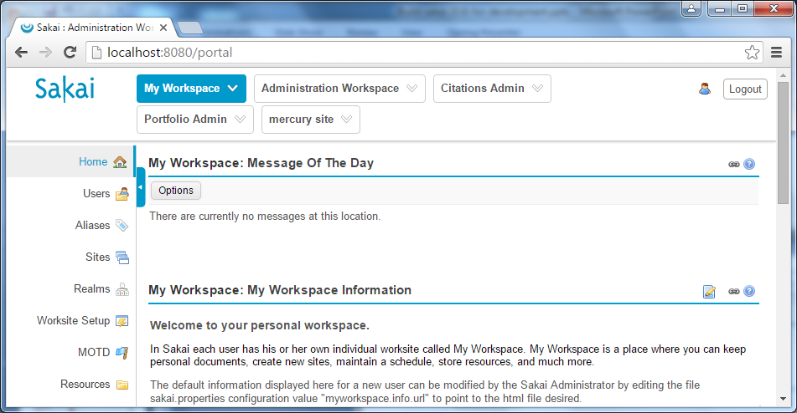
Explore sakai

Slide 8
Exsercises
https://github.com/software-handbook/qms/tree/master/Guideline/Sakai/print-version
Guideline_Deploy-elearning-portal-with-Sakai_Basic_Exercise01_CreateCourseSite.pdf
Guideline_Deploy-elearning-portal-with-Sakai_Basic_Exercise02_CreateQuestionBank.pdf
Guideline_Deploy-elearning-portal-with-Sakai_Basic_Exercise03_CreateAccount.pdf
Guideline_Deploy-elearning-portal-with-Sakai_Basic_Exercise04_CreateTestSession.pdf

