Slide 1
LBS-App

Slide 2
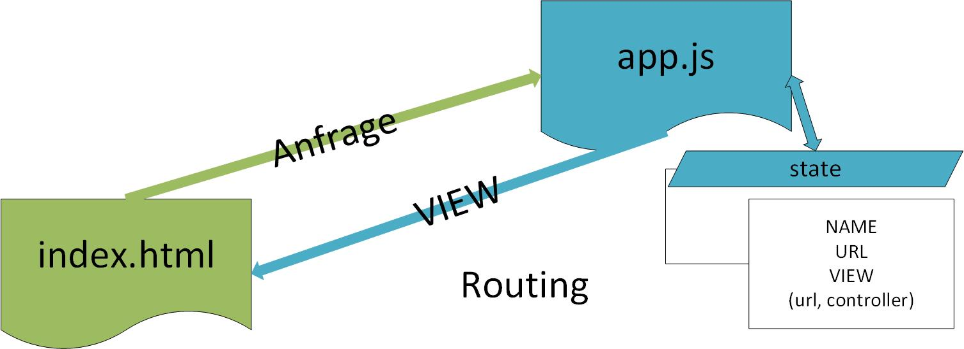
Allgemeiner Ablauf

Slide 3
State: /tab/play
Default-Fall

Slide 4
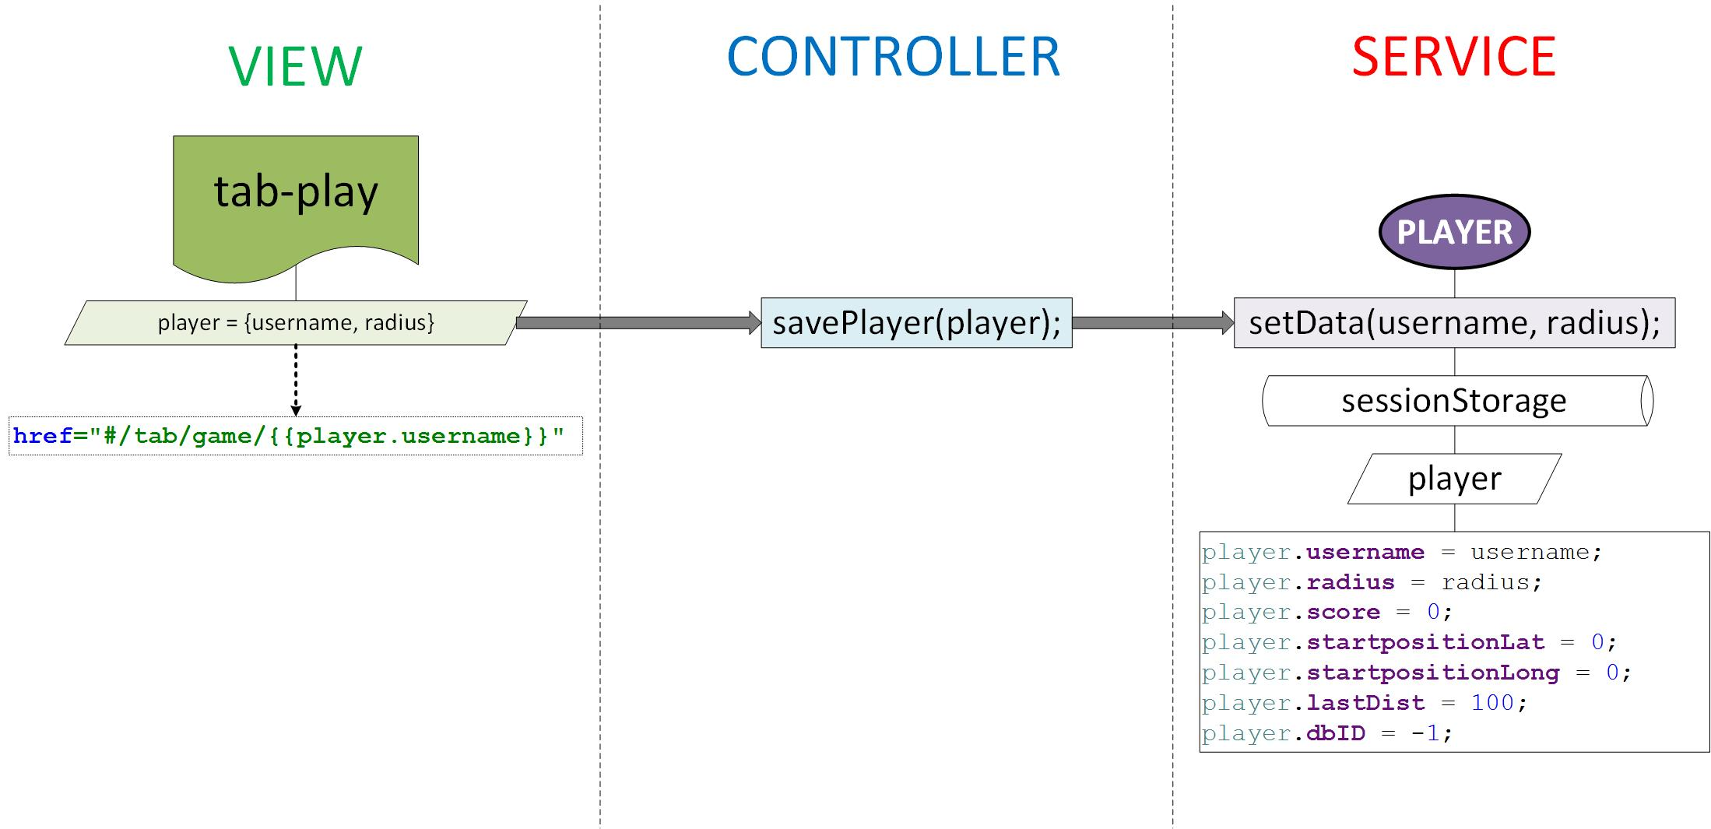
State: /tab/play

Slide 5
State: /tab/game

Slide 6
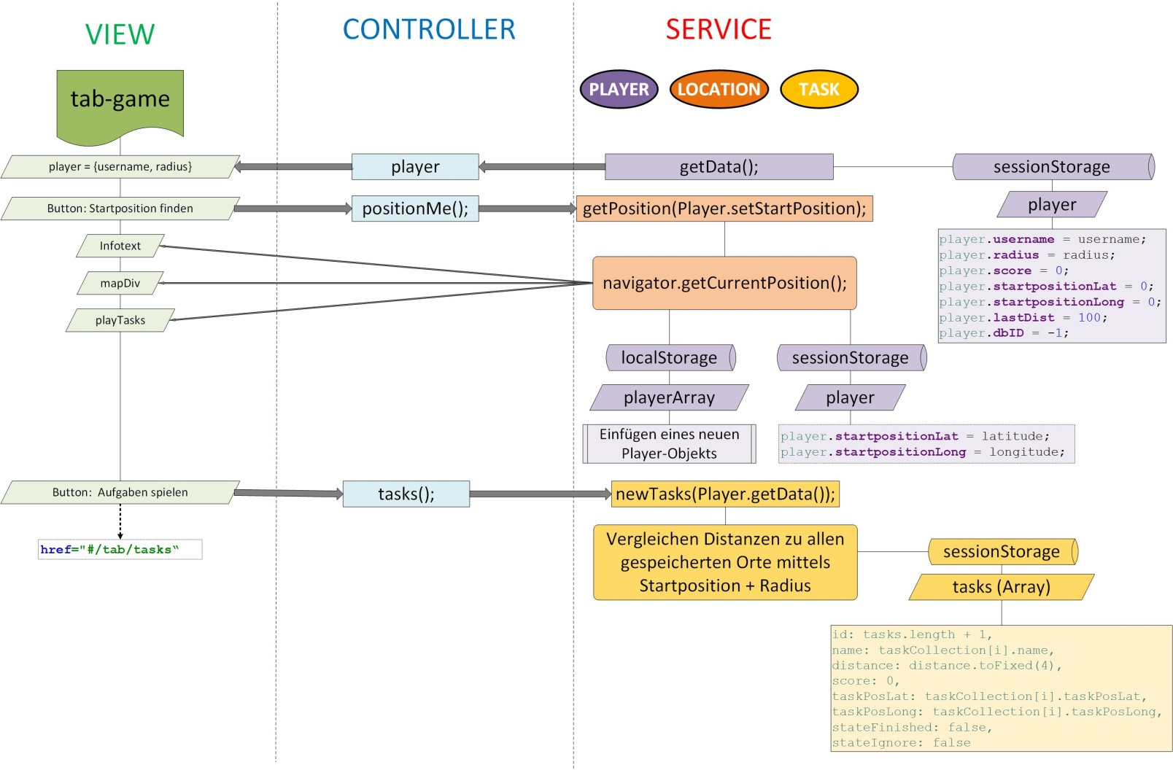
State: /tab/game

Slide 7
State: /tab/tasks

Slide 8
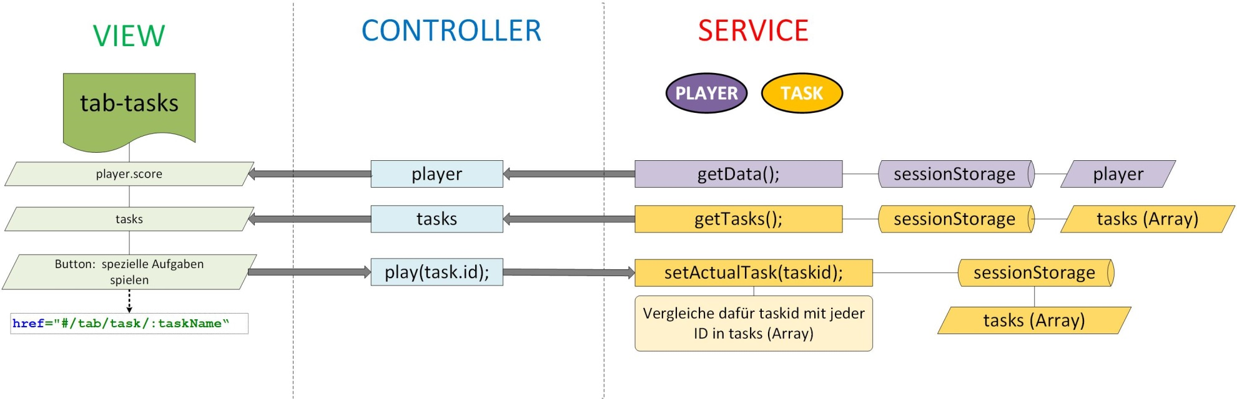
State: /tab/tasks

Slide 9
State: /tab/task

Slide 10
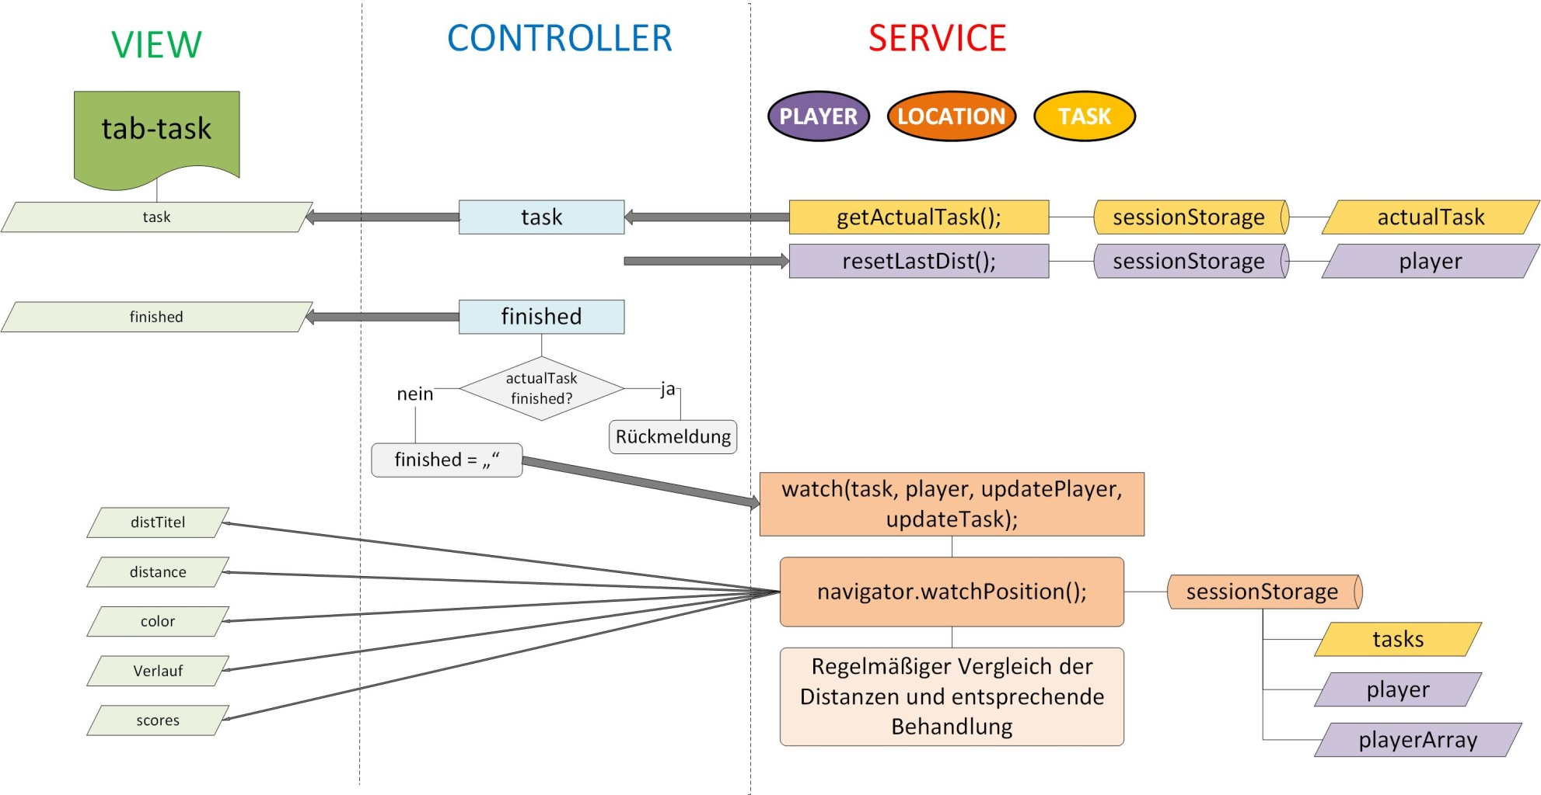
State: /tab/task

Slide 11
State: /tab/highscore

Slide 12
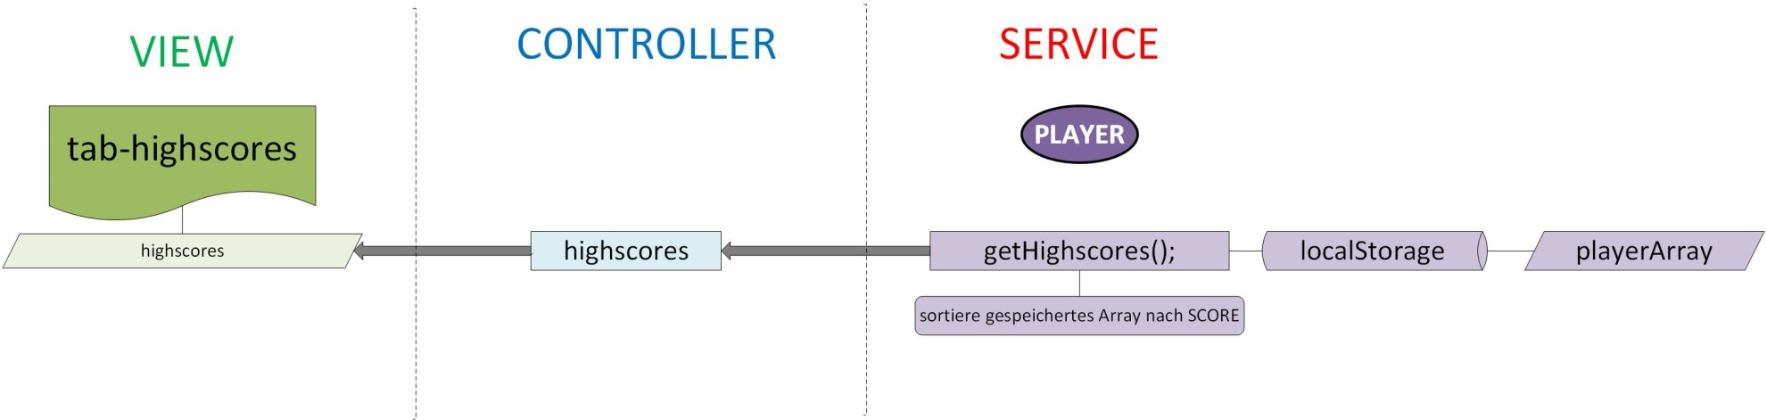
State: /tab/highscores

Slide 13
State: /tab/account

Slide 14
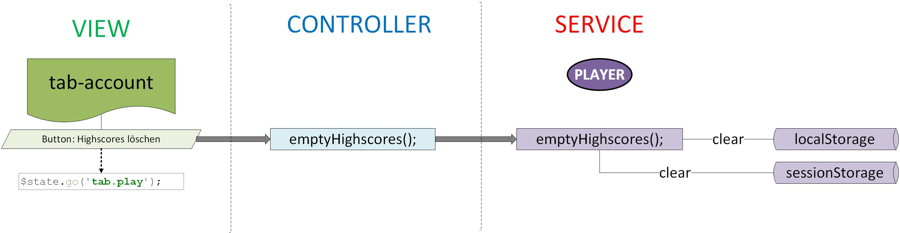
State: /tab/account

