Slide 1
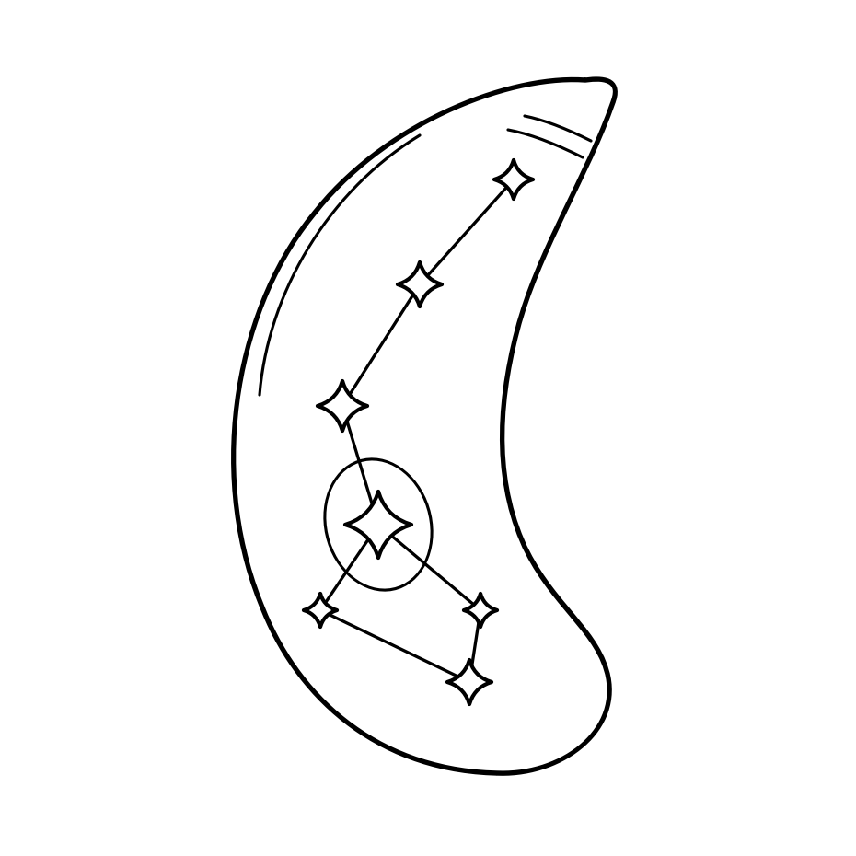
ParaScape
Explore what is known.
Evaluate what a model predicts.
A practical guide to the 0.43 release
Einar Olafsson · github.com/EinarOlafsson/parascape
PARASCAPE / 0.43 GUIDE
01 / 40
Notes:
ParaScape
Explore what is known.
Evaluate what a model predicts.
A practical guide to the 0.43 release
Source: https://einarolafsson.github.io/projects/parascape/

Slide 2
INTRODUCTION
Start with a gene. Keep the evidence.
Bring scattered measurements together without losing what they mean.
01
02
03
04
Collect
Connect
Explore
Evaluate
Published
measurements,
annotations and
protein features.
Match gene identities
and retain the source
of each value.
Read evidence,
compare relationships
and inspect gaps.
Test predictions on
held-out genes before
interpreting them.
A model suggests a hypothesis. Its evidence and validation determine how useful it is.
PARASCAPE / 0.43 GUIDE
02 / 40
Notes:
Start with a gene. Keep the evidence.
Bring scattered measurements together without losing what they mean.
Collect: Published measurements, annotations and protein features.
Connect: Match gene identities and retain the source of each value.
Explore: Read evidence, compare relationships and inspect gaps.
Evaluate: Test predictions on held-out genes before interpreting them.
A model suggests a hypothesis. Its evidence and validation determine how useful it is.
Source: https://einarolafsson.github.io/parascape/guide.html

Slide 3
INTRODUCTION
Two organisms. Separate maps.
Offline gene tables and networks are included in the installation.
8,140
5,720
130
Toxoplasma gondii
genes
Plasmodium falciparum
genes
Registered datasets and
computed layers
Coverage differs by assay and organism. These counts do not imply complete evidence for every gene.
PARASCAPE / 0.43 GUIDE
03 / 40
Notes:
Two organisms. Separate maps.
Offline gene tables and networks are included in the installation.
8,140: Toxoplasma gondii genes
5,720: Plasmodium falciparum genes
130: Registered datasets and computed layers
Coverage differs by assay and organism. These counts do not imply complete evidence for every gene.
Source: https://einarolafsson.github.io/parascape/datasets.html

Slide 4
INTRODUCTION
Choose the task you came to do.
Explore a gene
Predict a trait
Compare a screen
Find an accession, symbol or
product. Read
measurements and their
sources.
Choose an observed
outcome. Evaluate a model,
then inspect unlabelled-gene
hypotheses.
Join a gene-level results table
to the existing evidence.
Keep unresolved IDs visible.
Open these guided workflows from the Tools menu.
PARASCAPE / 0.43 GUIDE
04 / 40
Notes:
Choose the task you came to do.
Explore a gene: Find an accession, symbol or product. Read measurements and their sources.
Predict a trait: Choose an observed outcome. Evaluate a model, then inspect unlabelled-gene hypotheses.
Compare a screen: Join a gene-level results table to the existing evidence. Keep unresolved IDs visible.
Open these guided workflows from the Tools menu.
Source: https://einarolafsson.github.io/parascape/workflows.html

Slide 5
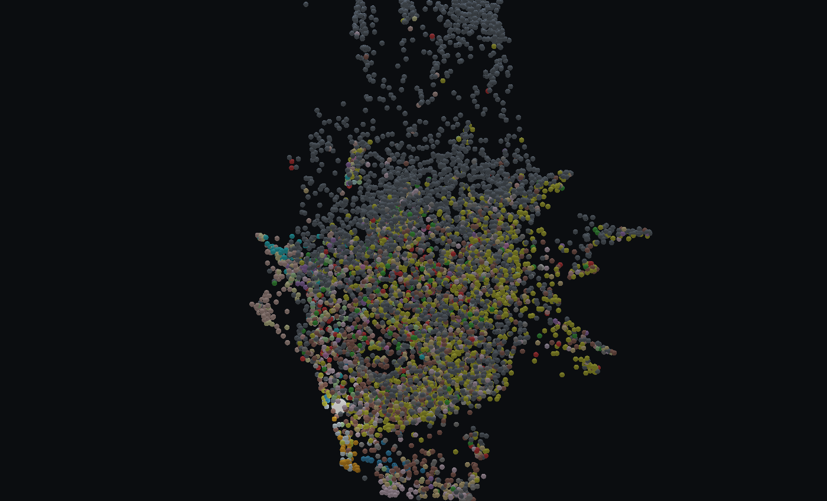
INTRODUCTION
The map is one view of the evidence.
One point represents one gene.
Position
Similarity under the chosen feature
recipe.
Colour
An annotation or measurement you
select.
Lines
One explicitly selected relationship
type.
Proximity alone does not establish function or a physical interaction.
PARASCAPE / 0.43 GUIDE
05 / 40
Notes:
The map is one view of the evidence.
One point represents one gene.
Position: Similarity under the chosen feature recipe.
Colour: An annotation or measurement you select.
Lines: One explicitly selected relationship type.
Proximity alone does not establish function or a physical interaction.
Source: https://einarolafsson.github.io/parascape/guide.html

Slide 6
GET STARTED
Install and open ParaScape.
Python 3.10+
pip install parascape
parascape
Use a dedicated environment when
possible.
Desktop display
The viewer needs a display and
working OpenGL.
CPU included
CUDA is optional; browsing does
not require a GPU.
Linux, macOS and Windows. Built tables are available offline.
PARASCAPE / 0.43 GUIDE
06 / 40
Notes:
Install and open ParaScape.
pip install parascape
parascape
Python 3.10+: Use a dedicated environment when possible.
Desktop display: The viewer needs a display and working OpenGL.
CPU included: CUDA is optional; browsing does not require a GPU.
Linux, macOS and Windows. Built tables are available offline.
Source: https://einarolafsson.github.io/parascape/releases.html

Slide 7
GET STARTED
Your first five minutes.
01
02
03
04
1 Choose
2 Search
3 Inspect
4 Compare
File > Species: select
the organism.
Tools > Explore a gene:
enter an accession or
product.
Read the evidence and
open its source links.
Change a colour or
edge layer; keep the
question specific.
Start with one familiar gene so you can check that the interpretation makes sense.
PARASCAPE / 0.43 GUIDE
07 / 40
Notes:
Your first five minutes.
1 Choose: File > Species: select the organism.
2 Search: Tools > Explore a gene: enter an accession or product.
3 Inspect: Read the evidence and open its source links.
4 Compare: Change a colour or edge layer; keep the question specific.
Start with one familiar gene so you can check that the interpretation makes sense.
Source: https://einarolafsson.github.io/parascape/guide.html

Slide 8
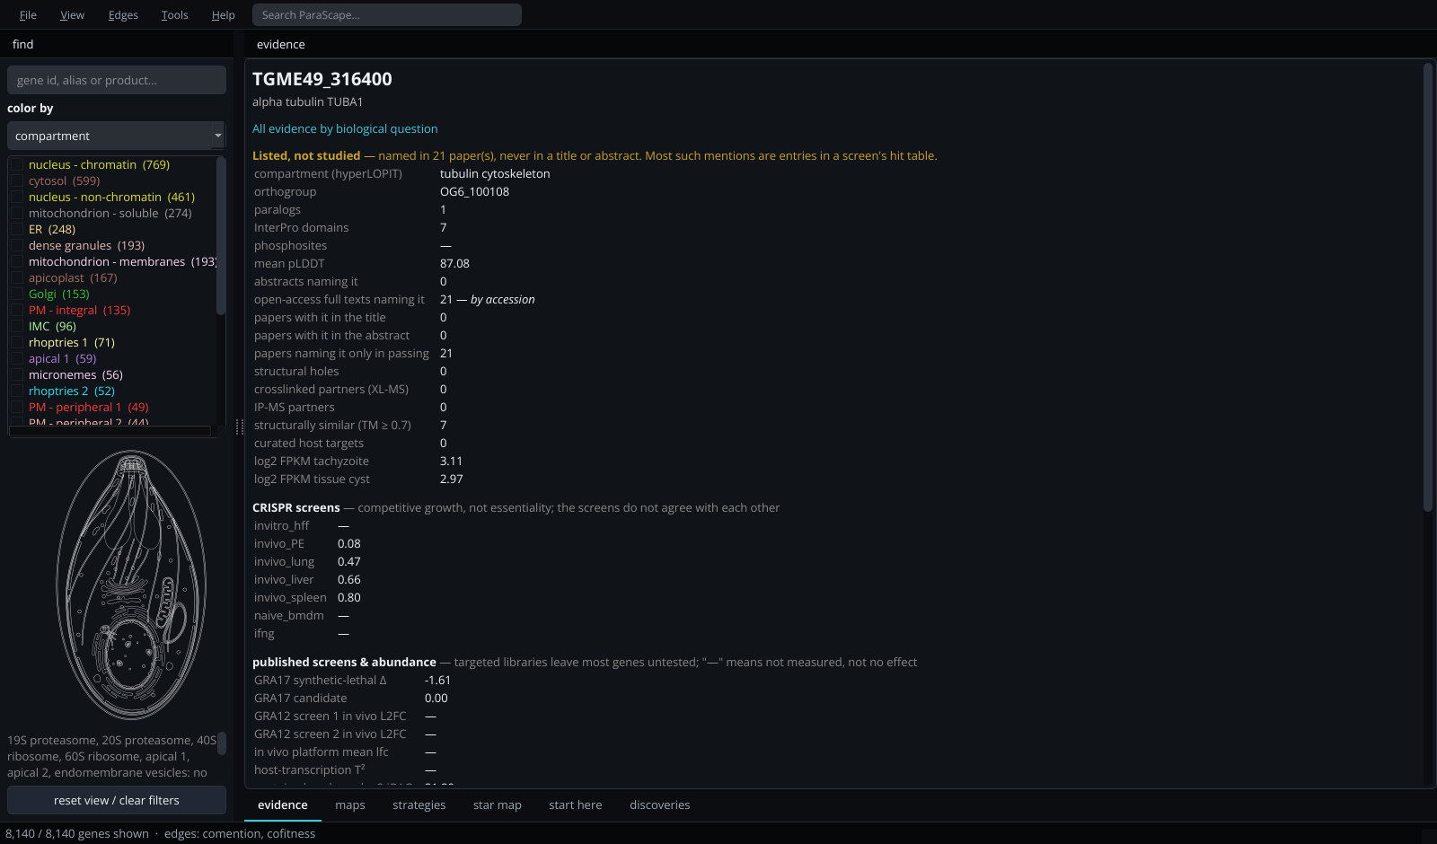
GET STARTED
Find your way around the workspace.
Map controls on the left. The gene map in the centre. Evidence on the right.
Tools opens guided workflows and analysis docks. View controls appearance and interaction.
PARASCAPE / 0.43 GUIDE
08 / 40
Notes:
Find your way around the workspace.
Map controls on the left. The gene map in the centre. Evidence on the right.
Tools opens guided workflows and analysis docks. View controls appearance and interaction.
Source: https://einarolafsson.github.io/parascape/guide.html

Slide 9
EXPLORE
Move the map. Keep your bearings.
Rotate and zoom
Select a gene
Focus a category
Left-drag in Navigate mode
to rotate. Scroll to move
closer or farther away.
Click a point to show its
evidence. Search can take
you directly to a gene.
Filter checked categories.
Double-click a category to
centre its genes.
Right-click the map for display options, export and reset.
PARASCAPE / 0.43 GUIDE
09 / 40
Notes:
Move the map. Keep your bearings.
Rotate and zoom: Left-drag in Navigate mode to rotate. Scroll to move closer or farther away.
Select a gene: Click a point to show its evidence. Search can take you directly to a gene.
Focus a category: Filter checked categories. Double-click a category to centre its genes.
Right-click the map for display options, export and reset.
Source: https://einarolafsson.github.io/parascape/guide.html

Slide 10
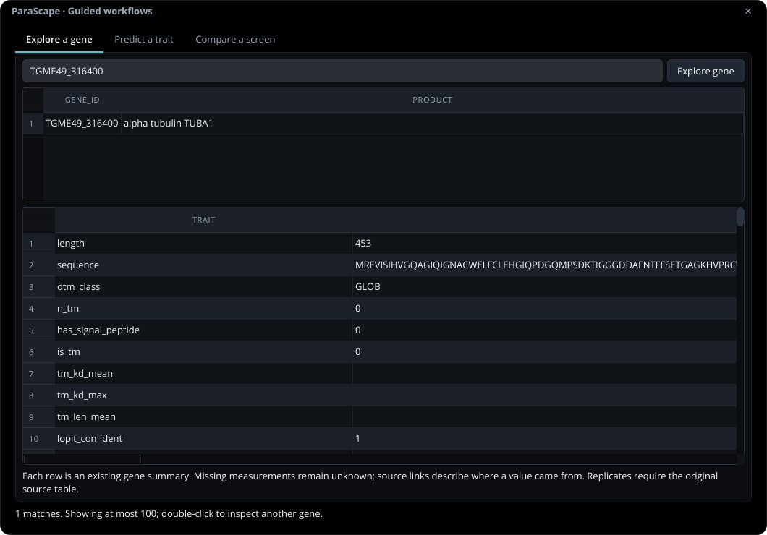
EXPLORE
Search by identity or description.
Tools > Explore a gene
Enter a query
Use a gene accession, symbol or
product text.
Check the match
Double-click a result to select the
same gene on the map.
Read the table
Inspect available values, missingness
and source evidence.
Shown here: an existing alpha-tubulin record, not a model-generated annotation.
PARASCAPE / 0.43 GUIDE
10 / 40
Notes:
Search by identity or description.
Tools > Explore a gene
Enter a query: Use a gene accession, symbol or product text.
Check the match: Double-click a result to select the same gene on the map.
Read the table: Inspect available values, missingness and source evidence.
Shown here: an existing alpha-tubulin record, not a model-generated annotation.
Source: https://einarolafsson.github.io/parascape/workflows.html

Slide 11
EVIDENCE
Read the source, not just the value.
What was measured?
In which context?
How was it obtained?
Distinguish expression,
localization, abundance,
sequence and interaction
evidence.
Check the organism, stage,
condition and assay before
comparing measurements.
Separate measured
evidence, computed
features, transferred
annotations and predictions.
Legacy gene summaries cannot reconstruct replicate-level uncertainty that was never retained.
PARASCAPE / 0.43 GUIDE
11 / 40
Notes:
Read the source, not just the value.
What was measured?: Distinguish expression, localization, abundance, sequence and interaction evidence.
In which context?: Check the organism, stage, condition and assay before comparing measurements.
How was it obtained?: Separate measured evidence, computed features, transferred annotations and predictions.
Legacy gene summaries cannot reconstruct replicate-level uncertainty that was never retained.
Source: https://einarolafsson.github.io/parascape/workflows.html

Slide 12
EVIDENCE
The full data catalogue stays one click away.
Evidence family
Examples
Read it as
Expression
Stage profiles and summaries
Condition-dependent measurements
Localization
Compartment annotations
Evidence with assay-specific coverage
Protein features
Sequence, domains, AF3 summaries
Measured or computed descriptors
Relationships
Coexpression and physical assays
Distinct types of connections
Literature
Mentions and reviewed assertions
Traceable source context
Each catalogue record links to its publication, source data or computed inputs.
PARASCAPE / 0.43 GUIDE
12 / 40
Notes:
The full data catalogue stays one click away.
Evidence family | Examples | Read it as
Expression | Stage profiles and summaries | Condition-dependent measurements
Localization | Compartment annotations | Evidence with assay-specific coverage
Protein features | Sequence, domains, AF3 summaries | Measured or computed descriptors
Relationships | Coexpression and physical assays | Distinct types of connections
Literature | Mentions and reviewed assertions | Traceable source context
Each catalogue record links to its publication, source data or computed inputs.
Source: https://einarolafsson.github.io/parascape/datasets.html

Slide 13
EVIDENCE
Unknown is different from zero.
0
Unknown
No call
A measured value that
really is zero
No usable value is
available
The model lacks enough
support
A missing annotation is not a negative example. Grey marks unknown evidence.
PARASCAPE / 0.43 GUIDE
13 / 40
Notes:
Unknown is different from zero.
0: A measured value that really is zero
Unknown: No usable value is available
No call: The model lacks enough support
A missing annotation is not a negative example. Grey marks unknown evidence.
Source: https://einarolafsson.github.io/parascape/workflows.html

Slide 14
RELATIONSHIPS
Different lines answer different questions.
Similarity
Shared domains, orthogroups, expression or structure.
Physical evidence
Crosslink MS and pulldown assays have their own
interpretation.
Literature context
Co-mention means appearing together in text; it is not proof
of binding.
Illustrative network; line meaning comes from its layer.
The Edges controls keep these layers separate.
PARASCAPE / 0.43 GUIDE
14 / 40
Notes:
Different lines answer different questions.
Similarity: Shared domains, orthogroups, expression or structure.
Physical evidence: Crosslink MS and pulldown assays have their own interpretation.
Literature context: Co-mention means appearing together in text; it is not proof of binding.
The Edges controls keep these layers separate.
Source: https://einarolafsson.github.io/parascape/guide.html

Slide 15
RELATIONSHIPS
Inspect one connection layer at a time.
01
02
03
04
Select
Choose
Read
Compare
Click a gene you want
to inspect.
Turn on a relevant
layer in Edges.
Check neighbouring
genes and the
evidence behind the
relation.
Switch the layer and
see which
relationships persist.
Draw all active edges is available, but dense networks are often easier to understand locally.
PARASCAPE / 0.43 GUIDE
15 / 40
Notes:
Inspect one connection layer at a time.
Select: Click a gene you want to inspect.
Choose: Turn on a relevant layer in Edges.
Read: Check neighbouring genes and the evidence behind the relation.
Compare: Switch the layer and see which relationships persist.
Draw all active edges is available, but dense networks are often easier to understand locally.
Source: https://einarolafsson.github.io/parascape/guide.html

Slide 16
EXPLORE
Select a group without changing the data.
Lasso: screen space
Brush: 3D space
Draw an outline around visible positions. Points
behind one another can be included.
Select a spatial neighbourhood around the gene you
press.
Choose View > Left mouse button > Select. Check the selected gene list before exporting.
PARASCAPE / 0.43 GUIDE
16 / 40
Notes:
Select a group without changing the data.
Lasso: screen space: Draw an outline around visible positions. Points behind one another can be included.
Brush: 3D space: Select a spatial neighbourhood around the gene you press.
Choose View > Left mouse button > Select. Check the selected gene list before exporting.
Source: https://einarolafsson.github.io/parascape/guide.html

Slide 17
ADVANCED ANALYSIS
Explore clusters and compare analyses.
Clusters
Search and validation
Saved results
Group similar coordinates
with clustering methods.
Noise label -1 means
unassigned, not a biological
class.
Compare recipes with
explicit targets and budgets.
Confirm a search winner
with independent evidence.
Name embeddings and
retain their recipes.
Right-click result tables to
export them; save selected
gene lists.
Cluster labels describe the chosen inputs. They do not establish a shared biological function.
PARASCAPE / 0.43 GUIDE
17 / 40
Notes:
Explore clusters and compare analyses.
Clusters: Group similar coordinates with clustering methods. Noise label -1 means unassigned, not a biological class.
Search and validation: Compare recipes with explicit targets and budgets. Confirm a search winner with independent evidence.
Saved results: Name embeddings and retain their recipes. Right-click result tables to export them; save selected gene lists.
Cluster labels describe the chosen inputs. They do not establish a shared biological function.
Source: https://einarolafsson.github.io/parascape/guide.html

Slide 18
ADVANCED MAPS
Change a map deliberately.
01
02
03
04
Features
Missingness
Scaling
Embedding
Choose relevant
measurement blocks.
Decide how absent
inputs are handled.
Keep feature
magnitudes and blocks
comparable.
Choose a method,
dimensions and a
seed.
Smaller UMAP neighbourhoods favour local structure. Lower minimum distance packs points more tightly.
PARASCAPE / 0.43 GUIDE
18 / 40
Notes:
Change a map deliberately.
Features: Choose relevant measurement blocks.
Missingness: Decide how absent inputs are handled.
Scaling: Keep feature magnitudes and blocks comparable.
Embedding: Choose a method, dimensions and a seed.
Smaller UMAP neighbourhoods favour local structure. Lower minimum distance packs points more tightly.
Source: https://einarolafsson.github.io/parascape/guide.html

Slide 19
PREDICTION
Explore in 3D. Evaluate separately.
The displayed map
A held-out prediction
An exploratory view of selected inputs.
Numeric localization confidence can be among
them.
A separate fitted model with target exclusions,
training-only transforms and untouched
evaluation groups.
The guided predictor does not classify the opening map.
PARASCAPE / 0.43 GUIDE
19 / 40
Notes:
Explore in 3D. Evaluate separately.
The displayed map: An exploratory view of selected inputs. Numeric localization confidence can be among them.
A held-out prediction: A separate fitted model with target exclusions, training-only transforms and untouched evaluation groups.
The guided predictor does not classify the opening map.
Source: https://einarolafsson.github.io/parascape/workflows.html

Slide 20
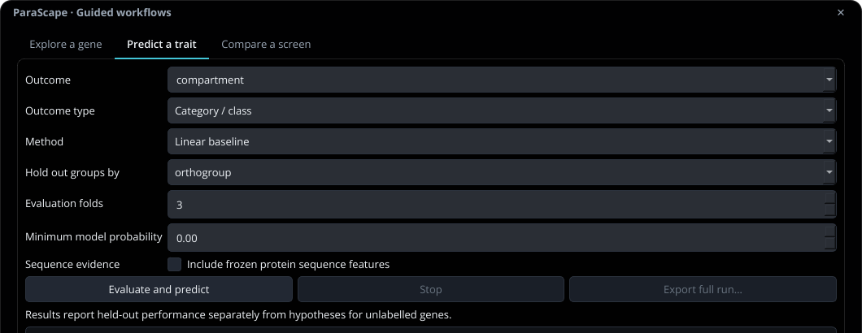
PREDICTION
Set up a prediction in one place.
Tools > Predict a trait
Outcome and type
Choose the observed target and
classification or regression.
Method and groups
Start with a baseline. Keep related
genes together with orthogroup.
Run and inspect
Evaluate and predict. Read held-out
metrics before the candidate table.
The Jobs panel runs the work. Stop requests cancellation between model fits.
PARASCAPE / 0.43 GUIDE
20 / 40
Notes:
Set up a prediction in one place.
Tools > Predict a trait
Outcome and type: Choose the observed target and classification or regression.
Method and groups: Start with a baseline. Keep related genes together with orthogroup.
Run and inspect: Evaluate and predict. Read held-out metrics before the candidate table.
The Jobs panel runs the work. Stop requests cancellation between model fits.
Source: https://einarolafsson.github.io/parascape/workflows.html

Slide 21
PREDICTION
Keep evaluation genes out of fitting.
Fit
Calibrate
Evaluate
Learn features and model
parameters.
Adjust probabilities or residual
intervals on separate groups.
Score predictions on groups
withheld from both steps.
Circles represent genes. Related genes stay within one group.
Outer folds rotate the evaluation groups. Grouped validation is harder and more informative than mixing relatives.
PARASCAPE / 0.43 GUIDE
21 / 40
Notes:
Keep evaluation genes out of fitting.
Fit: Learn features and model parameters.
Calibrate: Adjust probabilities or residual intervals on separate groups.
Evaluate: Score predictions on groups withheld from both steps.
Outer folds rotate the evaluation groups. Grouped validation is harder and more informative than mixing relatives.
Source: https://einarolafsson.github.io/parascape/benchmark-0.43.html

Slide 22
PREDICTION
Compare simple methods first.
Method
Useful starting question
Keep in mind
Prior / linear
Is there signal beyond a simple baseline?
Always retain a baseline
Boosted trees
Do nonlinear feature combinations help?
Use the same evaluation groups
Feature / PCA neighbours
Do similar measured genes agree?
Distance depends on preprocessing
UMAP / masked factors
Does a reduced representation help?
A compact map can lose signal
Weighted networks
Which fixed graph layers support labels?
Transductive; disconnected genes
abstain
No method is automatically best because it is more complex.
PARASCAPE / 0.43 GUIDE
22 / 40
Notes:
Compare simple methods first.
Method | Useful starting question | Keep in mind
Prior / linear | Is there signal beyond a simple baseline? | Always retain a baseline
Boosted trees | Do nonlinear feature combinations help? | Use the same evaluation groups
Feature / PCA neighbours | Do similar measured genes agree? | Distance depends on preprocessing
UMAP / masked factors | Does a reduced representation help? | A compact map can lose signal
Weighted networks | Which fixed graph layers support labels? | Transductive; disconnected genes abstain
No method is automatically best because it is more complex.
Source: https://einarolafsson.github.io/parascape/workflows.html

Slide 23
PREDICTION
Read performance and coverage together.
Accuracy
Macro F1
Coverage
The fraction of evaluation
genes called correctly.
Unsupported calls count as
misses.
Balances precision and recall
across classes, so common
labels do not dominate the
score.
The fraction with a
supported call. Selective
accuracy describes only that
supported subset.
Also inspect per-class precision, recall, average precision and calibration.
PARASCAPE / 0.43 GUIDE
23 / 40
Notes:
Read performance and coverage together.
Accuracy: The fraction of evaluation genes called correctly. Unsupported calls count as misses.
Macro F1: Balances precision and recall across classes, so common labels do not dominate the score.
Coverage: The fraction with a supported call. Selective accuracy describes only that supported subset.
Also inspect per-class precision, recall, average precision and calibration.
Source: https://einarolafsson.github.io/parascape/workflows.html

Slide 24
RESULTS
What worked in the localization benchmark?
3,827 measured genes · 26 classes · three orthogroup-held-out folds
Macro F1 (higher is better)
0.434 macro F1
Prior
0.013
Boosted trees with published, AF3 and
ESM inputs.
Linear
0.382
56.2% accuracy
UMAP 20D
0.228
Better than the compared
UMAP-neighbour models.
Boosted
0.390
Important limit
Boosted + AF3 + ESM
0.434
Several rare classes still have zero
top-class recall.
Development cross-validation, not prospective validation of new annotations.
PARASCAPE / 0.43 GUIDE
24 / 40
Notes:
What worked in the localization benchmark?
3,827 measured genes · 26 classes · three orthogroup-held-out folds
0.434 macro F1: Boosted trees with published, AF3 and ESM inputs.
56.2% accuracy: Better than the compared UMAP-neighbour models.
Important limit: Several rare classes still have zero top-class recall.
Development cross-validation, not prospective validation of new annotations.
Source: https://einarolafsson.github.io/parascape/benchmark-0.43.html

Slide 25
RESULTS
A confident score can still be wrong.
Combined boosted model: observed accuracy in held-out confidence bins
Mean confidence / observed accuracy
Check calibration
0.7-0.8
0.751
Temperature scaling uses separate
groups when enough labels exist.
0.709
0.850
Read the status
0.8-0.9
0.783
The app explicitly marks runs that
could not be calibrated.
0.9-1.0
0.937
Use abstention
0.911
A probability cutoff can withhold
uncertain calls; it is not a guarantee.
The 0.8-0.9 bin averaged 0.850 confidence but 0.783 accuracy across 465 genes.
PARASCAPE / 0.43 GUIDE
25 / 40
Notes:
A confident score can still be wrong.
Combined boosted model: observed accuracy in held-out confidence bins
Check calibration: Temperature scaling uses separate groups when enough labels exist.
Read the status: The app explicitly marks runs that could not be calibrated.
Use abstention: A probability cutoff can withhold uncertain calls; it is not a guarantee.
The 0.8-0.9 bin averaged 0.850 confidence but 0.783 accuracy across 465 genes.
Source: https://einarolafsson.github.io/parascape/benchmark-0.43.html

Slide 26
PROTEIN EVIDENCE
Add sequence evidence with one checkbox.
8,064 proteins
8,064 / 8,140
Bundled frozen ESM-2
representations.
Toxoplasma genes with this feature view
320 features
A numerical view of protein sequence,
separate from experimental
measurements.
No download to use
99.1% coverage in the bundled release
Enable Include frozen protein
sequence features in the guided
predictor.
Regenerating representations needs the optional sequence extra. Benchmark their value rather than assuming it.
PARASCAPE / 0.43 GUIDE
26 / 40
Notes:
Add sequence evidence with one checkbox.
8,064 proteins: Bundled frozen ESM-2 representations.
320 features: A numerical view of protein sequence, separate from experimental measurements.
No download to use: Enable Include frozen protein sequence features in the guided predictor.
Regenerating representations needs the optional sequence extra. Benchmark their value rather than assuming it.
Source: https://einarolafsson.github.io/parascape/protein-sequences.html

Slide 27
PROTEIN EVIDENCE
Your AF3 collection becomes traceable evidence.
1,210 matched genes
1,210 / 8,140
Exact sequence or uniquely placed
fragment matches in the available
local collection.
Toxoplasma genes with this feature view
Nine summary features
Confidence, sequence coverage and
descriptive geometry.
Coordinates stay local
14.9% coverage in the bundled release
The package includes features and
provenance, not the private model
files.
This is the verified subset in the synced folders, not the total number of proteins ever folded.
PARASCAPE / 0.43 GUIDE
27 / 40
Notes:
Your AF3 collection becomes traceable evidence.
1,210 matched genes: Exact sequence or uniquely placed fragment matches in the available local collection.
Nine summary features: Confidence, sequence coverage and descriptive geometry.
Coordinates stay local: The package includes features and provenance, not the private model files.
This is the verified subset in the synced folders, not the total number of proteins ever folded.
Source: https://einarolafsson.github.io/parascape/structures.html

Slide 28
PROTEIN EVIDENCE
Connect local folds to the structure viewer.
Index once
pip install 'parascape[structures]'
parascape-index-structures /path/to/models
Build the local structure catalogue
from your model folders.
Select a gene
The structure viewer checks the
local index before AlphaFold DB.
Read confidence
A predicted fold and its confidence
are not experimental validation.
Recreate the index if the drive moves. Full models take precedence over fragments.
PARASCAPE / 0.43 GUIDE
28 / 40
Notes:
Connect local folds to the structure viewer.
pip install 'parascape[structures]'
parascape-index-structures /path/to/models
Index once: Build the local structure catalogue from your model folders.
Select a gene: The structure viewer checks the local index before AlphaFold DB.
Read confidence: A predicted fold and its confidence are not experimental validation.
Recreate the index if the drive moves. Full models take precedence over fragments.
Source: https://einarolafsson.github.io/parascape/structures.html

Slide 29
RESULTS
Continuous traits stay continuous.
Protein abundance: 748 measured genes · grouped held-out evaluation
RMSE in log2 units (lower is better)
Choose regression
Prior
3.388
Use Continuous measurement
instead of converting an outcome into
classes.
Linear
3.023
Read error units
RMSE here is measured in log2
abundance units; lower is better.
Boosted
2.556
Small added gain
Boosted + AF3 + ESM
2.508
The combined-feature improvement
interval includes no improvement.
Nominal 90% intervals covered 94.9%, but their mean width was 9.94 log2 units.
PARASCAPE / 0.43 GUIDE
29 / 40
Notes:
Continuous traits stay continuous.
Protein abundance: 748 measured genes · grouped held-out evaluation
Choose regression: Use Continuous measurement instead of converting an outcome into classes.
Read error units: RMSE here is measured in log2 abundance units; lower is better.
Small added gain: The combined-feature improvement interval includes no improvement.
Nominal 90% intervals covered 94.9%, but their mean width was 9.94 log2 units.
Source: https://einarolafsson.github.io/parascape/benchmark-0.43.html

Slide 30
RESULTS
Network coverage is not prediction quality.
87.3% supported
0.195 macro F1
Combining domain, expression and structural
layers reaches more evaluation genes.
The combined fixed network remains well
below the compared feature models.
The graph includes evaluation nodes: report these results as transductive, not transfer to unseen nodes.
PARASCAPE / 0.43 GUIDE
30 / 40
Notes:
Network coverage is not prediction quality.
87.3% supported: Combining domain, expression and structural layers reaches more evaluation genes.
0.195 macro F1: The combined fixed network remains well below the compared feature models.
The graph includes evaluation nodes: report these results as transductive, not transfer to unseen nodes.
Source: https://einarolafsson.github.io/parascape/benchmark-0.43.html

Slide 31
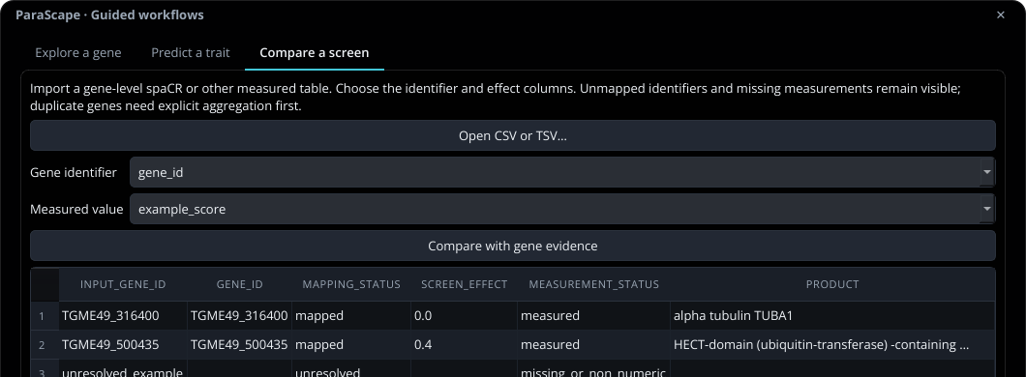
SCREEN WORKFLOW
Compare a screen without losing unmatched rows.
Tools > Compare a screen
Open a CSV or TSV
Use a gene-level table and choose its
identifier and value columns.
Inspect the join
Mapped and unresolved IDs remain
visible. Measured zero stays zero.
Export the comparison
Keep the table and source-file hash
together.
Screenshot values are illustrative. They are not biological screen results.
PARASCAPE / 0.43 GUIDE
31 / 40
Notes:
Compare a screen without losing unmatched rows.
Tools > Compare a screen
Open a CSV or TSV: Use a gene-level table and choose its identifier and value columns.
Inspect the join: Mapped and unresolved IDs remain visible. Measured zero stays zero.
Export the comparison: Keep the table and source-file hash together.
Screenshot values are illustrative. They are not biological screen results.
Source: https://einarolafsson.github.io/parascape/workflows.html

Slide 32
SCREEN WORKFLOW
Move from spaCR results to gene evidence.
01
02
03
04
spaCR
CSV / TSV
ParaScape
Evidence
Generate gene-level
measurement or effect
estimates.
Export identifiers and
the measured value
you want to compare.
Open Compare a
screen and inspect the
identifier mapping.
Read the existing
annotations and
source context
alongside the result.
The spaCR launcher opens ParaScape in a separate environment. It does not automatically transfer results.
PARASCAPE / 0.43 GUIDE
32 / 40
Notes:
Move from spaCR results to gene evidence.
spaCR: Generate gene-level measurement or effect estimates.
CSV / TSV: Export identifiers and the measured value you want to compare.
ParaScape: Open Compare a screen and inspect the identifier mapping.
Evidence: Read the existing annotations and source context alongside the result.
The spaCR launcher opens ParaScape in a separate environment. It does not automatically transfer results.
Source: https://einarolafsson.github.io/parascape/workflows.html

Slide 33
SCREEN WORKFLOW
Add measurements to a Toxoplasma session.
File > Import data
Check the preview
Rebuild deliberately
The advanced importer
accepts CSV, TSV, Excel or
Parquet for Toxoplasma
accessions.
Choose a useful column
prefix and explicitly handle
duplicates and missing
values.
Imported values do not
change map positions until
you include them in a new
embedding.
Advanced table import is Toxoplasma-only. The guided comparison supports the currently open organism.
PARASCAPE / 0.43 GUIDE
33 / 40
Notes:
Add measurements to a Toxoplasma session.
File > Import data: The advanced importer accepts CSV, TSV, Excel or Parquet for Toxoplasma accessions.
Check the preview: Choose a useful column prefix and explicitly handle duplicates and missing values.
Rebuild deliberately: Imported values do not change map positions until you include them in a new embedding.
Advanced table import is Toxoplasma-only. The guided comparison supports the currently open organism.
Source: https://einarolafsson.github.io/parascape/guide.html

Slide 34
REPRODUCIBILITY
Export the evidence behind a result.
01
02
03
predictions.csv
per_class.csv
run.json
Separate held-out evaluations
from unknown-gene hypotheses.
Inspect performance and
support for each class.
Retain settings, input identity,
split genes, excluded features
and versions.
Use Export full run. A ranked list alone cannot reproduce an analysis.
PARASCAPE / 0.43 GUIDE
34 / 40
Notes:
Export the evidence behind a result.
predictions.csv: Separate held-out evaluations from unknown-gene hypotheses.
per_class.csv: Inspect performance and support for each class.
run.json: Retain settings, input identity, split genes, excluded features and versions.
Use Export full run. A ranked list alone cannot reproduce an analysis.
Source: https://einarolafsson.github.io/parascape/workflows.html

Slide 35
PYTHON API
Use the same methods from Python.
Headless analysis
import pandas as pd
from parascape import paths
from parascape.prediction import TaskSpec, run
nodes = pd.read_parquet(
paths.cache_file('nodes.parquet'))
result = run(nodes, TaskSpec('compartment'))
result.save('localization_run')
Read bundled tables and run
methods without opening the
desktop.
One contract
The API uses the same evaluation
and export rules as the guided
workflow.
The generated module reference documents functions, arguments and return values.
PARASCAPE / 0.43 GUIDE
35 / 40
Notes:
Use the same methods from Python.
import pandas as pd
from parascape import paths
from parascape.prediction import TaskSpec, run
nodes = pd.read_parquet(
paths.cache_file('nodes.parquet'))
result = run(nodes, TaskSpec('compartment'))
result.save('localization_run')
Headless analysis: Read bundled tables and run methods without opening the desktop.
One contract: The API uses the same evaluation and export rules as the guided workflow.
The generated module reference documents functions, arguments and return values.
Source: https://einarolafsson.github.io/parascape/API.html

Slide 36
EVIDENCE API
Keep claims traceable and reviewable.
Observation records
Literature assertions
Explicit limits
Store entity, trait, value,
units, context, source,
uncertainty and missingness.
Retain the source passage
and negation. Extracted
claims begin pending review.
The API supports review
records; the desktop has no
bulk literature-curation
interface.
A reviewed interpretation of a passage is not experimental proof. Conflicting observations remain separate.
PARASCAPE / 0.43 GUIDE
36 / 40
Notes:
Keep claims traceable and reviewable.
Observation records: Store entity, trait, value, units, context, source, uncertainty and missingness.
Literature assertions: Retain the source passage and negation. Extracted claims begin pending review.
Explicit limits: The API supports review records; the desktop has no bulk literature-curation interface.
A reviewed interpretation of a passage is not experimental proof. Conflicting observations remain separate.
Source: https://einarolafsson.github.io/parascape/workflows.html

Slide 37
PRACTICAL USE
Run work in the background. Keep control.
Jobs and Stop
Optional GPU
Logs and help
Watch progress in the Jobs
panel. Cancellation happens
between model fits.
CPU analysis is the default.
NVIDIA CUDA analysis uses
the gpu extra on supported
Linux systems.
Hover over settings. Enable
file logging in Preferences
when investigating a
problem.
Offline browsing works immediately. Remote structures, publications and optional chat can require network access.
PARASCAPE / 0.43 GUIDE
37 / 40
Notes:
Run work in the background. Keep control.
Jobs and Stop: Watch progress in the Jobs panel. Cancellation happens between model fits.
Optional GPU: CPU analysis is the default. NVIDIA CUDA analysis uses the gpu extra on supported Linux systems.
Logs and help: Hover over settings. Enable file logging in Preferences when investigating a problem.
Offline browsing works immediately. Remote structures, publications and optional chat can require network access.
Source: https://einarolafsson.github.io/parascape/guide.html

Slide 38
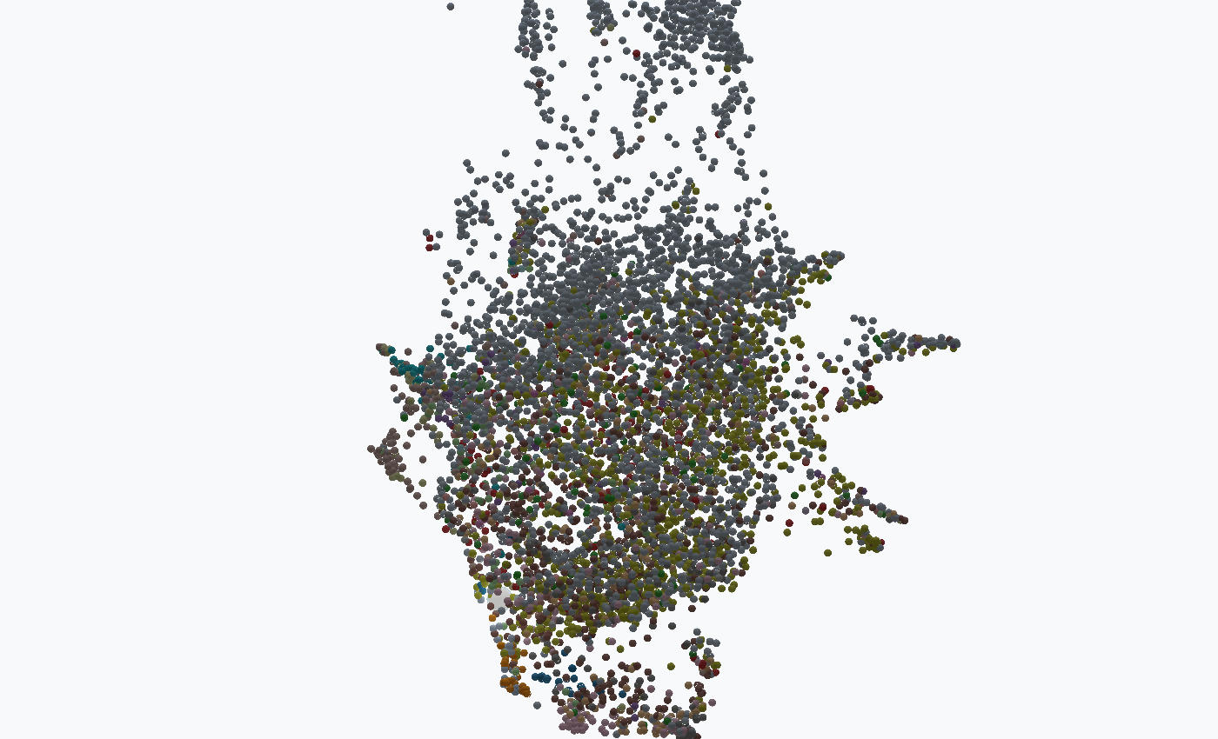
APPEARANCE
Choose a readable view.
View > Preferences: theme, colours, point rendering, lighting and text size.
Dark theme
Light theme
Lighting changes presentation only. Use neutral lighting when comparing measurement colours.
PARASCAPE / 0.43 GUIDE
38 / 40
Notes:
Choose a readable view.
View > Preferences: theme, colours, point rendering, lighting and text size.
Lighting changes presentation only. Use neutral lighting when comparing measurement colours.
Source: https://einarolafsson.github.io/parascape/guide.html

Slide 39
GOOD PRACTICE
Before interpreting a prediction, check four things.
01
02
03
04
Identity
Evidence
Validation
Uncertainty
Are the gene mapping,
organism and assay
context correct?
Which values are
measured, computed,
missing or transferred?
Were target-related
inputs excluded and
related genes held
together?
Do rare classes,
calibration and
coverage support the
intended
interpretation?
Model comparisons guide exploration. Independent evidence is needed to establish a new biological claim.
PARASCAPE / 0.43 GUIDE
39 / 40
Notes:
Before interpreting a prediction, check four things.
Identity: Are the gene mapping, organism and assay context correct?
Evidence: Which values are measured, computed, missing or transferred?
Validation: Were target-related inputs excluded and related genes held together?
Uncertainty: Do rare classes, calibration and coverage support the intended interpretation?
Model comparisons guide exploration. Independent evidence is needed to establish a new biological claim.
Source: https://einarolafsson.github.io/parascape/benchmark-0.43.html

Slide 40
START HERE
Open a gene. Ask a precise question.
pip install parascape
User guide
Guided workflows
Data sources
Open resource >
Open resource >
Open resource >
Python API
Benchmarks
Issues and source
Open resource >
Open resource >
Open resource >
ParaScape · Einar Olafsson · Open-source software, with original data sources credited.
PARASCAPE / 0.43 GUIDE
40 / 40
Notes:
Open a gene. Ask a precise question.
pip install parascape
User guide: https://einarolafsson.github.io/parascape/guide.html
Guided workflows: https://einarolafsson.github.io/parascape/workflows.html
Data sources: https://einarolafsson.github.io/parascape/datasets.html
Python API: https://einarolafsson.github.io/parascape/API.html
Benchmarks: https://einarolafsson.github.io/parascape/benchmark-0.43.html
Issues and source: https://github.com/EinarOlafsson/parascape
ParaScape · Einar Olafsson · Open-source software, with original data sources credited.
Source: https://einarolafsson.github.io/projects/parascape/

