Slide 1
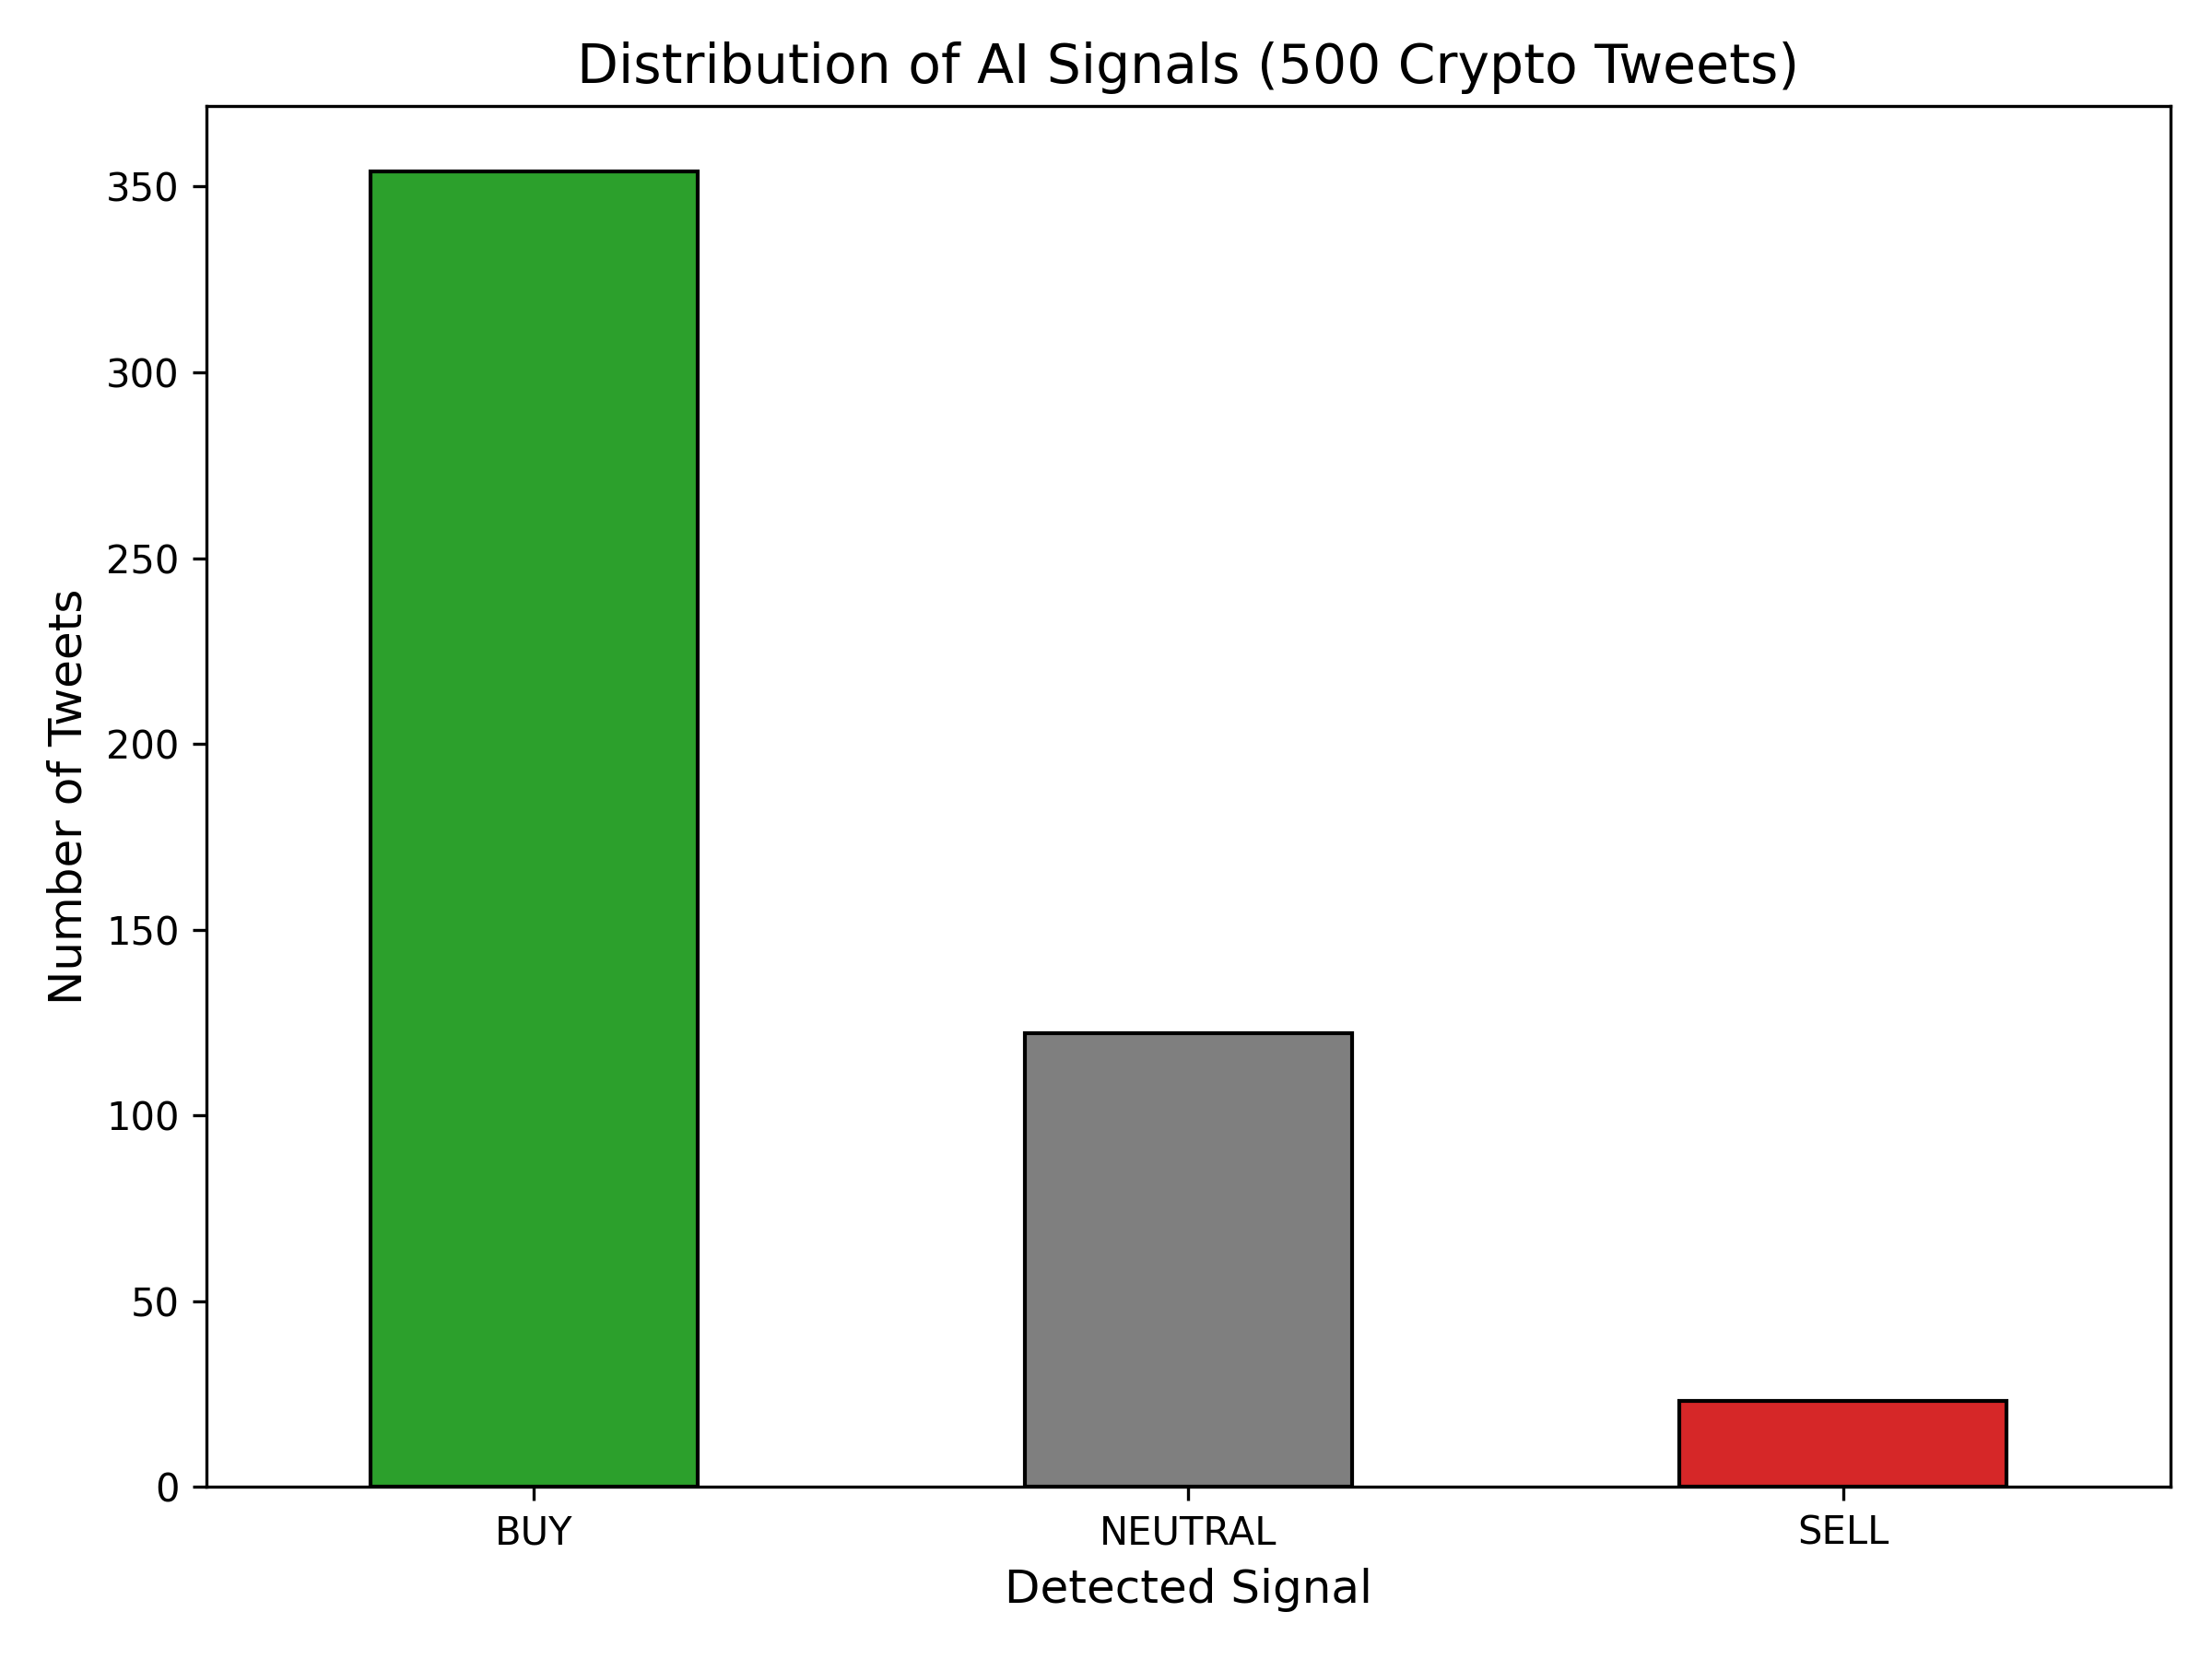
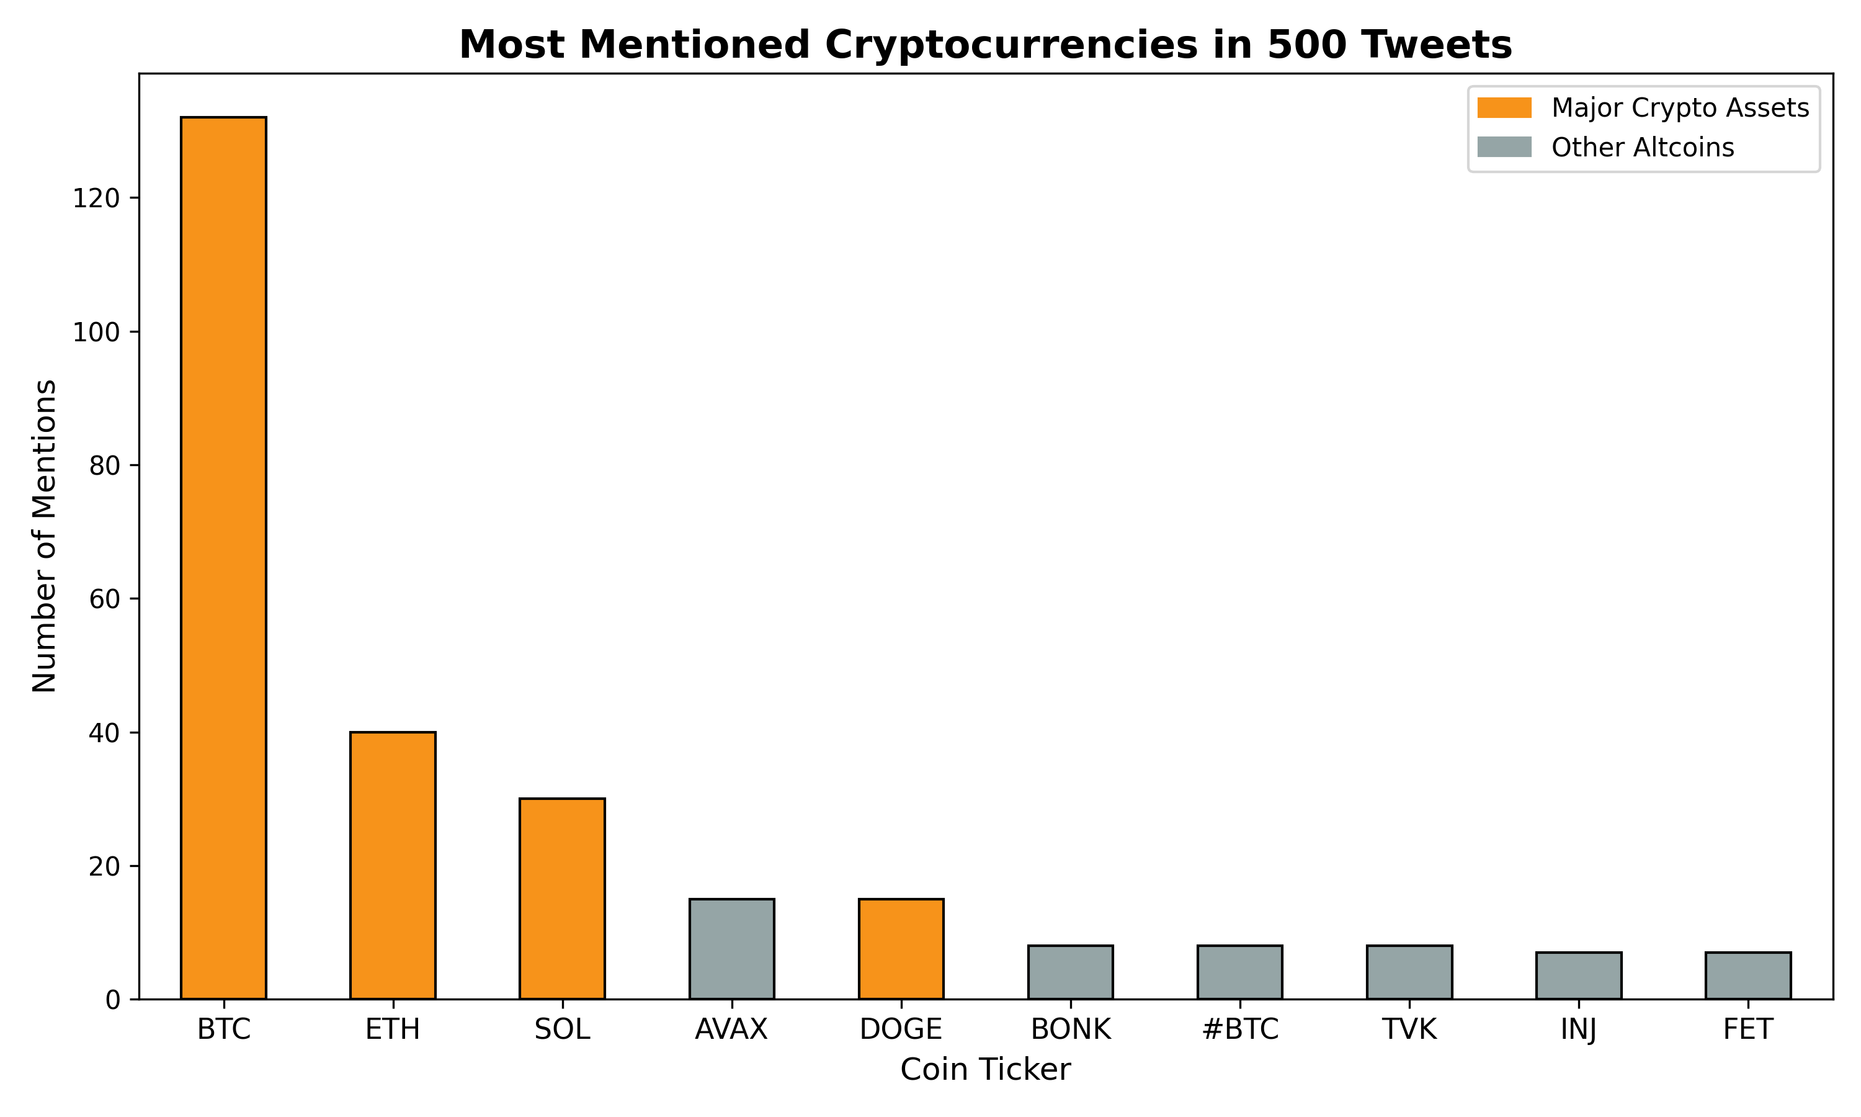
LLM-Based Crypto Market Signal Detection from X
Yeseok Bae, Emircan Haslak
Communication Networks Lab — Lab/Project Summer 2026, Technical University of Darmstadt
Motivation
Motivation
Market Vulnerability: While cryptocurrencies are popular investments, the markets are actually highly fragile and volatile
Social Media Impact: Public figures and influencers possess considerable power over market trends,
where a single social media post can trigger financial shifts
Project Objective: The goal is to apply Large Language Models (LLMs) to filter influential posts
and evaluate their exact impact on the market.
Other Motivation
Personal Experience: Experiencing firsthand how influencer hype (like Elon Musk and Dogecoin) directly
drives individual investment decisions.
[AAL+18]
Data Source: We automatically get a list of recent tweets about cryptocurrencies from online dataset sources
AI Analysis (Llama 3.1): We send the text of each tweet to a powerful AI model that reads it just like a human would
Result: The AI classifies the sentiment: Is it positive ("BUY") , neutral (“NEUTRAL”) or negative ("SELL")?
Detection: Identifying posts that could potentially trigger market movements (e.g. Like/Retweet counts)
Confirmation: Evaluating historical price data to verify whether a specific post actually caused a measurable impact
on the cryptocurrency market.
Implementation
Scale Up: The next phase will expand the processing pipeline from the initial 500-tweet sample
Price Correlation: Future work will focus on overlaying these generated AI sentiment signals with
actual historical cryptocurrency price charts to evaluate the true predictive power of social media trends
Future Work
Resources
[ABC20] Stephan Akkerman. "Financial Tweets Dataset." Hugging Face, 2023. https://huggingface.co/datasets/StephanAkkerman/financial-tweets
[ABC21] Mendeley Data. "Cryptocurrency Sentiment Analysis Dataset." Mendeley Data, 2020. https://data.mendeley.com/datasets/x7yvshrnxy/1

