Slide 1
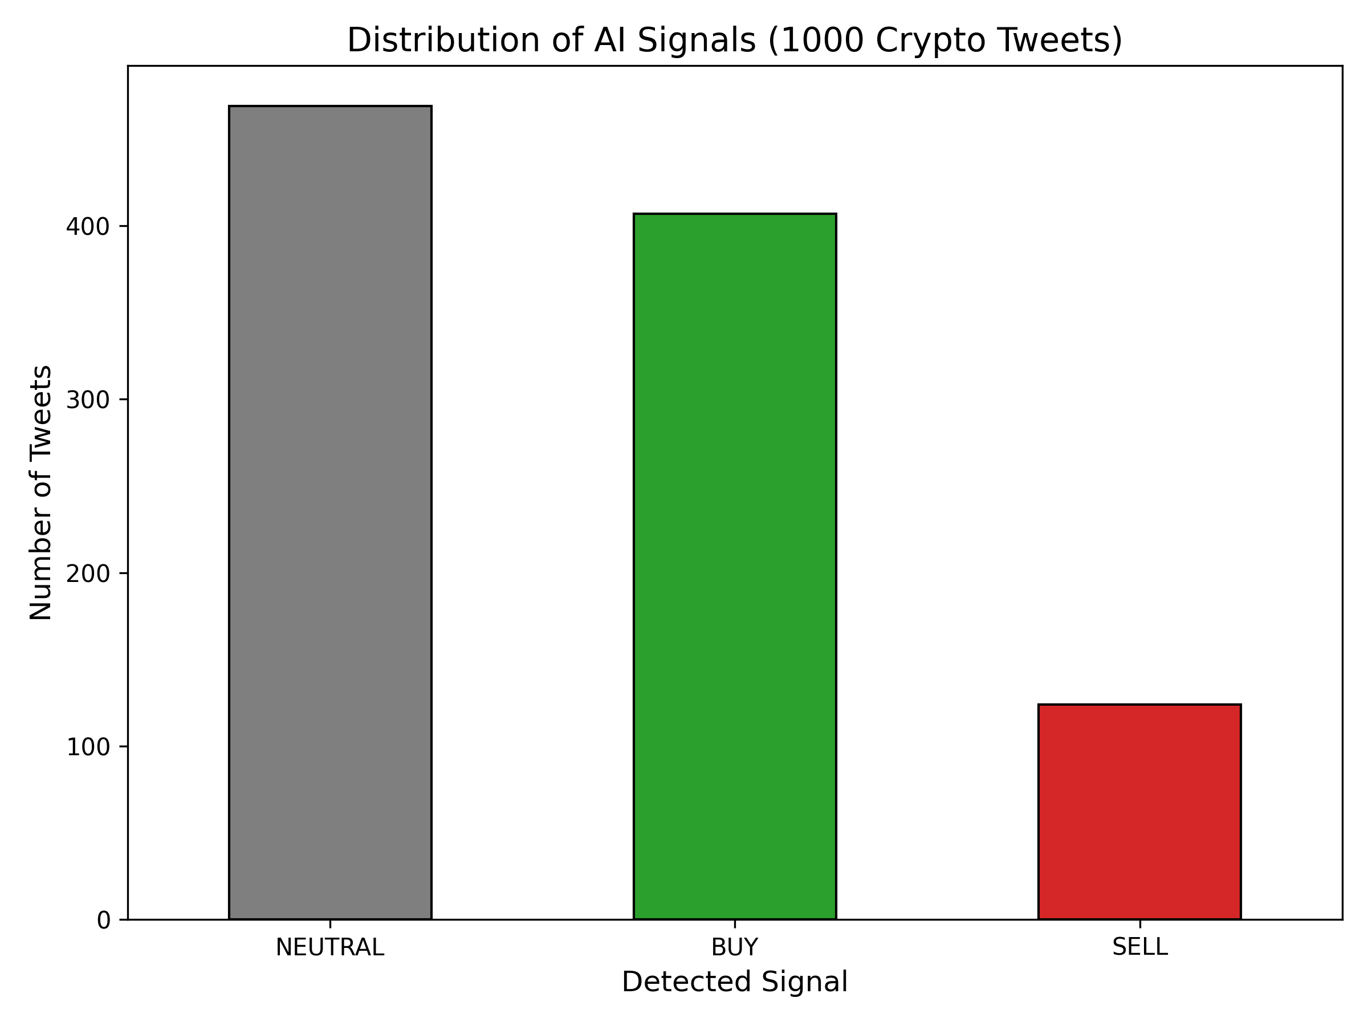
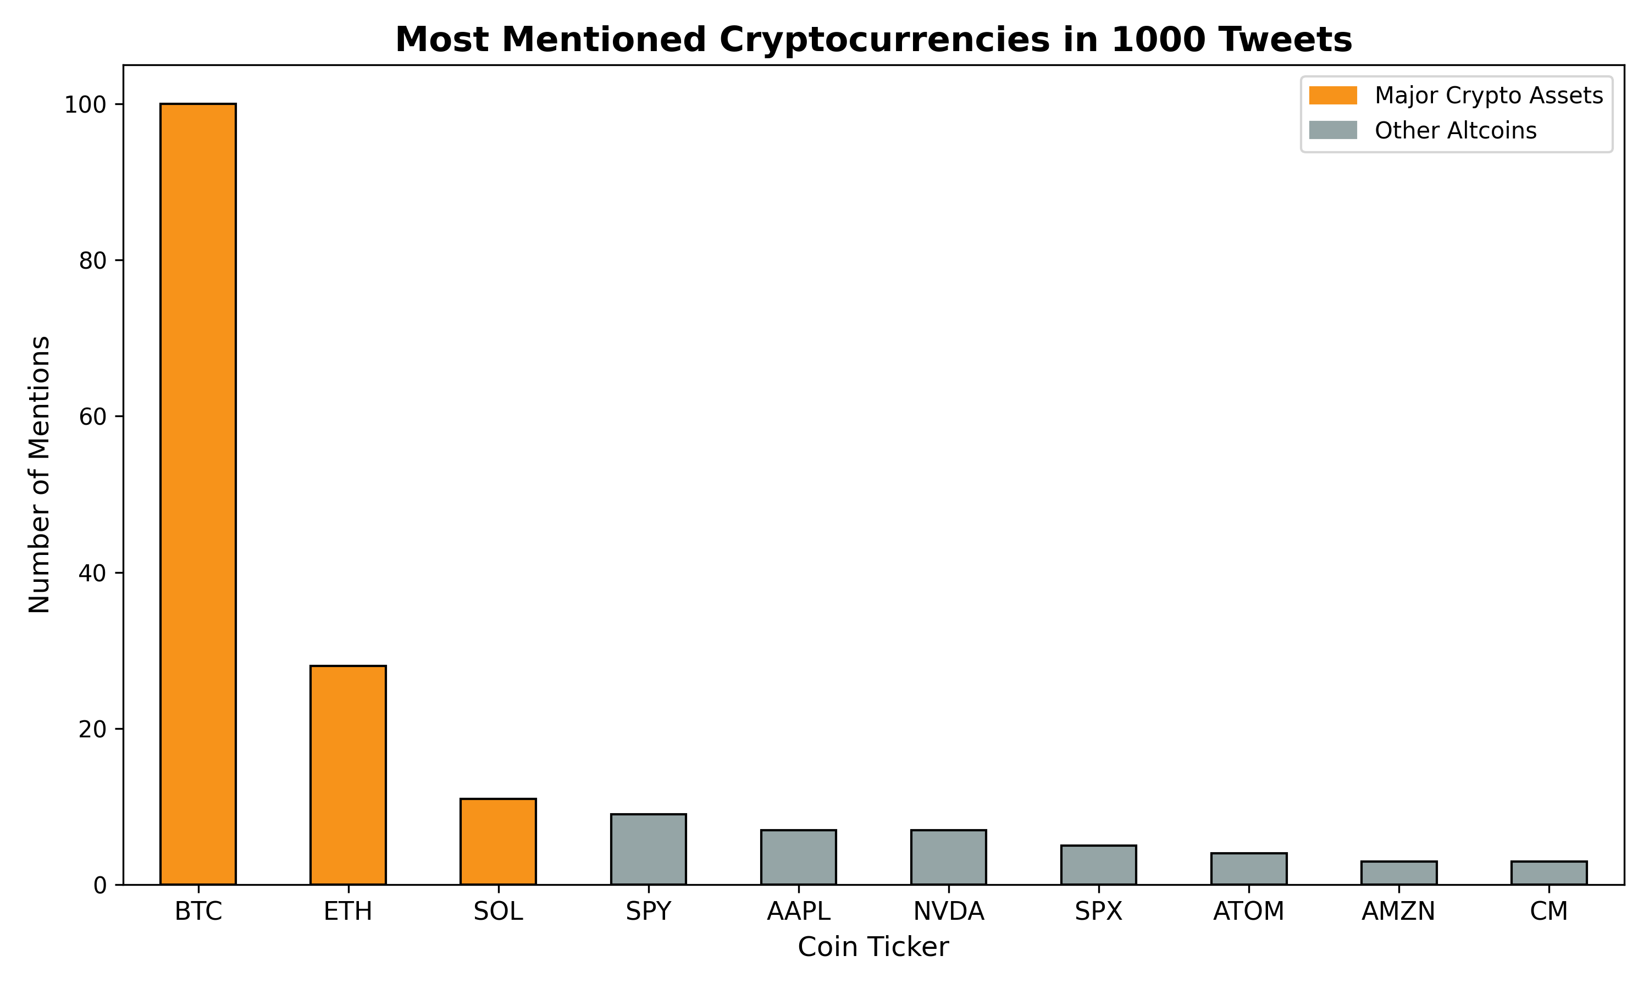
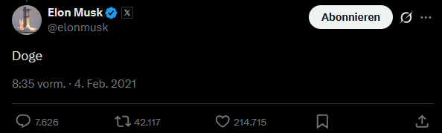
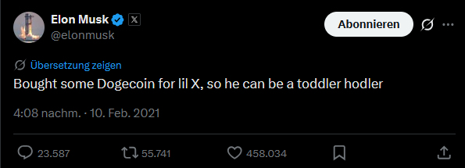
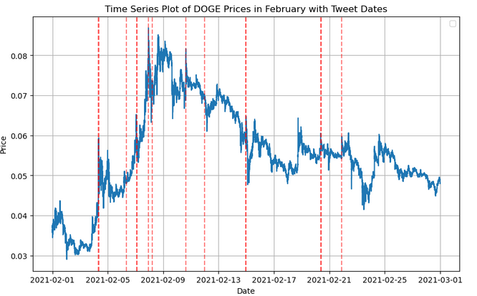
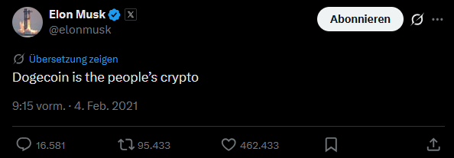
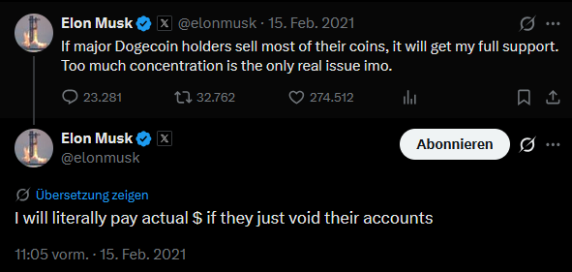

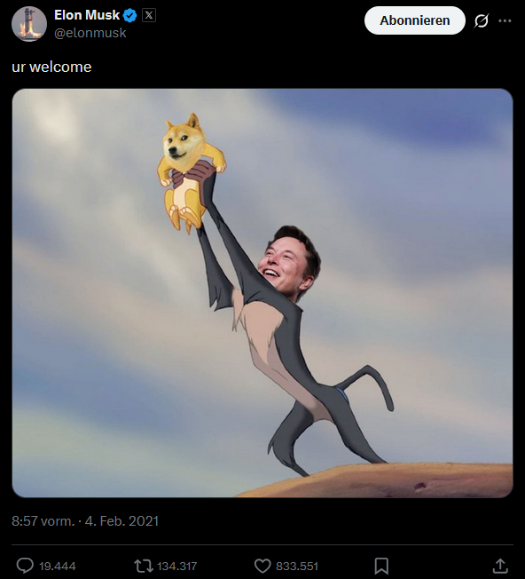
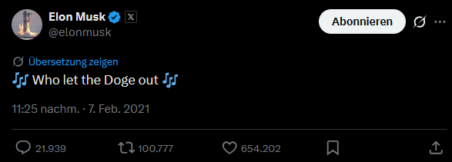
LLM-Based Crypto Market Signal Detection from X
Yeseok Bae, Emircan Haslak
Communication Networks Lab — Lab/Project Summer 2026, Technical University of Darmstadt
Motivation
Market Vulnerability: While cryptocurrencies are popular investments, the markets are highly unpredictable and erratic.
Social Media Impact: Public figures and influencers possess considerable power over market trends,
where a single social media post can trigger financial shifts
Project Objective: The goal is to apply Large Language Models (LLMs) to filter influential posts
and evaluate their exact impact on the market.
Data Source: Tweets are sourced from public datasets and analyzed by Llama 3.1 for sentiment
AI Analysis (Llama 3.1): We send the text of each tweet to an AI model that reads it
Result: The AI classifies the sentiment: Is it positive ("BUY") , neutral (“NEUTRAL”) or negative ("SELL")?
Detection: Identifying posts that could potentially trigger market movements (e.g. Like/Retweet counts)
Confirmation: Evaluating historical price data to verify whether a specific post actually caused a measurable impact
on the cryptocurrency market.
Implementation
Elon Musk’s Influence on Dogecoin
https://x.com/elonmusk/status/1357231313376456708
https://x.com/elonmusk/status/1359519541219500033
https://x.com/elonmusk/status/1357241340313141249
https://x.com/elonmusk/status/1361094185412100096
https://www.kaggle.com/code/johnsmith44/musk-doge-tweets-and-effect-on-price-feb-2021
https://x.com/elonmusk/status/1357244295091208193
Correlation: Significant price changes often happened right after popular tweets
https://x.com/elonmusk/status/1358542364948668418
https://x.com/elonmusk/status/1357236825589432322
Resources
[ABC20] Stephan Akkerman. "Financial Tweets Dataset." Hugging Face, 2023. https://huggingface.co/datasets/StephanAkkerman/financial-tweets
[ABC21] Mendeley Data. "Cryptocurrency Sentiment Analysis Dataset." Mendeley Data, 2020. https://data.mendeley.com/datasets/x7yvshrnxy/1
[ABC22] Jean (johnsmith44). “Musk Doge tweets and effect on price, Feb 2021” https://www.kaggle.com/code/johnsmith44/musk-doge-tweets-and-effect-on-price-feb-2021
[ABC23] Elon Musk. “Twitter/X Tweets from Feb 2021” https://x.com/elonmusk

