Slide 1

LLM-Based Crypto Market Signal Detection from X
KOM Lab Final Presentation – Group 7
Emircan Haslak & Yeseok Bae
emircan.haslak@stud.tu-darmstadt.de & leeys5868@gmail.com
Leonhard Balduf & Florian Raskob
Picture Reference: asendofnight17j03: "Sentiment Analysis || LLM || BERT ||" (Kaggle Notebook) – https://www.kaggle.com/code/endofnight17j03/sentiment-analysis-llm-bert

Slide 2
Motivation & Research Question
Crypto prices react strongly to public opinion [1, 2]
  A single post from an influential person can move prices within minutes [1]
Social media provides huge volumes of data, but most of it is noise [6]
  Spam, unfounded speculation, irrelevant opinions
Research question
  Can an LLM detect market-relevant signals in influencer tweets?
  Do these signals connect to measurable short-term price movements?
Assets: Bitcoin (BTC), Ethereum (ETH), Dogecoin (DOGE) + Solana (SOL, exploratory)

Slide 3
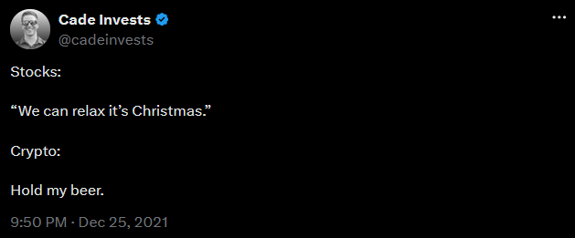
Three Core Challenges
1. Language [5, 6]
  Crypto slang (“HODL”, “to the moon”, “FOMO”), sarcasm, irony
  Dictionary-based sentiment analysis fails, deeper context is required
2. Source [1]
  Not all posts carry equal weight: millions of followers vs. unknown accounts
3. Timing [7]
  Reactions occur within minutes and often correct themselves the same day
  Daily closing prices hide the original impact of a post

Slide 4
Related Work
LLMs extract financial signals from text without financial training [3]
BloombergGPT: domain-specific training improves financial NLP [4]
  Our contrast: general-purpose model with few-shot prompting only
LLM sentiment analysis outperforms keyword methods for crypto [2]
Social media is dominated by noise [6], markets react to tweets within minutes [7]
  Motivates our design: curated accounts + minute-level evaluation

Slide 5
From Daily Signals to Per-Tweet Analysis
Initial approach
  Engagement-filtered tweets, one aggregated signal per day
  Compared against next-day prices: only ~30% hit rate
  Market usually corrected within a day, impact invisible in daily prices [7]
Final approach
  Curated influencer accounts instead of engagement thresholds
  Every tweet is evaluated individually, no daily aggregation
  Minute-level prices, horizons of 1 to 60 minutes after each tweet

Slide 6
System Overview: Four-Stage Pipeline
Data ingestion: one curated tweet dataset per coin
2. LLM inference: local Llama 3.1 [8] via Ollama [9]
  Local deployment: data privacy, no API costs, strict JSON output
3. Price data pipeline: Binance 1-minute data [10]
  Minute-to-minute price change and change rate per coin
4. Price matching
  Each tweet matched to the price series at its timestamp
  Two metrics: directional accuracy + price movement vs. baseline

Slide 7
Data: Influencer Selection & Datasets
Advocates (Saylor, Bukele), founders (Buterin, Yakovenko), official project accounts
  DOGE: single account, Elon Musk, documented history of moving the market [1]
Coin | Tweets | Accounts | Date range
BTC | 328 | 3 | Dec 2017 – Jun 2022
ETH | 414 | 4 | Sep 2017 – Feb 2021
SOL | 27 | 3 | Nov 2019 – Feb 2021
DOGE | 54,274 | 1 | Dec 2013 – Apr 2025
Strong imbalance: BTC 85% Saylor, ETH 64% Buterin – results reflect individual posting styles
DOGE: only 20,820 of 54,274 tweets processed (through Jan 2023), run incomplete

Slide 8
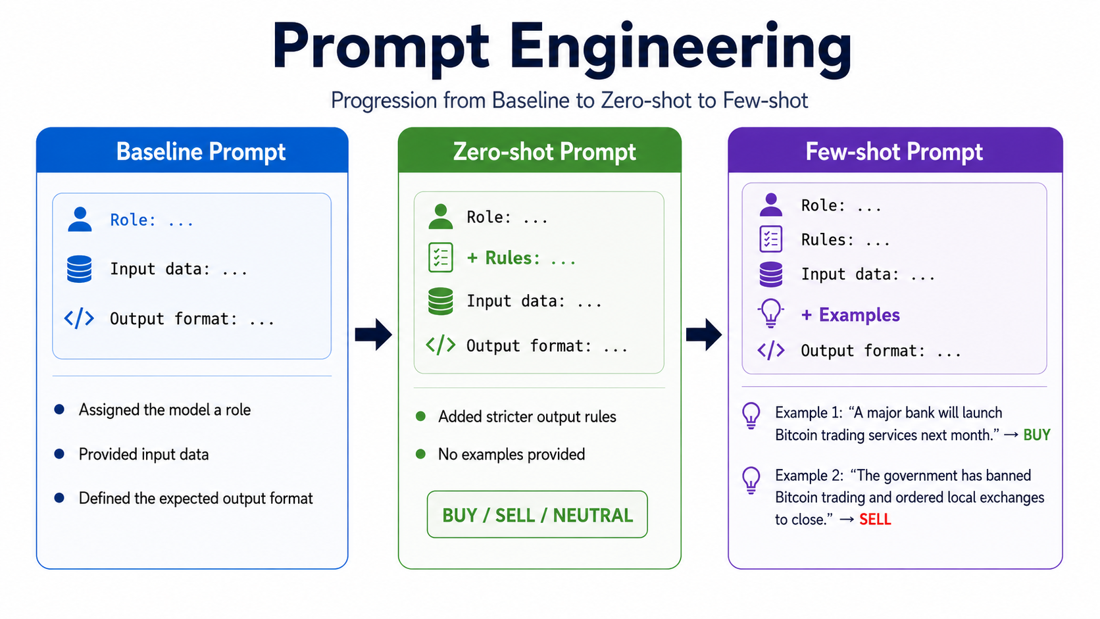
LLM Inference & Prompt Design
Prompt Engineering
  Assigned the model the role of a crypto market analyzer.
  Provided input data such as the username, tweet text, coin and date.
  Defined the expected JSON output format
Zero-shot prompt with rules
  Added stricter output rules without giving examples.
  The model was forced to choose only one of three labels: BUY, SELL, or NEUTRAL.
Few-shot prompt with examples
  Positive/negative news, unrelated tweets, vague mentions, hashtag-only promotion
    Example 1: “A major bank will launch Bitcoin trading services next month.” : signal → BUY
    Example 2: “The government has banned Bitcoin trading and ordered local exchanges to close.” : signal → SELL

Slide 9
LLM Inference & Prompt Design
Model output per tweet (strict JSON)
  signal (BUY / SELL / NEUTRAL),
  impact_strength (0–5),
  confidence (0.0–1.0)
Coin relevance filter is critical for DOGE
: most Musk tweets are not about Dogecoin
Output validation:
“BUYSIGNAL” mapped to BUY

Slide 10
Evaluation Methodology
Each tweet matched to minute-level prices at its timestamp
  Horizons: 1, 3, 5, 10, 15, 30, 60,120, 720, 1440 minutes after the tweet
Directional accuracy (BUY/SELL tweets only)
  Accuracy = correct / (correct + wrong) × 100
  Tweets without matching price data are excluded
Price movement vs. baseline (direction-independent)
  Avg. absolute price change rate after tweets vs. full-period and monthly baselines
Both metrics verified by recomputing summaries from per-tweet event data

Slide 11
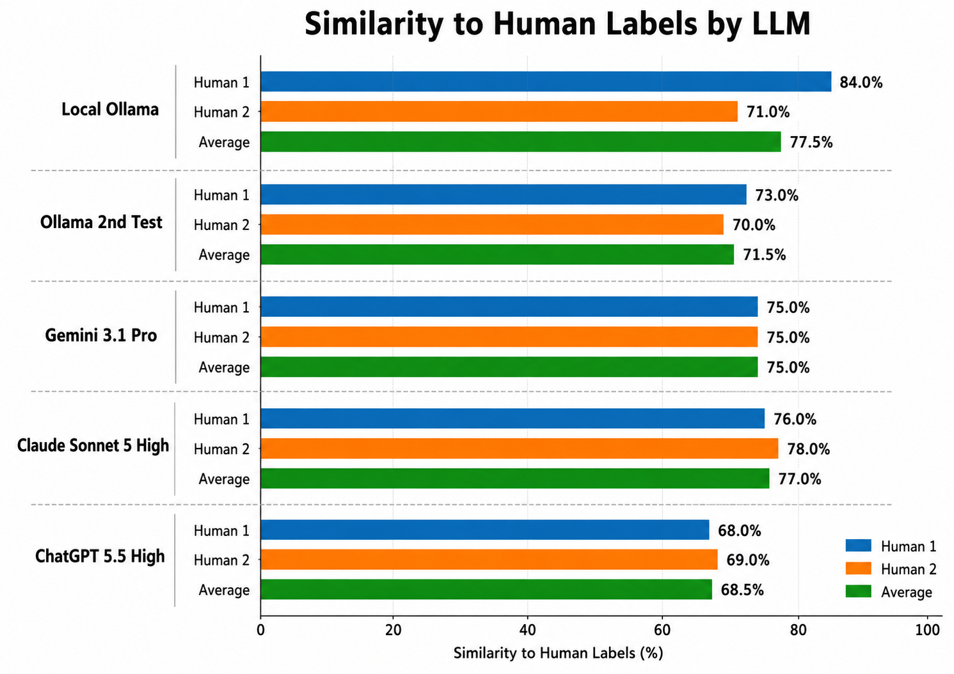
LLM Classification Accuracy
100 random tweets, annotated independently by 2 authors
  around 70-75% similarity between LLM classifications and human annotations
Strengths: clear institutional announcements, filtering out spam
Weaknesses: heavy sarcasm, highly ambiguous slang
Few-shot prompting provides a usable classifier

Slide 12
Directional Accuracy
Coin | 1 min | 3 min | 5 min | 10 min | 15 min | 30 min | 60 min | 120 min | 360 min | 720 min | 1440 min
BTC | 50.83 | 56.67 | 55.00 | 56.25 | 50.00 | 55.83 | 52.92 | 58.16 | 65.00 | 60.83 | 64.71
ETH | 51.25 | 43.21 | 43.75 | 48.78 | 46.34 | 43.37 | 46.43 | 54.22 | 54.76 | 59.52 | 58.33
DOGE* | 52.53 | 52.04 | 51.72 | 50.48 | 51.04 | 48.64 | 48.26 | 49.28 | 48.04 | 46.63 | 47.81
TRUMP** | 53.12 | 62.86 | 65.71 | 50.00 | 54.05 | 64.86 | 62.16 | 55.00 | 56.10 | 53.66 | 56.10
Overall | 52.25 | 52.44 | 52.04 | 51.06 | 50.79 | 49.51 | 48.94 | 50.55 | 50.32 | 48.81 | 50.21
Overall: 48.8–52.4% across 23,039 non-flat directional events – near chance level
BTC and Trump are slightly above chance (BTC 56.9%, TRUMP 57.5%),
but this pattern is not consistent across coins or horizons
Strong BUY skew, SELL barely tested: DOGE 2,207 BUY vs. 129 SELL overall

Slide 13
Price Movement after influencer tweet vs. usual Movement
Coin | Baseline | 1 min | 3 min | 5 min | 10 min | 15 min | 30 min | 60 min | 120 min | 360 min | 720 min | 1440 min
BTC | monthly | 1.16 | 1.05 | 1.23 | 1.14 | 1.18 | 1.15 | 1.14 | 1.07 | 1.09 | 1.02 | 1.10
 | overall | 1.28 | 1.16 | 1.36 | 1.28 | 1.33 | 1.29 | 1.26 | 1.20 | 1.20 | 1.11 | 1.19
ETH | monthly | 0.93 | 0.97 | 0.91 | 1.06 | 0.96 | 1.05 | 1.02 | 0.81 | 0.84 | 0.88 | 0.90
 | overall | 0.89 | 0.93 | 0.87 | 1.01 | 0.92 | 1.00 | 0.96 | 0.76 | 0.80 | 0.84 | 0.86
DOGE* | monthly | 1.35 | 1.32 | 1.35 | 1.29 | 1.30 | 1.27 | 1.16 | 1.12 | 1.11 | 1.20 | 1.37
 | overall | 1.52 | 1.49 | 1.51 | 1.43 | 1.44 | 1.41 | 1.30 | 1.25 | 1.23 | 1.34 | 1.54
TRUMP** | monthly | 1.59 | 1.88 | 1.96 | 1.70 | 1.86 | 1.42 | 1.23 | 1.19 | 1.20 | 0.93 | 0.69
 | overall | 1.85 | 2.20 | 2.31 | 2.00 | 2.20 | 1.68 | 1.46 | 1.42 | 1.42 | 1.11 | 0.82
Ratio > 1: price moved more than the coin's normal average after tweets
TRUMP: shows the strongest short-term movement, especially within 3-15 minutes
DOGE and BTC: show elevated movement, but the effect is weaker and more stable
ETH: no measurable excess – technical accounts, not market movers
Tweets flag elevated market activity even where direction is unpredictable

Slide 14
Conclusion & Future Work
Conclusions
  LLM understands crypto language: around 70-75% agreement with human annotation
  Directional accuracy near chance, BTC exception likely dataset composition
  Robust finding: elevated short-term volatility after influencer tweets
  Influencer tweets are better signals of increased market activity than of price direction.
Future work
  Conduct coin-specific analysis and interpretation to account for differences between BTC, DOGE, and other assets
  Introduce an information-origin filter to distinguish between original influencer content and tweets that merely forward external news
  Further investigate whether pre-filtering rules or scoring formulas might improve directional accuracy
  Live X API integration (exceeded project budget this term)

Slide 15
Sources
[1] M. Cary, “Down with the dogefather: Evidence of a cryptocurrency responding in real time to a crypto-tastemaker,” 2021. [Online]. Available: https://www.researchgate.net/publication/354391025
[2] B. T. Nguyen, T. T. Chu, S. X. Ha, and A. T. Nguyen, “Decoding market sentiment: the power of ChatGPT in explaining Bitcoin returns from X data,” 2025. [Online]. Available: https://doi.org/10.1108/CFRI-05-2024-0278
[3] A. Lopez-Lira and Y. Tang, “Can ChatGPT forecast stock price movements? Return predictability and large language models,” 2023. [Online]. Available: https://arxiv.org/abs/2304.07619
[4] S. Wu, O. Irsoy, S. Lu, V. Dabravolski, M. Dredze, P. Kambadur, D. Rosenberg, and A. Abdelkhalek, “BloombergGPT: A large language model for finance,” 2023. [Online]. Available: https://arxiv.org/abs/2303.17564
[5] D. Maynard and M. A. Greenwood, “Who cares about sarcastic tweets? Investigating the impact of sarcasm on sentiment analysis,” pp. 4238–4243, 2014. [Online]. Available: https://aclanthology.org/L14-1102
[6] F. Haase, T. Celig, O. Rath, and D. Schoder, “Wisdom of the crowd signals: Predictive power of social media trading signals for cryptocurrencies,” 2025. [Online]. Available: https://doi.org/10.1007/s12525-025-00815-6
[7] R. Lupu and P. C. Donoiu, “Sentiment matters for cryptocurrencies: Evidence from tweets,” 2025. [Online]. Available: https://www.mdpi.com/2306-5729/10/4/50
[8] Meta, “Introducing Llama 3.1,” 2024. [Online]. Available: https://ai.meta.com/blog/meta-llama-3-1/
[9] Ollama Team, 2023. [Online]. Available: https://github.com/ollama/ollama
[10] Binance, “Binance public data archive.” [Online]. Available: https://data.binance.vision/?prefix=data/spot/daily/klines/
[11] A. Garg, T. Shah, V. K. Jain, and R. Sharma, “CrypTop12: A dataset for cryptocurrency price movement prediction from tweets and historical prices,” pp. 379–384, 2021. [Online]. Available: https://github.com/am15h/CrypTop12
[12] kevsde, “Bitcoin tweets dataset,” 2022. [Online]. Available: https://www.kaggle.com/datasets/kevsde/bitcoin-tweets
[13] G. Chettiar, “Bitcoin sentiment analysis,” 2025. [Online]. Available: https://www.kaggle.com/datasets/gautamchettiar/bitcoin-sentiment-analysis-twitter-data
[14] L. Dada, “Elon Musk tweets 2010 to 2025 March,” 2026. [Online]. Available: https://www.kaggle.com/datasets/dadalyndell/elon-musk-tweets-2010-to-2025-march/versions/10

