Slide 1
MY ETHICAL QUESTION IS: Should AI be allowed to generate content indistinguishable from human created work?
By: Capilitan, Carlos Bonnie

Slide 2
What is an AI?
According to wikipedia an Artificial intelligence (AI) is the capability of computational systems to perform tasks typically associated with human intelligence, such as learning, reasoning, problem-solving, perception, and decision-making.

Slide 3
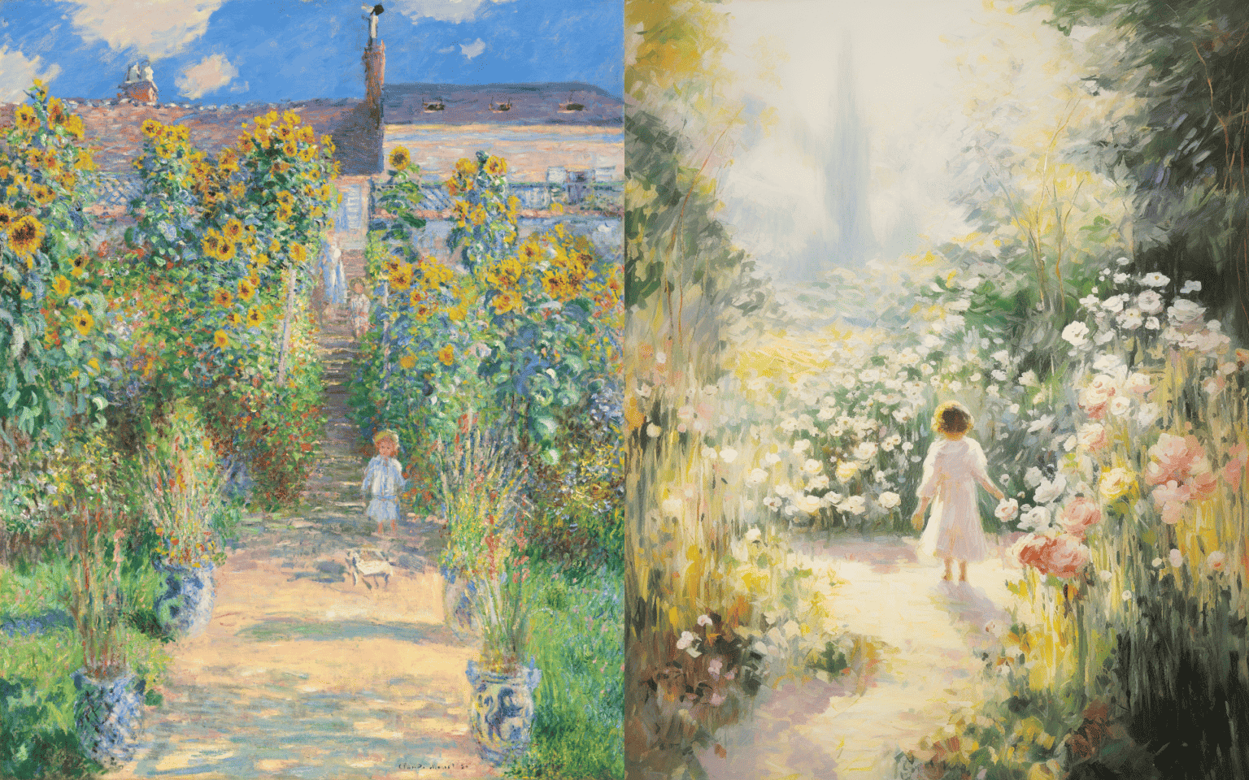
Expressionist (Monet, The Artist's Garden at Vétheuil)

Slide 4
Oil paintings are often characterized by brushwork. You can see the short and broken strokes in Monet’s painting, each applied with rapid but deliberate movements.
As for the AI art, the brushwork in the Midjourney image is too vague. There’s no pattern and it’s too thick.
Source: https://goldpenguin.org/blog/ai-vs-human-art/

Slide 5
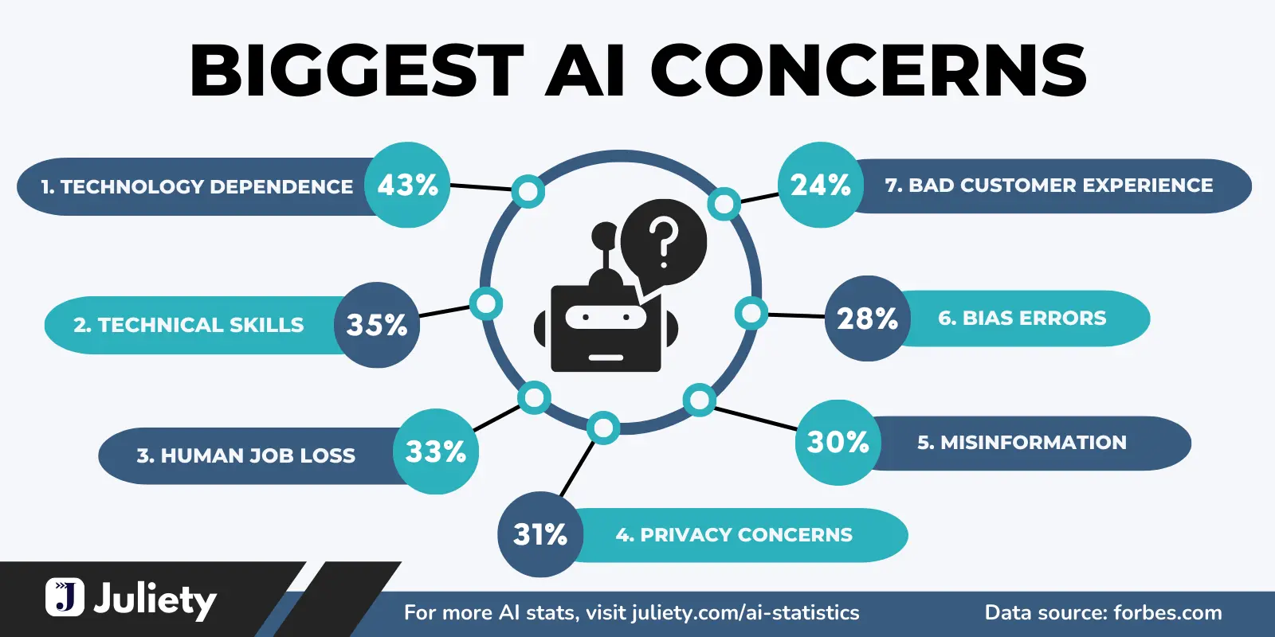
AI Risk

Slide 6
Copyright and Artificial Intelligence
Since launching an initiative in early 2023, the Copyright Office has been examining the copyright law and policy issues raised by artificial intelligence (AI), including the scope of copyright in AI-generated works and the use of copyrighted materials in AI training. After hosting public listening sessions and webinars, the Office published a notice of inquiry in the Federal Register in August 2023, which received over 10,000 comments by December 2023.
Source: https://www.copyright.gov/ai/

Slide 7
Famous authors' lawsuit against ChatGPT developer gets underway
The lawsuit, which seeks class-action status, was filed in September on behalf of the authors by the Authors Guild and accuses OpenAI of copying works of fiction without permission.

Slide 8
Conclusion
AI-generated content presents both opportunities (democratization, efficiency) and risks (fraud, artistic devaluation). It also helps people for there task being efficient and on time but abusing of using AI can risk not only you but the people who’s hard working for their works.

Slide 9
Thank you for watching

