Slide 1
SwIRL-Shared-Space
By Junjie Wang, Yupeng Hou, Tianyi Liu,
Jinhao Pan, Junyu Guo

Slide 2
About the Project

Slide 3
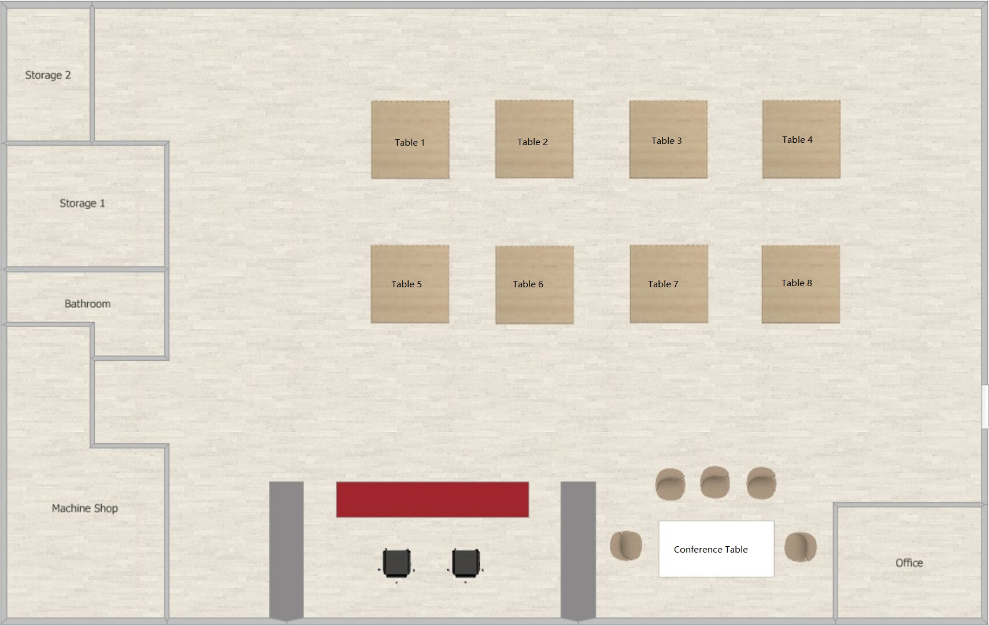
Scenarios

Slide 4
Scenarios
Shared space management. Make a reservation of a zone for team meeting or training.

Slide 5
Scenarios
Shared space management. Make a reservation of a zone for team meeting or training.
Team management. Maintain the team and team members.

Slide 6
Scenarios
Shared space management. Make a reservation of a zone for team meeting or training.
Team management. Maintain the team and team members.
Training registration and management. Maintain the training events and grades.

Slide 7
Scenarios
Shared space management. Make a reservation of a zone for team meeting or training.
Team management. Record the teams and team members.
Training registration and management. Maintain the training events and grades.
User management. Super users (admin, staff) and normal users with different authorities.

Slide 8
Tools & Framework

Slide 9
Tools
Frontend: html/css/js/Bootstrap/jQuery
Backend: Django
Database: PostgreSQL
Test: Django.test + Coverage
Frontend, backend, database and test.

Slide 10
Tools
Frontend: html/css/js/Bootstrap/jQuery
Backend: Django
Database: PostgreSQL
Test: Django.test + Coverage
Frontend, backend, database and test.

Slide 11
Tools
Frontend: html/css/js/Bootstrap/jQuery
Backend: Django
Database: PostgreSQL
Test: Django.test + Coverage
Frontend, backend, database and test.

Slide 12
Tools
Frontend: html/css/js/Bootstrap/jQuery
Backend: Django
Database: PostgreSQL
Test: Django.test + Coverage
Frontend, backend, database and test.

Slide 13
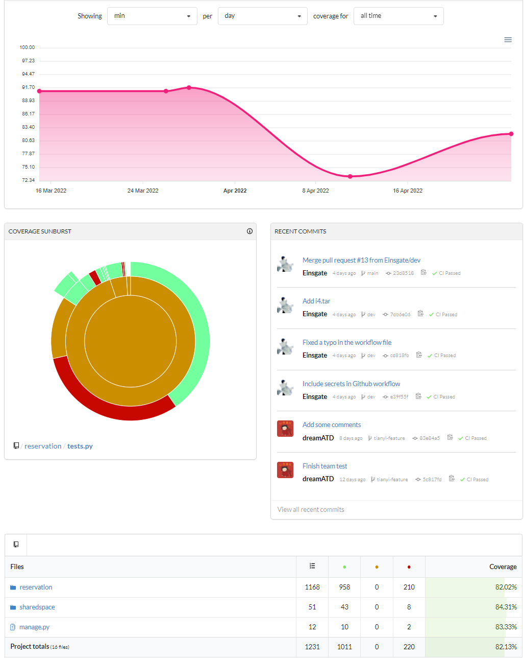
Testing and CI/CD
Github Action: run tests automatically after branch update.
Codecov is used to collect all testing report during the development.

Slide 14
Framework - MVC

Slide 15
Framework - MVC
Reservation
User
User Manager
Zone
Reservation Manager
View
Team
Team Manager
TeamMember
templates/*.html
Training
Training Manager
…
Controller
Model
reservation/views.py
reservation/models.py

Slide 16
Framework - MVC
Reservation
User
User Manager
Zone
Reservation Manager
View
Team
Team Manager
TeamMember
templates/*.html
Training
Training Manager
…
Controller
Model
reservation/views.py
reservation/models.py

Slide 17
Features

Slide 18
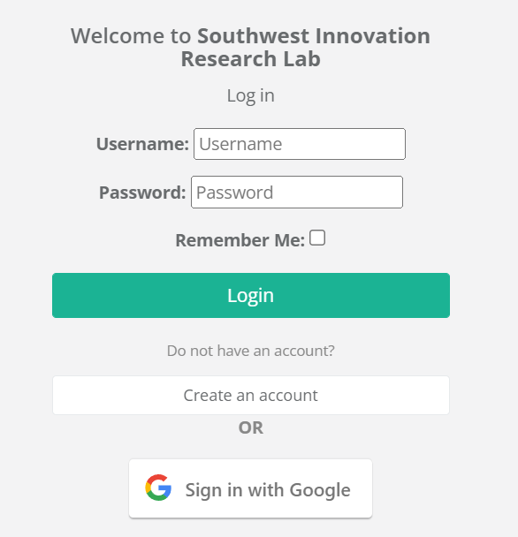
Log In

Slide 19
Log In
Username + password
Google sign-in

Slide 20


Log In
Username + password
Google sign-in

Slide 21
Reservation

Slide 22
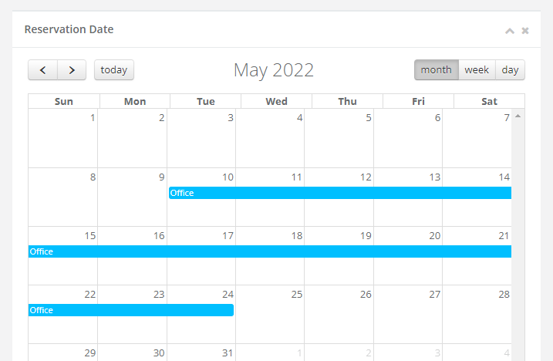
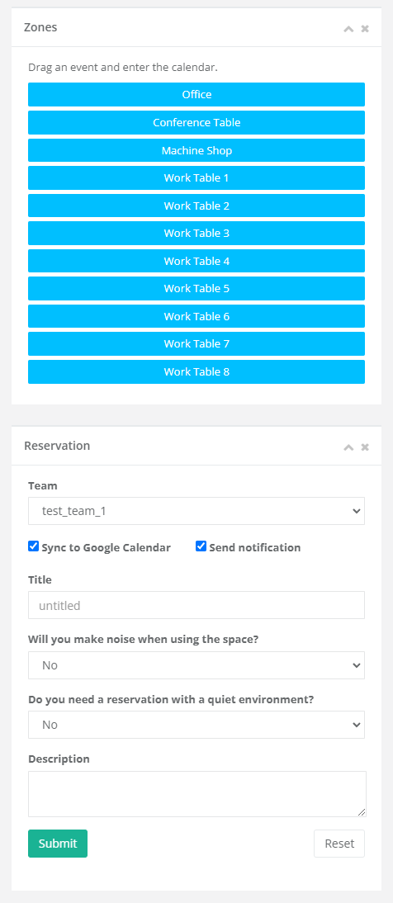
Reservation
Switch time range
FullCalendar
Draggable event

Slide 23
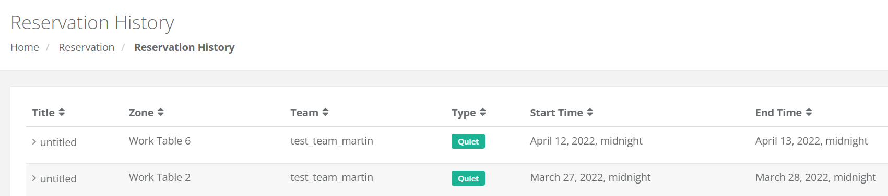
Reservation
Create / delete / view reservations. (super users and team leaders)

Slide 24
Reservation
Send invitation emails
Sync with Google Calendar

Slide 25
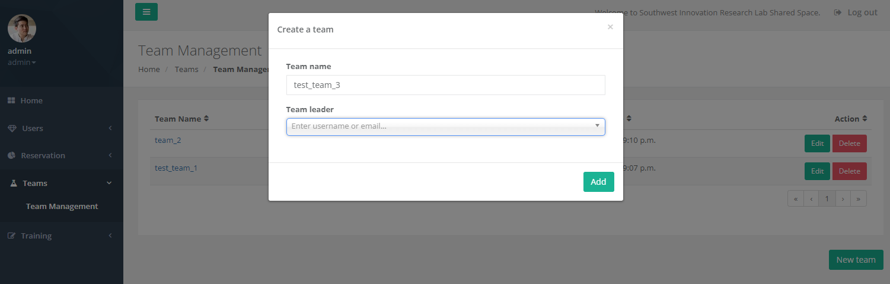
Team Management

Slide 26
Team Management
Create / Delete / Edit team name and leaders. (super users)

Slide 27
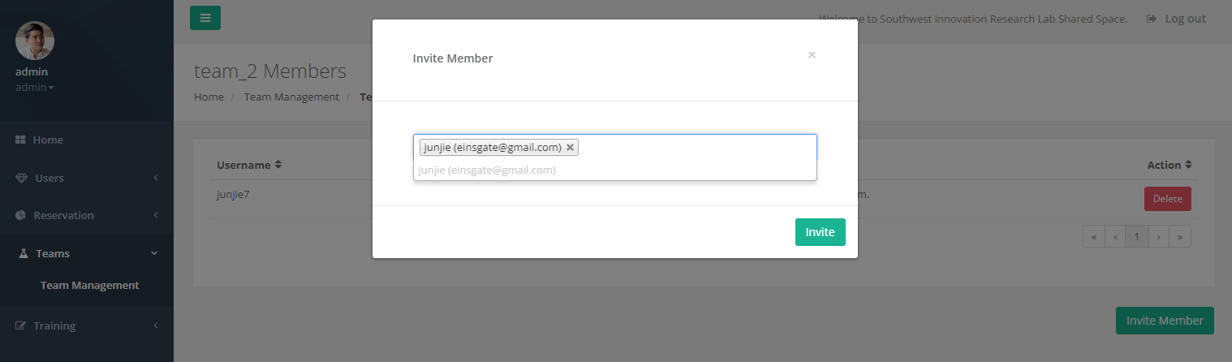
Team Management
Add / remove team members. (super users and the team leader)

Slide 28
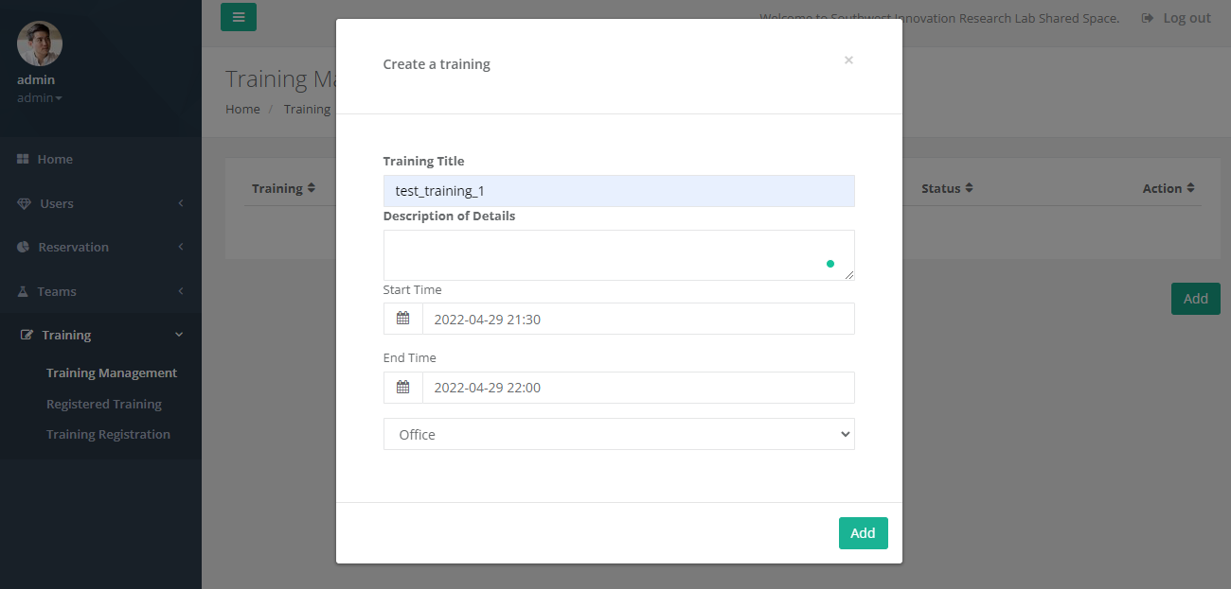
Training Management

Slide 29
Training Management
Create / delete training events (super users)

Slide 30
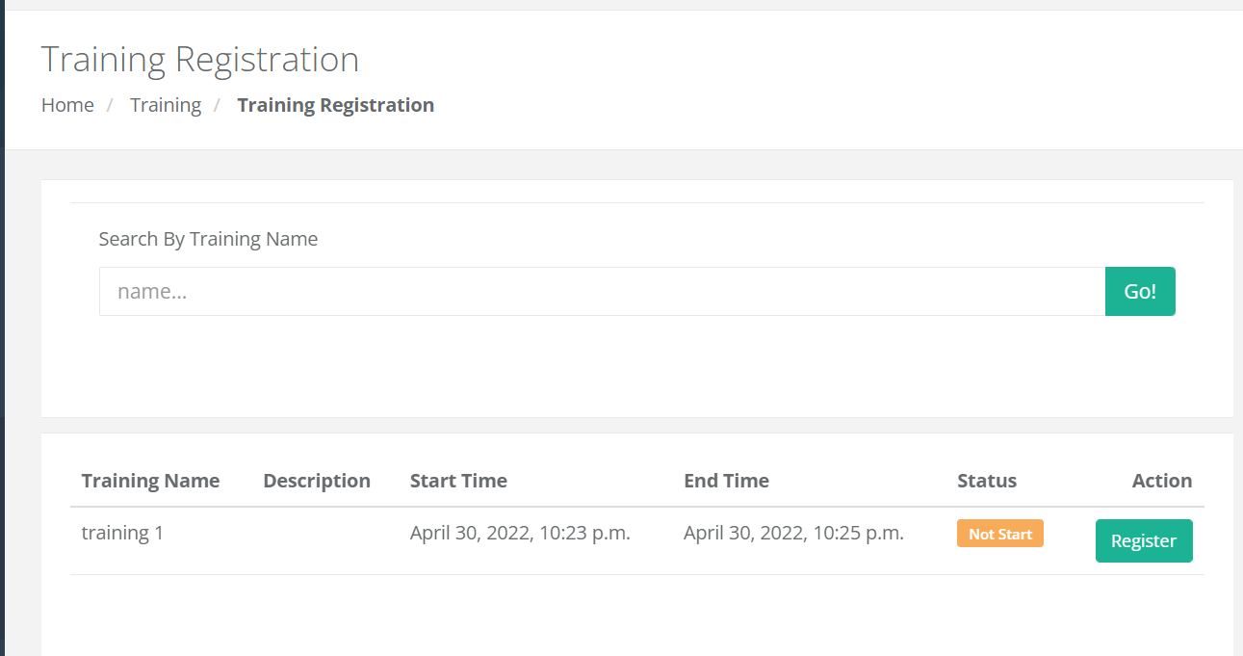
Training Management
View / register training events.

Slide 31
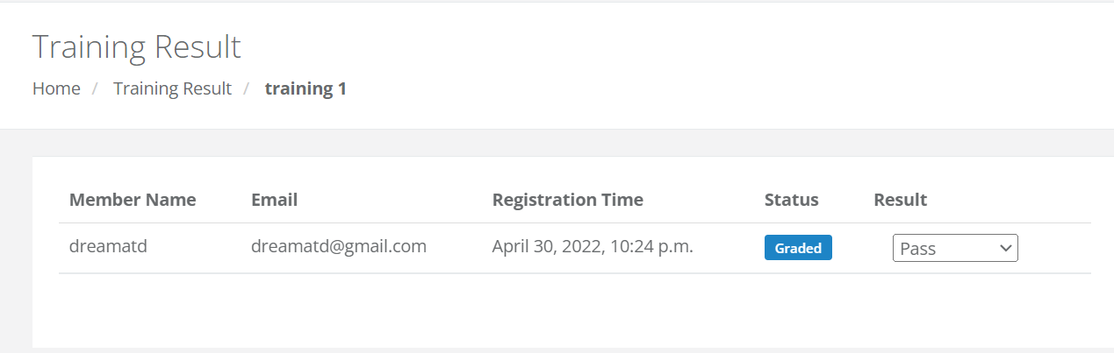
Training Management
Publish grades (super users)

Slide 32
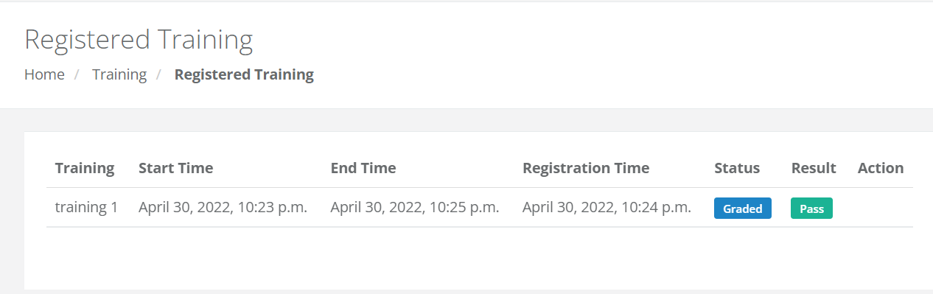
Training Management
View registered trainings and grades.

Slide 33
Team & Timeline

Slide 34
Team and timeline
Scrum Master: Junjie Wang
Product Owner: Yupeng Hou

Slide 35
Team and timeline
Scrum Master: Junjie Wang
Product Owner: Yupeng Hou
Members:
Junjie Wang, Yupeng Hou, Tianyi Liu
Jinhao Pan, Junyu Guo

Slide 36
Team and timeline
Scrum Master: Junjie Wang
Product Owner: Yupeng Hou
Members:
Junjie Wang, Yupeng Hou, Tianyi Liu
Jinhao Pan, Junyu Guo
Iteration 1: reservation management.

Slide 37
Team and timeline
Scrum Master: Junjie Wang
Product Owner: Yupeng Hou
Members:
Junjie Wang, Yupeng Hou, Tianyi Liu
Jinhao Pan, Junyu Guo
Iteration 1: reservation management.
Iteration 2: user and team management.

Slide 38
Team and timeline
Scrum Master: Junjie Wang
Product Owner: Yupeng Hou
Members:
Junjie Wang, Yupeng Hou, Tianyi Liu
Jinhao Pan, Junyu Guo
Iteration 1: reservation management.
Iteration 2: user and team management.
Iteration 3: training management and testing.

Slide 39
Team and timeline
Scrum Master: Junjie Wang
Product Owner: Yupeng Hou
Members:
Junjie Wang, Yupeng Hou, Tianyi Liu
Jinhao Pan, Junyu Guo
Iteration 1: reservation management.
Iteration 2: user and team management.
Iteration 3: training management and testing.
Iteration 4: support Google Calendar, bug fix.

Slide 40
Thank you!
Junjie Wang <jjwang@tamu.edu>
Yupeng Hou <hibernatehou@tamu.edu>
Tianyi Liu <tianyi@tamu.edu>
Jinhao Pan <jeffreypan@tamu.edu>
Junyu Guo <guojunyu@tamu.edu>

