Slide 1

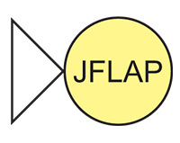
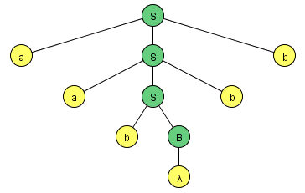
An Interactive Approach to Formal Languages and Automata with JFLAP
NSF Grant DUE CCLI-EMD 0442513
Susan H. Rodger
Duke University
rodger@cs.duke.edu
SIGCSE 2011 AlgoViz Workshop
March 9, 2011

Slide 2
Formal Languages and Automata Theory
Traditionally taught
  Pencil and paper exercises
  No immediate feedback
Different
  More mathematical than most CS courses
  Less hands-on than most CS courses
  Programming is in most of their CS courses, not here

Slide 3
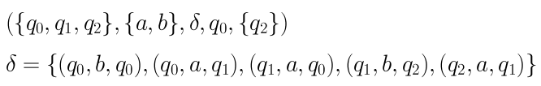
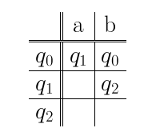
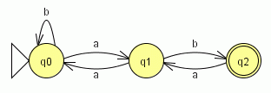
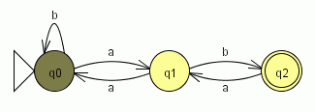
Why Develop Tools for Automata?
Textual
Tabular
Visual
Interactive

Slide 4
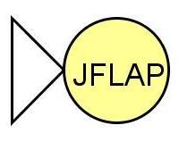
Overview of JFLAP
Java Formal Languages and Automata Package
Instructional tool to learn concepts of Formal Languages and Automata Theory
Topics:
  Regular Languages
  Context-Free Languages
  Recursively Enumerable Languages
  Lsystems
With JFLAP your creations come to life!

Slide 5
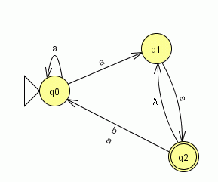
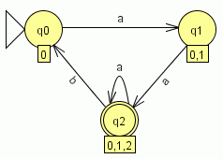
JFLAP – Regular Languages
Create
  DFA and NFA
  Moore and Mealy
  regular grammar
  regular expression
Conversions
  NFA to DFA to minimal DFA
  NFA ←→ regular expression
  NFA ←→ regular grammar

Slide 6
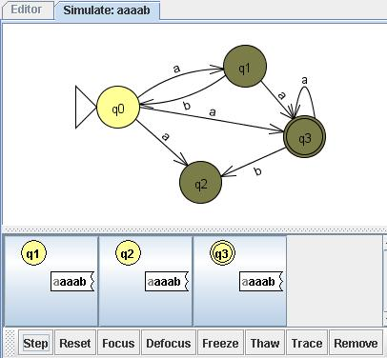
JFLAP – Regular languages (more)
Simulate DFA and NFA
  Step with Closure or Step by State
  Fast Run
  Multiple Run
Combine two DFA
Compare Equivalence
Brute Force Parser
Pumping Lemma

Slide 7
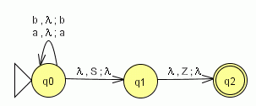
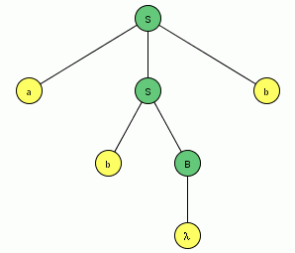
JFLAP – Context-free Languages
Create
  Nondeterministic PDA
  Context-free grammar
  Pumping Lemma
Transform
  PDA → CFG
  CFG → PDA (LL & SLR parser)
  CFG → CNF
  CFG → Parse table (LL and SLR)
  CFG → Brute Force Parser

Slide 8
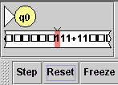
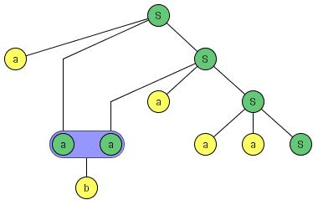
JFLAP – Recursively Enumerable Languages
Create
  Turing Machine (1-Tape)
  Turing Machine (multi-tape)
  Building Blocks
  Unrestricted grammar
Parsing
  Unrestricted grammar with brute force parser

Slide 9
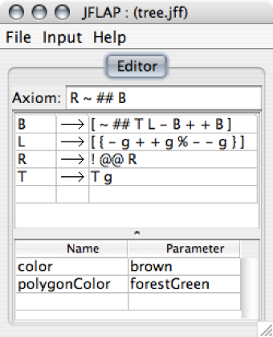





JFLAP - L-Systems
This L-System renders as a tree that grows larger with each successive derivation step.

Slide 10



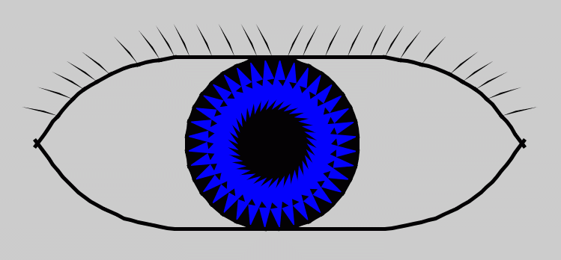
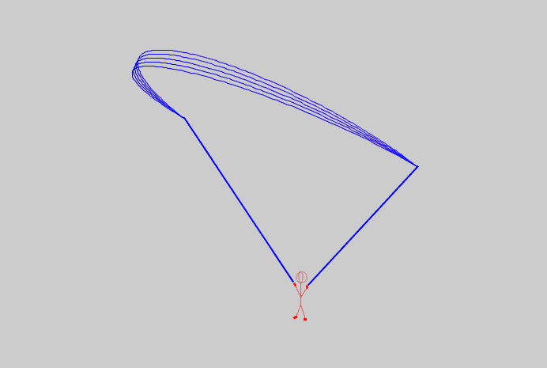

Students love L-Systems

Slide 11
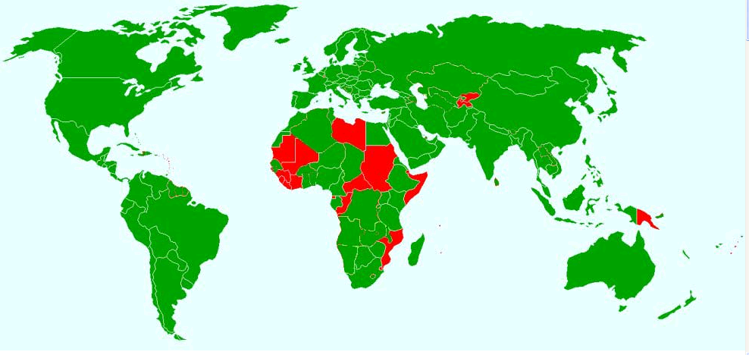
JFLAP’s Use Around the World
JFLAP web page has over 300,000 hits since 1996
Google Search
  JFLAP appears on over 9830 web pages
  Note: search only public web pages
JFLAP been downloaded in over 160 countries

Slide 12
Two-year JFLAP Study
Fourteen
Faculty Adopter Participants
Duke
UNC-Chapel Hill
Emory
Winston-Salem State University
United States Naval Academy
Rensselaer Polytechnic Institute
UC Davis
Virginia State University
Norfolk State University
University of Houston
Fayetteville State University
University of Richmond
San Jose State University
Rochester Institute of Technology
small, large
public, private
includes minority institutions

Slide 13
Key Findings
All the faculty used JFLAP in their courses
  They used it mostly for homework, some used it for class demonstrations.
Students had a high opinion of JFLAP
Four-fifths of the students thought JFLAP was easy to use to draw automata, simulate and interpret the results.
The majority of students felt that having access to JFLAP made learning course concepts easier, made them feel more engaged in the course and made the course more enjoyable.
Over half of the students used JFLAP to study for exams, and thought that the time and effort spent using JFLAP helped them get a better grade in the course.
There was a control group in the second year, but the difference in knowledge between the control group and the JFLAP group was not statistically significant.

Slide 14
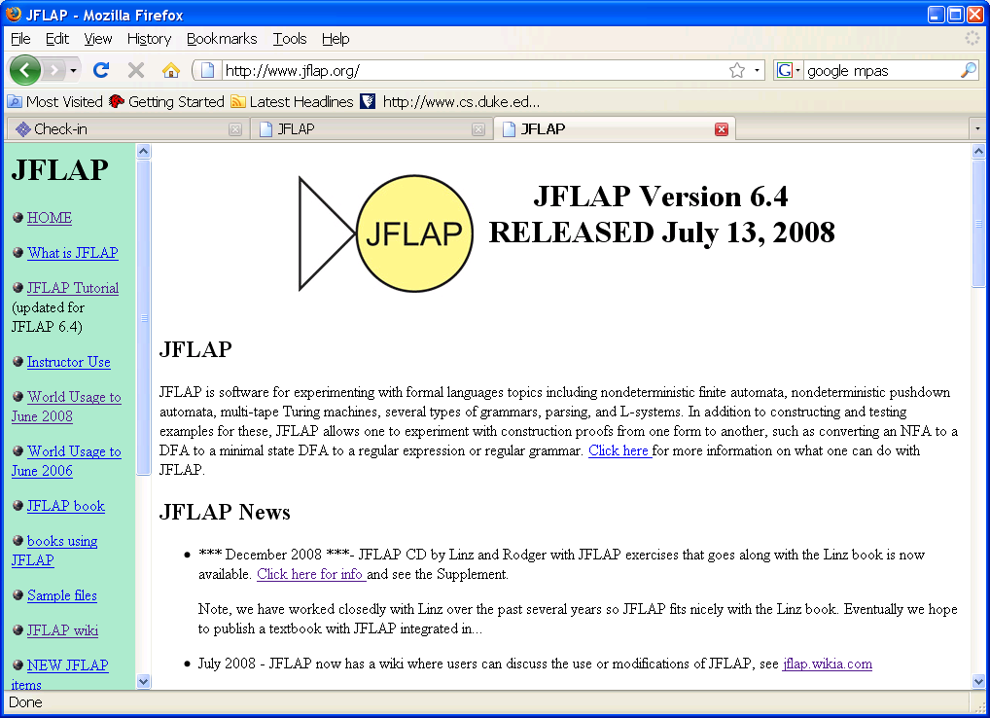
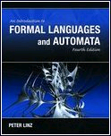
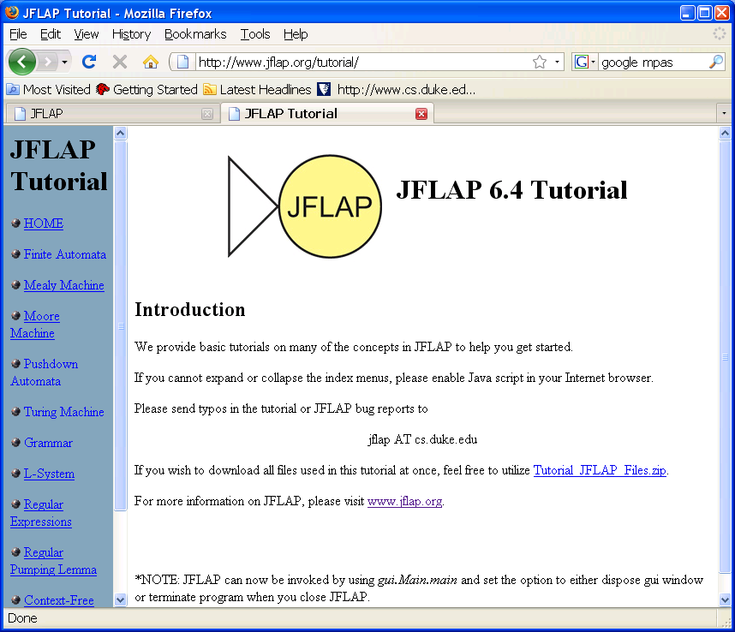
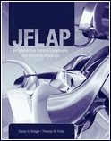
JFLAP Materials
www.jflap.org
JFLAP online tutorial
JFLAP works well with Linz book
New CD supplement with JFLAP exercises to go with this book
JFLAP book

Slide 15
JFLAP Examples in Lecture

Slide 16
Example
Create a DFA that recognizes strings with an even number of a’s and an even number of b’s

Slide 17
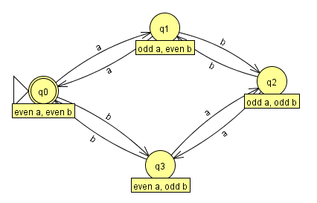
Example
Create a DFA that recognizes strings with an even number of a’s and an even number of b’s

Slide 18
Example – DFA for even binary numbers with an even number of ones

Slide 19
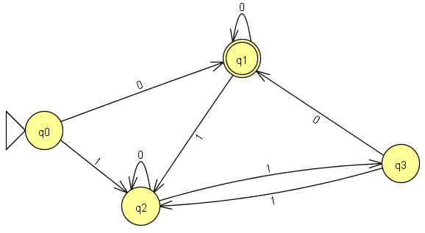
Example – DFA for even binary numbers with an even number of ones

Slide 20
Example: Build an NFA for valid integers
Example:
  Valid integers {-3, 8, 0, 456, 13, 500, …}
  Not valid: {006, 3-6, 4.5, …}

Slide 21
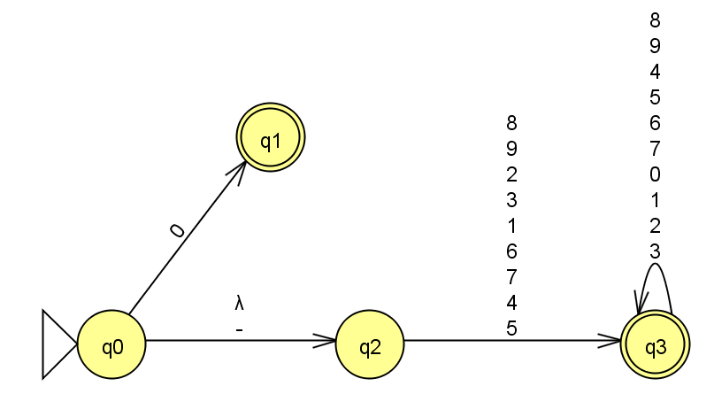
NFA for all valid integers

Slide 22
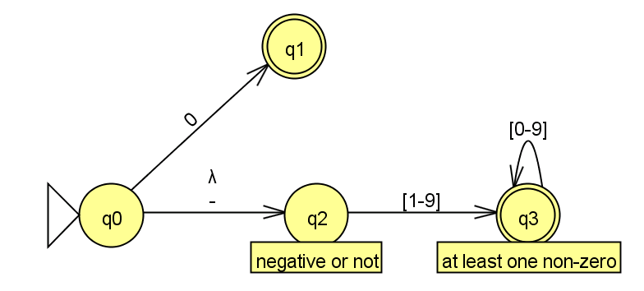
DFA annotated and w/shortcut

Slide 23
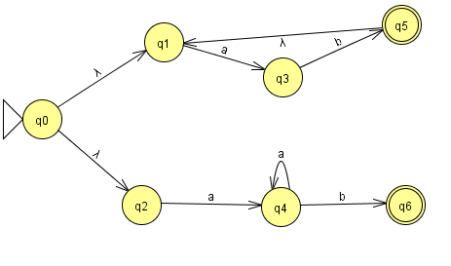
Example: NFA run and convert to DFA

Slide 24
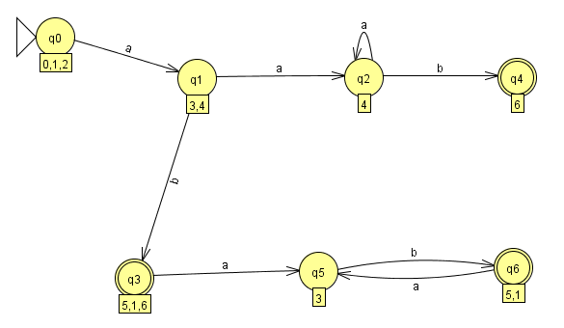
Corresponding DFA

Slide 25
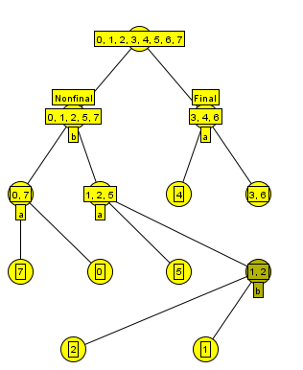
Minimize DFA
First add trap state q7 then build tree of distinguished states

Slide 26
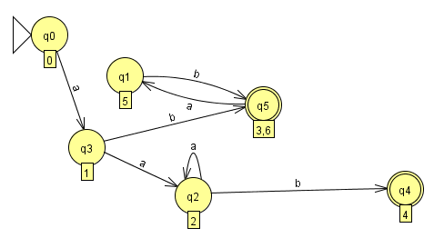
Final Minimal State DFA

Slide 27
What next?
Can convert to a regular expression …
Can convert to an NFA…

Slide 28
Using JFLAP during Lecture
Use JFLAP to build examples of automata or grammars
Use JFLAP to demo proofs
Load a JFLAP example and students work in pairs to determine what it does, or fix it if it is not correct.

Slide 29
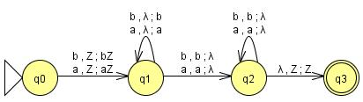
Example : JFLAP during Lecture
Ask students to write on paper an NPDA for palindromes of even length
Build one of their solutions using JFLAP
  Shows students how to use JFLAP

Slide 30
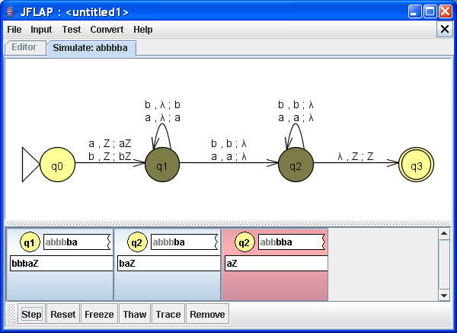
Example 1: JFLAP during Lecture (cont)
Run input strings on the NPDA
  Shows the nondeterminism

Slide 31

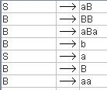
Example : JFLAP during Lecture
Brute Force Parser
  Give a grammar with a lambda-production and unit production
  Run it in JFLAP, see how long it takes (LONG)
    Is aabbab in L?
  Transform the grammar to remove the lambda and unit-productions
  Run new grammar in JFLAP, runs much faster!

Slide 32
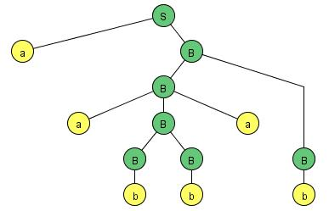
Example 2 (cont)
Parse Tree Results
First Grammar – 1863 nodes generated
Second Grammar – 40 nodes generated
Parse tree is the same.

Slide 33
With JFLAP, Exploring Concepts too tedious for paper
Load a Universal Turing Machine and run it
See the exponential growth in an NFA or NPDA
Convert an NPDA to a CFG
  Large grammar with useless rules
  Run both on the same input and compare
  Transform grammar (remove useless rules)

Slide 34
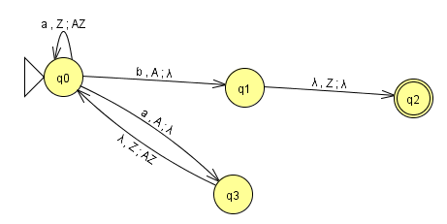
NPDA to CFG

Slide 35
JFLAP’s use Outside of Class
Homework problems
  Turn in JFLAP files
  OR turn in on paper, check answers in JFLAP
Recreate examples from class
Work additional problems
  Receive immediate feedback

Slide 36
Ordering of Problems in Homework
Order questions so they are incremental in the usage of JFLAP
  Load a DFA. What is the language?
    Students only enter input strings.
  Load a DFA that is not correct. What is wrong? Fix it.
    Students only modifying a small part.
  Build a DFA for a specific language.
    Last, students build from scratch.

Slide 37
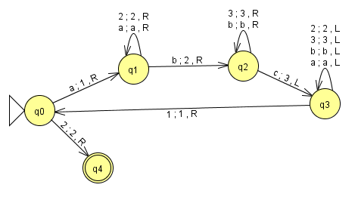
Is this a TM for anbncn?

Slide 38
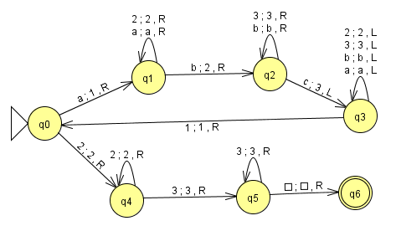
Here is the correct TM for anbncn

Slide 39
Why study finite automata?
Application: Compiler
Compiler identifies your syntax errors
Can write a big DFA to identify all words in a Java program
  integers, doubles, boolean
  keywords, variable names
  arithmetic operators, punctuation symbols
Example LR Parser…

Slide 40
Lsystems
Another type of grammar
  Show a simple L-System
  Show a tree
  Show a fractal

Slide 41
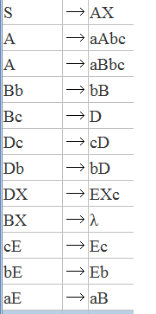
Unrestricted Grammar - anbncn

Slide 42
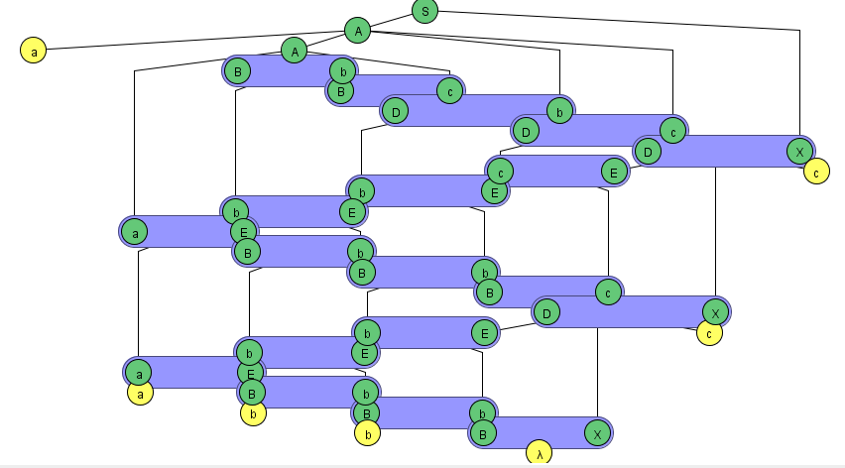
Trace aabbcc

Slide 43
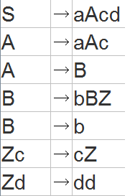
Example - Unrestricted Grammar anbmcndm

Slide 44
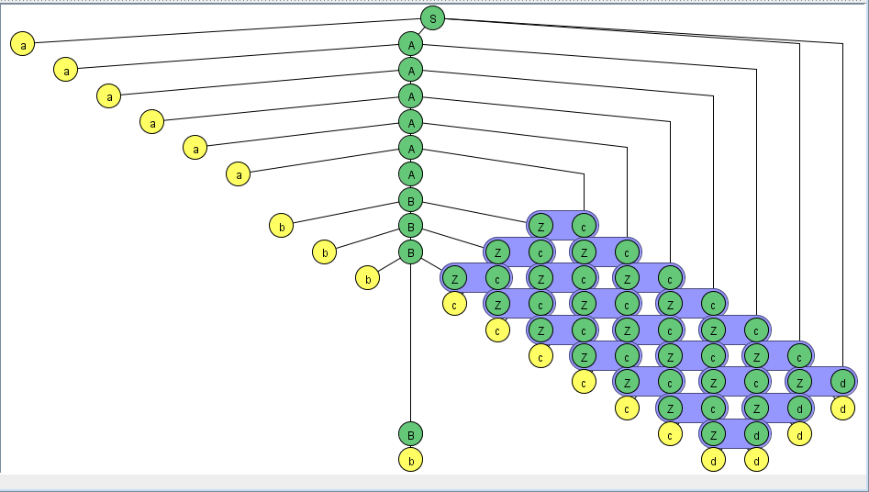
Example – Unrestricted Grammar (cont)

Slide 45
There are other ways to get interaction in this course besides software…

Slide 46
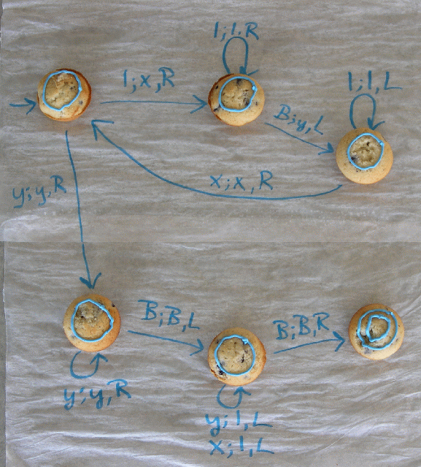
Interaction in Class – Props
Edible Turing Machine
TM for f(x)=2x where x is unary
TM is not correct, can you fix it? Then eat it!
States are blueberry muffins

Slide 47
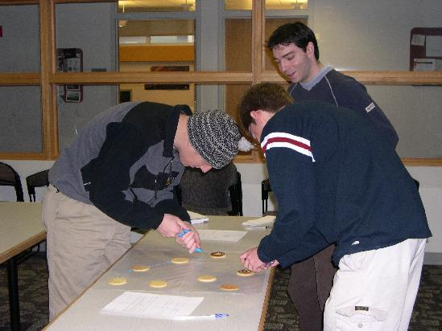
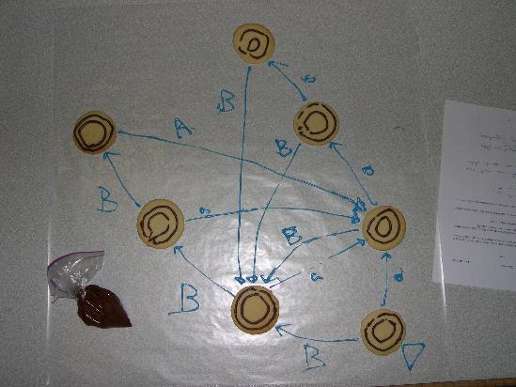
Students building DFA with cookies and icing

