Slide 1
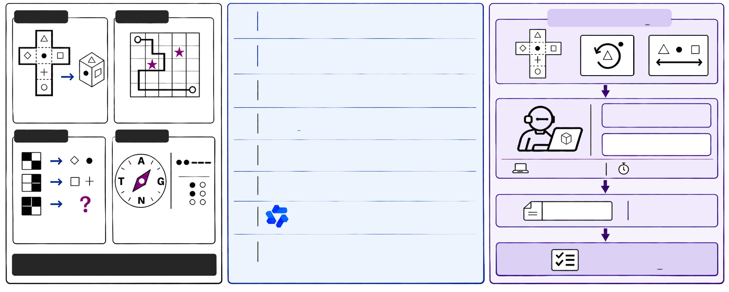






Visual Cipher Bench
Visual Puzzle Collection
Leaderboard
Agent Evaluation
Visual Puzzle Collection
Leaderboard
Agent Evaluation
10 puzzles
10 puzzles
01
GPT-6 Astra
max effort
26.7%
1–3 Fixed Images
02
GPT-6.1 Sol
max effort
21.7%
03
Claude Opus 5.5
xhigh effort
21.7%
Spatial Manipulation
Constraints & Planning
Infer Hidden Rules
04
GPT-6 Luna
max effort
0.8%
10 puzzles
10 puzzles
Connect Image Clues
05
Claude Sonnet 5.5
max effort
0.8%
Tools (Offline)
60 min / puzzle
06
DeepSeek V4.1 Flash
max effort
0.0%
answer.txt
Answer
07
Qwen3.8 Max
xhigh effort
0.0%
Submission
Rule Induction
Knowledge-Based
Decoding
08
Kimi K3.1 Pro
max effort
0.0%
Scoring
40 original puzzles • 67 images

