Slide 1
Next Generation Sequencing
Files and processing

Slide 2
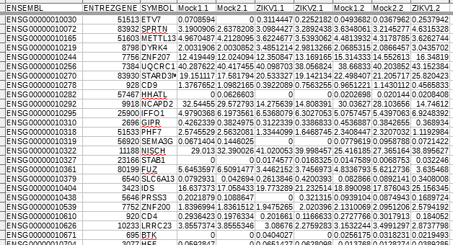
We’ve seen how to analyze data when it’s in a cleaned up state.
  Usually a simple m x n matrix
    M samples
    N variables
How do you get to that point with NGS data?

Slide 3
NGS
1. generate fastq
2. preprocessing fastq
3. alignment
4. feature counting
5. data analysis

Slide 4

1 NGS: Generate fastq
These are the base calls of your fragment data
  A,C,G,T
Along with quality scores for each base
  Phred score, in logarthmic scale
    0(low) – 60(high)
    mapped to ascii symbols

Slide 5
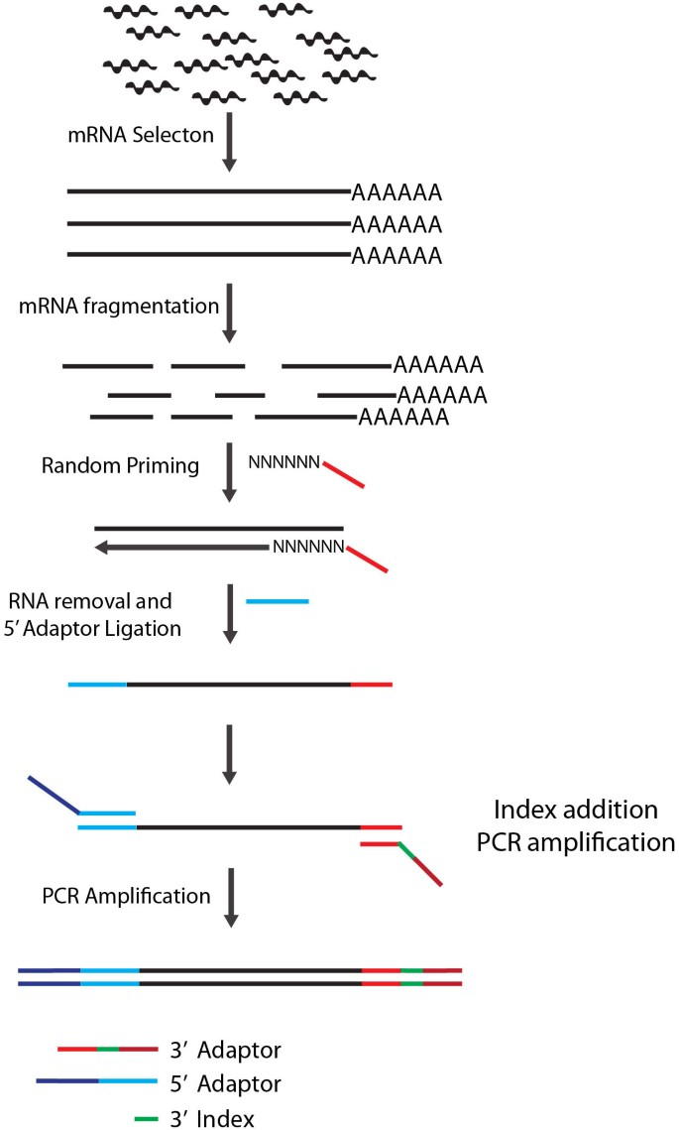
2 NGS: preprocessing
After the reads come from the sequencer they need to be cleaned up
  Trim the adapters
  Remove garbage reads
  Cut off low quality bases

Slide 6
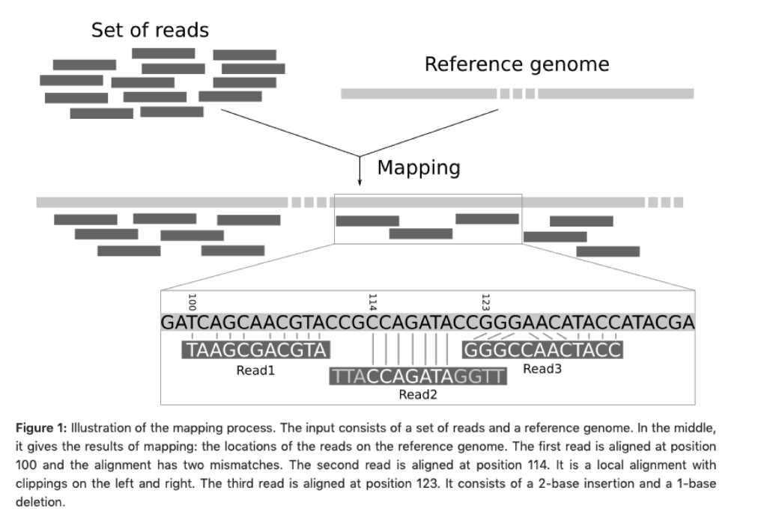
3 NGS: alignment
Once we have cleaned reads, we want to see where they map
Alignment to reference
  See where the reads fall along a known genome
Denovo alignment (very slow)
  Use the reads to construct a new reference
Pseudo alignment (very fast)
  Map to transcripts instead of entire genome.

Slide 7
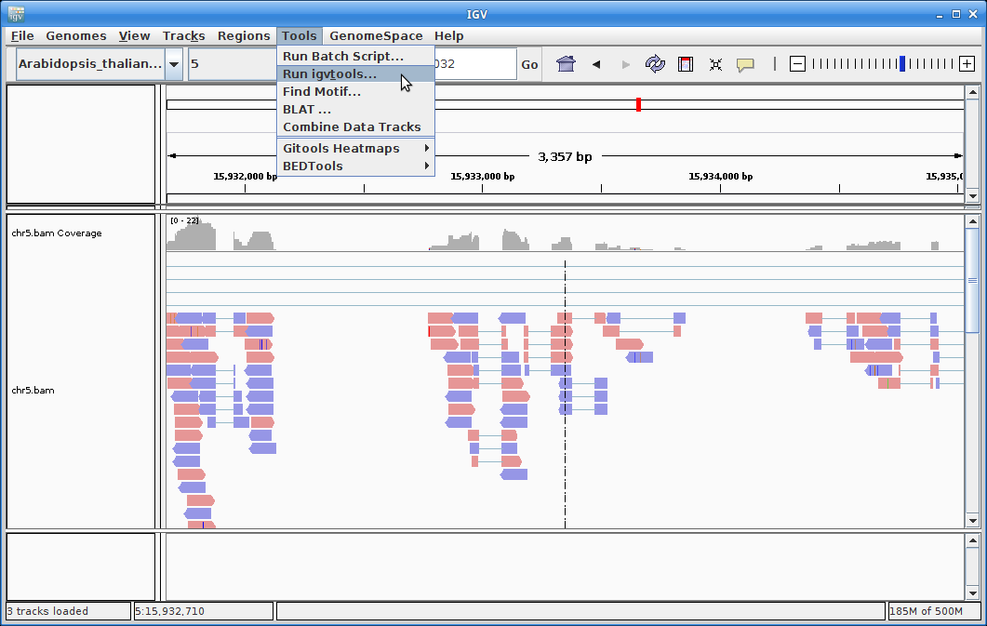
3a NGS: visualizing alignment
Once you’ve mapped your reads to the reference, it’s always a good idea to take a look at the bam file.
Integrative Genomics Viewer (IGV)

Slide 8
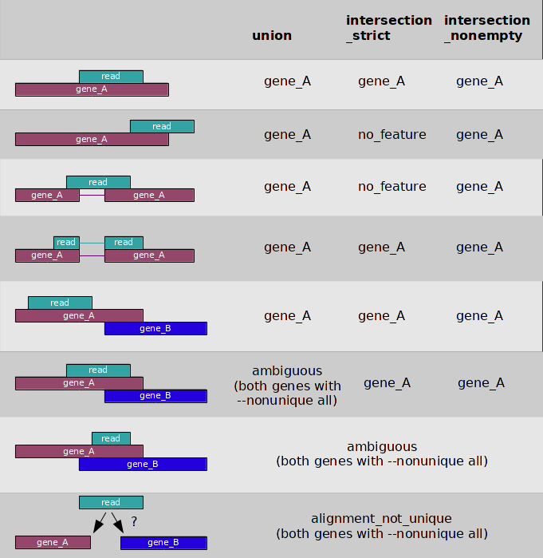
4 NGS: feature counting
Once we know where the reads map, we want to see how many fall within a region (gene, exon, promoter, etc)
Usually we can just sum the reads within a chromosomal region but we have to be careful.
  How to deal with PCR duplicates?
  What to do about reads spanning multiple regions?

Slide 9
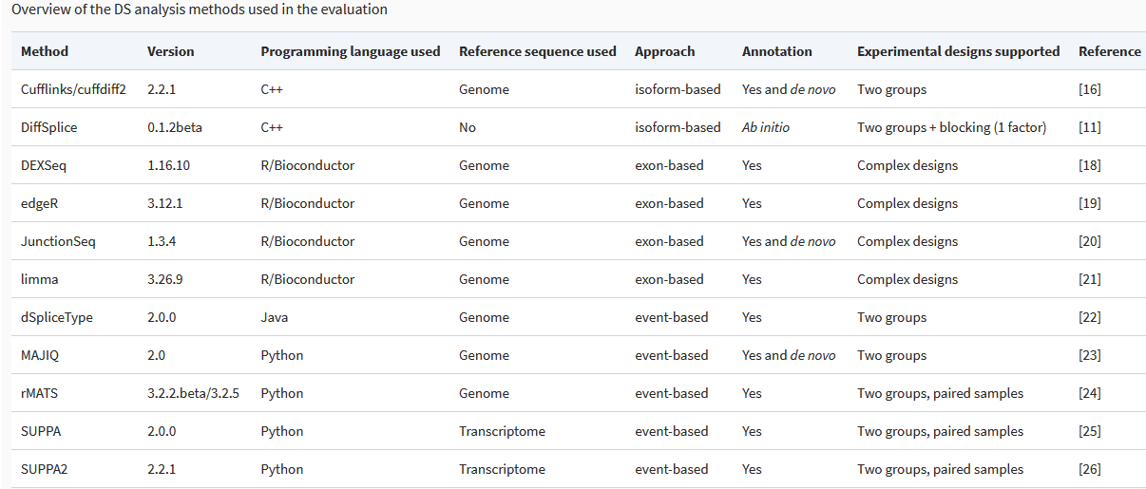
5 NGS: data analysis
RNA differential expression
  Deseq2
  Edger
RNA splicing
  Rmats
DNA variant detection
  GATK software pipeline
  BCFtools
Chipseq/Atacseq
  MACS2 peak detection
    Feature counting on peaks
    DE analysis on peak counts
Motif analysis
  homer
Arfa Mehmood, Asta Laiho, Mikko S Venäläinen, Aidan J McGlinchey, Ning Wang, Laura L Elo, Systematic evaluation of differential splicing tools for RNA-seq studies, Briefings in Bioinformatics, Volume 21, Issue 6, November 2020, Pages 2052–2065, https://doi.org/10.1093/bib/bbz126

