Slide 1
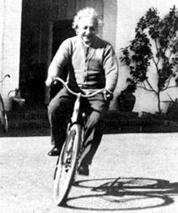
On special relativity
We shall raise this conjecture (whose content
will be called "the principle of relativity"
hereafter) to the status of a postulate and
shall introduce, in addition, the postulate,
only seemingly incompatible with the former one, that in empty space light is always propagated with a definite velocity V which is independent of the state of motion of the emitting body.

