Slide 1
Crypto-currency Tracking Application
Submitted by:
Diwakar Adhikari

Slide 2
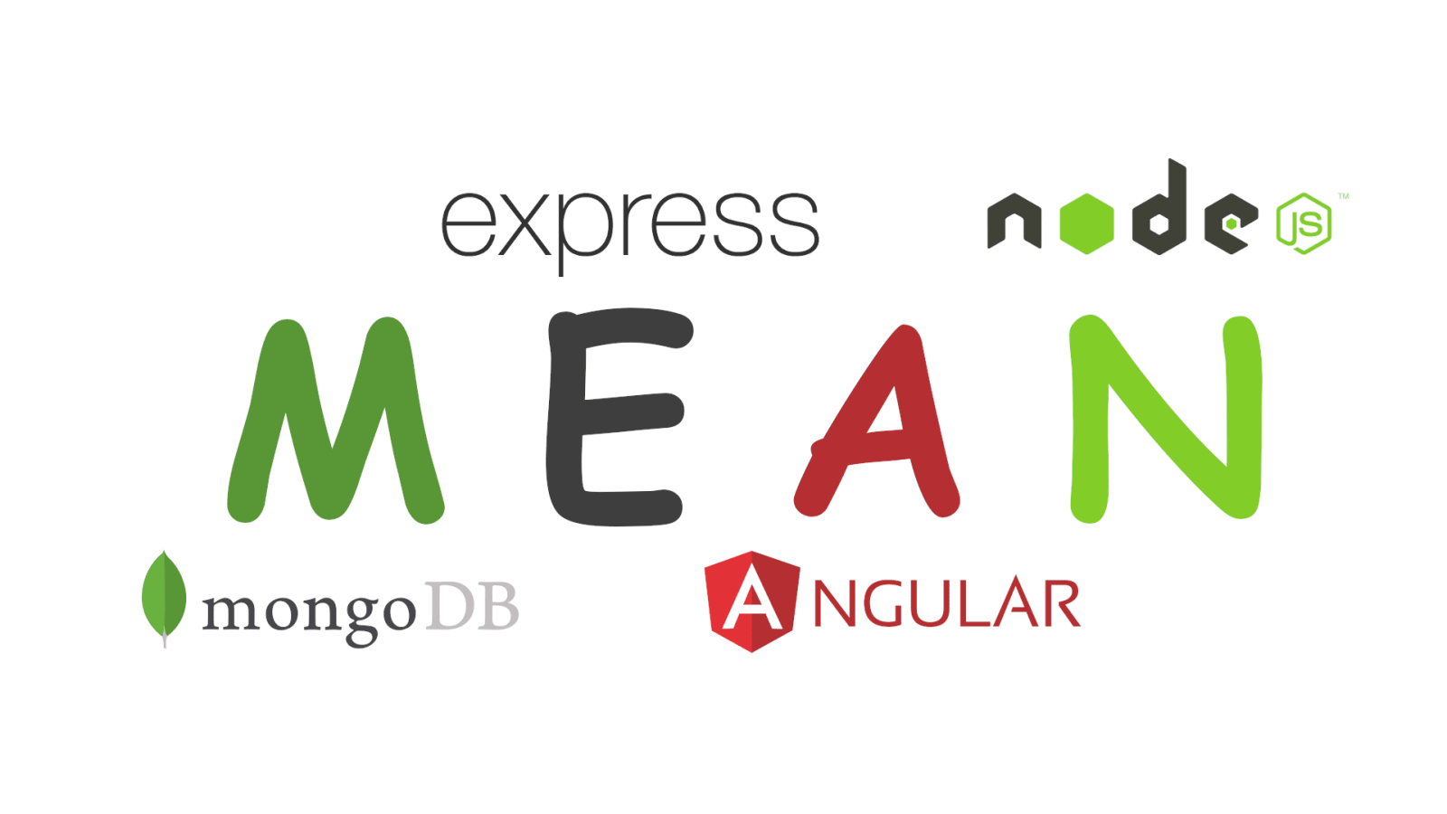


Technology Stack

Slide 3
Packages and Libraries used.

Slide 4
Overview
A cryptocurrency portfolio tracker is a digital platform, such as an app or website, that enables you as an investor to keep track of the ever-changing value of your different coins so that you can manage your portfolio properly. Cryptocurrency trackers connect with crypto wallets, which enable individuals to control their digital currencies. Some also integrate with actual crypto exchanges, where investors can trade digital assets, including crypto coins. A cryptocurrency price tracker monitors the current value of different digital currencies and tokens. Many of these services provide historical data as well, allowing users to compare current prices against older values. Some of these services even have a tool that allows users to contrast the performance of multiple cryptocurrencies against one another.

Slide 5
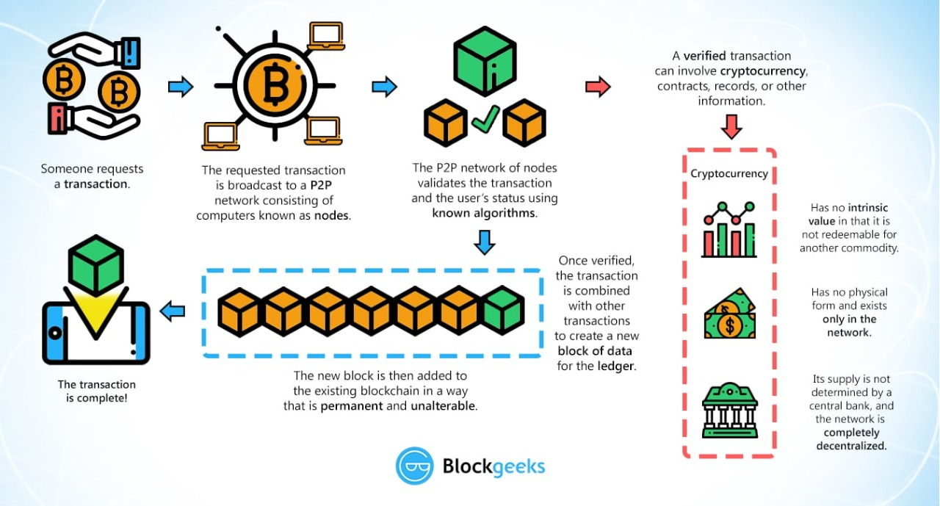
End to end diagram

Slide 6
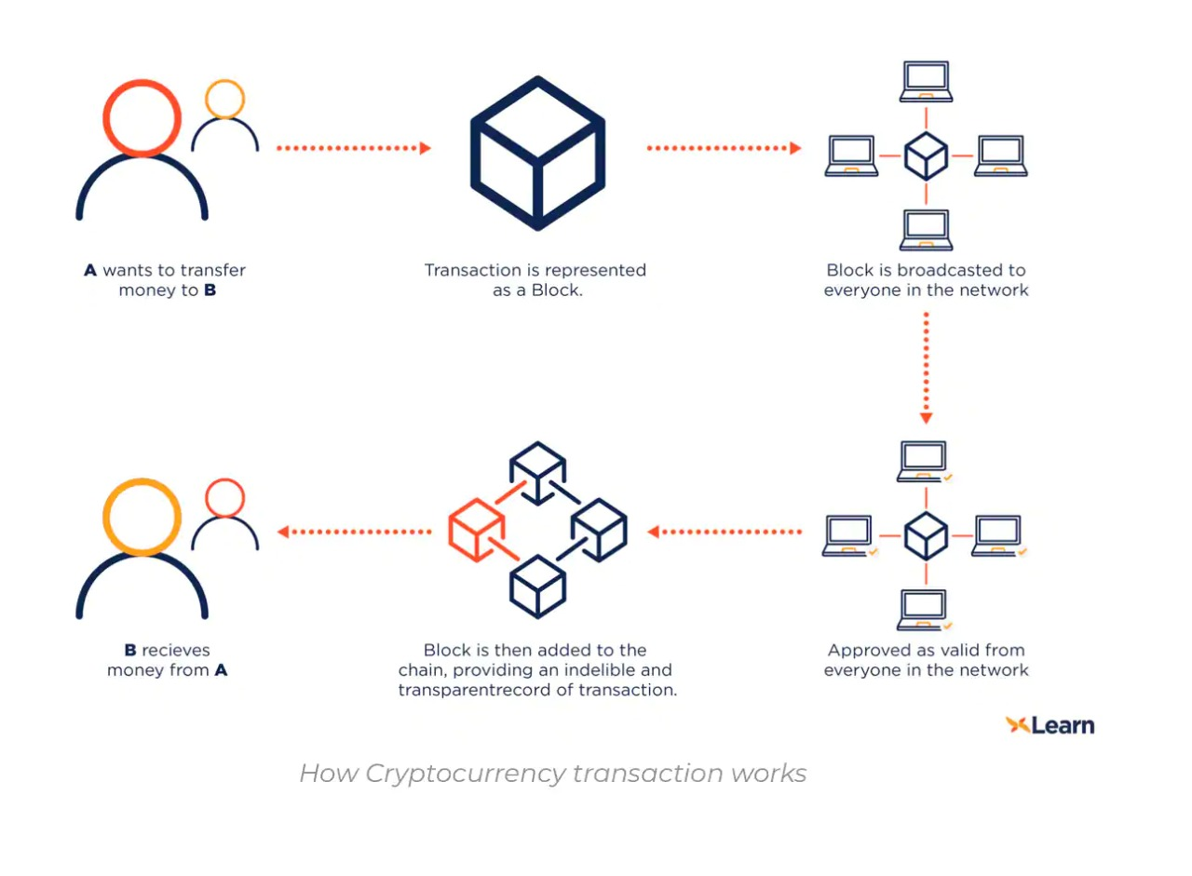

Slide 7
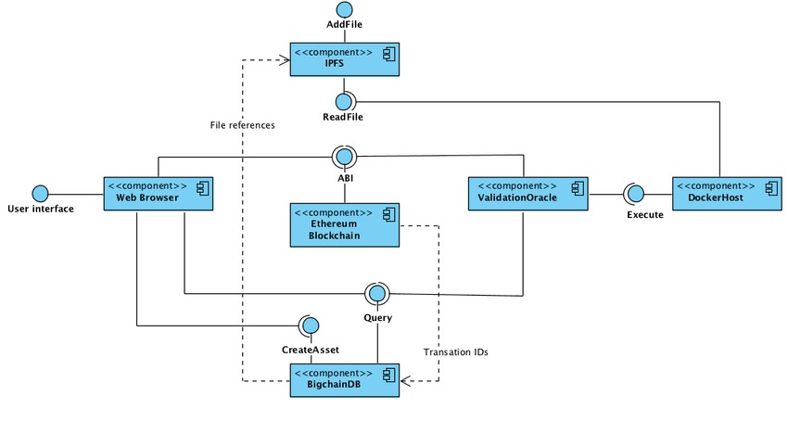

Slide 8
