Slide 1
Meteor workshop
Faggruppemøte JS-Platform
Skuret
Eirik Vigeland og Kristian Johannessen
12/05/15

Slide 2
What is meteor?
Open source application platform for building web (and mobile) applications using JavaScript
Not Node.js (though it uses Node)
Isomorphic
Real time
Main goal: Simplicity, to do a lot with as few lines of code as possible
Sort of like building web applications with legos.

Slide 3

Getting started
How to install:
Mac:
Windows: Use the official installer: https://install.meteor.com/windows
Gives you a command-line tool
Highligh commands:
meteor create [appname]
meteor or meteor run
meteor mongo
meteor add [package name]
meteor create –package [package name]

Slide 4
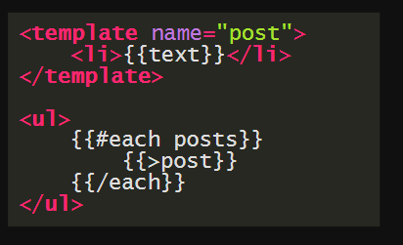
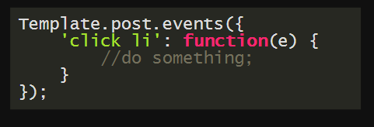
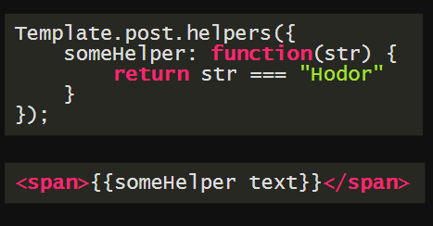
Templates
Blaze/Spacebars
Looks like Handlebars
Represented as objects on the global Template object
Allows you to write helpers, listen to events
Can also have global helpers.

Slide 5
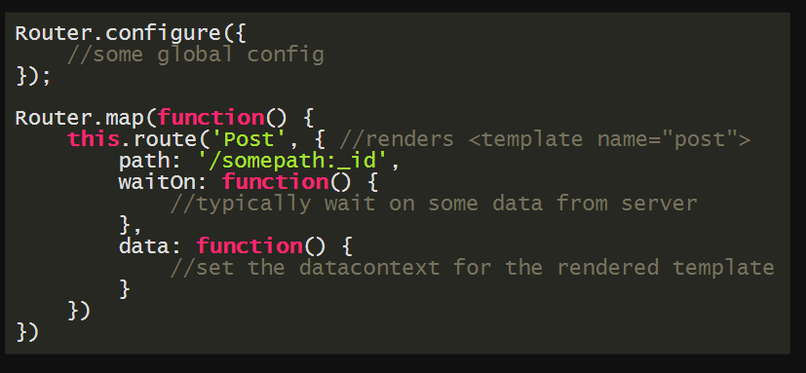
Routing
iron:router
De facto standard for routing with Meteor
Typically renders a template into a layout template
Can have multiple areas where content can go (in this workshop we only have one)
Global configuration, config pr. Route
Custom controllers
Etc, etc…

Slide 6
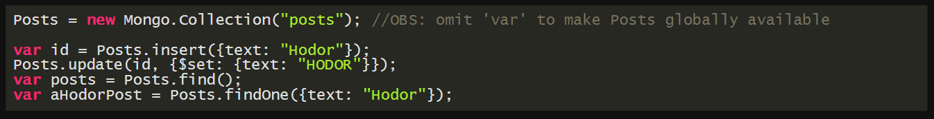
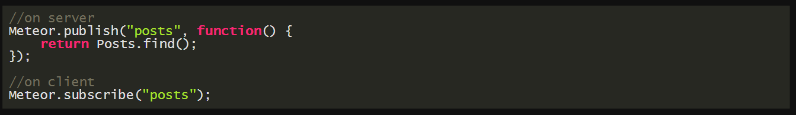
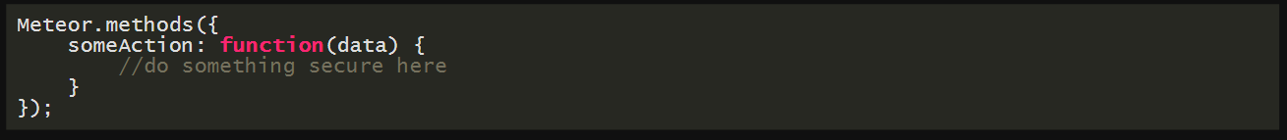
Collections
MongoDb! – others on the way
Publish/Subscribe – full control
Methods – security and latency compensation

Slide 7
Reactivity
All collections are reactive
Can add stuff directly in meteor mongo shell, and it appears on the clients
Session (local state)
Useful for writing ui-helpers that update themselves
Tracker
Not neccessary for the workshop, but useful to know about.

Slide 8
Bundling and other magic
File load order , from the docs:
Html template files are always loaded before everything else
Files beginning with main. are loaded last
Files inside any lib/ directory are loaded next
Files with deeper paths are loaded next
Files are then loaded in alphabetical order of the entire path
Packages give you more control, so it may be the way to go.
But we actually don’t know!
Meteor is very new, and there seems to be no clear proposal for structuring an app.
Folders to be aware of: public (static files), server and client
Pro-Meteor-tip: forget most of your normal JavaScript standards (require, (function(){})() etc..

Slide 9
Repo: https://github.com/EirikV/meteor-workshop/

