Slide 1
🚀 Team NASA 🚀
INF112
2nd obligatory assignment

Slide 2

Agenda
Development process and results
Process and development style
Rules
Product specification:
Graphics
Modelling
System requirements
Challenges and solutions
Retrospect

Slide 3



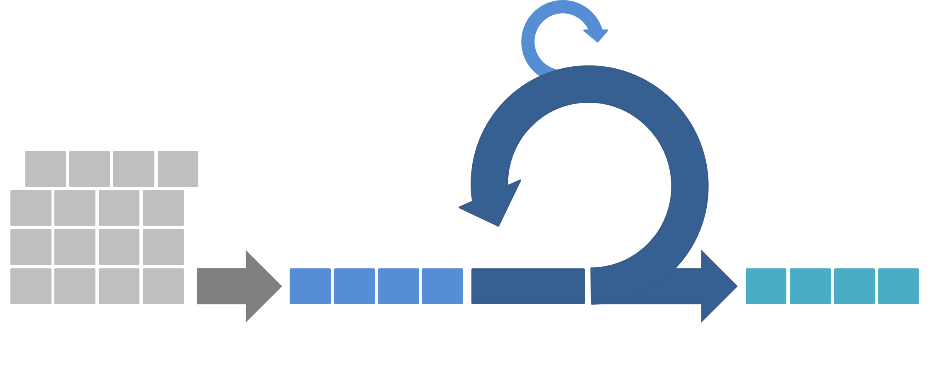

Process and development style
Slack, Google Drive, Facebook
Scrum - agile methods
Smaller groups
Group meetings
Review
Git -> two branches
dev
master

Slide 4
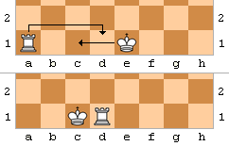
Rules
This iteration: Focus on traditional rules
Onwards: Easily expandable code

Slide 5




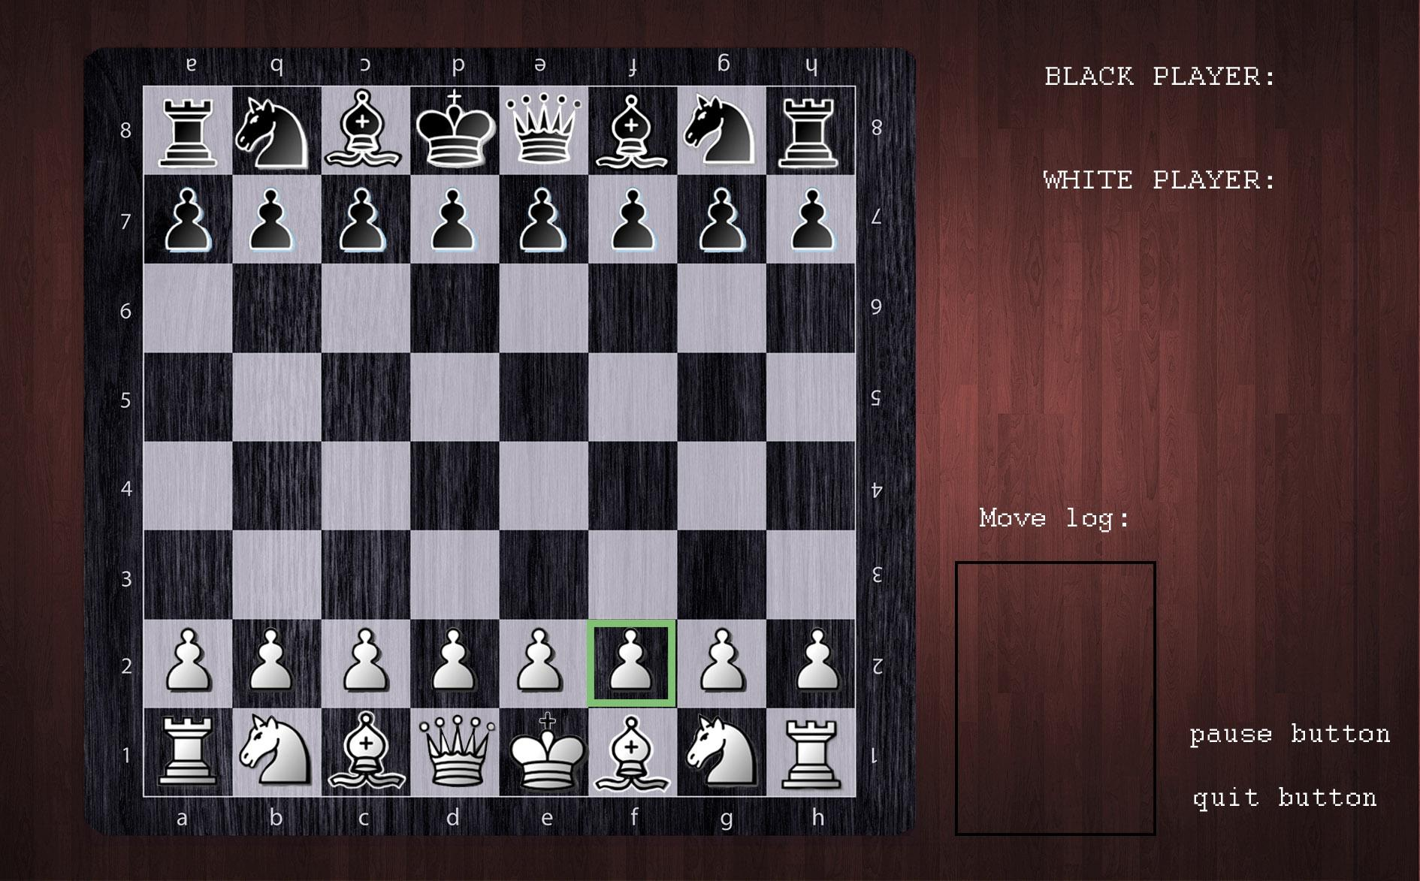








Graphics suggestion

Slide 6
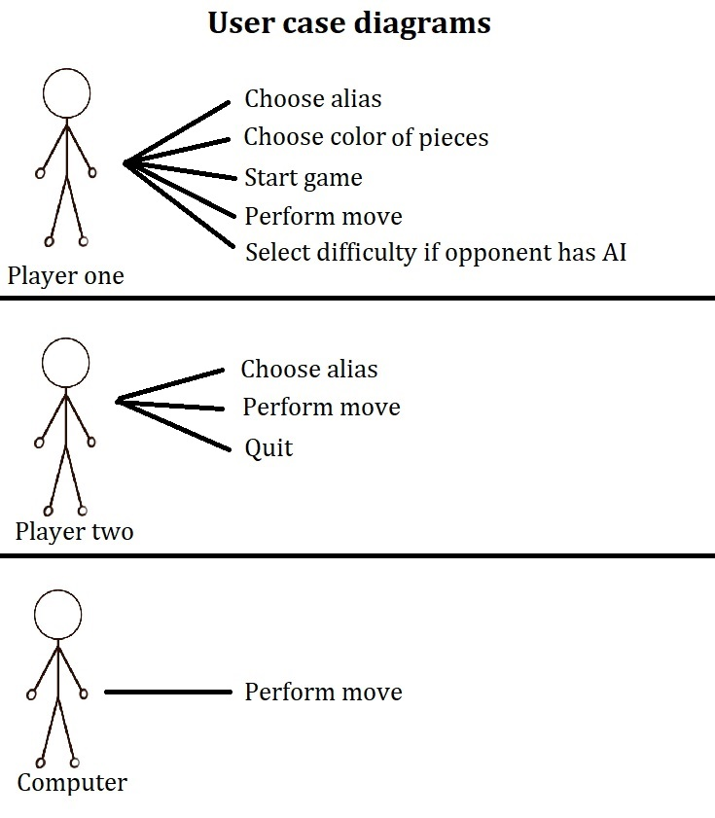
Interactive modeling: user case diagrams
Abstraction of interactions and user operations
Often used early in a development process
Advantages:
Identify user requirements
Communication

Slide 7
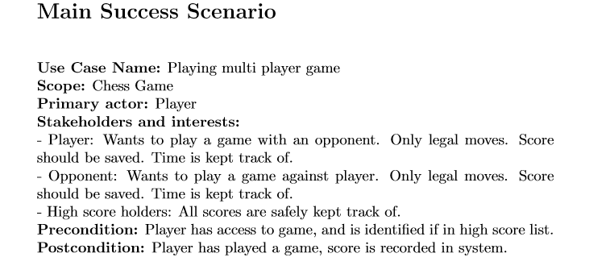
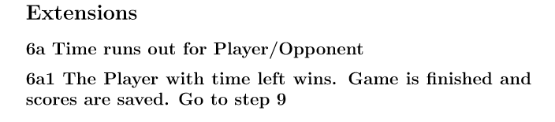
Interactive modeling: fully dressed user case
Purpose?
Cases: 1. Multi player 2. Single player (AI)
Structure - Main Success Scenario - Extensions

Slide 8
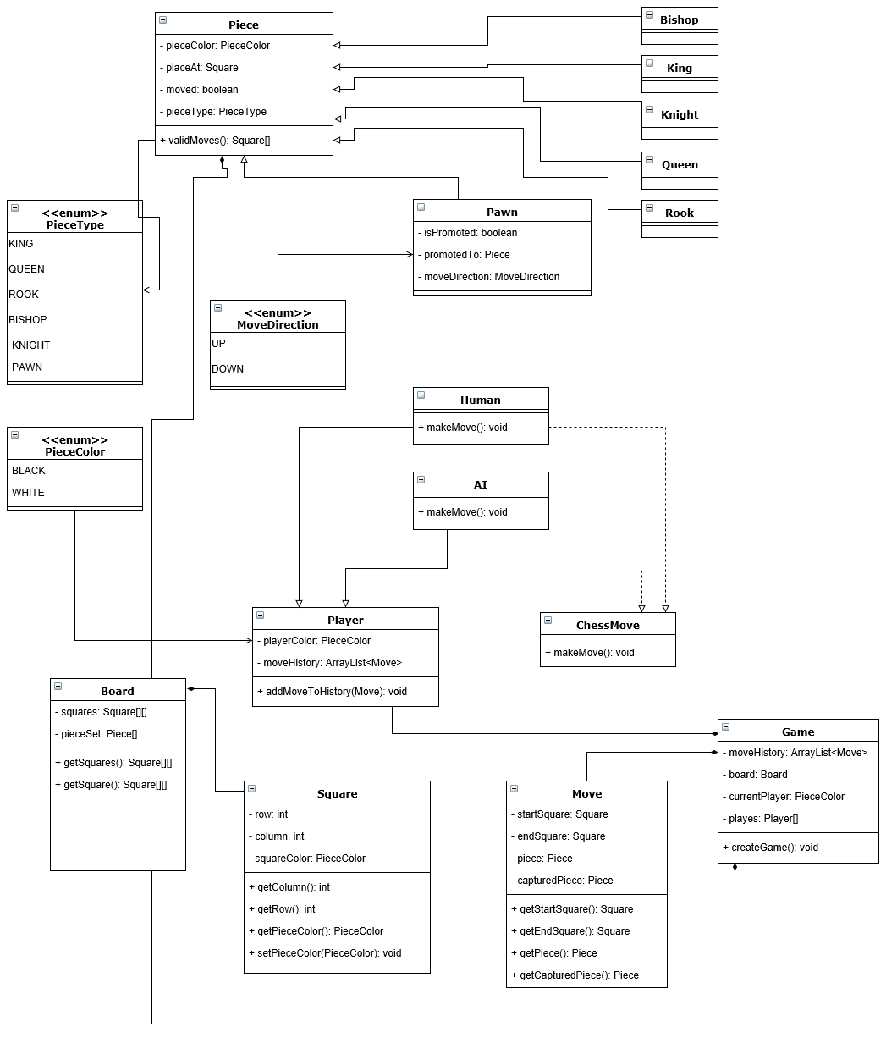
Structual modeling
→ class diagram
Notes:
Forslag:
Hovedstruktur?
Fordeler ved slikt diagram

Slide 9
System Requirements - Scope
Scope:
Multiplayer/Single player
3 Intelligence level
2D Chess board - standard chess rules
Each piece with valid moves
Necessary notifications
Records each moves and results of each games

Slide 10
System Requirements - Functional
Getting ready for a chess game:
Multiplayer / Single player option
Single player - 3 Levels of intelligence
User registration
Selecting the color of the pieces
Displaying the chess board

Slide 11
System Requirements - Functional
2 . Playing the chess game
Enable the moves of each chess piece (Pawn, knight, bishop, rook, queen and King)
Enable castling, en-passant moves.
Displaying the valid moves on selection of pieces.
Notification for invalid moves.
Last move UNDO option.
Notification for check, stalemate and checkmate(winner)
Time keeping for each move.
Displaying the captured pieces.

Slide 12
System Requirements - Functional
3. Ranking of players
Points calculation based on games win and intelligence level.
Recording the results of each game played.
Ranking of players based on the points they earned.
Quit the game option in case of boredom.

Slide 13
System Requirements - Non-Functional
Reliability
Performance
Response time.
Maintainability
Scalability

Slide 14
Challenges and solutions
How to organize the team and communicate in an efficient manner
How to properly define and distribute tasks
Scrum methodology combined with communication tools such as Slack
Inclusion of all team members and even workload
Frequent meetings - tasks defined collectively and distributed
Notes:
Hvordan organisere oss og kommunisere på mest hensiktsmessig måte
Jobbe preventivt - klargjøre informasjon på best mulig måte/åpen kommunikasjon, hyppige møter
Problemer som oppstår: Generell håndtering “ta opp asap via slack/møter”
Rolleavklaring
Work delegation
Hvordan fordele på mest hensiktsmessig og rettferdig måte?
Kan bli lettere etterhvert som teamet blir bedre kjent med hverandres ferdigheter og interesser
Har noen konkrete problemer oppstått?

Slide 15

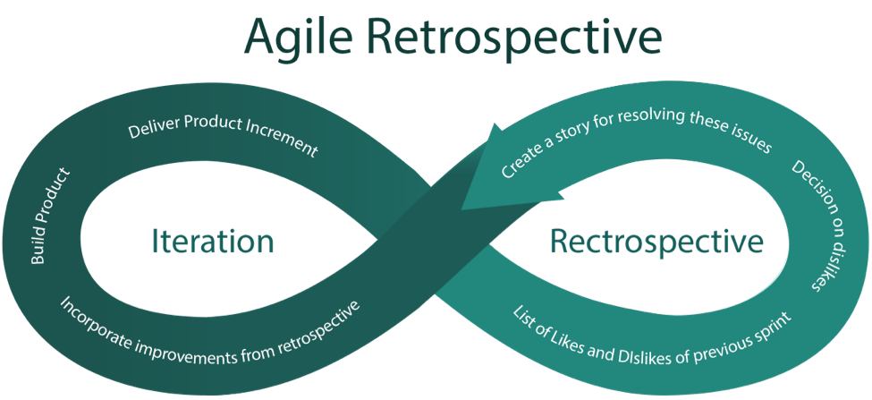
Retrospective
What went well?
Planned adjustments of the next iteration:
Stricter quality control
Class diagram
Notes:
Forslag:
Kort: hvorfor viktig?
Hva gikk bra, hva gikk dårlig, hvilke konkrete fokus gjør at vi kan forbedre dette ved neste iterasjon?

