Slide 1
Life in Sweden
A Nordic Adventure
Demo created with PowerPoint MCP Server

Slide 2
Agenda
Swedish Culture & Traditions
Cost of Living Comparison
Climate Throughout the Year
Popular Activities & Attractions
Work-Life Balance Statistics

Slide 3
Swedish Culture

Slide 4
Sweden vs European Neighbors
Sweden 🇸🇪
Population: ~10.5M
Work hours: 40h/week
Vacation days: 25+
Parental leave: 480 days
Fika culture ☕
EU Average
Varies widely
Work hours: 35-45h/week
Vacation days: 20-25
Parental leave: varies
Less structured breaks

Slide 5
Average Monthly Costs (SEK)

Slide 6
A Year in Sweden
Jan-Feb
❄️ Polar nights & skiing
Mar-Apr
🌷 Spring awakening
May-Jun
🌞 Midnight sun begins
Jul-Aug
☀️ Summer holidays & festivals
Sep-Oct
🍂 Autumn colors & coziness
Nov-Dec
🎄 Christmas markets & lights

Slide 7
Top Swedish Cities to Live In
City | Population | Known For | Vibe
Stockholm | 975K | Capital, Islands | Cosmopolitan
Gothenburg | 580K | Coast, Food Scene | Laid-back
Malmö | 345K | Diversity, Design | International
Uppsala | 175K | University, History | Academic
Lund | 125K | Science, Innovation | Student City

Slide 8
Moving to Sweden: The Process
1. Get job offer or admission
2. Apply for residence permit
3. Register with Skatteverket
4. Get Swedish ID (personnummer)
5. Enjoy Swedish life! 🎉

Slide 9
Swedish Traditions You'll Love
Fika - Coffee break culture (sacred!)
Midsummer - Dancing around maypoles
Crayfish parties in August
Lucia procession in December
Allemansrätten - Freedom to roam nature

Slide 10
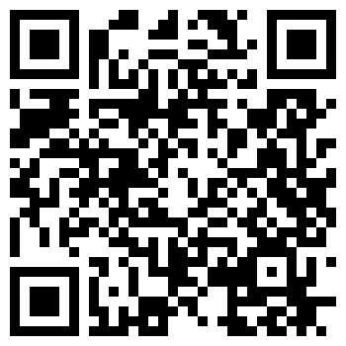
Want to Learn More?
Scan to visit the PowerPoint MCP Server
GitHub Repository

Slide 11
Tack så mycket!
Thank you very much!
Created with PowerPoint MCP Server

