Slide 1
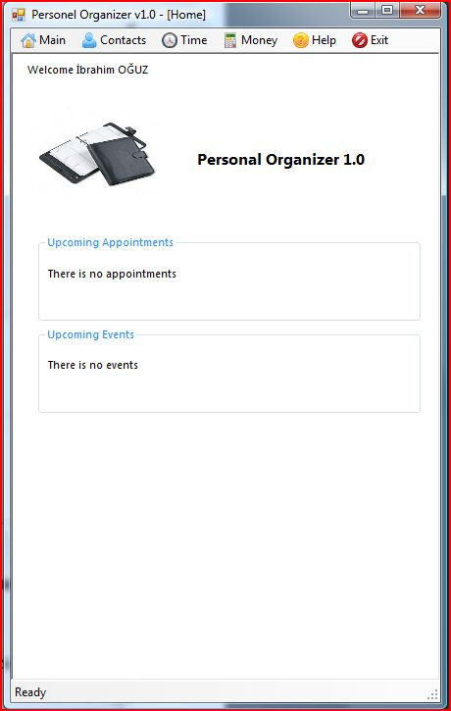
Personal Organizer
User Interface
Business Services
Types
class AddContactBS
{
AddContact(CONTACTDataSet ds)
{
//calls type class methods. Create business here
}
}
class CONTACTDataSet
{ // properties here
private string Name;
private string Surname;
……
Save(CONTACTDataSet ds)
{
// save contacts….
}
}

