Slide 1
Hashing, Hash function, Hash Table

Slide 2
Note !!!!!
All detailed material discussed in class this slides are merely represent roadmap of lecture coverage.

Slide 3
contents
Hashing
Why introduced
Hash function
Hash Table
Collision
Resolving methods
complexity

Slide 4
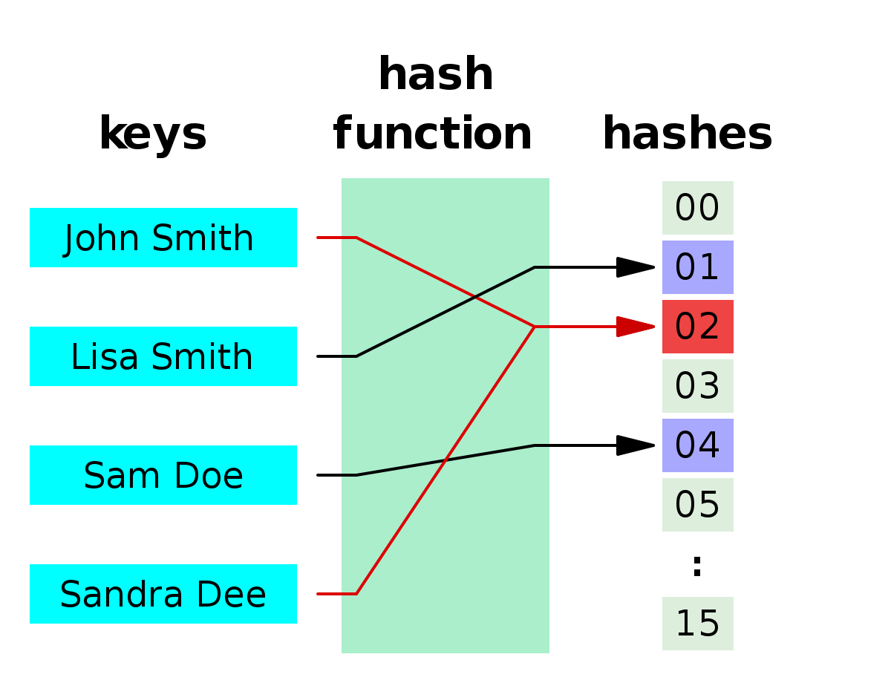
Implementation of Hashing
Associative arrays
ADT
Takes (key, value)

Slide 5
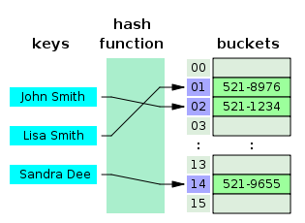
Using Bucket of Arrays

Slide 6
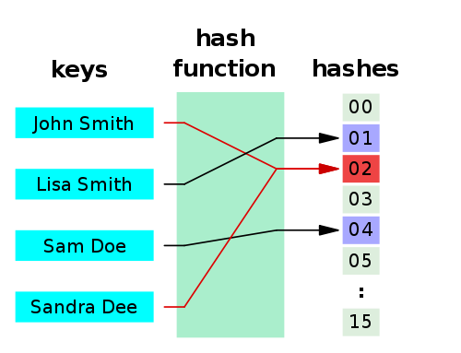
Collision

Slide 7
Resolve
Separate Channing
Open Addressing
Linear Probing
Quadratic Probing
Double Hashing

Slide 8
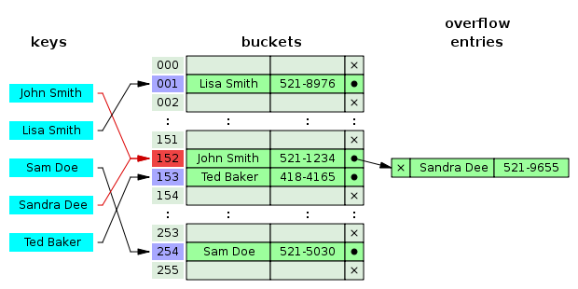
Hash collision by separate chaining using bucket array.

Slide 9
Analysis
Separate Channing
Advantage
Disadvantage
Complexity
Load factor

