Slide 1
Operating Systems
Linked Topics (studied earlier)
Instruction Set Architecture
Structure of Computers
Hardware support for Operating System functions
Interfaces with applications

Slide 2
Overview of Operating System
Introduction and Overview
Operating System Structures

Slide 3
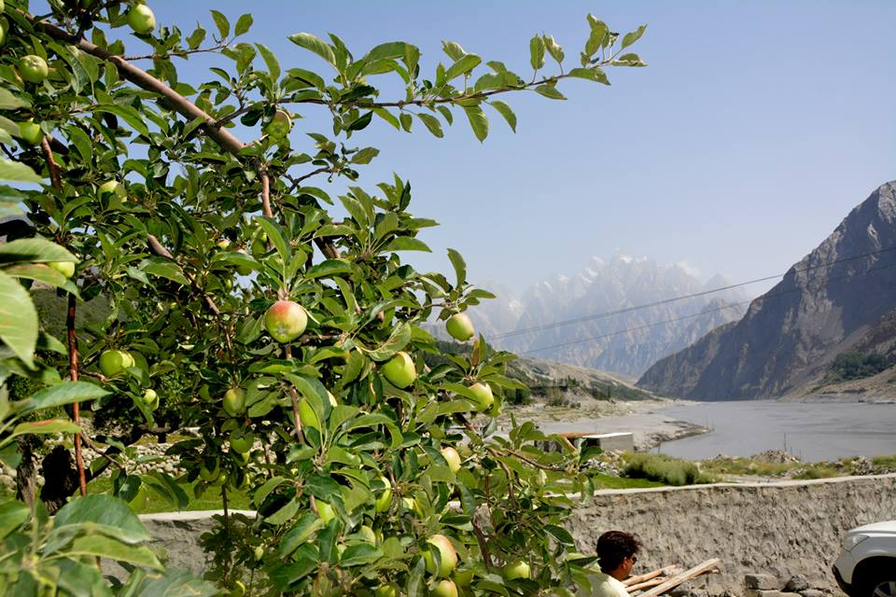
Introduction
Definitions
Computer Systems Organization and Architecture
Operating Systems Structure
Dual Mode of Operation
Concept of Process and its Management
Memory and Storage Management
Protection and Security of Systems
Various Computing Environments
Notes:
What is an OS? Give a few names – a name that is not being given by others

Slide 4
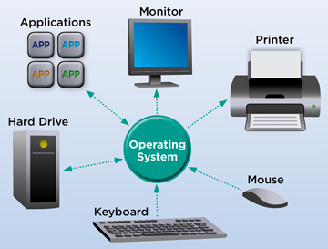

Slide 5
Introduction to Operating System Concepts
What is an OS?
An interface between the user of the computer and the hardware that forms the computer
Coordination and Abstraction
A program that manages and controls the hardware
It provides an environment for application programs
Acts as an intermediary between a computer user and the hardware
Operating systems vary in their design according to their purpose of use

Slide 6
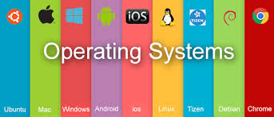

Slide 7
Introduction to Operating System Concepts
Some operating systems are designed to optimize utilization of hardware
Some are designed that supports activities including games, business applications, etc.
Due to the complexity and the large size
OS is consciously designed to be modular with a layered architecture
Role of an OS?
Control and coordinate the use of resources among various application programs
Notes:
Example of first: Servers and mainframes Examples of second: personal computers, etc.,

Slide 8
Computer System Structure
Computer system consists of four components
Hardware comprises of the basic computing resources for the system
Includes CPU, memory, I/O devices, etc.
Application programs define the ways the resources are used to solve users’ computing problems
Word processors, compilers, web browsers, etc.
Operating system controls the resources and coordinates its use to provide an environment in which various programs can do useful work
Users make use of the computing system

Slide 9
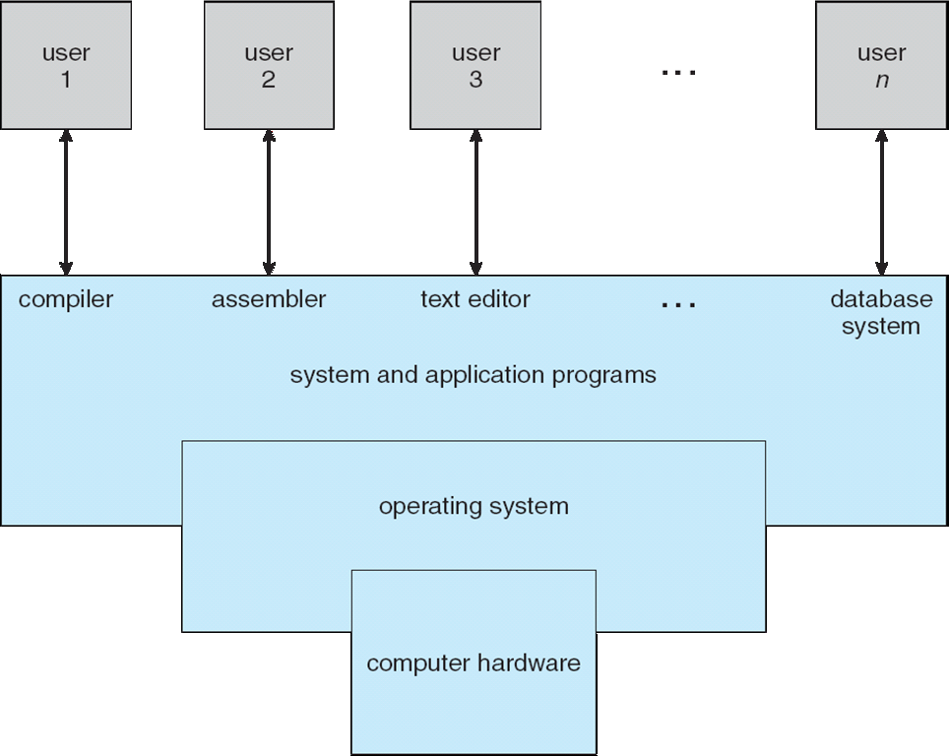
Abstract view of the Components of a Computer System

Slide 10
Introduction to Operating System Concepts
User View
Varies according to the interface used
Operating system for a PC is optimized for
Ease of use and performance
Improving single user experience
Little effort is made for efficient resource utilization
Mainframe and minicomputers
OS is designed to maximize resource utilization
Network of workstations and servers
OS is designed to compromise between individual usability and resource utilization

Slide 11
Introduction to Operating System Concepts
Mobile computers – smart phones and tablets
OS is designed for individual usability
Performance per unit of battery life is also important
Embedded computers
Have little or no user view
OS may be designed to run without user intervention
System View
Views the operating system as a resource allocator
CPU time Memory space
File-storage space I/O devices etc.

Slide 12
Introduction to Operating System Concepts
OS acts as the manager of resources
Conflicting requests may also be generated
Manage and allocate resources efficiently and fairly
OS is a control program that controls and manages the execution of user programs
Prevent errors and improper use of computer
Operation and control of I/O devices

Slide 13
Operating System Definition
“One program that is running at all times on the computer with everything else being system programs and application programs”
The Kernel
The one program that the vendor ships
Resource allocator and control program
Operating system for mobile devices also include middleware
A set of software frameworks that provide additional services to application developers
Notes:
Databases, multimedia and graphics

Slide 14
Computer System Organization
Computer system consists of
One or more CPUs
Memory and memory controller
Device controllers
Bootstrap program
Initializes all aspects of computer system
Loads OS kernel into memory
OS starts execution and waits for an event to occur
System processes or system daemons
System waits for an event to occur
Event occurrence
The occurrence of an event is signaled by a hardware or a software interrupt
Notes:
First system process is init

Slide 15
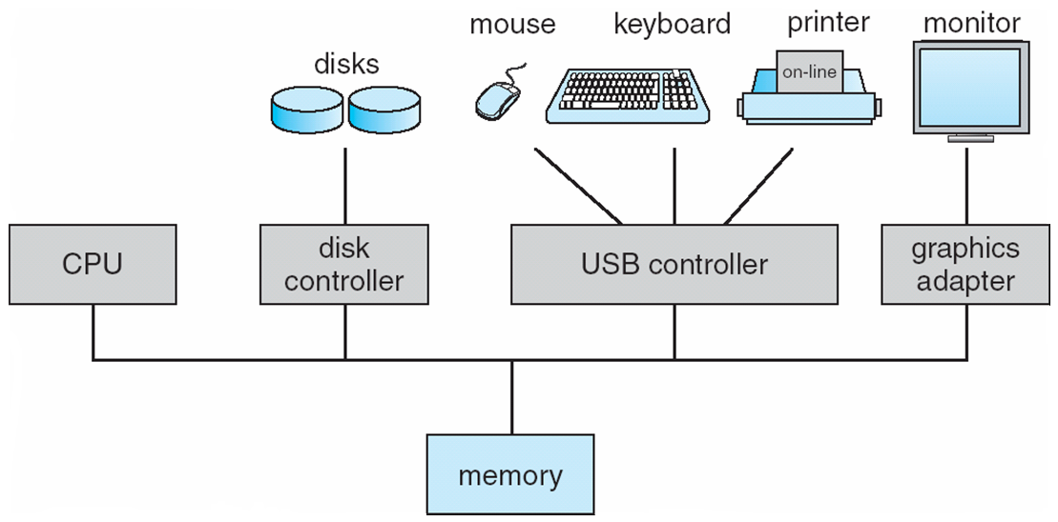
A Modern Computer System

Slide 16
Computer System Organization
Hardware interrupt
A signal sent to the CPU anytime
Software interrupt
Execute a special operation
System call or monitor call
Interrupts cause a transfer to take place to the relevant interrupt service routine (ISR)
Methods of transfer varies
Saving the address of the interrupted instruction and the state of the processor
Registers, runtime stack or fixed memory addresses
Notes:
What are interrupts? Exceptions?
Vectored interrupt? How?

Slide 17
Storage Structure
Units of storage
Bit and bytes
Kilobyte, Megabyte and Gigabyte
Terabyte and Petabyte
Main memory has program and data accessed by the CPU for execution directly
Volatile and too small to contain all information
Secondary storage solves the problems
Extension of main memory
Store large quantities of information permanently
Storage system is organized in a hierarchy
Varies in speed, capacity, cost and volatility
Notes:
What do the units mean? Main memory cannot hold code and data permanently because of volatility and size.

Slide 18
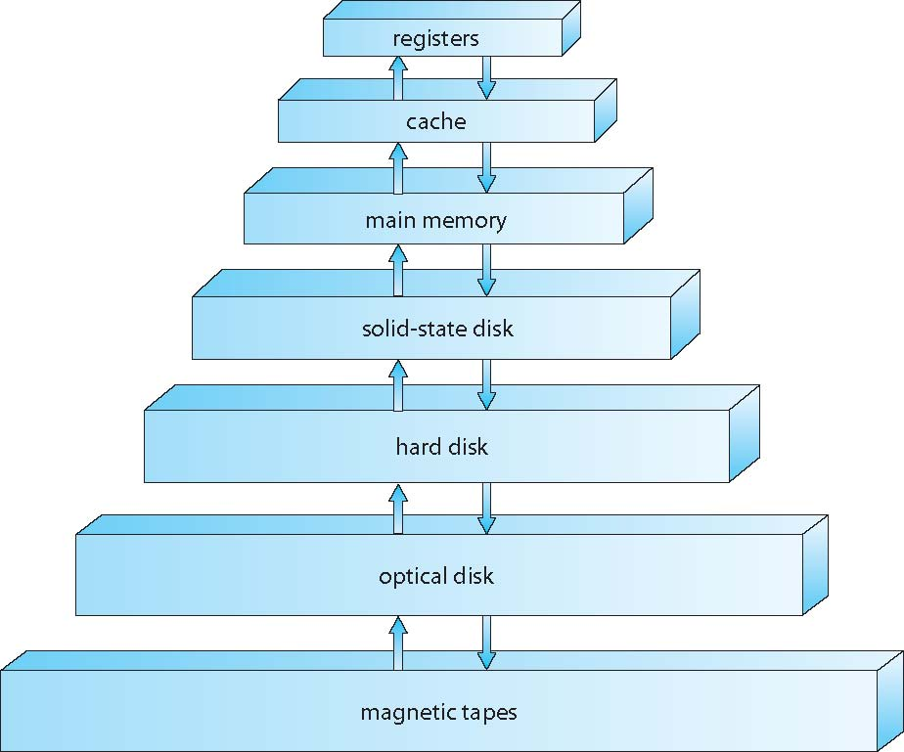
Storage-Device Hierarchy

Slide 19
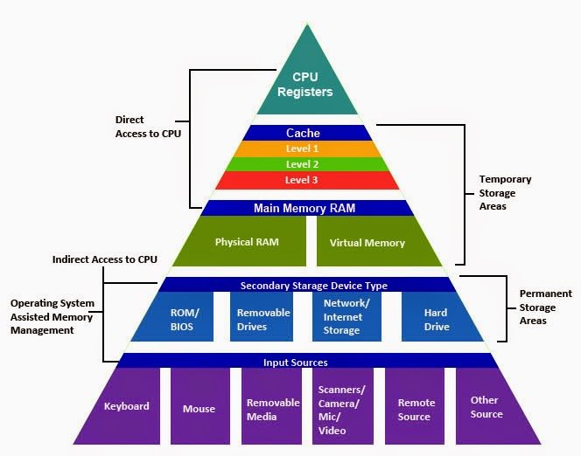
Storage-Device Hierarchy

Slide 20
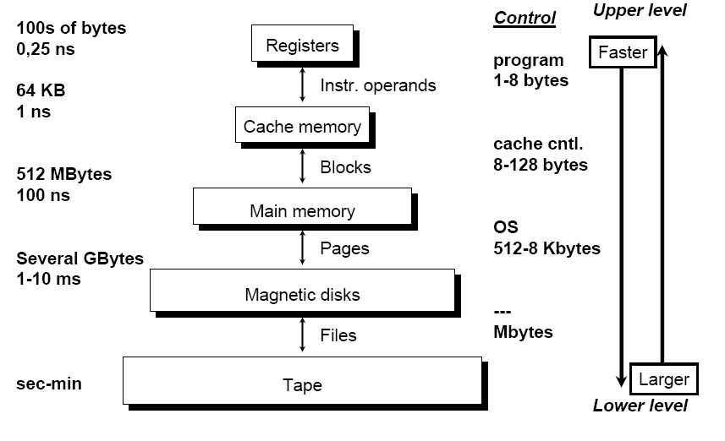
Storage-Device Hierarchy

Slide 21
Storage Structure
Higher to lower levels
Decrease in speed
Increase in size
Decrease in cost
More persistence (non-volatile)
SSDs (Solid Storage Disks) are faster than magnetic disks and are nonvolatile
Flash memory is used in PDAs and other such devices
Design of memory system must balance all factors

Slide 22
Operating System Structure
Memory management is required when several jobs are resident in memory at the same time
CPU scheduling is the process of choosing one of several jobs in memory to run on CPU
Swapping may be required to swap processes in and out of main memory to ensure reasonable response time
Virtual memory is a technique that allows the execution of a process that is not completely in memory
Programs larger than the physical memory can be run
File system and disk management is also required to run time-sharing systems
Other requirements are protection, mechanisms for job synchronization and communication
Notes:
One of the main features of OS is its ability to multiprogram. Many processes in memory figure

Slide 23
Operating System Operations
Operating systems are interrupt driven
Events are signaled by the occurrence of an interrupt or a trap
A trap or an exception
A software-generated interrupt caused by a special request from a user program or caused by an error
A number of user programs are sharing all the resources of the system
Protection is an essential requirement to be performed by the operating system

