Slide 1
Operating System Structures
OS Services
OS Structures

Slide 2

Types of System Calls
Systems calls are grouped into six categories
Process control
File management
Device management
Information maintenance
Communications
Protection
Process Control
end, abort load, execute
wait event, signal event
allocate and free memory
create process, terminate process
get process attributes, set process attributes
wait for time

Slide 3
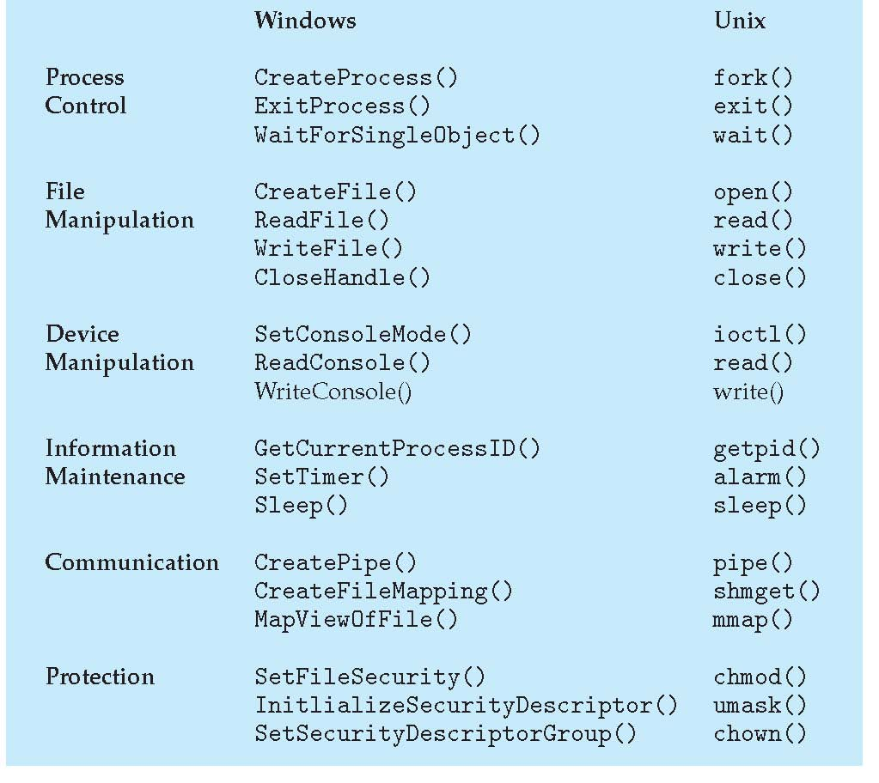
Examples of Windows and Unix System Calls

Slide 4
System Calls for Process Control
end, abort
A running process may need to end normally (end) or abnormally (abort)
Abnormal termination provides the error code
load, execute
A process may want to load another process for execution
Where does control return as the new process terminates?
Depends on whether the existing process is lost, saved or allowed to continue execution concurrently
If the return is to the existing process, memory image of the process should be saved

Slide 5
System Calls for Process Control
create process, terminate process
New processes may be created by an existing process
set process attributes, get process attributes
This provides the ability to control and set the attributes of a new process or to determine the attributes of an existing process
wait for time
Wait for a certain amount of time for a process to terminate
wait event, signal event
Wait for a specific event or the process itself signals completion
Other system calls are available for debugging, getting memory dump, profiling, etc.

Slide 6
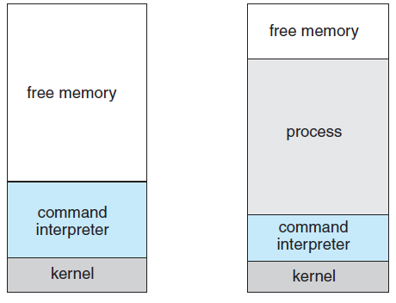
MS-DOS execution
(a) At system startup (b) running a program
Notes:
6

Slide 7
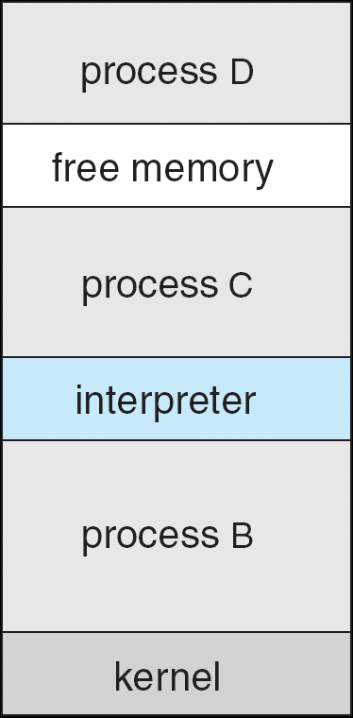
FreeBSD Running Multiple Programs
Notes:
7

Slide 8
File Management System Calls
create file, delete file
Requires the name of the file and its attributes
open, close
After creation, file should be opened for specific operations
read, write, reposition
Operations that can be performed on open file
get file attributes, set file attributes
Get attributes of a file and possibly set them if desired
Attributes are name, type, protection codes, accounting information, etc.
Some systems provide more file management functions and system calls

Slide 9
Device Management System Calls
Resources controlled by the OS are treated as devices
Physical and virtual devices
request device, release device
If there are multiple users of various devices, processes require to request for devices before making use of it and release it after using it
read, write, reposition
Operations that can be performed on the devices that are allocated
Get device attributes, set device attributes
Logically attach or detach devices

Slide 10
Information Maintenance System Calls
System calls that are used only to transfer information between user and OS programs
get time or date, set time or date
get system data, set system data
get process, file or device attributes
set process, file or device attributes
OS maintains information to respond to the calls that are relevant

Slide 11
Communication System Calls
Interprocess communication models
Message-passing model
Processes exchange messages to transfer information directly or indirectly
Shared-memory model
For exchange of information through common, shared memory areas
create, delete communication connection
A connection is established before messages are exchanged between processes
send, receive messages
transfer status information
attach or detach remote devices

Slide 12
Protection Related System Calls
Protection provides a mechanism for controlling access to resources provided by a computer system
Set_permission and get_permission
Manipulates permission settings of resources such as files and disks
Allow_user and deny_user
Whether users be allowed or not allowed access to certain resources

Slide 13
System Programs
Provide a convenient environment for program development and execution – system utilities
Varies from simple to complex ones
Divided into a number of categories
File management
Programs that manipulate files and directories
Status information
Programs that format and print the output from the status information system calls
Registry may be supported that store and retrieve configuration information
File modification
Several text editors may be available with various options like search or transformations

Slide 14
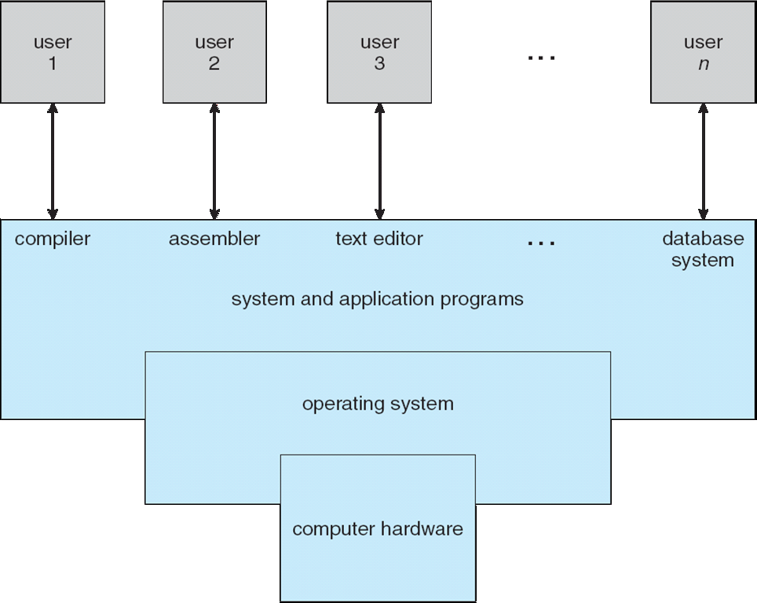
Abstract view of the Components of a Computer System

Slide 15
System Programs
Programming language support
Compilers, assemblers, debuggers and interpreters for common programming languages
Program loading and execution
Used for loading and execution of programs
Communications
Provide mechanism for creating virtual connections among processes, users and computer systems
Other programs are supplied: perform common operations: web browsers, spreadsheets, etc.

Slide 16
Operating-System Design and Implementation
Design Goals
Define goals and specifications
Affected by the choice of hardware and the type of system
General purpose or specific
Next level requirements: user and system goals
User goals
System should be convenient to use
It should be reliable, safe and fast
How to achieve these objectives?
System goals
System should be easy to design, implement and maintain - It should be flexible, reliable, error free and efficient

Slide 17
Mechanisms and Policies
An important principle of OS design is to separate policy from mechanism
Mechanisms determine how to do something
Policies determine what will be done
This is important for flexibility
Policies are likely to change over time and place
A general mechanism insensitive to policy changes is desirable
Microkernel-based OS separate mechanisms from policies
Implements basic set of primitive building blocks that are totally policy free

Slide 18
Implementation
All current generation OS is implemented in a high-level language
Easier to write, understand and debug
Portability is achieved
Suffers from reduced speed and increased storage requirements
Performance improvement measures can be used to offset the disadvantage
Bottleneck routines can be identified and replaced with assembly language equivalents
Bottleneck is identified through programs that measure system behavior
Traces can be run to achieve the objectives

Slide 19
Operating System Structure
Design the system by defining small components or modules
Each module is a well-defined portion of the system with carefully defined inputs, outputs and functions
Simple Structure
Many operating systems do not have well- defined structures
MS-DOS is an example
Interfaces and levels of functionality are not well separated
System is prone to crashes
Original UNIX OS also had limited structuring
Consists of two separable parts

Slide 20
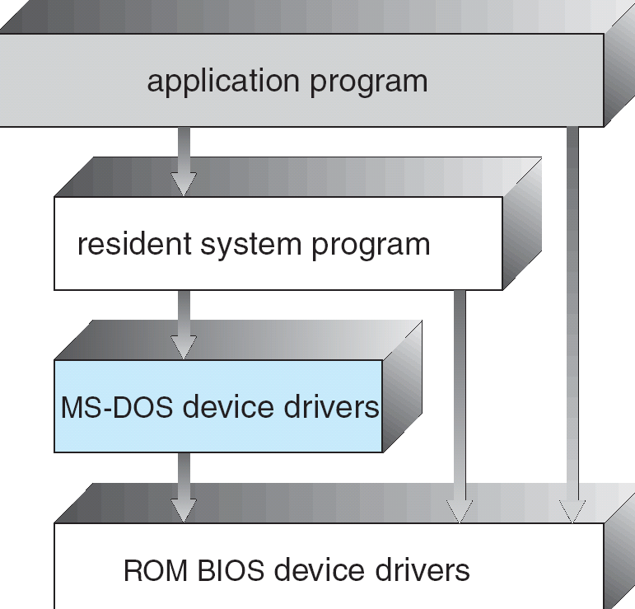
MS-DOS Layered Structure
Notes:
20

Slide 21
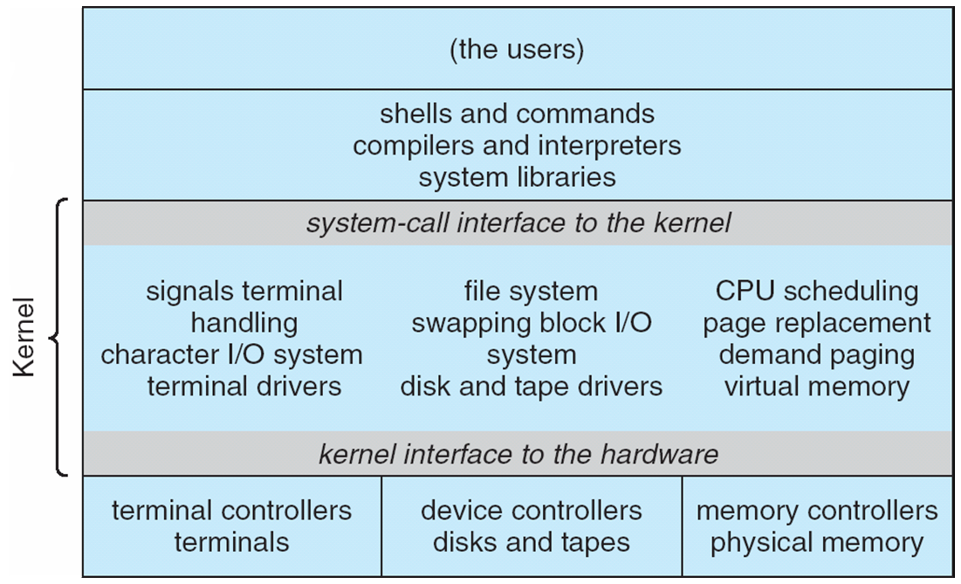
Traditional UNIX System Structure
Notes:
21

Slide 22
Layered Approach
Proper hardware support allows OS to be partitioned into smaller modules
A top-down approach can be taken to design the modular system
Modular system can be designed using a number of approaches
Layered approach
OS is broken into a number of layers or levels
Bottom layer is the hardware and the highest layer is the user interface
An OS layer is an implementation of an abstract object made up of data and the operations that can manipulate data
Layer M consists of data structures and a set of routines that the higher-level layers can invoke

Slide 23
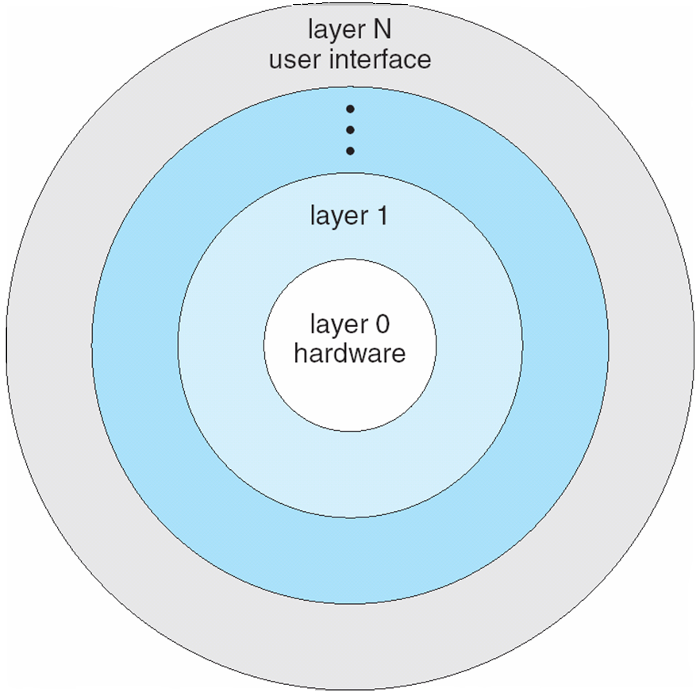
Layered Operating System
Notes:
23

Slide 24
Layered Approach
Advantages of layered approach
Simplicity of construction and debugging
Simplifies system verification
Problems with layered approach
How to appropriately define the layers
Some layers may not be completely self- contained violating the basic principle of layered approach
Less efficient in terms of performance
Recent developments
Fewer layers with more functionality have been designed to overcome the above problems

Slide 25
Microkernels
This method structures the kernel by removing all nonessential components and implements them as system and user-level programs
Results in smaller kernel
Microkernel provides minimal process and memory management and some communication facility
Communication is through message passing
Benefits of microkernel approach
Ease of extending the OS
Easier to port
It provides more security and reliability
Examples are Tru64 UNIX and QNX
This approach suffers from performance losses

Slide 26
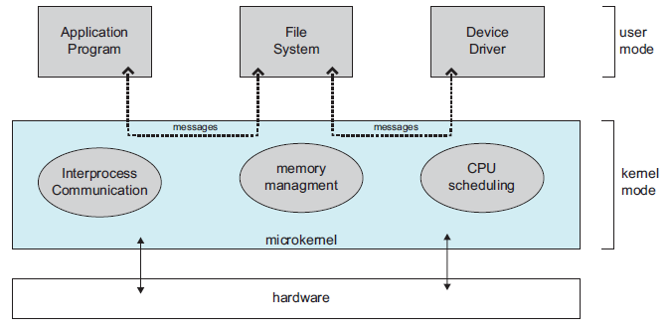
Architecture of a Typical Microkernel

Slide 27
Modules
Current methodology is to use loadable kernel modules
Kernel has a set of core components
Links dynamically with additional services during boot time or during run time
Implementations of UNIX using this methodology
Solaris, Mac OS X, etc.
Solaris
A core kernel with seven types of loadable modules
Reading assignment

Slide 28
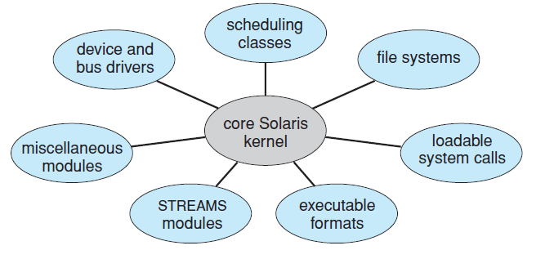
Solaris Loadable Modules

Slide 29
Hybrid Systems
Most of the operating systems are a hybrid of the previously mentioned structures
They address the issues of performance, security and usability
Linux, Solaris are monolithic but also have modular behavior
Reading assignment (contents of book)
Mac OS X iOS
Android

Slide 30
Process Management
Part 2
Processes
Threads
Process Synchronization
CPU Scheduling
Deadlocks

Slide 31
Process Management
A process is a program in execution
Needs resources to accomplish its task
System consists of a collection of processes executing concurrently
OS processes and user processes
Processes may be of single thread or may have multiple threads
OS activities for process and thread management
Creation and deletion of both user and system processes
Scheduling of processes
Provision of mechanisms for
Synchronization Communication
Deadlock handling

Slide 32
Process Concept
Definitions
States of a process
Process Control Block
Threads of a process
Scheduling and schedulers
Scheduling queues
Operations on processes
Process creation and termination
Communication between processes
A brief introduction

Slide 33
Process Concept
All activities including OS programs and user programs are termed as processes
Job and process are terms used interchangeably
A process comprises of
A program code or text section
Program counter content and content of processor registers
Process stack and a data section
It may also contain a heap that is dynamically allocated at run time
Two processes may be associated with the same program but are considered to be separate processes

Slide 34
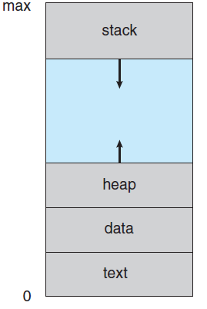
Process in Memory

Slide 35
Process State
Processes change states as they execute
New: The process is being created
Running: Instructions are being executed
Only one process can be running on a processor in system at any instant
Waiting: The process is waiting for some event to occur
Ready: The process is waiting to be assigned to the processor
Many processes may be ready and waiting
Terminated: The process has completed execution

Slide 36
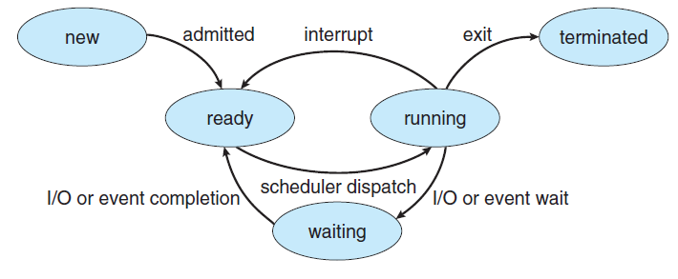
Diagram of Process State

Slide 37
Process Control Block
Each process in the system is represented by a task control or a process control block (PCB)
PCB serves as the repository for information that may vary from process to process
Includes the following information
Process state
Program counter
CPU registers
Number and type depends on the processor architecture
CPU scheduling information
Contains scheduling parameters
Memory management information
Accounting information
I/O state information

Slide 38
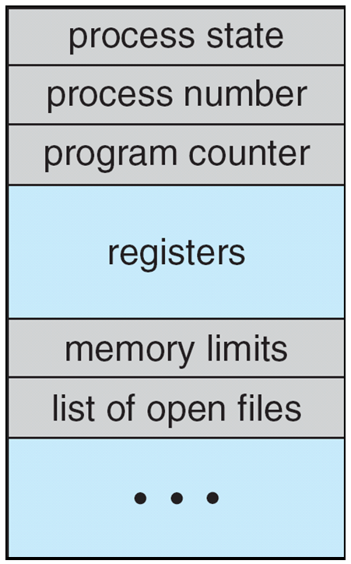
Process Control Block (PCB)

Slide 39
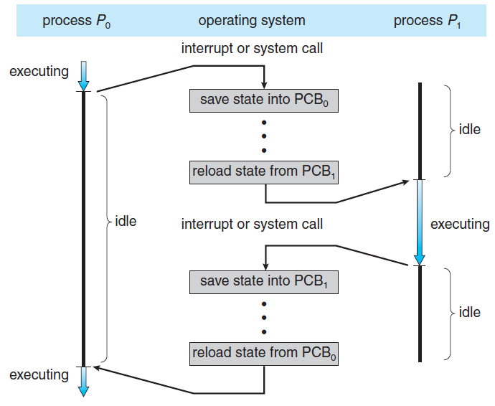
CPU Switch From Process to Process

Slide 40
Threads
The process model implies that a process performs a single thread of execution
A single thread of instructions
Allows the process to execute only one task at a time
Current generation OS allow a process to perform multiple threads of execution at a time
Perform more than one task at a time

Slide 41
Process Scheduling
Process scheduler performs both time sharing and multiprogramming among processes
Selects an available process for execution on the CPU
Scheduling Queues
Job queue consists of all processes in the system
Ready queue consists of all processes that are residing in main memory waiting to execute
Generally stored as a linked list
Ready queue header and pointer field of each PCB
System includes other queues too
Device queue contains a list of processes waiting for a particular device

Slide 42
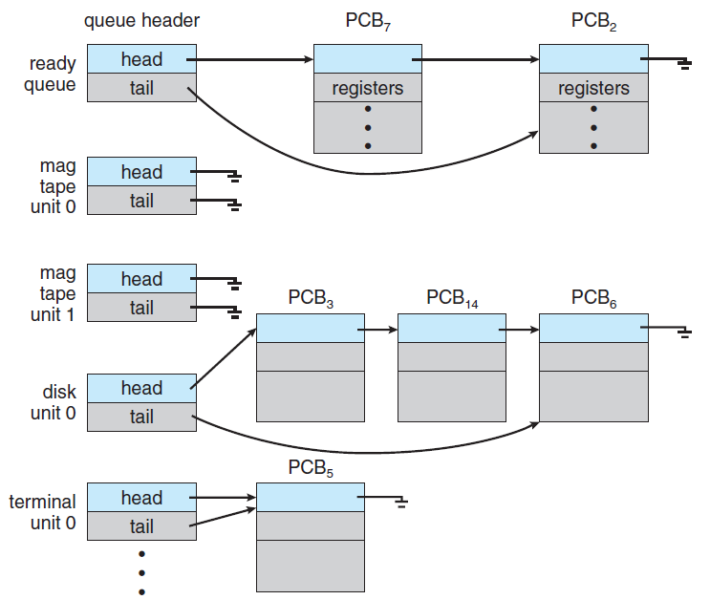
Ready Queue And Various I/O Device Queues

Slide 43
Scheduling Queues
A queuing diagram represents process scheduling
A new process is placed in a ready queue
It waits until it is selected for execution or is dispatched
One of several events may occur while the process is in execution
Process issues an I/O request and is placed in an I/O queue
Process creates a child process and waits for the child’s termination
Process eventually goes back to ready queue
Process is interrupted and put in ready queue
Process continues with this cycle until it terminates and releases all its resources

Slide 44
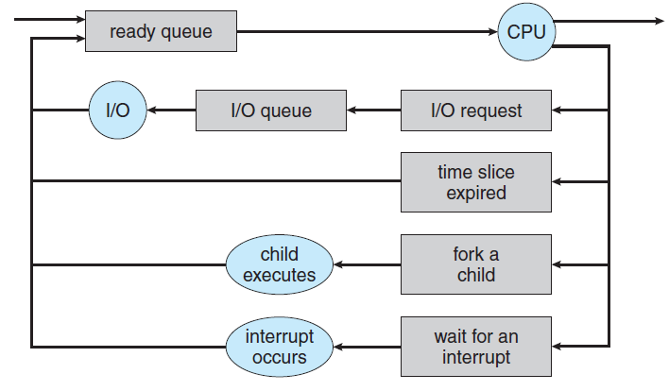
Queuing-diagram representation of Process Scheduling

Slide 45
Schedulers
Schedulers select a process from any of the given queues
Long-term scheduler or job scheduler selects processes from job pool and loads them into memory
Short-term scheduler or CPU scheduler selects from the processes in memory that are ready for execution and allocates the CPU
Frequency of execution of short-term scheduler is much higher than a long-term scheduler
It should be fast
Long-term scheduler controls the degree of multiprogramming (DOM)
If DOM is stable, average rate of process creation is equal to the average rate of departure of processes after termination

Slide 46
Schedulers
I/O-bound processes spend more time performing I/O than doing computations
CPU-bound processes spend more time in computation than in I/O
Long-term scheduler should make a careful selection of process mix
Some time-sharing systems do not have long-term scheduler
Stability of these systems depend on a physical limitation or the self-adjusting nature of humans
There may be a medium-term scheduler in some time-sharing systems
It can be beneficial to remove a process from memory to reduce the DOM – swapping

Slide 47
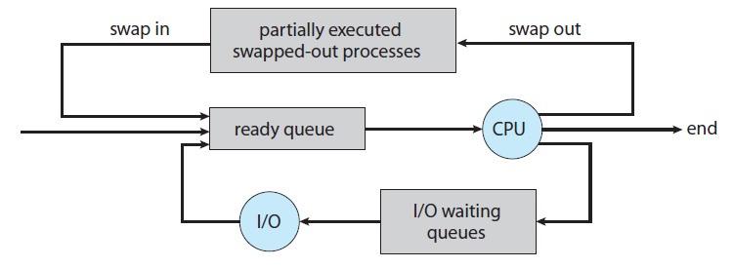
Addition of Medium Term Scheduling

