Slide 1
Goodness-of-Fit Tests
Osama Bin Ajaz
Lecturer at FAST-NUCES,
Main Campus, Karachi

Slide 2
Chi-Sq. Goodness-of-Fit Test
To see whether a frequency distribution fits a specific pattern, the chi-square goodness-of-fit test is used. For example:
a manufacturer of running shoes may wish to see whether buyers show a preference for a specific style.
A traffic engineer may wish to see whether accidents occur more often on some days than on others, so that he can increase police patrols accordingly.
An emergency service may want to see whether it receives more calls at certain times of the day than others, so that it can provide adequate staffing.

Slide 3

Example # 01
suppose a market analyst wished to see whether consumers have any preference among five flavors of a new fruit soda. A sample of 100 people provided the following data:
If there were no preference, one would expect that each flavor would be selected with equal frequency. Is there enough evidence to reject the claim that there is no preference in the selection of fruit soda flavors? Let α = 0.05.

Slide 4
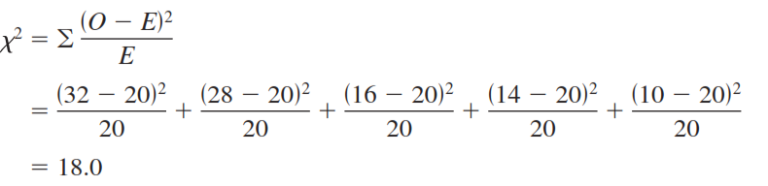
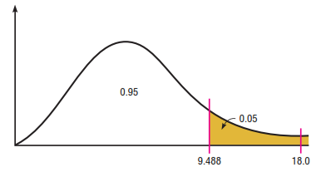
Solution (Example 01)
Ho: Consumers show no preference to flavors (claim).
H1: Consumers show a preference
α = 0.05
Computation: The frequencies obtained by calculation (as if there were no preference) are called the expected frequencies. The expected value for each category is 20.
Decision: The decision is to reject the null hypothesis, since 18.0 > 9.488.
Notes:
DF=Categories – 1 = 5 – 1 = 4

Slide 5
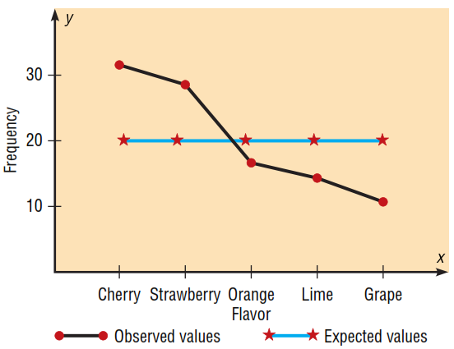
Solution #01 (Contd.)
Graph of Observed Vs. Expected Frequencies:
When the observed values and expected values are close together, the chi-square test value will be small.
Then, the decision will be not to reject the null hypothesis.

Slide 6
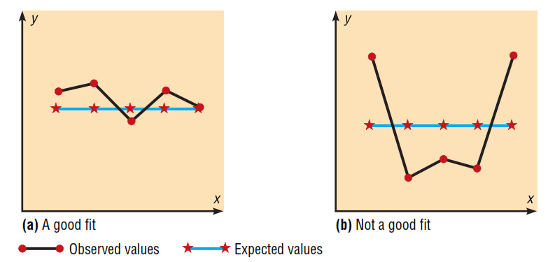
Good Fit Vs. Not Good Fit

Slide 7
Example # 02
The advisor of an ecology club at a large college believes that the group consists of 10% freshmen, 20% sophomores, 40% juniors, and 30% seniors. The membership for the club this year consisted of 14 freshmen, 19 sophomores, 51 juniors, and 16 seniors. At α = 0.10, test the advisor’s conjecture.

Slide 8
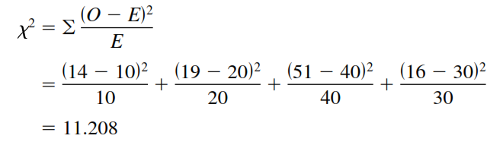
Solution (Example # 02)
Ho: The club consists of 10% freshmen, 20% sophomores, 40% juniors, and 30% seniors (claim).
H1: The distribution is not the same as stated in the null hypothesis.
α : 0.10
Computation: The expected values are computed as follows:
0.10 x 100 =10, 0.40 x 100 = 40, 0.20 x 100 = 20 0.30 x 100 =30
Decision: Reject the null hypothesis, since 11.208 > 6.251.
Notes:
DF=4 – 1 = 3

Slide 9
Example # 03
The Russel Reynold Association surveyed retired senior executives who had returned to work. They found that after returning to work: 38% were employed by another organization, 32% were self-employed, 23% were either freelancing or consulting, and 7% had formed their own companies. In order to see if these percentages are consistent with those of Allegheny County residents, a local researcher surveyed 300 retired executives who had returned to work and found that 122 were working for another company, 85 were self-employed, 76 were either freelancing or consulting, and 17 had formed their own companies. At α =0.10, test the claim that the percentages are the same for those people in Allegheny County.

Slide 10

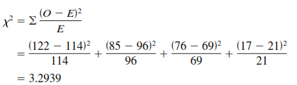
Solution Example # 03
Ho: The retired executives who returned to work are distributed as follows: 38% are employed by another organization, 32% are self-employed, 23% are either freelancing or consulting, and 7% have formed their own companies (claim).
H1: The distribution is not the same as stated in the null hypothesis.
α: 0.10
Computation: The expected values are computed as follows:
Decision: Since 3.2939 < 6.251, the decision is not to reject the null hypothesis.

Slide 11
Example # 04
Fit a Poisson distribution and test the goodness of fit at 0.05 level of significance.
x | 0 | 1 | 2 | 3 | 4 | 5
f | 40 | 32 | 18 | 8 | 2 | 0

Slide 12


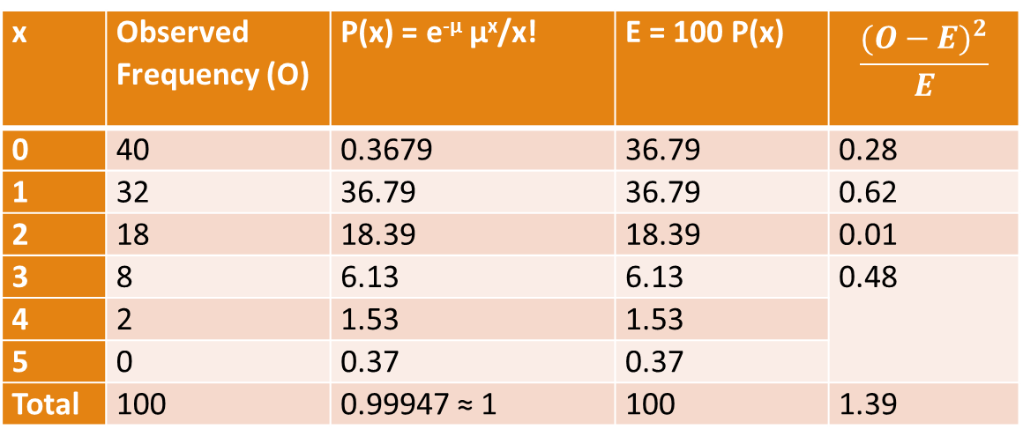
Solution to Example # 04
Ho: The data follows the Poisson distribution.
H1: the data does not follow the Poisson distribution.
α : 0.05
Test Statistics: with d. f. = (# Classes – 1 -- # estimated parameters) =k – 1 – m
x | Observed Frequency (O) | P(x) = e^{-µ} µ^{x}/x! | E = 100 P(x) | $$\frac{{(O−E)}^{2}}{E}$$
0 | 40 | 0.3679 | 36.79 | 0.28
1 | 32 | 36.79 | 36.79 | 0.62
2 | 18 | 18.39 | 18.39 | 0.01
3 | 8 | 6.13 | 6.13 | 0.48
4 | 2 | 1.53 | 1.53
5 | 0 | 0.37 | 0.37
Total | 100 | 0.99947 ≈ 1 | 100 | 1.39
Decision: Do not reject Ho.

Slide 13
Example # 05
Fit a binomial distribution to the following data and test the goodness of fit.
No. Heads (x) | 0 | 1 | 2 | 3 | 4
f | 10 | 40 | 50 | 20 | 5

Slide 14

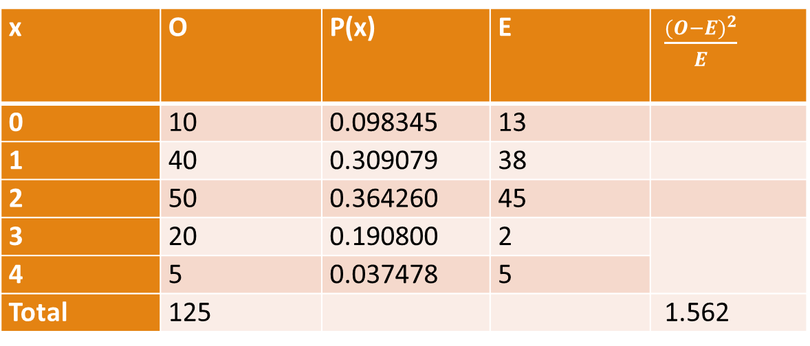
Solution to Example # 05
Ho: the Data follows the Binomial distribution,
H1: Data does not follow the binomial distribution
α = 0.05
x | O | P(x) | E | $\frac{{(O−E)}^{2}}{E}$
0 | 10 | 0.098345 | 13
1 | 40 | 0.309079 | 38
2 | 50 | 0.364260 | 45
3 | 20 | 0.190800 | 2
4 | 5 | 0.037478 | 5
Total | 125 |  |  | 1.562
Notes:
Mean = 1.76 , n = 4 , N = 125
Mean= np & p = Mean/n = 0.44 and q = 0.56

Slide 15
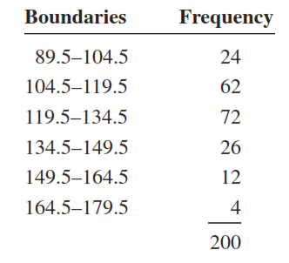
Example # 06
Use chi-square to determine if the variable shown in the frequency distribution is normally
distributed. Use α = 0.05.

Slide 16

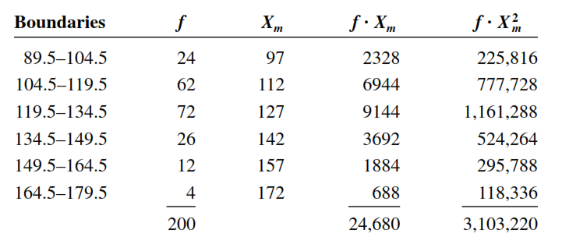
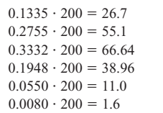
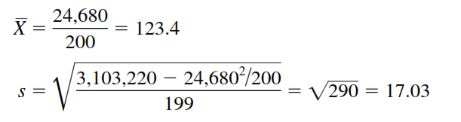
Solution to Example # 06
Notes:
Z=(UCB – mean)/SD, P(z < -1.11) = 0.1335.

Slide 17

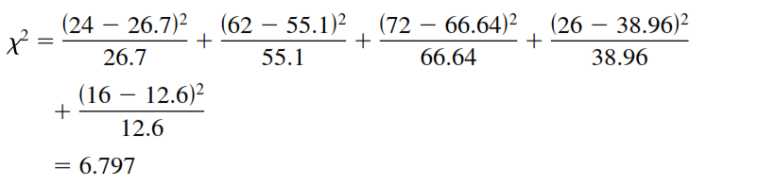
Example # 06 (contd.)
The critical value with d.f. = (5 – 1 – 2) = 2 is 5.991, so the null hypothesis is rejected.

Slide 18
Test of Independence
The chi-square independence test can be used to test the independence of two variables.
For example, suppose a new postoperative procedure is administered to a number of patients in a large hospital.
The researcher can ask the question, Do the doctors feel differently about this procedure from the nurses, or do they feel basically the same way?
Note that the question is not whether they prefer the procedure but whether there is a difference of opinion between the two groups.
To answer this question, a researcher selects a sample of nurses and doctors and tabulates the data in table form, as shown. (see next slide)

Slide 19
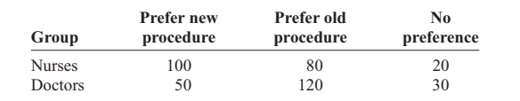


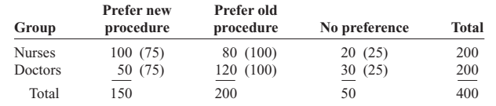
Notes:
Total freq=400

Slide 20
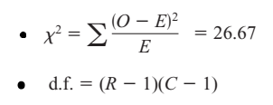
Notes:
Chi-sq critical = 5.991, Reject Ho.

Slide 21
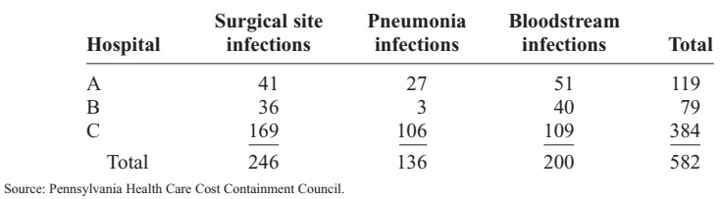
Example # 08: Hospitals & Infections
A researcher wishes to see if there is a relationship between the hospital and the number of patient infections. A sample of 3 hospitals was selected, and the number of infections for a specific year has been reported. The data are shown next.
At α = 0.05 can it be concluded that the number of infections is related to the hospital where they occurred?
Notes:
Critical value = 9.448

Slide 22

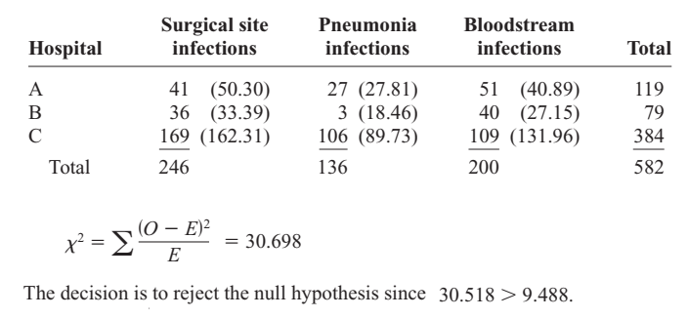
Solution (Example 08)

Slide 23
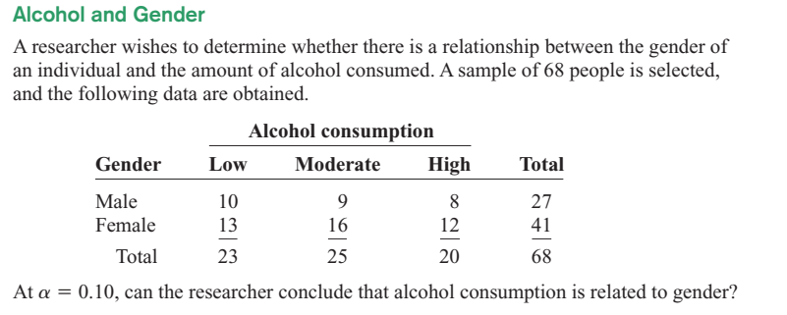
Example # 09
Notes:
Critical = 4.605, Reject Ho.

