Slide 1
Database System
CL 203
Lab 01
Introduction and Basics

Slide 2
Who Am I?
Graduate of FAST – BS(CS) - 2012
Currently enrolled in Masters Program

Slide 3
Tentative Grading Scheme (May Vary)
Class Participation / Lab Activities – 15%
Lab Quizzes – 5%
Assignments – 10%
Project – 10%
Lab Mid – 20%
Lab Final Exam – 40%

Slide 4
Contacting me
Email:
Basit.jasani@nu.edu.pk
Contact Number:
+92 345 3603970 – Only texts
Room: PHD Room

Slide 5
Introduction
Lets get to know you people one by one…
Name
Your area of interests?
What you want to be in future?
Computer Science why?
What unique you can do through Computer Science?

Slide 6
Any Idea??
Conventional Data saving in ancient times?
What is a Database?
What is DBMS?
Name some DBMSs?
Why is Database used?

Slide 7
DATABASE
“Collection of inter-related data in an organized manner”
DBMS
“A program that manages Database”

Slide 8
Role of DBMS
STORES
DBMS
Eg. Sql Server,Oracke,My sql,DB2
DB
RETREIVES
MODIFIES

Slide 9
RDB
What is a Relational Database?
“Collection of relations (tables) or 2-dimensional Tables”

Slide 10
Key Points
A table is a basic storage structure unit of an RDBMS
Easy to use
Flexible in structure
Security and Authorization methods are well defined
Protect Data integrity
Can be accessed and modifies by executing structured query language statements
Uses a set of relational Operators(Selection,Join) and a set operation Union, Intersection etc
Contains a collection of tables with No Physical Pointers as we use Primary Key & Foreign Key to access and relate data
Keeps logical representation of data independent of its physical storage characteristics

Slide 11
Sl.# | DBMS | RDBMS
1 | Introduced in 1960s. | Introduced in 1970s.
2 | During introduction it followed the navigational modes (Navigational DBMS) for data storage and fetching. | This model uses relationship between tables using primary keys, foreign keys and indexes.
3 | Data fetching is slower for complex and large amount of data. | Comparatively faster because of its relational model.
4 | Used for applications using small amount of data. | Used for complex and large amount of data.
5 | Data Redundancy is common in this model | Keys and indexes are used in the tables to avoid redundancy.
6 | Example systems are dBase, Microsoft Acces, LibreOffice Base, FoxPro. | Example systems are SQL Server, Oracle, MySQL, MariaDB, SQLite

Slide 12
Schema
Set of Relational Tables in a DB
Table: Basic Unit of storage composed of Rows and Columns
Columns represent attributes of an entity
Rows represent tuple or a record
In RDB a Table representing one entity is called a relation and the connection between 2 different tables is a relationship

Slide 13
What is SQL?
Special Purpose Programming Language designed to work upon and manage the data held in RDBMS

Slide 14

In most RDBMS, SQL is used as a language interpreter
SQL
RDBMS
DB
User Tells
“What to do” in form of Query Language such as SQL
SQL interprets commands & queries to make them Understandable
RDBMS retrieves/modify Data as per Requested by the user

Slide 15
SQL (Continued..)
It is a non-procedural Language i.e. User Only tell “What To Do” not “How To Do”
SQL is used for:
Data Manipulation
Data Definition
Data Administration
All are expressed as an SQL statement or command.

Slide 16
PL/SQL
An Oracle Procedural Language which extends SQL by adding application logic

Slide 17
SQL Categories/Classification
DQL: Data Query Language
Select
DML: Data Manipulation Language
Insert, Update, Delete…
DDL: Data Definition Language
Create, Alter, Drop, Truncate, Rename
DCL: Data Control Language
Grant, Revoke
Transaction Control
Commit, Roll Back, Check Point

Slide 18
SQL (DQL) Syntax
Demobld: Create demo schema
Demodrop: Delete demo schema
Select:
Select [Column Name] from [Table Name] Selects a particular column data from a table
Select * from [Table Name] Selects all records from a table in a database
Select with Where clause: Limits the selected rows
Select [column name] from [table name] where [condition]

Slide 19
Null Values
Null is a value that is unavailable, unassigned, inappropriate, inapplicable, or unknown
A null is not the same as zero or blank

Slide 20
Conditions in SQL
Between: Between two values
AND: Both values should be true
In (SET): Among a set of values
Like: Like a character pattern
Is Null: is a null value

Slide 21
Arithmetic Precedence
*, /, +, -
Same priority evaluated from left to right

Slide 22
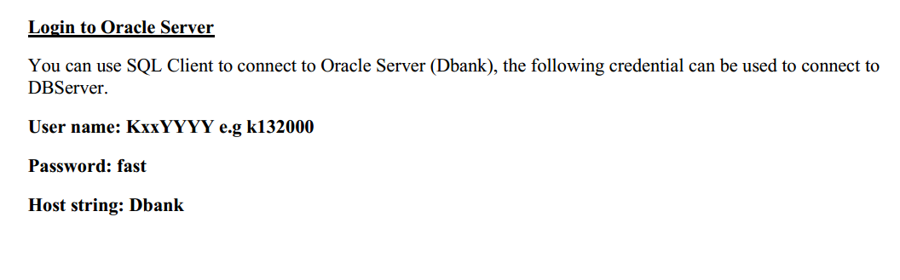

Slide 23
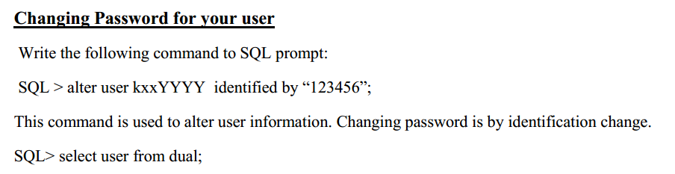

Slide 24
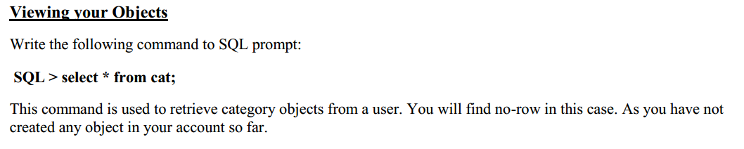

Slide 25
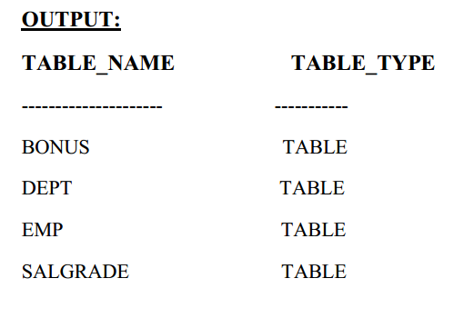

Slide 26
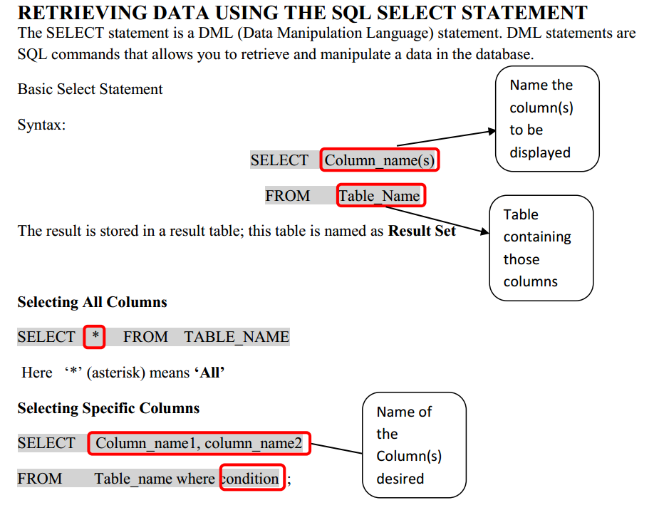

Slide 27
