Slide 1

Week 10 XML: Extensible Markup Language
Uzaira Saeed uzaira.saeed@google.com

Slide 2
Road Map
Structured, Semi-structured and Un-structured Data
XML Hierarchical (Tree) Data Model
XML Documents, DTD, and XML Schema
Storing and Extracting XML Documents from Databases
XML Languages
Extracting XML Documents from Relational Databases

Slide 3
Structured, Semi-structured and Un-structured Data

Slide 4
Definitions
The information stored in databases is known as structured data because DB design is well organized
For example, each tuple in relation follows the same format
Sometimes, we have semi-structured data
not all the data collected have identical structure
Some attributes may be shared among various entities, but other attributes may exist only in a few entities
there is no predefined schema

Slide 5
Definitions
Several data models based on using tree or graph data structures (but not flat relational model structures) have been introduced for representing semi-structured data
Thus, the key difference between structured and semi-structured data is about how the schema constructs (such as the names of attributes, relationships, and entity types) are handled

Slide 6
Self-Describing Data
In semi-structured data the schema information is mixed in with the data values, as each data object can have different attributes. this type of data is called self-describing data
For example, we want to collect a list of bibliographic references to some research project
These could be books, technical reports, research articles in journals or conference proceedings or could be complete journal issues or conference proceedings
Each of these have different attributes and different types of information even if they belong to the same reference

Slide 7
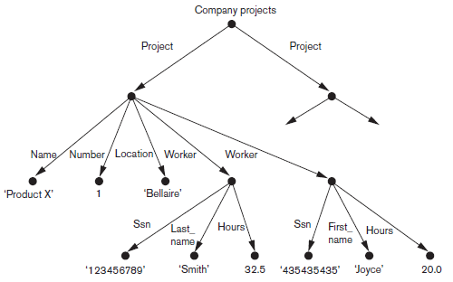
Semi-structured Data
Semi-structured data may be displayed as a directed graph
labels or tags on directed edges represent schema names: names of attributes, object types (or entity types or classes), and relationships
internal nodes represent individual objects or composite attributes
leaf nodes represent actual data values of simple (atomic) attributes

Slide 8
Semi-structured Data
There are two main differences between the semi-structured model and the object model
1. The schema information: in semi-structured model names of attributes, relationships, and classes are intermixed with the objects and their data values in the same data structure.
2. Need of predefined schema: In semi-structured model, there is no requirement for a predefined schema to which the data objects must conform, although it is possible to define a schema; if necessary

Slide 9
Un-structured Data
In unstructured data, there is very limited indication of the type of data
For example, Web pages in HTML that contain some data are considered to be un-structured data
In a HTML file, Text appears between angled brackets, <...>…. </...>, known as an HTML tag
The tags mark-up the document1 in order to instruct an HTML processor how to display the text

Slide 10
Un-structured Data
Mostly, the tags specify document formatting rather than the meaning of the various data elements in the document
HTML tags specify look and feel as well as text structuring in docs, eg. specifying a numbered or unnumbered list or a table etc
HTML uses a large number of predefined tags, which are used to specify a variety of commands for formatting Web documents for display
The start and end tags specify the range of text to be formatted by each command

Slide 11
Un-structured Data
In an HTML page; information ma be static or may be extracted dynamically from some database
When information is taken at run time, we need to use the same HTML formatting tags for displaying it
Hence, the information displayed for one person will have the same format as that of anyone else but the content will be different. Such Web pages are called dynamic

Slide 12
XML Hierarchical (Tree) Data Model

Slide 13
XML Basics
basic object in XML model is the XML document
XML document is constructed from
elements and attributes
there are additional concepts of entities, identifiers, and references as well
As in HTML, elements are identified in a document by their start tag and end tag.
The tag names are enclosed between angled brackets < ... >, and end tags are further identified by a slash, </ ... >
Attributes in XML provide additional information that describes elements

Slide 14
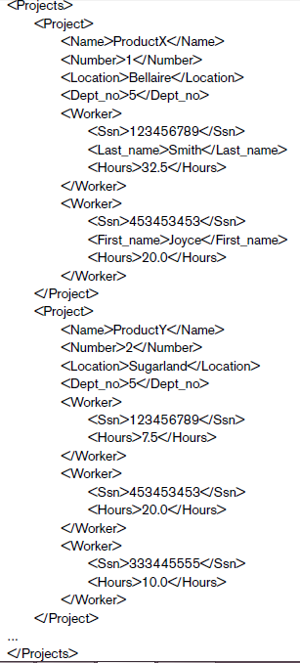
XML Basics

Slide 15
XML Basics
XML elements can be Complex or Simple
Complex elements are constructed from other elements hierarchically, whereas
Simple elements contain data values
XML tag names can be defined in DTD or schema document, to give a semantic meaning to tag names that can be exchanged among multiple users

Slide 16
XML Basics
Differences Between XML & HTML
HTML | XML
HTML was designed to display data | XML was designed to carry data
HTML displays data and focuses on how data looks | XML describes data and focuses on what data is
HTML displays information | XML describes information
All element names are predefined and fixed | Element names are user defined
An element cannot be extended | Element names can be defined in DTD or some schema document, and can be extended to any required number of hierarchical levels

Slide 17
Types of XML Documents
There are three main types of XML documents:
Data-centric XML documents: These documents have many small data items that follow a specific structure and hence may be extracted from a structured database
Document-centric XML documents: These are documents with large amounts of text, such as news articles or books. There are few or no structured data elements in these documents
Hybrid XML documents: These documents may have parts that contain structured data and other parts that are predominantly textual or unstructured. They may or may not have a predefined schema

Slide 18
Other Types of XML Documents
XML documents that do not follow a predefined schema of element names and corresponding tree structure are known as schemaless XML documents
Data-centric XML documents can be considered either as Semi-structured data or as structured data
If XML document conforms to a predefined XML schema or DTD then the document can be considered as structured document
On the other hand, XML allows documents that do not conform to any schema; these would be considered as semi-structured data and are schemaless XML documents

Slide 19
Other Types of XML Documents
XML attributes are generally used in a manner similar to how they are used in HTML
That is, to describe properties and characteristics of the elements (tags) within which they appear
It is also possible to use XML attributes to hold the values of simple data elements; but it is not recommended

Slide 20
XML Documents & DTD

Slide 21
Well-Formed XML Documents & XML DTD
An XML document is well formed if it follows a few conditions
it must start with an XML declaration to indicate the version of XML being used as well as any other relevant attributes, as shown in the first line
It must follow syntactic guidelines of tree data model
It must have a single root element
every element must include a matching pair of start and end tags within the start and end tags of the parent element
The nested elements must specify a well-formed tree structure

Slide 22
Well-Formed XML Documents & XML DTD
Well-formed XML document is syntactically correct
Thus it can be processed by generic processors that traverse the document and create an internal tree representation
A standard model associated with DOM (Document Object Model) allows programs to manipulate the resulting tree representation corresponding to a well-formed XML document
However, the whole document must be parsed beforehand when using DOM

Slide 23
Well-Formed XML Documents & XML DTD
Another API called SAX (Simple API for XML) allows processing of XML documents by notifying a start or end tag
This makes it easier to process large documents and allows for processing of so-called streaming XML documents
where the processing program can process the tags as they are encountered
This is also known as event-based processing.

Slide 24
Well-Formed XML Documents & XML DTD
A well-formed XML document can also be schemaless
there is no predefined set of elements
it can have any tag names for the elements
Thus you have freedom to specify new elements
but reduces possibilities for automatically interpreting the meaning or semantics of the elements

Slide 25
Well-Formed XML Documents & XML DTD
In case, you have stronger criterion is for an XML document
resulting document will be well formed following some schema
In such case, elements must follow the structure specified in XML DTD (Document Type Definition) file or XML schema file
A special syntax exists for specifying DTD files

Slide 26
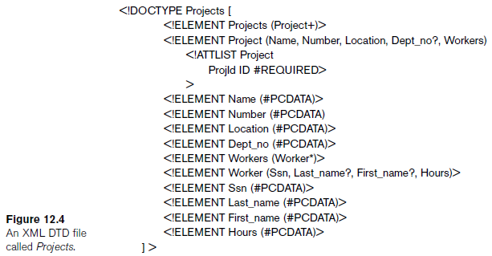
Well-Formed XML Documents & XML DTD

Slide 27
Well-Formed XML Documents & XML DTD
When specifying elements, the following notation is used:
A * following the element name means
element can be repeated zero or more times in the document
Such element is known as an optional multivalued (repeating) element
A + following the element name means
the element can be repeated one or more times in the document
This kind of element is a required multivalued (repeating) element
A ? following the element name means
the element can be repeated zero or one times
This kind is an optional single-valued (nonrepeating) element
Elements appearing without any of the preceding three symbols
Must appear exactly once in the document
This kind is a required single-valued (nonrepeating) element

Slide 28
Well-Formed XML Documents & XML DTD
The type of the element is specified via parentheses following the element
If the parentheses include names of other elements, the latter elements are children of the element in the tree structure
If the parentheses include the keyword #PCDATA
the element is a leaf node
PCDATA stands for parsed character data which is roughly similar to a string data type
list of attributes that can appear within an element can also be specified via the keyword !ATTLIST
Project element has an attribute ProjId
If type of an attribute is ID, then it can be referenced from another attribute whose type is IDREF within another element
Notice that attributes can also be used to hold the values of simple data elements of type #PCDATA

Slide 29
Well-Formed XML Documents & XML DTD
Parentheses can be nested when specifying elements
bar symbol ( e1 | e2 ) specifies that either e1 or e2 can appear in the document
To require that an XML document be checked for conformance to a DTD, we must specify this in the declaration of the document <?xml version=“1.0” standalone=“no”?> <!DOCTYPE Projects SYSTEM “proj.dtd”>

Slide 30
Well-Formed XML Documents & XML DTD

Slide 31
XML Schema

Slide 32
Difference between DTD & Schema
DTD | XSD
DTDs have a unique syntax derived from SGML | XML Schema utilize a XML-based syntax
DTD doesn't support datatypes | XML Schema has the capability to create and use datatypes in Schema in conjunction with element and attribute declarations
There is no concept of namespaces in DTD | XML schemas allow support for namespaces
there are three symbols that you can use to limit the number of occurrences of an element: *, + and ? | In Schema there is no control on Occurances
DTD is not extensible | XML schemas are extensible

Slide 33
XML Schema
XML schema language is a standard for specifying the structure of XML documents
It uses the same syntax rules as regular XML documents
To distinguish the two types of documents, we will use the terms:
XML instance document or XML document for a regular XML document
XML schema document for a document that specifies XML schema
It is unlikely to display the whole database (along with it’s complete data) as a single document in XML format
But there have been proposals to store data in native XML format as an alternative to storing the data in relational databases

Slide 34
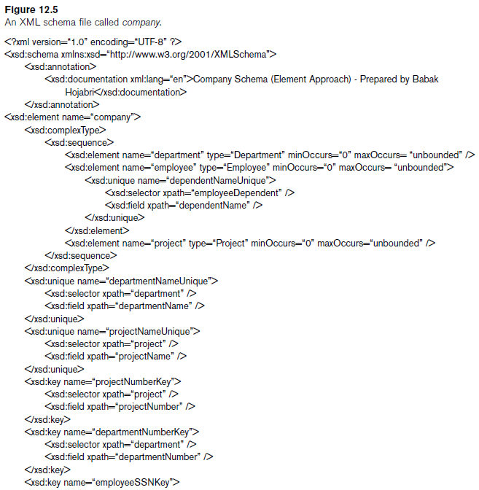
XML Schema

Slide 35
XML Schema
XML schema, just like XML DTD, is based on tree data model
elements and attributes as main structuring concepts
XML Schema has additional concepts from database
like keys, references, and identifiers

Slide 36
Features of XML Schema
Schema descriptions and XML namespaces
First line of the document specifies XML version
Second line gives the file used in this example, which is http://www.w3.org/2001/XMLSchema. This is a commonly used standard for XML schema commands
Each such definition is called XML namespace, because it defines the set of commands (names) that can be used
The file name is assigned to the variable xsd (XML schema description) using the attribute xmlns (XML namespace)
xsd is a variable that is used as a prefix to all XML schema commands (tag names)
when we write xsd:element or xsd:sequence,
We are referring to the definitions of the element and sequence tags as defined in the file http://www.w3.org/2001/XMLSchema.

Slide 37
Features of XML Schema
Annotations, documentation, and language used
XML schema elements refers to the tags:
xsd:annotation and xsd:documentation, which are used for providing comments and other descriptions in the XML document
The attribute xml:lang of the xsd:documentation element specifies the language being used, where en stands for the English language.

Slide 38
Features of XML Schema
Elements and types
Next, we specify the root element of our XML schema.
In XML schema, the name attribute of the xsd:element tag specifies the element name, which is called company for the root element
The structure of the company root element can then be specified,
which in our example is xsd:complexType
as this is further specified to be a sequence of departments, employees, and projects using the xsd:sequence structure of XML schema

Slide 39
Features of XML Schema
First-level elements in the COMPANY database
First level elements are written in xsd:element tag
Next, we specify the first-level elements under the company root element
In our case, we have: EMPLOYEE, DEPARTMENT and PROJECT
If a tag has only attributes and no further subelements or data within it, it can be ended with the backslash symbol (/>)
These are called empty elements

Slide 40
Features of XML Schema
Specifying element type and minimum & maximum occurrences
In XML schema; attributes type, minOccurs and maxOccurs in the xsd:element tag specify the type and multiplicity of each element
If we specify a type attribute in an xsd:element, the structure of the element must be described separately, typically using the xsd:complexType element of XML schema.
On the other hand, if no type attribute is specified, the element structure can be defined directly following the tag
The minOccurs and maxOccurs tags are used for specifying lower and upper bounds on the number of occurrences of an element in any XML document that conforms to the schema specifications
If they are not specified, the default is exactly one occurrence. These serve a similar role to the *, +, and ? symbols of XML DTD.

Slide 41
Features of XML Schema
Specifying keys
In XML schema, it is possible to specify constraints that correspond to unique and primary key constraints as well as foreign keys (or referential integrity) constraints
The xsd:unique tag specifies elements that correspond to unique attributes in a relational database
xsd:selector and xsd:field tags are used to identify the element type that contains the unique element and the element name within it that is unique via the xpath attribute
For specifying primary keys, the tag xsd:key is used
For specifying foreign keys, the tag xsd:keyref is used
When specifying a foreign key, the attribute refer of the xsd:keyref tag specifies the referenced primary key
xsd:selector and xsd:field specify the referencing element type and foreign key

Slide 42
Features of XML Schema
Specifying the structures of complex elements via complex types
complex elements are detailed using the tag xsd:complexType
complex elements are given as a sequence of subelements corresponding to the database attributes of each entity type
by using the xsd:sequence and xsd:element tags of XML schema
Each element is given a name and type via the attributes name and type of xsd:element
minOccurs and maxOccurs attributes are added if we need to change the default of exactly one occurrence
For (optional) database attributes where null is allowed, we need to specify minOccurs = 0,
For multivalued database attributes we need to specify maxOccurs = “unbounded”
when unique, primary key and foreign key constraints need to be specified; we must define complex types to specify the element structures

Slide 43
Featured of XML Schema
Composite (compound) attributes
Composite objects are called complex types
For Example: Address, Name, Worker, and WorksOn complex types
These could have been directly embedded within their parent elements

Slide 44
Storing and Extracting XML Documents from DB
Using DBMS to store the documents as text
A relational or object DBMS can be used to store whole XML documents as text fields within the DBMS
This approach can be used if the DBMS has a special module for document processing

Slide 45
Storing and Extracting XML Documents from DB
Using a DBMS to store the document contents as data elements
This approach would work for storing a collection of documents that follow a specific XML DTD or XML schema
Because all the documents have the same structure, one can design a relational (or object) database to store the leaf-level data elements within the XML documents
This approach would require mapping algorithms to design a database schema that is compatible with the XML document structure as specified in the XML schema or DTD and to recreate the XML documents from the stored data
These algorithms can be implemented either as an internal DBMS module or as separate middleware that is not part of the DBMS.

Slide 46
Storing and Extracting XML Documents from DB
Designing a specialized system for storing native XML data
A new type of database system based on the hierarchical (tree) model could be designed and implemented
Such systems are being called Native XML DBMSs
It would include specialized indexing and querying techniques, and would work for all types of XML documents. It could also include data compression techniques to reduce the size of the documents for storage

Slide 47
Storing and Extracting XML Documents from DB
Creating or publishing customized XML documents from pre-existing relational databases
Because there are enormous amounts of data already
stored in relational databases, parts of this data may need to be formatted as
documents for exchanging or displaying over the Web. This approach would
use a separate middleware software layer to handle the conversions needed
between the XML documents and the relational database
In particular, we show how tree structured documents can be created from graph-structured databases

Slide 48
XPath & XQuery

Slide 49
XPath
XPath is a syntax for defining parts of XML document
It uses path expressions to navigate in XML document
It contains a library of standard functions
Gives path expressions to identify certain nodes (elements) or attributes within an XML document that match specific patterns

Slide 50
XPath Expresion
Returns a sequence of items that satisfy a certain pattern as specified by the expression
Either values (from leaf nodes) or elements or attributes
Separators are used when specifying a path:
Single slash (/) and double slash (//)

Slide 51
XPath Expresion
XML File
<?xml version="1.0" encoding="UTF-8"?>
<bookstore>
<book>
<title lang="en">Harry Potter</title>
<author>J K. Rowling</author>
<year>2005</year>
<price>29.99</price>
</book>
<book>
<title lang="en">Learning XML</title>
<author>A Mishra</author>
<year>2009</year>
<price>39.95</price>
</book>
</bookstore>

Slide 52
XPath Expresion
Expression | Meaning
Nodename | Selects all child nodes of the node
/ | Selects from the root node
// | Selects nodes in the document from the current node that match the selection no matter where they are
. | Selects the current node
.. | Selects the parent of the current node
@ | Selects attributes

Slide 53
XPath Expresion
Path Expression | Result
bookstore | Selects all the child nodes of the bookstore element
/bookstore | Selects the root element bookstore Note: If the path starts with a slash ( / ) it always represents an absolute path to an element!
bookstore/book | Selects all book elements that are children of bookstore
//book | Selects all book elements no matter where they are in the document
bookstore//book | Selects all book elements that are descendant of the bookstore element, no matter where they are under the bookstore element
//@lang | Selects all attributes that are named lang
/bookstore/book[1] | Selects the first book element that is the child of the bookstore element
/bookstore/book[last()] | Selects the last book element that is the child of the bookstore element

Slide 54
XPath Expresion
Path Expression | Result
/bookstore/book[last()-1] | Selects the last but one book element that is the child of the bookstore element
/bookstore/book[position()<3] | Selects the first two book elements that are children of the bookstore element
//title[@lang] | Selects all the title elements that have an attribute named Lang
//title[@lang='eng'] | Selects all the title elements that have an attribute named lang with a value of 'eng'
/bookstore/book[price>35.00] | Selects all the book elements of the bookstore element that have a price element with a value greater than 35.00
/bookstore/book[price>35.00]/title | Selects all the title elements of the book elements of the bookstore element that have a price element with a value greater than 35.00

Slide 55
XPath Expresion
Path Expression | Result
/bookstore/* | Selects all the child nodes of the bookstore element
//* | Selects all elements in the document
//title[@*] | Selects all title elements which have any attribute
Wildcard | Description
* | Matches any element node
@* | Matches any attribute node
node() | Matches any node of any kind

Slide 56
XQuery
XQuery is the language for querying XML data
XQuery for XML is like SQL for databases
XQuery is built on XPath expressions
XQuery is supported by all major databases
XQuery is a W3C Recommendation

Slide 57
XQuery
XQuery can be used to:
Extract information to use in a Web Service
Generate summary reports
Transform XML data to XHTML
Search Web documents for relevant information

Slide 58
XQuery
Four main clauses of XQuery
FOR <variable bindings to individual nodes (elements)>
LET <variable bindings to collections of nodes (elements)>
WHERE <qualifier conditions>
RETURN <query result specification>

Slide 59
XQuery
FOR vs. LET
FOR $x IN list-expr
Binds $x in turn to each value in the list expr
LET $x = list-expr
Binds $x to the entire list expr
Useful for common sub-expressions and for aggregations

Slide 60
XQuery
Find books whose price is larger than average:
LET $a = avg(document("bookCtlg.xml")/bookCtlg/book/price)
FOR $b in document("bookCtlg.xml")/bookCtlg/book
WHERE $b/price > $a
RETURN $b

Slide 61
Q & A
?

Slide 62
Thank You

