Slide 1

Week 8 The Enhanced Entity-Relationship (EER) Model
Uzaira Saeed uzaira.saeed@google.com

Slide 2
Road Map
Subclasses, Superclasses & Inheritance
Specialization & Generalization
Characteristics of Specialization & Generalization Hierarchies
Modeling of UNION Types Using Categories
Sample UNIVERSITY EER Schema, Design Choices & Formal Definitions

Slide 3
Subclasses, Superclasses & Inheritance

Slide 4
Overview
EER model includes all modeling concepts of ER-model
It further includes the concepts of
Subtype or Subclass
Supertype or Superclass
Specialization & Generalization
Category or Union Type
Attribute and Relationship Inheritance

Slide 5
Subtype & Supertype
In many cases an entity type has numerous subgroupings or subtypes of its entities
These subtypes need to be represented explicitly because of their significance to the database application.
For example, EMPLOYEE entity type may be distinguished further into SECRETARY, ENGINEER, MANAGER, TECHNICIAN, SALARIED_EMPLOYEE, HOURLY_EMPLOYEE, and so on

Slide 6
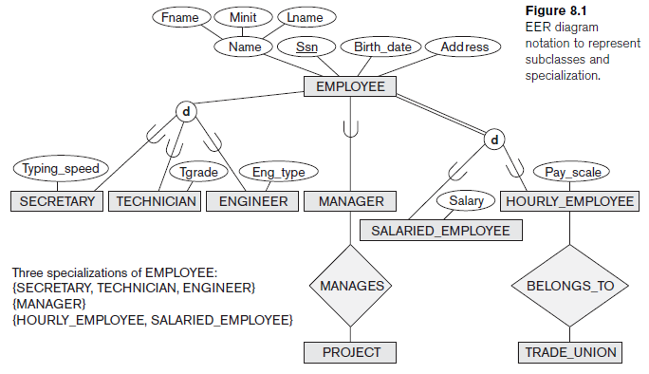
Subtype & Supertype

Slide 7
Subtype & Supertype
The set of entities in each of the latter groupings is a subset of the entities that belong to the EMPLOYEE entity set, meaning that every entity that is a member of one of these subgroupings is also an employee.
We call each of these “subgroupings” or “subclass” or “subtype” of the EMPLOYEE entity type.
Thus, Subtypes hold all the properties of their corresponding Super-types

Slide 8
Subtype & Supertype
EMPLOYEE entity type is called the superclass or supertype for each of the employee subtypes.
Subclass member is the same as the entity in the superclass, but in a distinct specific role
When we implement a superclass/subclass relationship in DBMS, we may represent a member of the subclass as some distinct DB Object— that is, a distinct record that is related via the key attribute to its superclass entity

Slide 9
Subtype & Supertype
Entity in a subclass; must also be a member of the superclass
Subtypes hold all the properties of their corresponding Super-types
class/subclass relationship is often called an IS-A (or IS-AN) relationship
We say a SECRETARY is an EMPLOYEE, a TECHNICIAN is an EMPLOYEE, and so on

Slide 10
Subtype & Supertype
Subtype entity can be included optionally as a member of any number of subclasses.
For example, a salaried employee who is also an engineer belongs to the two subclasses ENGINEER and SALARIED_EMPLOYEE of the EMPLOYEE entity type.
However, it is not necessary that every entity in a superclass is a member of some subclass

Slide 11
Subtype & Supertype
“Type of entity” is the attributes it possesses and the relationship types it participates in
Entity in the subclass represents the same real-world entity from the superclass
It should possess values for its specific attributes and
the values of its attributes as a member of the superclass
“Type Inheritance” means that:
subclass entity inherits all attributes of it’s superclass.
subclass entity also inherits all relationships of it’s superclass

Slide 12
Specialization and Generalization

Slide 13
Specialization
Specialization is the process of defining a set of subclasses of an entity type (called the superclass )
For example, subclasses {SECRETARY,ENGINEER, TECHNICIAN} are a specialization of the superclass EMPLOYEE
distinguishing factor: job type
There can be more than one specializations of the same entity type based on different distinguishing characteristics
For example, EMPLOYEE can have subclasses {SALARIED_EMPLOYEE, HOURLY_EMPLOYEE}
distinguishing factor: method of payment

Slide 14
Specialization
The subclasses that define a specialization are attached by lines to a circle that represents the specialization, which is connected in turn to the superclass.
The subset symbol on each line connecting a subclass to the circle indicates the direction of the superclass/subclass relationship

Slide 15
Specialization
Specific attributes (or local attributes) of subclass: Attributes that apply only to entities of a particular subclass
such as TypingSpeed of SECRETARY—are attached to the rectangle representing that subclass.
Similarly, a subclass can participate in specific relationship types
such as the HOURLY_EMPLOYEE subclass participating in the BELONGS_TO relationship

Slide 16
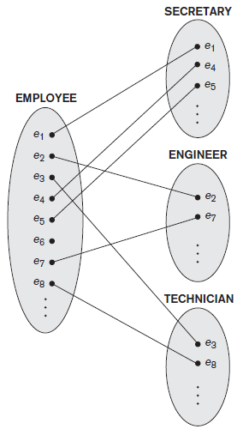
Specialization
superclass/subclass relationship (such as EMPLOYEE/ SECRETARY etc.) resembles 1:1 relationship

Slide 17
Specialization
Two reasons for including specializations in a data model:
Few attributes may apply to some but not all entities of the superclass
Few relationship types may only be participated in by few subclasses and not all. For example, HOURLY_EMPLOYEES can belong to a Trade Union
Summary of specialization process:
Define a set of subclasses of an entity type
Establish additional specific attributes with each subclass
Establish additional specific relationship types between each subclass and other entity types or other subclasses

Slide 18
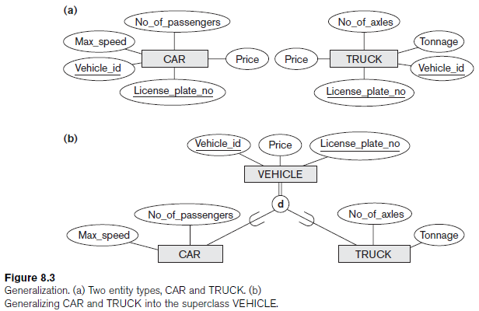
Generalization
Generalization refers to the process of defining a generalized entity type from the given entity types
Generalization is functionally the inverse of Specialization process
For Example; {CAR, TRUCK} as a specialization of VEHICLE
EMPLOYEE is a generalization of SECRETARY, TECHNICIAN, and ENGINEER etc.

Slide 19
Constraints & Characteristics of Specialization & Generalization Hierarchies

Slide 20
Constraints on Specialization & Generalization
Specialization may consist of a single subclass. In this case, circle notation is not used…
In some specializations; we determine which entities will become members of each subclass by placing condition on some attribute(s) of Superclass
such Subclasses are called predicate-defined (or condition-defined) subclasses
For example, if the EMPLOYEE entity type has an attribute Job_Type, we can specify the condition of membership in the SECRETARY subclass by the condition (Job_type = ‘Secretary’), which we call the defining predicate of the subclass.
We display a predicate-defined subclass by writing the predicate condition next to the line that connects the subclass to the specialization circle.

Slide 21
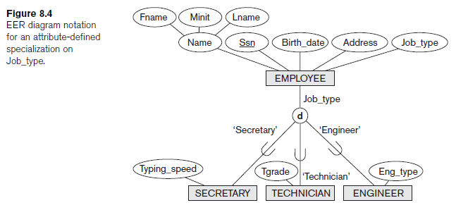
Constraints on Specialization & Generalization
If all subclasses in a specialization have their membership condition on same attribute of the superclass, the specialization is called “attribute-defined specialization”
Such attribute is called “discriminator” or “defining attribute” of the specialization

Slide 22
Constraints on Specialization & Generalization
In case, we do not have a condition for determining membership in subclass, the subclass is called “user-defined”
Membership in such subclass is specified individually for each entity by the user and is not done by any condition

Slide 23
Constraints on Specialization & Generalization
“disjointness” (or disjointedness) constraint specifies that the subclasses of the specialization must be disjoint
that is, entity can be a member of at most one of the subclasses of the specialization
Attribute-Defined Specialization automatically implies disjointness constraint
d in the circle stands for “disjoint”
d notation also applies to user-defined subclasses of a specialization that are disjoint. For Example, {HOURLY_EMPLOYEE, SALARIED_EMPLOYEE}

Slide 24
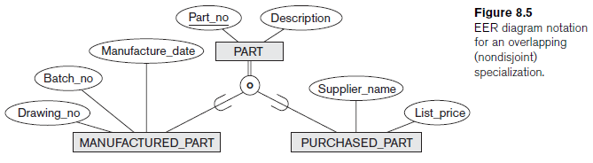
Constraints on Specialization & Generalization
If the subclasses are not constrained to be disjoint, their sets of entities might be overlapping
It means, the same (real-world) entity may be a member of more than one subclass of the specialization.
It is represented by placing an o in the circle
“Completeness” (or totalness) is another constraint which may be total or partial

Slide 25
Constraints on Specialization & Generalization
“Total specialization” constraint specifies that every entity in the superclass must be a member of at least one subclass in the specialization
For example, if every EMPLOYEE must be either an HOURLY_EMPLOYEE or a SALARIED_EMPLOYEE, then it is a total specialization of EMPLOYEE.
It is shown in EER diagrams by a double line to connect the superclass to the circle
Single line is used to display “partial specialization” which allows entity not to belong to any of the subclasses.
For example, if some EMPLOYEE entities do not belong to any of the subclasses {SECRETARY, ENGINEER, TECHNICIAN} then that specialization is partial

Slide 26
Constraints on Specialization & Generalization
“disjointness” and “completeness” constraints are independent
Hence, following are the four possible constraints on specialization:
Disjoint, total
Disjoint, partial
Overlapping, total
Overlapping, partial
Correct constraint can be determined from the real-world meaning of the scenario

Slide 27
Constraints on Specialization & Generalization
Mostly, superclasses identified through generalization process are total, because the superclass is derived from subclasses and hence contains only the entities that are in the subclasses
Following are the rules applicable to insertion and deletion of specialization (and generalization):
Deleting an entity from a superclass implies that it is automatically deleted from all the subclasses to which it belongs.
Inserting an entity in a superclass implies that the entity is mandatorily inserted in all predicate-defined (or attribute-defined) subclasses for which the entity satisfies the defining predicate.
Inserting an entity in a superclass of a total specialization implies that the entity is mandatorily inserted in at least one of the subclasses of the specialization.

Slide 28
Hierarchies & Lattices
Subclass may have further subclasses forming hierarchy or lattice of specializations
For example, ENGINEER is a subclass of EMPLOYEE and is also a superclass of ENGR_MANAGER; this represents the real-world constraint that every engineering manager is required to be an engineer
In Specialization hierarchy every subclass has only one parent resulting in tree structure or strict hierarchy
In Specialization lattice, a subclass can be a subclass in more than one class/subclass relationship

Slide 29
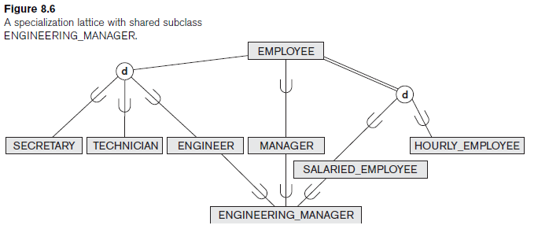
Hierarchies & Lattices

Slide 30
Hierarchies & Lattices
Consider the requirements for UNIVERSITY DB:
We have three types of persons: employees, alumni and students
Person can belong to one, two, or all three of these types
Person info: name, SSN, sex, address, and birth date
Employee has salary and there are three types of employees: Faculty, Staff and Student Assistants
Each employee belongs to exactly one of these types
For each alumnus, record of degree(s) that he or she earned at the university is kept
name of the degree, year granted, the major department

Slide 31
Hierarchies & Lattices
Each faculty has rank
Each staff member has staff position
Student assistants are classified further as either Research Assistants or Teaching Assistants
Percentage of time they work in is recorded in DB
Research assistants have their research project stored
Teaching assistants have the current course they work on

Slide 32
Hierarchies & Lattices
Each student has a major department
Students are classified as Graduate or Undergraduate
specific attributes degree program (M.S., Ph.D., M.B.A., and so on) are for graduate students
class (freshman, sophomore, and so on) for undergraduates

Slide 33
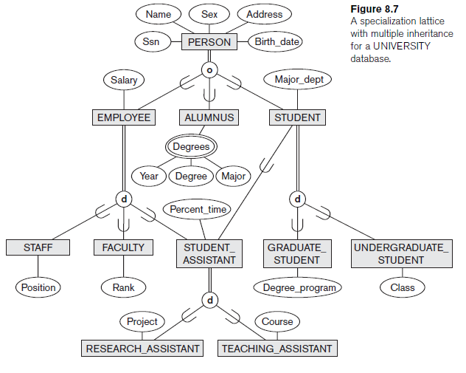
Hierarchies & Lattices
Consider the shared subclass STUDENT_ASSISTANT which inherits attributes from both EMPLOYEE and STUDENT. Here, both EMPLOYEE and STUDENT inherit the same attributes from PERSON. The rule states that if an attribute (or relationship) originating in the same superclass (PERSON) is inherited more than once via different paths (EMPLOYEE and STUDENT) in the lattice, then it should be included only once in the shared subclass (STUDENT_ASSISTANT).Hence, the attributes of PERSON are inherited only once in the STUDENT_ASSISTANT subclass

Slide 34
Hierarchies & Lattices
Subclass inherits the attributes of its direct superclass, but also of all its predecessor superclasses all the way to the root
leaf node is a class that has no subclasses of its own
Entity may exist in several leaf nodes of the hierarchy
Subclass with more than one superclass is called a shared subclass
For Example ENGINEERING_MANAGER
This appears in multiple inheritance, where the shared subclass ENGINEERING_MANAGER directly inherits attributes and relationships from multiple classes
Existence of at least one shared subclass leads to a lattice (and hence to multiple inheritance)
If no shared subclasses existed, we would have a hierarchy rather than a lattice and only single inheritance would exist

Slide 35
Hierarchies & Lattices
There are some models and languages that are limited to singleinheritance and do not allow multiple inheritance (shared subclasses)
Some models and languages do not allow an entity to have multiple types, thus entity can be a member of only one leaf class
means the class is further restricted to be a leaf node in the hierarchy or lattice
Hence it is necessary to create additional subclasses as leaf nodes to cover all possible combinations
For example, in the overlapping specialization of PERSON into {EMPLOYEE, ALUMNUS, STUDENT} (or {E, A, S} for short), it would be necessary to create seven subclasses of PERSON in order to cover all possible types of entities: E, A, S, E_A, E_S, A_S, and E_A_S

Slide 36
Specialization & Generalization in Refining Conceptual Schemas
In specialization process, we take one Entity Type and then define subclasses for it
In above example we first specify an entity type PERSON for a university database Then we discover that three types: Employees, Alumni and Students
We choose the overlapping constraint, because person may belong to more than one subclasses

Slide 37
Specialization & Generalization in Refining Conceptual Schemas
EMPLOYEE is specialized into {STAFF, FACULTY, STUDENT_ASSISTANT}
STUDENT is specialized into {GRADUATE_STUDENT, UNDERGRADUATE_STUDENT}
STUDENT_ASSISTANT is specialized into {RESEARCH_ASSISTANT, TEACHING_ASSISTANT}
This successive specialization corresponds to top-down conceptual refinement process during conceptual schema design
This is a hierarchy
but STUDENT_ASSISTANT is a shared subclass
since it is also a subclass of STUDENT hence it leads to a lattice

Slide 38
Specialization & Generalization in Refining Conceptual Schemas
Generalization is to arrive at the same hierarchy or lattice from the other direction
Thus it leads to bottom-up conceptual synthesis
In this case, designers first discover entity types such as STAFF, FACULTY, ALUMNUS, GRADUATE_STUDENT, UNDERGRADUATE_STUDENT, RESEARCH_ASSISTANT, TEACHING_ASSISTANT,

Slide 39
Specialization & Generalization in Refining Conceptual Schemas
then they generalize {GRADUATE_STUDENT, UNDERGRADUATE_STUDENT} into STUDENT;
Further {RESEARCH_ASSISTANT, TEACHING_ASSISTANT} are generalized into STUDENT_ASSISTANT
{STAFF, FACULTY, STUDENT_ASSISTANT} are generalized into EMPLOYEE
{EMPLOYEE, ALUMNUS, STUDENT} are generalized into PERSON

Slide 40
Specialization & Generalization in Refining Conceptual Schemas
Hierarchies or lattices resulting from either process are identical
For practical reasons neither generalization process nor specialization process is followed but a combination of the two processes is employed
New classes are continually incorporated into a hierarchy or lattice as the design evolve…

Slide 41
Modeling of UNION Types Using Categories

Slide 42
UNION Types Using Categories
It is sometimes necessary to represent a single superclass/subclass relationship with more than one superclasses each representing different Entity Types
In such cases; subclass will represent a collection of objects that is a subset of the UNION of distinct entity types;
such a subclass is called a union type or a category

Slide 43
UNION Types Using Categories
Say we have three entity types: PERSON, BANK and COMPANY
In Motor Vehicle Registration DB, an “Owner” of a vehicle can be a person, a bank (holding a lien on a vehicle) or a company
Hence, Category (union type) OWNER is a subclass of UNION of the three entity sets of COMPANY, BANK, and PERSON
Superclasses COMPANY, BANK and PERSON are connected to the circle with the ∪ symbol which stands for the set union operation
An arc with the subset symbol connects the circle to the (subclass) OWNER category

Slide 44
UNION Types Using Categories
If a defining predicate is needed, it is displayed next to the line from the superclass to which the predicate applies
Hence, we have two categories:
OWNER, which is a subclass of the union of PERSON, BANK, and COMPANY
REGISTERED_VEHICLE, which is a subclass of the union of CAR and TRUCK

Slide 45
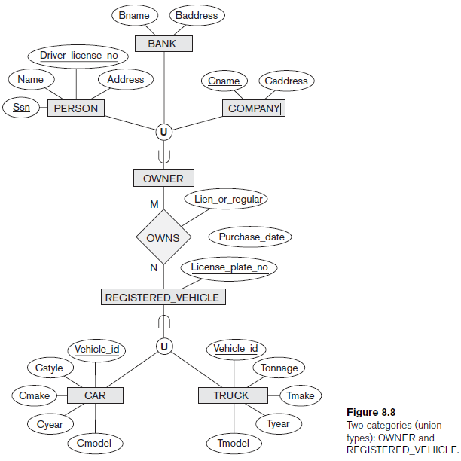
UNION Types Using Categories

Slide 46
UNION Types Using Categories
Category has two or more superclasses that may represent distinct entity types
superclass/subclass relationships always have a single superclass
Let us compare a category, such as OWNER with the ENGINEERING_MANAGER shared subclass

Slide 47
UNION Types Using Categories
ENGINEERING_MANAGER is a subclass of each of the three superclasses ENGINEER, MANAGER, and SALARIED_EMPLOYEE
so an entity that is a member of ENGINEERING_MANAGER must exist in all three Entity Types
Hence, the constraint that an engineering manager must be an ENGINEER, a MANAGER, and a SALARIED_EMPLOYEE
Thus, ENGINEERING_MANAGER is a subset of the intersection of the three SuperClasses (sets of entities)
On the other hand, a category is a subset of the union of its superclasses
Hence, an entity that is a member of OWNER must exist in only one of the super classes
This represents the constraint that an OWNER can only be one of either COMPANY, a BANK or a PERSON

Slide 48
UNION Types Using Categories
Attribute inheritance works more selectively in the case of categories.
OWNER entity inherits the attributes of a COMPANY, a PERSON, or a BANK, depending on the superclass to which the entity belongs
On the other, hand, a shared subclass such as ENGINEERING_MANAGER inherits all the attributes of its superclasses SALARIED_EMPLOYEE, ENGINEER, and MANAGER.

Slide 49
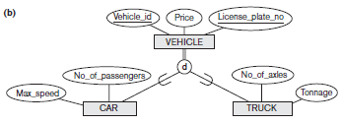
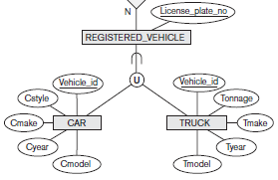
UNION Types Using Categories
It is interesting to note the difference between the category REGISTERED_VEHICLE and generalized superclass VEHICLE
In Figure (b), every car and every truck is a VEHICLE; but REGISTERED_VEHICLE category includes some cars and some trucks but not necessarily all of them (for example, some cars or trucks may not be registered)
Specialization or generalization which is partial such as in (b) would not prevent VEHICLE from containing other types of entities, such as motorcycles
However, a category such as REGISTERED_VEHICLE implies that only cars and trucks, but not other types of entities, can be members of REGISTERED_VEHICLE

Slide 50
UNION Types Using Categories
A category can be total or partial
Total category holds the union of all entities in its superclasses, whereas a partial category can hold a subset of the union
A total category is represented diagrammatically by a double line connecting the category and
the circle, whereas a partial category is indicated by a single line
The superclasses of a category may have different key attributes, as demonstrated by the OWNER category or they may have the same key attribute, as demonstrated by the REGISTERED_VEHICLE category
Notice that if a category is total (not partial), it may be represented alternatively as a total specialization (or a total generalization). In this case, the choice of which representation to use is subjective

Slide 51
UNION Types Using Categories
If the two classes represent the same type of entities and share numerous attributes, including the same key attributes, specialization/generalization is preferred; otherwise, categorization (union type) is more appropriate.
It is important to note that some modeling methodologies do not have union types…

Slide 52
Q & A
?

Slide 53
Thank You

