Slide 1

Week 9 Part - I Relational Database Design
Uzaira Saeed uzaira.saeed@google.com

Slide 2
Road Map
Relational Database Design Using ER-to-Relational Mapping Algorithm
Last points on Mapping for ER Model Constructs

Slide 3
Relational Database Design Using ER-to-Relational Mapping

Slide 4
ER-to-Relational Mapping Algorithm
Step 1: Mapping of Regular Entity Types
For each regular (strong) entity type E in the ER schema, create a relation R that includes all the simple attributes of E
Choose one of the key attributes of E as the primary key for R
If multiple keys were identified for E during the conceptual design:
Information describing the attributes that form the key is kept to specify other (unique) keys of relation R
The information is also useful for indexing purposes

Slide 5
ER-to-Relational Mapping Algorithm
Step 1: Mapping of Regular Entity Types
The foreign key and relationship attributes, if any, are not included
Relations created from the mapping of entity types are called Entity Relations
each tuple represents an Entity Instance

Slide 6
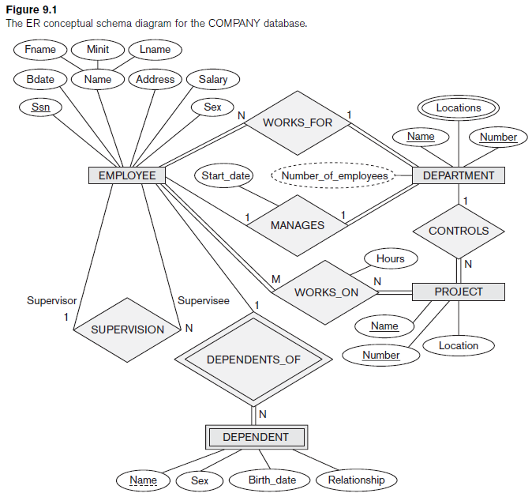
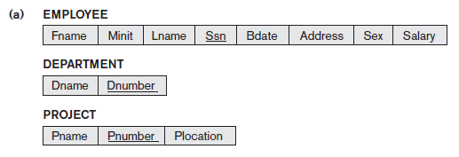
ER-to-Relational Mapping Algorithm

Slide 7
ER-to-Relational Mapping Algorithm
Step 2: Mapping of Weak Entity Types
For each weak entity type W in the ER-schema with owner entity type E, make relation R and include all simple and composite attributes
Include foreign key attributes of R to reflect the identifying relationship type of W

Slide 8
ER-to-Relational Mapping Algorithm
Step 2: Mapping of Weak Entity Types
For each weak entity type W in the ER-schema with owner entity type E, make relation R and include all simple and composite attributes
Include foreign key attributes of R to reflect the identifying relationship type of W
The primary key of W is the combination of the primary key(s) of the owner(s) and the partial key of the weak entity type W, if any

Slide 9
ER-to-Relational Mapping Algorithm
Step 2: Mapping of Weak Entity Types
If there is a weak entity type W2 whose owner is also a weak entity type W1, then W1 should be mapped before W2 so as to determine its primary key first
We include the primary key Ssn of the EMPLOYEE relation—which corresponds to the owner entity type—as a foreign key attribute of DEPENDENT; we rename it Essn, although this is not necessary

Slide 10

ER-to-Relational Mapping Algorithm

Slide 11
ER-to-Relational Mapping Algorithm
Step 3: Mapping of Binary 1:1 Relationship Types
For each binary 1:1 relationship type R in the ER schema, identify the relations S and T that correspond to the entity types participating in R
There are three possible approaches:
the foreign key approach
the merged relationship approach
the cross reference or relationship relation approach

Slide 12
ER-to-Relational Mapping Algorithm
Step 3: Mapping of Binary 1:1 Relationship Types
The Foreign Key Approach
Include as a foreign key in S the primary key of T
It’s better to choose an entity type with total participation in R in the role of S
Include all the simple and composite attributes of the 1:1 relationship type R as attributes of S

Slide 13
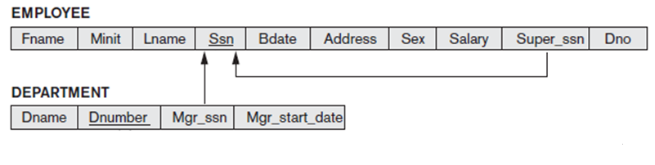
ER-to-Relational Mapping Algorithm
Step 3: Mapping of Binary 1:1 Relationship Types
The Foreign Key Approach
In our example, we map the 1:1 relationship type MANAGES by choosing the participating entity type DEPARTMENT to serve in the role of S
We include the primary key of the EMPLOYEE relation as foreign key in the DEPARTMENT relation and rename it Mgr_ssn
We also include the simple attribute Start_date of the MANAGES relationship type in the DEPARTMENT relation and rename it Mgr_start_date

Slide 14
ER-to-Relational Mapping Algorithm
Step 3: Mapping of Binary 1:1 Relationship Types
The Foreign Key Approach … alternate approach
It is also possible to include the primary key of S as a foreign key in T instead means having foreign key attribute, Department_managed in the EMPLOYEE table
but it will have a NULL value for employee tuples who do not manage a department
If only 2 percent of employees manage a department, then 98 percent of the foreign keys would be NULL in this case

Slide 15
ER-to-Relational Mapping Algorithm
Step 3: Mapping of Binary 1:1 Relationship Types
The Foreign Key Approach … alternate approach
The last possibility is to have foreign keys in both relations S and T redundantly
this will create redundancy and incurs a penalty for consistency maintenance

Slide 16
ER-to-Relational Mapping Algorithm
Step 3: Mapping of Binary 1:1 Relationship Types
The Merged Relationship Approach
An alternative mapping of a 1:1 relationship type is to merge the two entity types and the relationship into a single relation
It’s possible when both participations are total, as this would indicate that the two tables will have the exactly same number of tuples at all times

Slide 17
ER-to-Relational Mapping Algorithm
Step 3: Mapping of Binary 1:1 Relationship Types
Cross-reference or relationship relation Approach
The third option is to set up a third relation R for the purpose of cross-referencing the primary keys of the two relations S and T representing the entity types
The relation R is called a relationship relation (or sometimes a lookup table) since each tuple in R represents a relationship instance that relates one tuple from S with one tuple from T
relation R will include the primary key attributes of S and T as foreign keys to S and T
primary key of R will be one of the two foreign keys, and the other foreign key will be a unique key of R
Drawback: is having an extra relation, and requiring an extra join operation when combining related tuples from the two tables

Slide 18
ER-to-Relational Mapping Algorithm
Step 4: Mapping of Binary 1:N Relationship Types
For each binary+1:N relationship type R
relation S represents the participating entity type at the N-side of the relationship type
Include as foreign key in S the primary key of the relation T that represents the other entity type participating in R
we do this because each entity instance on the N-side is related to at most one entity instance on the 1-side of the relationship type
Include any simple attributes (or simple components of composite attributes) of the 1:N relationship type as attributes of S

Slide 19
ER-to-Relational Mapping Algorithm
Step 4: Mapping of Binary 1:N Relationship Types
In our example, we now map the 1:N relationship types WORKS_FOR, CONTROLS, and SUPERVISION
In WORKS_FOR we include the primary key Dnumber of the DEPARTMENT relation as foreign key in the EMPLOYEE relation and call it Dno
For SUPERVISION we include the primary key of the EMPLOYEE relation as foreign key in the EMPLOYEE relation itself—because the relationship is recursive— and call it Super_ssn
The CONTROLS relationship is mapped to the foreign key attribute Dnum of PROJECT, which references the primary key Dnumber of the DEPARTMENT relation

Slide 20
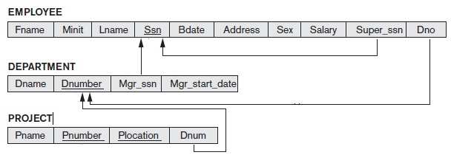
ER-to-Relational Mapping Algorithm
Step 4: Mapping of Binary 1:N Relationship Types

Slide 21
ER-to-Relational Mapping Algorithm
Step 4: Mapping of Binary 1:N – Alternative Approach
The alternative approach is to use the relationship relation (cross-reference) option
as in the third option for binary 1:1 relationships. We create a separate relation R
whose attributes are the primary keys of S and T, which will also be foreign keys to S and T
The primary key of R is the same as the primary key of S
This option will lead to excessive NULL values in the foreign key for most of the tuples

Slide 22
ER-to-Relational Mapping Algorithm
Step 5: Mapping of Binary M:N Relationship Types
For each binary M:N relationship type R, create a new relation S_T to represent R
Include as foreign key attributes in S_T the primary keys of the relations that represent the participating entity types
their combination will form the primary key of S_T
Also include any simple attributes of the M:N relationship type as attributes of S_T
Notice that we cannot represent M:N relationship type by a single foreign key attribute in one of the participating relations because of the M:N cardinality ratio;
we must create a separate relationship relation S_T

Slide 23
ER-to-Relational Mapping Algorithm
Step 5: Mapping of Binary M:N Relationship Types
In our example, we map the M:N relationship type by creating the relation WORKS_ON
We include the primary keys of the PROJECT and EMPLOYEE relations as foreign keys in WORKS_ON and rename them Pno and Essn, respectively
We also include an attribute Hours in WORKS_ON to represent the Hours attribute of the relationship type
Primary key of the WORKS_ON relation is the combination of the foreign key attributes {Essn, Pno}.

Slide 24

ER-to-Relational Mapping Algorithm
Step 5: Mapping of Binary M:N Relationship Types

Slide 25
ER-to-Relational Mapping Algorithm
Step 6: Mapping of Multivalued Attributes
For each multivalued attribute A, create a new relation R
R will include
an attribute corresponding to A
the primary key attribute K—as a foreign key in R—of the relation that represents the entity type or relationship type that has A as a multivalued attribute
The primary key of R is the combination of A and K

Slide 26

ER-to-Relational Mapping Algorithm
Step 6: Mapping of Multivalued Attributes
In our example, Department Locations is a multivalued attribute
Hence, we create relation DEPT_LOCATIONS
The attribute Dlocation represents the multivalued attribute LOCATIONS of DEPARTMENT
Dnumber—as foreign key—represents the primary key of DEPARTMENT relation
Primary key of DEPT_LOCATIONS is the combination of {Dnumber, Dlocation}
Thus a separate tuple will exist in DEPT_LOCATIONS for each location that a department may attain

Slide 27
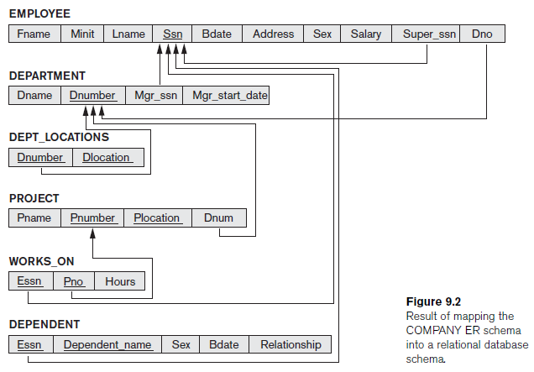
ER-to-Relational Mapping Algorithm

Slide 28
ER-to-Relational Mapping Algorithm
Step 7: Mapping of N-ary Relationship Types
For each n-ary relationship type R, where n > 2, create a new relation S to represent R
Include as foreign key attributes in S the primary keys of the relations that represent the participating entity types
Also include any simple attributes of the n-ary relationship type as attributes of S
The primary key of S is usually a combination of all the foreign keys that reference the relations representing the participating entity types
However, if the cardinality constraints on any of the entity types E participating in R is 1, then the primary key of S should not include the foreign key attribute that references the relation E corresponding to E

Slide 29
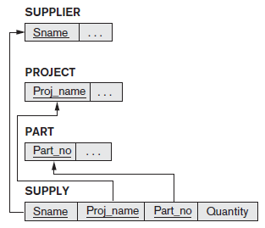
ER-to-Relational Mapping Algorithm
Step 7: Mapping of N-ary Relationship Types
For example, consider the relationship type SUPPLY
This can be mapped to the relation SUPPLY The primary key is the combination of the three foreign keys {Sname, Part_no, Proj_name}

Slide 30
Last points on Mapping for ER Model Constructs

Slide 31
Summary of Mapping
in a relational schema, relationship types are not represented explicitly
instead, they are represented by having two attributes A and B, one a primary key and the other a foreign key (over the same domain) included in two relations S and T
Two tuples in S and T are related when they have the same value for A and B
By using the EQUIJOIN operation (or NATURAL JOIN if the two join attributes have the same name) over S.A and T.B, we can combine all pairs of related tuples from S and T

Slide 32
Summary of Mapping
When a binary 1:1 or 1:N relationship type is involved, a single join operation is usually needed
For a binary M:N relationship type, two join operations are needed
whereas for n-ary relationship types, n joins are needed to fully materialize the relationship instances

Slide 33
Summary of Mapping
For example, to form a relation that includes the employee name, project name, and hours that the employee works on each project, we need to connect each EMPLOYEE tuple to the related PROJECT tuples via the WORKS_ON
Hence, we must apply:
EQUIJOIN operation to the EMPLOYEE and WORKS_ON relations
join condition Ssn = Essn, and then
apply another EQUIJOIN operation to the resulting relation and the PROJECT relation
the join condition for the next relation will be Pno = Pnumber.
Hence, when multiple relationships need to be traversed, numerous join operations must be specified

Slide 34
Summary of Mapping
relational database user must always be aware of the foreign key attributes in order to use them correctly in combining related tuples from two or more relations
This is sometimes considered to be a drawback of the relational data model, because the foreign key/primary key correspondences are not always obvious upon inspection of relational schemas

Slide 35
Summary of Mapping
If an EQUIJOIN is performed among attributes of two relations that do not represent a foreign key/primary key relationship, the result can often be meaningless and may lead to spurious data
For example, the reader can try joining the PROJECT and DEPT_LOCATIONS relations on the condition Dlocation = Plocation and examine the result

Slide 36
Summary of Mapping
In the relational schema we create a separate relation for each multivalued attribute
For a particular entity with a set of values for the multivalued attribute, the key attribute value of the entity is repeated once for each value of the multivalued attribute in a separate tuple because the basic relational model does not allow multiple values (a list, or a set of values) for an attribute in a single tuple
For example, because department 5 has three locations, three tuples exist in the DEPT_LOCATIONS relation; each tuple specifies one of the locations
Thus, we apply EQUIJOIN to DEPT_LOCATIONS and DEPARTMENT on the Dnumber attribute to get the values of all locations along with other DEPARTMENT attributes
In the resulting relation, the values of the other DEPARTMENT attributes are repeated in separate tuples for every location that a department has

Slide 37
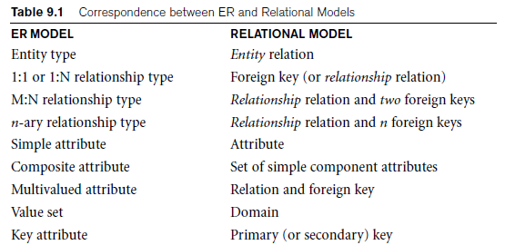
Summary of Mapping

Slide 38
Q & A
?

Slide 39
Thank You

