Slide 1

Week 3 DB System Concepts & Architecture
Uzaira Saeed uzaira.saeed@google.com

Slide 2
Road Map
Relational Model Concepts
Relational Model Constraints & DB Schema
Operations
Transactions & Dealing with Constraint Violations
Codd's 12 rules for defining Relational DB

Slide 3
Relational Model Concepts

Slide 4
Relation
Database is considered as a collection of relations
Relation is a “table of values”. In other words, it is a flat file of records…
A relation may be regarded as a set of tuples (rows).
relation may alternately be thought of as a set of attributes (columns).

Slide 5
Relation… Tuple
Row is called a “tuple”
Each row represents a fact that corresponds to a real-world entity.
Each row has a value of an item or set of items that uniquely identifies that row in the table.
Sometimes row-ids or sequential numbers are assigned to identify the rows in the table.

Slide 6
Relation… Attribute
Column Header is called “attribute”
Table is called “relation”
All values of a column attain the same data type
Data types describing the “types of value” for a column is called “domain of possible vales”

Slide 7
Domain
Domain “D” is a set of atomic values…
Examples
NIC Number: should be of format XXXXX-XXXXXXX-X where X is a digit
Employee Ages: digits in the rage of 15 to 80
Data Type must be specified for each domain

Slide 8
Relation Schema & Domain
Relation Schema R(A₁, A₂, …, A_{n}) is composed of:
relation R and
set of attributes A₁, A₂, …, A_{n}
Each attribute A_{i} specifies some domain D within the relation R
D is the domain of A_{i} and is given by dom(A_{i})
Relational Schema is used to describe relation “R”
“Degree” or “Arity” of a Relation is the number of attributes n of it’s relation schema.

Slide 9
Relation Schema & Domain
Example: STUDENT is a relation of degree 7:
Roll No, Name, Father Name, NIC, Home Add, Residence Ph.#, Cell No.
Using data types, it is written as:
(Roll No: string, Name: string, Father Name: string, NIC: string, Home Add: string, Residence Ph.#: integer, Cell No.: integer)
Order of the attributes is of importance for referring them

Slide 10
Relation Schema & Domain
“Relation State” r of a Relation Schema R(A₁, A₂, …, A_{n}) is denoted by r(R)
r(R) is a set of n-tuples r={t₁, t₂, …, t_{m}}
Each “n-tuple” is an ordered list of “n” values t=< v₁, v₂, …, v_{n} >
Each value v_{i} ; 1<=i<=n is an is an element of domain A_{i} or is a special value NULL
i^{th} value of tuple t, which corresponds to the attribute A_{i}, is denoted by t[A_{i}] or t. A_{i} or t[i]; if we use positional notation

Slide 11
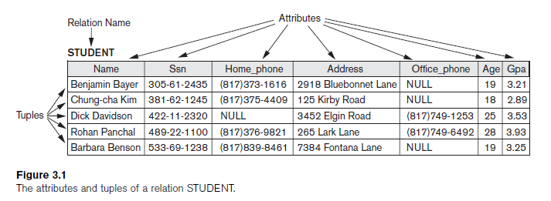
Relation Schema & Domain
Schema R is also called “Relation Intension”
Relation State r(R) is also called “Relation Extension”

Slide 12
Relation Schema & Domain
In set theory, Relation State r(R) is a mathematical relation of degree “n” on domains dom(A₁), dom( A₂), …, dom(A_{n}) which is a subset of the Cartesian Product that define R:
r(R) ⊂ (dom(A₁)X dom( A₂)X …X dom(A_{n}))
Cartesian product defines all possible combination values from the underlying domains…

Slide 13
Relation Schema & Domain
Let S1 = {0,1}
Let S2 = {a,b,c}
Let R ⊂ S1 X S2
Then for example: r(R) = {<0,a> , <0,b> , <1,c> }

Slide 14
Relation Schema & Domain
Cardinality in domain D is given by |D|
|dom(A₁)| X |dom( A₂)| X …X |dom(A_{n})|
while all the given domains are finite….
This represents the total number of possible tuples that can ever exist in any relation state r(R)
“Current Relation State” reflects the valid tuples that represent a particular state of the real world
Several attributes can have the same domain e.g. home phone, office phone and cell phone etc…

Slide 15
Definition Summary
INFORMAL TERMS | FORMAL TERMS
Table | Relation
Column | Attribute
Row | Tuple
Values in a column | Domain
Table Definition | Schema of a Relation
Populated Table | Extension

Slide 16
Characteristics of Relations
Ordering of tuples in a relation r(R): The tuples are not considered to be ordered, even though they appear to be in the tabular form.
Ordering of attributes in a relation schema R (and of values within each tuple): We will consider the attributes in R(A₁, A₂, ..., A_{n}) and the values in t=<v₁, v₂, ..., v_{n}> to be ordered .
Values in a tuple: All values are considered atomic (indivisible). A special null value is used to represent values that are unknown or inapplicable to certain tuples.

Slide 17
Characteristics of Relations
Interpretation (meaning) of a relation r(R)
Relational Schema is considered as a type of “assertion”
Example: Assert the fact that there is a student in STUDENT relation with name “Asif Khan”…
Hence each tuple is a “fact” or an instance of the “assertion”
Relational Schema is also a “predicate”
Column values of each tuple satisfy the “predicate”
“Closed World Assumption” states that the only true facts in the Universe are those which are present within the extension of the Relation…

Slide 18
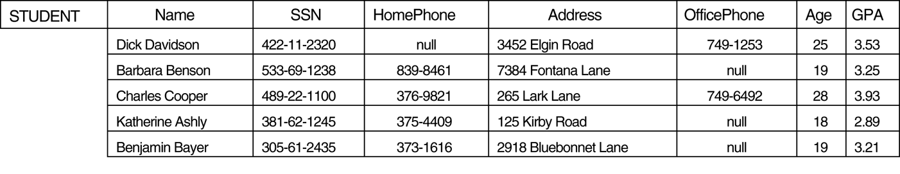
Relational Model Notation
We refer to component values of a tuple t by t[A_{i}] = v_{i} (the value of attribute A_{i} for tuple t).

Slide 19
Relational Model Constraints and Relational Database Schemas

Slide 20
Database Constraints
Constraints are conditions that must hold on all valid relation instances.
There are three main types of constraints
Inherent Model-Based Constraints
Schema-Based Constraints
Application-Based or Semantic Constraints
Notes:
20

Slide 21
Types of Constraints
Inherent or Model-Based Constraints
Also called “Implicit Constraints”
Constraints that are inherent in the Data Model
Example:
Relation cannot have duplicate tuples
Notes:
21

Slide 22
Types of Constraints
Schema-Based Constraints
Also called “Explicit Constraints”
Constraints that are explicitly given in Schema by specifying them explicitly through DDL
Types:
Domain Constraints
Key Constraints
Constraints on NULLs
Entity Integrity Constraints
Referential Integrity Constraints
Notes:
22

Slide 23
Types of Constraints
Application-Based or Semantic Constraints
Constraints that cannot be directly expressed in Schema of Data Model and thus has to be enforced through the application program
Also called “Business Rules”
These constraints relate to behavior of attributes and are checked within the application program because it is difficult enforcing them else where
Notes:
23

Slide 24
Data Dependency
Another category of Constraints
Tests the goodness of Design of Relational DB
Two Types
Functional Dependency
Multivalued Dependency
Notes:
24
Inaccurate Estimate
Ineffective Control
Insufficient Tracking
Requirements not fulfilled

Slide 25
Domain Constraints
Constraints that specify that within a tuple the attribute values must be Atomic and must belong to domain dom(A)
Notes:
25
Inaccurate Estimate
Ineffective Control
Insufficient Tracking
Requirements not fulfilled

Slide 26
Key Constraints & Constraints on NULLs
All tuples within a relation are distinct
Means that no two tuples can have the same combination of values for all their attributes
For each relation, we keep a subset of attributes that have unique combination of values for all tuples in Relation State r(R)
We take such set of attributes as SK
Then for any two distinct tuples t1 & t2; t1[SK] ≠ t2[SK]
Such set of attributes SK is called “Super Key” and must specify a Uniqueness Constraint
Ever relation must have at least 1 default Super Key
Notes:
26
Inaccurate Estimate
Ineffective Control
Insufficient Tracking
Requirements not fulfilled

Slide 27
Key Constraints & Constraints on NULLs
Key of R: A "minimal" Superkey K; such that removal of any attribute from K results in a set of attributes that is not a superkey.
Must hold Uniqueness Constraint
It is minimal…
Example: The CAR relation schema:
CAR(State, Reg#, SerialNo, Make, Model, Year)
has two superkeys SK1 = {State, Reg#}, SK2 = {SerialNo} {SerialNo, Make} is a superkey but not a key.
Notes:
27
Inaccurate Estimate
Ineffective Control
Insufficient Tracking
Requirements not fulfilled

Slide 28
Key Constraints & Constraints on NULLs
Having Keys in a relation is the property of Relational Schema
A Relation can have multiple keys.
If so, each key is called “candidate key”
If a relation has several candidate keys, one is chosen to be the “Primary Key”. The primary key attributes are underlined….
Notes:
28
Inaccurate Estimate
Ineffective Control
Insufficient Tracking
Requirements not fulfilled

Slide 29
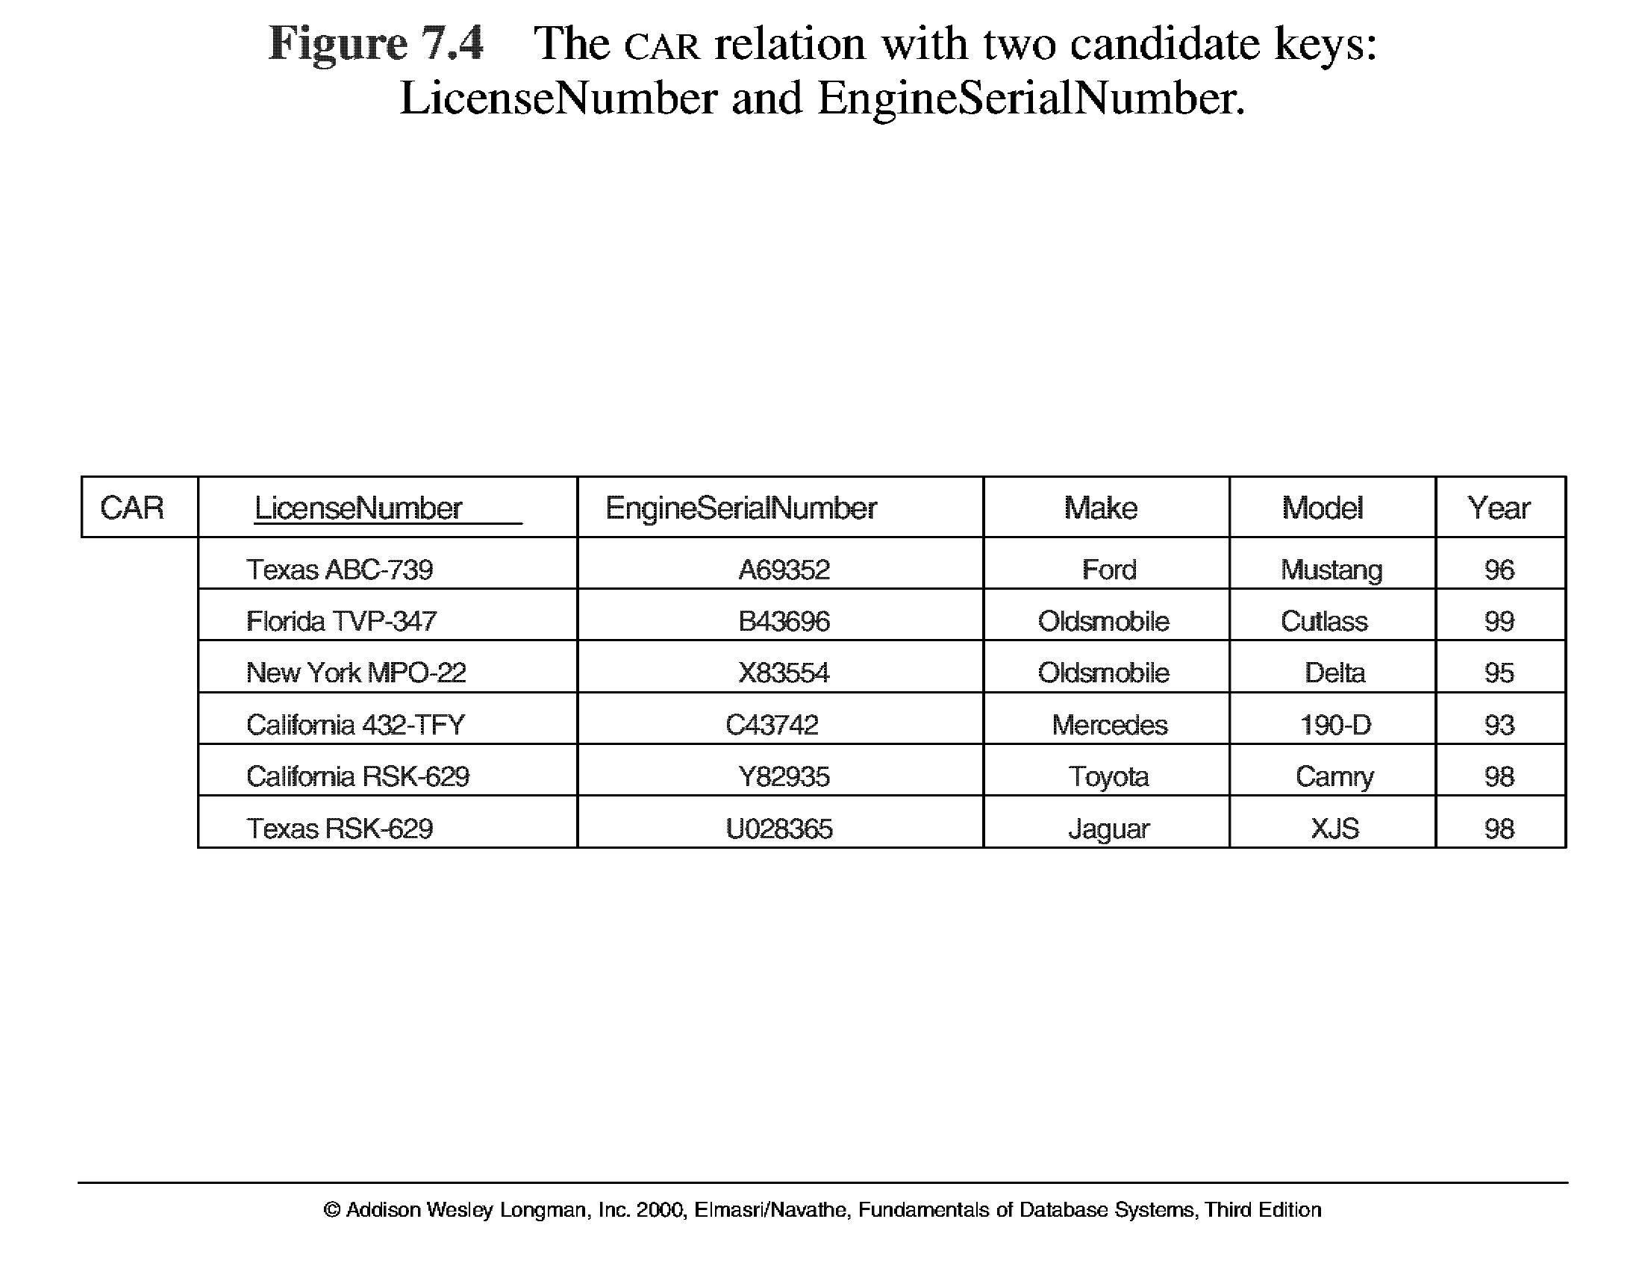
Key Constraints & Constraints on NULLs
Key Constraints & Constraints on NULLs
Notes:
29
Inaccurate Estimate
Ineffective Control
Insufficient Tracking
Requirements not fulfilled

Slide 30
Relational DB Schema
A set S of relation schemas that belong to the same database S = {R₁, R₂, ..., R_{n}} and a set of Integrity Constraints IC.
DB states that abide by all set of Integrity Constraints ICs are called “Valid States”
Notes:
30
Inaccurate Estimate
Ineffective Control
Insufficient Tracking
Requirements not fulfilled

Slide 31
Entity Integrity Constraints
Entity Integrity Constraints
The primary key attributes PK of each relation schema R in S cannot have null values in any tuple of r(R). This is because primary key values are used to identify the individual tuples.
t[PK] ≠ null for any tuple t in r(R)
Note: Other attributes of R may be similarly constrained to disallow null values, even though they are not members of the primary key.
Notes:
31
Inaccurate Estimate
Ineffective Control
Insufficient Tracking
Requirements not fulfilled

Slide 32
Referential Integrity
A constraint involving two relations...
Used to specify a relationship among tuples in two relations: the referencing relation and the referenced relation
Tuples in the referencing relation R₁ have attributes FK (called foreign key attributes) that reference the primary key attributes PK of the referenced relation R₂.
A tuple t₁ in R₁ is said to reference a tuple t₂ in R₂ if t₁[FK] = t₂[PK].
A referential integrity constraint can be displayed in a relational database schema as a directed arc from R₁.FK to R₂.
Notes:
32
Inaccurate Estimate
Ineffective Control
Insufficient Tracking
Requirements not fulfilled

Slide 33
Referential Integrity Constraints
The value in the foreign key column(s) FK of the referencing relation R1 can be either:
a value of an existing primary key value of the corresponding primary key PK in the referenced relation R2, or..
a null.
In case (2), the FK in R1 should not be a part of its own primary key.
Notes:
33
Inaccurate Estimate
Ineffective Control
Insufficient Tracking
Requirements not fulfilled

Slide 34
Other Types of Constraints
Semantic Integrity Constraints:
based on application semantics and cannot be expressed by the model per se
E.g., “the max. no. of hours per employee for all projects he or she works on is 56 hrs per week”
A constraint specification language may have to be used to express these
SQL-99 allows triggers and ASSERTIONS to allow for some of these
Notes:
34
Inaccurate Estimate
Ineffective Control
Insufficient Tracking
Requirements not fulfilled

Slide 35
Operations, Transactions & Avoiding Constraint Violations

Slide 36
Operations in DB
Three basic operations can change some Relation State in DB:
Insert
To insert new data
Delete
To delete old data
Update (or Modify)
To change value of some attribute(s) in existing tuples
While applying these rules, Integrity Constraints on the Relational DB Schema should not be voilated
Notes:
36
Inaccurate Estimate
Ineffective Control
Insufficient Tracking
Requirements not fulfilled

Slide 37
Insert Operation
Provides a list of values for a new tuple t that is to be inserted into a Relation R
Insert can violate any of the four types of Constraints…
Domain Constraint
is violated if the given value does not belong to appropriate domain
In other words, that value is of in-appropriate data type…
Example INSERT INTO Course (CourseCode, CourseName) VALUES (CS501, 217356725);
Notes:
37
Inaccurate Estimate
Ineffective Control
Insufficient Tracking
Requirements not fulfilled

Slide 38
Insert Operation
Key Constraint
is violated if a key value given in the tuple, already exists for some other tuple in relation r(R)
Example INSERT INTO Course (CourseCode, CourseName) VALUES (CS501,‘Database Management Systems’); will fail if CS501 alread exists in DB for some other subject…
Entity Integrity Constraint
is violated if any part of Primary Key of the new tuple t is NULL
Example INSERT INTO Course (CourseCode, CourseName) VALUES (NULL,‘Database Management Systems’);
Notes:
38
Inaccurate Estimate
Ineffective Control
Insufficient Tracking
Requirements not fulfilled

Slide 39
Insert Operation
Referential Integrity Constraint
is violated if the value of Foreign Key in tuple t does not exist in the referenced relation
Example INSERT INTO STUDENT_COURSE (StudentRollNo, CourseCode) VALUES (02-1102,‘CS000’);
If the insertion violates any constraint, the whole insertion operation is rejected
Notes:
39
Inaccurate Estimate
Ineffective Control
Insufficient Tracking
Requirements not fulfilled

Slide 40
Delete Operation
Delete Operation can violate the Referential Integrity Constraint only
This occurs if the tuple being deleted is referenced by foreign keys from other tuples in DB
Example DELETE FROM Customers WHERE CustomerID=‘CUST80’;
Will give Referential Integrity violation iff the said customer have placed any orders… In other words he is being referred in ORDERS table
Notes:
40
Inaccurate Estimate
Ineffective Control
Insufficient Tracking
Requirements not fulfilled

Slide 41
Delete Operation
If Delete Operation causes violation, we have few options:
“restrict” is to reject the said deletion operation
“cascade” is to propagate the deletion by deleting tuples that reference the said tuple
“set null” or “set default” will be done for each referenced attribute. But in this case, if the referencing attribute is a part of PRIMARY KEY Entity Integrity violation will occur
Notes:
41
Inaccurate Estimate
Ineffective Control
Insufficient Tracking
Requirements not fulfilled

Slide 42
Delete Operation
When Referential Integrity Constraint is specified in DDL, DBMS allows the Designer to specify the option that will be triggered when the constraint will occur…
Notes:
42
Inaccurate Estimate
Ineffective Control
Insufficient Tracking
Requirements not fulfilled

Slide 43
Update Operation
It is necessary to specify the condition on attributed of tuples to be modified
Referential Integrity Constraint Violation
Example UPDATE Student SET StudentID =’16-1101’ WHERE StudentID =‘16-0008';
Fails because of Referential Integrity Violation as this student has already registered several courses and that data appears in STUDENT_COURSE table…
Notes:
43
Inaccurate Estimate
Ineffective Control
Insufficient Tracking
Requirements not fulfilled

Slide 44
Update Operation
Primary Key Constraint Violation
Example UPDATE Course SET CourseCode =‘CS101’ WHERE CourseName =' Database Management Systems ';
Fails because it repeats the Primary Key value that already exists for some other tuple…
Also Referential Integrity Violation Occurs as this course has already been registered by many students and that data appears in STUDENT_COURSE table…
Notes:
44
Inaccurate Estimate
Ineffective Control
Insufficient Tracking
Requirements not fulfilled

Slide 45
Update Operation
Hence, Updating an attribute which is neither a part of Primary Key nor Foreign Key causes no problem
DBMS only confirms that the new value is of correct domain…
Notes:
45
Inaccurate Estimate
Ineffective Control
Insufficient Tracking
Requirements not fulfilled

Slide 46
Transaction
“Transaction” is an executing program that includes some DB Operation
It leaves DB in some valid consistent state satisfying the specified constraints
One single Transaction includes a number of retrieval and update operations
Notes:
46
Inaccurate Estimate
Ineffective Control
Insufficient Tracking
Requirements not fulfilled

Slide 47
Transaction
Example
Retrieving amount from bank account requires:
Confirming balance amount
Checking customer validity
And finally withdrawing cash
Online Transaction Processing (OLTP) supports several hundred transactions per second
Notes:
47
Inaccurate Estimate
Ineffective Control
Insufficient Tracking
Requirements not fulfilled

Slide 48
Dr. E. F. Codd's 12 rules for Defining Relational DB

Slide 49
Defining Relational DB
No fully relational DBMS is available today…
Set of 13 rules proposed by Edgar F. Codd, a pioneer of the relational model for databases
0. Foundation Rule
A relational database management system must manage its stored data using only its relational capabilities.
1. Information Rule
All information in the database should be stored as values in a table.
Notes:
49
Inaccurate Estimate
Ineffective Control
Insufficient Tracking
Requirements not fulfilled

Slide 50
Defining Relational DB
2. Guaranteed Access Rule
All data must be accessible
Each and every atomic value (attribute value) is accessed by a combination of
table name+ primary key value+ column name.
3. Systematic Treatment of Null Values
Null values (distinct from empty character string or a string of blank characters and distinct from zero or any other number) are supported in the fully relational DBMS for representing missing information in a systematic way, independent of data type.
Notes:
50
Inaccurate Estimate
Ineffective Control
Insufficient Tracking
Requirements not fulfilled

Slide 51
Defining Relational DB
4. Active On-line Catalog Based on the Relational Model
Database Dictionary (Catalog) should have description of Database
Database Dictionary should be stored as tables and accessible through the regular data access language
Same query language should be used on both Catalog and user DB
Notes:
51
Inaccurate Estimate
Ineffective Control
Insufficient Tracking
Requirements not fulfilled

Slide 52
Defining Relational DB
5. Comprehensive Data Sublanguage Rule
Should have one well defined language to provide all sorts of access to data
It should support:
a. data definition
b. view definition
c. data manipulation
d. integrity constraints
e. authorization
f. transaction boundaries (begin, commit, and rollback).
Notes:
52
Inaccurate Estimate
Ineffective Control
Insufficient Tracking
Requirements not fulfilled

Slide 53
Defining Relational DB
6. View Updating Rule
View is a “Virtual Table” temporarily derived from some base table
Since, view is formed from tables, changes to view should be reflected in base table
7. High-level Insert, Update, and Delete
System should support insert, delete & update operations with atomicity
Notes:
53
Inaccurate Estimate
Ineffective Control
Insufficient Tracking
Requirements not fulfilled

Slide 54
Defining Relational DB
8. Physical Data Independence
Application programs and terminal activities remain logically unimpaired whenever any changes are made in either storage representation or access methods.
9. Logical Data Independence
Application programs and terminal activities remain logically unimpaired when information preserving changes of any kind that theoretically permit un-impairment are made to the base tables.
Notes:
54
Inaccurate Estimate
Ineffective Control
Insufficient Tracking
Requirements not fulfilled

Slide 55
Defining Relational DB
10. Integrity Independence
All Integrity constraints pertaining to the database should be stored in Data Catalog
DBMS should ensure the ICs for the said relational DB
11. Distribution Independence
Distribution of the portion of DB at different physical locations should be invisible of users of DB
DB should work properly overall regardless of it’s distribution across the network
Notes:
55
Inaccurate Estimate
Ineffective Control
Insufficient Tracking
Requirements not fulfilled

Slide 56
Defining Relational DB
12. Non-subversion Rule
If low-level access to DB is allowed it must not bypass integrity or security rules
This can also be achieved using encryption or locking mechanisms
Notes:
56
Inaccurate Estimate
Ineffective Control
Insufficient Tracking
Requirements not fulfilled

Slide 57
Q & A
?

Slide 58
Thank You

